Slide 1
Blood Types

Slide 2
For today’s assignment, you are to make a chart showing all the combinations of blood a person can give and receive based on their blood type. In total, you should have 8 sections on your paper (one for each blood type) and who they can give blood to as well as who can give them blood. The 8 blood types you must include are: A+,A-,B+,B-,AB+,AB-,O+ and O-.
Once you have completed the blood types section, use 5 of the boxes on the back to draw the 5 types of white blood cells and give a brief description on what their function is. You can find the answer by googling “5 types of white blood cells and their functions”.
Use the attached photos to help you complete the blood types section.

Slide 3
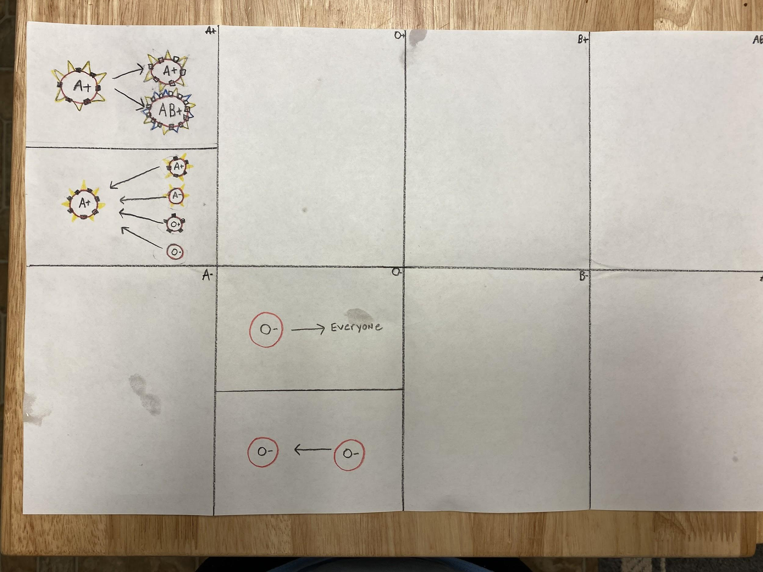
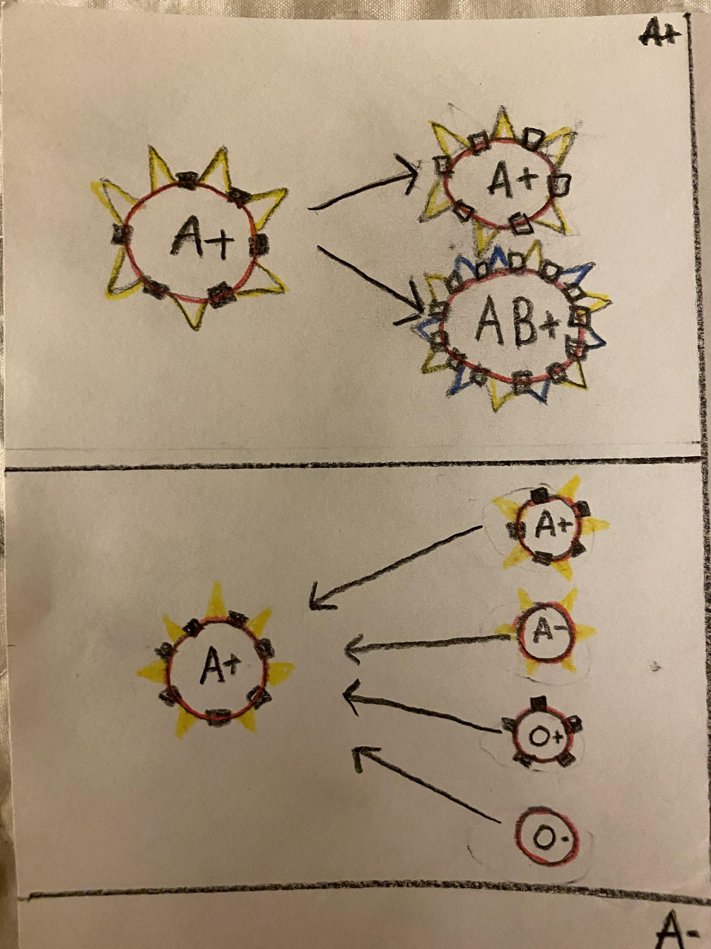
A+ Can Donate To:
Examples
O+
B+
AB+
A+ Can Receive From:
A-
O-
B-
AB-

Slide 4
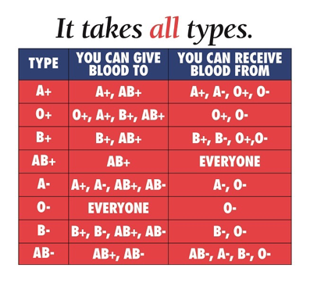
Blood type giving and receiving combinations

Slide 5
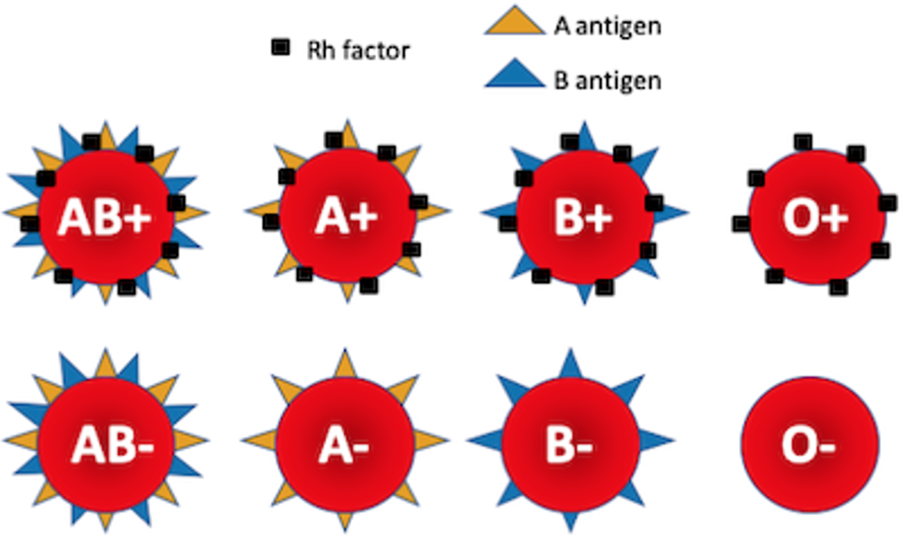
How to draw each blood type

Slide 6
Picture of Blood Type Assignment
Be sure I can clearly see all of the boxes. If necessary, take multiple pictures close up of your work instead.

Slide 7
Picture of your 5 white blood cells

