Slide 1

Convergent Boundary
By: Nushmia Khan

Slide 2


Slide 8


Slide 23
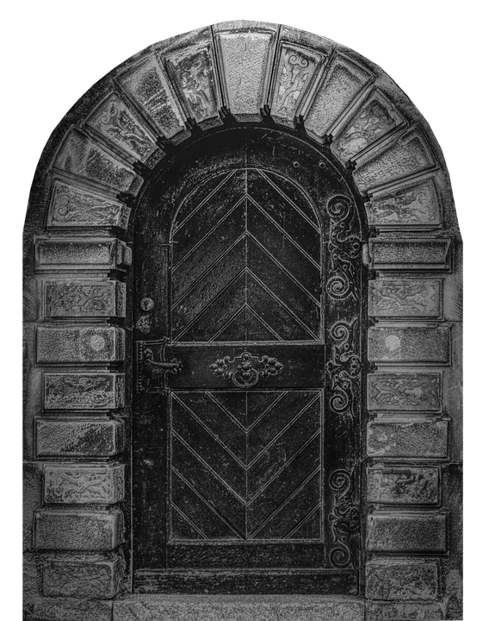

Slide 26
Meanwhile…. With Patrick…

Slide 28
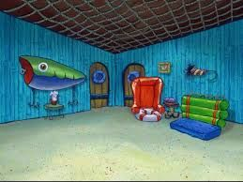

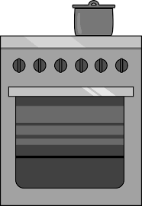


Slide 36
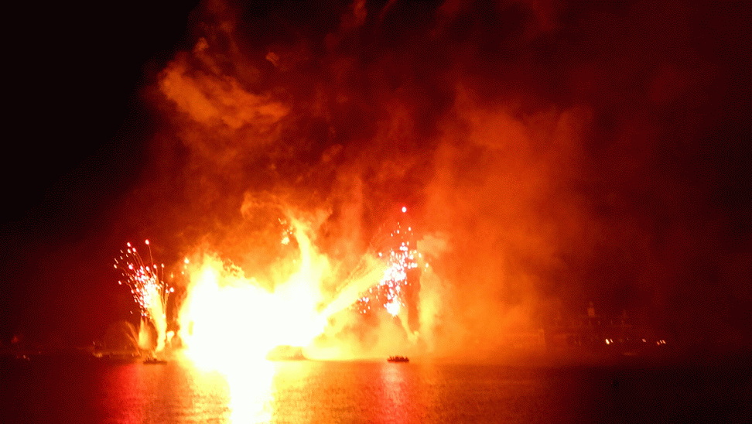
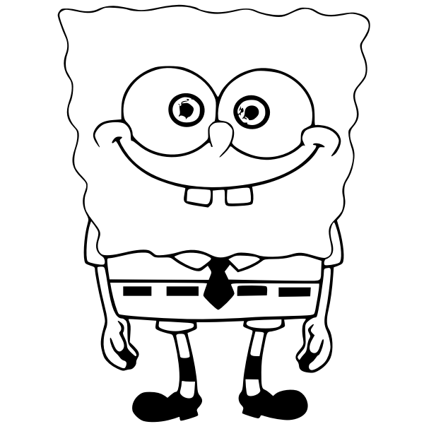

Slide 37
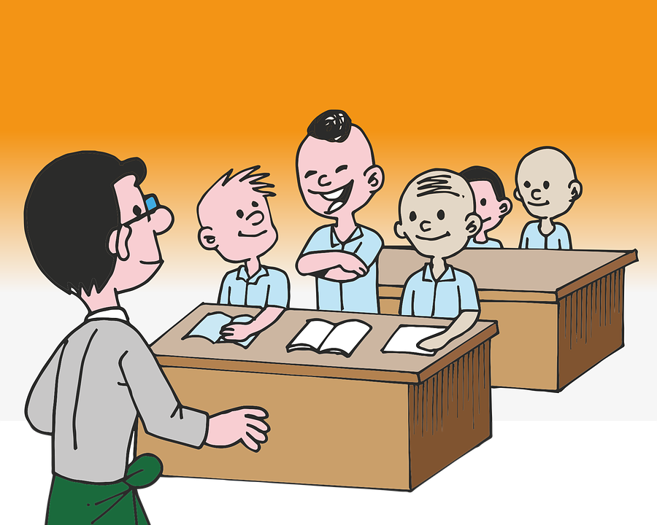
Because of Patrick’s jealousy of Spongebob’s Krabby Patties, He decided to burn Spongebob’s house =)

Slide 38
But the story was all about convergent boundary because the hills slowly started moving.

Slide 39
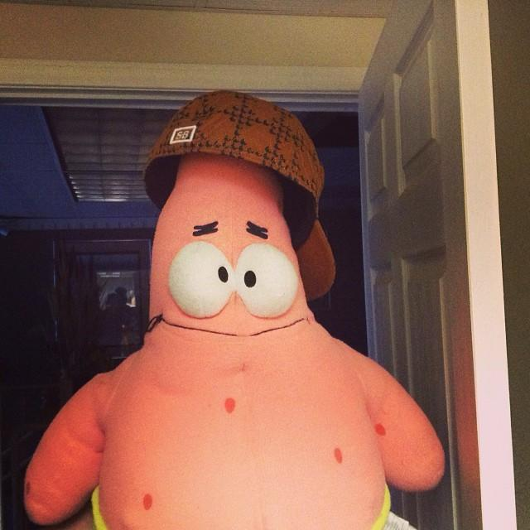
Whatever happened to Spongebob? Eh whatever =)

Slide 40


