Slide 1
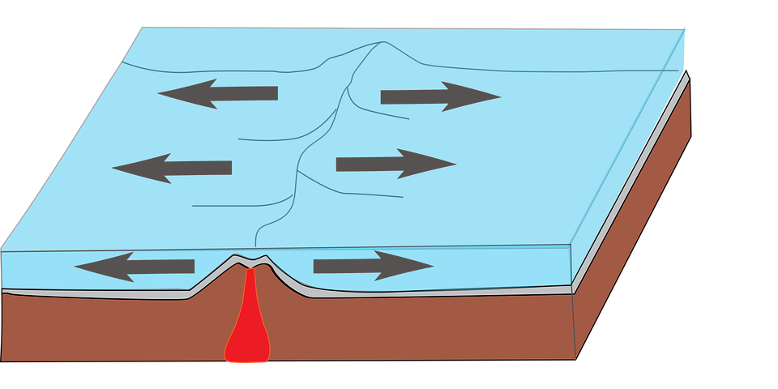
Divergent Boundary

Slide 47

BOOM

Slide 48
BOOM

Slide 49
BOOM

Slide 50
BOOM

Slide 51
BOOM

Slide 52
BOOM

Slide 53
BOOM

Slide 54
BOOM

Slide 55
BOOM

Slide 56
BOOM

Slide 57
Hope you enjoyed my Plate Boundary slideshow!
-Yasleen Perez

