Slide 1
Three toed Sloth
By America Estrada
Notes:
1 Background Color
1 Title (or write the question)
1 Pictures
1 Include Transitions
0 Answering question using complete sentences (multiple sentences if needed to fully explain your answer)
1 Accuracy of information
5
Sloth should be capitalized.

Slide 2
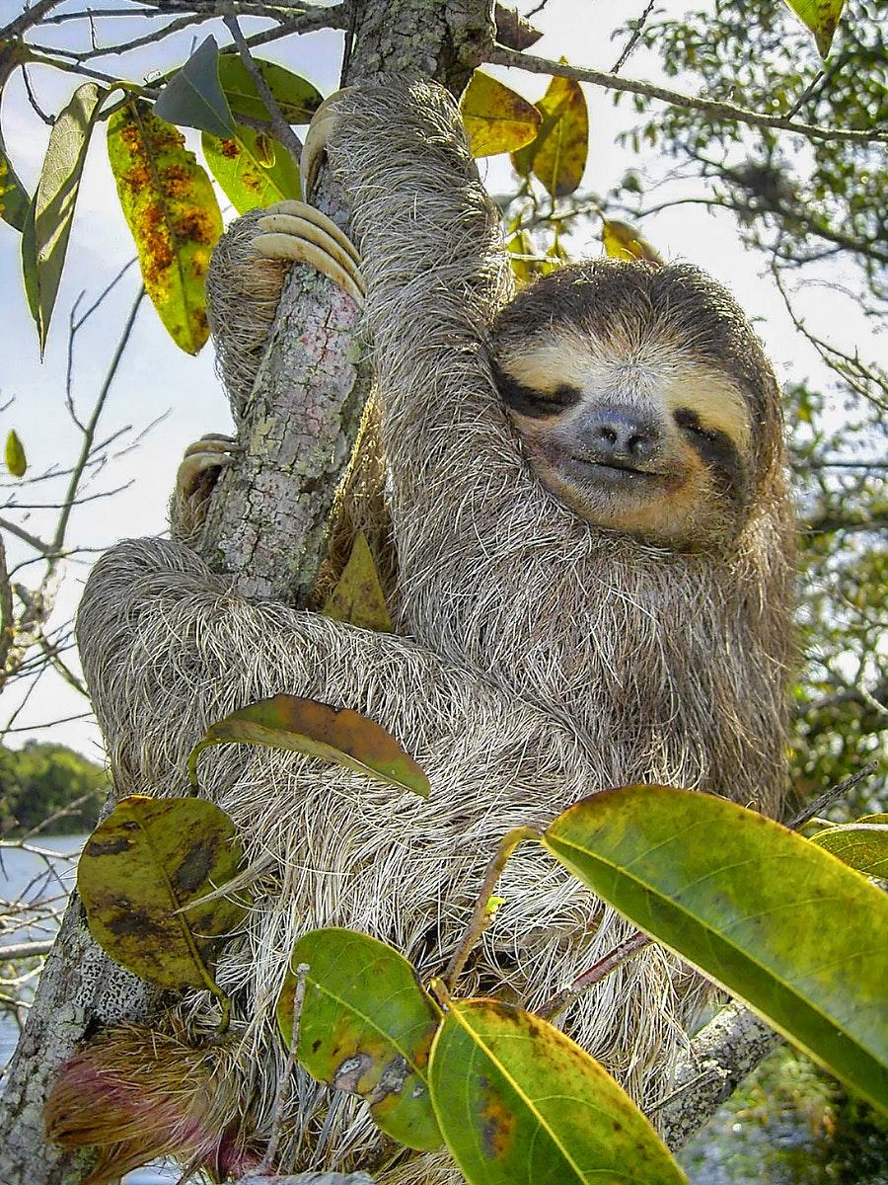
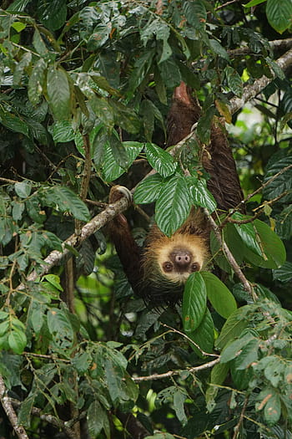
Where my creature came from
The Three Toed sloth comes from the tropical forests in Central and South America.
Notes:
1 Background Color
1 Title (or write the question)
1 Pictures
1 Include Transitions
0 Answering question using complete sentences (multiple sentences if needed to fully explain your answer)
1 Accuracy of information
5
Three Toed Sloth should be capitalized.

Slide 3
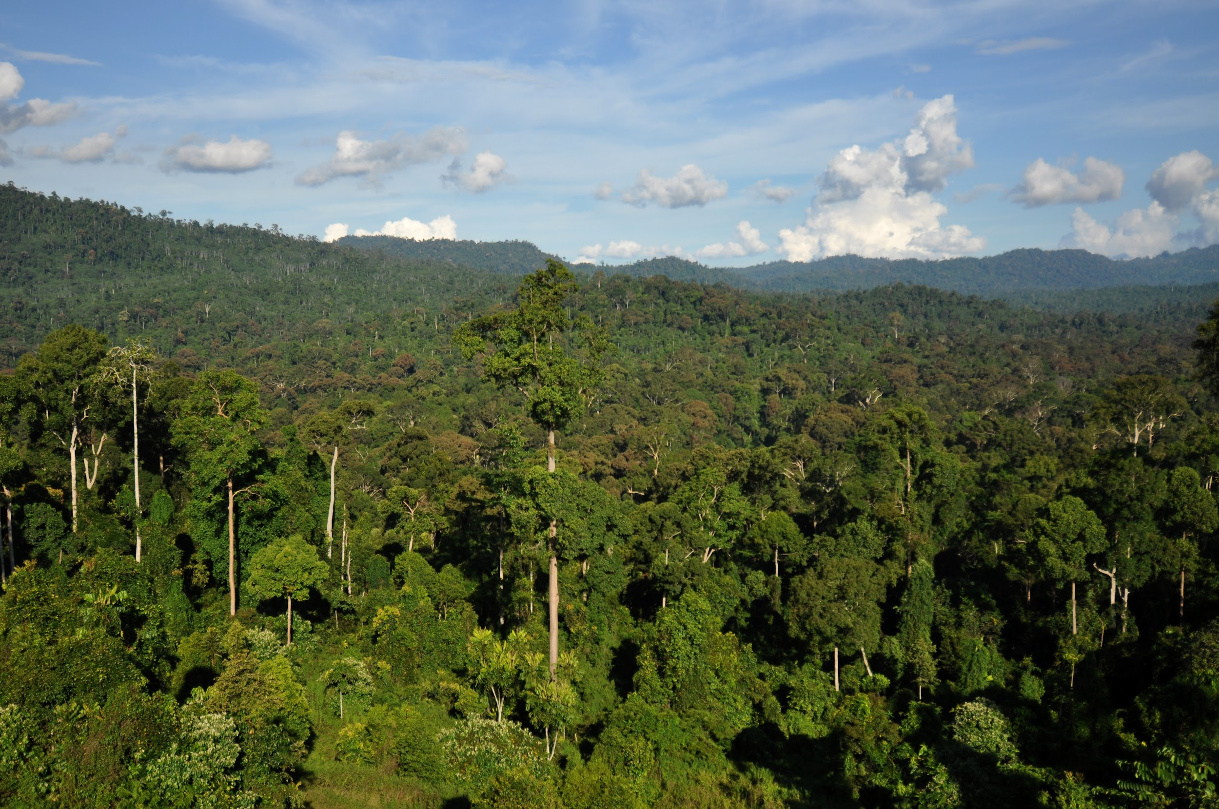
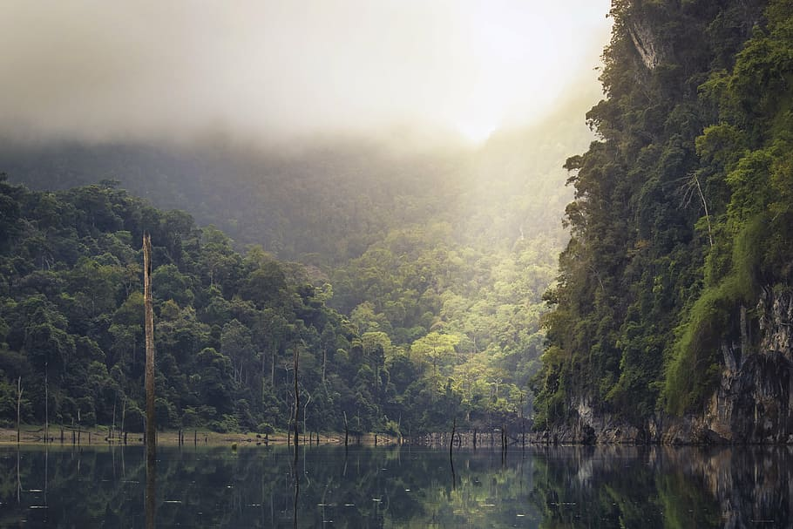
What ecosystem do they live in?
The Sloths live in tropical forests
Notes:
1 Background Color
1 Title (or write the question)
1 Pictures
1 Include Transitions
0 Answering question using complete sentences (multiple sentences if needed to fully explain your answer)
1 Accuracy of information
5
Sloths should be caplitalized on all slides

Slide 4
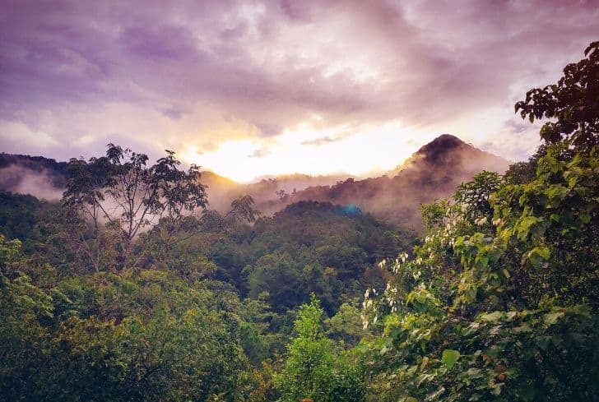
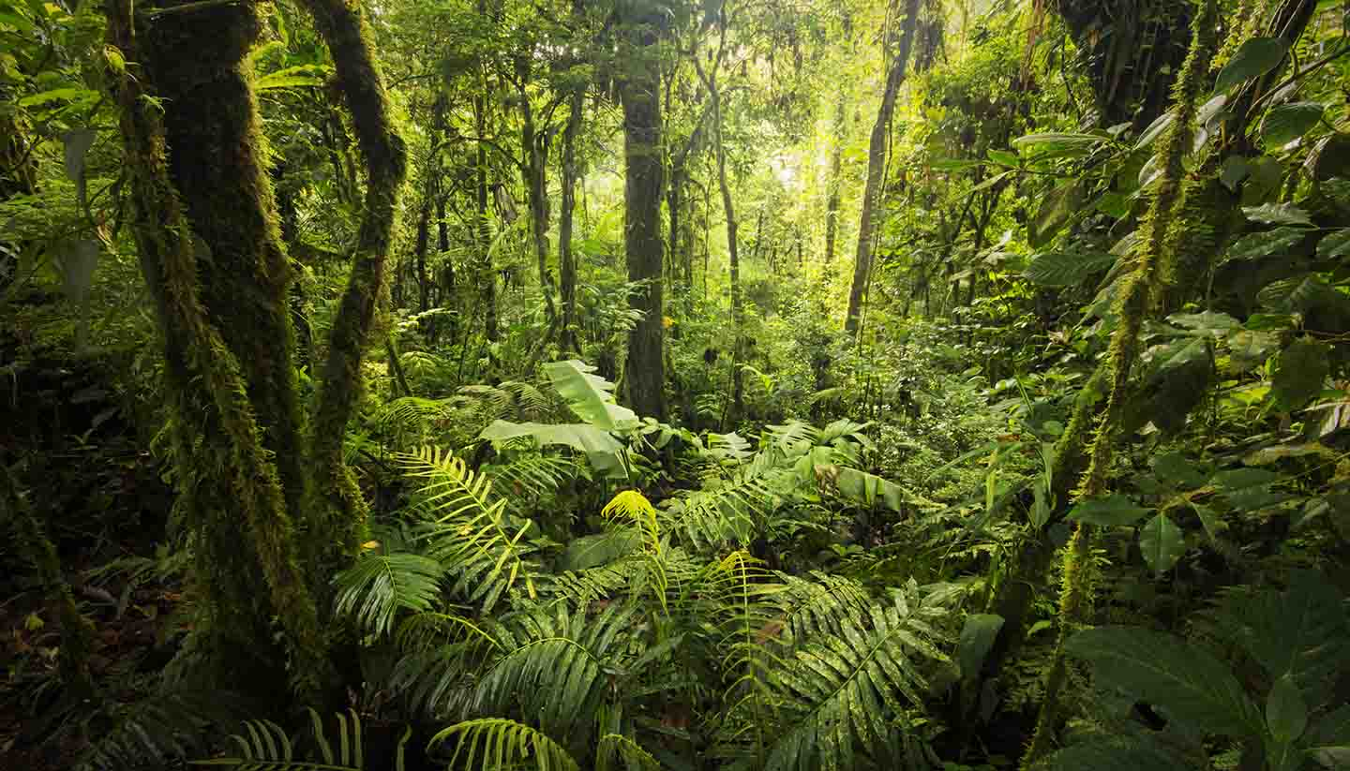
What is the weather like in the tropical Forest?
The weather in the tropical forests is warm and humid the temperature is 21 - 30 degrees celsius but in fahrenheit it is 70 to 85 degrees.
Notes:
1 Background Color
1 Title (or write the question)
1 Pictures
1 Include Transitions
1 Answering question using complete sentences (multiple sentences if needed to fully explain your answer)
1 Accuracy of information
6

Slide 5
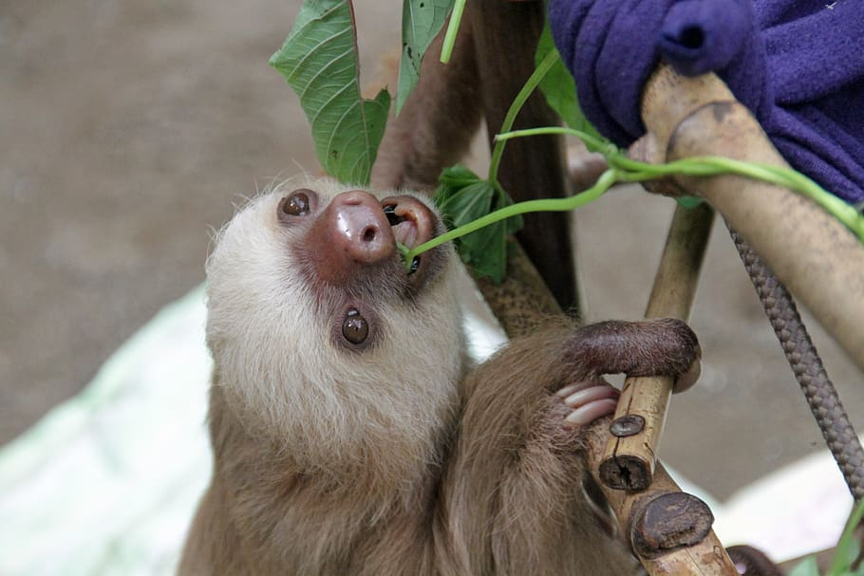
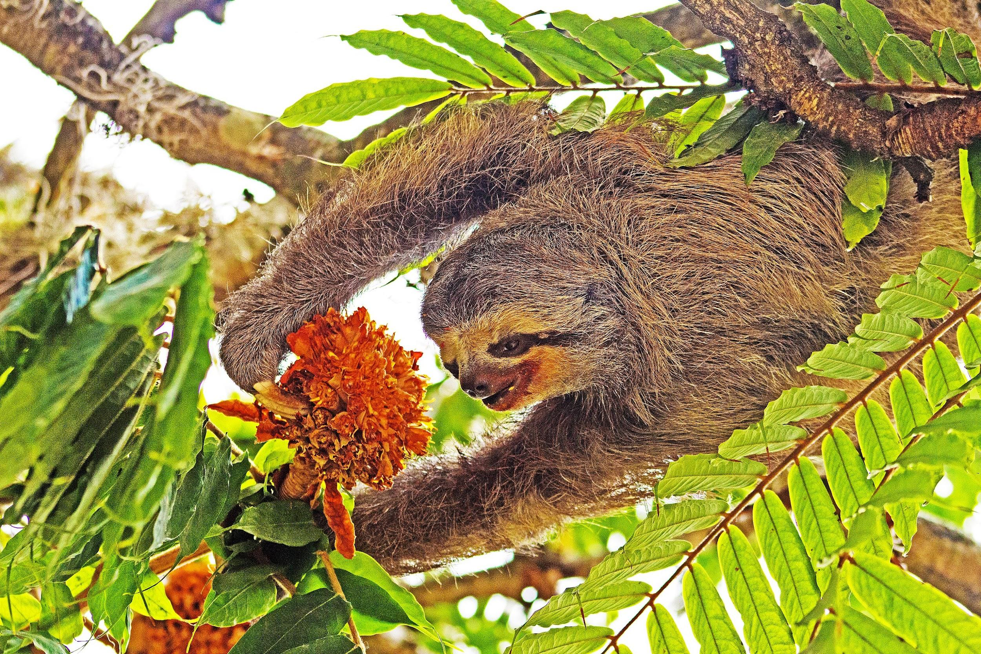
What type of consumers are they?
The 3 Toed Sloths are herbivores.
Notes:
1 Background Color
1 Title (or write the question)
1 Pictures
1 Include Transitions
0 Answering question using complete sentences (multiple sentences if needed to fully explain your answer)
1 Accuracy of information
5
Three Toed Sloth should be capitalized.

Slide 6
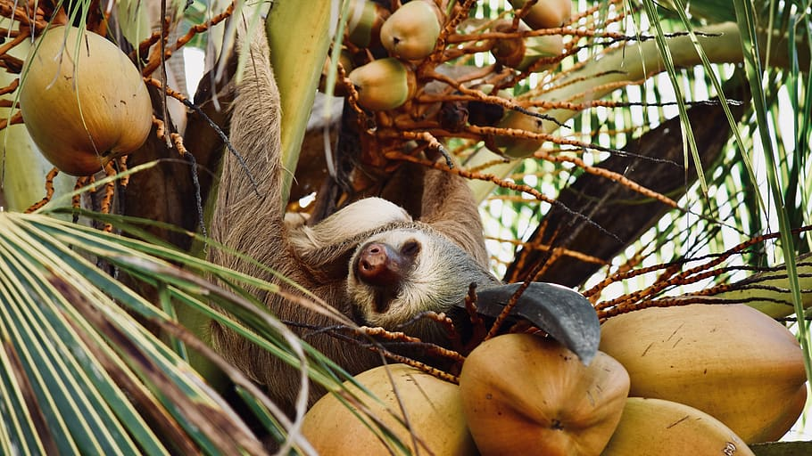
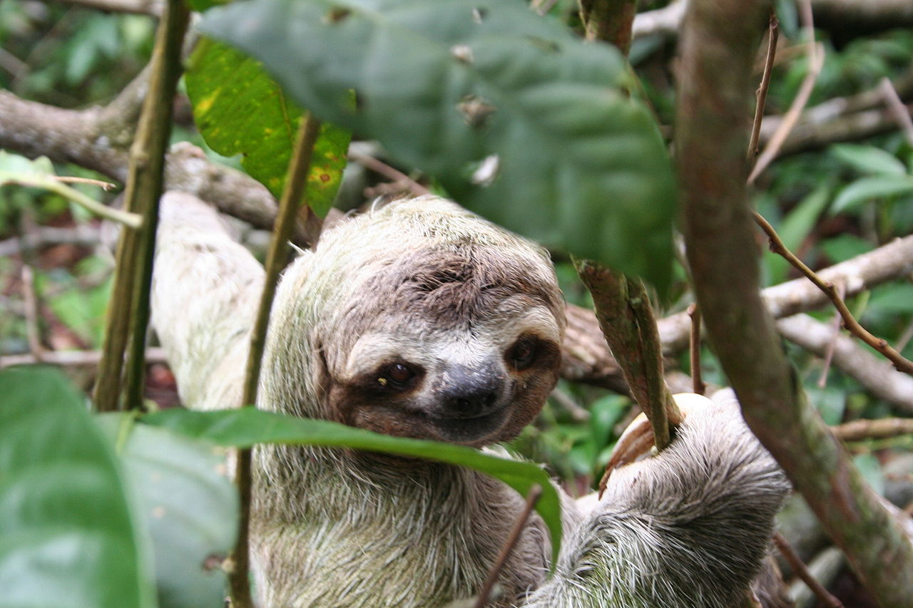
What foods does the Sloth typically eat?
They typically eat leaves, shoots, and fruit.
Notes:
1 Background Color
1 Title (or write the question)
1 Pictures
1 Include Transitions
0 Answering question using complete sentences (multiple sentences if needed to fully explain your answer)
1 Accuracy of information
5
Three Toed Sloth should be capitalized.

Slide 7

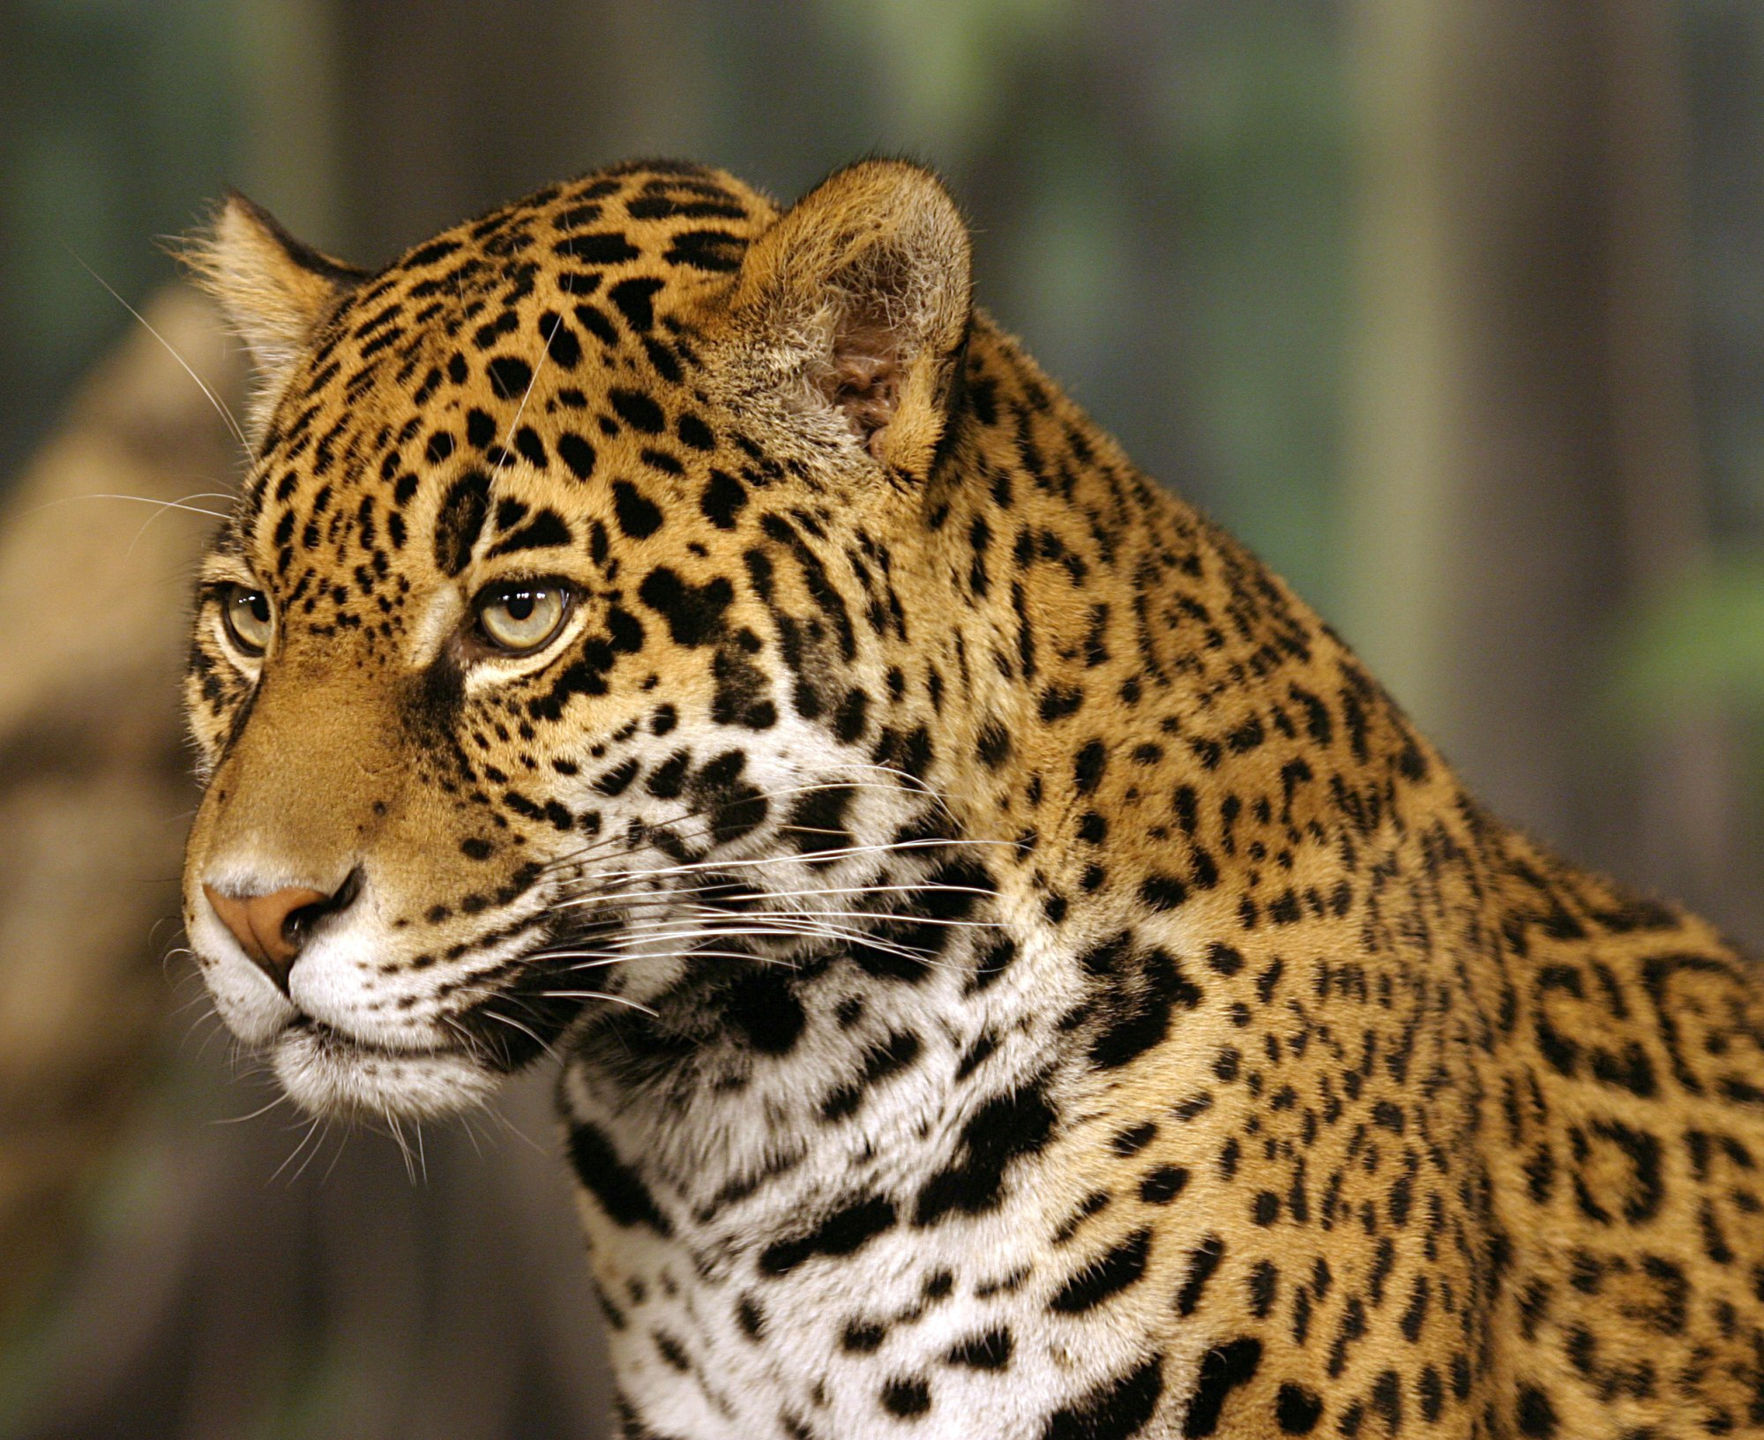
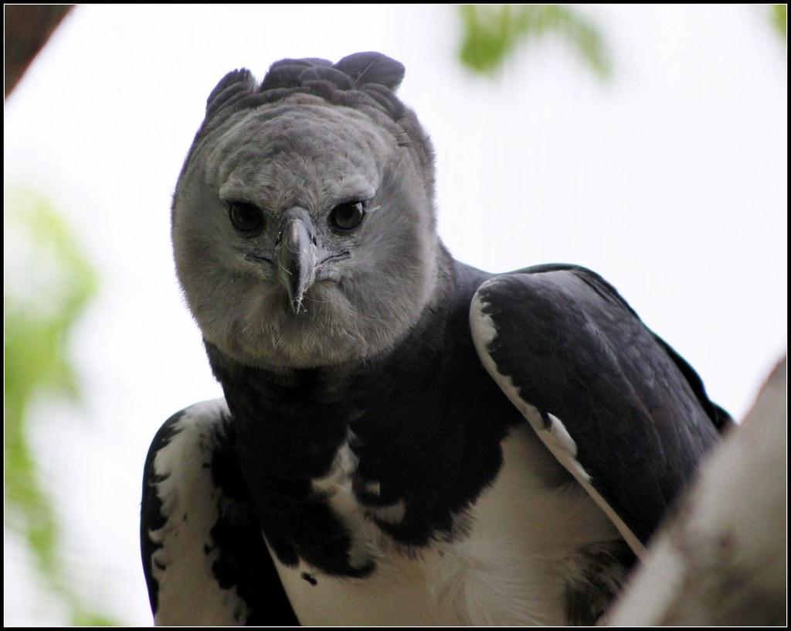
Does the Sloth have any predators?
The Three Toed Sloths predators are Jaguars, Harpy Eagles, and humans.
Notes:
1 Background Color
1 Title (or write the question)
1 Pictures
1 Include Transitions
0 Answering question using complete sentences (multiple sentences if needed to fully explain your answer)
1 Accuracy of information
5
Three Toed Sloth should be capitalized.
Harpy Eagles should be Caplitalized..

Slide 8
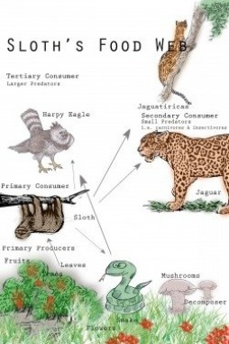

What is the Sloths typical food chains?
The Sloths typical food chain is mostly leaves and fruit.
Notes:
1 Background Color
1 Title (or write the question)
1 Pictures
1 Include Transitions
0 Answering question using complete sentences (multiple sentences if needed to fully explain your answer)
1 Accuracy of information
5
Three Toed Sloth should be capitalized.

Slide 9
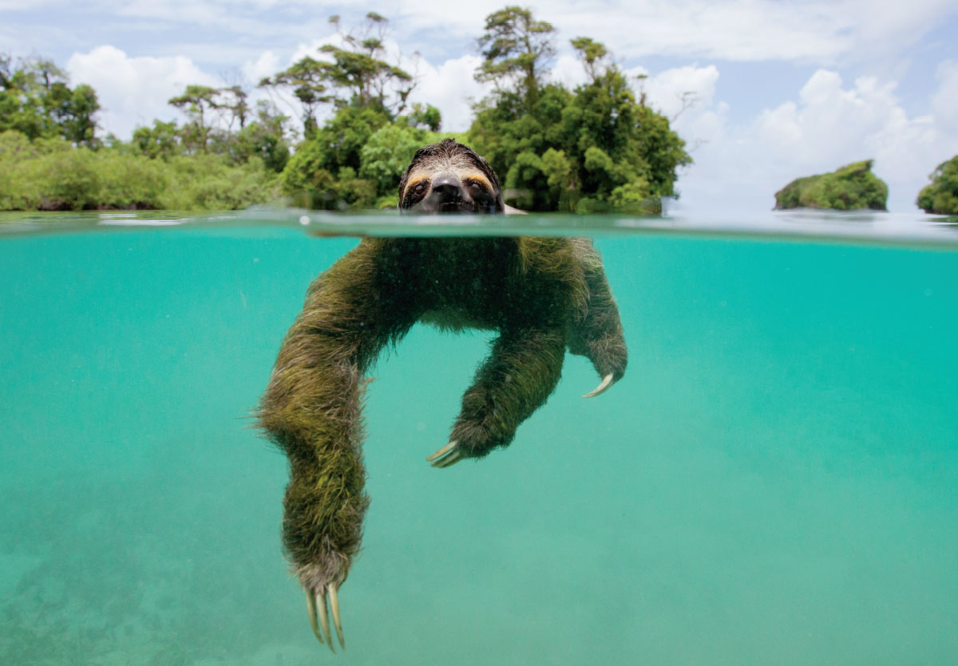
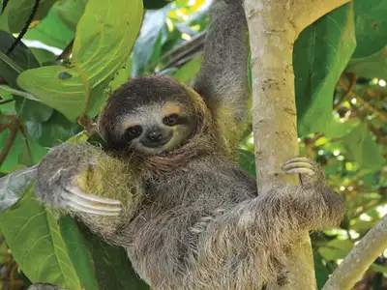
Do Sloths have adaptations to help it survive?
The adaptations Sloth’s have is having their curved feet to grasp on the trees branches, are good swimmers, and their fur helps them when it rains (water goes off easily) also to camouflage.
Notes:
1 Background Color
1 Title (or write the question)
1 Pictures
1 Include Transitions
0 Answering question using complete sentences (multiple sentences if needed to fully explain your answer)
1 Accuracy of information
5
Do Soth’s have…
Sloth should be capitalized.

Slide 10
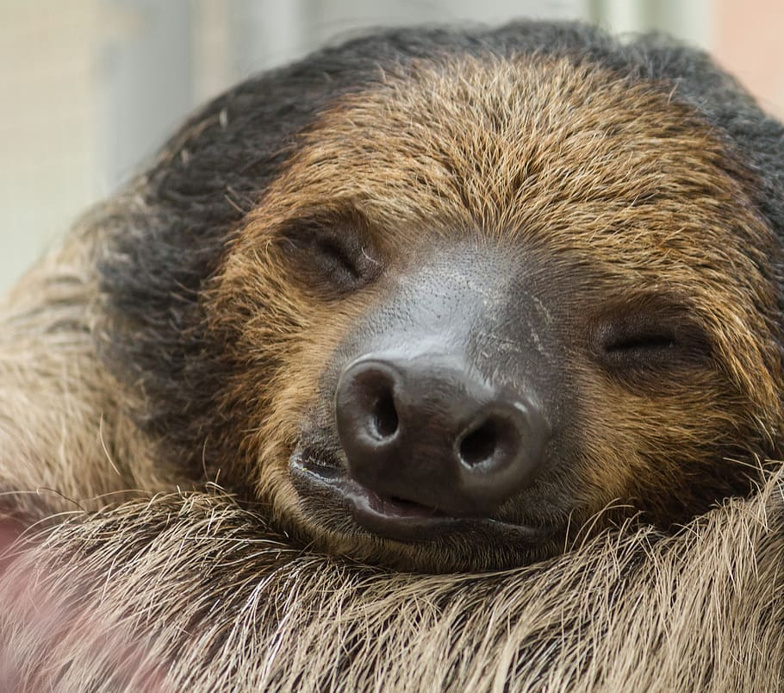
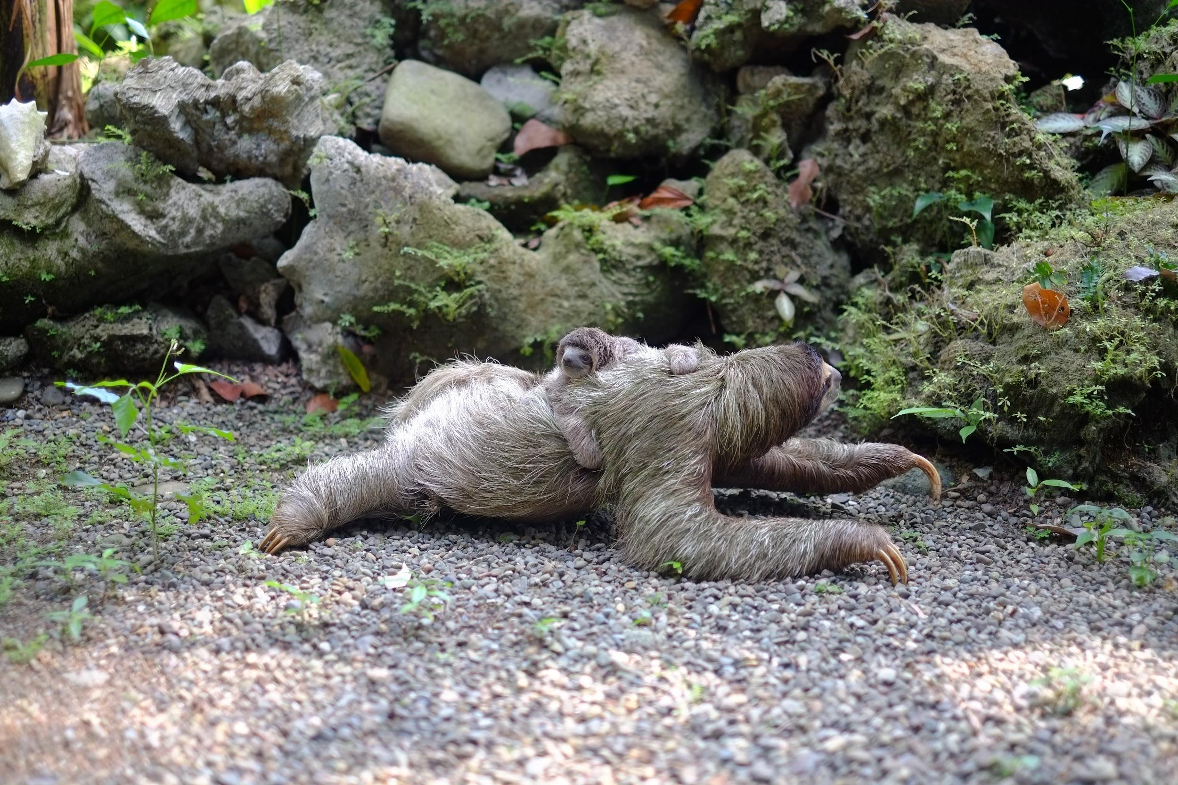
What does a Sloth look like?
The Sloth has a round head, small snout, small eyes, long legs, small ears, and stubby tail. They are around 23 -27 inches long and weight 8 to 10 pounds.
Notes:
1 Background Color
1 Title (or write the question)
1 Pictures
1 Include Transitions
0 Answering question using complete sentences (multiple sentences if needed to fully explain your answer)
1 Accuracy of information
5
Sloth should be capitalized.

Slide 11
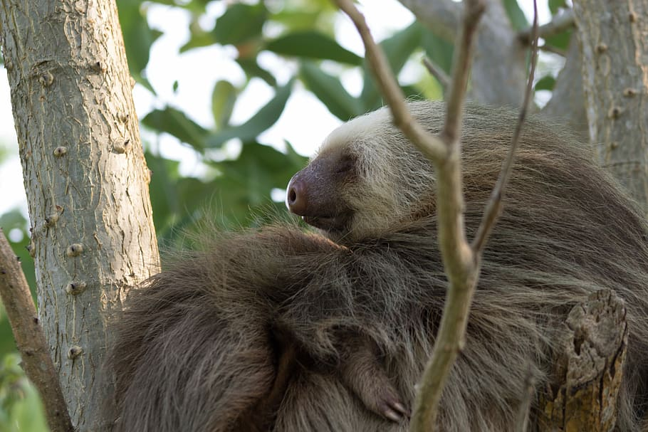
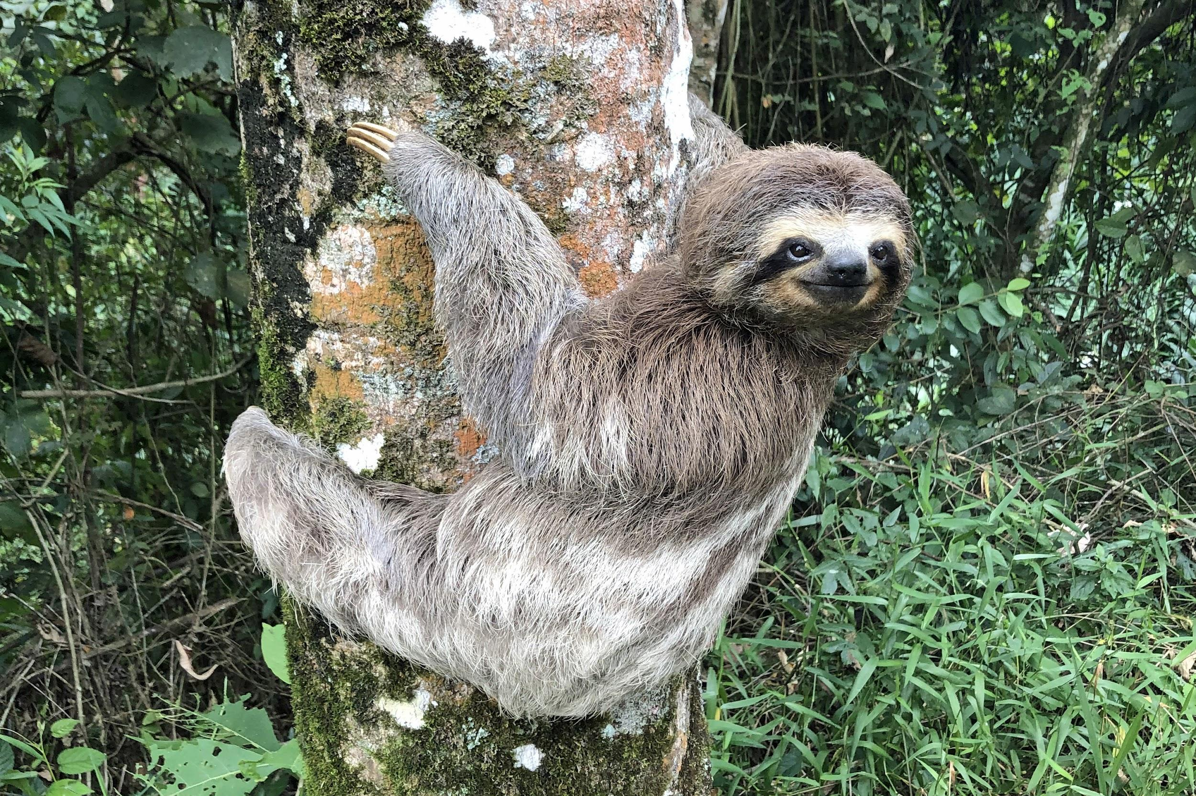
Do male and female Sloths weigh the same and are they the same size?
Male and female Sloths do not weigh the same. For example the males weigh up to 8- 10 pounds while females weigh 9 - 13 pounds. The height for a male and female Sloth is 23 -27 inches.
Notes:
1 Background Color
1 Title (or write the question)
1 Pictures
1 Include Transitions
0 Answering question using complete sentences (multiple sentences if needed to fully explain your answer)
1 Accuracy of information
5
Sloth should be capitalized.

Slide 12
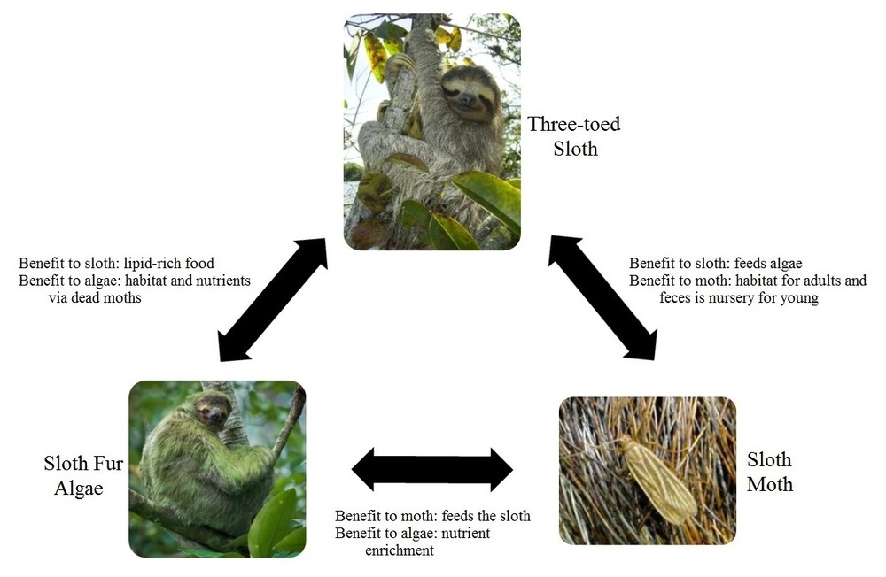
What is the Sloth’s lifespan?
The Sloths lifespan is 25 to 30 years.
Notes:
1 Background Color
1 Title (or write the question)
1 Pictures
1 Include Transitions
1 Answering question using complete sentences (multiple sentences if needed to fully explain your answer)
1 Accuracy of information
6

Slide 13
8 facts about the 3 Toed Sloth
They can hold their breath for 40 minutes underwater.
They are the world’s slowest mammal.
Algae grows on its fury coat.
They are arboreal (tree dwelling).
They sleep up to 15 -20 hours a day .
It descends once a week.
On ground they travel 6-8 ft per minute.
Sloths poop once a week.
Notes:
1 Background Color
1 Title (or write the question)
1 Pictures
1 Include Transitions
1 Answering question using complete sentences (multiple sentences if needed to fully explain your answer)
1 Accuracy of information
5
Periods behind sentences

Slide 14
Sources
https://www.rainforest-alliance.org/species/sloth/\
https://animals.mom.com/environment-sloth-3879.html
https://www.nationalgeographic.com/
http://earjecosystem.weebly.com/
https://www.smore.com/
https://animalfactguide.com
https://en.wikipedia.com
https://emborawild.com
https://www.livescience.com
https://animalfactguide.com
Notes:
1 Background Color
1 Title (or write the question)
1 Pictures
1 Include Transitions
1 Answering question using complete sentences (multiple sentences if needed to fully explain your answer)
1 Accuracy of information
6

