Slide 1
Emperor tamarin monkey project
By Austin Del rio
Notes:
1 Background Color
1 Title (or write the question)
1 Pictures
1 Include Transitions
0 Answering question using complete sentences (multiple sentences if needed to fully explain your answer)
1 Accuracy of information
5
Make sure that Emperor Tamarin Monkey is capitalized properly throughout the slide.

Slide 2
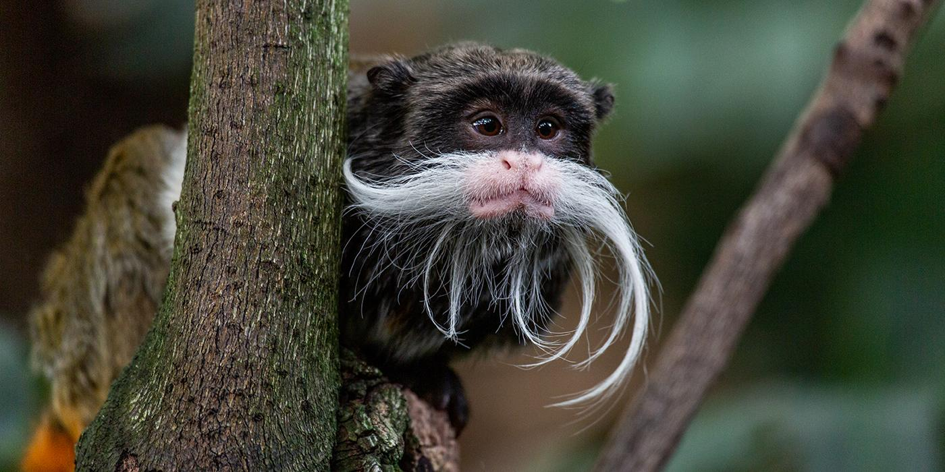
Emperor Tamarin Habitat
Emperor tamarins are native to the southwest Amazon Basin, with a range that crosses Peru, Brazil, and Bolivia.
Notes:
1 Background Color
1 Title (or write the question)
1 Pictures
1 Include Transitions
1 Answering question using complete sentences (multiple sentences if needed to fully explain your answer)
1 Accuracy of information
6

Slide 3
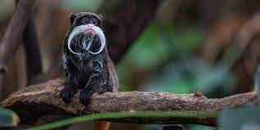
Emperor Tamarin Ecosystem
They live in a variety of wooded habitats, including lowland, mountain and seasonal flooded forests.
Notes:
1 Background Color
1 Title (or write the question)
1 Pictures
1 Include Transitions
1 Answering question using complete sentences (multiple sentences if needed to fully explain your answer)
1 Accuracy of information
6

Slide 4


Emperor Tamarin Ecosystem Waether
Emperor tamarins live in the Amazon lowland and lower montane rainforests.
The weather is usually warm but it does rain often.
Notes:
1 Background Color
1 Title (or write the question)
1 Pictures
1 Include Transitions
1 Answering question using complete sentences (multiple sentences if needed to fully explain your answer)
1 Accuracy of information
6
Weather is misspelled.

Slide 5
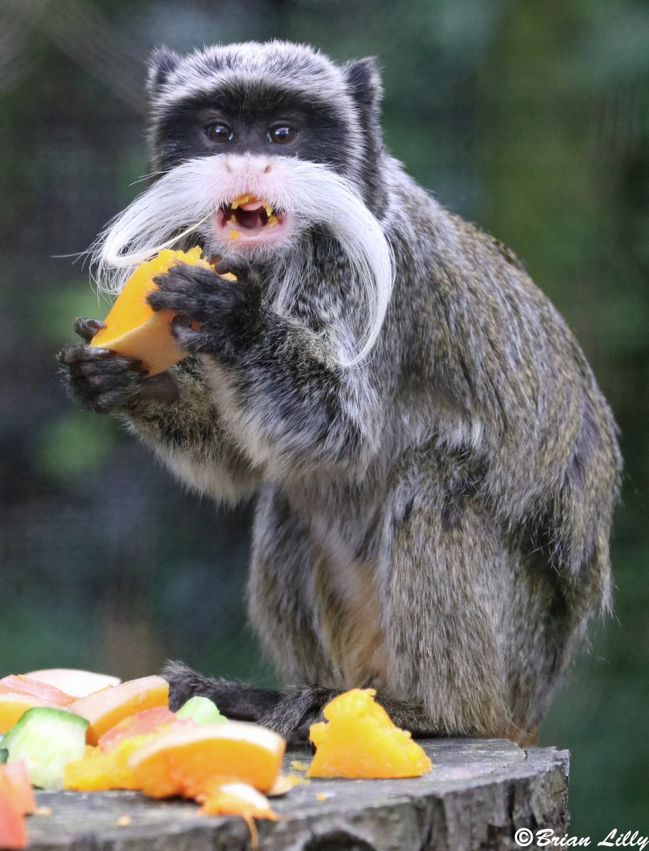
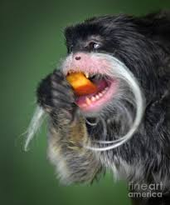
Emperor Tamarin Consumer Type
Emperor tamarins are omnivores.
Notes:
1 Background Color
1 Title (or write the question)
1 Pictures
1 Include Transitions
0 Answering question using complete sentences (multiple sentences if needed to fully explain your answer)
1 Accuracy of information
5
Capitalization

Slide 6
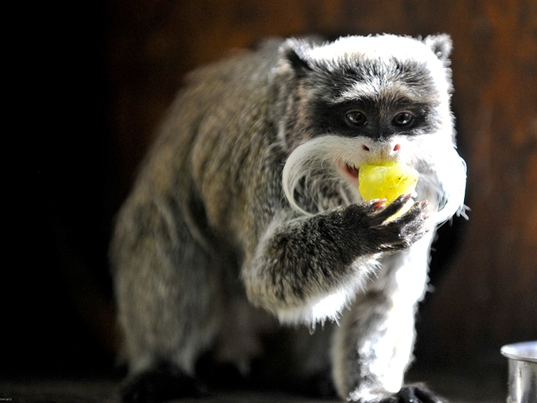
Emperor Tamarin Food Habits
Emperor tamarins mostly eat fruit.
Emperor tamarins sometimes also eat insects, nectar, leaves, and gum.
Notes:
1 Background Color
1 Title (or write the question)
1 Pictures
1 Include Transitions
0 Answering question using complete sentences (multiple sentences if needed to fully explain your answer)
1 Accuracy of information
5
Captalization

Slide 7
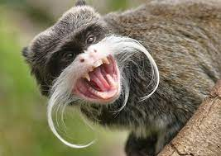
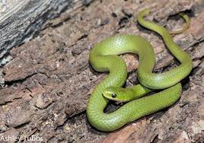
Emperor Tamarin Predators
Emperor tamarins are small so they do have a number of predators like wild cats, dogs, snakes and birds of prey that all live in the same ecosystem.
Notes:
1 Background Color
1 Title (or write the question)
1 Pictures
1 Include Transitions
1 Answering question using complete sentences (multiple sentences if needed to fully explain your answer)
1 Accuracy of information
6

Slide 8
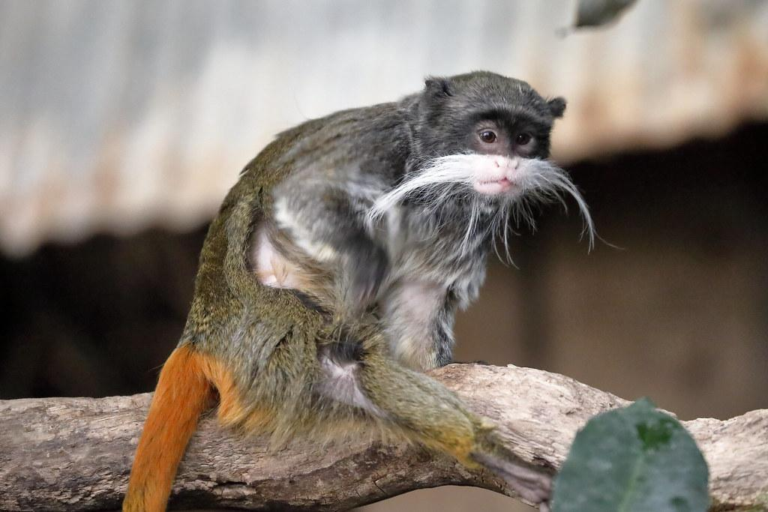
Emperor Tamarin Food Chain
Their food chain is a Omnivore one.
Notes:
1 Background Color
1 Title (or write the question)
1 Pictures
1 Include Transitions
1 Answering question using complete sentences (multiple sentences if needed to fully explain your answer)
1 Accuracy of information
6

Slide 9
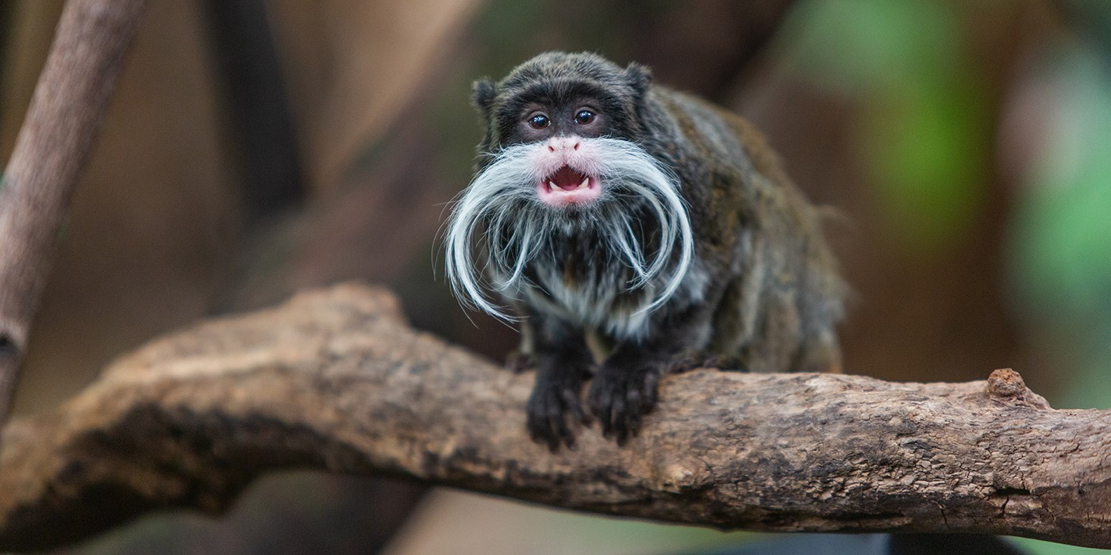
Emperor Tamarin Adaptations
Emperor tamarins have claws to help them find food in tree trunks.
Emperor tamarins also have long hands to help them grip on branches and swing.
Notes:
1 Background Color
1 Title (or write the question)
1 Pictures
1 Include Transitions
0 Answering question using complete sentences (multiple sentences if needed to fully explain your answer)
1 Accuracy of information
5
Capitalization

Slide 10
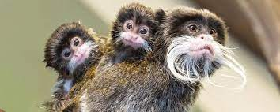
Emperor Tamarin Weight And Height
Emperor tamarins weigh 1 pound when their an adult and are 9 - 10 inches tall.
Notes:
1 Background Color
1 Title (or write the question)
1 Pictures
1 Include Transitions
0 Answering question using complete sentences (multiple sentences if needed to fully explain your answer)
1 Accuracy of information
5

Slide 11
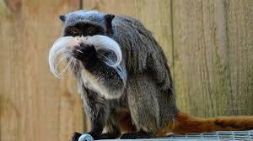
Emperor Tamarin Gender Differences And Similarities
Both male and female Emperor tamarins are similar as they both weigh the same and are the same height.
Notes:
1 Background Color
1 Title (or write the question)
1 Pictures
1 Include Transitions
0 Answering question using complete sentences (multiple sentences if needed to fully explain your answer)
1 Accuracy of information
5

Slide 12
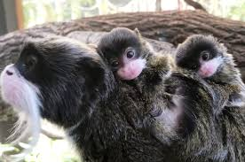
Emperor Tamarin Lifespan
Emperor tamarins live from ten to twenty years old.
Notes:
1 Background Color
1 Title (or write the question)
1 Pictures
1 Include Transitions
0 Answering question using complete sentences (multiple sentences if needed to fully explain your answer)
1 Accuracy of information
5

Slide 13
Emperor Tamarin Facts
Emperor tamarins weigh 1.6 oz. at birth.
They live in groups of two up too fifteen.
Emperor tamarins live in trees.
Female Emperor tamarins can see a wider range of colors that helps them find more ripe fruit.
Emperor tamarins are friendly.
They also live with different species of tamarins
Emperor tamarins have long whiskers that make it look like they have a mustache.
Emperor tamarins mostly give birth to twins but occasionally they have triplets or sometimes just one.
Notes:
1 Background Color
1 Title (or write the question)
1 Pictures
1 Include Transitions
0 Answering question using complete sentences (multiple sentences if needed to fully explain your answer)
1 Accuracy of information
5
Capitalization, and punctuation at the end of sentences.

Slide 14
Resources That I used
These are the resources I used.
https://racinezoo.org/emperor-tamarin-fact-sheet
https://nationalzoo.si.edu/animals/emperor-tamarin
Notes:
1 Background Color
1 Title (or write the question)
1 Pictures
1 Include Transitions
1 Answering question using complete sentences (multiple sentences if needed to fully explain your answer)
1 Accuracy of information
6

