Slide 1
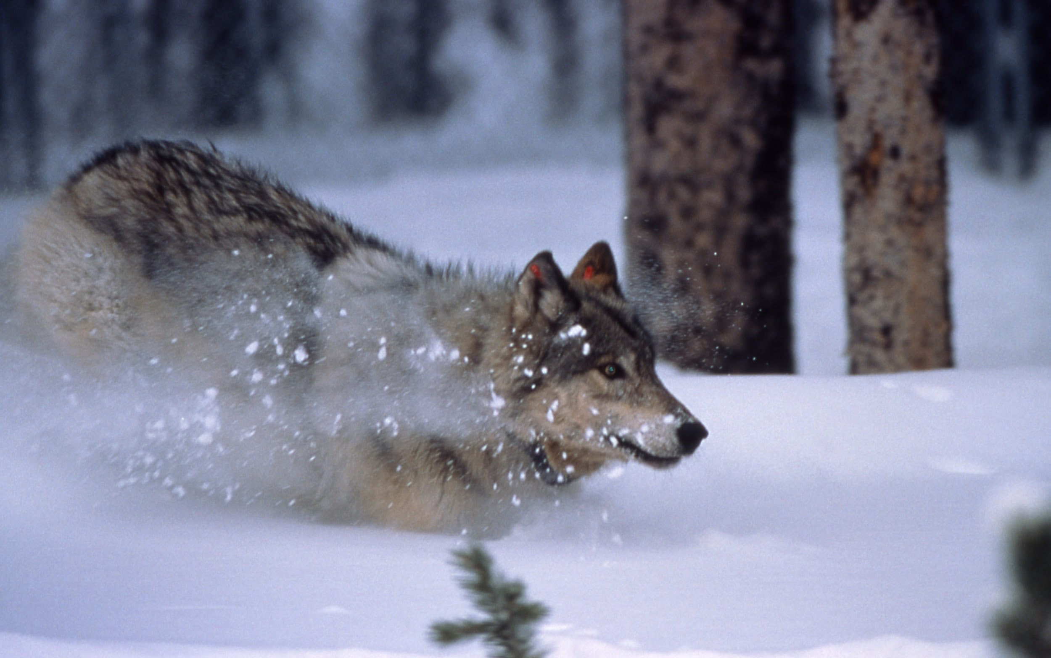
Gray wolf
Notes:
1 Background Color
1 Title (or write the question)
1 Pictures
1 Include Transitions
0 Answering question using complete sentences (multiple sentences if needed to fully explain your answer)
1 Accuracy of information
5
Grey Wolf needs capitalization since it is a title.

Slide 2
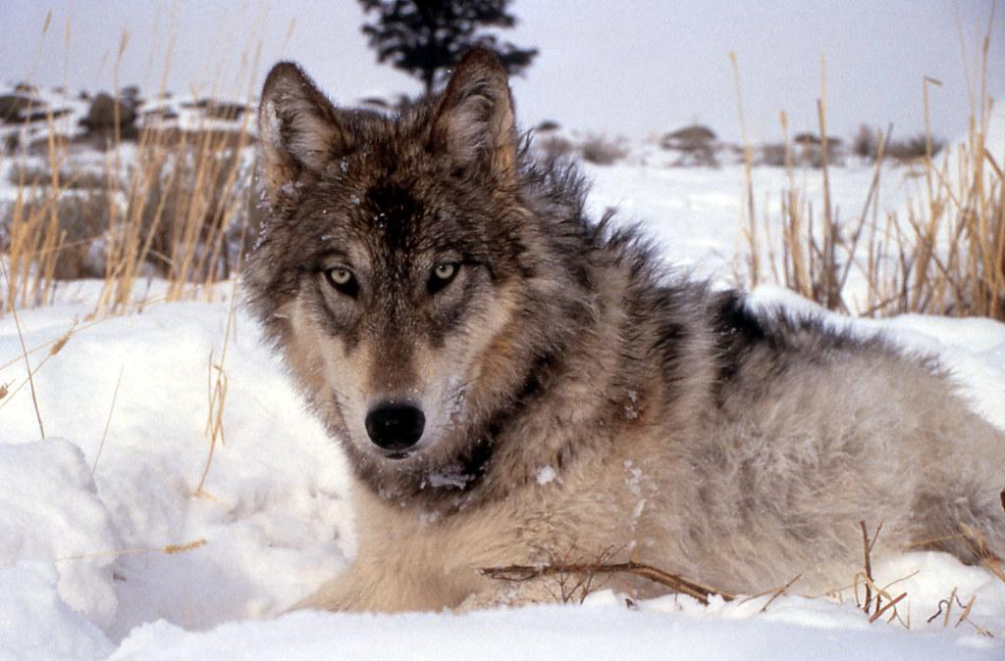
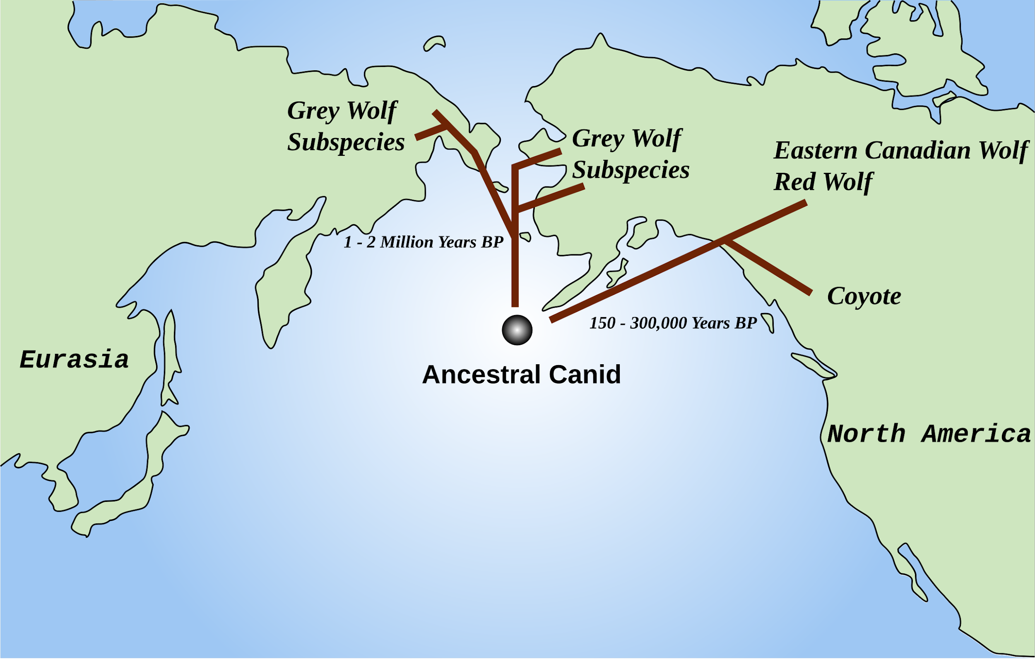
History of where your creature came from.
The Gray Wolf (Canis Lupus) is a large canine native to Eurasia and North America.
Notes:
1 Background Color
1 Title (or write the question)
1 Pictures
1 Include Transitions
1 Answering question using complete sentences (multiple sentences if needed to fully explain your answer)
1 Accuracy of information
6

Slide 3
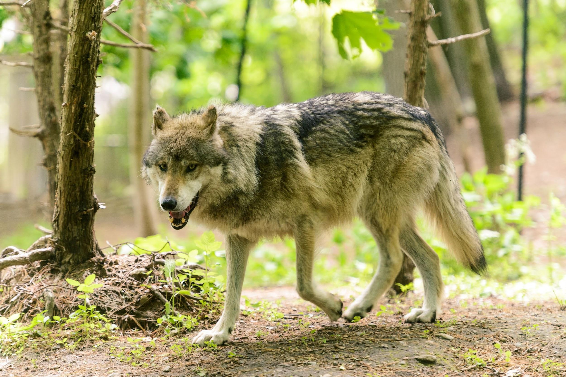
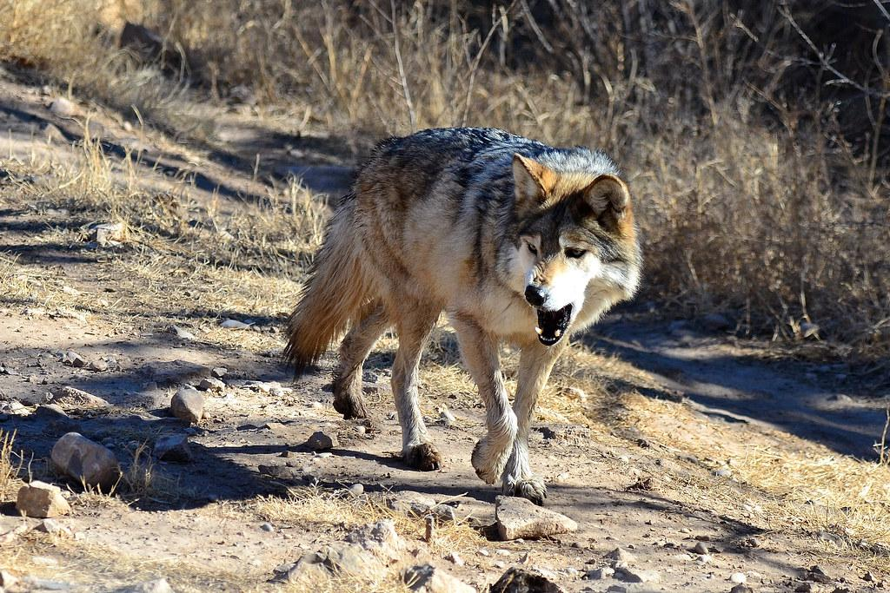
2. What ecosystem do they live in?
Gray wolves can thrive a diversity of habitats from the tundra to woodlands, as well as forests, grasslands, and even desserts.
Notes:
1 Background Color
1 Title (or write the question)
1 Pictures
1 Include Transitions
1 Answering question using complete sentences (multiple sentences if needed to fully explain your answer)
1 Accuracy of information
6

Slide 4
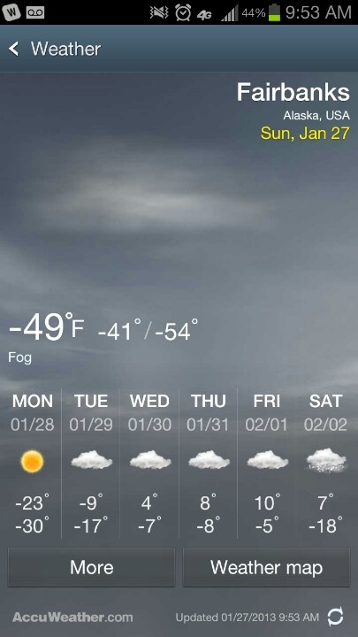
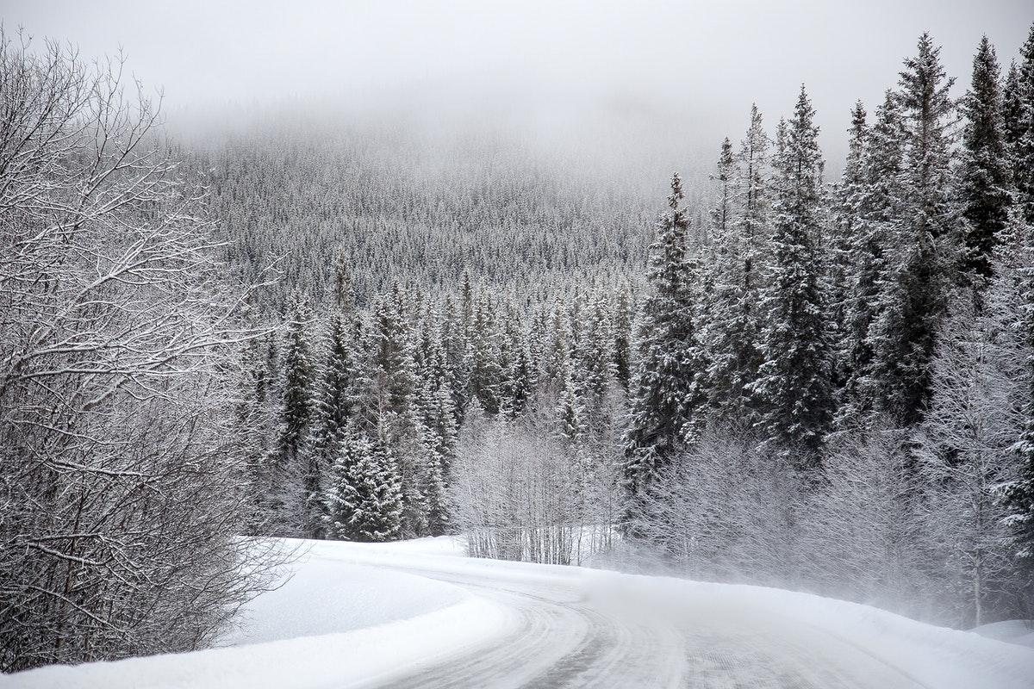
4. What is it like in the ecosystem? Please include a picture of the average temperature where your creature lives?
Gray Wolves don’t live only in colder climates, but they can live in temperatures that range from -70 to 120 degrees F (minus 50 to 48.8 degrees C)
Notes:
1 Background Color
1 Title (or write the question)
1 Pictures
1 Include Transitions
1 Answering question using complete sentences (multiple sentences if needed to fully explain your answer)
1 Accuracy of information
6

Slide 5
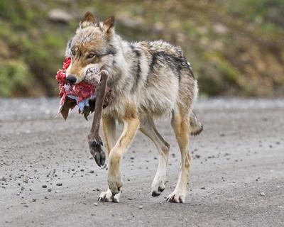
5. What type of consumer is your creature?
My creature, the Gray Wolf, is a carnivore, meaning that they eat animal flesh.
Notes:
1 Background Color
1 Title (or write the question)
1 Pictures
1 Include Transitions
1 Answering question using complete sentences (multiple sentences if needed to fully explain your answer)
1 Accuracy of information
6

Slide 6
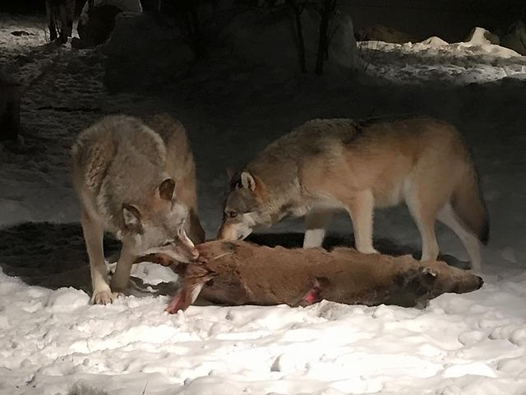
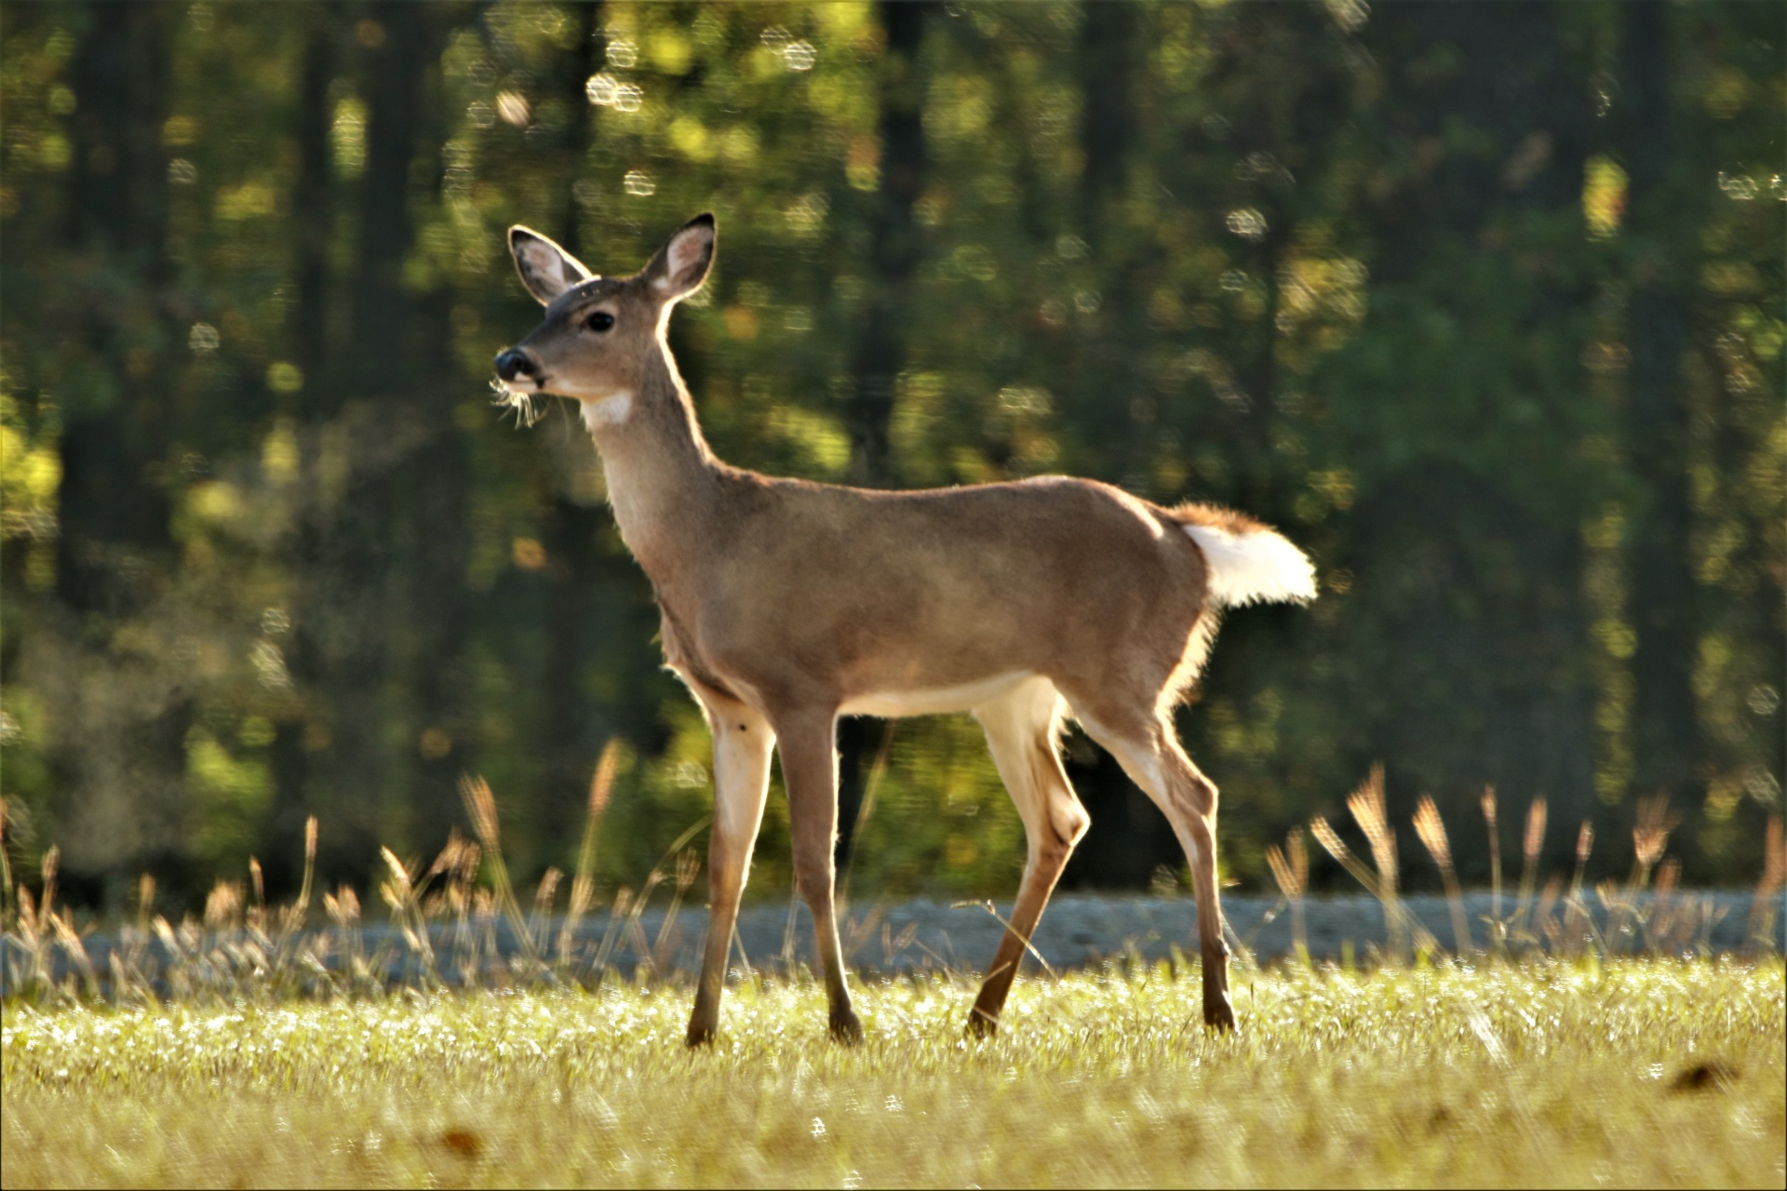
6. Based on question 5, what specific foods does your creature typically eat?
Since they are carnivores, the kind of food that the Gray Wolf usually eats are animals but specifically they prefer to eat large hoofed mammals such as deer, elk, bison and moose. They can eat up to 20 lbs (9kg) of food during one meal.
Notes:
1 Background Color
1 Title (or write the question)
1 Pictures
1 Include Transitions
1 Answering question using complete sentences (multiple sentences if needed to fully explain your answer)
1 Accuracy of information
6

Slide 7
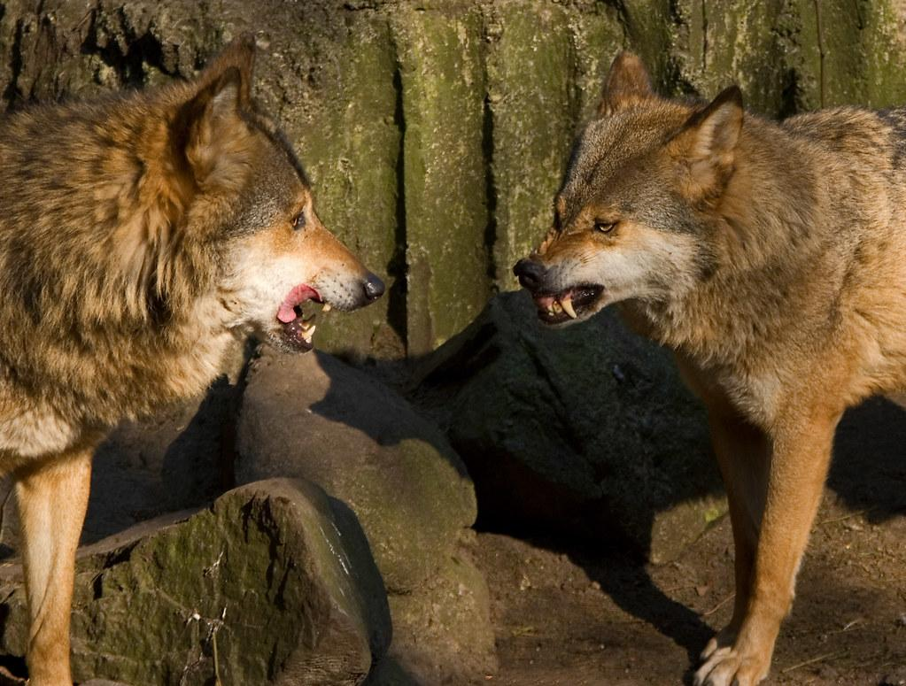
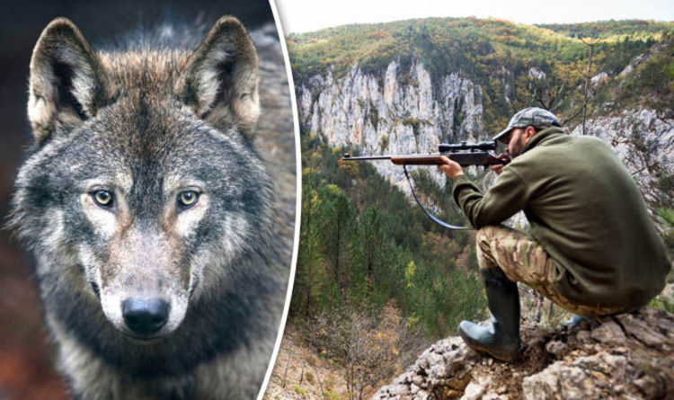
7. Does your creature have any predators?
Gray Wolves have a few natural enemies other than human beings. Such as diseases and parasites are some of the main causes that wolves are killed but in areas of high wolf density and declining prey populations, the major causes of their deaths are killing by other wolves and starvation.
Notes:
1 Background Color
1 Title (or write the question)
1 Pictures
1 Include Transitions
1 Answering question using complete sentences (multiple sentences if needed to fully explain your answer)
1 Accuracy of information
6

Slide 8
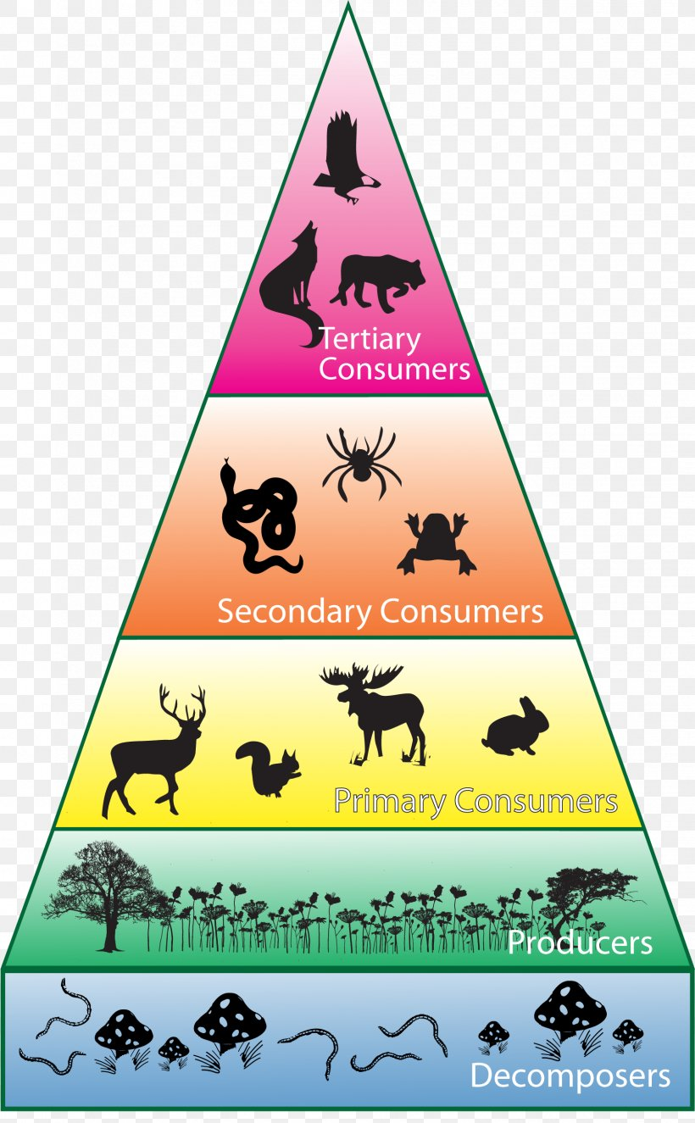
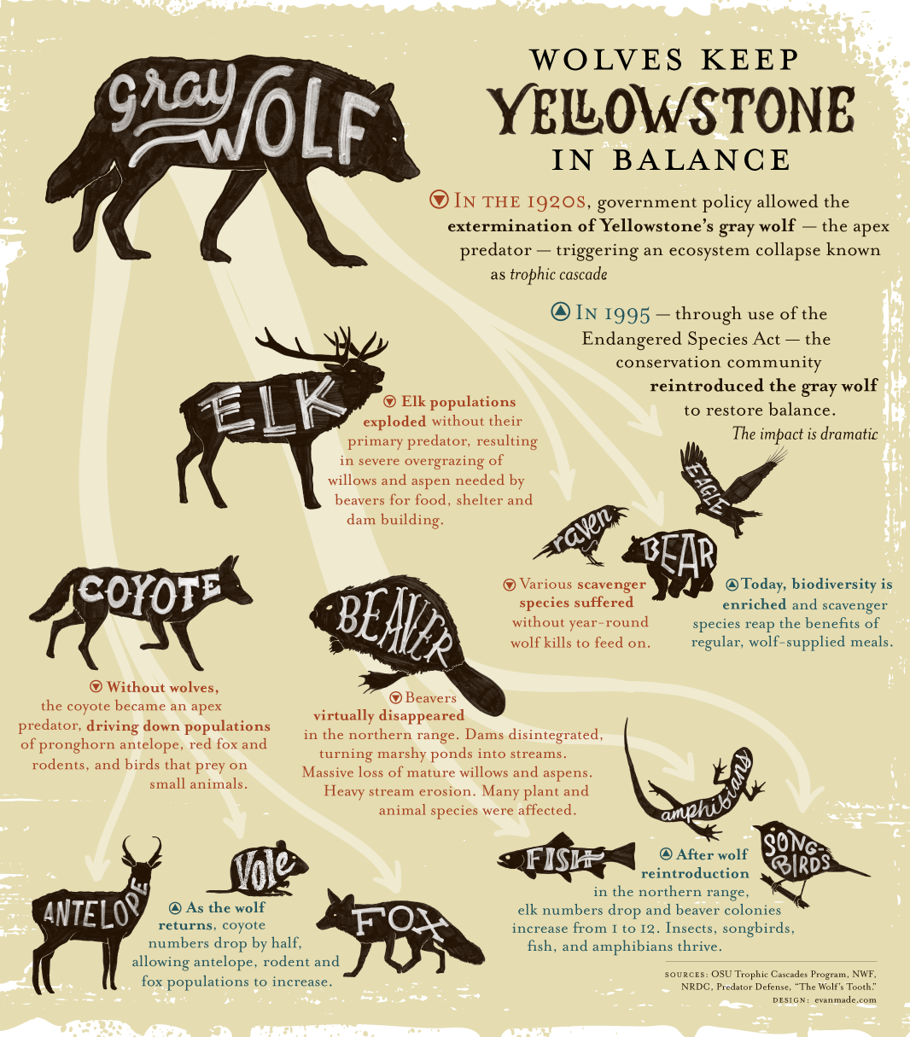
8. What is a typical food chain for your creature?
The typical food chain of the Gray Wolf looks like this:
Notes:
1 Background Color
1 Title (or write the question)
1 Pictures
1 Include Transitions
1 Answering question using complete sentences (multiple sentences if needed to fully explain your answer)
1 Accuracy of information
6

Slide 9
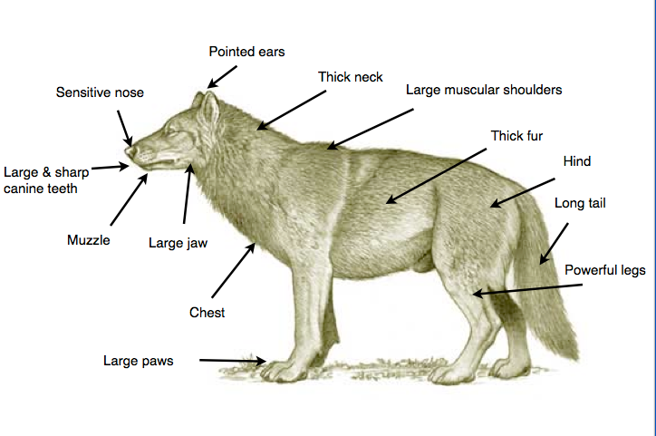
9. Does your creature have any specific adaptations to help it survive?
The Gray Wolf does have many adaptations for survival. For example, their coats are made up of wooly fur in order for them to get insulation and they have long guard hairs so that it keeps the moisture out. Their paws have fleshy pads, and claws for traction and they can spread to provide better support in snow.
Notes:
1 Background Color
1 Title (or write the question)
1 Pictures
1 Include Transitions
1 Answering question using complete sentences (multiple sentences if needed to fully explain your answer)
1 Accuracy of information
6

Slide 10
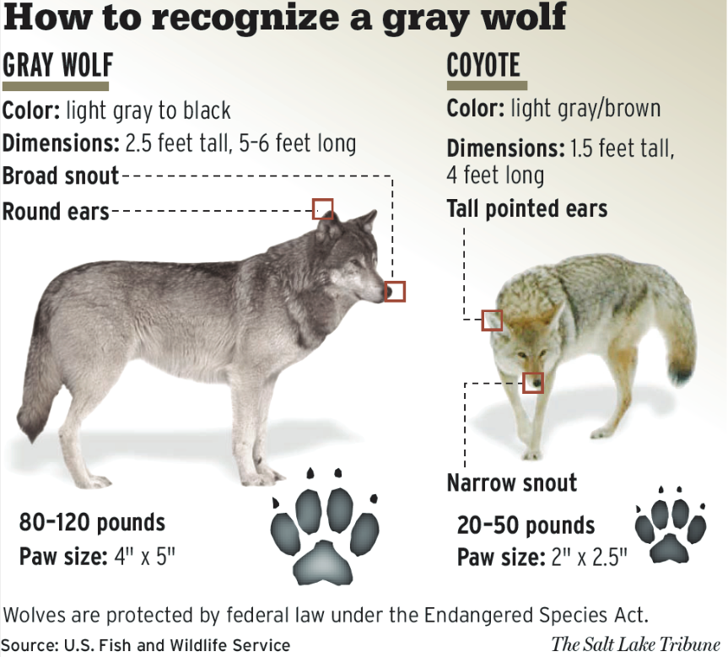
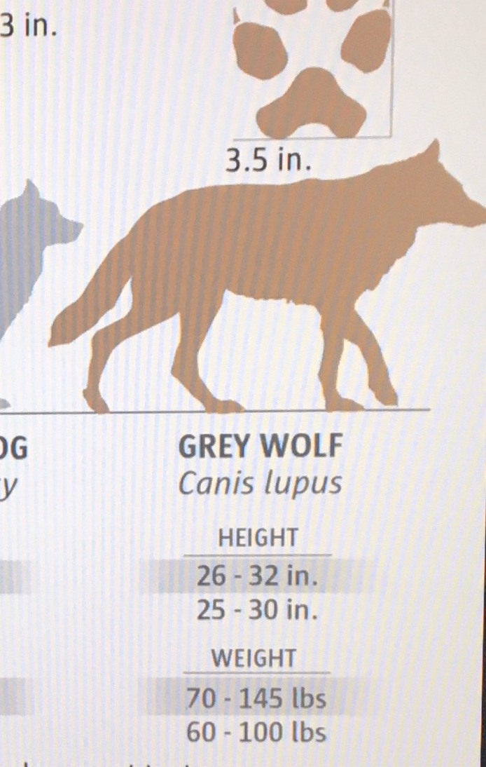
10. What does your creature look like, how much does it weigh, and how tall is it?
The Gray wolf weight is 66 - 180 lbs for an adult, their height can be 26 to 32 in. Their fur color can be light gray to black and their paws are around 4’’ x 5’’.
Notes:
1 Background Color
1 Title (or write the question)
1 Pictures
1 Include Transitions
1 Answering question using complete sentences (multiple sentences if needed to fully explain your answer)
1 Accuracy of information
6

Slide 11
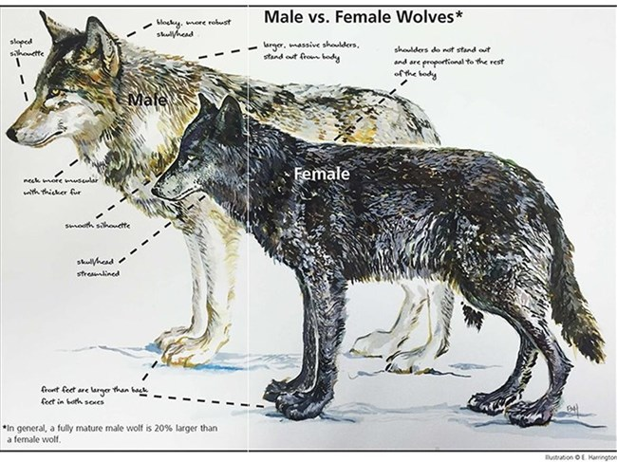
11. Do males and females of your creature weigh the same and are the same size?
No, male Gray Wolves weigh more than the females, the average weight for a male Gray Wolf is 70 to 145 lbs, and the average weight for a female is 60 to 100 lbs. The length also has a difference, since the male’s average length is 5- 6.5 feet from nose to tip of the tail, while the female’s is 4.5 to 6 feet.
Notes:
1 Background Color
1 Title (or write the question)
1 Pictures
1 Include Transitions
1 Answering question using complete sentences (multiple sentences if needed to fully explain your answer)
1 Accuracy of information
6

Slide 12
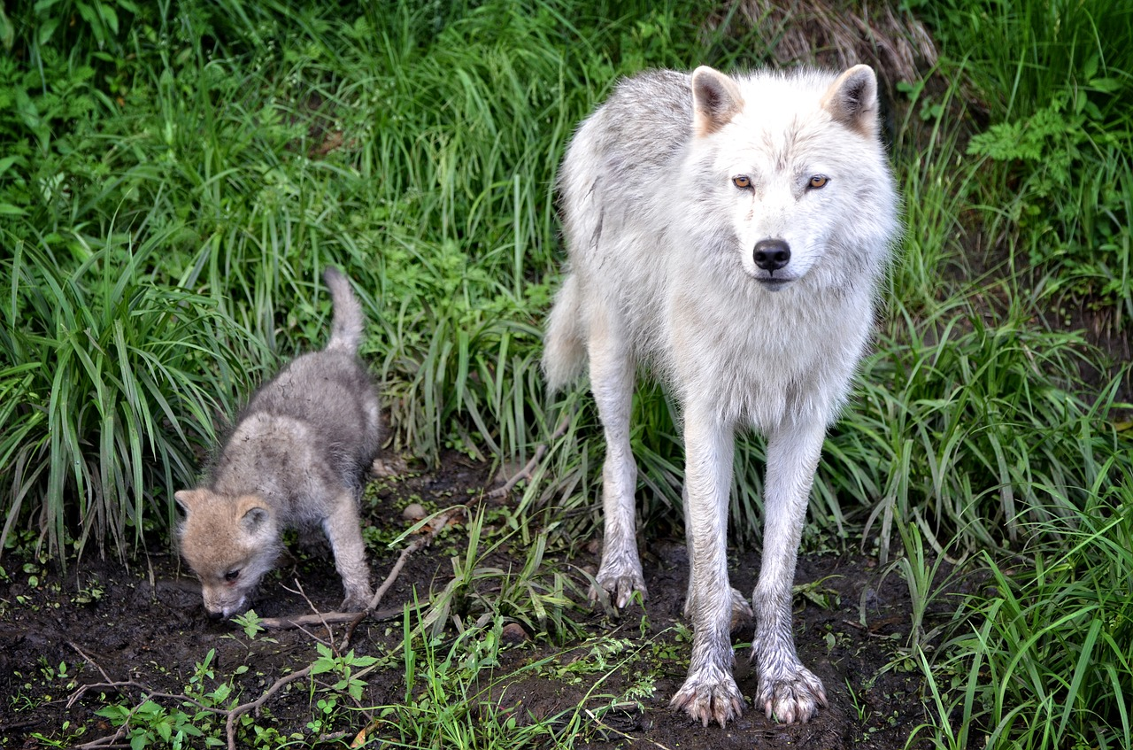
12. What is the lifespan of your creature?
The lifespan of a wolf depends on whether they are in captivity or if they are in the wild, for example, a wolf that is in captivity lasts about 16 years while a wolf that is in the wild lasts about 14 years
Notes:
1 Background Color
1 Title (or write the question)
1 Pictures
1 Include Transitions
1 Answering question using complete sentences (multiple sentences if needed to fully explain your answer)
1 Accuracy of information
6

Slide 13
13. Please include 8 facts about your creature
- On average, they can eat up to 20 to 30 pounds of meat in one meal.
- Wolves are the largest members of the dog family.
- Wolves are legendary because of their spine-tingling howl, which they use to communicate.
- Pups are born deaf with bright blue eyes.
- Wolves can run at 36 to 38 miles per hour.
- A howl can communicate a wolf’s location, warnings about predators and the position of prey.
- A wolf can be pregnant from 62 to 75 days.
- Chocolate is poisonous to wolves.
Notes:
1 Background Color
1 Title (or write the question)
1 Pictures
1 Include Transitions
1 Answering question using complete sentences (multiple sentences if needed to fully explain your answer)
1 Accuracy of information
6

Slide 14
Sources:
https://en.wikipedia.org
https://www.livescience.com/
https://www.nwf.org
https://www.blueplanetbiomes.org/
Notes:
1 Background Color
1 Title (or write the question)
1 Pictures
1 Include Transitions
1 Answering question using complete sentences (multiple sentences if needed to fully explain your answer)
1 Accuracy of information
6

