Slide 1
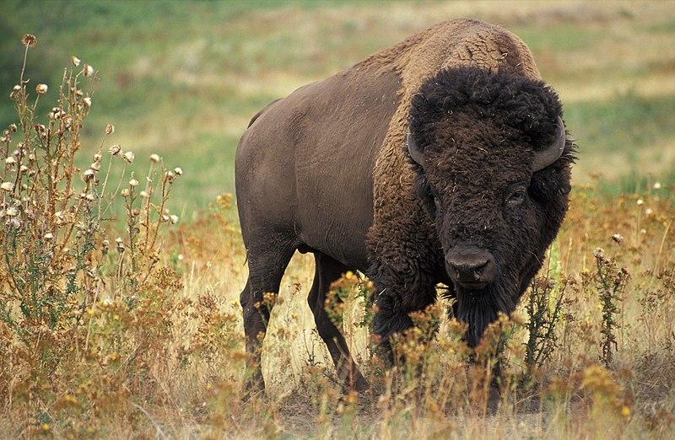
The American Bison
By D’Macio Acosta

Slide 2
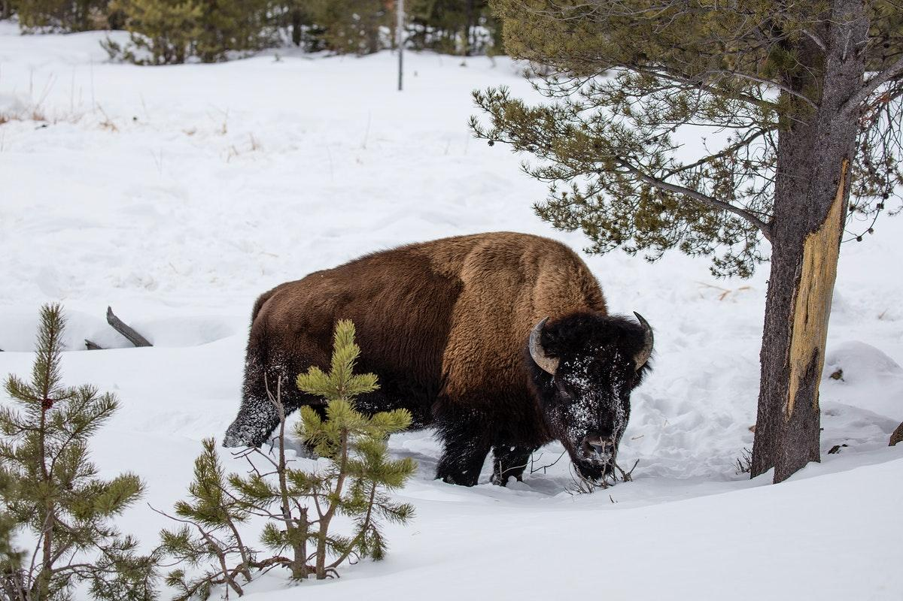
Where the American Bison originated from?
The original bisons were discovered in Alaska and came to America over a land bridge between Asia and Alaska.

Slide 3
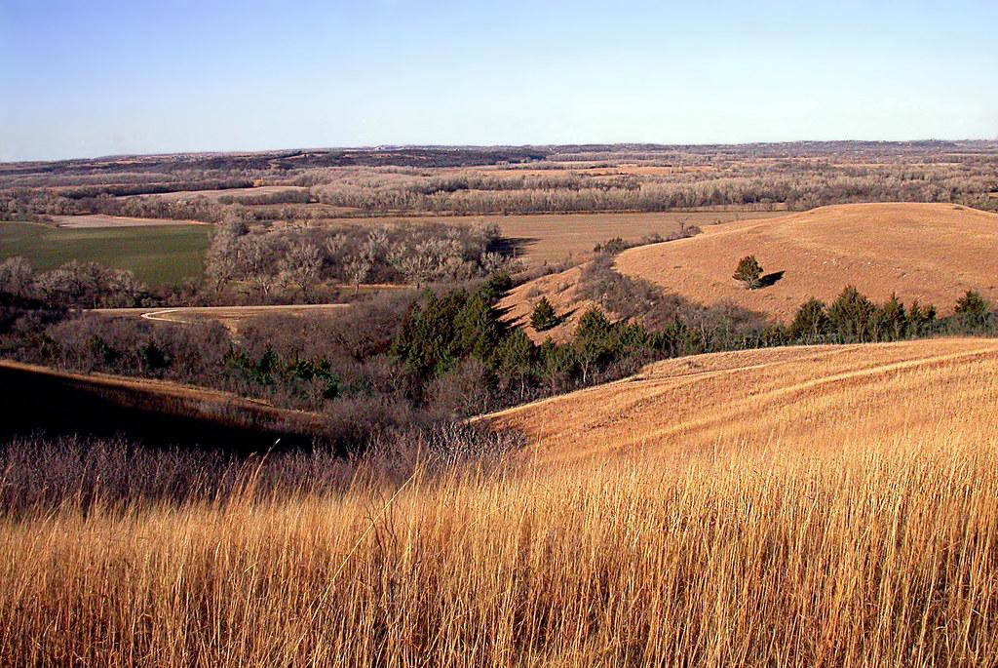
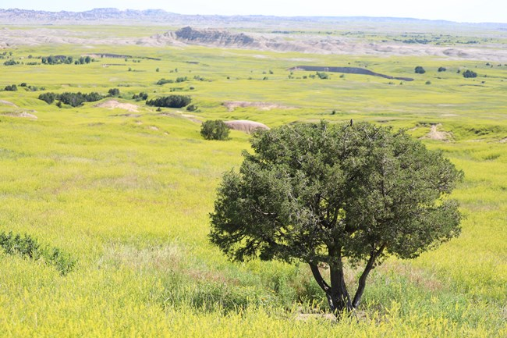
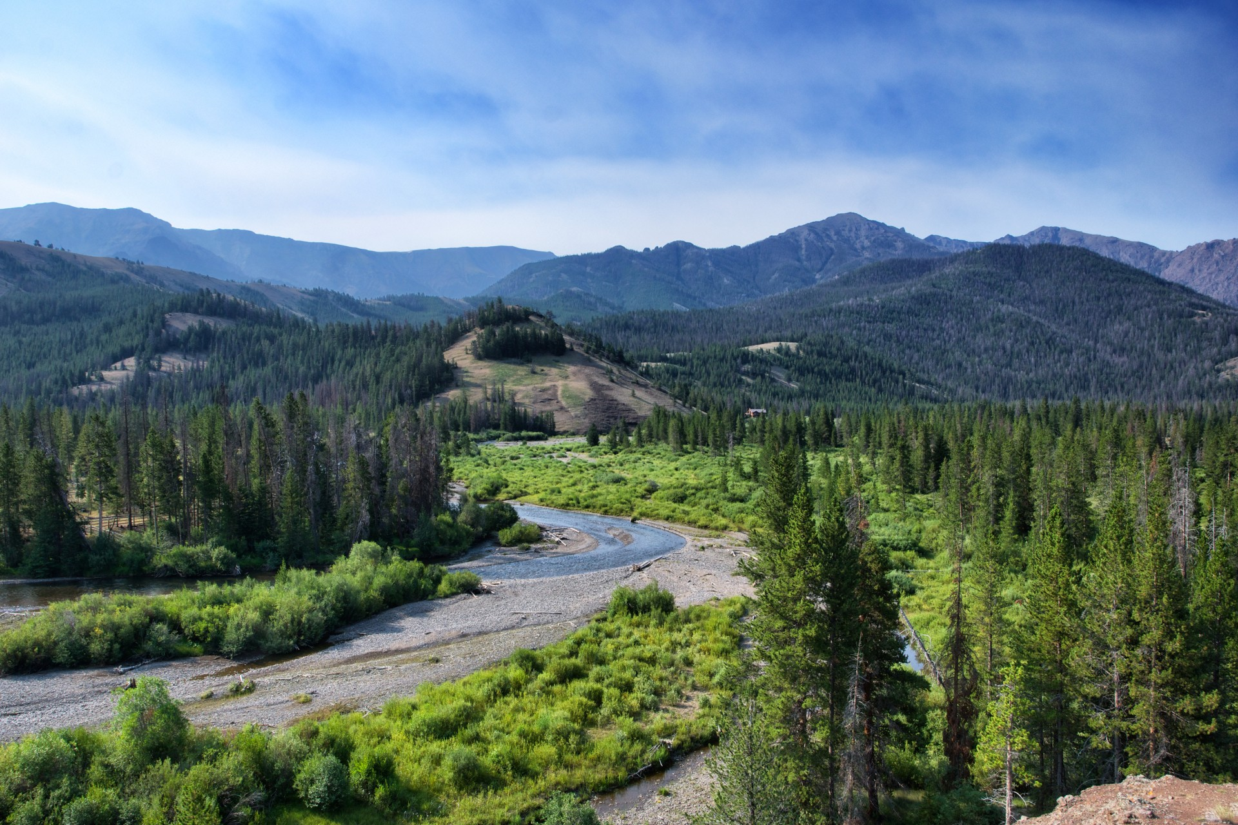
What ecosystem do American Bison live in?
The American bisons live on plains, prairies, and river valleys..

Slide 4
What is an American Bison ecosystem like?
The American bison ecosystems temperature can range from 19°F to 79°F and is rarely below 4°F or above 86°F.

Slide 5
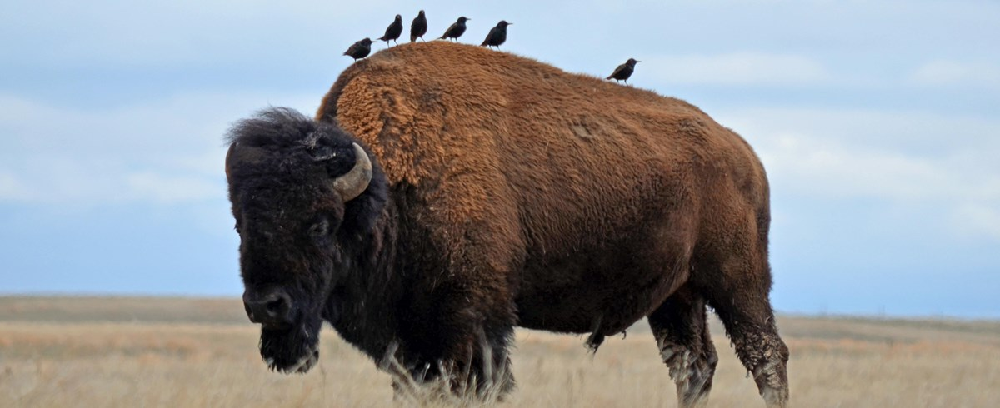
What type of consumer is the American Bison?
American bison are herbivores.

Slide 6

What food do American Bisons eat?
American Bison like eating low growing grass and sedges.

Slide 7
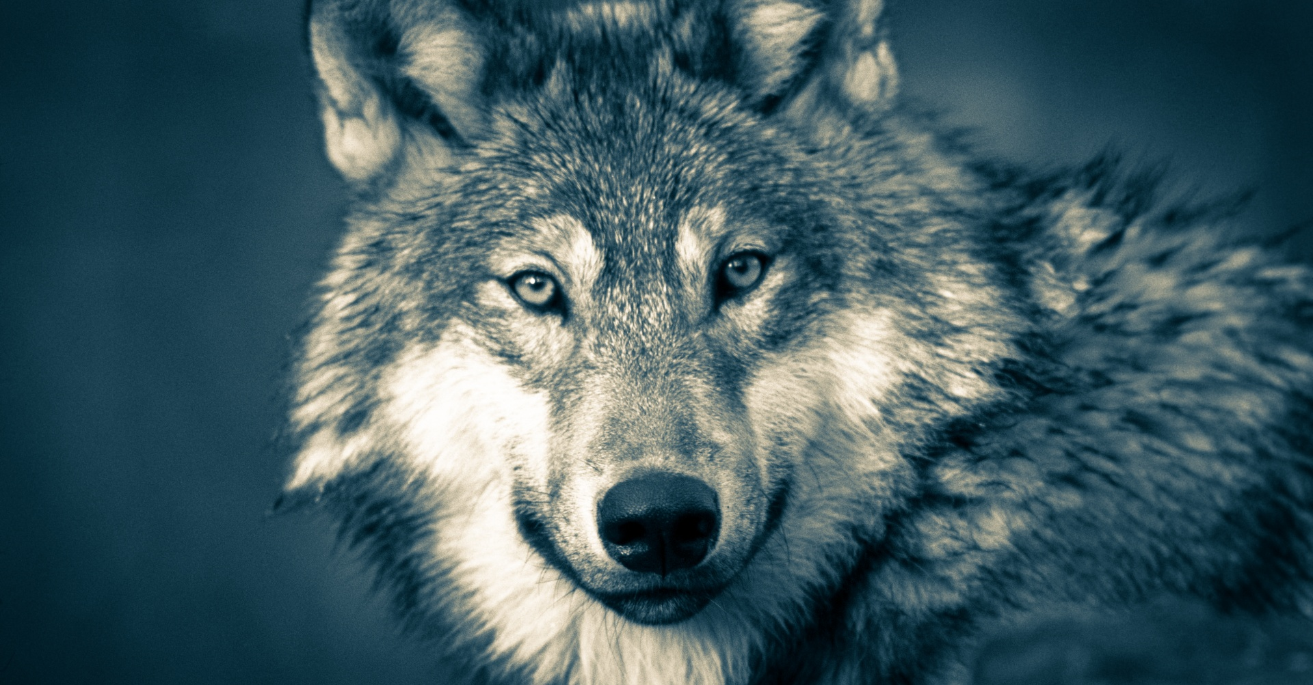
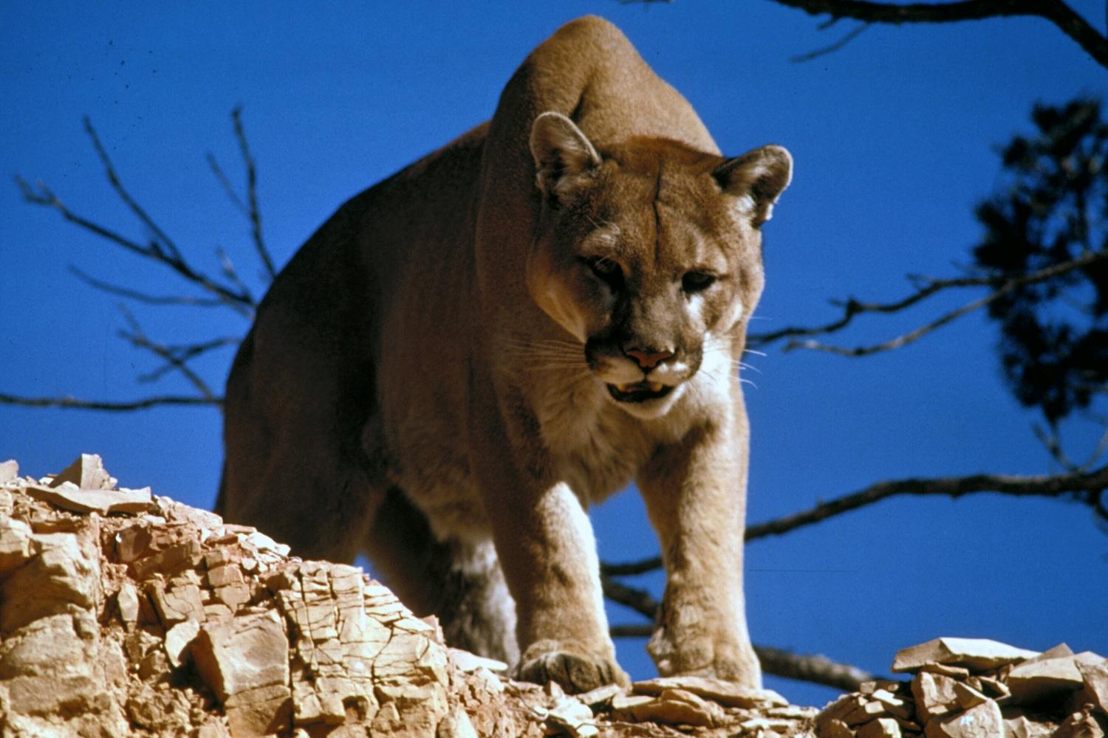
What are the American Bisons predators?
Wolves and mountain lions usually prey on the sick, young, weak, and old bison.

Slide 8

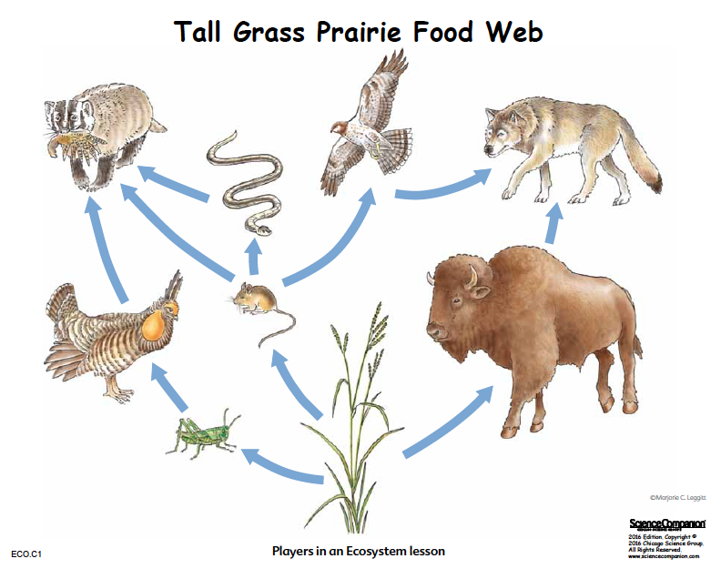
What is the American Bison food chain?
The American Bison food chain goes like this

Slide 9
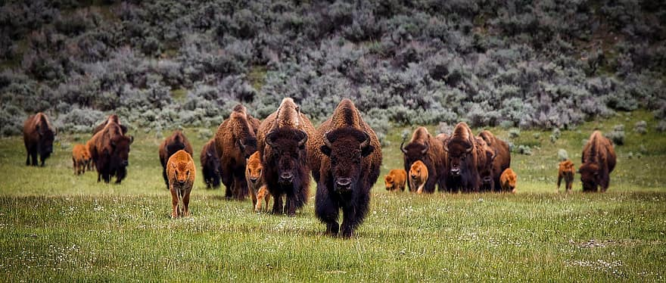
How do the American Bison adapt to survive?
The American Bison adapt to the cold temperature by having a thick fur to survive the cold weather and to survive from predators they travel in herds.

Slide 10

What do American Bison look like?
American bison can weigh up to 2,000 pounds and can stand up to six feet tall.The bison has long shaggy brown fur, a mane and beard under its chin and a long tail with a tuft of hair at the end. It has a big head with short black horns and a hump on its shoulders.

Slide 11
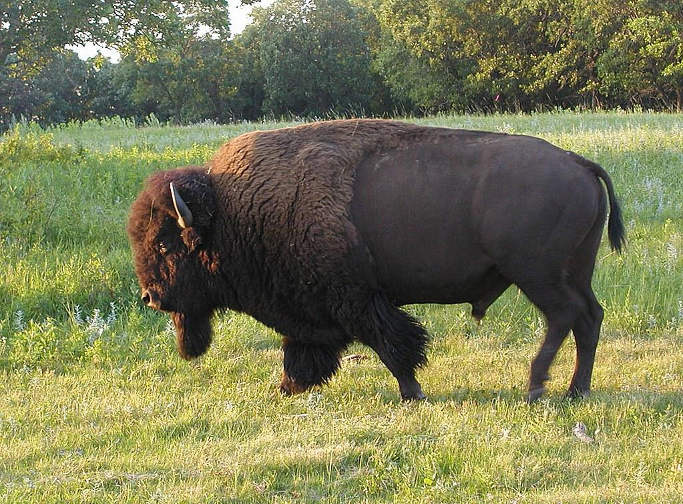
Do male and female Bison have the same traits?
Bison are the largest mammal in North America.Male bison weigh up to 2,000 pounds and stand 6 feet tall, while females weigh up to 1,000 pounds and reach a height of 4-5 feet. Bison calves weigh 30-70 pounds at birth.

Slide 12
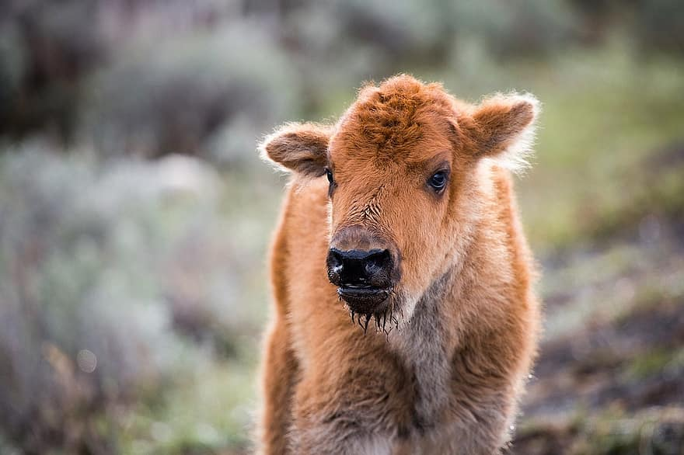
What is the American Bison lifespan?
Bison can live up to 20 years old. The average lifespan for a bison is 10–20 years, but some live to be older.How ever in captivity they can live up to 40 years old.

Slide 13
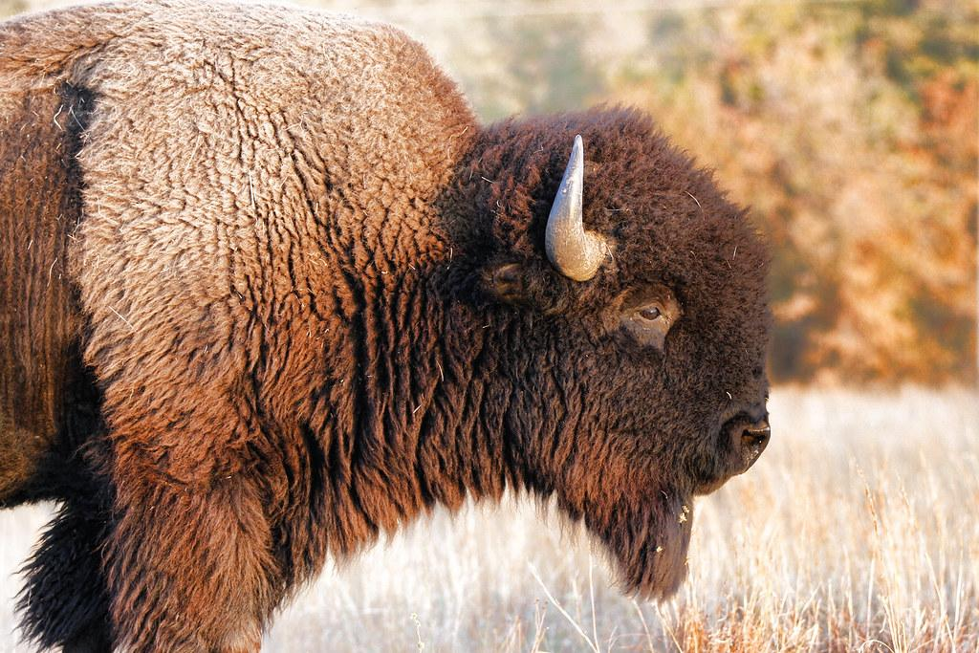
Facts about the American Bison
Bison can be 10 to 12 feet long.
Bison can spin around quickly to defend themselves against predators.
Even though weighing a ton bison can up to 6 feet.
Bison are surprisingly strong swimmers.
Bison can run up to 35 miles per hour.
Sadly there are only 500,000 Bison left in the world.
The American Bison has 4 stomachs.
One Bison can drink 30 gallons of water each day.

Slide 14
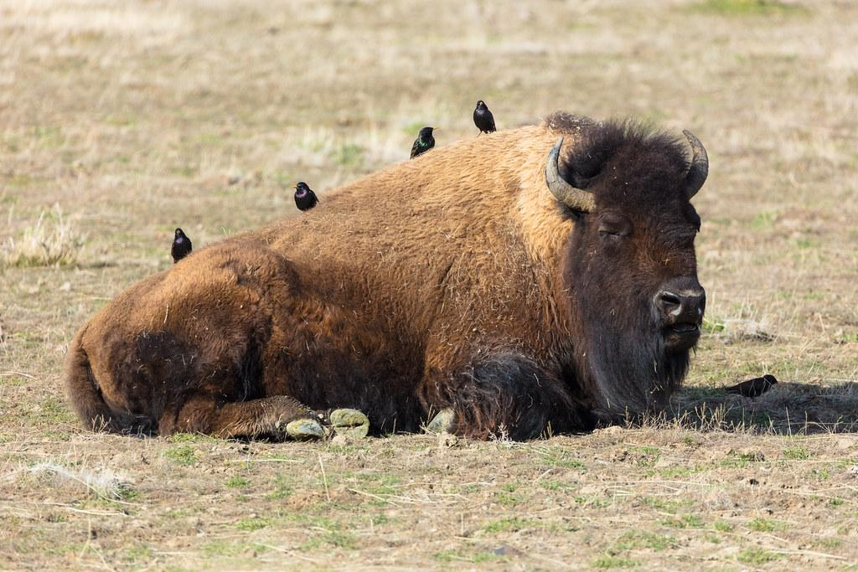
Sources
Farm. Food. Life.
15 Facts About Our National Mammal: The American Bison
https://www.doi.gov
Wikipedia

