Slide 1
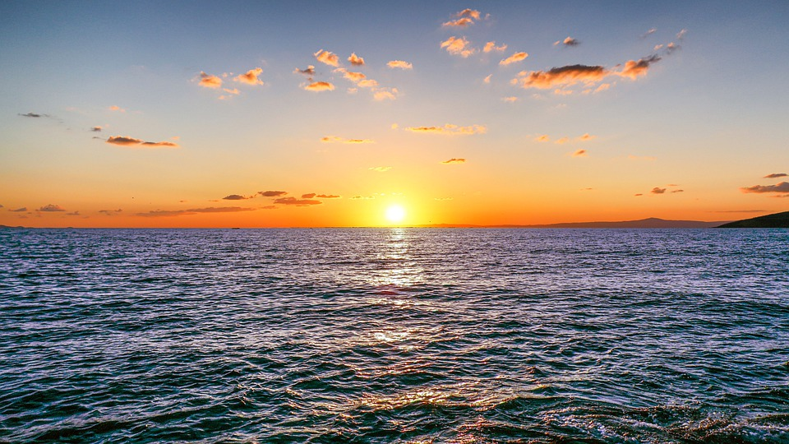
Creature Project
Dolphin
By Emily Verboonen Garcia

Slide 2
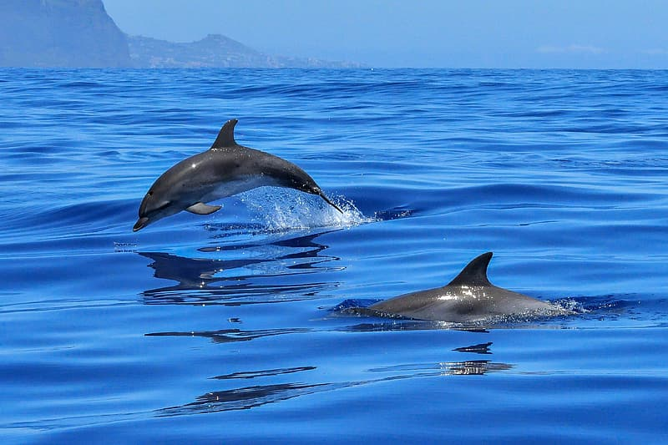
Dolphin
My creature is a Dolphin, because Dolphins have a reputation for being friendly, but they are actually wild animals who should be treated with caution and respect. Interactions with people change dolphin behavior for the worse. They lose their natural wariness, which makes them easy targets for vandalism and shark attack.

Slide 3
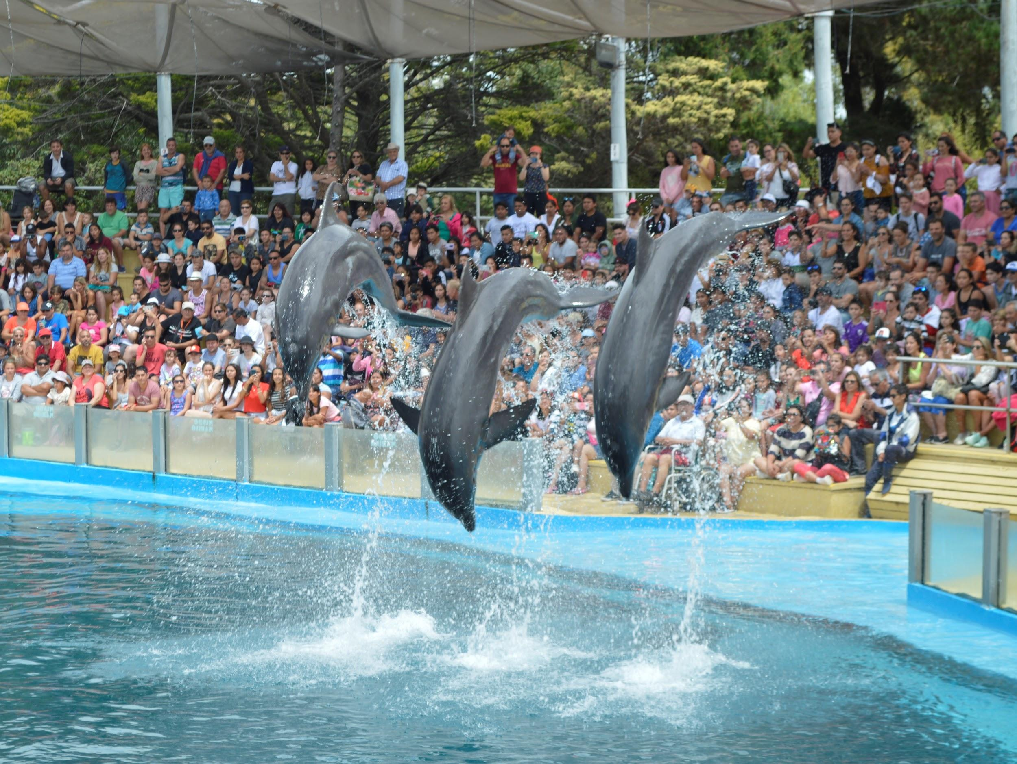
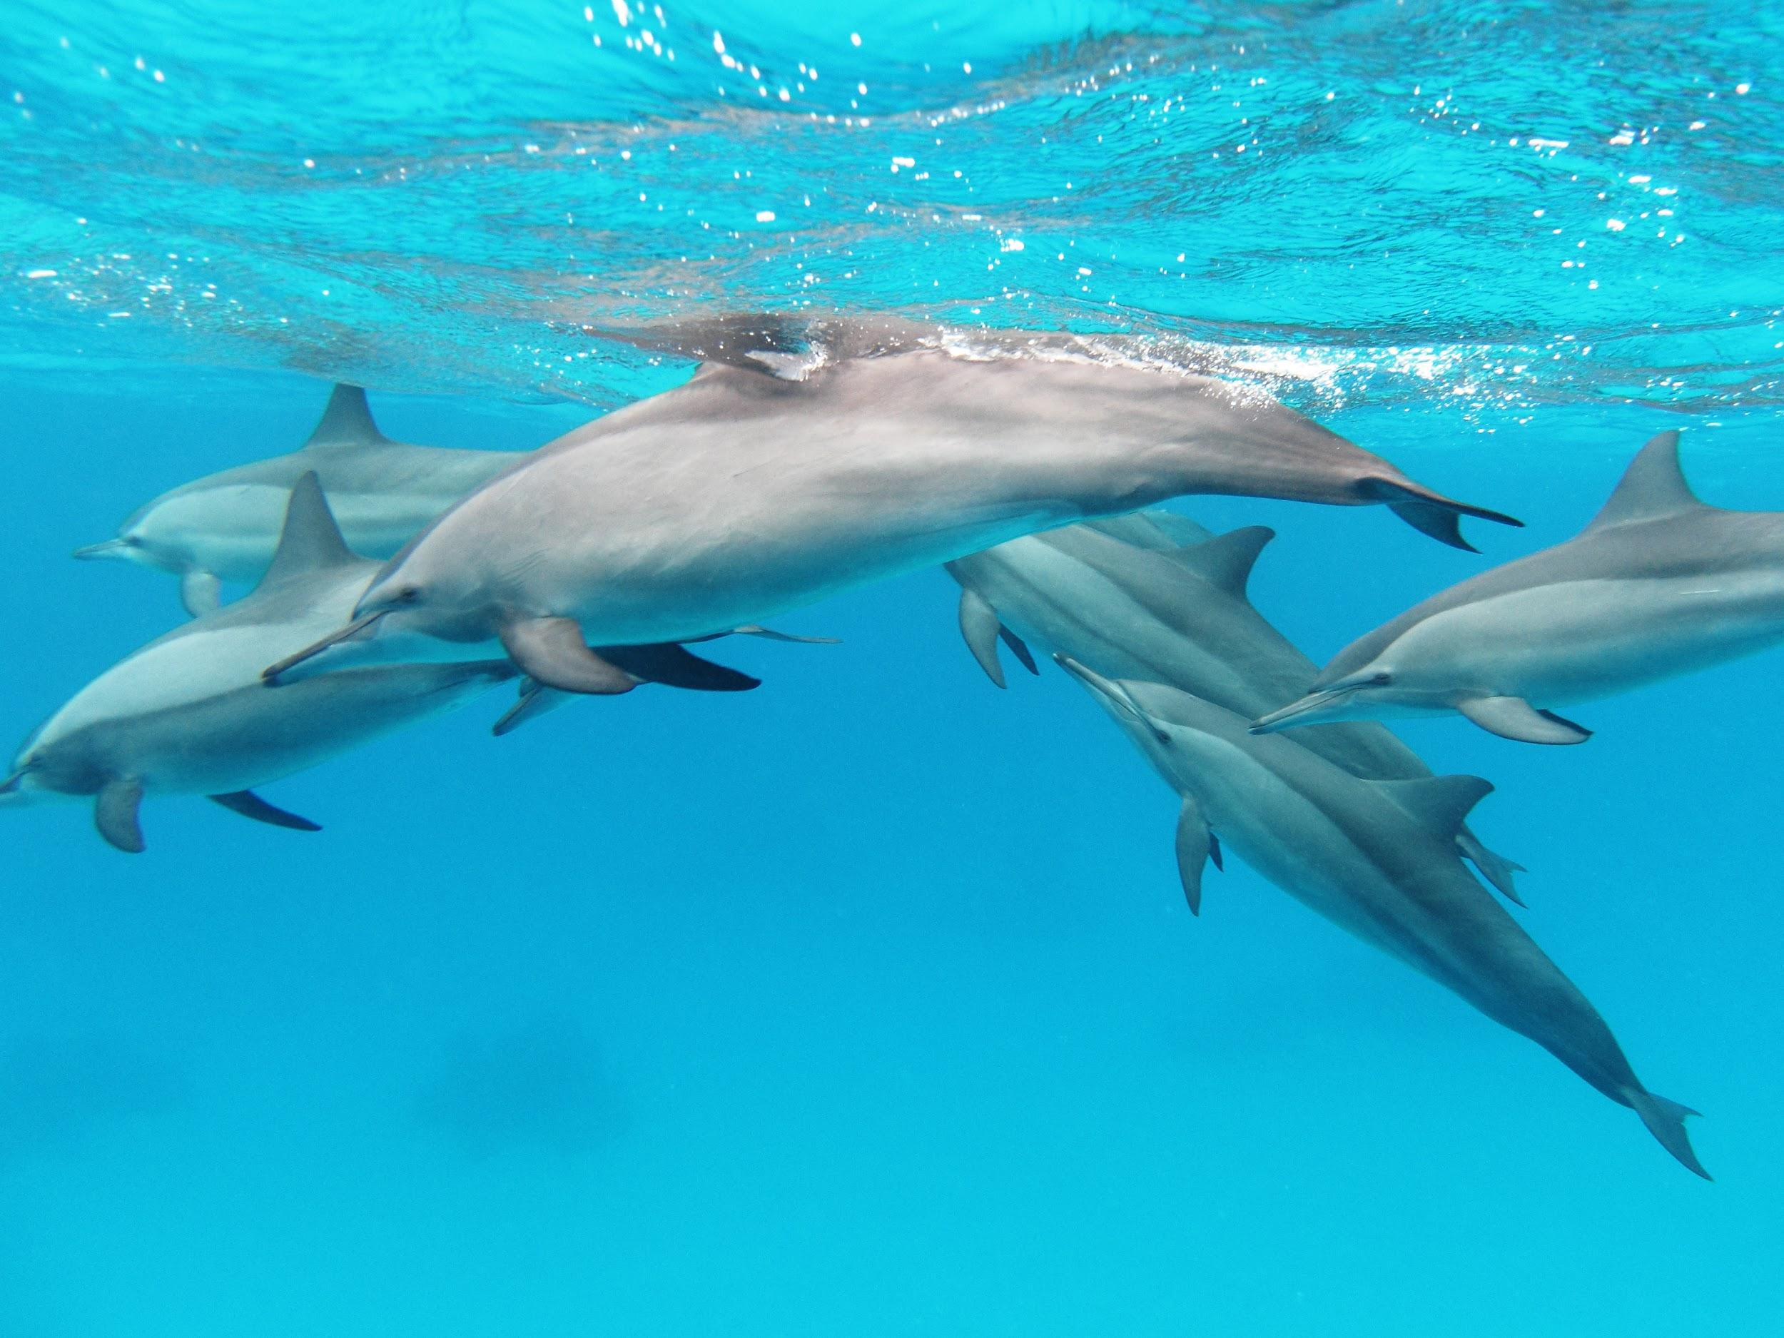
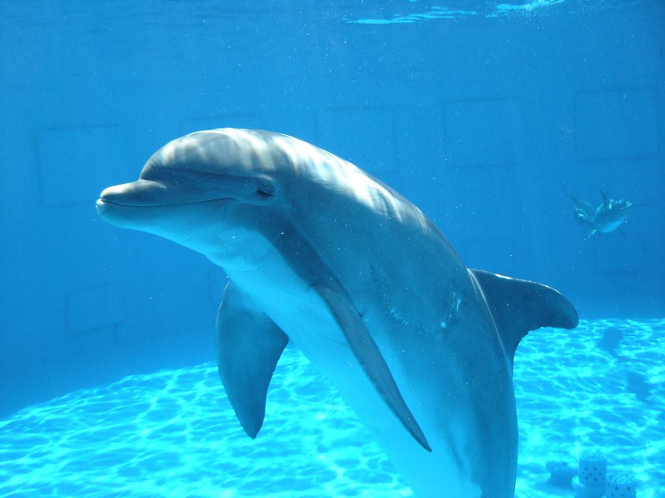
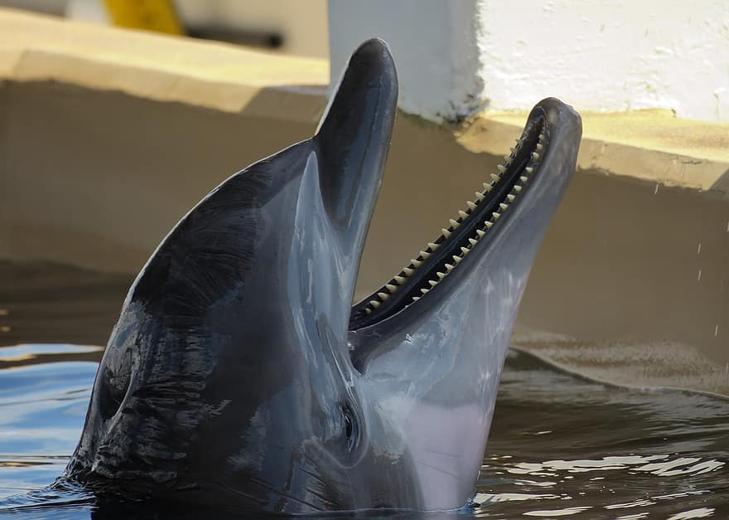
'Mesonyx',
Scientists believe that dolphins evolved from a hoofed, land-living mammal called 'Mesonyx', and returned to live in the seas some fifty million years ago. They may have looked like a large dog originally, but have looked dolphin-shaped for millions of years.

Slide 4
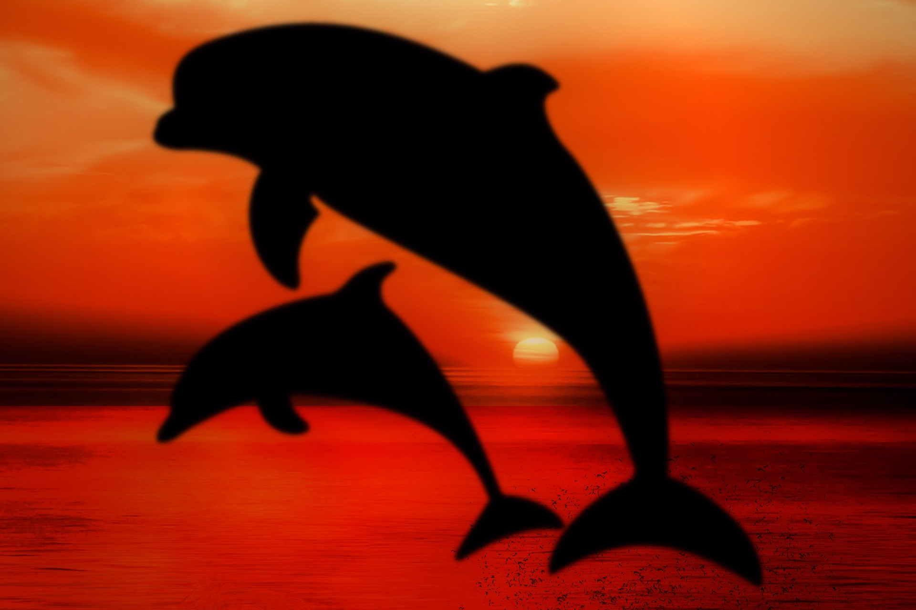
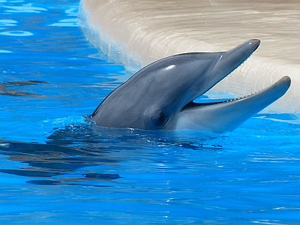
Ecosystem
Bottlenose dolphins are found in temperate and tropical waters around the world. They inhabit a wide variety of habitats, including harbors, bays, gulfs, and estuaries, as well as nearshore coastal waters, deeper waters over the continental shelf, and even far offshore in the open ocean.Dolphins thrive in both tropical and cooler, more temperate waters. Humans have encountered dolphin pods both near shore and in deep offshore waters like the Indian Ocean.

Slide 5
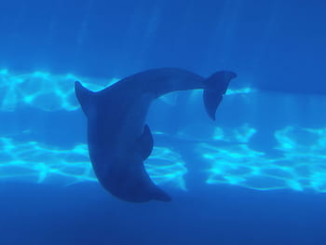
Consumers
Dolphins are consumers like many other animals. Consumers are animals that need to eat other plants and/or animals in order to survive. Dolphins are a type of consumer called a carnivore because they eat only meat. Dolphins are part of an ocean food chain.Dolphins eat a variety of fish, squid, shrimps, jellyfish and octopuses. The types of fish and other creatures dolphins eat depend on the species of dolphin, where the dolphins live and the wildlife that shares their habitats.

Slide 6
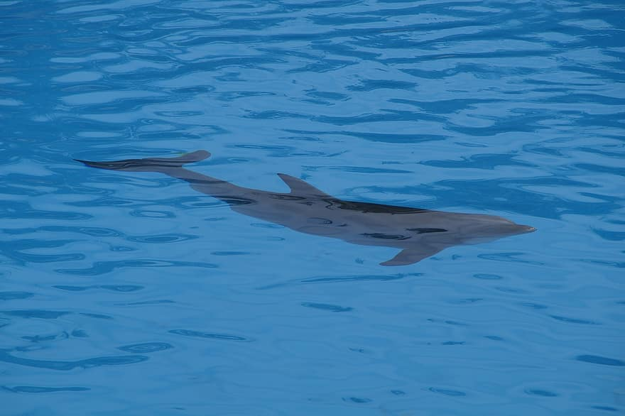
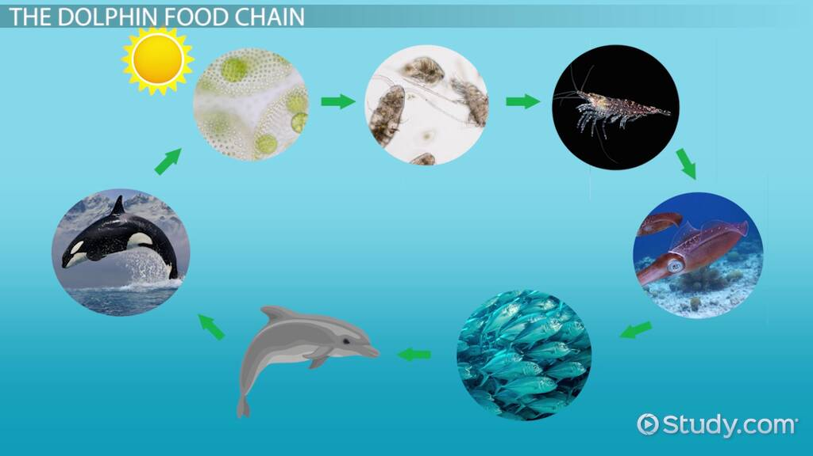
Food
Bottlenose dolphins are top ocean predators with few predators of their own, although they sometimes become prey for sharks and orcas. They can also become entangled in fishing gear and are still hunted by humans in some parts of the world.

Slide 7
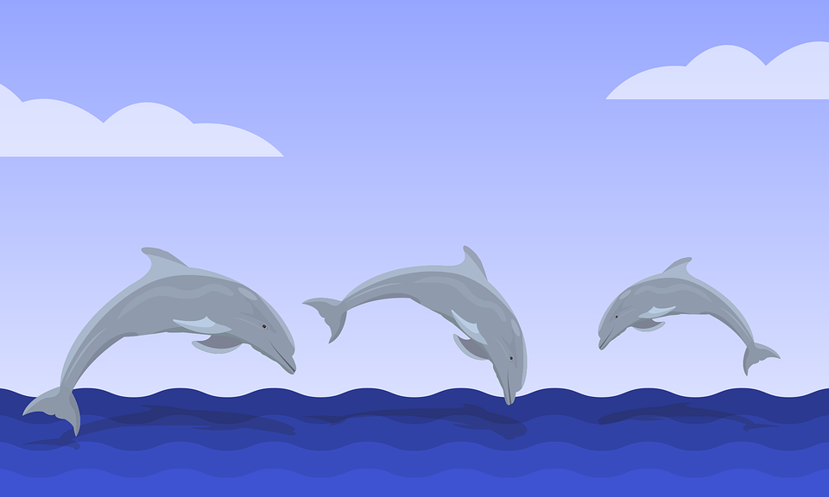
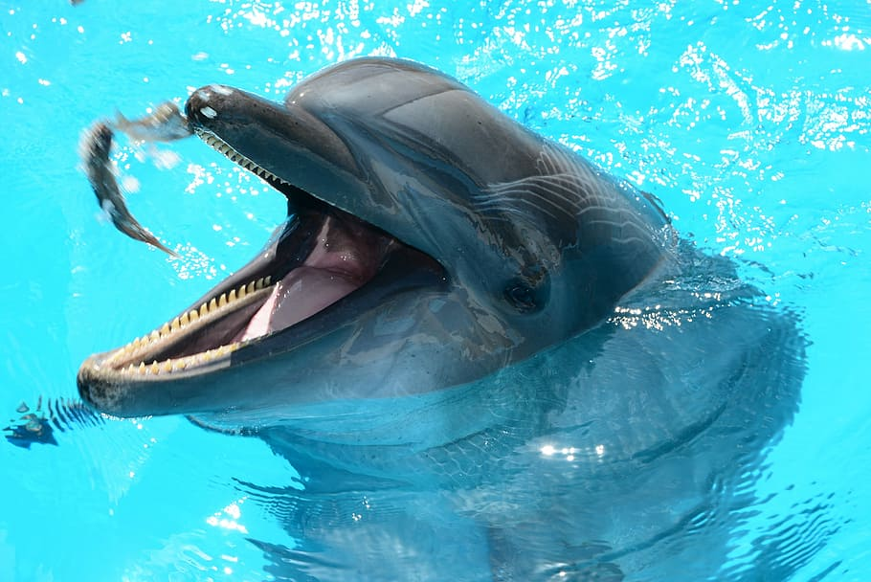
Fight
Dolphins have many adaptations that help them survive in the ocean. Their bodies have been streamlined and their limbs have been modified. The pectoral flippers on the sides of their body help the animal steer and stop.

Slide 8
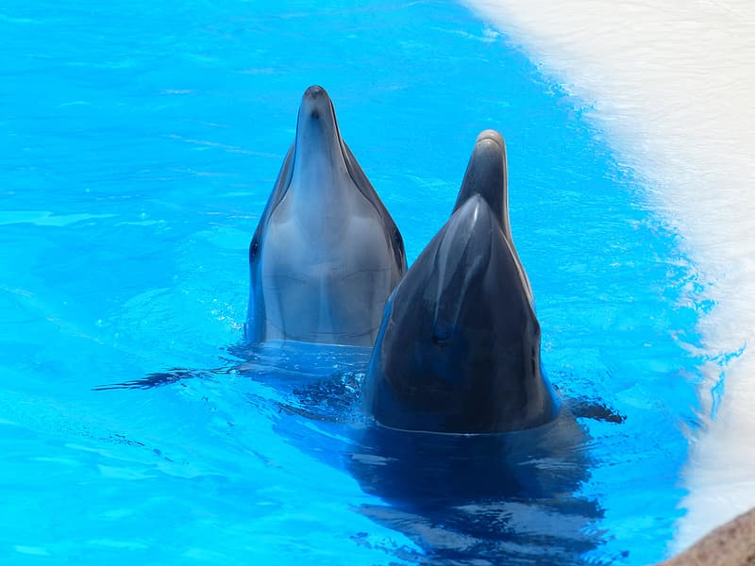
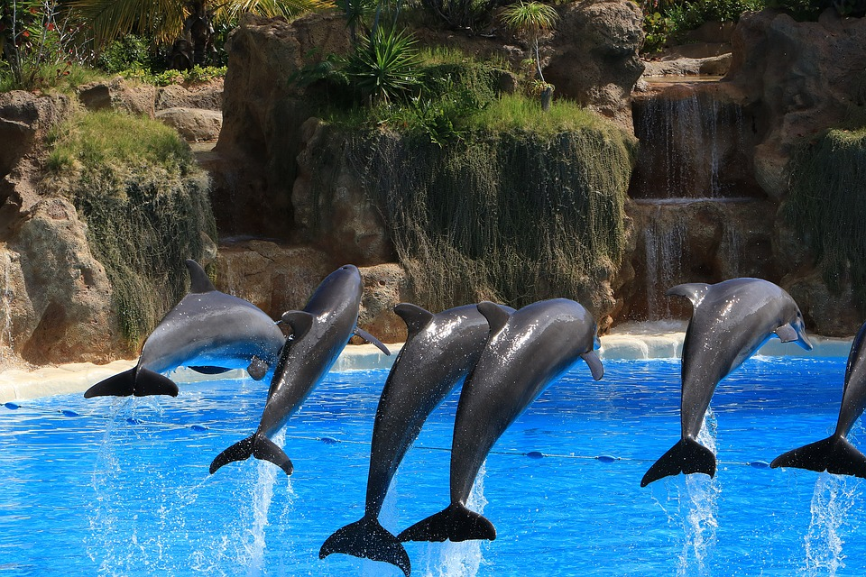
Dolphins:
In general, bottlenose dolphins are 2 to 3.9 m (6.6 to 12.8 ft.). Their average weight is 150 to 200 kg (331.5 to 442 lbs.). Maximum length and weight reported in the wild was from an individual in the Eastern North Atlantic that measured 4.1 m (13.5 ft.) and 650 kg (1,400 lbs.).Adult males are about 18 ft in length whereas adult females can reach about 12 ft in length. ... They reach an average 10 ft to 13 ft and like most dolphins males are typically slightly larger than females, Weighing 660 lbs to 1,100lbs making it the largest species called “dolphin”. Dolphins can also live up to 40 years without dying.

Slide 9
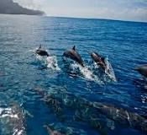
Facts about dolphins
Dolphins can be found all over the world and in different environments. ...
Freshwater dolphins. ...
Underwater noise pollution is a real threat to dolphins. ...
They're fast sprinters. ...
How do you eat a fish? ...
They like to blow bubbles. ...
Dolphins are chatty animals. ...
They're intelligent, like us.

Slide 10
Resources:
1.Protect Wild Dolphins
2.From Land to Water: the Origin of Whales, Dolphins, and …
3.DOLPHIN FACTS: EVERYTHING YOU NEED TO KNOW
4.Dolphin Food Chain: Lesson for Kids - Study.com
5. What do dolphins eat? - Whale & Dolphin Conservation USA
7.Atlantic Bottlenose Dolphin - National Aquarium

