Slide 1
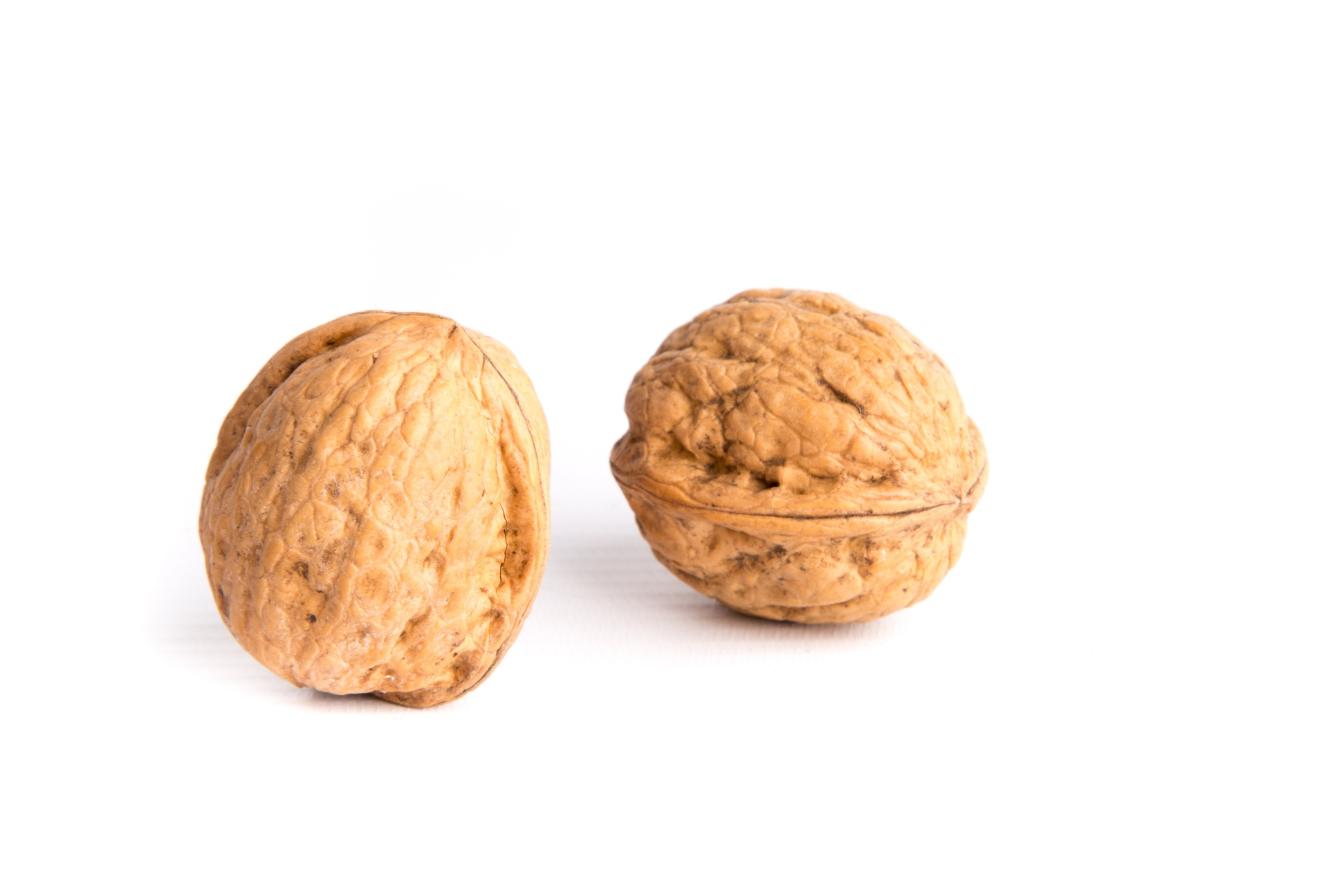
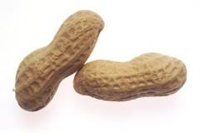
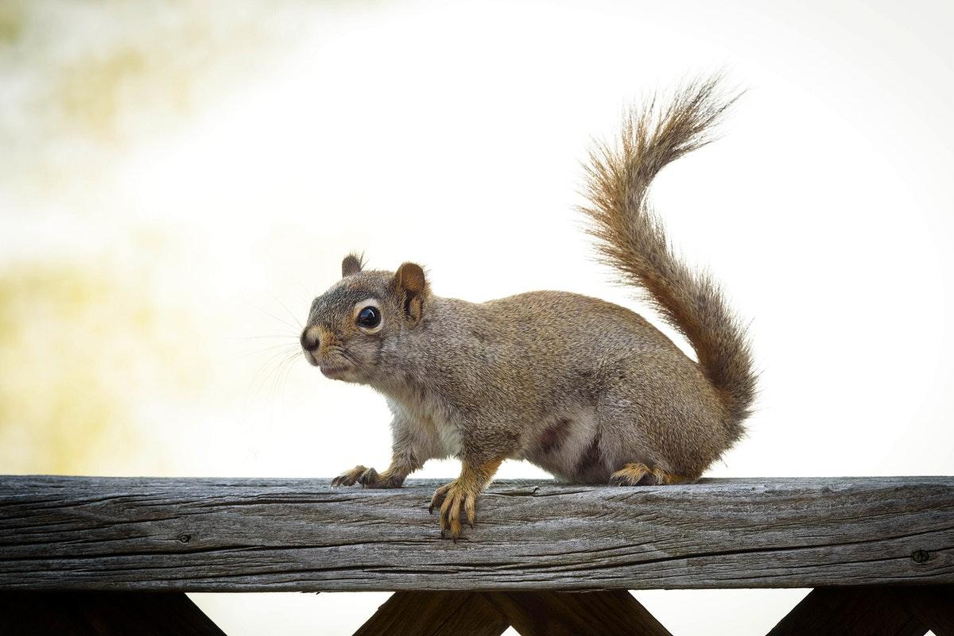
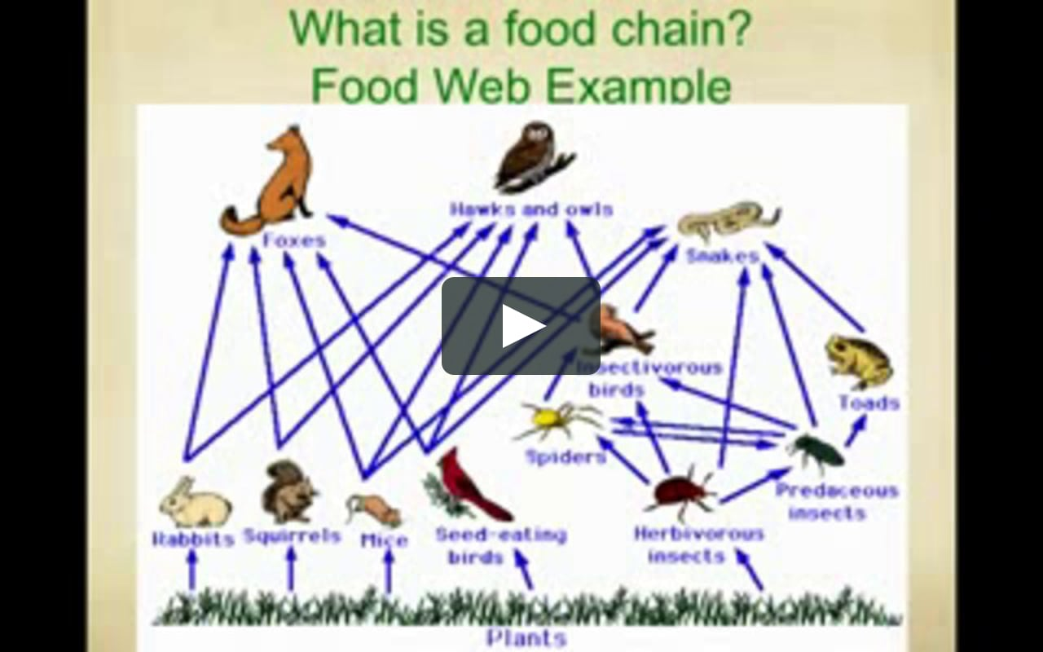
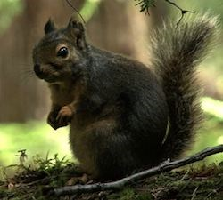

Squirrel
By.Jasmine
Notes:
1 Title (or write the question)
1 Pictures
0 Include Transitions
1 Answering question using complete sentences (multiple sentences if needed to fully explain your answer)
1 Accuracy of information
5
Needs a transition.

Slide 2
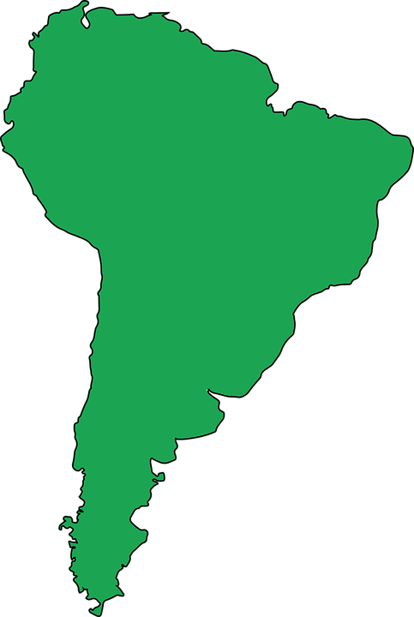

History Of a Squirrel
My creature comes from america , eurasia, and africa.There really common places to find squirrels of most types.Squirrels are easily found in Fields or trees.
Notes:
1 Title (or write the question)
1 Pictures
0 Include Transitions
0 Answering question using complete sentences (multiple sentences if needed to fully explain your answer)
1 Accuracy of information
4
Needs a transition.
Title…. Either History of a Squirrel or History of a squirrel.
Please put a space after each comma. There are really common…. Two spaces after a period. Ie… …types. Squirrels are easily found in fields or trees.

Slide 3
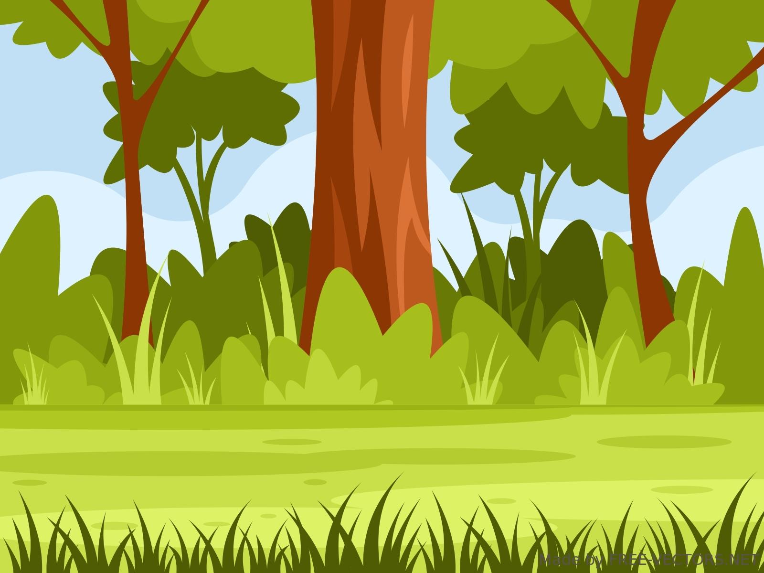
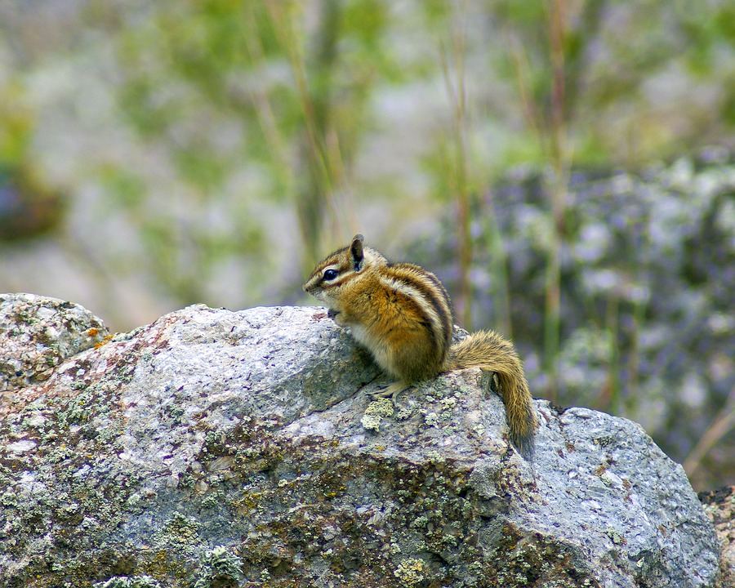
Where is a squirrels ecosystem at?
Forests are Most likely to have a bunch of squirrel, Squirrels are found around forests or camp areas because of what they eat for example Seeds,nuts,walnuts it's really important for them to be near trees or campus of fruit to stay alive..
Notes:
1 Title (or write the question)
1 Pictures
0 Include Transitions
0 Answering question using complete sentences (multiple sentences if needed to fully explain your answer)
1 Accuracy of information
4
Needs a transition.
…squirrel’s ecosystem…
Make Forest: either a title on its own line, or make the font the same size at the rest.

Slide 4
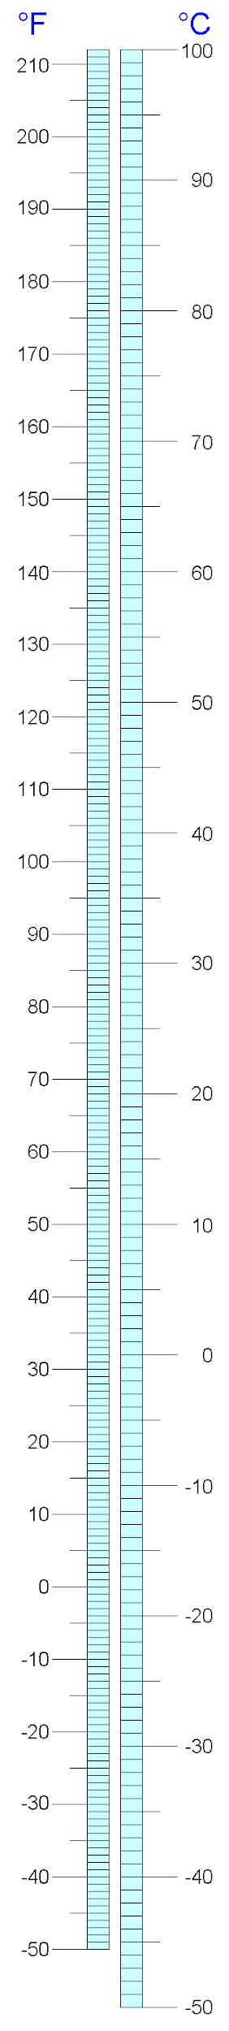
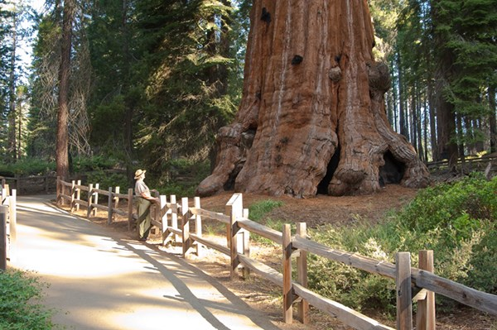
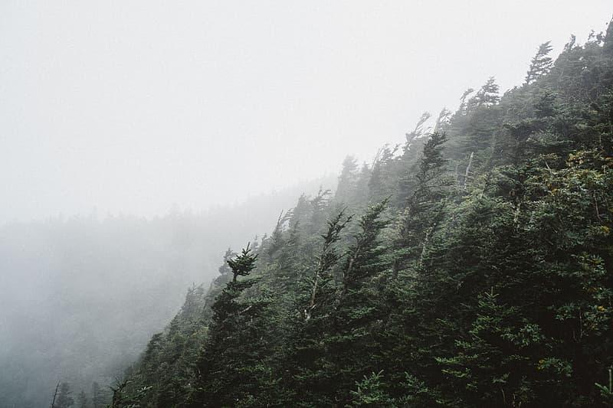
What is it like in there ecosystem?
Good question,Squirrels live in under 33 degrees Fahrenheit or when weather turns windy or stormy then it changes of course.
Windy, Foggy, Stormy,
https://aeroanimalrescue.org/2019/02/25/wind-blown-squirrels-and-what-to-do-with-them/
Notes:
1 Title (or write the question)
1 Pictures
0 Include Transitions
0 Answering question using complete sentences (multiple sentences if needed to fully explain your answer)
1 Accuracy of information
4
There is no transition.
Put a space after each comma. Fahrenheit is capitalized. You need a qualifying adverb… Squirrel can lin in under….
Please put all references on the last page under the heading Sources.

Slide 5
What type of consumer is a squirrel?
https://wildsight.ca/wp-content/uploads/2020/06/lesson-plan-food-forest-web-backgrounder.pdf
A squirrel can get its energy from plants but can not eat animal meat that is basically called a herbivores.
A squirrel can eat about one pound of food per week .Squirrels can eat about anything BUT they have natural appetite such as plants and nuts.
Notes:
1 Title (or write the question)
1 Pictures
0 Include Transitions
0 Answering question using complete sentences (multiple sentences if needed to fully explain your answer)
1 Accuracy of information
4
There is no transition. Put all references on the last slide under sources.
…plants, but they do not eat meat this is why they are called herbivores.
Two spaces after a period. …anything, but they have a natural appetite for plants and nuts.

Slide 6
5 different types of foods squirrels eat.
1.”Acorns are the most common to be found in trees” .
2.”Walnuts are found in orchards around trees where your most likely to find them” .
3.”Cashews are also there go to or kinda least option in food there not really easy to find” .
4.”Pistachios are also found in orchards which are mostly found around easy” . areas.https://clever.com/in/live-oak-unified-school-distfdef841010000040c
Notes:
1 Title (or write the question)
1 Pictures
0 Include Transitions
0 Answering question using complete sentences (multiple sentences if needed to fully explain your answer)
1 Accuracy of information
4
There is no transition.
Put two spaces after a period. All sentences should start with a capital letter and end with punctuation. #3 please read this outloud to yourself.. Put all references on the last slide under the title “Sources”

Slide 7
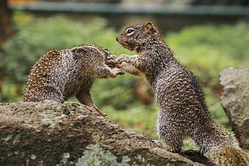
What is a squirrels enemy?
For instance One of the squirrels enemy is a hawk, fox, and coyote. Also some squirrels also prey other squirrels if in need of food .
‘Fighting over nuts’
Notes:
1 Title (or write the question)
1 Pictures
0 Include Transitions
0 Answering question using complete sentences (multiple sentences if needed to fully explain your answer)
1 Accuracy of information
4
There is no transition.
What are the enemies of a squirrel?
Put a space after each comma. When creating a list using comma the last item gets an “and”.
For instance, A list of some of squirrel enemies might include the hawk, fox, and coyote. Also, some squirrels prey on other squirrels when in need.

Slide 8
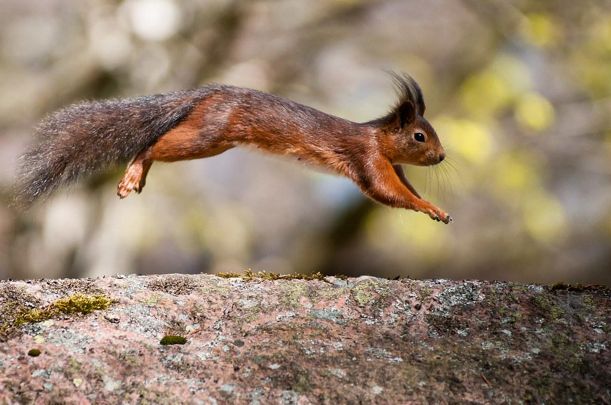
Adaptations
Squirrels can rotate the back of their legs to jump in trees or just self defiance
.ioweb.uwlax.edu/bio203/s2012/toellner_kayl/adaptation.htm#:~:text=One%20adaptation%20that%20is%20extremely,traveling%
Notes:
1 Title (or write the question)
1 Pictures
0 Include Transitions
0 Answering question using complete sentences (multiple sentences if needed to fully explain your answer)
1 Accuracy of information
4
There is no transition.
…trees, or just in defiance.
Please place all references on the last page.

Slide 9
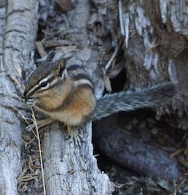
weights,appearance,height
Height:About 1.5 pounds.
Appearance:Furry, brown, And black small and fast.
Height
Notes:
1 Title (or write the question)
1 Pictures
0 Include Transitions
0 Answering question using complete sentences (multiple sentences if needed to fully explain your answer)
1 Accuracy of information
4
There is no transition.
Weight, Appearance, Height.
Two spaces after a colon.

Slide 10
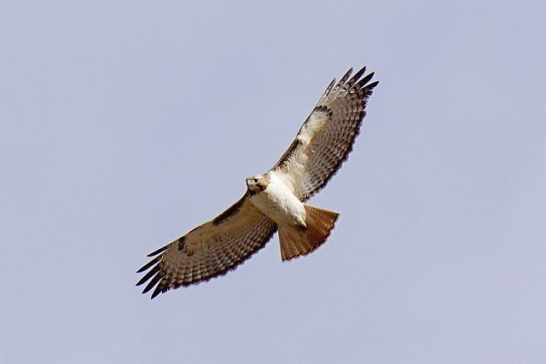
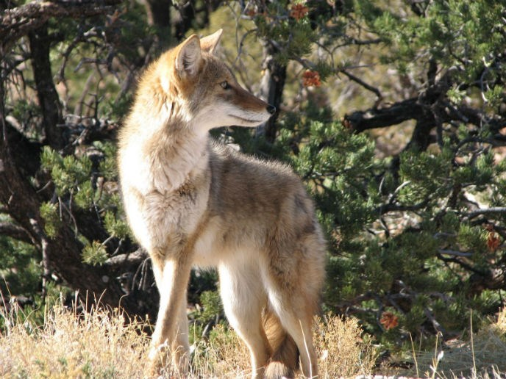
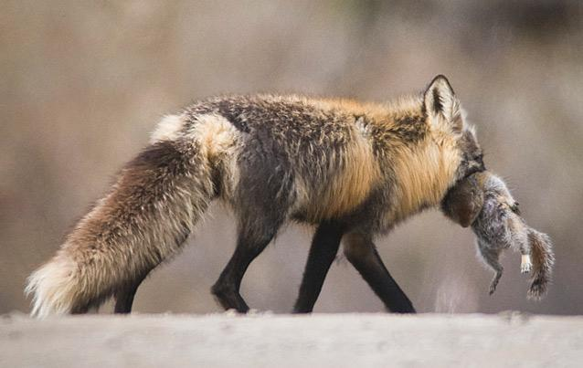
Squirrels predators.
1.Red tailed hawk is one of the most common to be a squirrels predator.
2.coyotes are also common to be around orchards.
3.foxes
15% to 22% continue to live after
There born.
Notes:
Not scored duplicate slide.
There is no transition.
You already had a predator slide.
Two spaces after a period.

Slide 11
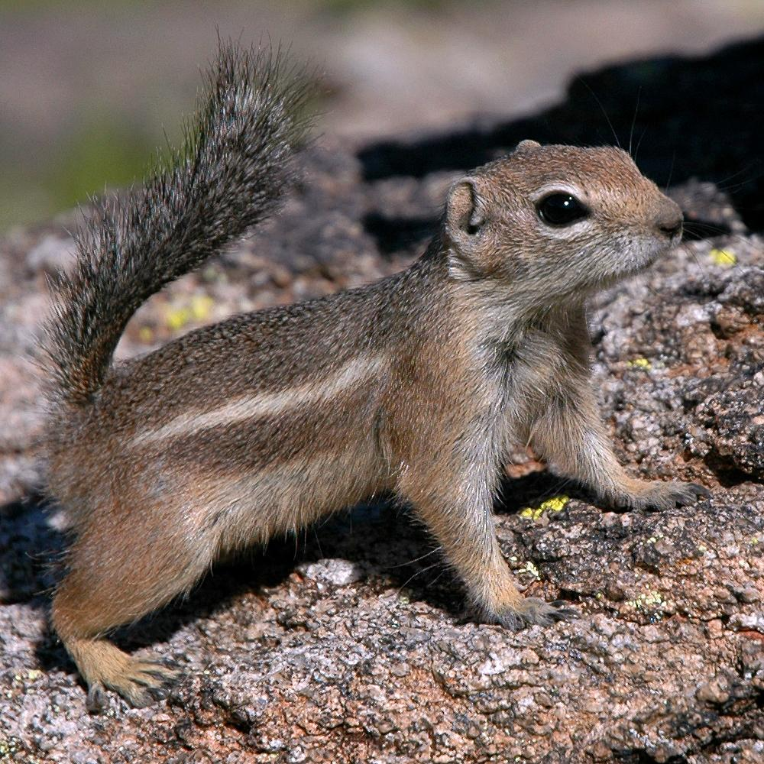
Similar to a squirrel.
Apparently there is not really much similar to a squirrel unless its the food habitat.
Notes:
Not scored extra topic.
There is no transition.
Apparently, there are not really many animals similar to…

Slide 12
8 facts about a squirrel.
1.They live around 6-10 years
2.family around a medium or small family.
3.They also eat plants
4.They eat meat too.
5.birthing is around 46/56 days
6.6 young squirrels are born.
7.They come in different colors like black and brown white.
8.They come from africa and eurasia
Notes:
1 Title (or write the question)
1 Pictures
0 Include Transitions
0 Answering question using complete sentences (multiple sentences if needed to fully explain your answer)
1 Accuracy of information
4
There is no transition.
6 young squirrels are born? Two spaces after a period. Each sentence should start with a capital letter and end with punctuation. Africa and Eurasia need to be capitalized.
You are missing slides… 4 by my count…

