Slide 1
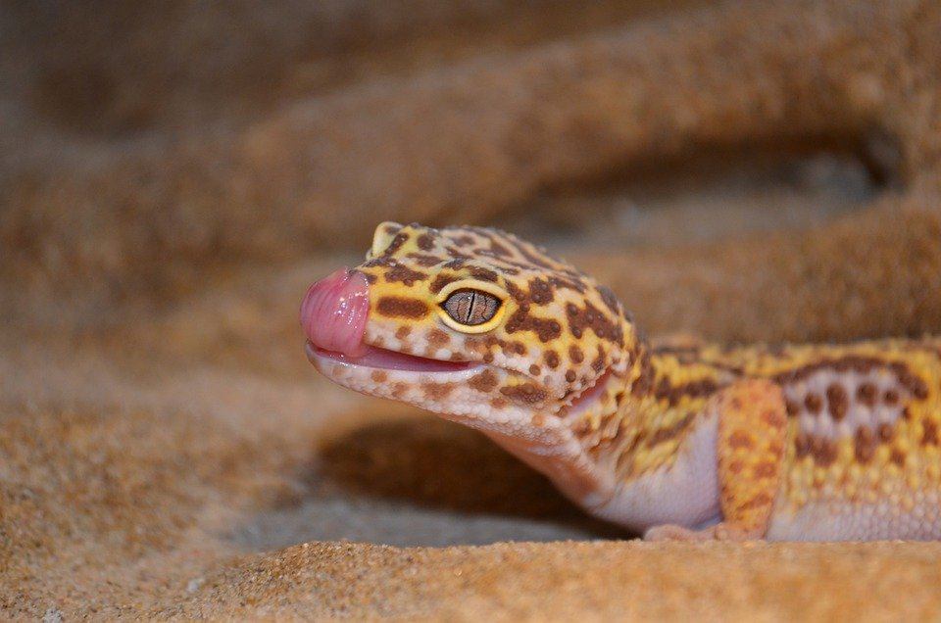
Leopard Gecko Project
By Jayna F
Notes:
1 Background Color
1 Title (or write the question)
1 Pictures
1 Include Transitions
1 Answering question using complete sentences (multiple sentences if needed to fully explain your answer)
1 Accuracy of information

Slide 2

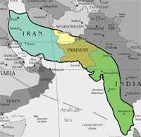
Where do leopard geckos live??
These geckos live in Asia to Middle East. They’re primarily found in Northern India, Pakistan, Afghanistan and Iran in arid, mountainous deserts.
Notes:
1 Background Color
1 Title (or write the question)
1 Pictures
1 Include Transitions
0 Answering question using complete sentences (multiple sentences if needed to fully explain your answer)
1 Accuracy of information
Gecko should be capitalized on all slides.

Slide 3
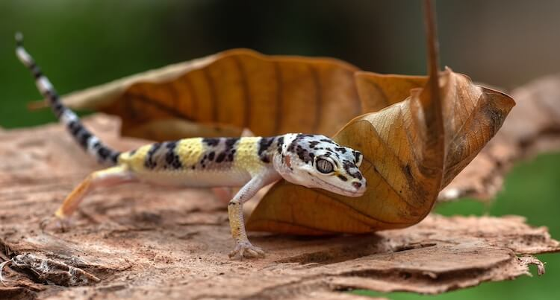
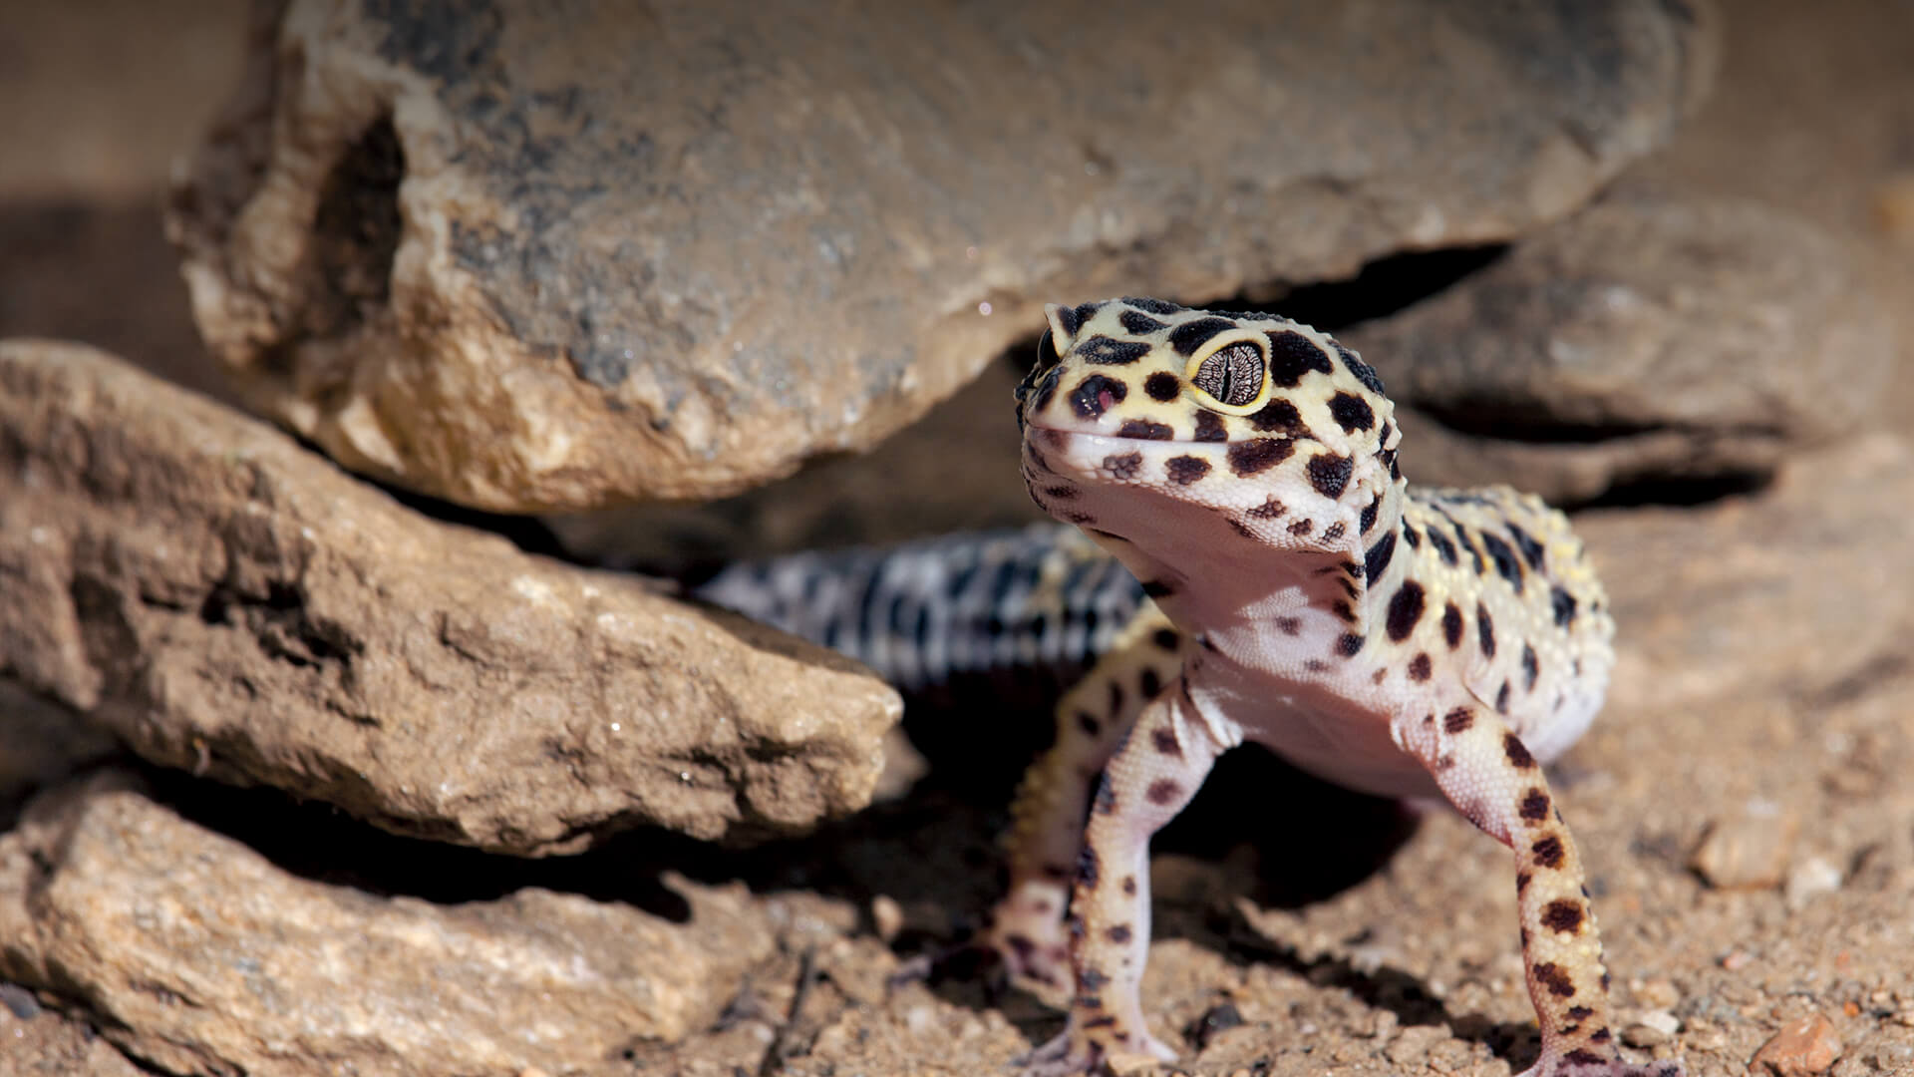
What ecosystem do Leopard Geckos live in?
Leopard geckos live in dry deserts and grasslands They are more rocky lands.
Notes:
1 Background Color
1 Title (or write the question)
1 Pictures
1 Include Transitions
0 Answering question using complete sentences (multiple sentences if needed to fully explain your answer)
1 Accuracy of information

Slide 4
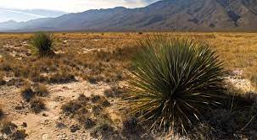
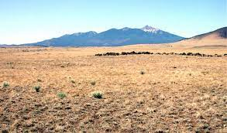
What is the area they live in like?
The temperature of grasslands and deserts are 55-61 degrees Fahrenheit, which is what temperature Leopard Geckos must deal with then.
Notes:
1 Background Color
1 Title (or write the question)
1 Pictures
1 Include Transitions
1 Answering question using complete sentences (multiple sentences if needed to fully explain your answer)
1 Accuracy of information

Slide 5
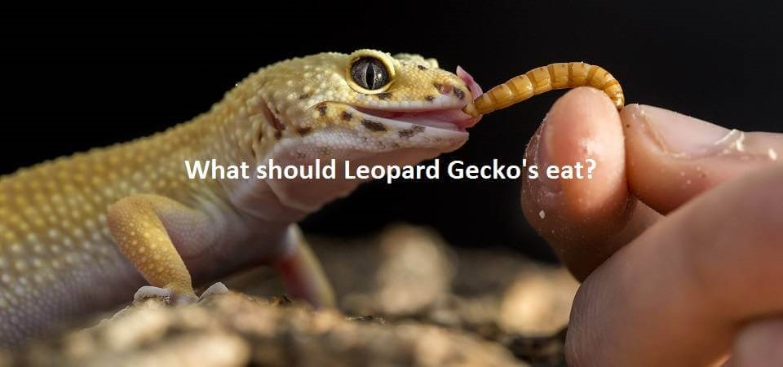
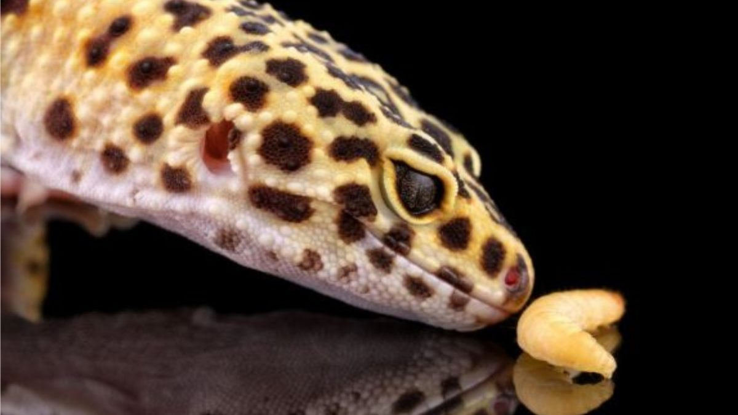
What kind of consumer is the Leopard Gecko?
They are carnivores. They only can consume bugs/meat.
Notes:
1 Background Color
1 Title (or write the question)
1 Pictures
1 Include Transitions
1 Answering question using complete sentences (multiple sentences if needed to fully explain your answer)
1 Accuracy of information

Slide 6
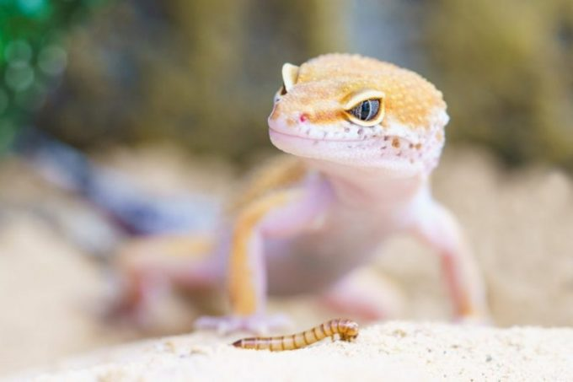
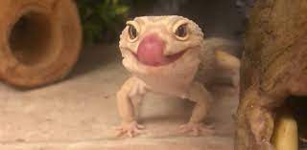
What do leopard geckos eat mainly?
Leopard geckos eat live insects. They also only drink water. They eat worms, like wax worms, calci worms, and small locusts. They also can eat crickets.
Notes:
1 Background Color
1 Title (or write the question)
1 Pictures
1 Include Transitions
0 Answering question using complete sentences (multiple sentences if needed to fully explain your answer)
1 Accuracy of information

Slide 7
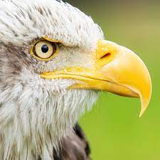
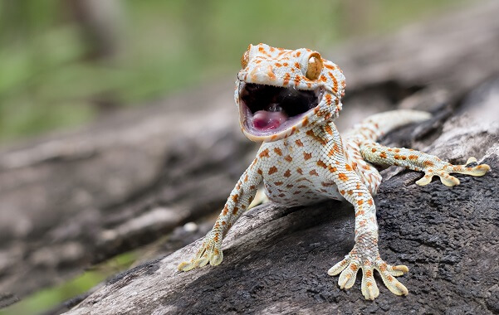
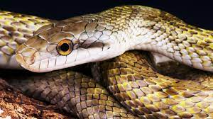
What predators do leopard geckos have?
Snakes, birds, spiders, dogs, and cats all are predators of the leopard gecko.
Notes:
1 Background Color
1 Title (or write the question)
1 Pictures
1 Include Transitions
1 Answering question using complete sentences (multiple sentences if needed to fully explain your answer)
1 Accuracy of information

Slide 8
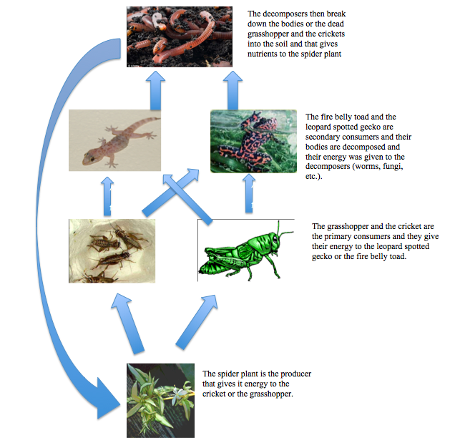
What is a typical food chain of a leopard gecko?
The food chain would go; grass, cricket, gecko, snake, hawk, fungi.
Notes:
1 Background Color
1 Title (or write the question)
1 Pictures
1 Include Transitions
0 Answering question using complete sentences (multiple sentences if needed to fully explain your answer)
1 Accuracy of information

Slide 9
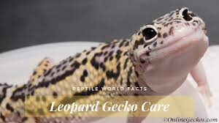
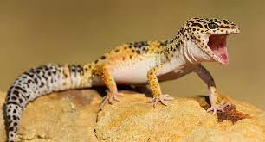
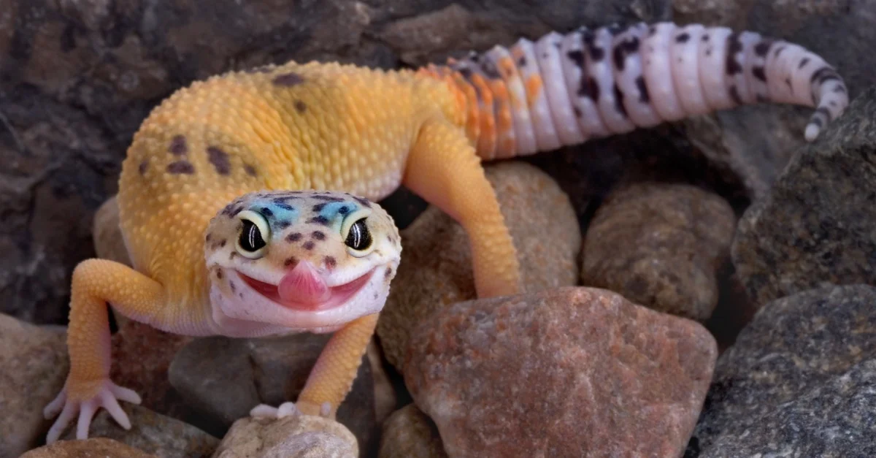
What features help it survive?
Geckos have claws to help them get insects, and eyes on the sides to help them look for predators. They have no fur because they live in grasslands and deserts so it’d be too hot.
Notes:
1 Background Color
1 Title (or write the question)
1 Pictures
1 Include Transitions
1 Answering question using complete sentences (multiple sentences if needed to fully explain your answer)
1 Accuracy of information

Slide 10
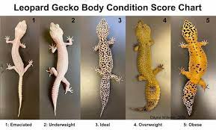
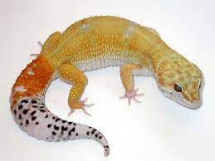
What are features of a leopard gecko?
Hatchlings are normally 7-10 cm. They weigh 2-5 grams. Adults are normally 18-28 in, and weigh 50-80 grams. It also depends on gender.
Notes:
1 Background Color
1 Title (or write the question)
1 Pictures
1 Include Transitions
0 Answering question using complete sentences (multiple sentences if needed to fully explain your answer)
1 Accuracy of information

Slide 11
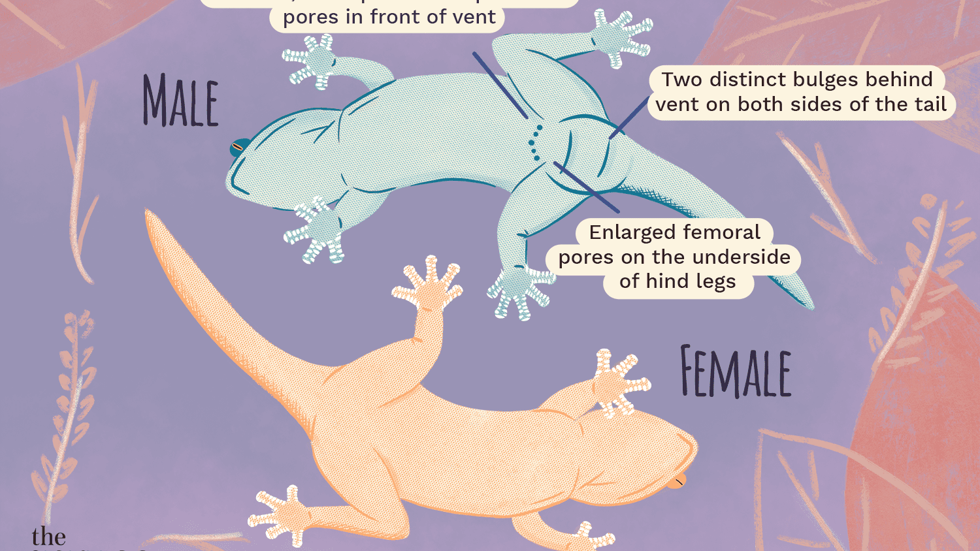
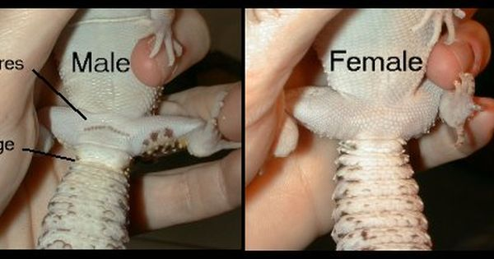
What are the differences of males and females?
Females
Weigh 50-70 grams
Are 18-20 cm
Males
Weigh 60-80 grams
Are 20-28 cm.
Notes:
1 Background Color
1 Title (or write the question)
1 Pictures
1 Include Transitions
1 Answering question using complete sentences (multiple sentences if needed to fully explain your answer)
1 Accuracy of information

Slide 12
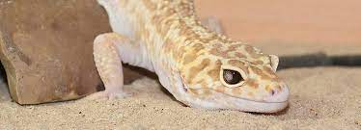
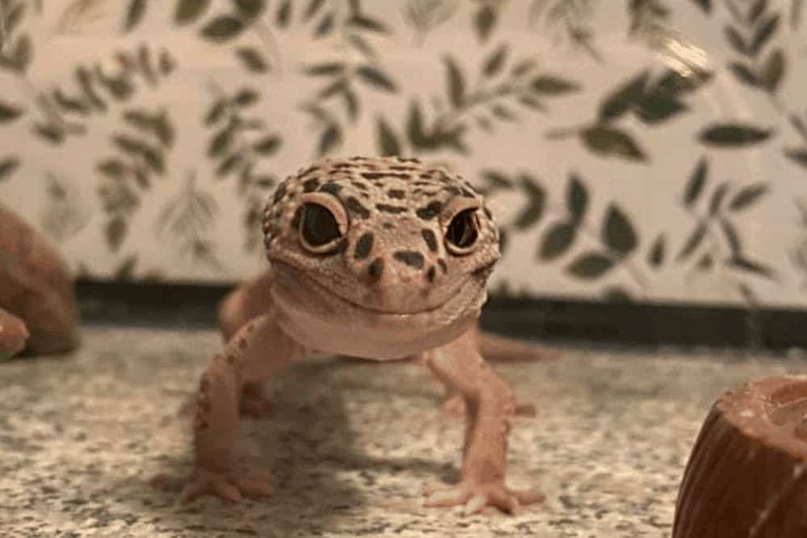
How long do leopard geckos live?
Leopard geckos live normally 15 years in the wild. They can live 10-20 in captivity.
Notes:
1 Background Color
1 Title (or write the question)
1 Pictures
1 Include Transitions
0 Answering question using complete sentences (multiple sentences if needed to fully explain your answer)
1 Accuracy of information

Slide 13
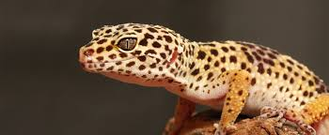
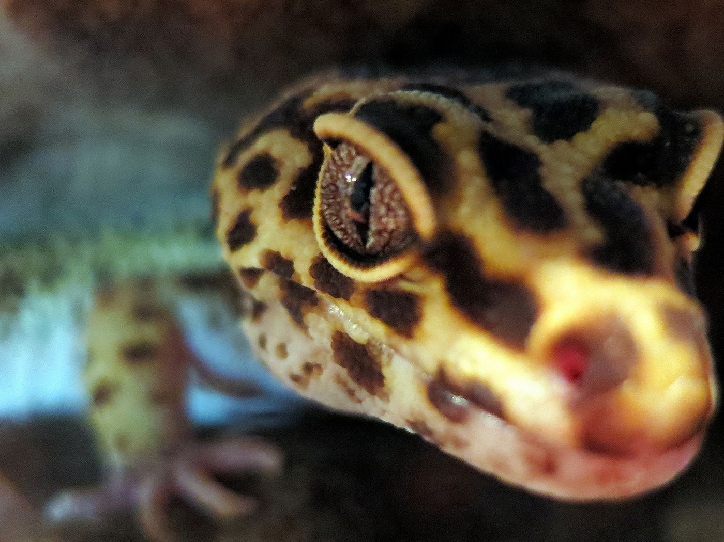
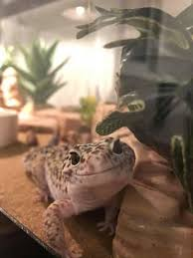
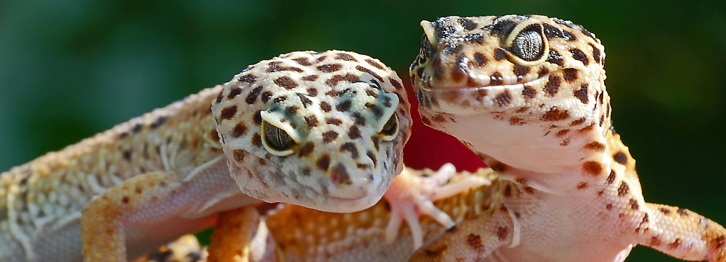
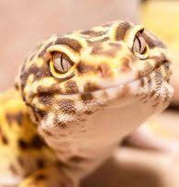
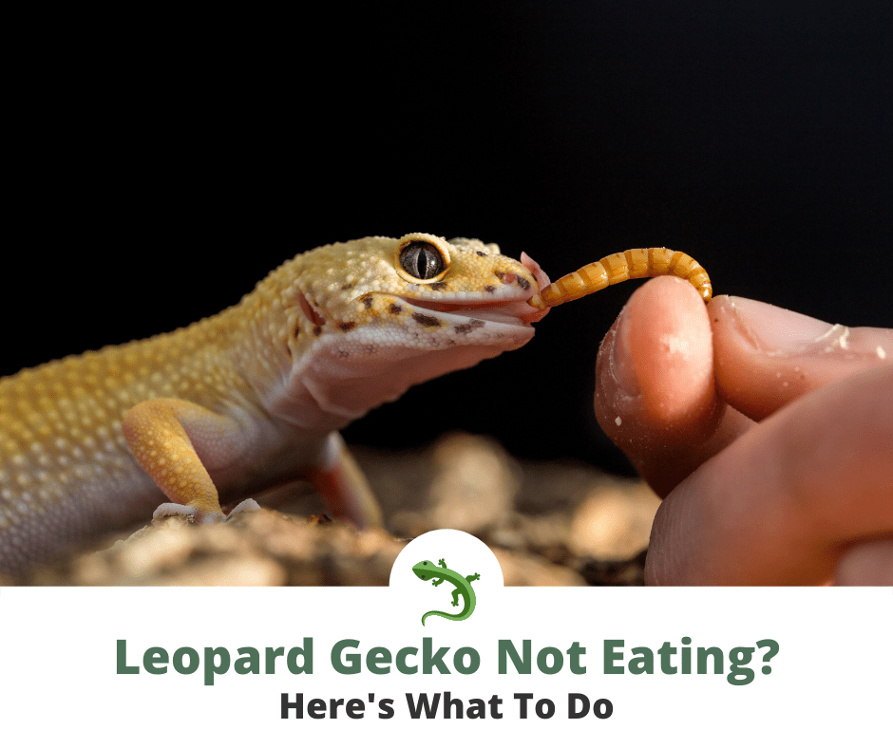
8 facts about geckos
They cannot eat any human foods
While most geckos lack eyelids, leopard geckos actually have them and can sleep with their eyes shut and can blink!
Leopard geckos are not as vocal, and only have a small bark
They have claws instead of sticky pads
They shake their tail when mating, defending territory, and hunting.
At 90 F eggs will most likely be male, while at 80 F they will most likely be female.
They are nocturnal
Their tails are used to store fat in case of lack of food!
Notes:
1 Background Color
1 Title (or write the question)
1 Pictures
1 Include Transitions
0 Answering question using complete sentences (multiple sentences if needed to fully explain your answer)
1 Accuracy of information

Slide 14
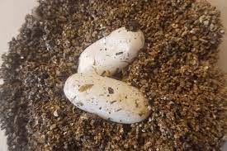
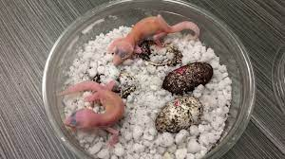
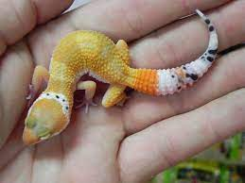
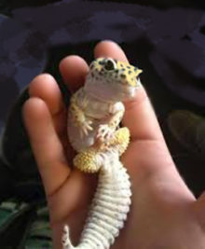
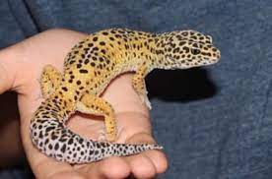
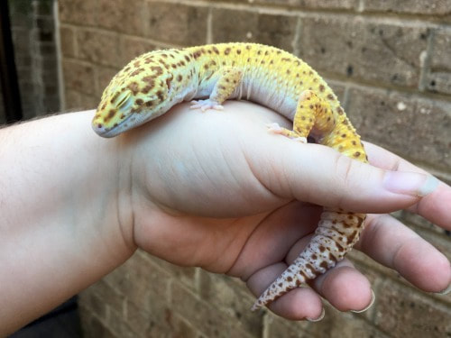
Gecko life
Notes:
1 Background Color
1 Title (or write the question)
1 Pictures
1 Include Transitions
1 Answering question using complete sentences (multiple sentences if needed to fully explain your answer)
1 Accuracy of information

Slide 15
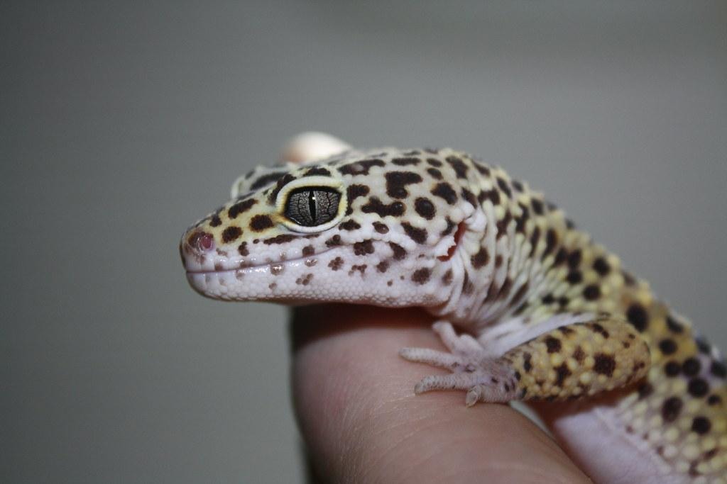
Credit
Slide 1 Slide 13
Slide 2
Slide 3
Slide 4
Slide 5
Slide 6
Slide 10-11
Slide 12
Notes:
1 Background Color
0 Title (or write the question)
1 Pictures
1 Include Transitions
0 Answering question using complete sentences (multiple sentences if needed to fully explain your answer)
0 Accuracy of information
Please reformat this page as those notes will not show up in the slideshow.

