Slide 1
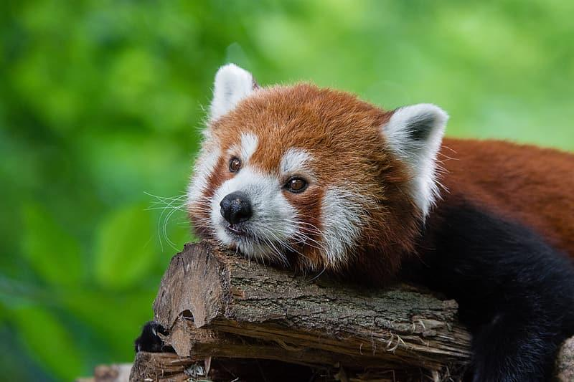
What are Red Pandas?
Jennifer Ramirez
Notes:
1 Background Color
0 Title (or write the question)
1 Pictures
1 Include Transitions
0 Answering question using complete sentences (multiple sentences if needed to fully explain your answer)
1 Accuracy of information
5
The title is hard to read.

Slide 2
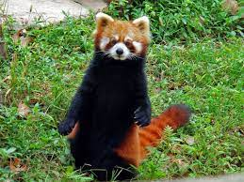
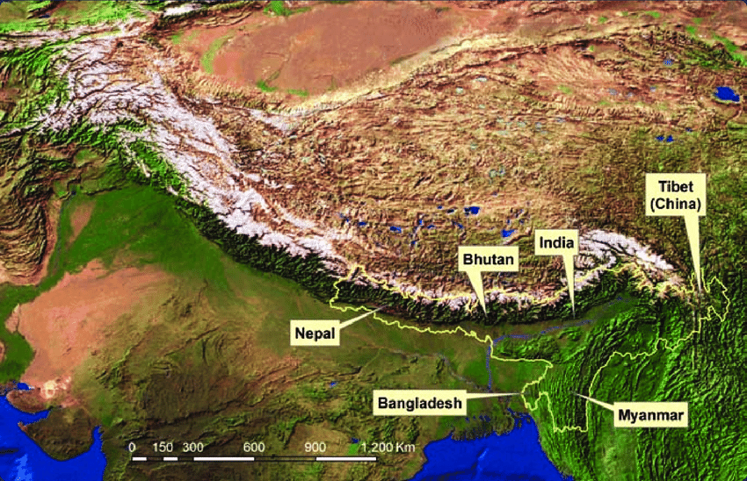
Where did Red Pandas come from?
Red Pandas came from the Eastern Himalayas in places like China, Nepal,Bhutan and spent most of their time in trees.
Notes:
1 Background Color
1 Title (or write the question)
1 Pictures
1 Include Transitions
1 Answering question using complete sentences (multiple sentences if needed to fully explain your answer)
1 Accuracy of information
6

Slide 3
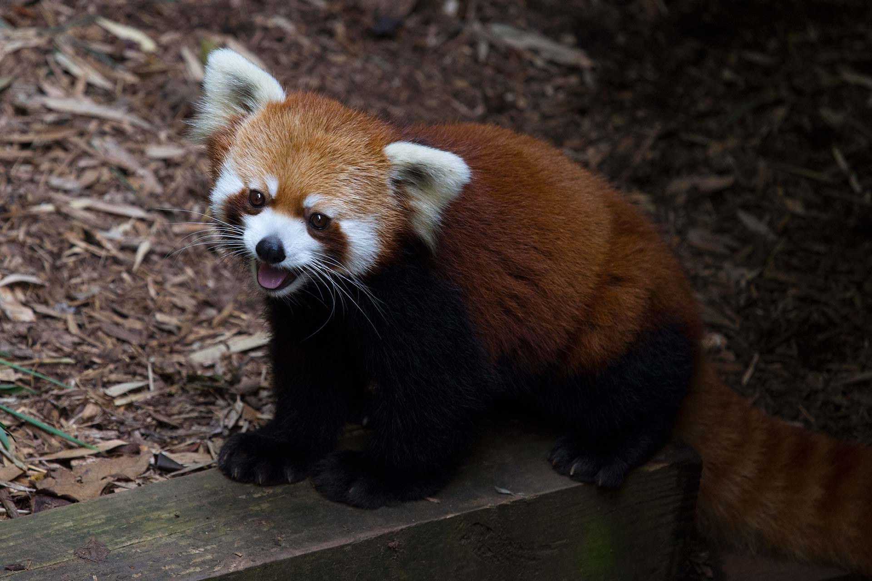
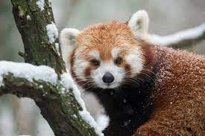
What ecosystem do Red Pandas live in?
Red pandas live in temperate climates in deciduous and coniferous forests, generally with a bamboo understory.
Notes:
1 Background Color
1 Title (or write the question)
1 Pictures
1 Include Transitions
0 Answering question using complete sentences (multiple sentences if needed to fully explain your answer)
1 Accuracy of information
5
Red pandas needs to be capitalized

Slide 4
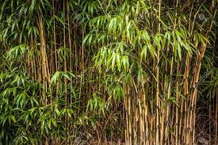
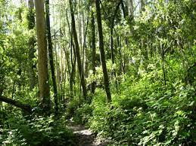
What is it like in the ecosystem for Red Pandas?
Red pandas live in remote mountainous areas of the Himalayas in dense forest and bamboo thickets.
Notes:
1 Background Color
1 Title (or write the question)
1 Pictures
1 Include Transitions
0 Answering question using complete sentences (multiple sentences if needed to fully explain your answer)
1 Accuracy of information
5
Red pandas needs to be capitalized

Slide 5
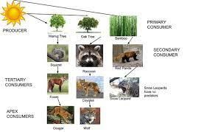
What type of consumer is a Red Panda?
The Red Panda is a primary consumer.
Notes:
1 Background Color
1 Title (or write the question)
1 Pictures
1 Include Transitions
0 Answering question using complete sentences (multiple sentences if needed to fully explain your answer)
1 Accuracy of information
5
Red pandas needs to be capitalized

Slide 6
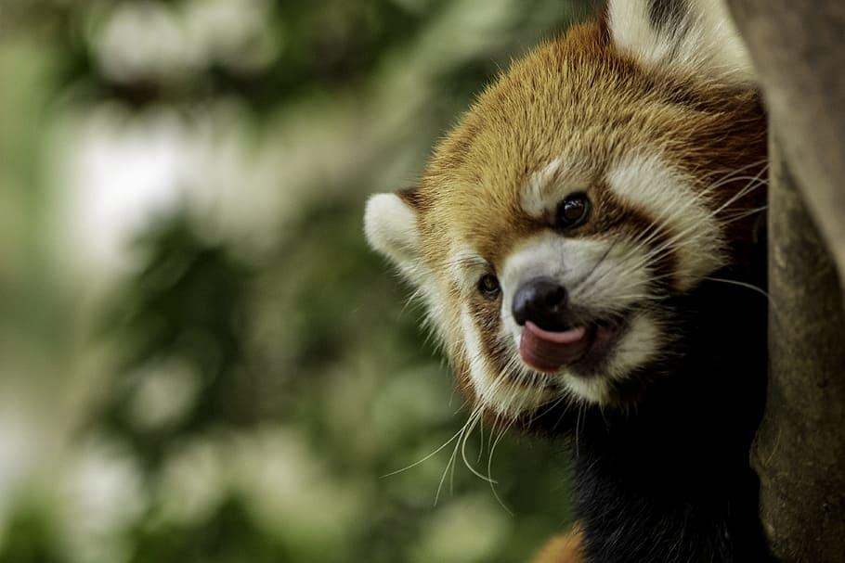
What do Red Pandas specifically eat?
Red Pandas feed mainly on bamboo and leaves, and snacks on bird eggs, insects and small lizards.
Notes:
1 Background Color
0 Title (or write the question)
1 Pictures
1 Include Transitions
0 Answering question using complete sentences (multiple sentences if needed to fully explain your answer)
1 Accuracy of information
5
Red pandas needs to be capitalized the title is hard to read.

Slide 7
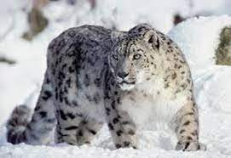
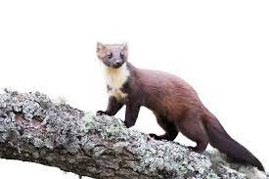
Do Red pandas have any predators?
Red pandas does have predators known as, Snow Leopards and Martens.
Notes:
1 Background Color
1 Title (or write the question)
1 Pictures
1 Include Transitions
1 Answering question using complete sentences (multiple sentences if needed to fully explain your answer)
1 Accuracy of information
6

Slide 8
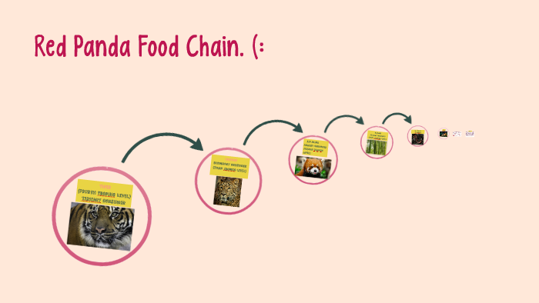
Food chain
Snow leopards and martens mainly hunt and eat red pandas
Notes:
1 Background Color
1 Title (or write the question)
1 Pictures
1 Include Transitions
0 Answering question using complete sentences (multiple sentences if needed to fully explain your answer)
1 Accuracy of information
5
Food Chain needs to be capitalized since it is the title. So does Martens and Red pandas.

Slide 9
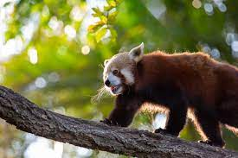
Do red pandas have specific adaptations to help it survive?
Yes, red pandas have many. Their small body mass allows them to walk on thin branches.
Notes:
1 Background Color
1 Title (or write the question)
1 Pictures
1 Include Transitions
0 Answering question using complete sentences (multiple sentences if needed to fully explain your answer)
1 Accuracy of information
5
Red pandas needs to be capitalized the first sentence is incomplete. Add the word adaptations on the end of the sentence.

Slide 10
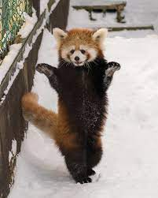
What my creature looks like:
Red pandas have round heads and short snouts with large, pointed ears
Red pandas weigh between 8 and 17 pounds
Red pandas are 22 to 24.6 inches tall
Notes:
1 Background Color
1 Title (or write the question)
1 Pictures
1 Include Transitions
0 Answering question using complete sentences (multiple sentences if needed to fully explain your answer)
1 Accuracy of information
5
Make sure each sentence ends with a period.

Slide 11
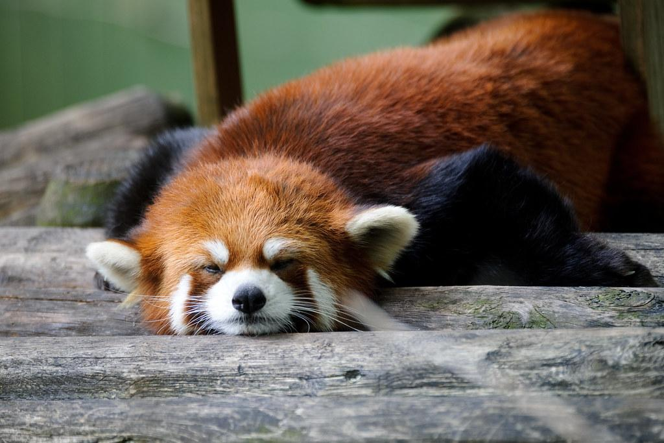
What do female and male Red Pandas weigh and do they have the same size?
No, male and female red pandas do not weigh the same.
Male red pandas weigh 4.2–13.4 kg (9.3–29.5 lb)
Female red pandas weigh 4–15 kg (8.8–33.1 lb)
Notes:
1 Background Color
0 Title (or write the question)
1 Pictures
1 Include Transitions
0 Answering question using complete sentences (multiple sentences if needed to fully explain your answer)
1 Accuracy of information
4
Red pandas needs to be capitalized this is hard to read against the picture. Add periods at the end of each sentence.

Slide 12
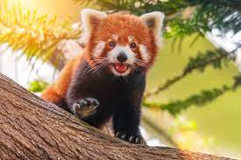
What is the lifespan for Red Pandas?
Red Pandas may live as long as 23 years and show symptoms around ages 12 - 14.
Notes:
1 Background Color
1 Title (or write the question)
1 Pictures
1 Include Transitions
0 Answering question using complete sentences (multiple sentences if needed to fully explain your answer)
1 Accuracy of information
5
Red pandas needs to be capitalized

Slide 13
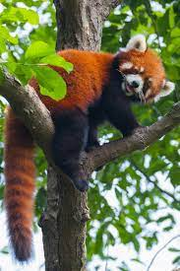
Fact 1 of Red Pandas:
Red pandas are good at climbing trees
Notes:
1 Background Color
1 Title (or write the question)
1 Pictures
1 Include Transitions
0 Answering question using complete sentences (multiple sentences if needed to fully explain your answer)
1 Accuracy of information
5
Red pandas needs to be capitalized add periods at the end of each sentence. I did not score the extra facts pages…

Slide 14
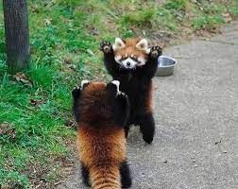
Fact 2 of Red Pandas:
Red Pandas stand up when being threatened or provoked.
Notes:
Caps .. periods…

Slide 15
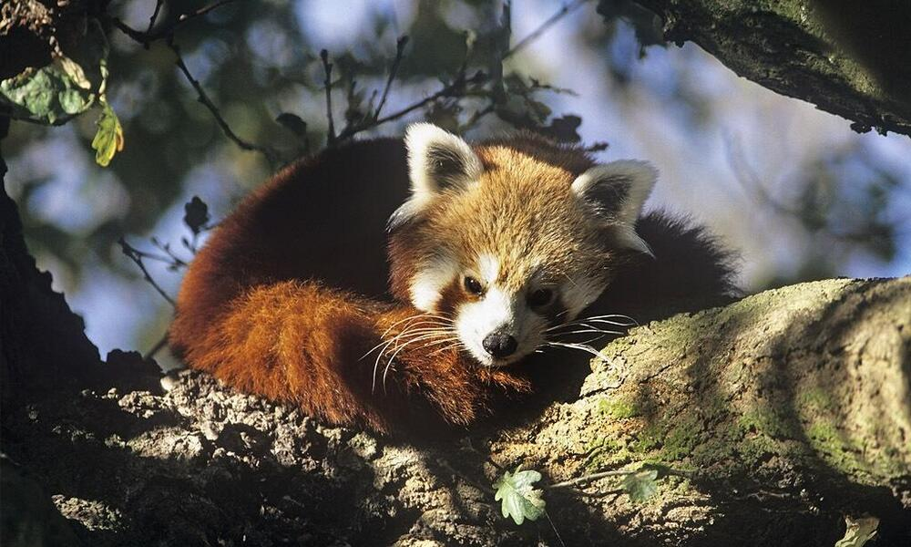
Fact 3 of Red Pandas:
Red Pandas are alone most of the time but come together in pairs in the breeding season
Notes:
Caps

Slide 16
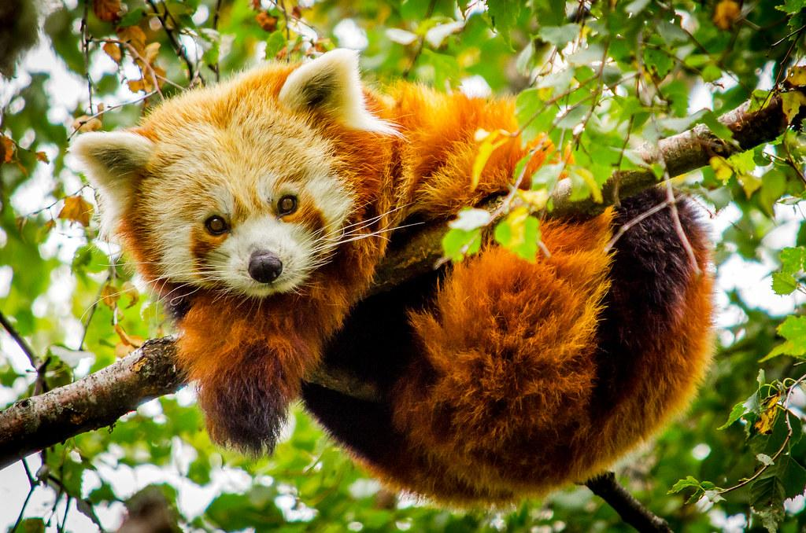
Fact 4 of Red Pandas:
A international day was set for Red Pandas and it was celebrated on Saturday September third every year since 2010.
Notes:
Hard to read against this picture. Caps…

Slide 17
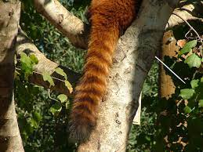
Fact 5 of red pandas:
The red panda's tail is an important feature and has a thick bushy tail with alternating red and buff rings

Slide 18
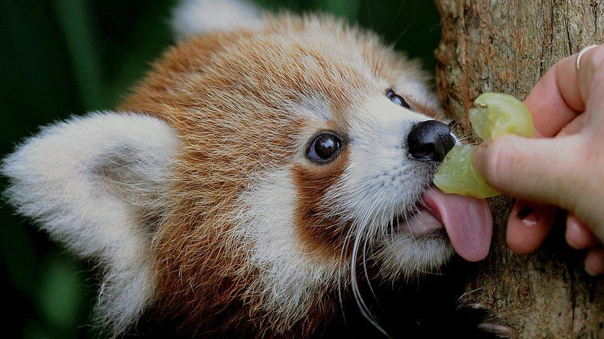
Fact 6 of red pandas:
Red Pandas spend most of their time sleeping and eating.
Notes:
Caps.

Slide 19
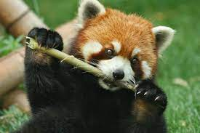
Fact 7 of Red Pandas:
Red Pandas are carnivores, while like giant pandas, and feed mainly on bamboo.
Notes:
Caps.

Slide 20
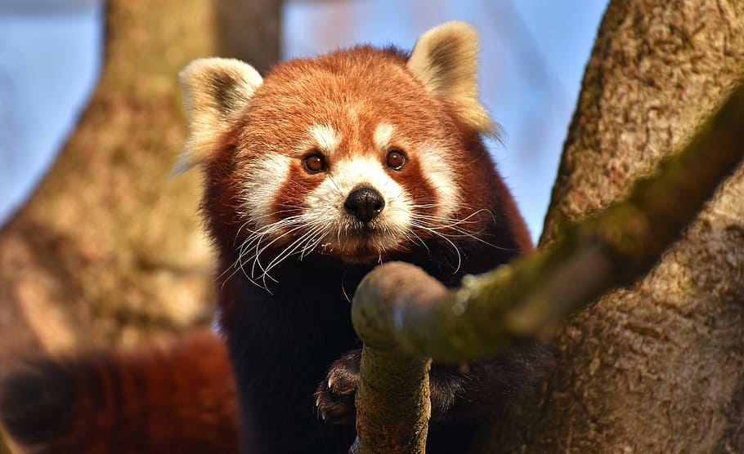
Last fact of Red Pandas:
Red Pandas have their own independent family and were firstly classified in the raccoon family and then the bear family.
Notes:
Caps. Hard to read against this background.

Slide 21
Sources:
https://artsandculture.google.com/story/zwVxBWm2dUoh7g
https://en.wikipedia.org/wiki/Red_panda#:~:text=The%20red%20panda%20has%20a,%E2%80%9329.5%20lb)%20for%20males.
https://www.livescience.com/57312-red-pandas.html#:~:text=Red%20pandas%20have%20large%20round,according%20to%20the%20National%20Zoo.
http://bioweb.uwlax.edu/bio203/s2007/kuczmars_kayl/Adaptations.htm#:~:text=Red%20pandas%20have%20many%20adaptations.&text=Their%20small%20body%20mass%20allows,panda%20uses%20hind%2Dfoot%20mobility.
http://mancredpanda.weebly.com/biome-and-food-chain.html
https://www.worldwildlife.org/stories/where-do-red-pandas-live-and-other-red-panda-facts#:~:text=What%20do%20red%20pandas%20eat,eggs%20and%20small%20lizards%2C%20too.
https://study.com/academy/answer/where-is-the-red-panda-in-the-food-chain.html#:~:text=The%20red%20panda%20is%20a,shoots%2C%20nuts%2C
https://animalcorner.org/animals/red-panda/
https://zooatlanta.org/animal/red-panda/#:~:text=and%20southern%20China.-,Habitat%3A,components%20of%20their%20preferred%20habitats.
https://www.worldwildlife.org/stories/where-do-red-pandas-live-and-other-red-panda-facts#:~:text=Red%20pandas%20live%20in%20the,of%20their%20time%20in%20trees.
Notes:
6

