Slide 1
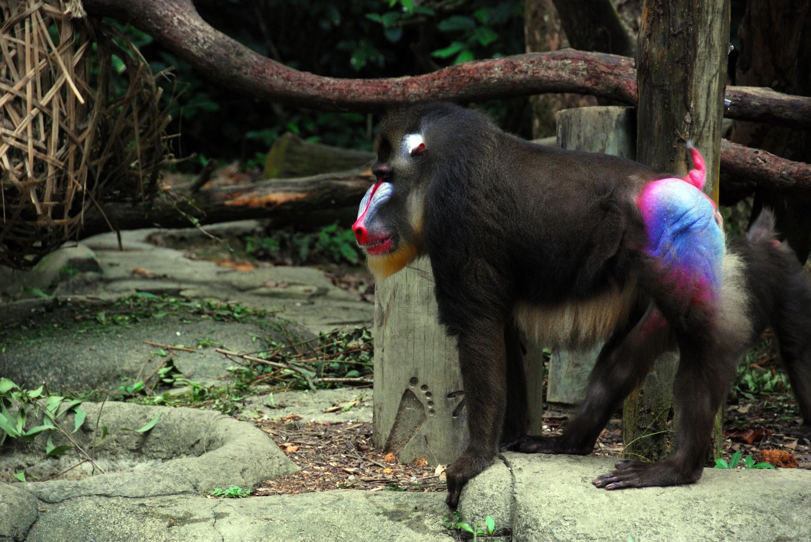
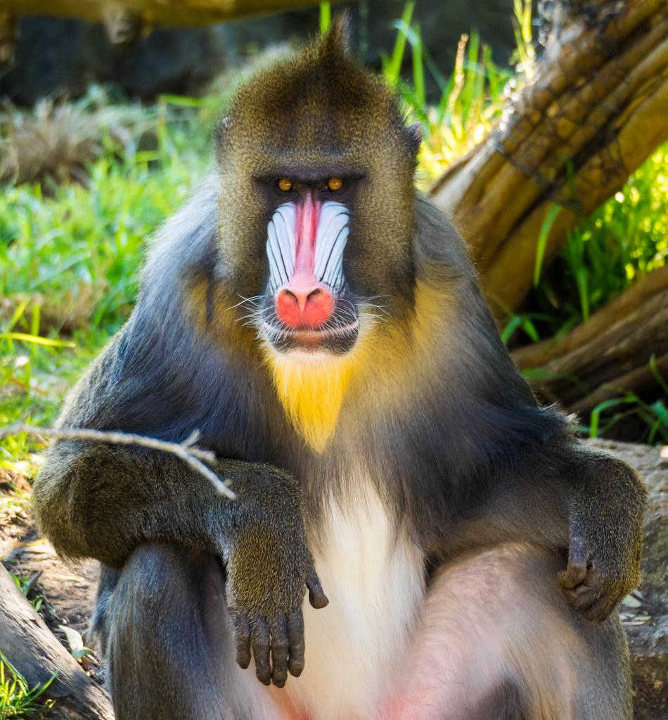
My creature is a Mandrill baboon.
Notes:
1 Background Color
1 Title (or write the question)
1 Pictures
1 Include Transitions
1 Answering question using complete sentences (multiple sentences if needed to fully explain your answer)
1 Accuracy of information
6

Slide 2
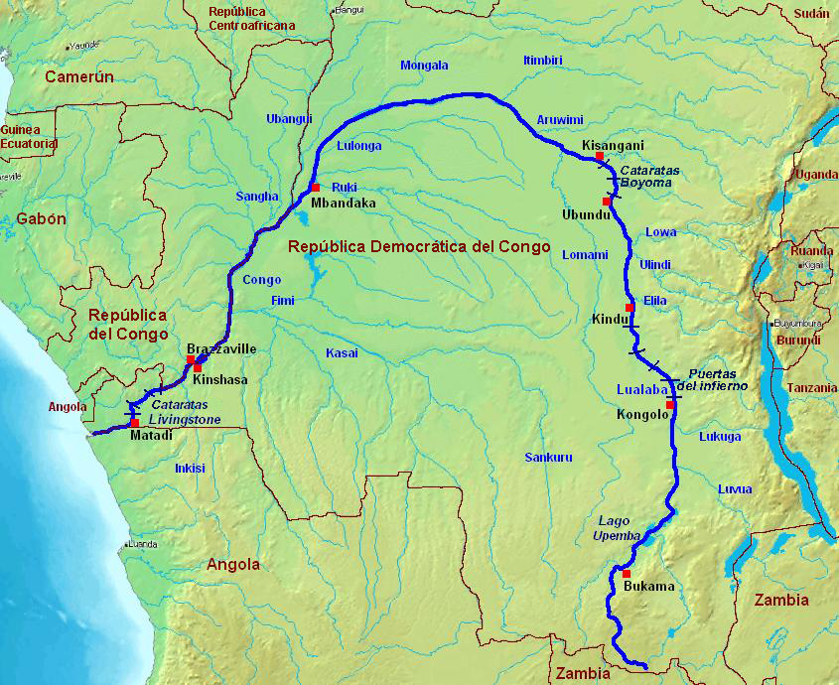
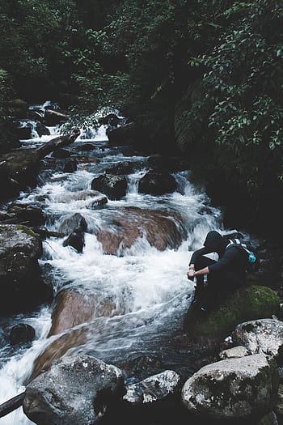
History of where your creature came from.
The Mandrill baboon came from the rainforest of equatorial Africa from the Sanaga river.
Notes:
1 Background Color
1 Title (or write the question)
1 Pictures
1 Include Transitions
0 Answering question using complete sentences (multiple sentences if needed to fully explain your answer)
1 Accuracy of information
5
Mandrill baboon, and Sanaga needs to be capitalized.

Slide 3
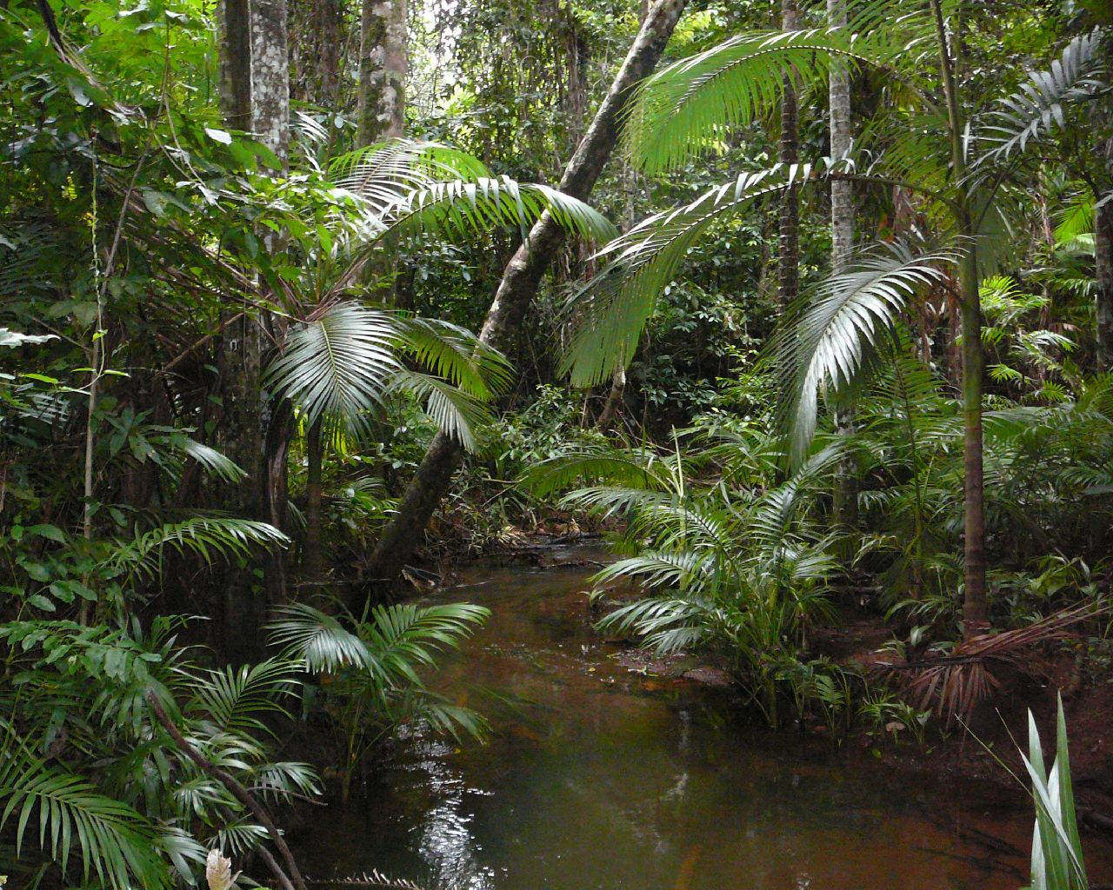
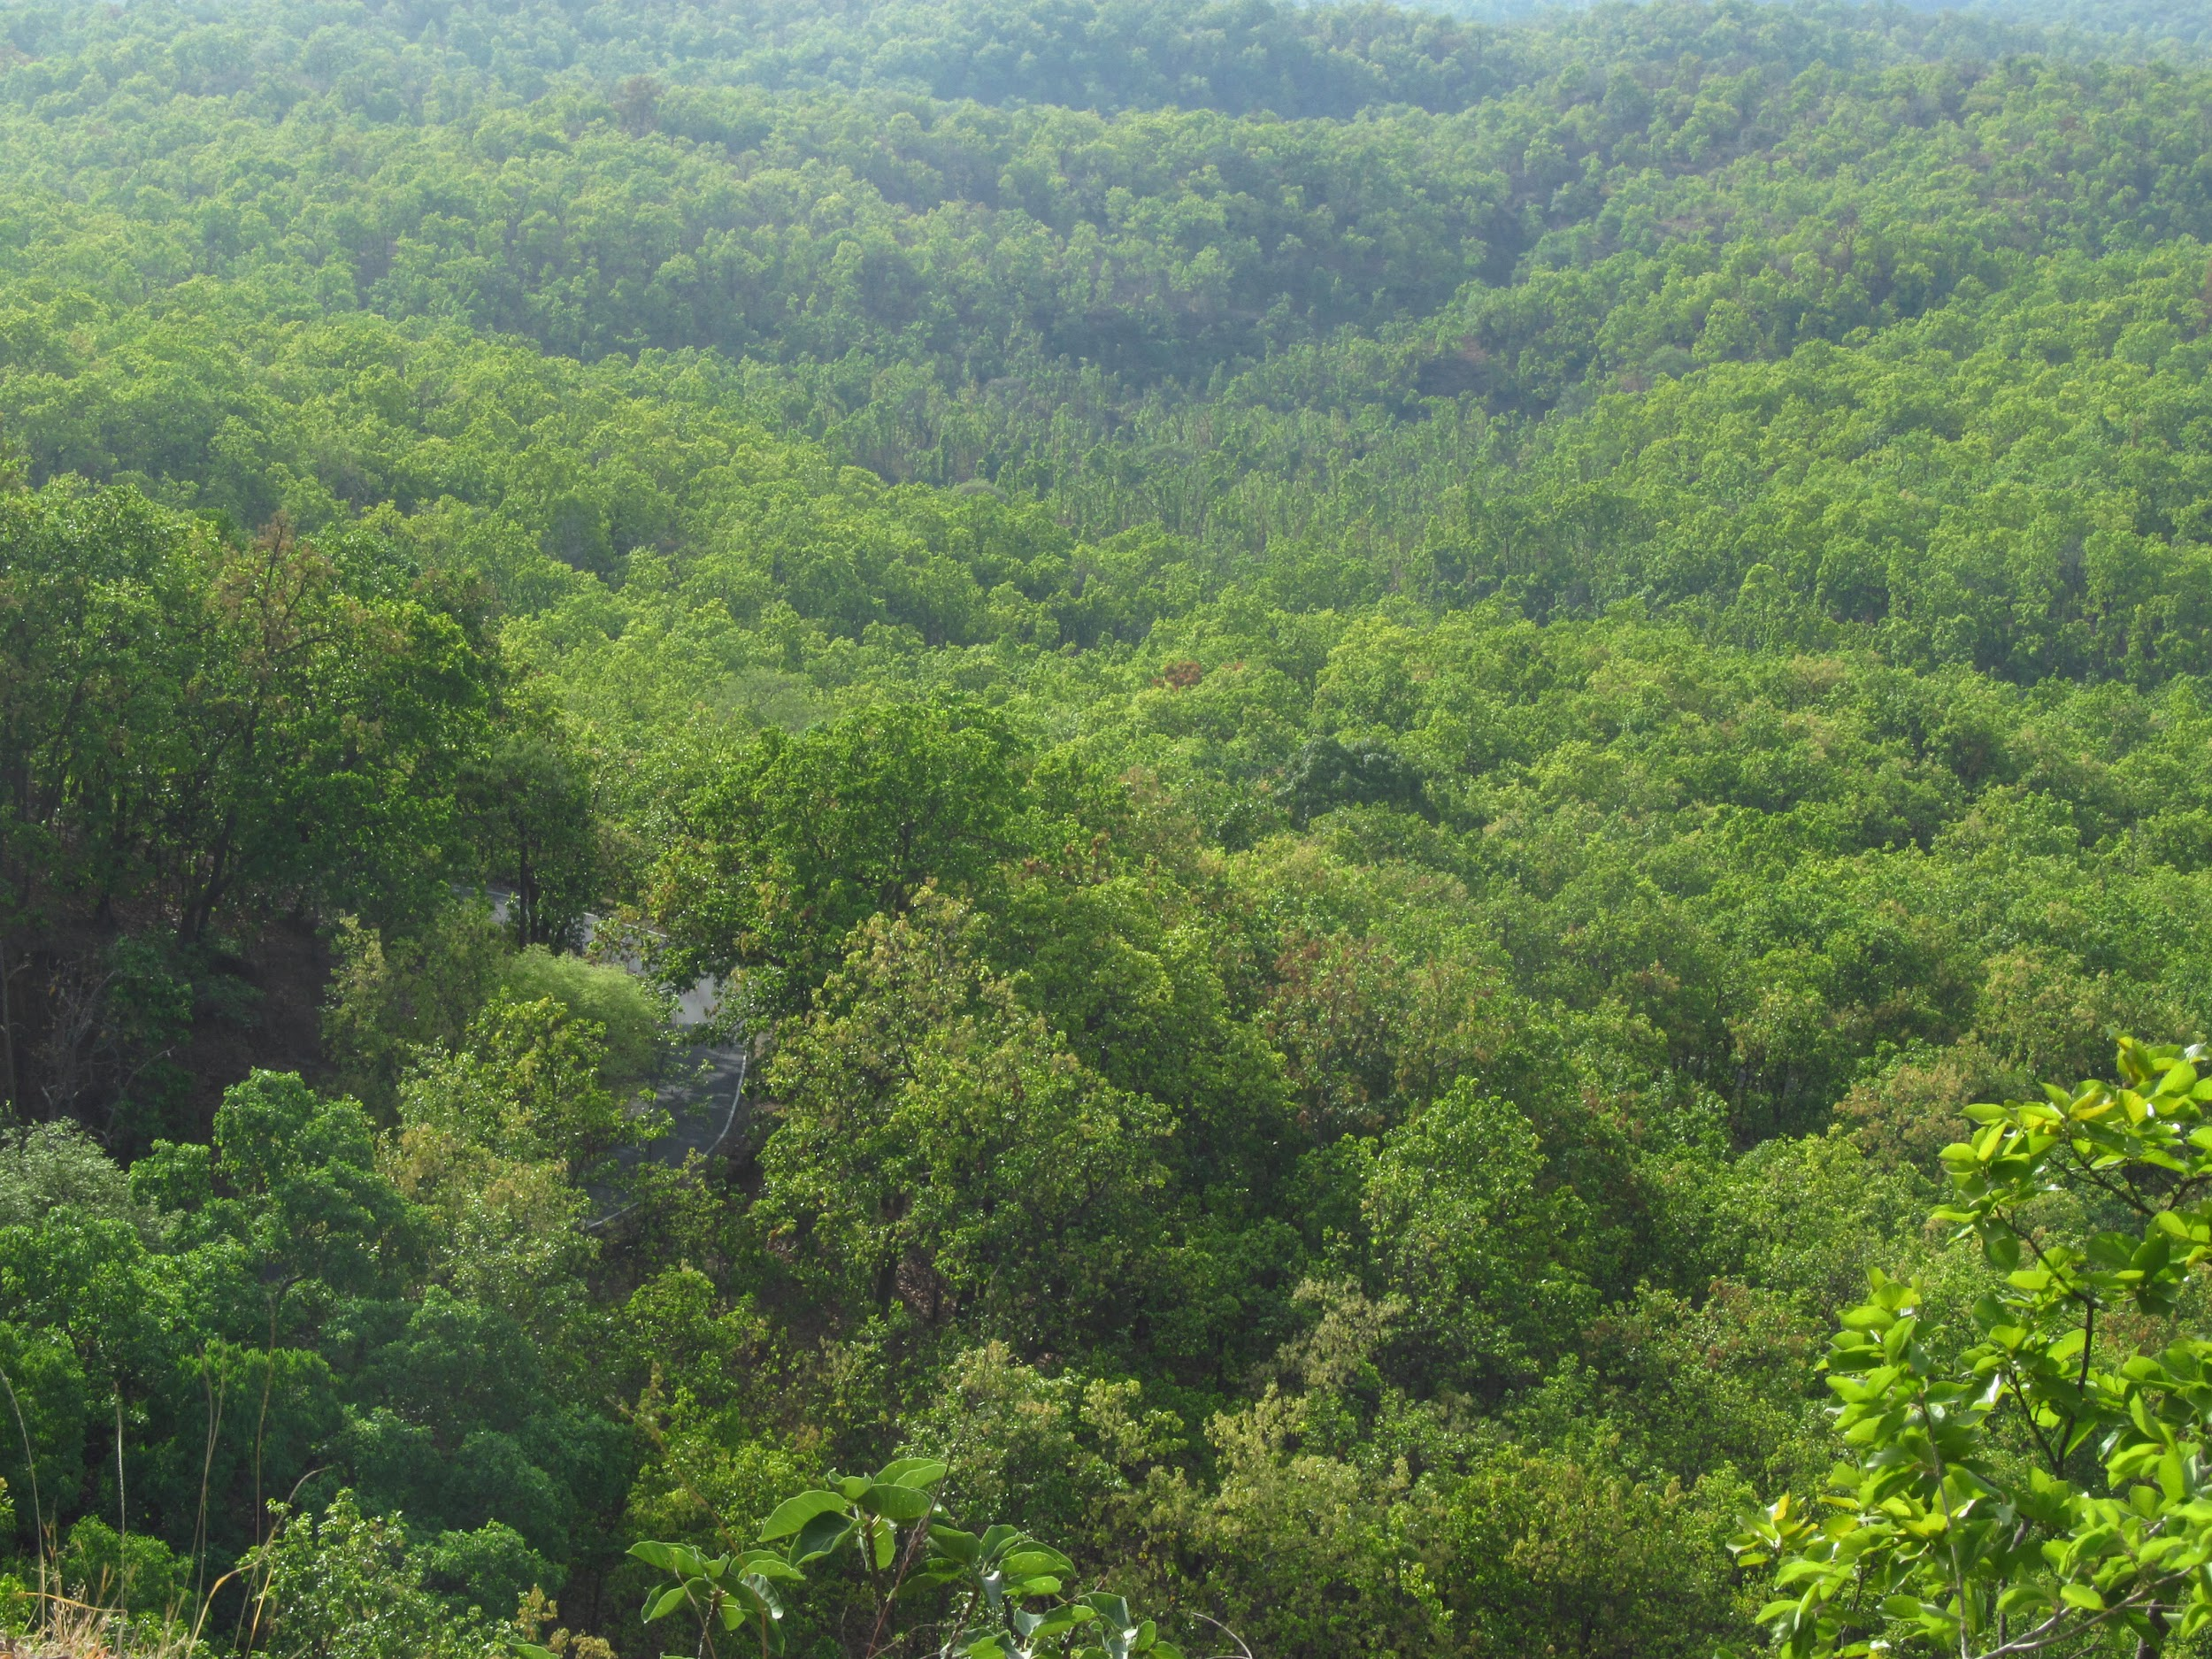
What ecosystem do Mandrill baboon live in?
Mandrills are found in tropical rain forest habitats, mountain and thick secondary forests,and thick bush. Although, they are adapted to live in the ground. Mandrills seek shelter in the trees during the night.
Notes:
1 Background Color
1 Title (or write the question)
1 Pictures
1 Include Transitions
0 Answering question using complete sentences (multiple sentences if needed to fully explain your answer)
1 Accuracy of information
5
Mandrill baboon needs to be capitalized. Space between comma and mountain? Forests, and thick. Two spaces after a period, a comma after the transition word Although. A period after ground, Mandrills is a new sentence.

Slide 4
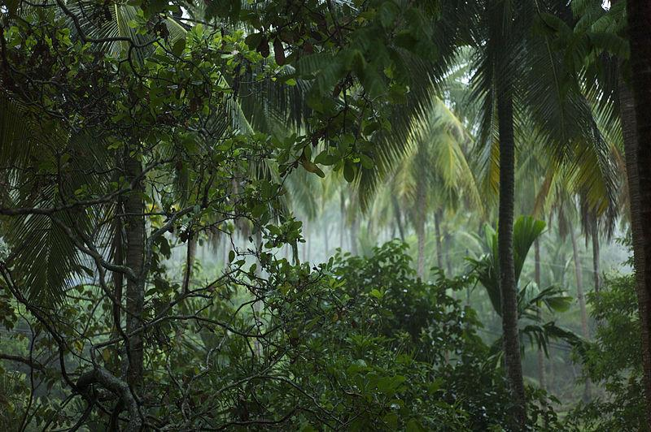
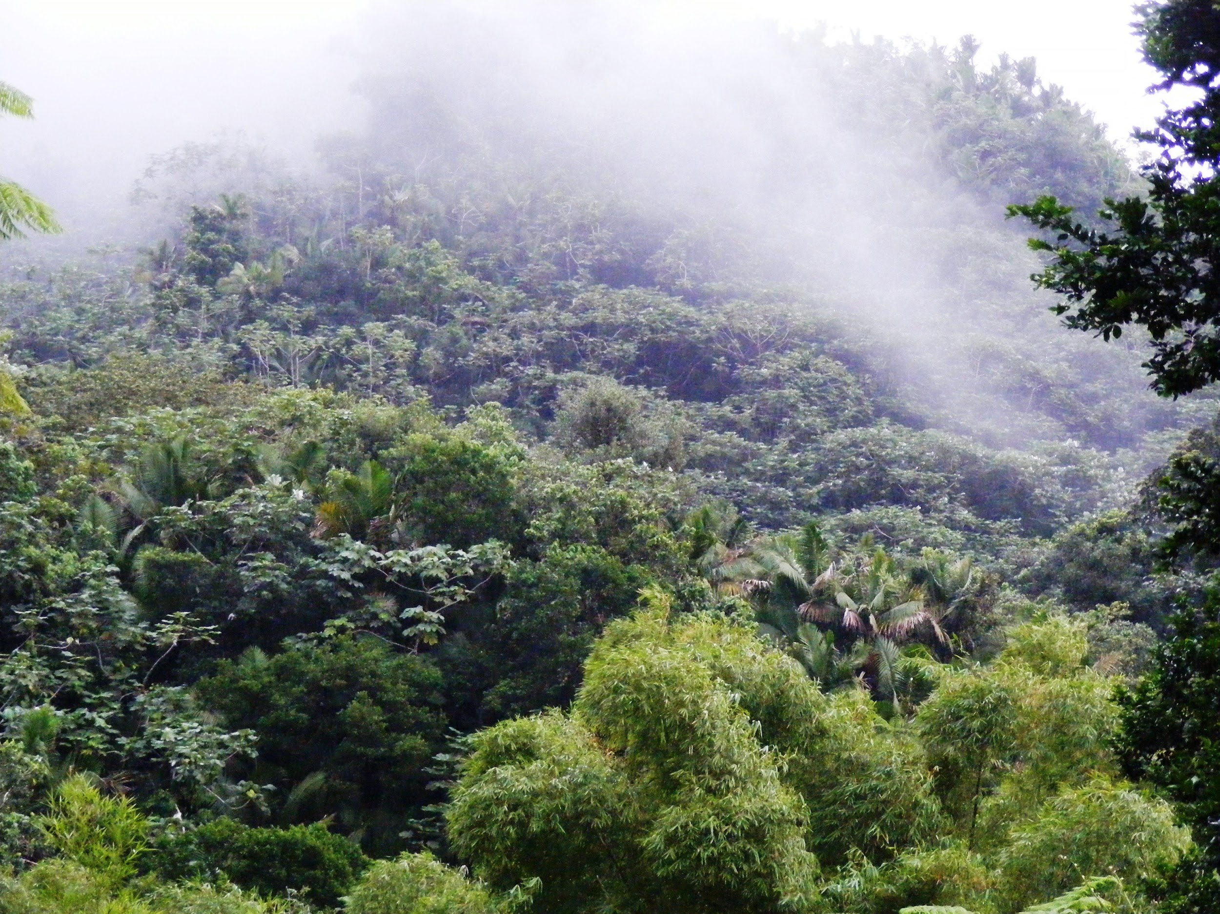
What is it like in the ecosystem?
A typical year sees 2,000 to 10,000 millimeters (79 to 394 inches) of rain per year.and the average daily temperature range from 20°C (68°F) to 25°C (77°F).
Notes:
1 Background Color
o Title (or write the question)
1 Pictures
1 Include Transitions
0 Answering question using complete sentences (multiple sentences if needed to fully explain your answer)
1 Accuracy of information
4
Both the title and the paragraph are hard to read. Replace the word “also” with and…

Slide 5
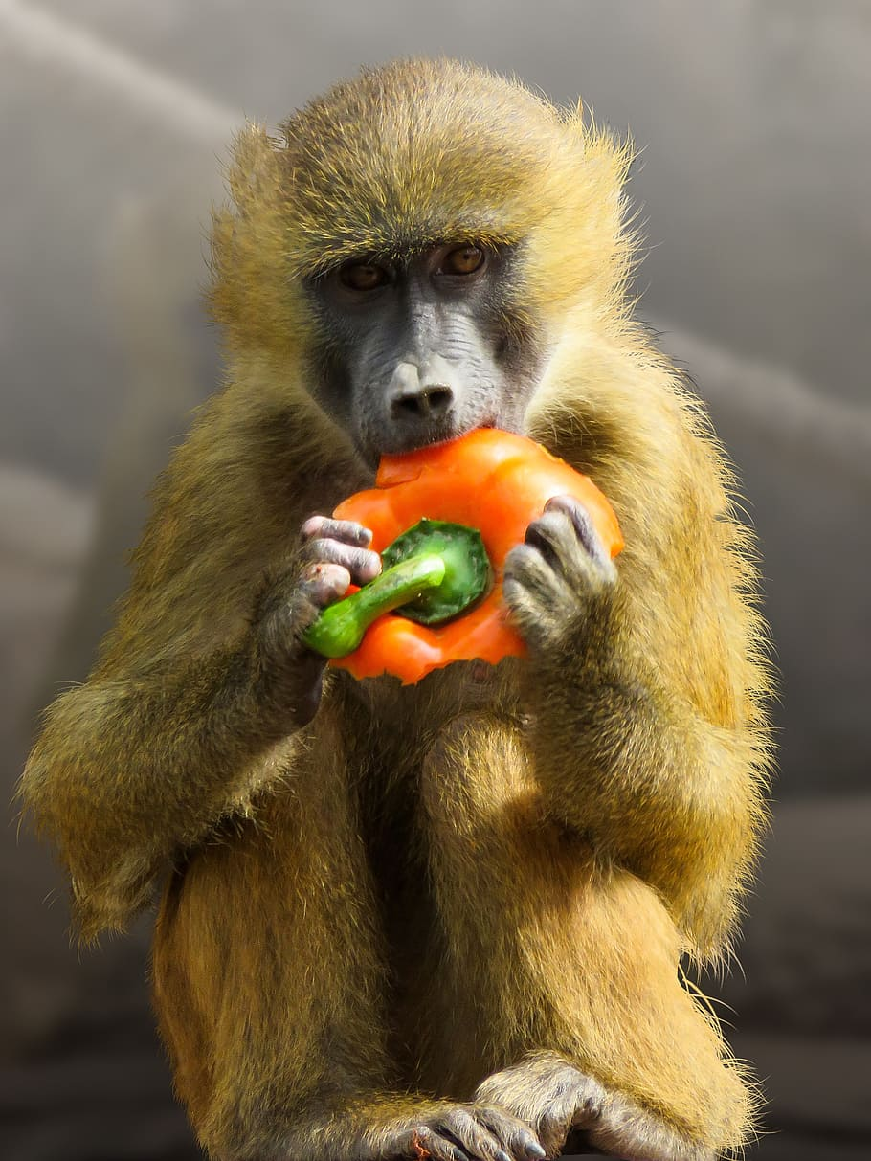
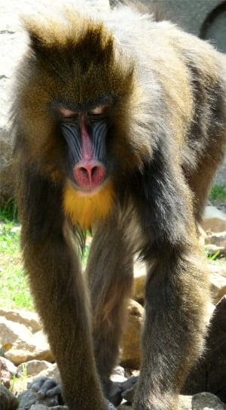
What type of consumer is a Mandrill baboon?
A Mandrill baboon is an omnivore. It usually consumes plants, which it eats over a hundred species.
Notes:
1 Background Color
1 Title (or write the question)
1 Pictures
1 Include Transitions
0 Answering question using complete sentences (multiple sentences if needed to fully explain your answer)
1 Accuracy of information
5
Mandrill baboon,needs to be capitalized. Two spaces after a period. One space after a comma.

Slide 6
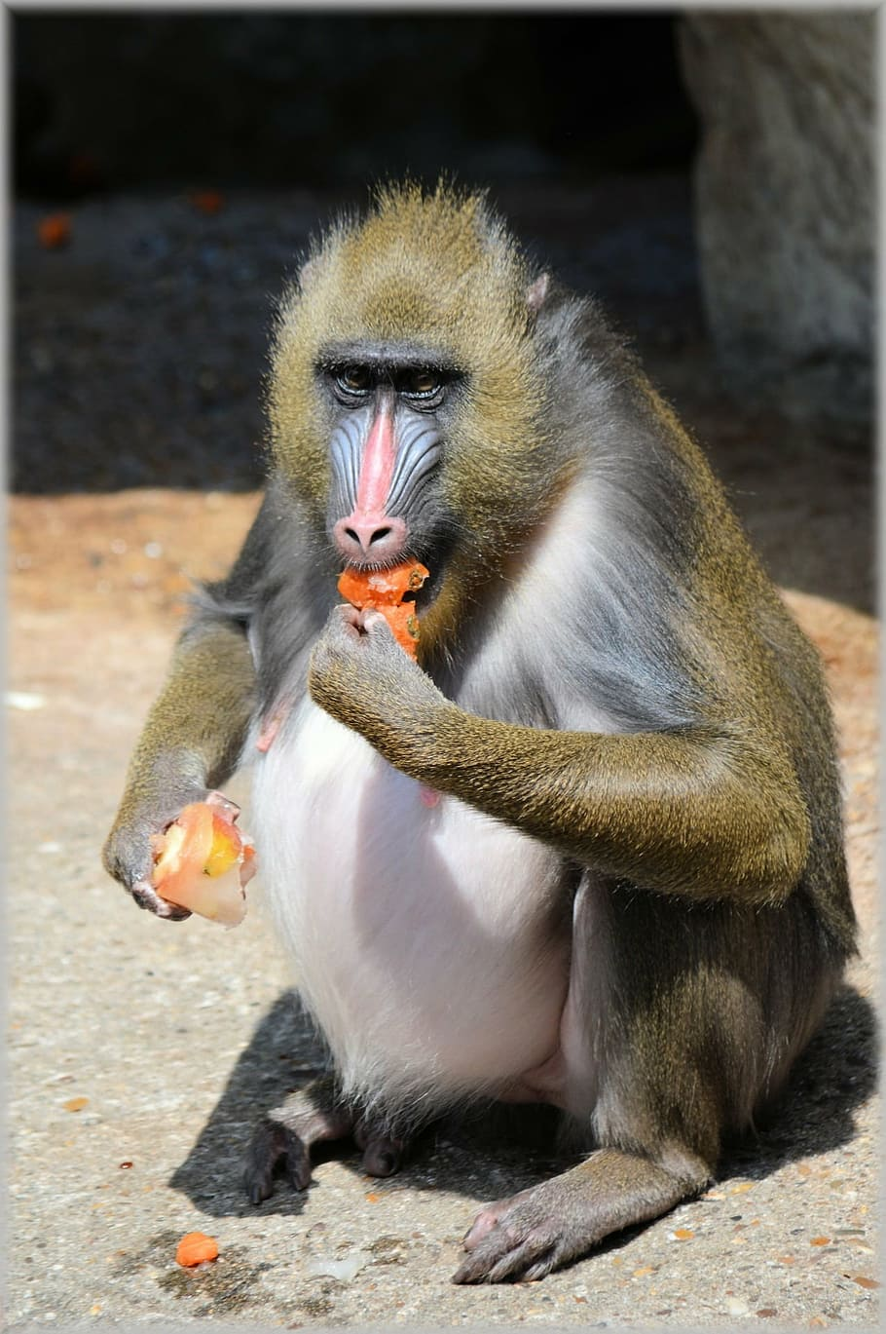
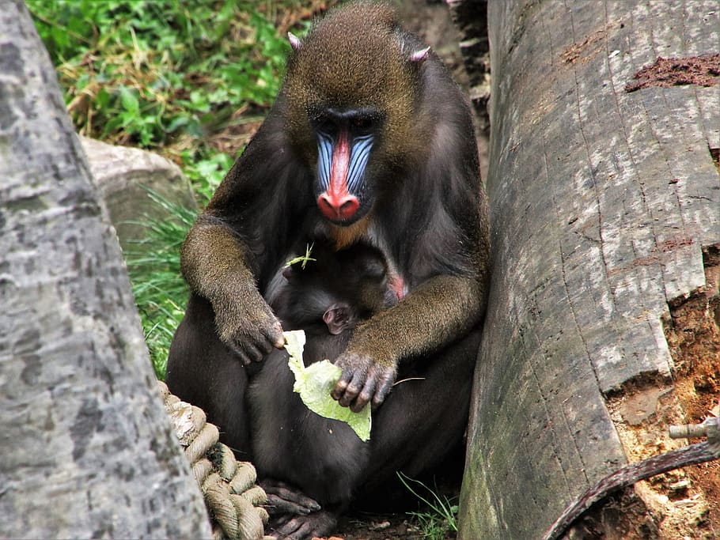
What specific food does a mandrill baboon eat?
Mandrill baboons have a highly varied diet including, fruit, seeds, fungi, roots, insects, snails, worms, frogs, lizards, snakes, and even small vertebrates.
Notes:
1 Background Color
1 Title (or write the question)
1 Pictures
1 Include Transitions
0 Answering question using complete sentences (multiple sentences if needed to fully explain your answer)
1 Accuracy of information
5
Mandrill baboon, needs to be capitalized. In the paragraph the a in Mandrill need to be lower case. One space after a comma. When creating a list with items separated by commas only the last item gets the “and”…

Slide 7
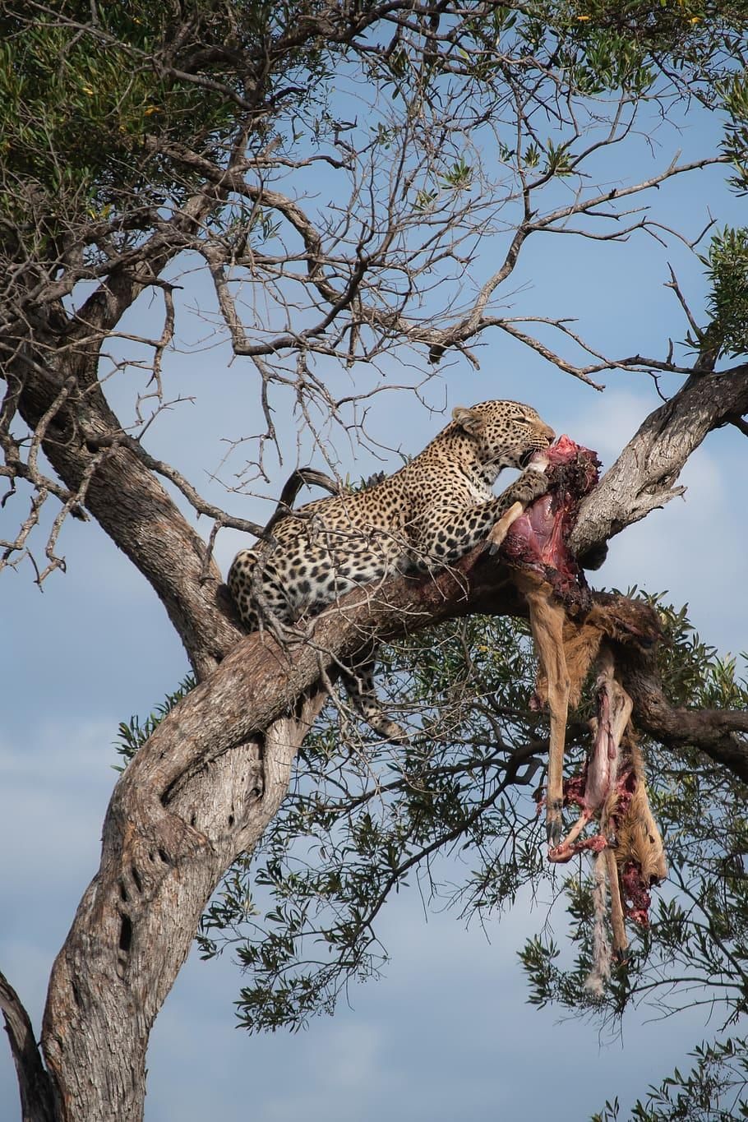
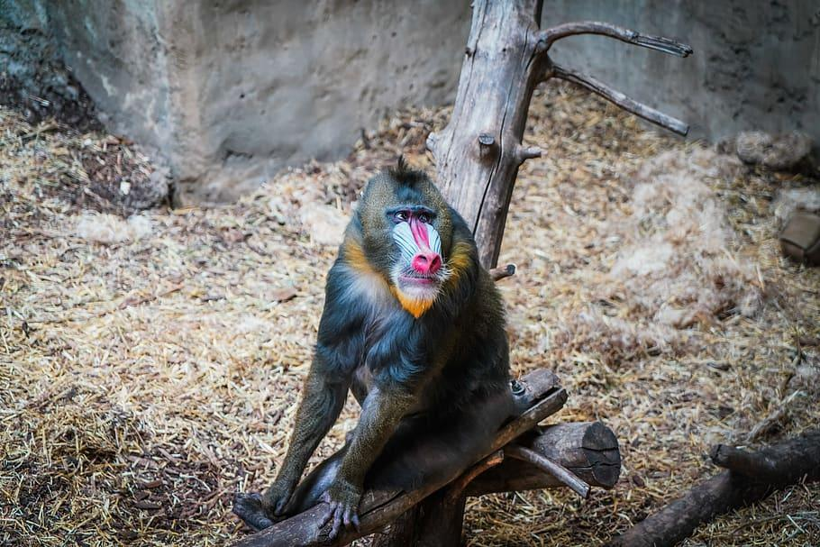
Does a Mandrill baboon have any predators?
Because of their large size, Mandrills have few natural predators in the wild, except for leopards and, of course, humans, who have traditionally hunted them for food.
Notes:
1 Background Color
0 Title (or write the question)
0 Pictures
1 Include Transitions
0 Answering question using complete sentences (multiple sentences if needed to fully explain your answer)
1 Accuracy of information
3
Mandrill baboon, needs to be capitalized. Start the sentence a the word Because delete “it says” The text is hard to read do to the background color, one picture is off the page a bit.

Slide 8
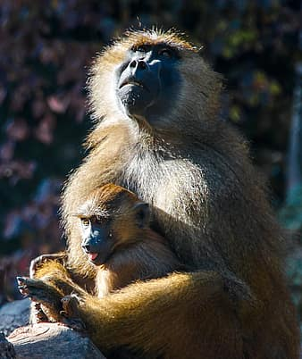
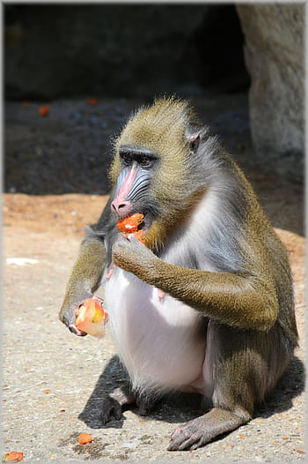
What is a typical food chain food a Mandrill baboon?
Mandrills have a highly varied diet including fruit, seeds, fungi, and roots.
Notes:
1 Background Color
1 Title (or write the question)
1 Pictures
1 Include Transitions
0 Answering question using complete sentences (multiple sentences if needed to fully explain your answer)
1 Accuracy of information
5
Mandrill baboon needs to be capitalized. …fruit, seeds, fungi, and roots.

Slide 9
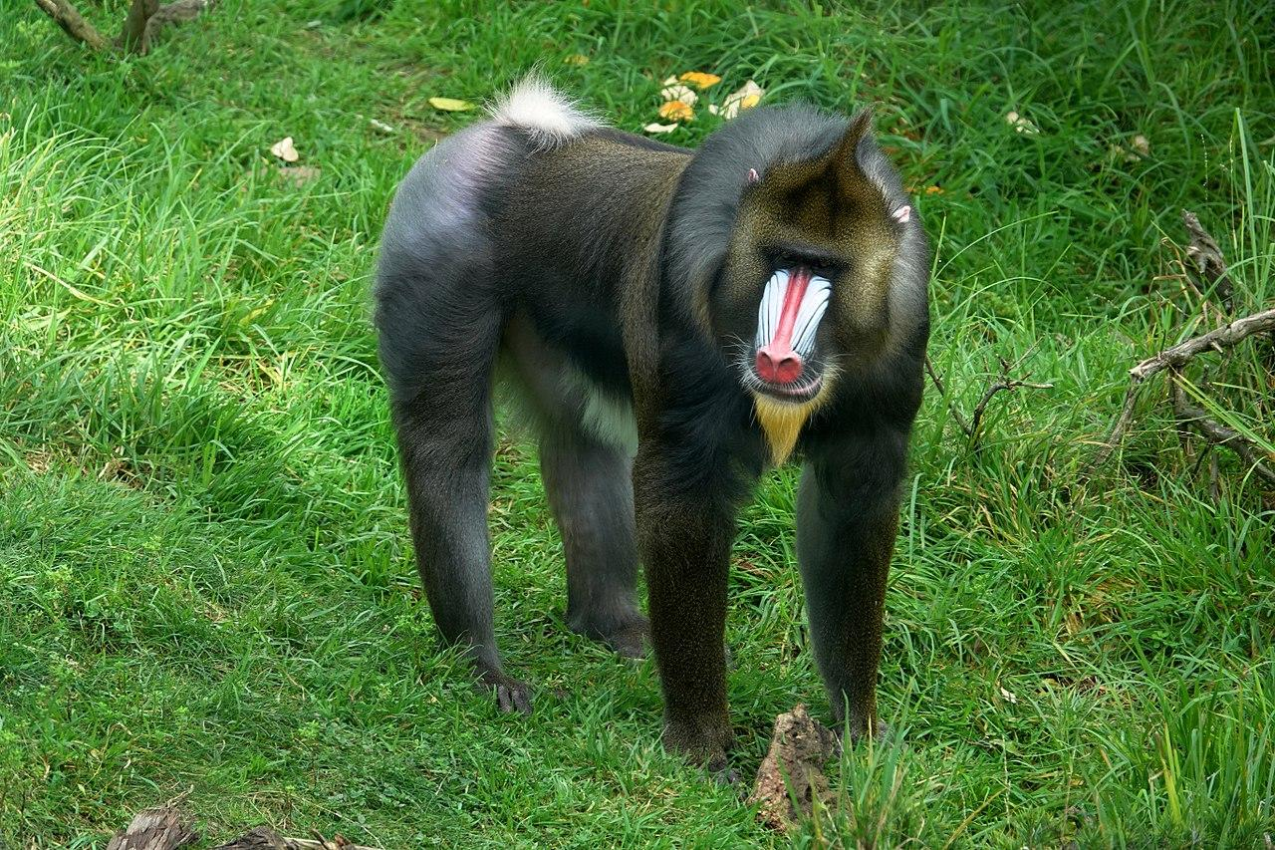
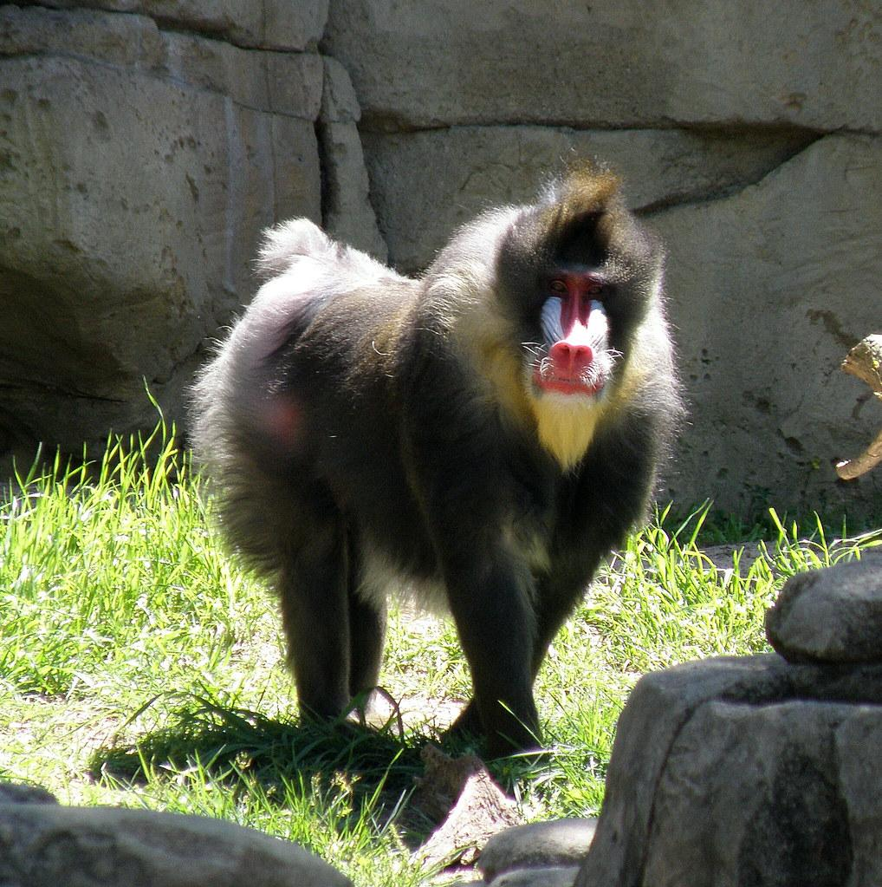
Does a Mandrill baboon have any specific adaptations to help it survive ?
Mandrill baboons have long arms and they could travel long distances on ground.
Notes:
1 Background Color
1 Title (or write the question)
1 Pictures
1 Include Transitions
0 Answering question using complete sentences (multiple sentences if needed to fully explain your answer)
1 Accuracy of information
5
Mandrill baboon needs to be capitalized. Delete the space between the word survive and the ?

Slide 10
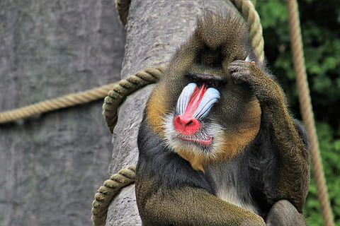
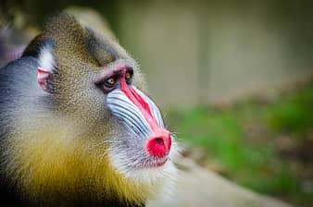
What does a Mandrill baboon look like, how much does it weigh, and how tall is it?
They have thick ridges along the nose that are purple and blue, red lips, nose, and a golden beard. They weigh 42-82 ibs. A mandrill is 1.8-2.1 ft tall but standing up it is 3 feet tall.
Notes:
1 Background Color
1 Title (or write the question)
1 Pictures
1 Include Transitions
0 Answering question using complete sentences (multiple sentences if needed to fully explain your answer)
1 Accuracy of information
5
Mandrill baboon needs to be capitalized. Purple and blue, with redlips and nose, and a golden beard and it weighs 42…..You are missing the word “tall” in the last sentence 2.1ft tall, but can… end with a period.

Slide 11
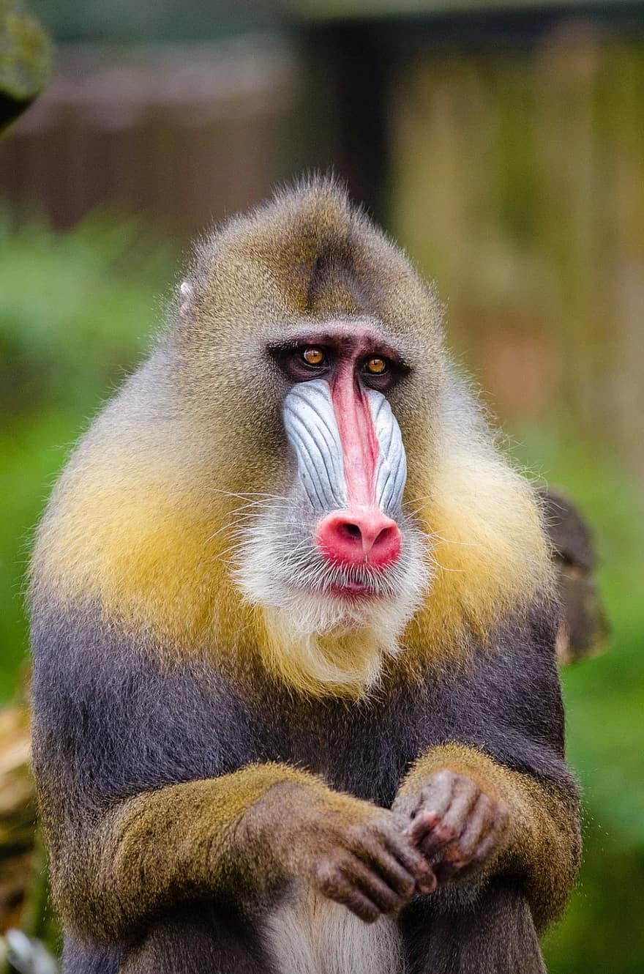
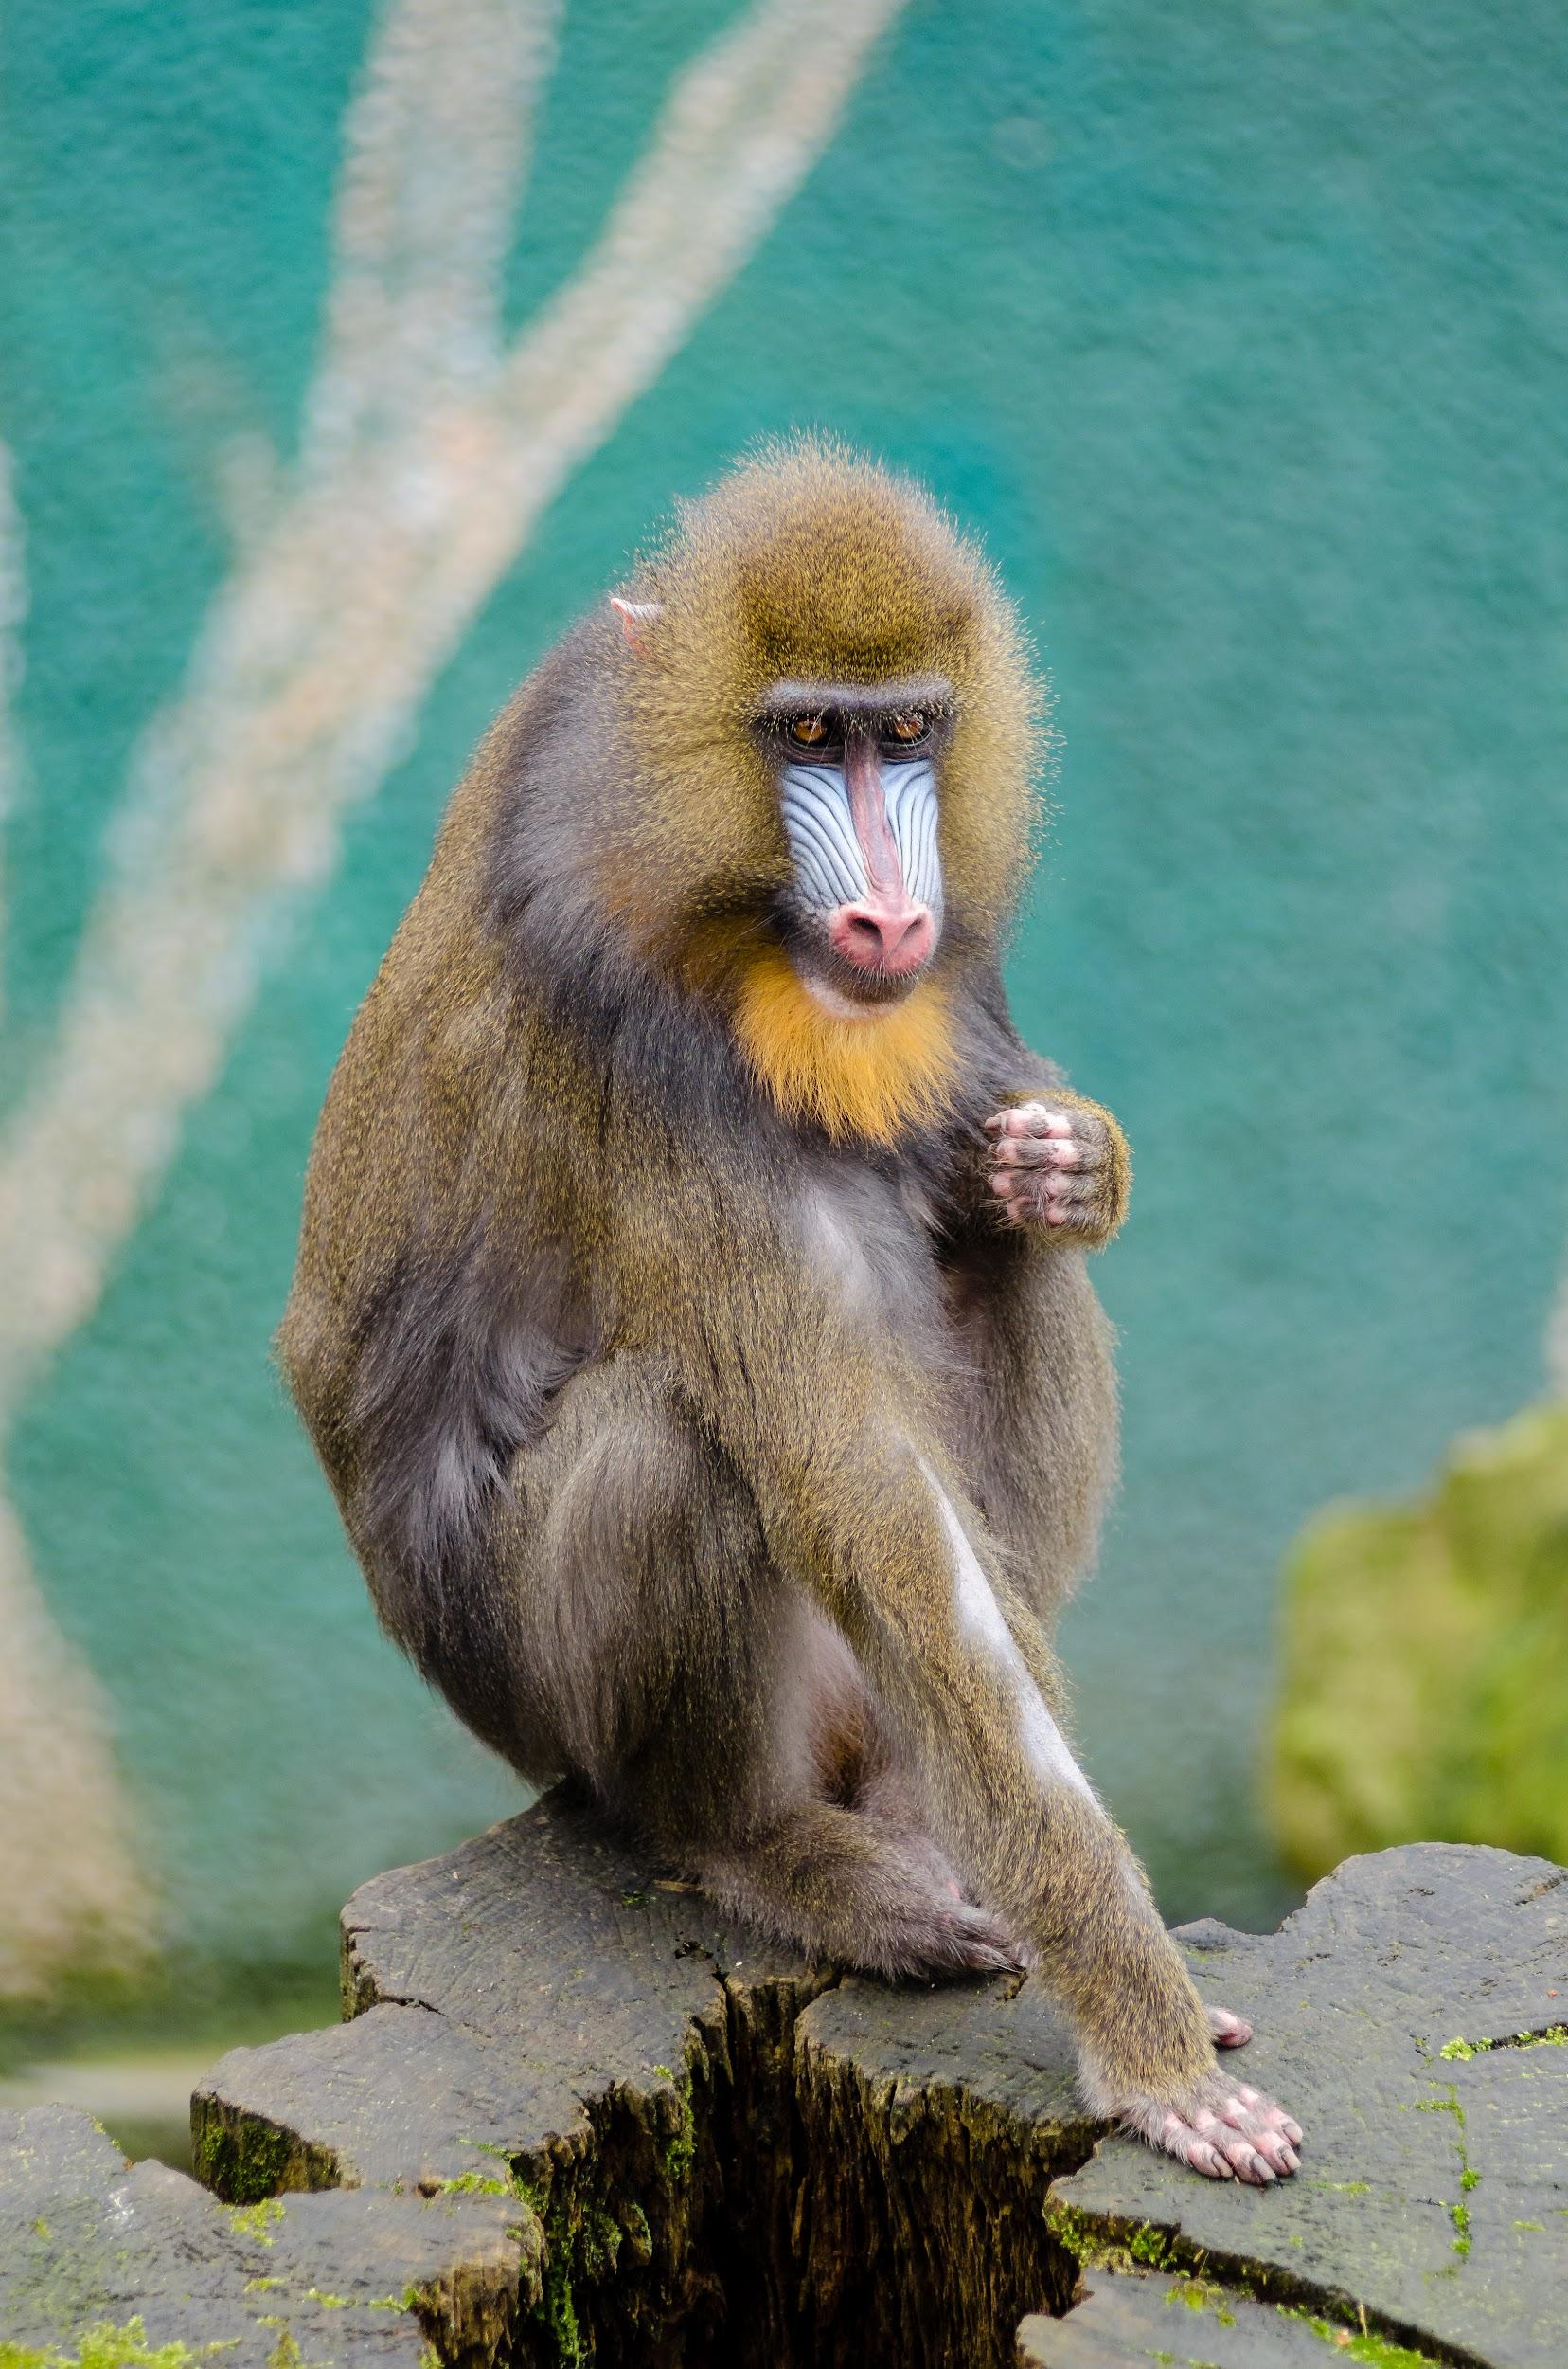
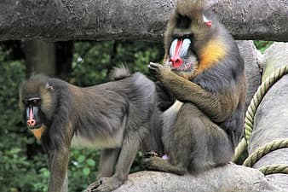
Do males and females of a mandrill weigh the same, and are the same size?
The male of the species can weigh around 70 pounds and possibly more than 100 pounds while reaching a height of more than 30 inches. However, the female is significantly smaller than the male; it weighs only around 30 pounds.
Notes:
1 Background Color
0 Title (or write the question)
1 Pictures
1 Include Transitions
1 Answering question using complete sentences (multiple sentences if needed to fully explain your answer)
1 Accuracy of information
5
Mandrill needs to be capitalized in the title.

Slide 12
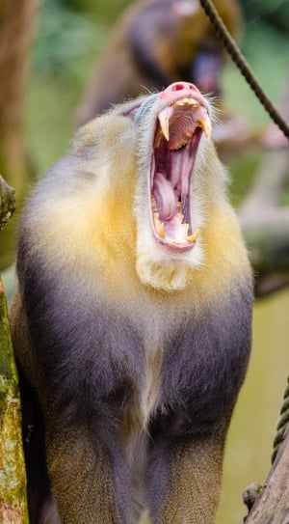
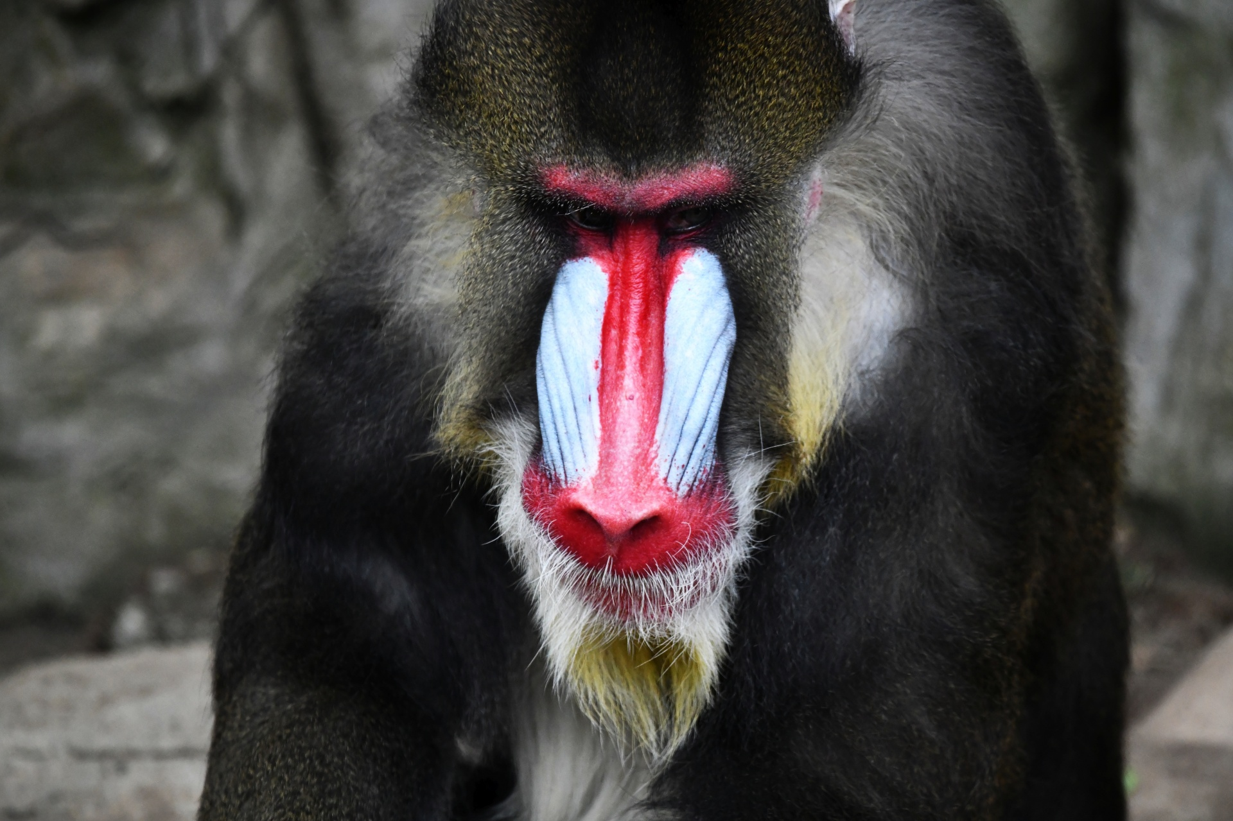
What is the lifespan for a Mandril?
A lifespan of a mandrill is 20 years.
Notes:
1 Background Color
1 Title (or write the question)
1 Pictures
1 Include Transitions
0 Answering question using complete sentences (multiple sentences if needed to fully explain your answer)
1 Accuracy of information
5
Mandrill baboon,needs to be capitalized. Also add a question mark to the end of the title.

Slide 13
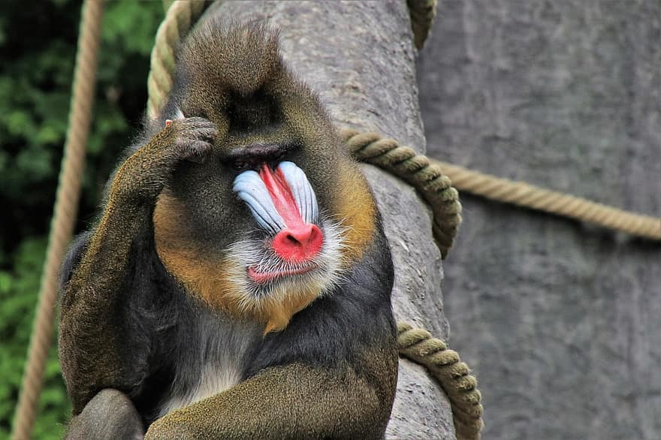
What are 8 facts about the Mandrill baboon?
Mandrills have extremely long canine teeth (2.5 inches long).
Mandrills sometimes expose their teeth as a greeting sign.
Mandrills also have cheek pouches adapted for a the storage of food.
A mandrills top speed is 25 mph.
Mandrills are the largest of all monkeys.
There are about 4,000 mandrills left.
Mandrills are diurnal animals.
Mandrills are noisy animals.
Notes:
1 Background Color
1 Title (or write the question)
1 Pictures
1 Include Transitions
0 Answering question using complete sentences (multiple sentences if needed to fully explain your answer)
1 Accuracy of information
5
Make sure every sentence ends with a period.

Slide 14
Where I found my sources
https://a-z-animals.com/animals/mandrill
https://www.britannica.com/animal/mandrill
https://www.softschools.com/facts/animals/mandrill_facts/
https://www.primatespark.com/mandrill-height/
https://animals.sandiegozoo.org/animals/mandrill
Notes:
1 Background Color
0 Title (or write the question)
1 Pictures
1 Include Transitions
1 Answering question using complete sentences (multiple sentences if needed to fully explain your answer)
1 Accuracy of information
5
This slide needs a title. And eiter keep them all linked or make them all unlinked.

