Slide 1
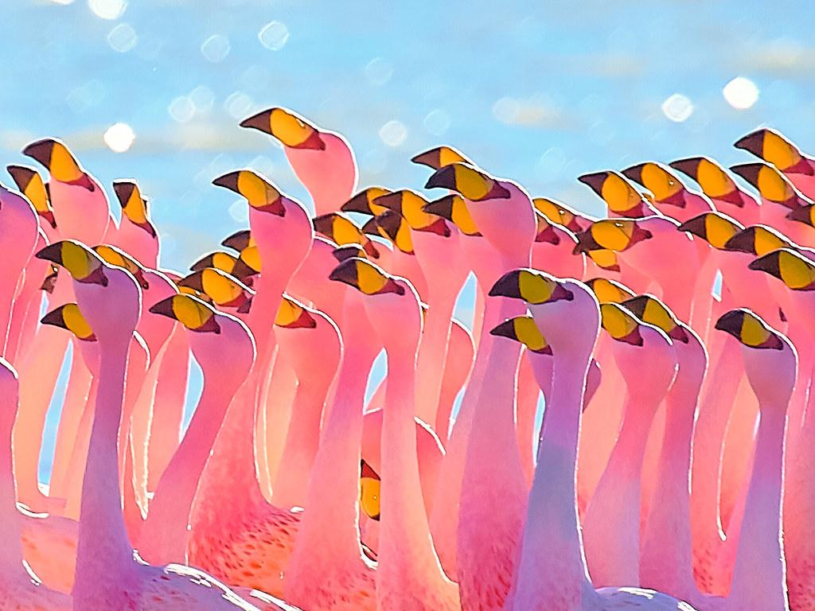
Flamingo?
By Jesus Valdez
Notes:
1 Background Color
1 Title (or write the question)
1 Pictures
1 Include Transitions
1 Answering question using complete sentences (multiple sentences if needed to fully explain your answer)
1 Accuracy of information

Slide 2
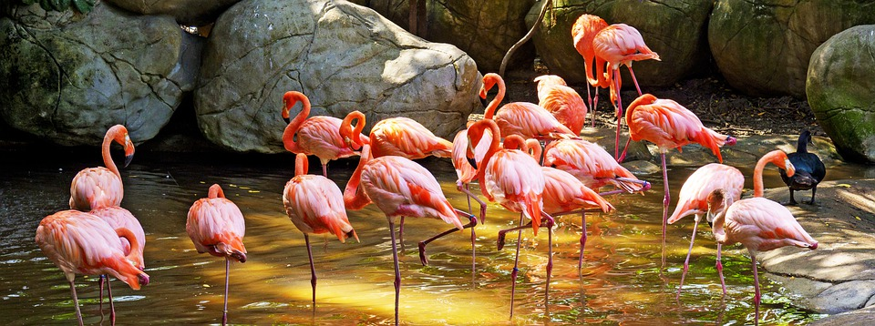
Where Flamingo Came From?
Greater flamingos are found in parts of Africa, Asia, and Europe. They are also the largest and tallest species of flamingos. Chilean, Andean, and James's flamingos are found only in South America. The Andean flamingo are the rarest of the six species, with fewer than 40,000 birds. Also the American flamingo live in the West Indies, Yucatán, in the northern part of South America and along the Galapagos Islands.
Notes:
1 Background Color
1 Title (or write the question)
1 Pictures
1 Include Transitions
1 Answering question using complete sentences (multiple sentences if needed to fully explain your answer)
1 Accuracy of information

Slide 3
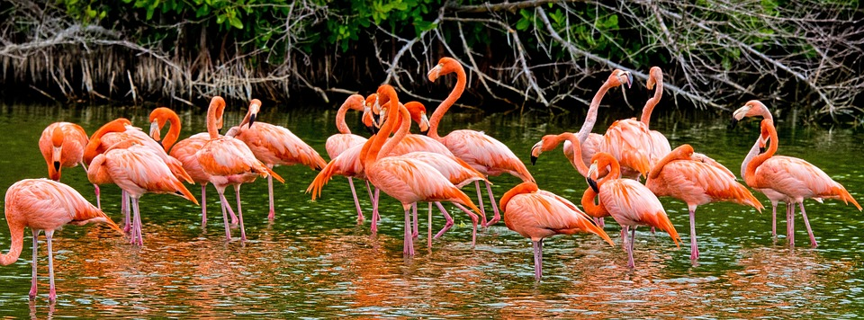
Flamingos Ecosystem
“The flamingo's most characteristic habitats are large alkaline or saline lakes or estuarine lagoons that usually lack vegetation. Lakes may be far inland or near the sea. A variety of habitats are used by flamingos: mangrove swamps, tidal flats, and sandy islands in the intertidal zone.”
Notes:
1 Background Color
1 Title (or write the question)
1 Pictures
1 Include Transitions
1 Answering question using complete sentences (multiple sentences if needed to fully explain your answer)
1 Accuracy of information

Slide 4
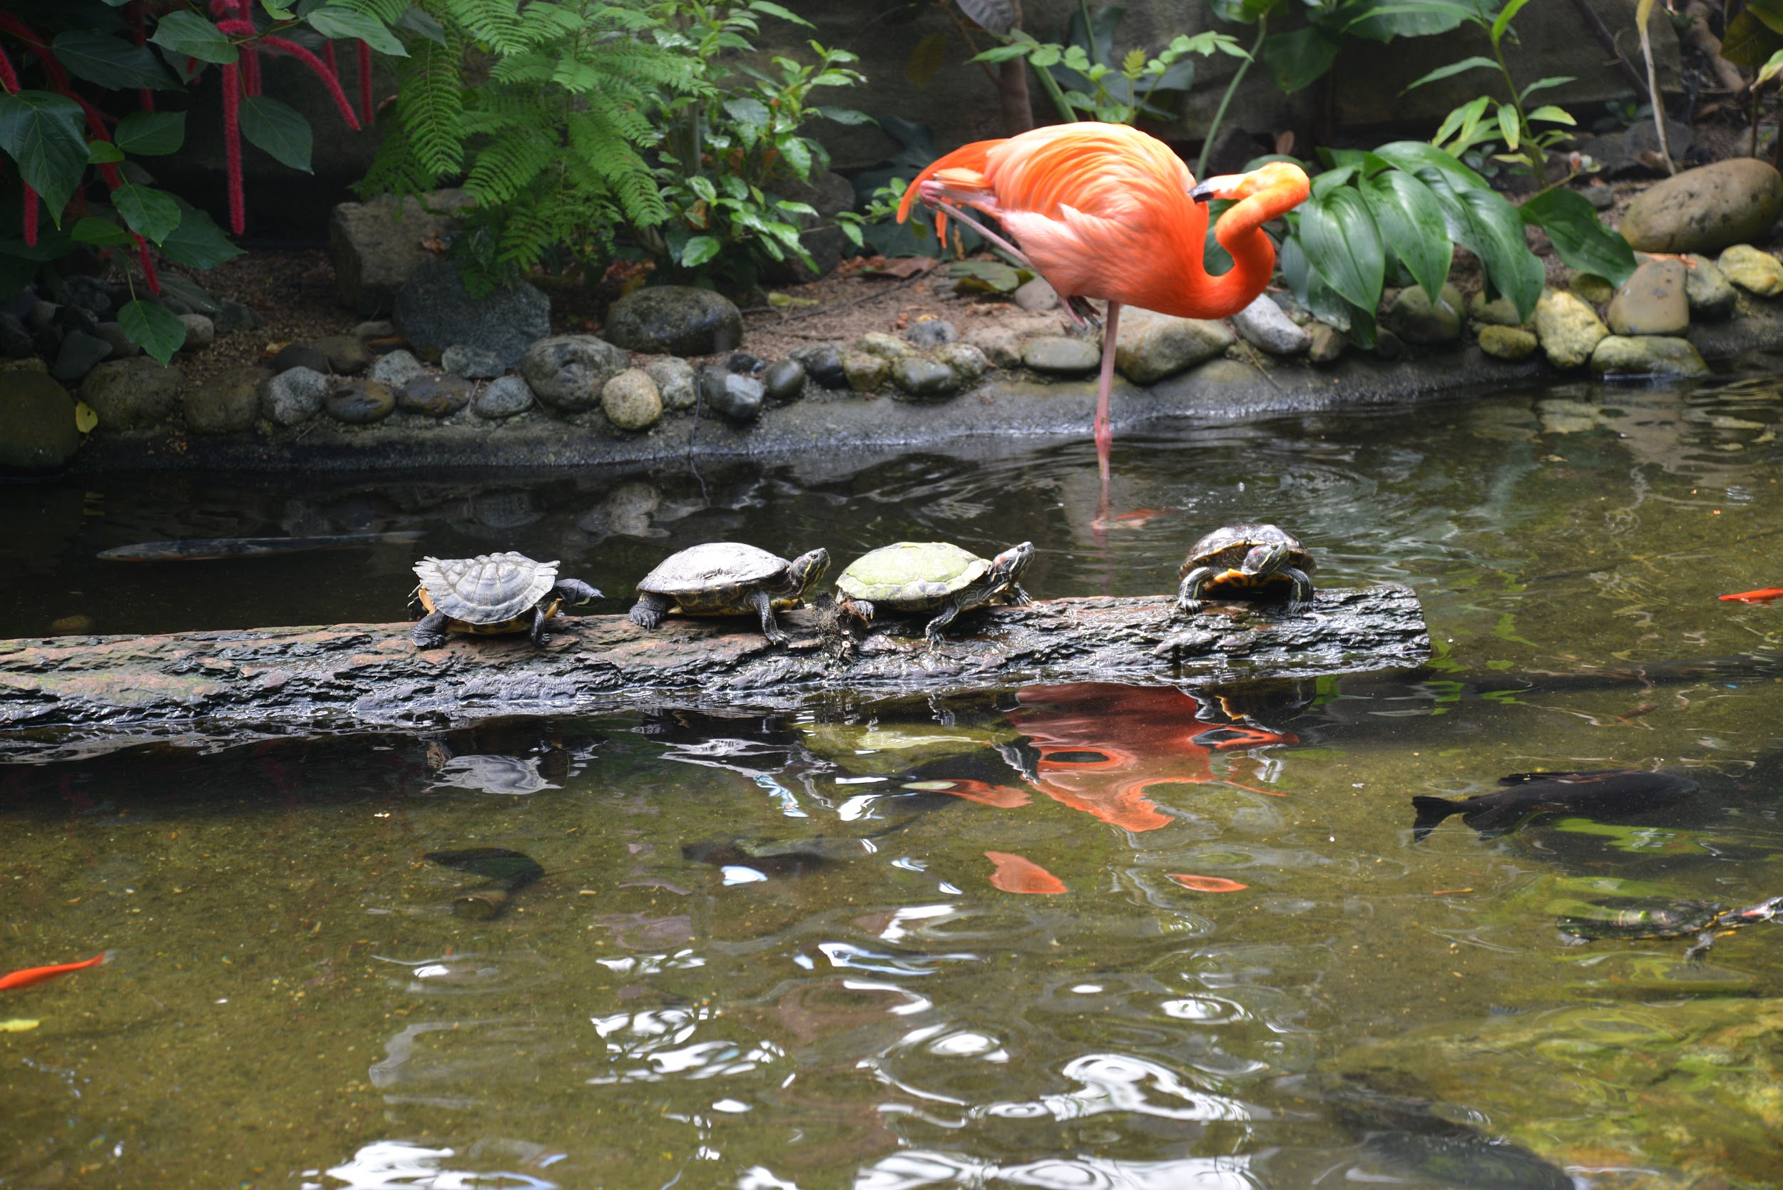
What It’s Like In There Ecosystem?
Phoenicopterus ruber or the American Flamingo have evolved a number of thermoregulatory mechanisms to keep itself cool during the light period and warm during the dark period without expending too much energy. The American flamingo has been observed in a temperature niche between 17.8–35.2 °C (64.0–95.4 °F).
Notes:
1 Background Color
1 Title (or write the question)
1 Pictures
1 Include Transitions
1 Answering question using complete sentences (multiple sentences if needed to fully explain your answer)
1 Accuracy of information

Slide 5

Flamingos Lifespan
The flamingo can live for up to 20 years in the wild. Flamingos can live a long time – some individuals have been recorded at 70 years of age, giving them one of the longest lifespans in the bird world. In the wild, their biggest threats are predators like eagles and even baboons.
Notes:
1 Background Color
1 Title (or write the question)
1 Pictures
1 Include Transitions
1 Answering question using complete sentences (multiple sentences if needed to fully explain your answer)
1 Accuracy of information

Slide 6
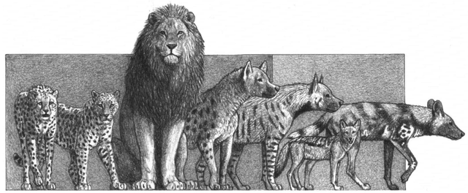
Flamingos Predators!!!
These predators vary according to the species of flamingo and environment in which the flamingo lives. The lesser flamingo is preyed upon by lions, leopards, cheetahs, and jackals. Pythons have also been known to attack flamingos. The Andean flamingo is preyed upon by the Andean fox and Geoffrey's cat.
Notes:
1 Background Color
1 Title (or write the question)
1 Pictures
1 Include Transitions
1 Answering question using complete sentences (multiple sentences if needed to fully explain your answer)
1 Accuracy of information

Slide 7
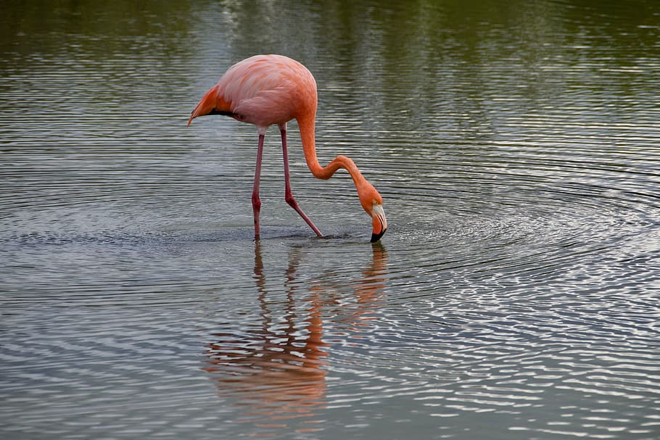
What type of consumer is a flamingo?
In the Food Web the Caribbean Flamingo is able to act as the primary consumer or the secondary consumer. If it feeds on algae or any plant material, it is acting as a primary consumer because it is feeding on something that can produce its own food by photosynthesis.
Notes:
1 Background Color
1 Title (or write the question)
1 Pictures
1 Include Transitions
1 Answering question using complete sentences (multiple sentences if needed to fully explain your answer)
1 Accuracy of information

Slide 8
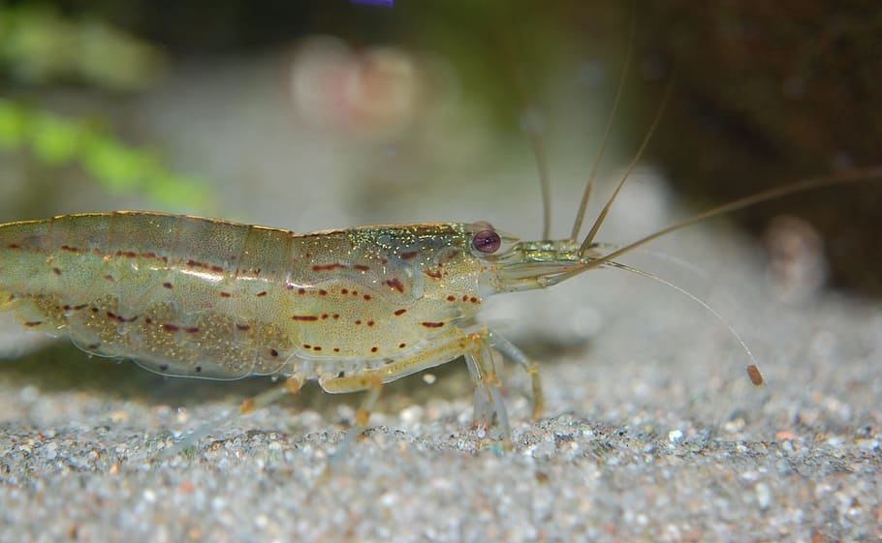
Flamingos Food Chain
When a flamingo spots potential dinner—favorite foods include shrimp, snails, and plant like water organisms called algae—it plunges its head into the water, twists it upside down, and scoops the fish using its upper beak like a shovel.
Notes:
1 Background Color
1 Title (or write the question)
1 Pictures
1 Include Transitions
1 Answering question using complete sentences (multiple sentences if needed to fully explain your answer)
1 Accuracy of information

Slide 9
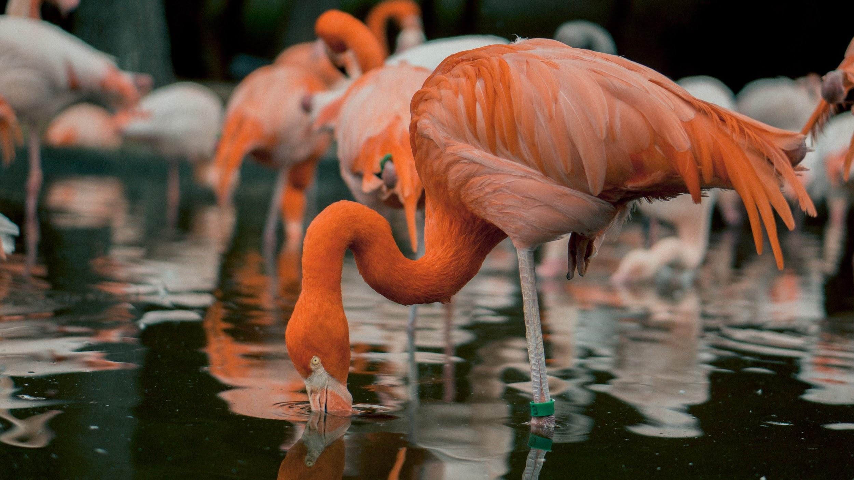
How Do Flamingos Survive?
A flamingo's anatomy is adapted to its diet—shrimp, crustaceans, mollusks, fishes, and algae that live in shallow coastal waters. Their flexible necks, long legs, and webbed feet help flamingos stir around mud—bringing those tiny bottom-dwellers to the surface.

Slide 10
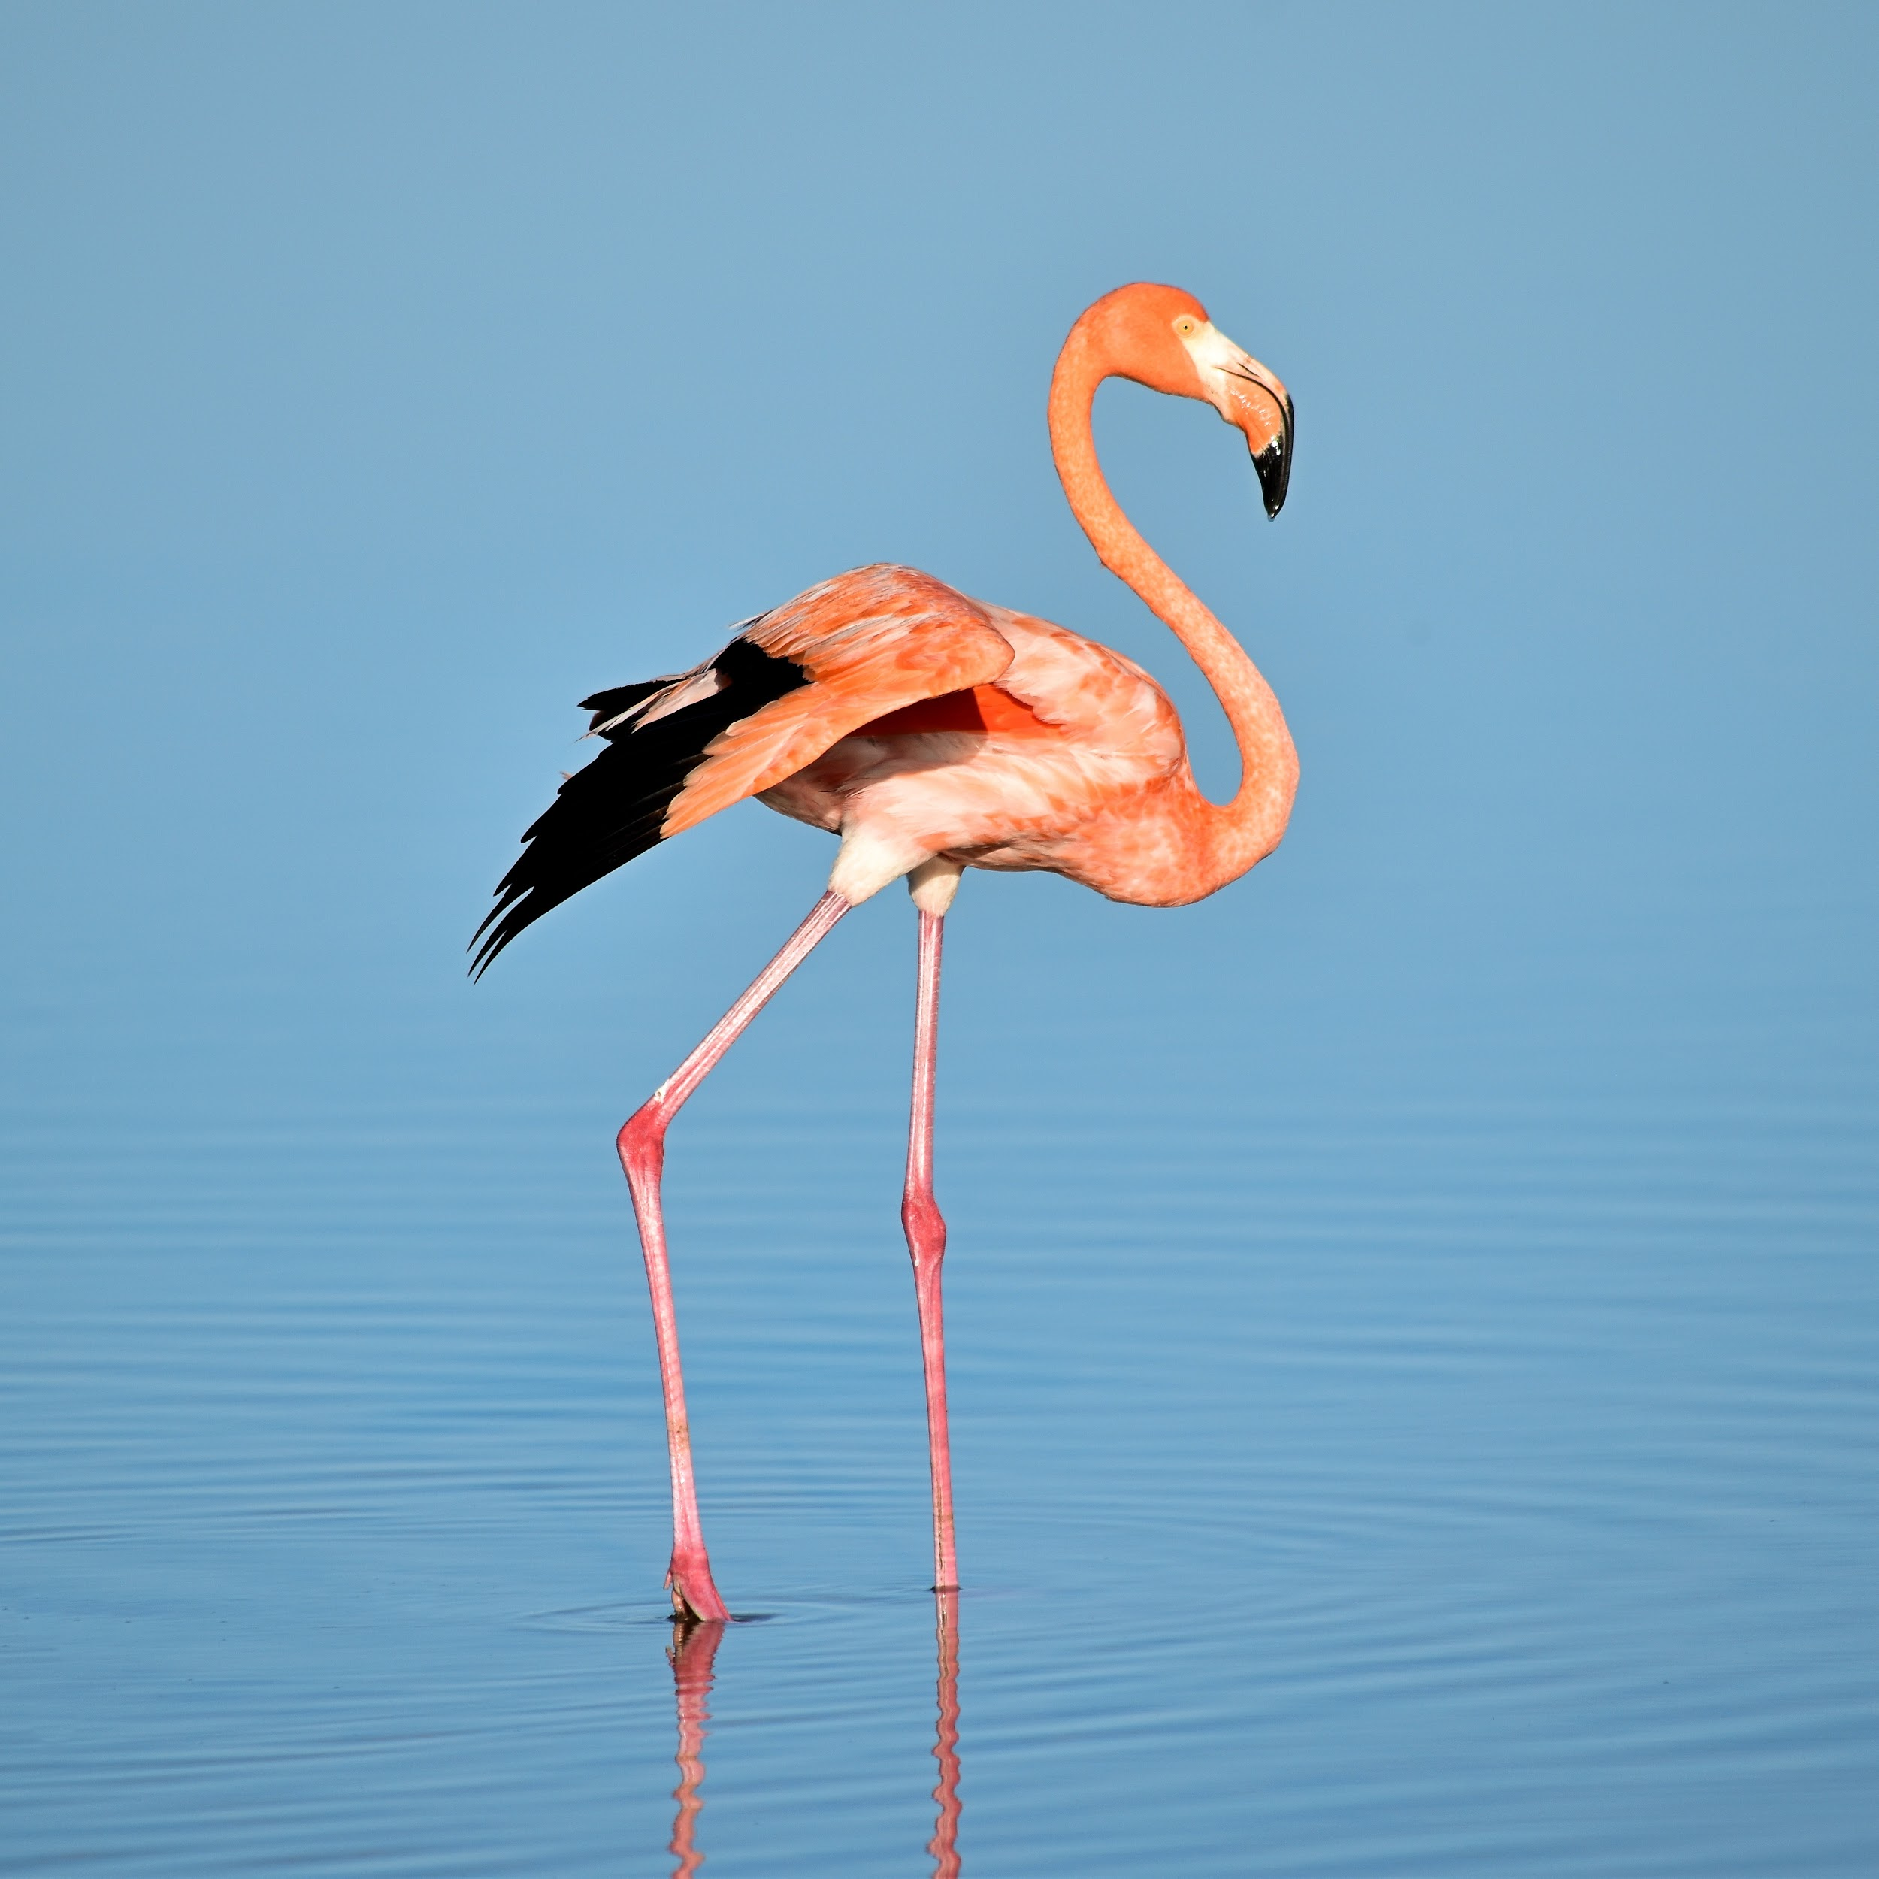
How tall is flamingo and how much does it weigh?
The American flamingo is one of the largest species of flamingo. An average adult is 5 feet (1.5 meters) tall and weighs 4-8 pounds (1.8-3.6 kilograms). American, or Caribbean, flamingos are distributed throughout the Caribbean Islands and along the northern coast of South America.

Slide 11

Do males and females of a flamingo weigh the same and are the same size?
Male flamingos are slightly larger than females, weighing more and having longer wingspans; however, visual genders determination of flamingos is unreliable. The wingspan of flamingos ranges from 95 to 100 cm (37-39 in.) for the lesser flamingo to 140 to 165 cm (55-65 in.) for the greater flamingo.

Slide 12

Interesting facts about Flamingos
Flamingo nests are made of mud. … Flamingos get their pink color from their food. … Flamingos are filter feeders and turn their heads “upside down” to eat. … A group of flamingos is called a flamboyance. … There are six flamingo species.

Slide 13
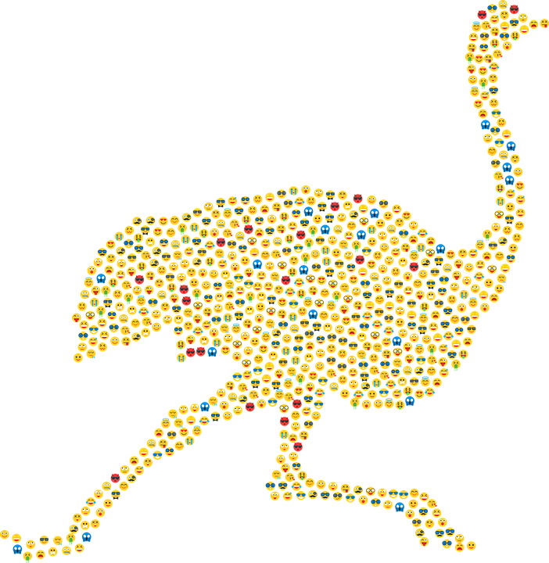
Interesting facts about flamingos pt2
Flamingos are usually found in swamps and mudflats.There are six known species of Phoenicopteridae: the greater flamingo, lesser flamingo, James’s flamingo, Chilean flamingo, Andean flamingo, and American flamingo. Fully-grown flamingos stand at 4 ft to 5 ft tall. A flamingo typically weighs 4 to 8 pounds – that’s only around 1 kg to 3 kg.They are not endangered. Flamingos are classified under “least concern.”

Slide 14
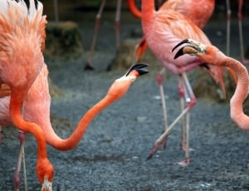
My sources about flamingo
https://nationalzoo.si.edu/animals/news/why-are-flamingos-pink-and-other-flamingo-facts https://facts.net/flamingo-facts/

