Slide 1
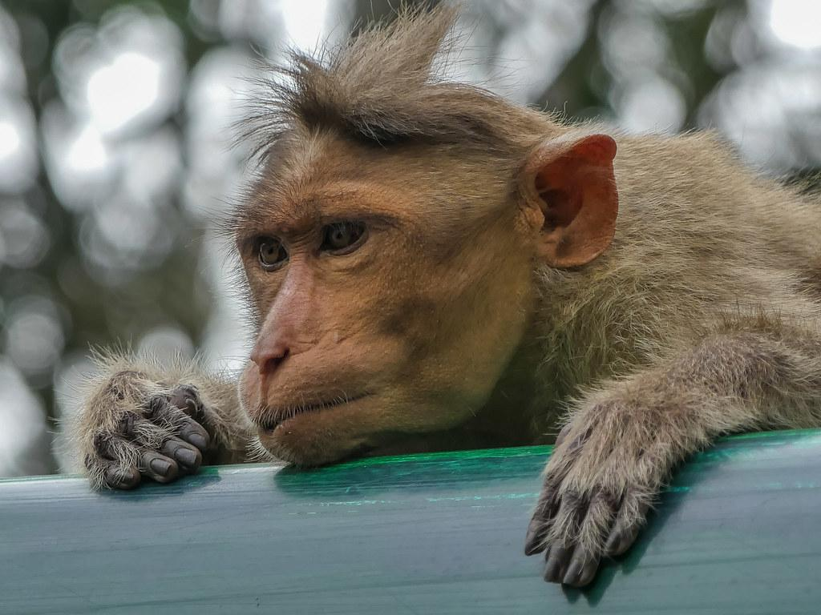
Bonnet macaque
By Jose Rodriguez
Notes:
0 Background Color
1 Title (or write the question)
1 Pictures
0 Include Transitions
0 Answering question using complete sentences (multiple sentences if needed to fully explain your answer)
1 Accuracy of information
3
This slide has no transition.
This is hard to read against this background.

Slide 2
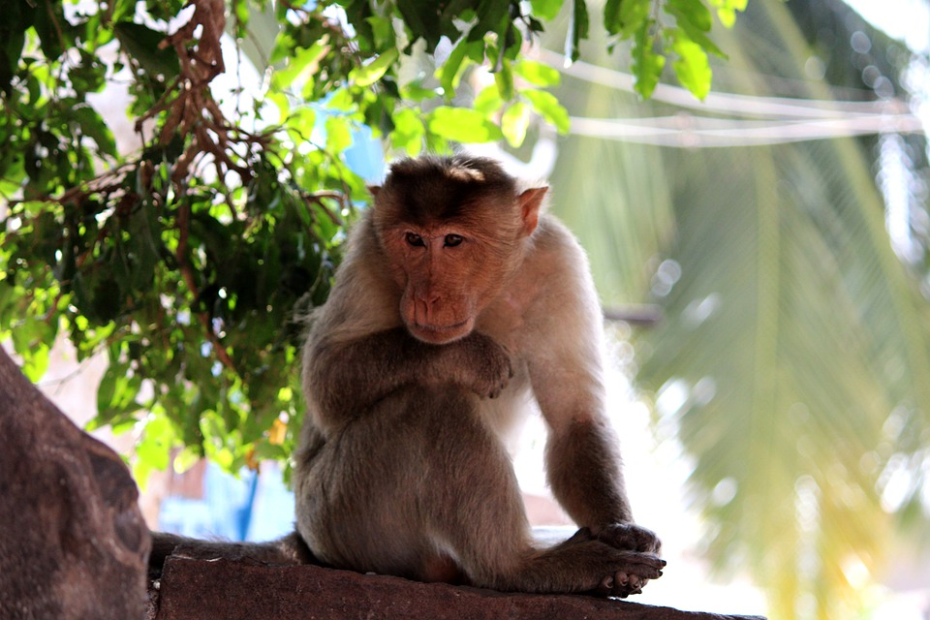
Where do bonnet macaque come from.
Most of the bonnet macaque come from southern indian.
Notes:
0 Background Color
1 Title (or write the question)
1 Pictures
0 Include Transitions
0 Answering question using complete sentences (multiple sentences if needed to fully explain your answer)
1 Accuracy of information
3
This slide has no transition.
Put a question mark at the end of the title.
This is hard to read against this background.

Slide 3
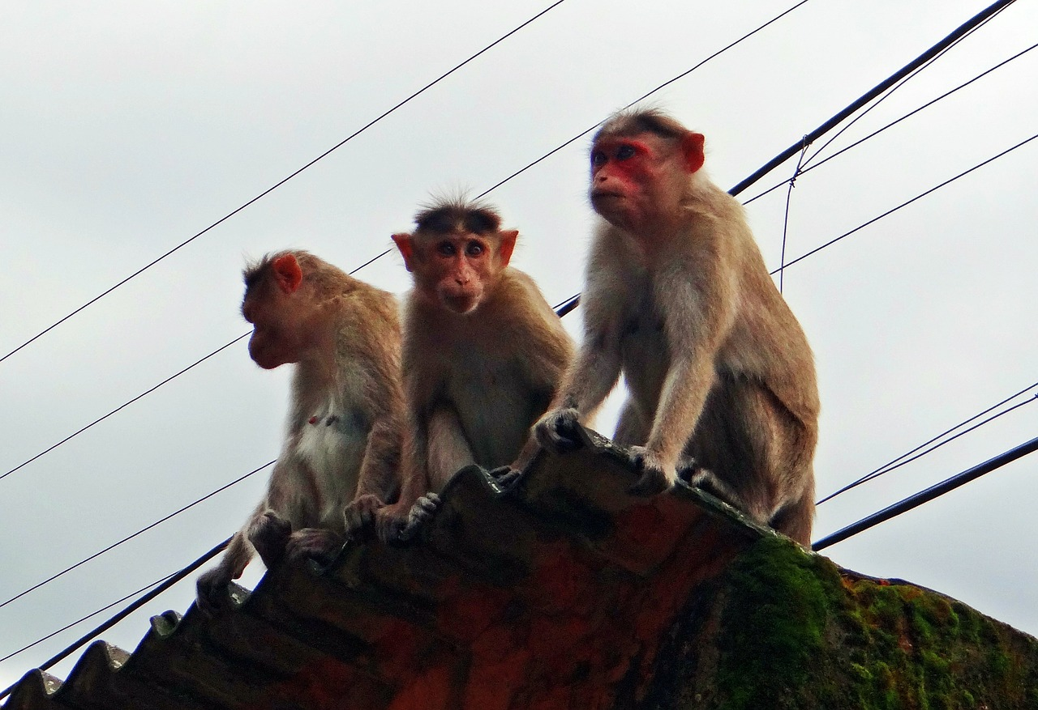
What ecosystem do they live in.
Some times they are found in a peninsula( piece of land surrounded by water on three sides) but there most common found in western ghat mountains.
Notes:
0 Background Color
1 Title (or write the question)
1 Pictures
1 Include Transitions
0 Answering question using complete sentences (multiple sentences if needed to fully explain your answer)
1 Accuracy of information
4
Put a question mark at the end of the title.
This is hard to read against this background. Western Ghat mountains.

Slide 4
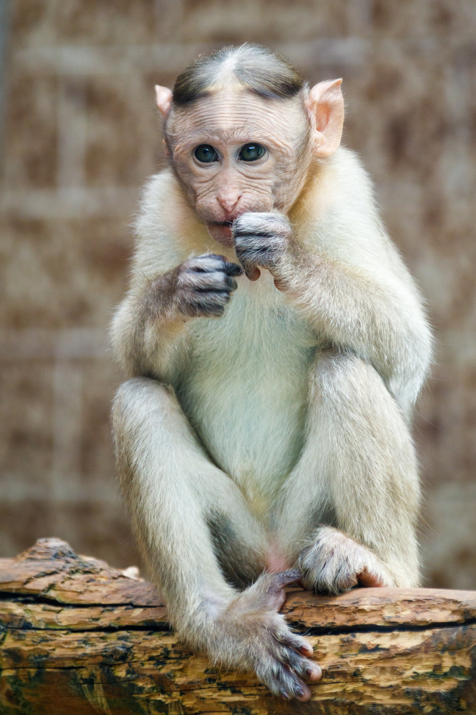
What type of consumers are bonnet macaque.
Bonnet macaque are omnivores, meaning they eat plants and animal products. There diet is fruit,supplemented by insects and leaves.
Notes:
0 Background Color
1 Title (or write the question)
1 Pictures
0 Include Transitions
0 Answering question using complete sentences (multiple sentences if needed to fully explain your answer)
1 Accuracy of information
3
This slide has no transition.
Put a question mark at the end of the title.
This is hard to read against this background. There should always be a space after a comma.

Slide 5
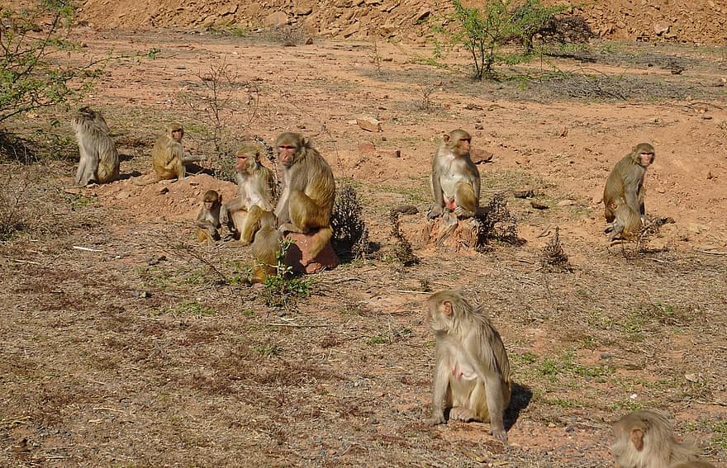
Do they have any predators.
leopards,tigers,crocodiles, pythons,eagles are the predators of a bonnet macaque.
Notes:
0 Background Color
1 Title (or write the question)
1 Pictures
0 Include Transitions
0 Answering question using complete sentences (multiple sentences if needed to fully explain your answer)
1 Accuracy of information
3
This slide has no transition.
Put a question mark at the end of the title.
This is hard to read against this background.

Slide 6
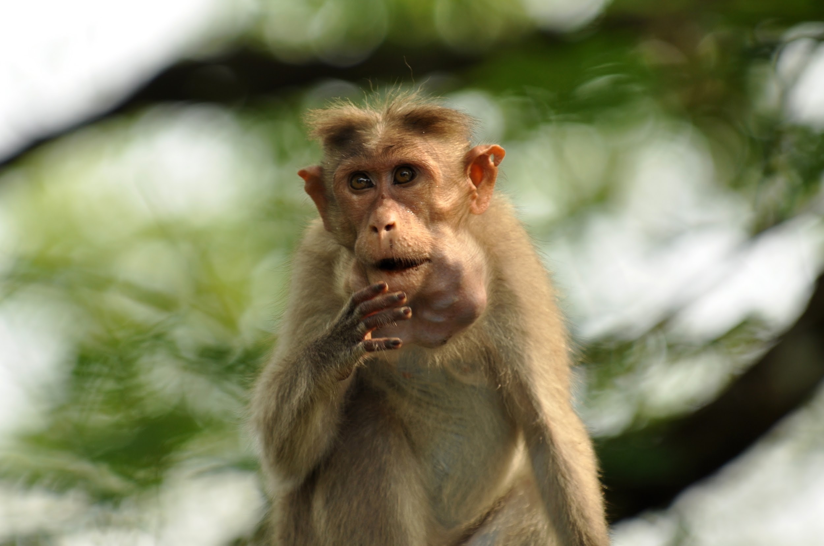
Do they have any adaptations.
They are adapted to solid ground and in the trees. Bonnet macaque are also excellent swimmers.
Notes:
1 Background Color
1 Title (or write the question)
1 Pictures
0 Include Transitions
0 Answering question using complete sentences (multiple sentences if needed to fully explain your answer)
0 Accuracy of information
3
This slide has no transition.
Put a question mark at the end of the title.
Biological adaptations please…

Slide 7
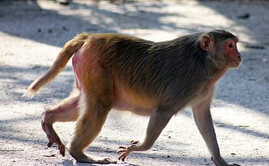
How tall and how much do they weight.
They are 14-24 inches tall and weight 6.7kg.
Notes:
0 Background Color
1 Title (or write the question)
1 Pictures
0 Include Transitions
0 Answering question using complete sentences (multiple sentences if needed to fully explain your answer)
1 Accuracy of information
4
This slide has no transition.
Put a question mark at the end of the title.

Slide 8
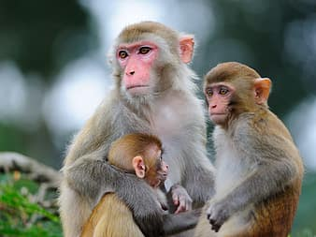
Difference between male and female bonnet macaque
The difference is the male’s weight more than the female.
Notes:
1 Background Color
1 Title (or write the question)
1 Pictures
0 Include Transitions
0 Answering question using complete sentences (multiple sentences if needed to fully explain your answer)
1 Accuracy of information
4
This slide has no transition.
.
Capitalize Bonnet Macaque when in the title.

Slide 9
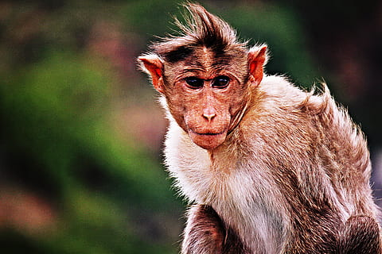
What is the lifespan of a bonnet macaque?
The lifespan of a macaque is 35 years.
Notes:
0 Background Color
1 Title (or write the question)
1 Pictures
0 Include Transitions
0 Answering question using complete sentences (multiple sentences if needed to fully explain your answer)
1 Accuracy of information
3
This slide has no transition.
.
This is hard to read against this background.

Slide 10
facts

Slide 11
facts

Slide 12
facts

Slide 13
facts

