Slide 1
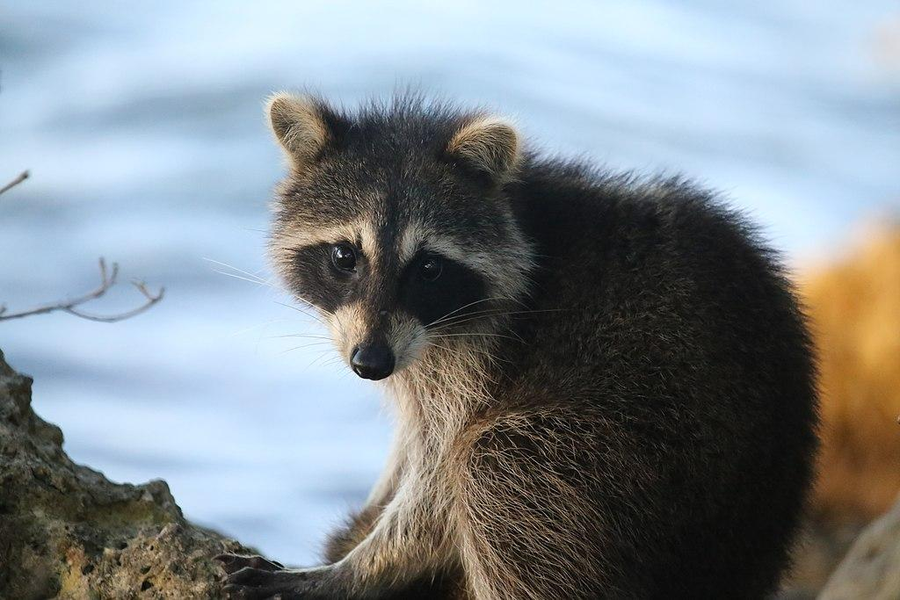
Raccoons/procyon lotor simus
By
Joshua M
Notes:
1 Background Color
1 Title (or write the question)
1 Pictures
0 Include Transitions
0 Answering question using complete sentences (multiple sentences if needed to fully explain your answer)
1 Accuracy of information
4
This slide has no transition.
.
Racoons / Procyon Lotor

Slide 2
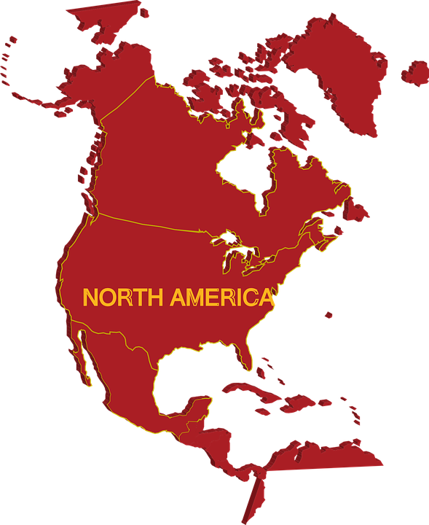
Where did they come from?
This specific type of raccoon is native to north america due to the climate
Notes:
0 Background Color
1 Title (or write the question)
1 Pictures
0 Include Transitions
0 Answering question using complete sentences (multiple sentences if needed to fully explain your answer)
1 Accuracy of information
3
This slide has no transition.
The text is hard to read against this background.
Every sentence starts with a capital and ends with punctuation.

Slide 3
What ecosystem does a racoon live in?
Raccoons are extremely adaptable so they can live anywhere and in different types of habitats but they do prefer moist woodlands areas or like places with freshwater
Notes:
1 Background Color
1 Title (or write the question)
0 Pictures
0 Include Transitions
0 Answering question using complete sentences (multiple sentences if needed to fully explain your answer)
1 Accuracy of information
3
This slide has no transition.
This slide has no picture.
…habitats, but they do….woodland areas or places with fresh water.

Slide 4
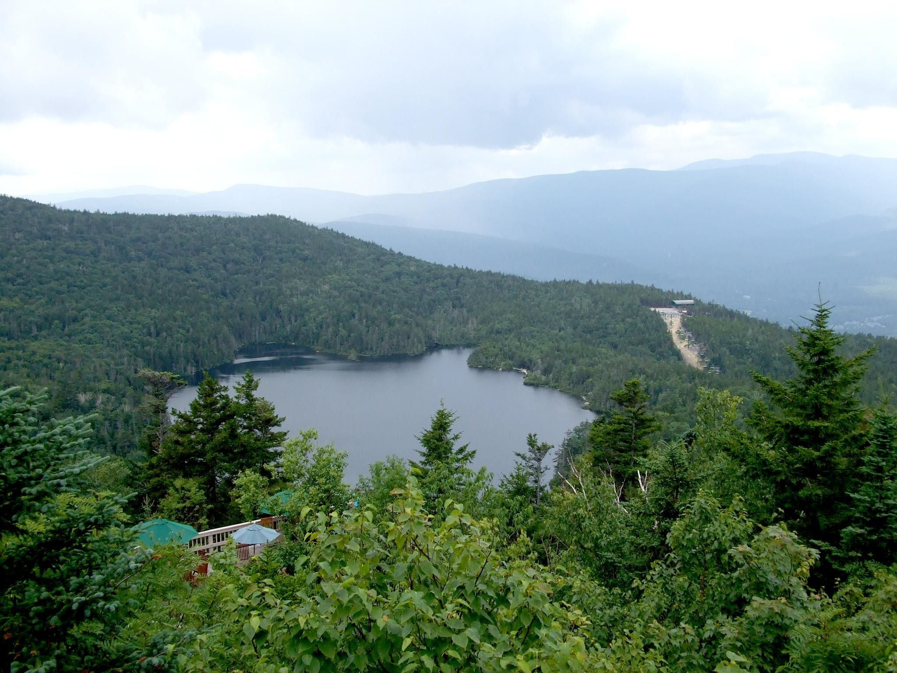
What is it like in their ecosystem?
A raccoons ecosystem is mostly in forest with water like a river lake or some type of water source they don't like the rain that's why you won't see them that much when its raining they will either by hiding in a den waiting for the water to past or dance with the rain they like warm areas so that why they will travel to a warmer area but most of the time you will find a raccoon or a two in moist woodlands
Notes:
1 Background Color
1 Title (or write the question)
1 Pictures
0 Include Transitions
0 Answering question using complete sentences (multiple sentences if needed to fully explain your answer)
1 Accuracy of information
4
This slide has no transition.
This slide has no picture.
This is called a run on sentence… please separate this text into several sentences. Make sure to use proper punctuation.

Slide 5
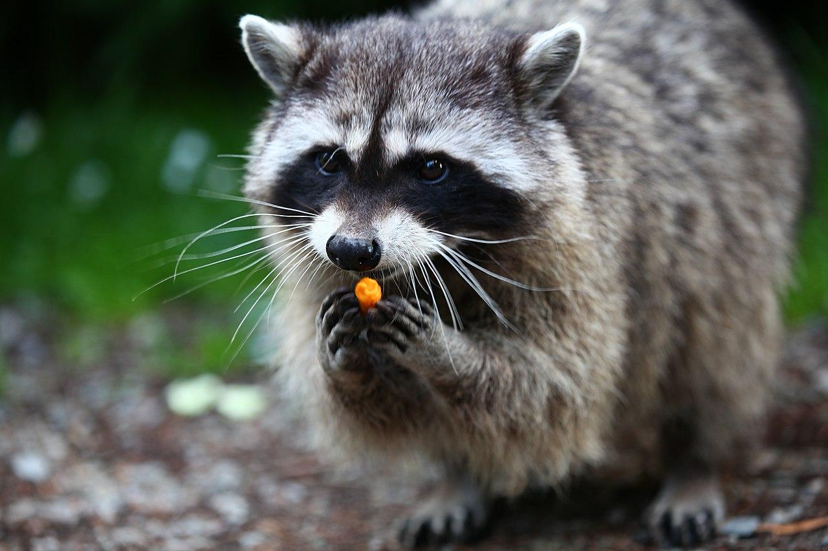
What type of consumer is a raccoon/procyon lotor simus
Racoons are omnivores which mean they eat both meat and plants
Notes:
1 Background Color
1 Title (or write the question)
1 Pictures
0 Include Transitions
0 Answering question using complete sentences (multiple sentences if needed to fully explain your answer)
1 Accuracy of information
4
This slide has no transition.
Capitalize when in the title… Raccoon / Procyon Loto add a question mark at the end. And a period at the end of the paragraph text.

Slide 6
What food does your creature like to eat?
Well since racoons are omnivores they can eat both plants and meat their favorite type of food is nuts,berries,insects and eggs.
Notes:
1 Background Color
1 Title (or write the question)
0 Pictures
0 Include Transitions
0 Answering question using complete sentences (multiple sentences if needed to fully explain your answer)
1 Accuracy of information
3
This slide has no transition.
This slide has no picture.
A space always follows a comma… nuts, berries, insects, and eggs.

Slide 7
Does your creature have any predators
Yes it has predators but the majors are hawks,owls,humans and snakes to prey on the young raccoons.
Notes:
1 Background Color
1 Title (or write the question)
0 Pictures
0 Include Transitions
0 Answering question using complete sentences (multiple sentences if needed to fully explain your answer)
1 Accuracy of information
3
This slide has no transition.
This slide has no picture.
Put a question mark at the end of the title.
Yes? Raccoons have predators. The major ones are hawks, owls, humans, and snakes. These especially like to eat young raccoons.

Slide 8
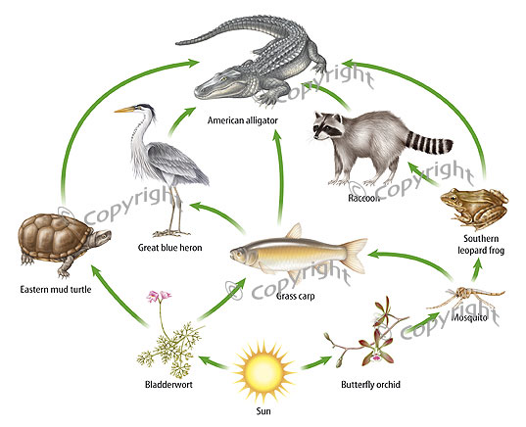
What is the typical food chain of a raccoon?
This is the usual food chain of a raccoon but every now and then it can change
Notes:
1 Background Color
1 Title (or write the question)
1Pictures
0 Include Transitions
0 Answering question using complete sentences (multiple sentences if needed to fully explain your answer)
1 Accuracy of information
3
This slide has no transition.
Period at the end of the sentence.

Slide 9
Does your creature have any specific adaptations to help it survive?
Yes they have almost like a camouflage type of fur so they can hide easily from predators and with their dexterous claws they can easily hunt fish,small fish, frogs, and some crayfish from rivers and streams they are quite the fisherman and adapter.
Notes:
1 Background Color
1 Title (or write the question)
0 Pictures
0 Include Transitions
0 Answering question using complete sentences (multiple sentences if needed to fully explain your answer)
1 Accuracy of information
3
This slide has no transition.
This slide has no picture.
Before you can use a pronoun you must first use the noun… so Yes raccoons camouflage fur so they can hide….predators. With their…

Slide 10
What does your creature look like, how much does it weigh, and how tall is it?
Well a raccoon is dog like thats where the word that's where the word procyon lotor comes which means dog like. A raccoon is 9.1-12 in. and weighs from 7.7-20 lbs
Notes:
1 Background Color
1 Title (or write the question)
0 Pictures
0 Include Transitions
0 Answering question using complete sentences (multiple sentences if needed to fully explain your answer)
1 Accuracy of information
3
This slide has no transition.
This slide has no picture.
Period on the end.

Slide 11
Do males and females of your creature weigh the same and are the same size?
Female raccoons are smaller than the males. Males are about 10 or 30 percent bigger than the females and weigh a little more than the females.
Notes:
1 Background Color
1 Title (or write the question)
0 Pictures
0 Include Transitions
0 Answering question using complete sentences (multiple sentences if needed to fully explain your answer)
1 Accuracy of information
3
This slide has no transition.
This slide has no picture.
Title.. .and are they the same size?

Slide 12
What is the life span of your creature?
The usual lifespan of a raccoon is 3 years when its out in the wild
Notes:
1 Background Color
1 Title (or write the question)
0 Pictures
0 Include Transitions
0 Answering question using complete sentences (multiple sentences if needed to fully explain your answer)
1 Accuracy of information
3
This slide has no transition.
This slide has no picture.
Lifespan is one word.
Place a period at the end of the sentence.

Slide 13
What are the interesting things about a raccoon?
Raccoons are sneaky and will probably snatch food from another animal. They are great fisherman and a good swimmer. Racoons don't usually give up if you ever see one in your backyard and you spook them a away most likely it will come back another day with some of his friends.raccoons hide in dens and can survive without food for a while. Raccoons are not dumb if they see something ad they want it they will try to find a way to get it untill they are tired.
Notes:
1 Background Color
1 Title (or write the question)
0 Pictures
0 Include Transitions
0 Answering question using complete sentences (multiple sentences if needed to fully explain your answer)
1 Accuracy of information
3
This slide has no transition.
This slide has no picture.
This should be titled 8 things…. And it should be a list
You are missing the sources slide please add it…

