Slide 1
Creature Project: Bearded dragon
Kaiden D.

Slide 2
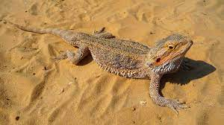
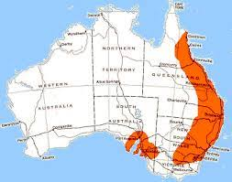
Bearded Dragon
Bearded dragon originated from Australia.

Slide 3
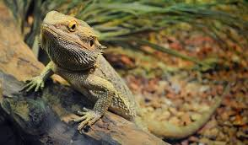
Where do Bearded dragons live?
Bearded dragons live in woodlands, coastal dunes, heathland, tropical savannas and deserts. They're often seen basking on tree stumps, fence posts, branches or boulders.

Slide 4
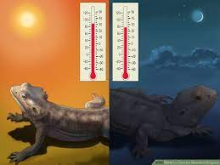
4.What is it like in the ecosystem?
Habitat. In the wild, bearded dragons' range extends across most of Australia. They typically prefer to stick to warm, arid areas: deserts, subtropical woodlands, savannas, and scrublands. ... A warm habitat is crucial for bearded dragons.

Slide 5
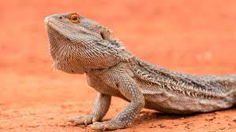
What type of consumer is your creature?
The bearded dragon is diurnal and an omnivore. It forages for food such as insects, small lizards and mammals, fruit, flowers, and other plant material during the day time.

Slide 6
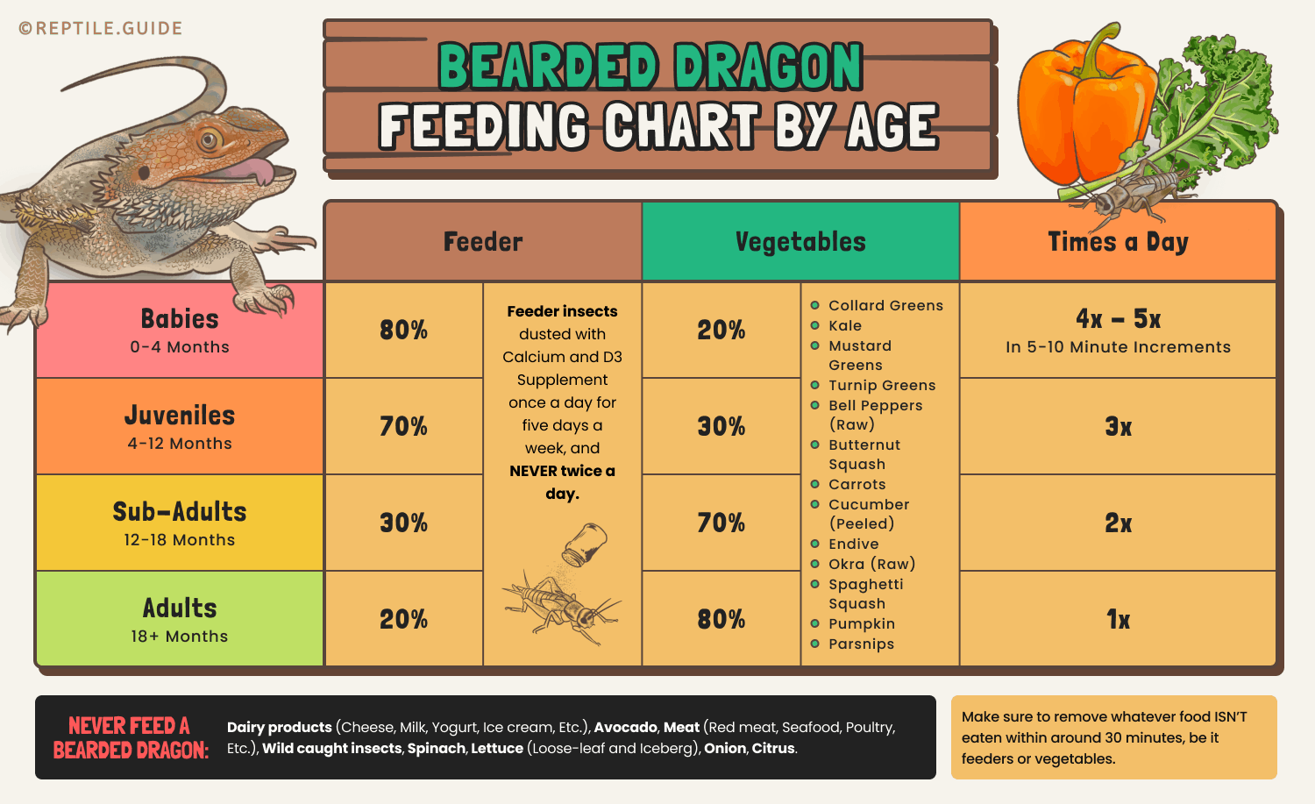
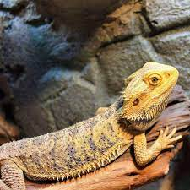
What specific foods do bearded dragons typically eat?
Bearded dragons enjoy live mealworms, waxworms and crickets that have been “gut loaded,” which means fed lizard-friendly vitamins and nutrients. Young beardies should eat once a day; adults may only need to dine every two days. If beardies don't finish their entire meal, try feeding them less next time.

Slide 7
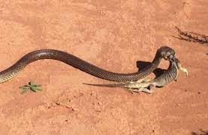
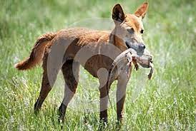
Do bearded dragons have any predators?
Central bearded dragons have a number of known predators, but none poses a significant threat to the species. These predators include introduced foxes, feral cats, gull-billed terns, birds of prey, black-headed pythons, dingo, and goannas (Australian monitor lizards).

Slide 8
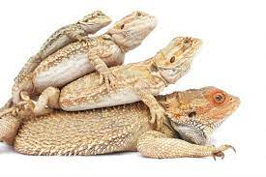
What is a typical food chain for your creature?
The bearded dragon is an omnivore. Its diet consists of beetles, some rodent species, lizards, and plant matter such as flowers, fruits, leaves, and flowers.
...

Slide 9
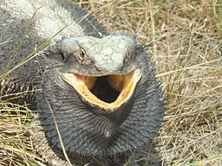
Do bearded dragons have any adaptations to help it survive?
There are a few adaptations that help bearded dragons survive in their environment. The “beard” itself is helpful because the bearded dragon can appear larger to scare away predators. ... Social gestures are another main adaptations of the bearded because they are very social animals.

Slide 10
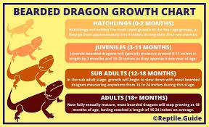
How much do bearded dragons weigh, and length?
A healthy and well-nourished adult Bearded Dragon will be 16 to 24 inches in length and 380 to 510 grams in weight. Hatchlings are born three inches long. They will grow two inches per month for their first three months.

Slide 11
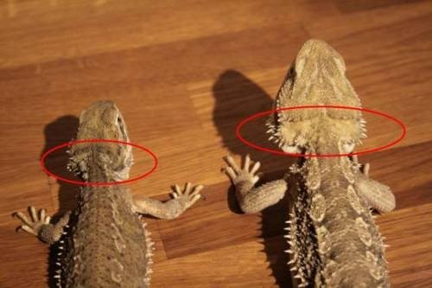
Do female and male bearded dragons weigh the same?
When grown, males are larger than females, with notably bigger heads. In front of the animal's vents, between their hind legs, you'll notice bigger femoral pores in the males. Bearded dragons use these pores to mark territories with their scents.
Female Male

Slide 12
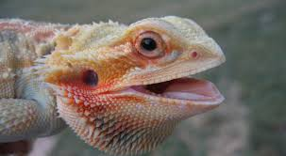
What is a lifespan of Bearded dragons?
Bearded dragons, or 'beardies', are one of the most popular lizards in captivity in the UK. They have a lifespan of 10 to 15 years, or even longer, so they're quite a commitment and it's important to keep them in a way that mimics the wild as much as possible.

Slide 13
8 Facts
1.
2.
3.
4.
5.
6.
7.
8.

Slide 14
Source
https://www.marylandzoo.org/animal/central-bearded-dragon/
https://www.rspca.org.uk/adviceandwelfare/pets/other/beardeddragon#:~:text=Caring%20for%20your%20bearded%20dragon,wild%20as%20much%20as%20possible.

