Slide 1
Southwest african lion
By karla hernandez
Notes:
1 Background Color
1 Title (or write the question)
1 Pictures
1 Include Transitions
0 Answering question using complete sentences (multiple sentences if needed to fully explain your answer)
1 Accuracy of information
5
African Lion should be capitalized.

Slide 2
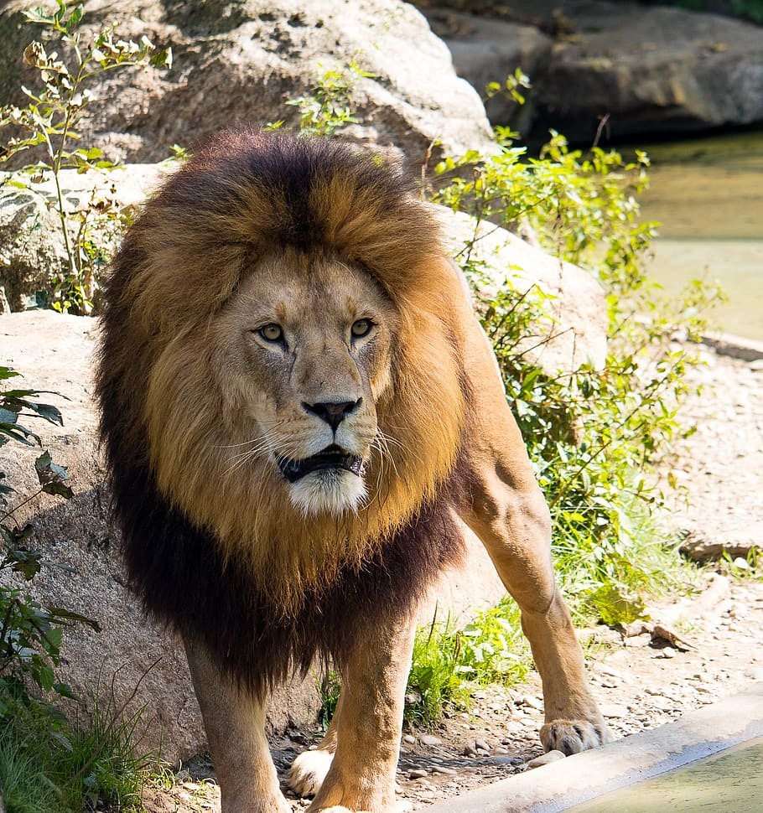
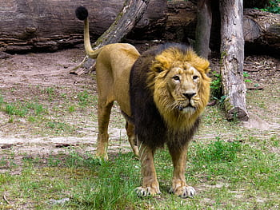
Where did lions come from
Genetic studies suggest that the lion evolved in eastern and southern africa.
Notes:
1 Background Color
1 Title (or write the question)
1 Pictures
1 Include Transitions
0 Answering question using complete sentences (multiple sentences if needed to fully explain your answer)
1 Accuracy of information
5
Question mark missing in title..

Slide 3
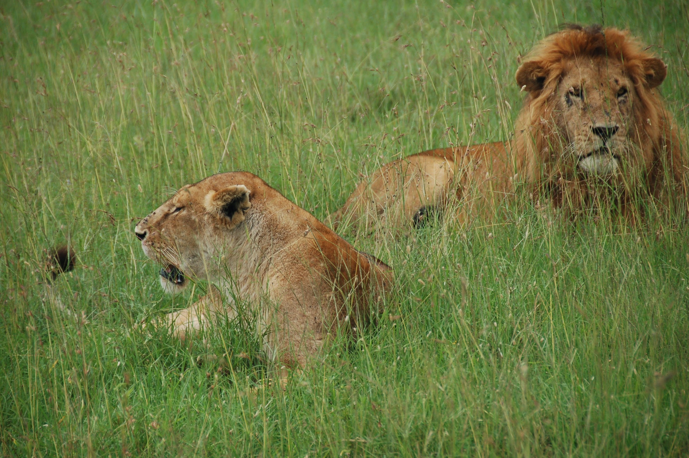
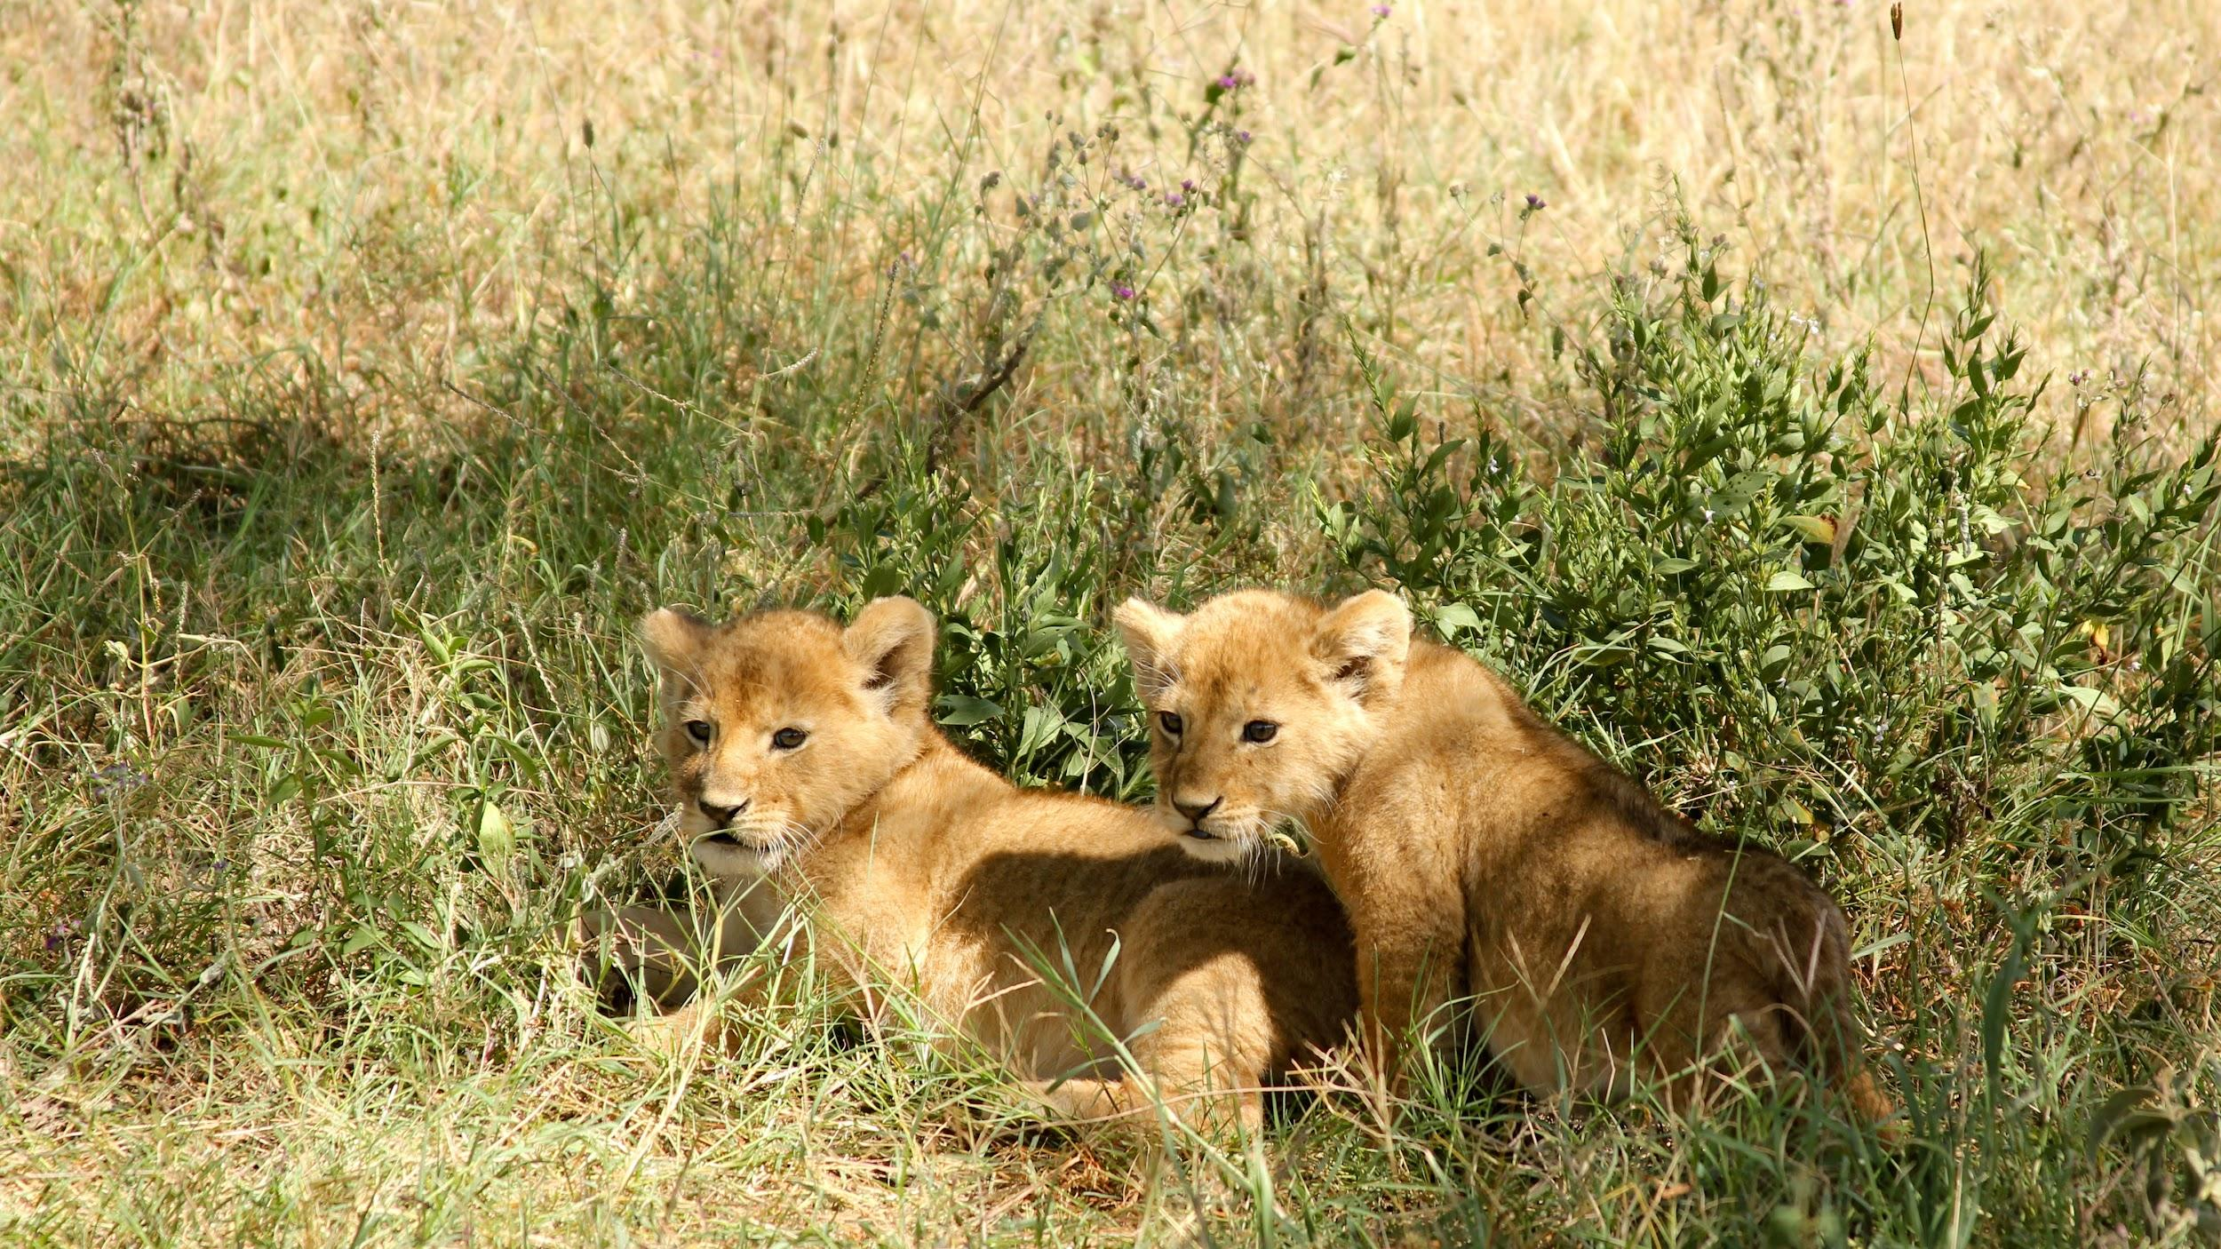
What type of consumer is the southwest african lion?
Southwest african lions mainly stick to the grassland, scrub, or open woodlands where they can more easily hunt their prey but they can live in most habitats aside from tropical rainforests and deserts.
Notes:
1 Background Color
1 Title (or write the question)
1 Pictures
1 Include Transitions
0 Answering question using complete sentences (multiple sentences if needed to fully explain your answer)
1 Accuracy of information
5
African lion should be capitalized.

Slide 4
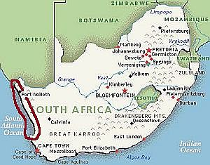
What is it like in the ecosystem?
The southwest african lion is found in the democratic republic of the congo, angola, namibia, and the western sections of zambia
The southwest african lions temperature rate is usually around 61 fahrenheit and 68 fahrenheit in the summer
Notes:
1 Background Color
1 Title (or write the question)
1 Pictures
1 Include Transitions
0 Answering question using complete sentences (multiple sentences if needed to fully explain your answer)
1 Accuracy of information
5
African lion should be capitalized.

Slide 5
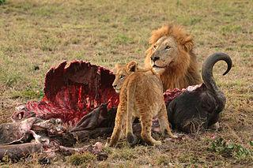
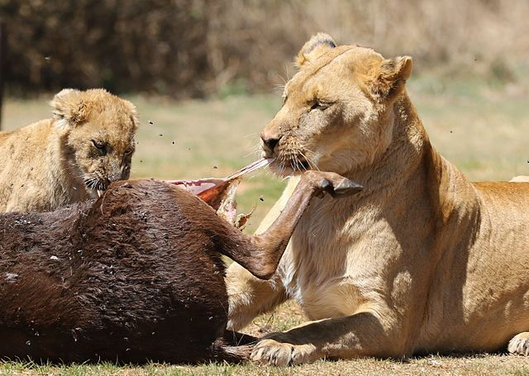
What type of consumer is the southwest african lion?
The southwest african lion is an omnivore meaning it eats plants and animals
Notes:
1 Background Color
1 Title (or write the question)
1 Pictures
1 Include Transitions
0 Answering question using complete sentences (multiple sentences if needed to fully explain your answer)
1 Accuracy of information
5
African lion should be capitalized.

Slide 6
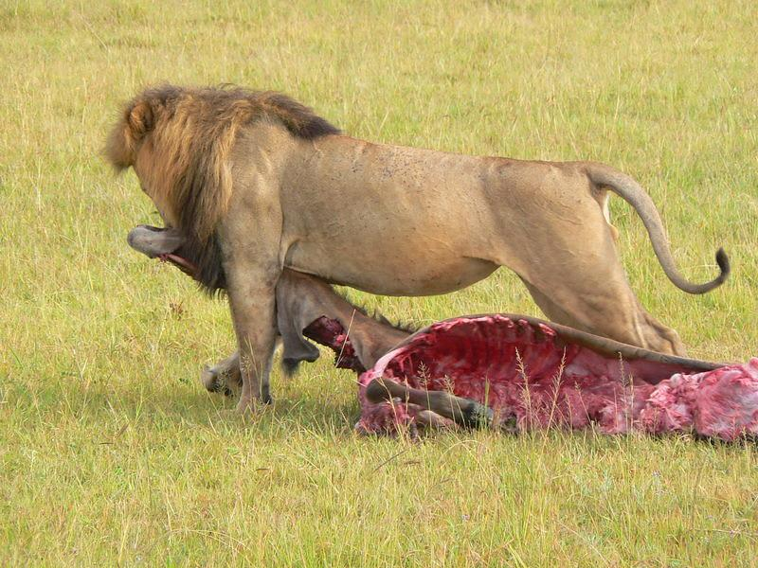
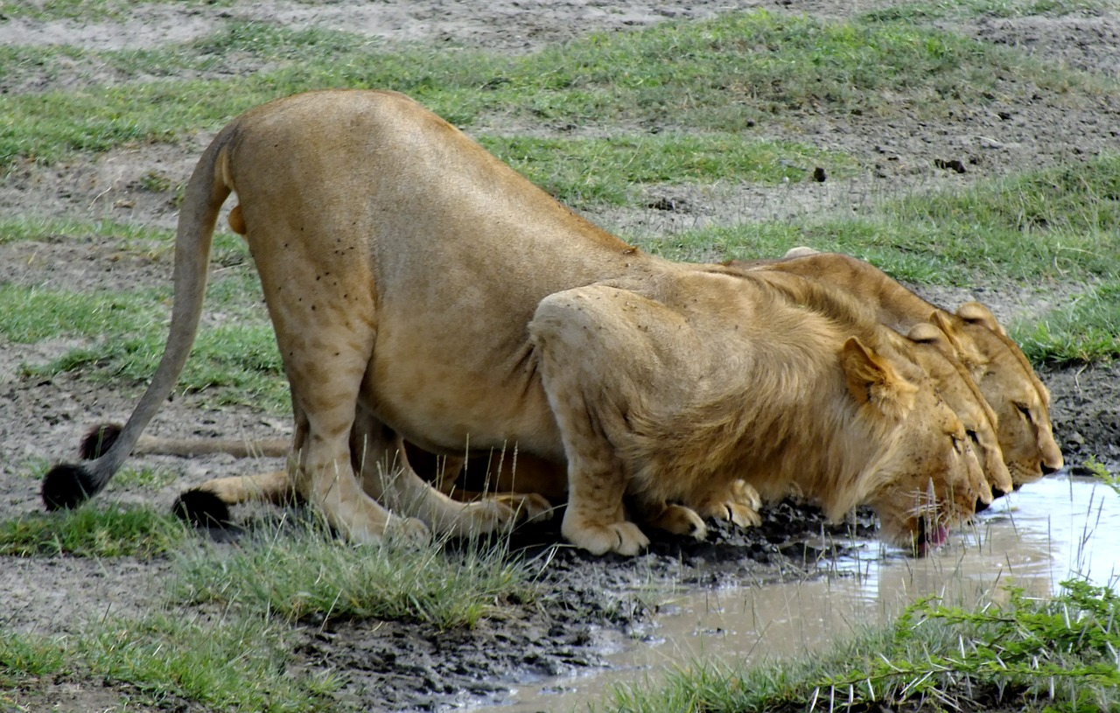
What specific food do southwest african lions eat?
Southwest african lions usually eat meat by hunting for their prey, they eat stuff like zebras, warthogs, antelopes, and wildebeests. They also eat vegetables and fruit.
Notes:
1 Background Color
1 Title (or write the question)
1 Pictures
1 Include Transitions
0 Answering question using complete sentences (multiple sentences if needed to fully explain your answer)
1 Accuracy of information
5
African lion should be capitalized.

Slide 7
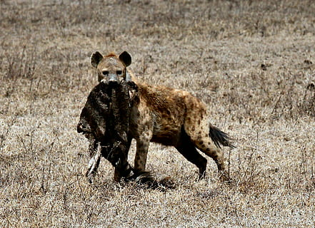
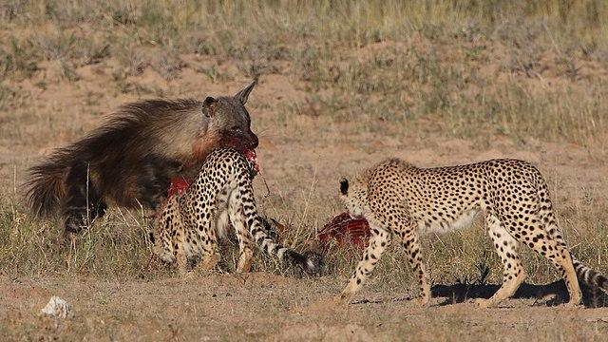
Does the southwest african lion have any predators?
In some cases hyenas (especially a pack/pride of hyenas at a carcass) and humans. Leopards, hyenas, african wild dog, cheetah, and jackal will kill lion cubs when the opportunity rises.
Notes:
1 Background Color
1 Title (or write the question)
1 Pictures
1 Include Transitions
0 Answering question using complete sentences (multiple sentences if needed to fully explain your answer)
1 Accuracy of information
5
African lion should be capitalized.

Slide 8
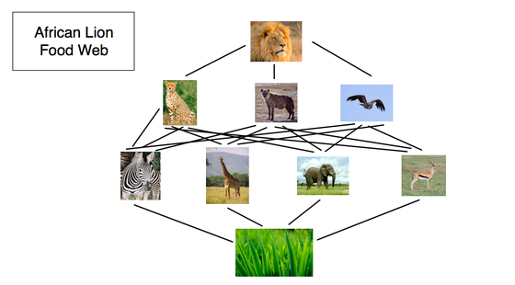
What is the typical food chain for southwest african lions?
The southwest african lion is usually at the top of the food chain.
Notes:
1 Background Color
1 Title (or write the question)
1 Pictures
1 Include Transitions
0 Answering question using complete sentences (multiple sentences if needed to fully explain your answer)
1 Accuracy of information
5
African lion should be capitalized.

Slide 9
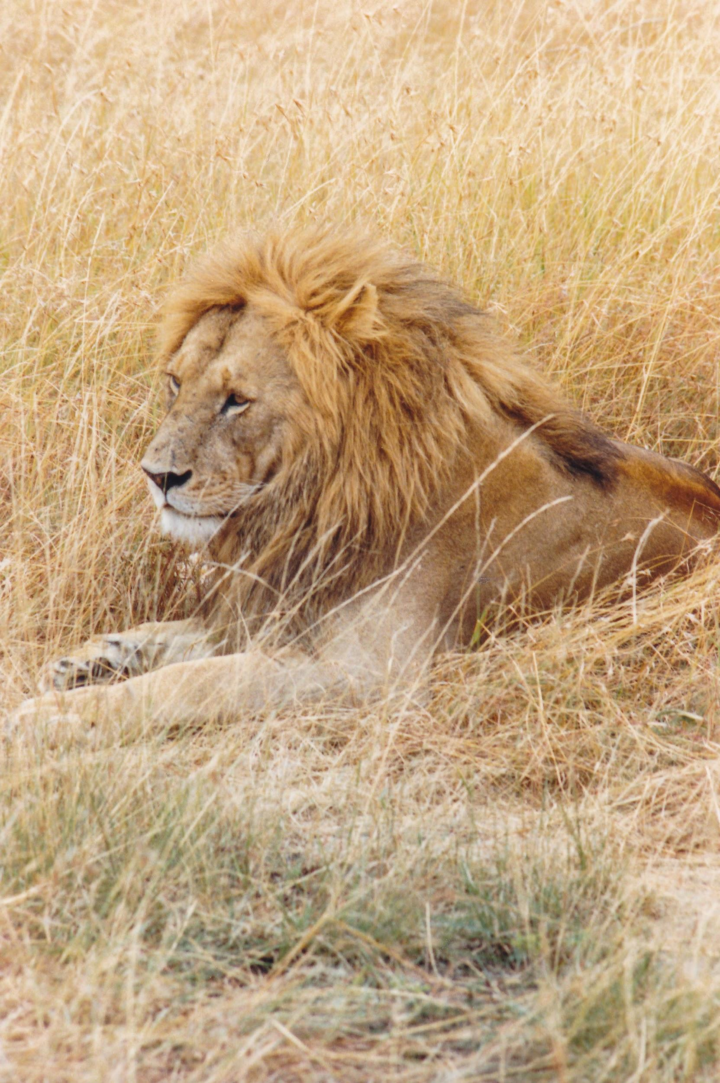
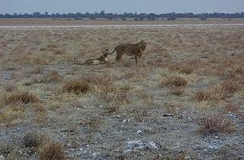
The southwest african lions adaptation
Their tan color allows them to blend in with the savannas, open woodlands and deserts in which they live
Notes:
1 Background Color
1 Title (or write the question)
1 Pictures
1 Include Transitions
0 Answering question using complete sentences (multiple sentences if needed to fully explain your answer)
1 Accuracy of information
5
Southwest African lion should be capitalized.
Also, the text is hard to read against the background.

Slide 10
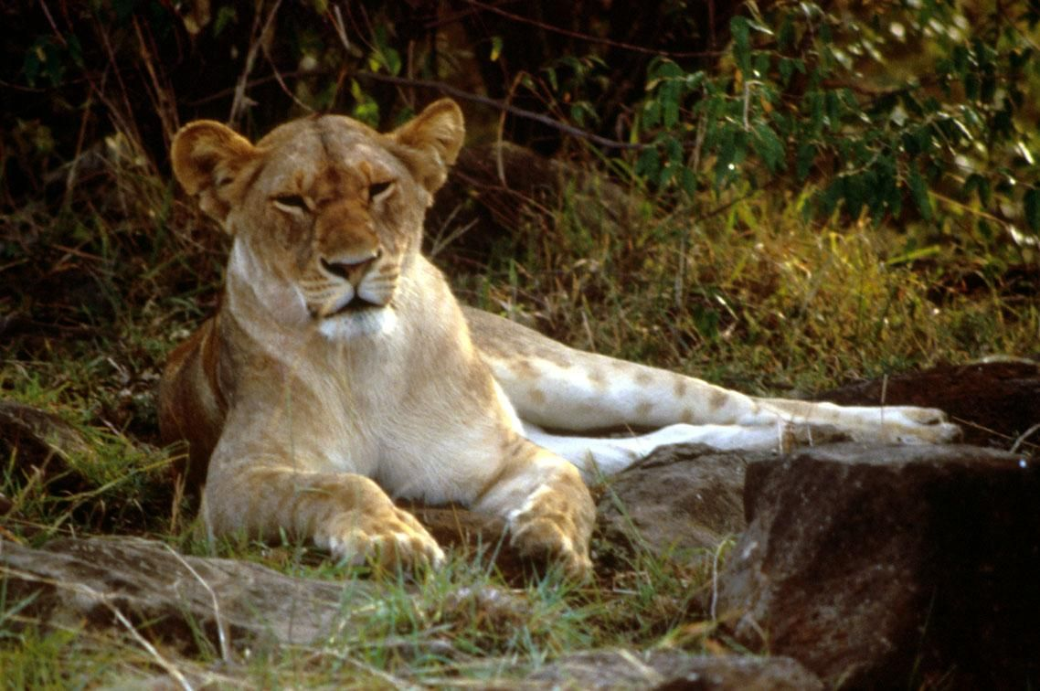
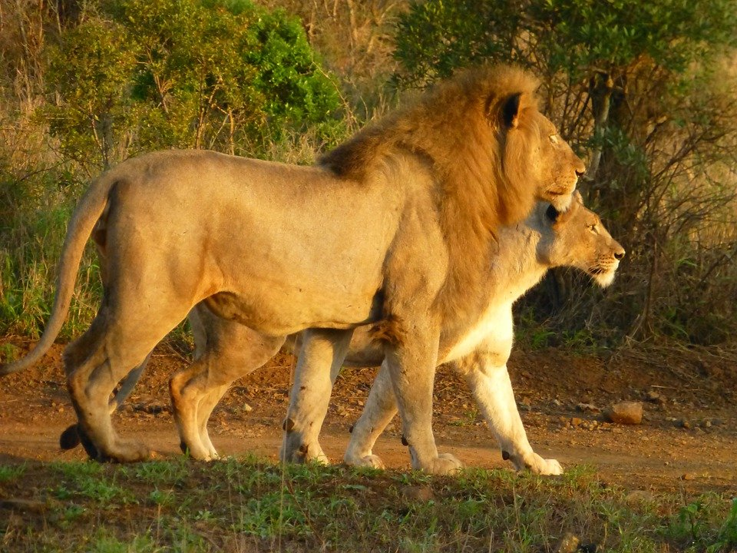
Features, and weight of southwest african lion.
Adult males weights around 309-534 (140-242 kilograms). The females weigh between 231-375 pounds (105-170 kilograms).
Fully matured adults males are usually around 8.2-9.8 feet (2.5 to 3 meters) long. The females are a it smaller they are around 7.5-8.5 feet (2.3 - 2.6 meters)
Notes:
1 Background Color
1 Title (or write the question)
1 Pictures
1 Include Transitions
0 Answering question using complete sentences (multiple sentences if needed to fully explain your answer)
1 Accuracy of information
5
African lion should be capitalized.

Slide 11
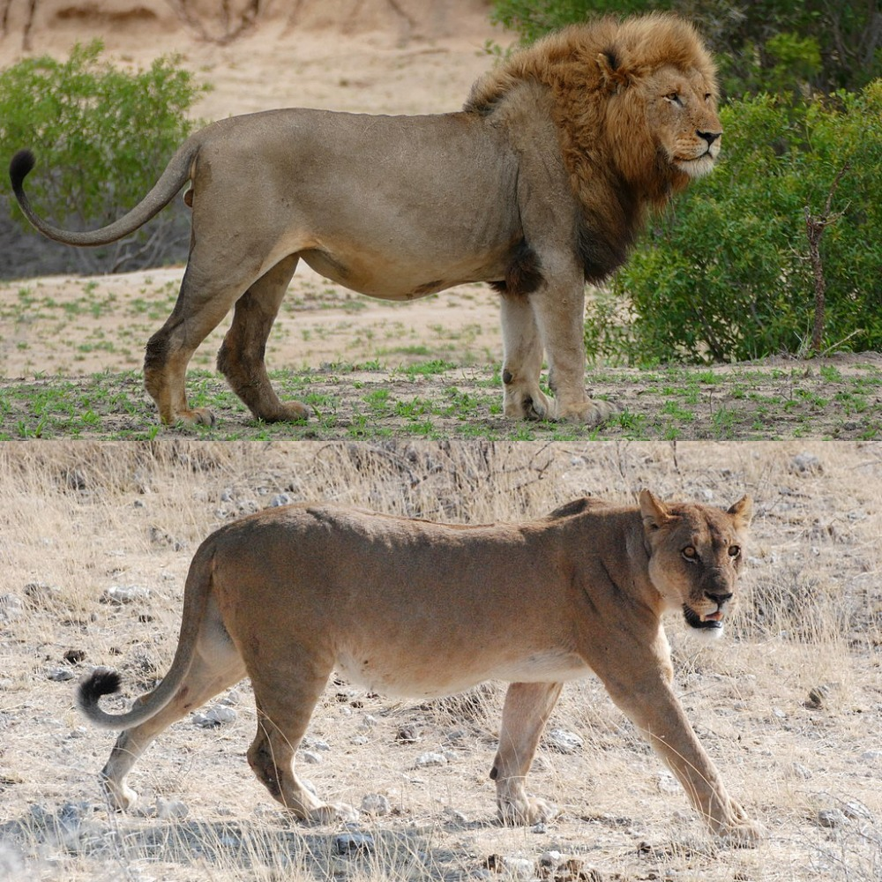
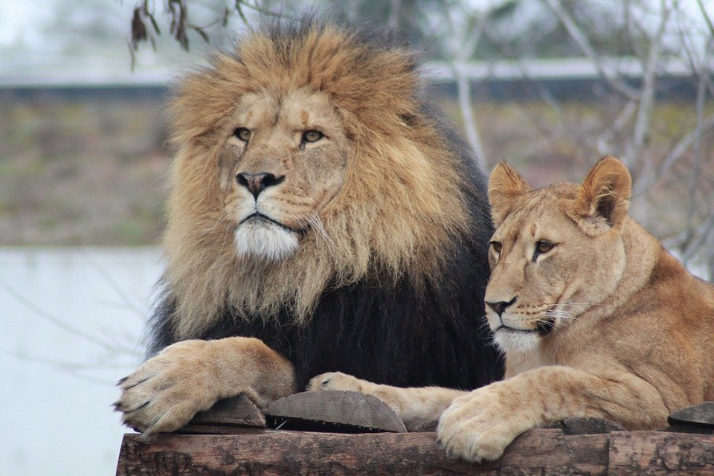
Do female and male southwest african weight the same?
No, male and female southwest african lions do not weigh the same. The females are a bit more underweight than the males. The females are also a bit more smaller in height than the males.
Notes:
1 Background Color
1 Title (or write the question)
1 Pictures
1 Include Transitions
0 Answering question using complete sentences (multiple sentences if needed to fully explain your answer)
1 Accuracy of information
5
African lion should be capitalized.Also the title is missing the word lion.

Slide 12
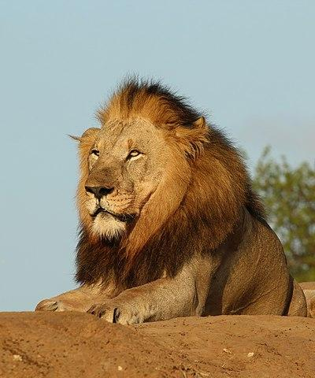
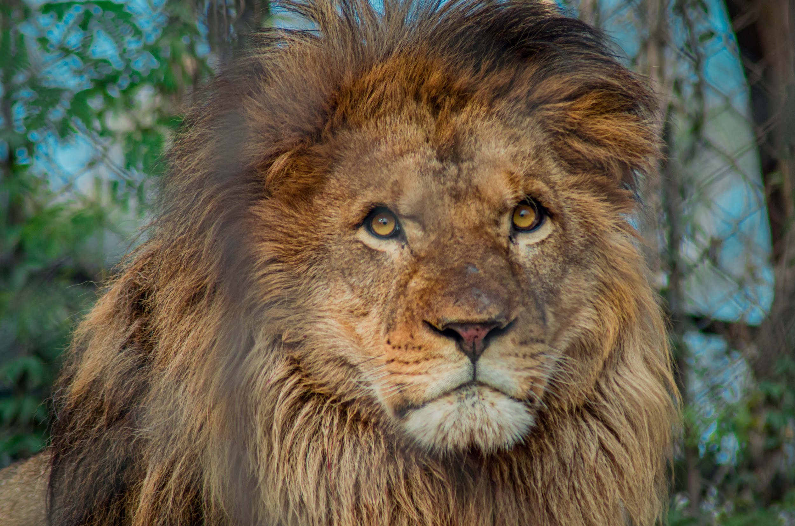
What is the lifespan of southwest african lion?
The lifespan of the lion is usually approximately 15 years. However in captivity, it can be as long as 30 years.
Notes:
1 Background Color
1 Title (or write the question)
1 Pictures
1 Include Transitions
0 Answering question using complete sentences (multiple sentences if needed to fully explain your answer)
1 Accuracy of information
5
African lion should be capitalized. Comma after However, …no comma after captivity.

Slide 13
Facts about the southwest african lion
Southwest african lions are one of the largest lion subspecies to be found today.
Nearly all wild lions live in africa, but one small population exists elsewhere
They can weigh 30 stone
They start off spotty
Cubs are reared together
Lions can get their water from plants
Lions can eat up to 40kg of meat in a single meal
They hunt during storms
Notes:
1 Background Color
1 Title (or write the question)
1 Pictures
1 Include Transitions
0 Answering question using complete sentences (multiple sentences if needed to fully explain your answer)
1 Accuracy of information
5
African lion should be capitalized. Punctuation at the end of each sentence.

Slide 14
Sources
https://www.wwf.org.uk/learn/fascinating-facts/lions
https://lionalert.org/african-lions/#:~:text=Lifespan%3A%20In%20the%20wild%2C%20the,all%20times%20of%20the%20year.
https://www.worldatlas.com/articles/southwest-african-lion-facts-animals-of-africa.html#:~:text=Adult%20male%20weights%20around%20309,when%20standing%20on%20all%20fours.
https://sciencing.com/lions-adapt-their-environment-4567536.html
Notes:
1 Background Color
1 Title (or write the question)
1 Pictures
1 Include Transitions
1 Answering question using complete sentences (multiple sentences if needed to fully explain your answer)
1 Accuracy of information
6

Slide 15
Sources part 2
https://study.com/academy/lesson/the-food-chain-of-a-lion.html
https://www.wildlifesouthafrica.com/blog/mammals-of-south-africa/lion-fact-file#:~:text=Enemies%3A,cubs%20when%20the%20opportunity%20rises.

