Slide 1
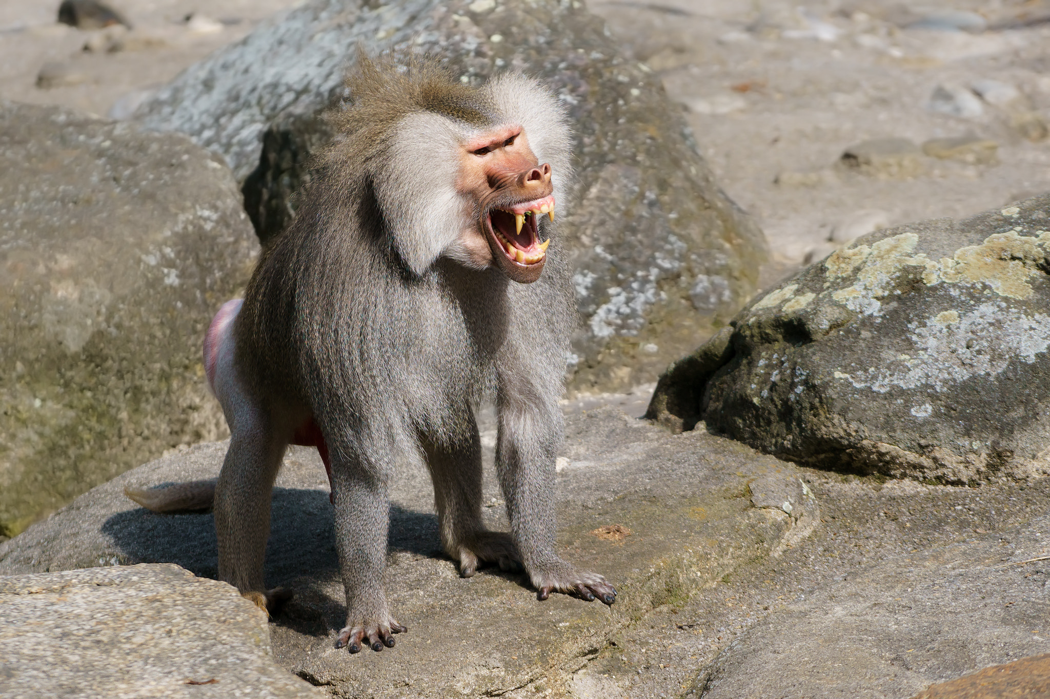
Baboon by keyaan khan
Notes:
6

Slide 2
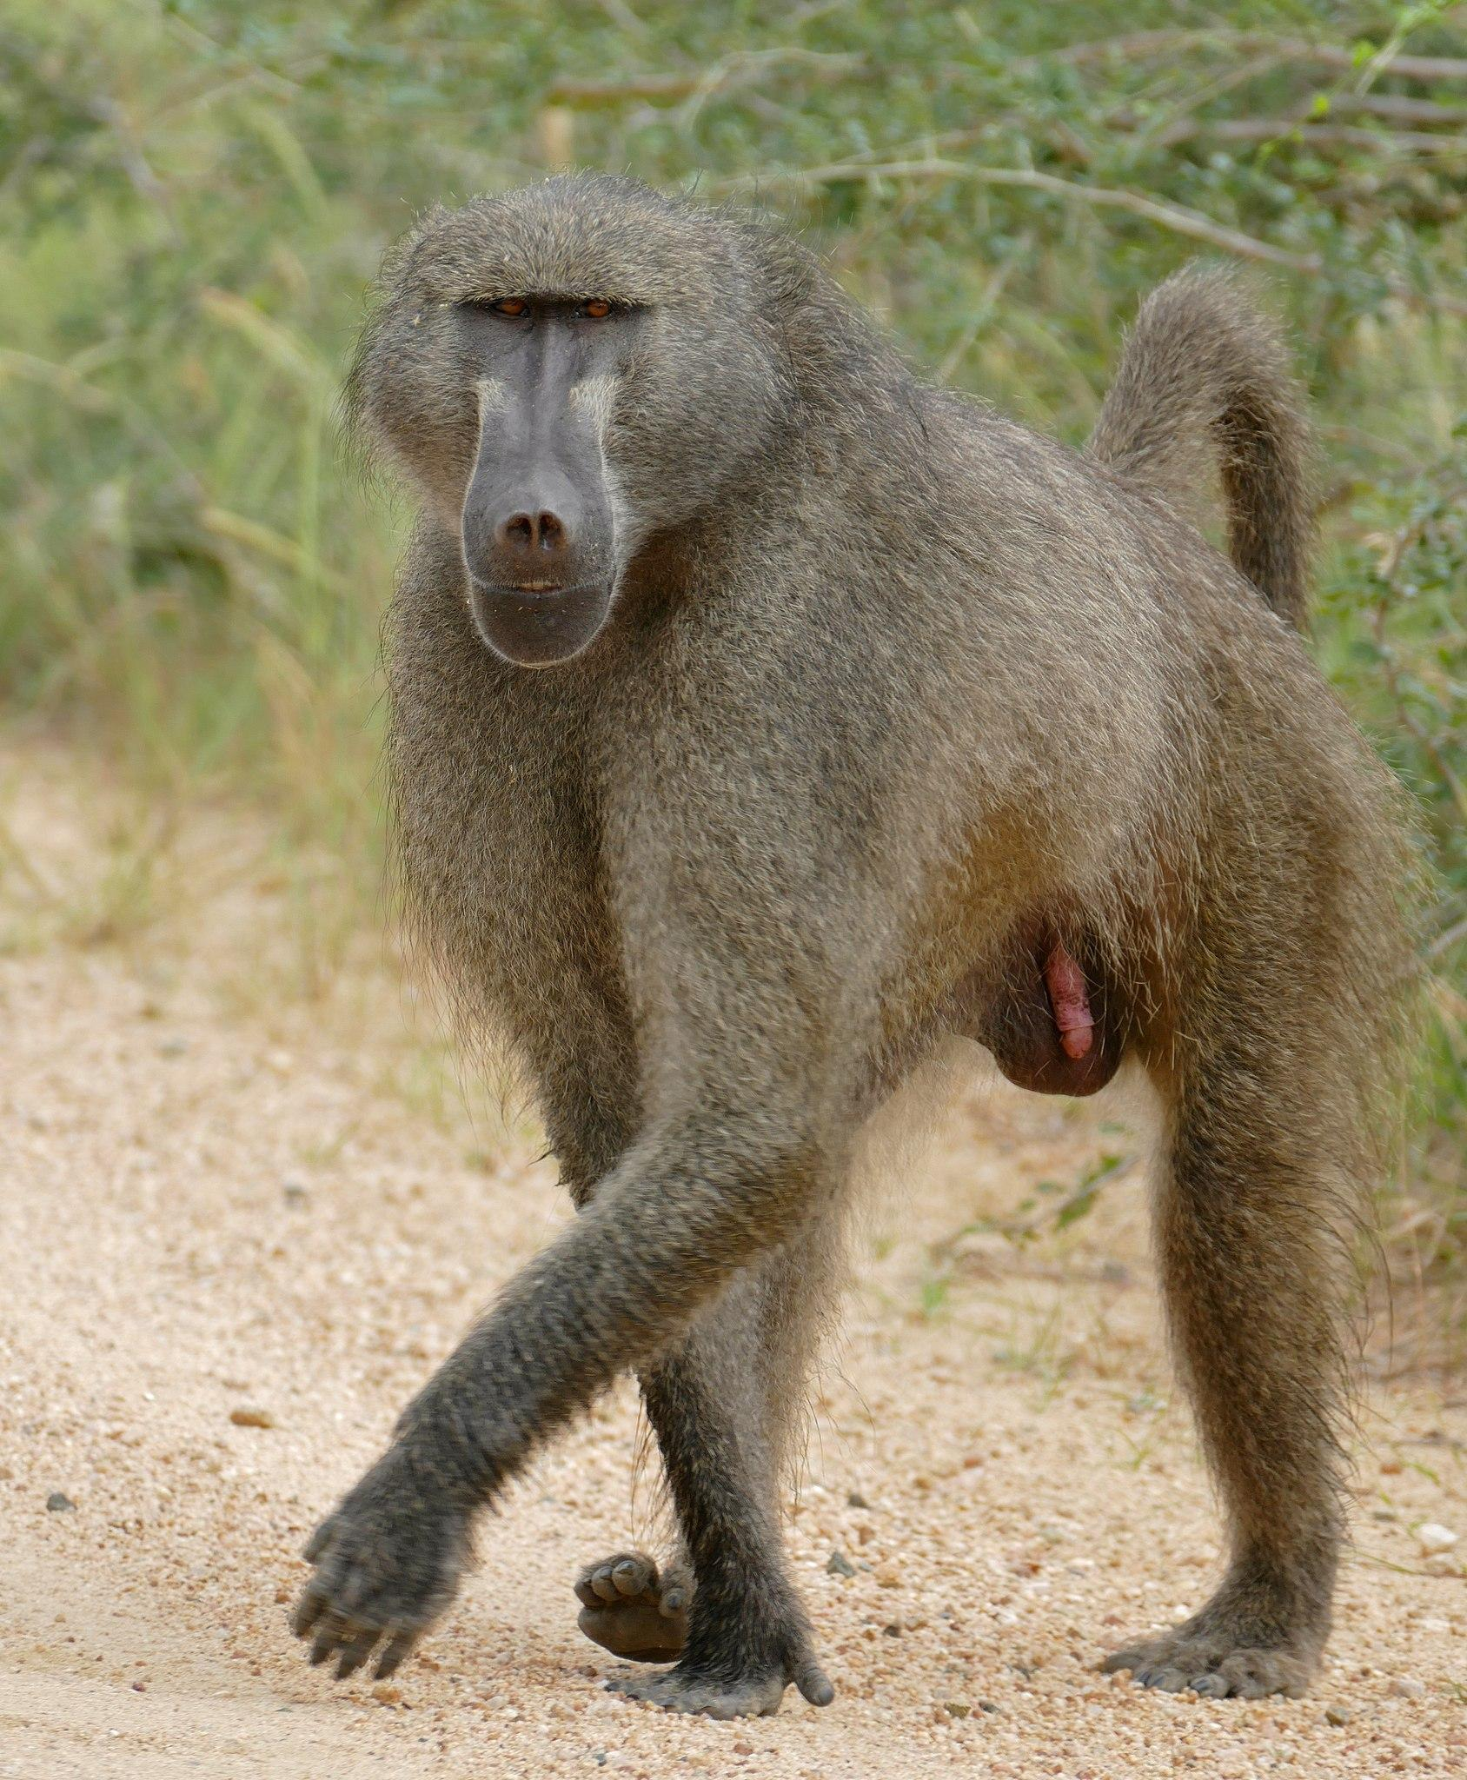
Where Baboon’s came from?
All extant baboons belong to the genus Papio. The genus is part of the tribe Papionini, within the family Cercopithecidae.
Notes:
1 Background Color
1 Title (or write the question)
0 Pictures
1 Include Transitions
0 Answering question using complete sentences (multiple sentences if needed to fully explain your answer)
1 Accuracy of information
4
Where Baboon’s came from. Capitalization errors.
Each slide other than the first on and the last one needs a picture. .

Slide 3
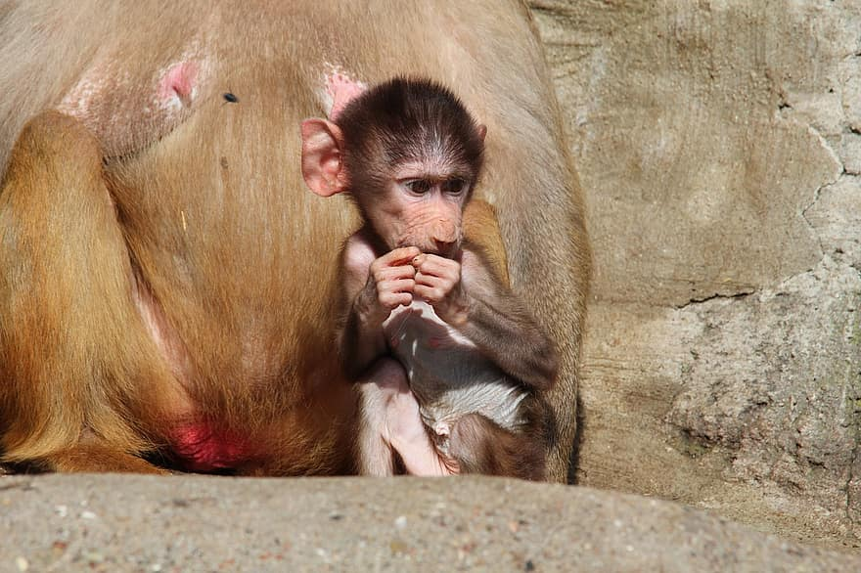
What ecosystem do they live in?
These monkeys prefer semi-arid habitats, like savannas and bushland , but some live in tropical forests and mountains.
Notes:
1 Background Color
1 Title (or write the question)
1 Pictures
1 Include Transitions
1 Answering question using complete sentences (multiple sentences if needed to fully explain your answer)
1 Accuracy of information
6

Slide 4
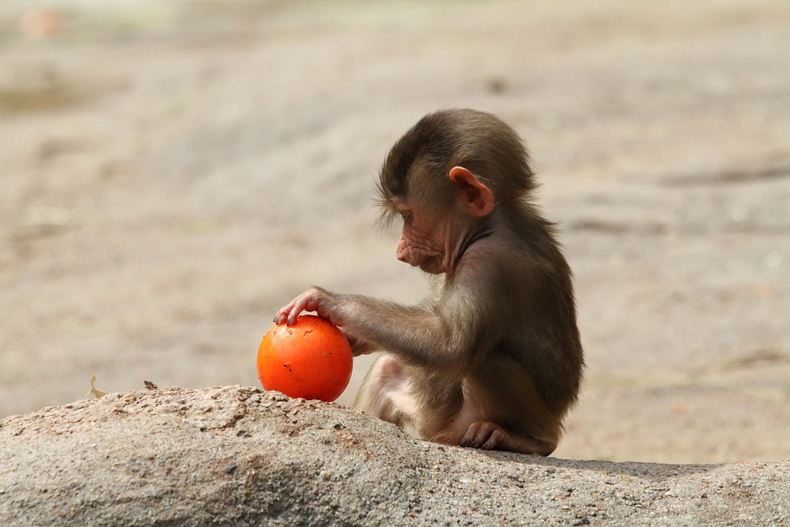
What type of consumer is your creature?
Herbivore.
Notes:
1 Background Color
1 Title (or write the question)
0 Pictures
1 Include Transitions
0 Answering question using complete sentences (multiple sentences if needed to fully explain your answer)
1 Accuracy of information
4
There should be a questionmark after the title
Each slide other than the first on and the last one needs a picture. .

Slide 5
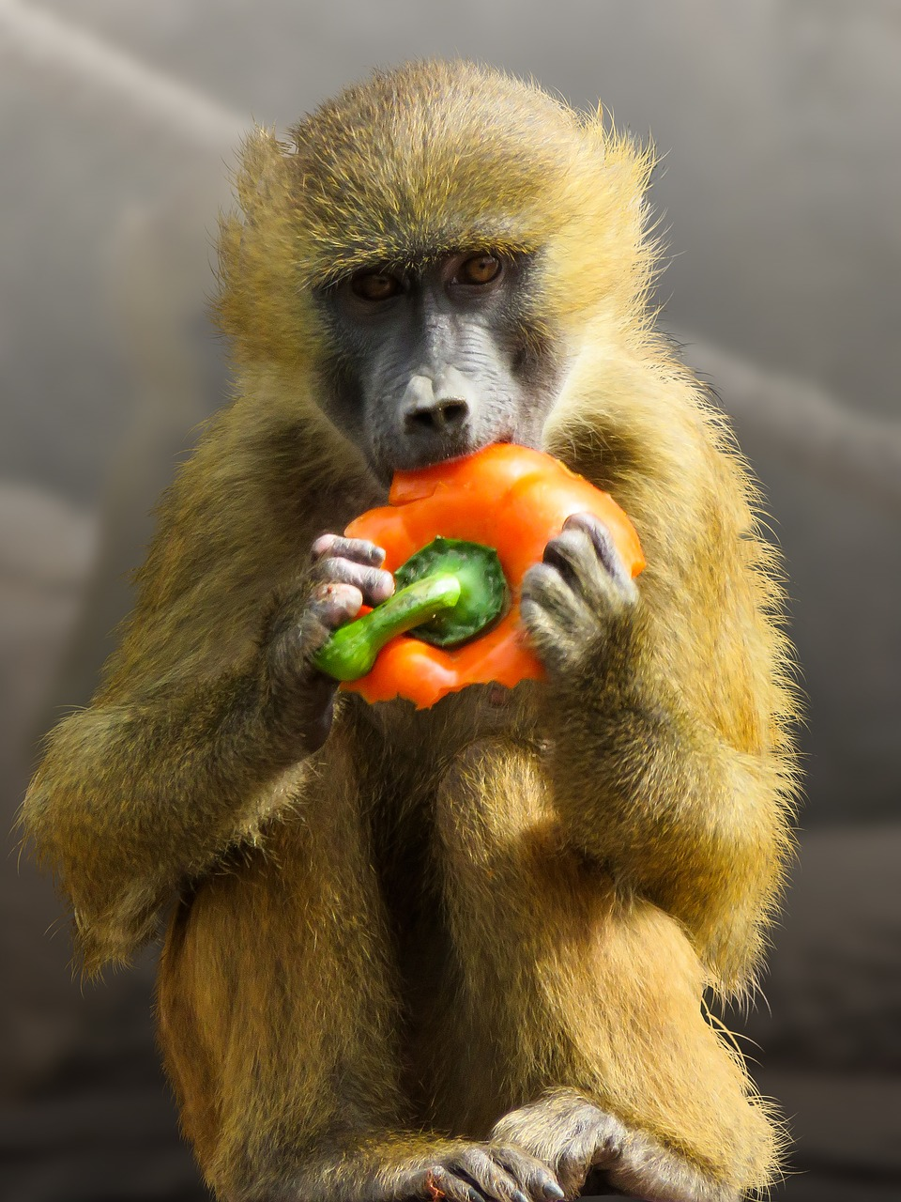
What specific foods does your creature typically eat?
They eat fruits, grasses, seeds, bark, and roots, but also have a taste for meat. They eat birds, rodents, and even the young of larger mammals, such as antelopes and sheep.
Notes:
1 Background Color
1 Title (or write the question)
1 Pictures
1 Include Transitions
0 Answering question using complete sentences (multiple sentences if needed to fully explain your answer)
1 Accuracy of information
5
The title should be larger font than the paragraph.
.

Slide 6
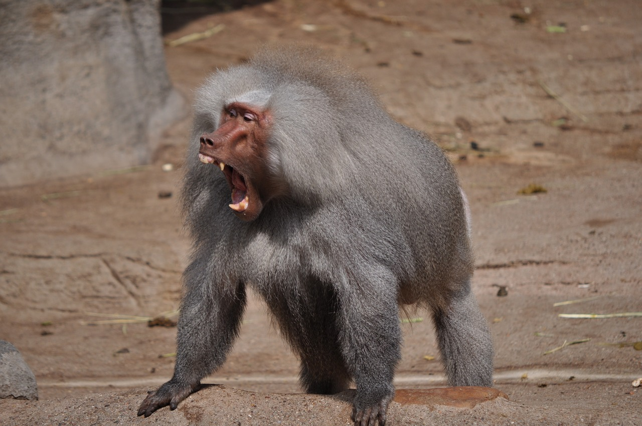
Does your creature have any predators?
The Baboon's predators are humans, cheetahs and leopards.
Notes:
1 Background Color
1 Title (or write the question)
1 Pictures
1 Include Transitions
0 Answering question using complete sentences (multiple sentences if needed to fully explain your answer)
1 Accuracy of information
5
There should be a question mark after the title.
Baboon’s should be capitalized

Slide 7
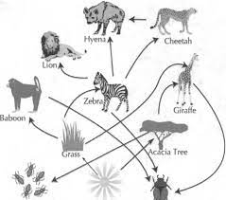
What is a typical food chain for your creature?
Notes:
1 Background Color
1 Title (or write the question)
1 Pictures
1 Include Transitions
1 Answering question using complete sentences (multiple sentences if needed to fully explain your answer)
1 Accuracy of information
6

Slide 8
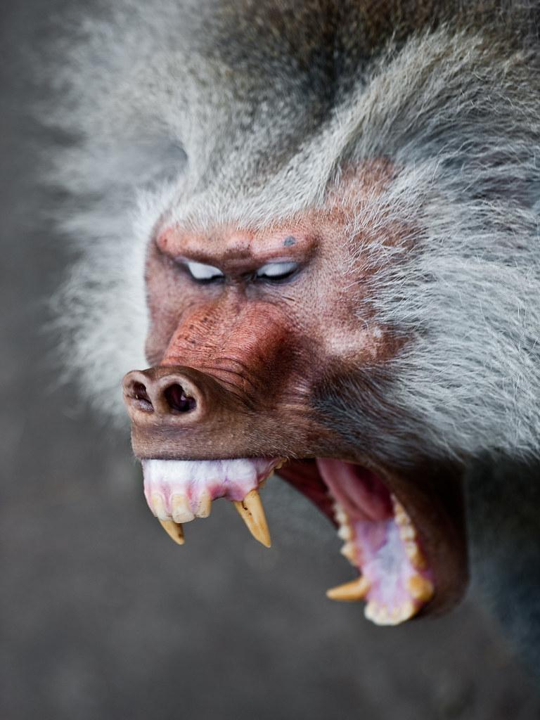
Does your creature have any specific adaptations to help it survive?
Baboons have very long fangs that help them to not just catch and eat prey, but defend themselves from predators.
Notes:
1 Background Color
1 Title (or write the question)
1 Pictures
1 Include Transitions
0 Answering question using complete sentences (multiple sentences if needed to fully explain your answer)
1 Accuracy of information
5
Baboons. Capitalization errors.
The title needs to be larder font than the paragraph.

Slide 9
What does your creature look like, how much does it weigh, and how tall is it?
They have hair on either side of their faces and large, hairless bottoms that can turn red.
A Baboon is 2.3 feet tall
33 to 82 pounds
Notes:
1 Background Color
1 Title (or write the question)
0 Pictures
1 Include Transitions
0 Answering question using complete sentences (multiple sentences if needed to fully explain your answer)
1 Accuracy of information
4
Justify the text. Usie periods at the end of each sentence.
Where Baboon’s came from. Capitalization errors.

Slide 10
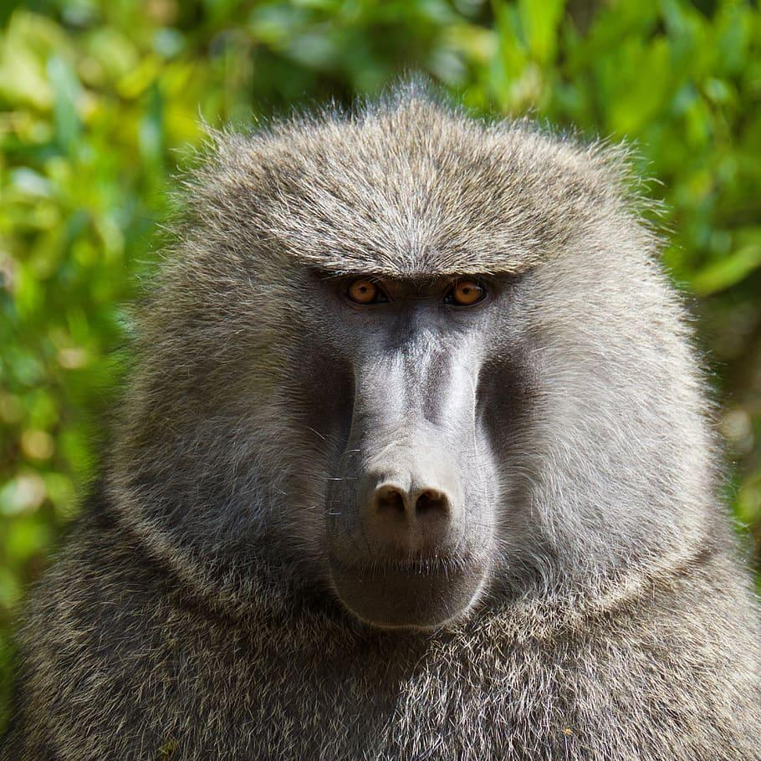
Do males and females of your creature weigh the same and are the same size? No they are not the same
Male:is 44-66 lb
Female : is 20-33 lb
Males are physically bigger than the females.
Baboon males have an average height of 3.94 ft
Females measure 3.20 ft
Notes:
1 Background Color
1 Title (or write the question)
0 Pictures
1 Include Transitions
0 Answering question using complete sentences (multiple sentences if needed to fully explain your answer)
1 Accuracy of information
4
And are they the same size…. And punctuation at the end of the sentences.
Each slide other than the first on and the last one needs a picture. .

Slide 11

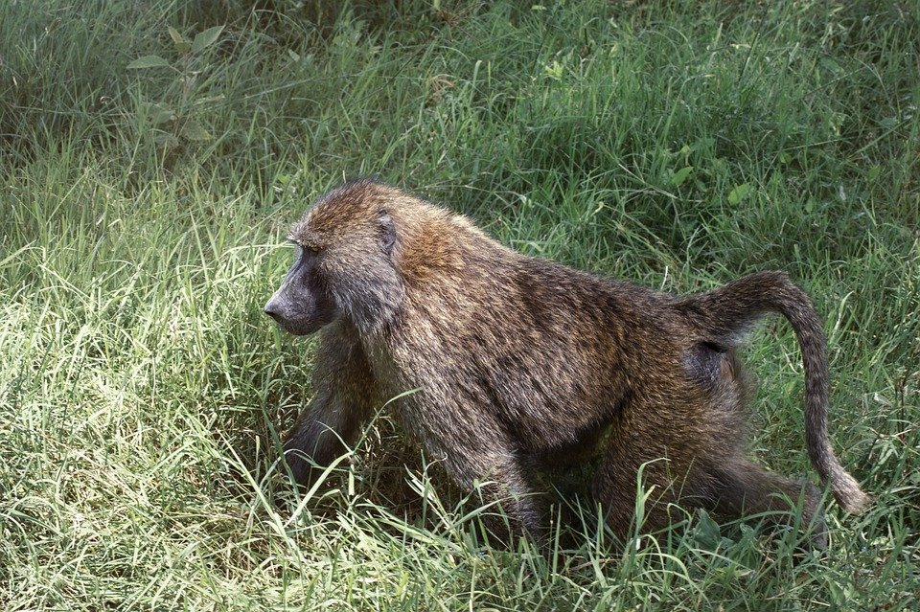
What is the lifespan of a Baboon?
A lifespan for a baboon is 35-45 years.
Notes:
1 Background Color
1 Title (or write the question)
1 Pictures
1 Include Transitions
0 Answering question using complete sentences (multiple sentences if needed to fully explain your answer)
1 Accuracy of information
5
Lifespan is one word. Punctuation at the end of each sentence.

Slide 12
8 facts about a Baboon
Baboons have loose cheeks which allow them to gather food while foraging to eat later once they return to an area of safety
A little before a baboon turns 2 years old, it starts becoming a juvenile and grows one pound every three months,
A Baboon can travel at speeds of up to 30 miles per hour.
A male baboon's hands and arms are said to be roughly eight times as powerful as a male human's.
Baboon fangs can reach up to two inches long
There 5 different types of baboons
Baboons have long, dog-like muzzle and strong jaw equipped with sharp canines.
Baboons use 30 different sounds for communication.
Notes:
1 Background Color
1 Title (or write the question)
1 Pictures
1 Include Transitions
0 Answering question using complete sentences (multiple sentences if needed to fully explain your answer)
1 Accuracy of information
5
Punctuation. You have different size fonts in the same paragraph make them all the same size.
Problem sith plural and ownership. Plural is Baboons, ownership is Baboon’s

Slide 13
This is the end of my Baboon slides
https://www.nationalgeographic.com › https://www.softschools.com
Notes:
1 Background Color
0 Title (or write the question)
1 Pictures
1 Include Transitions
1 Answering question using complete sentences (multiple sentences if needed to fully explain your answer)
1 Accuracy of information
5
Missing the title.
Also, you should have no less than 14 slides.

