Slide 1
volcano rabbit
By: Miley Barajas
Notes:
1 Background Color
1 Title (or write the question)
1 Pictures
0 Include Transitions
0 Answering question using complete sentences (multiple sentences if needed to fully explain your answer)
1 Accuracy of information
4
Volcano Rabbit should be capitalized. Missing the transition. .

Slide 2
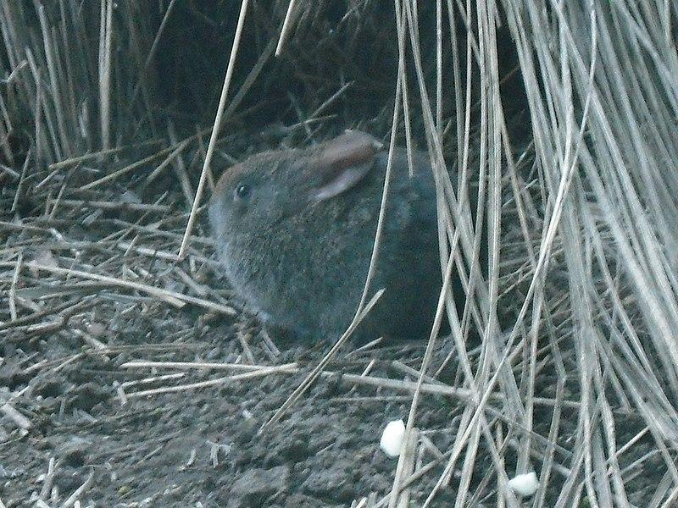
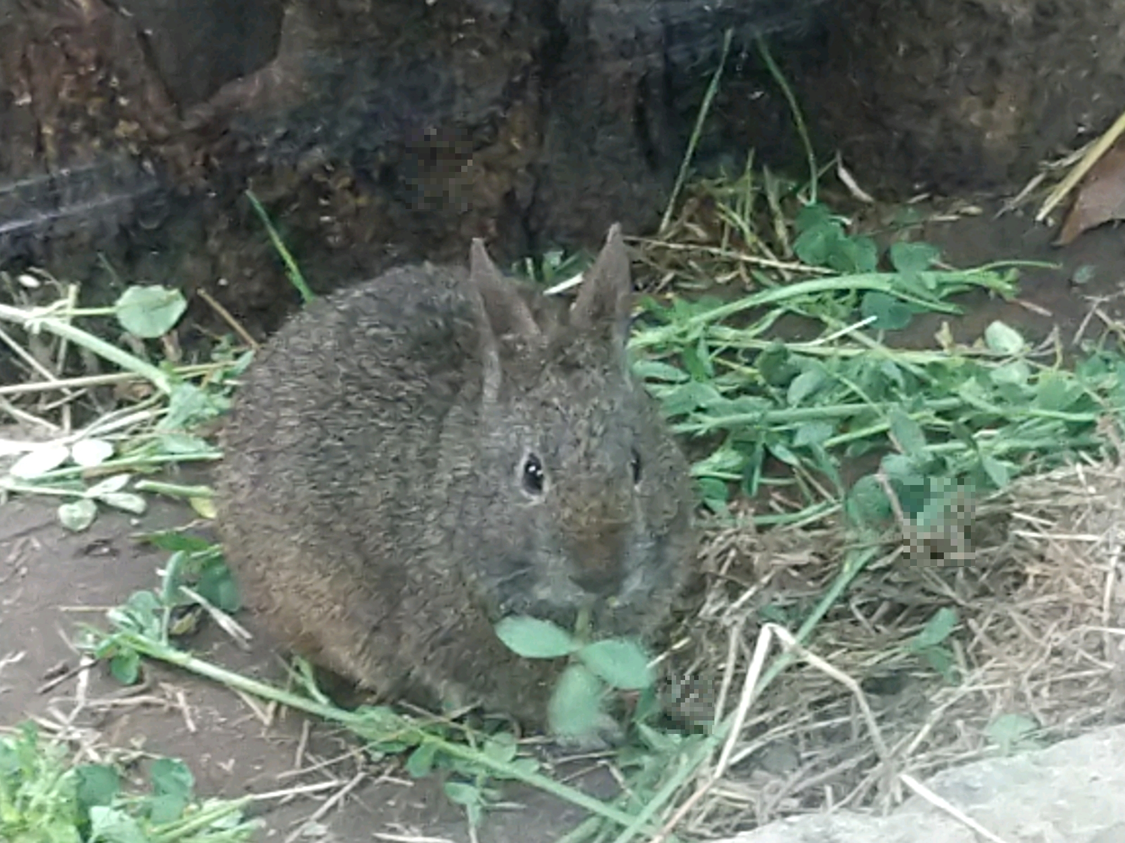
Where do volcano rabbits come from ?
Volcano rabbits are an endangered species endemic to mexico. Specifically, the rabbits is native to four volcanoes just south and east of mexico city, the largest of these volcanic regions is within the izta-popo national park, other areas include the chichinautzin and pelado volcanos.
Notes:
1 Background Color
1 Title (or write the question)
1 Pictures
1 Include Transitions
0 Answering question using complete sentences (multiple sentences if needed to fully explain your answer)
1 Accuracy of information
5
Volcano rabbit should be capitalized. Missing the transition.
Delete the space before the question mark. Mexico shouldbe Capitalized Mexico City should be capitalized. Run on sentence.. Start a new sentence at ..The largest of these…. Izta-popo National Park needs to be Capitalized. Chichinautzin and Pelado volcanos needs to be capitalized. Remember if it is the proper name of something it needs tobe Capitalized. .

Slide 3
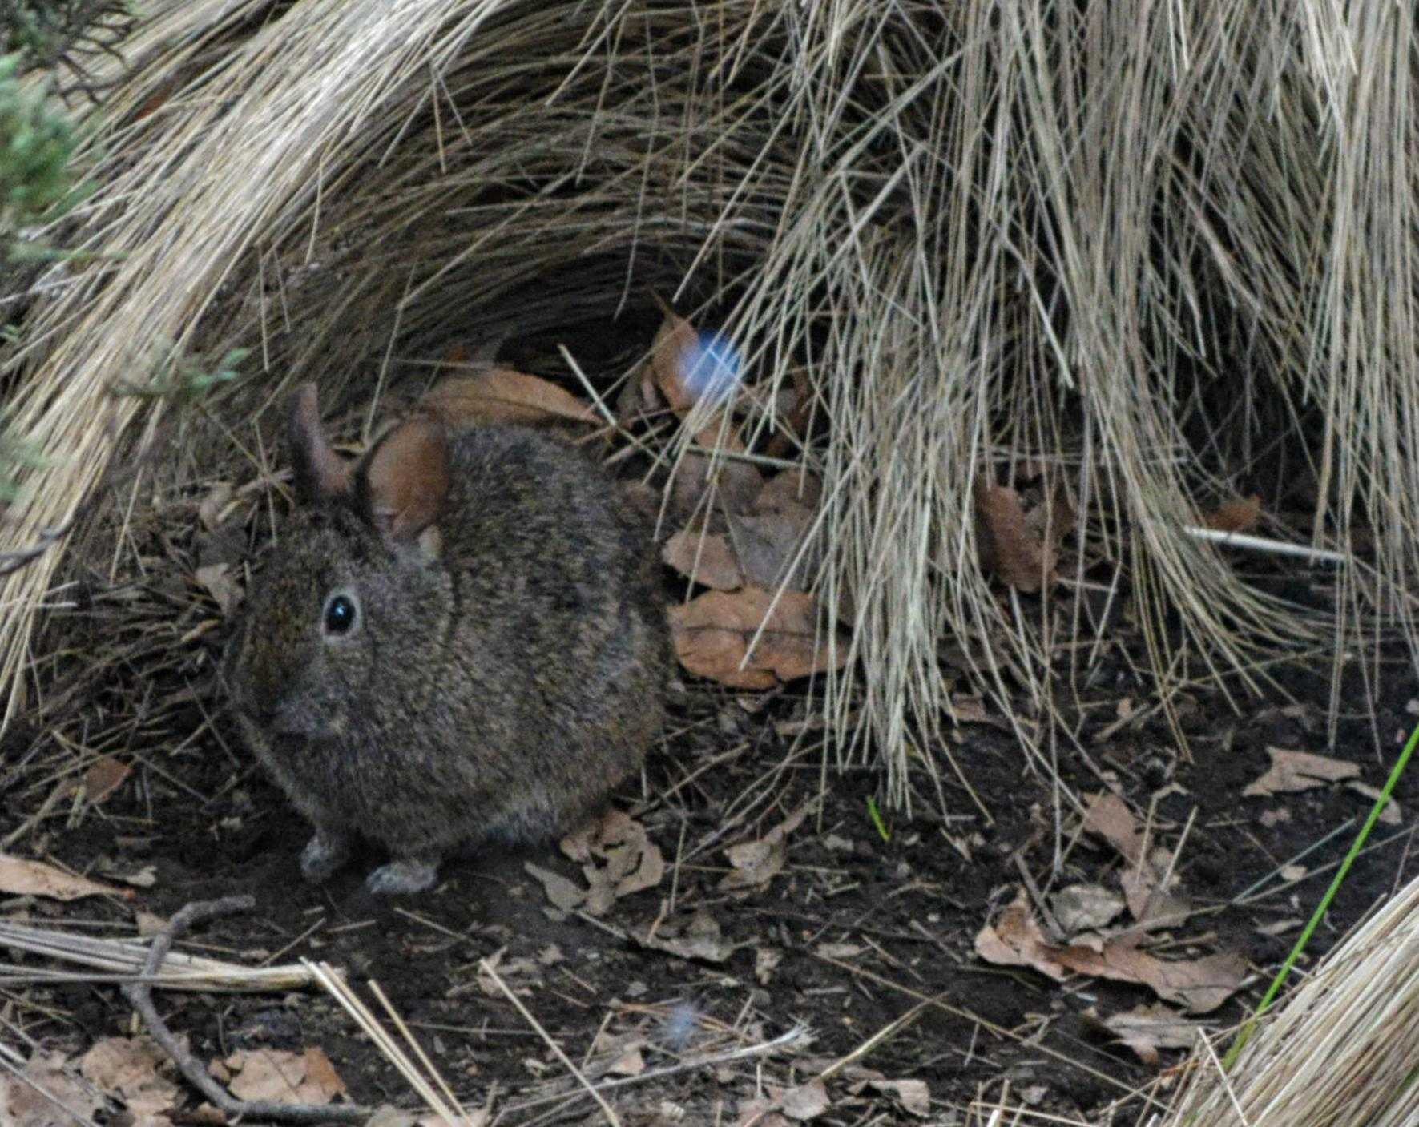
What is it like in the ecosystem
Volcano rabbits live on the slopes of just four extinct volcanoes in central mexico, each about 45 minutes away from mexico city. Over the course of the year, the temperature from 43°F to 80°F and is rarely below 37°F
Notes:
1 Background Color
1 Title (or write the question)
1 Pictures
1 Include Transitions
0 Answering question using complete sentences (multiple sentences if needed to fully explain your answer)
1 Accuracy of information
5
There should be a question mark after ecosystem.. Mexico needs capitalized, Mexico City.. there needs to be a period at the end of the sentence. .

Slide 4
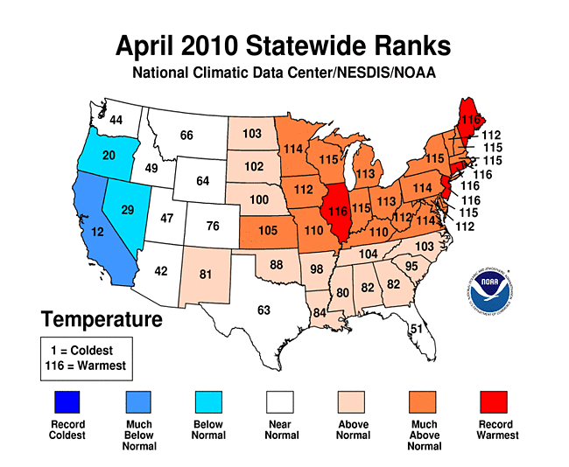
uh
The climate in mexico is tropical with rainy and dry season and little temperature fluctuate from season to season. The temperature in all areas of mexico typically ranges between 50° F and 90°F throughout the year
Notes:
1 Background Color
1 Title (or write the question)
1 Pictures
1 Include Transitions
0 Answering question using complete sentences (multiple sentences if needed to fully explain your answer)
1 Accuracy of information
5
The title need to be fised “uh” will not do. Mexico needs capitalized,. there needs to be a period at the end of the sentence. .

Slide 5
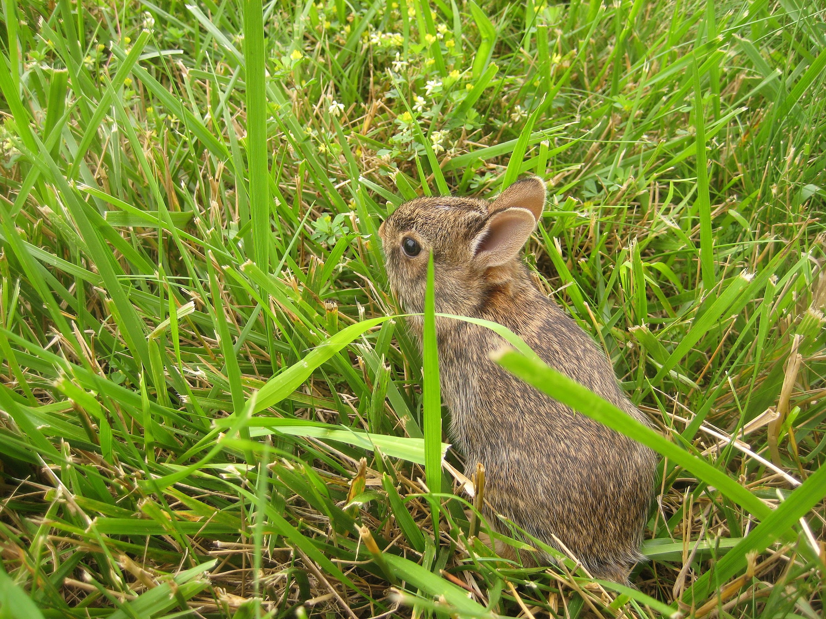
What type of consumer is a volcano rabbit
Volcano rabbits are herbivores graminivores and feed primarily on grasses which are abundant during wet seasons. During the dry season, they typically feed on shrubs and small trees, as well as other woody plants. Their diet also includes leaves, foliage, and flowers.
Notes:
1 Background Color
1 Title (or write the question)
1 Pictures
1 Include Transitions
0 Answering question using complete sentences (multiple sentences if needed to fully explain your answer)
1 Accuracy of information
5
Volcano rabbit needs to be capitalized, Also, there should be a question mark after rabbit. . .

Slide 6
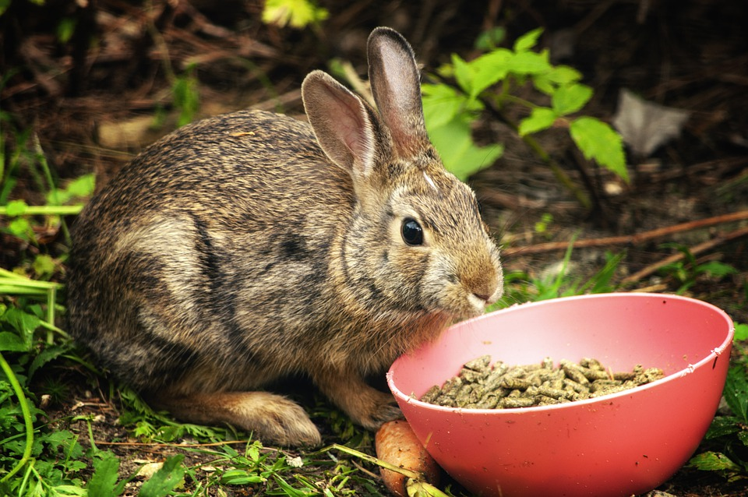
What volcano rabbits eat
Volcano rabbits consume leaves, foliage, and flowers indiscriminately under poor conditions, as habitat loss has eliminated much of their food sources. The volcano rabbit feeds primarily on grasses such as Festuca amplissima, Muhlenbergia macroura, Stipa ichu, and Eryngium rosei.
Notes:
1 Background Color
1 Title (or write the question)
1 Pictures
1 Include Transitions
0 Answering question using complete sentences (multiple sentences if needed to fully explain your answer)
1 Accuracy of information
5
Volcano rabbit needs to be capitalized, Also, there should be a question mark after eat. . .

Slide 7
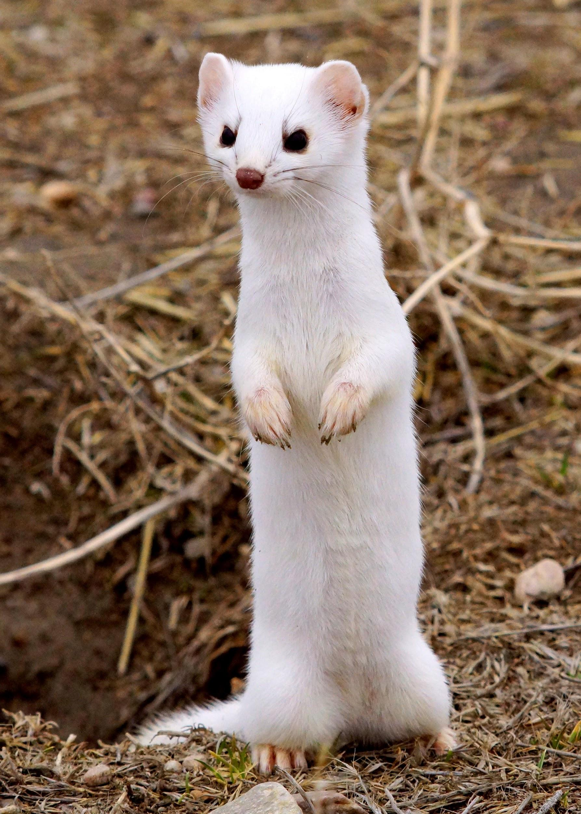
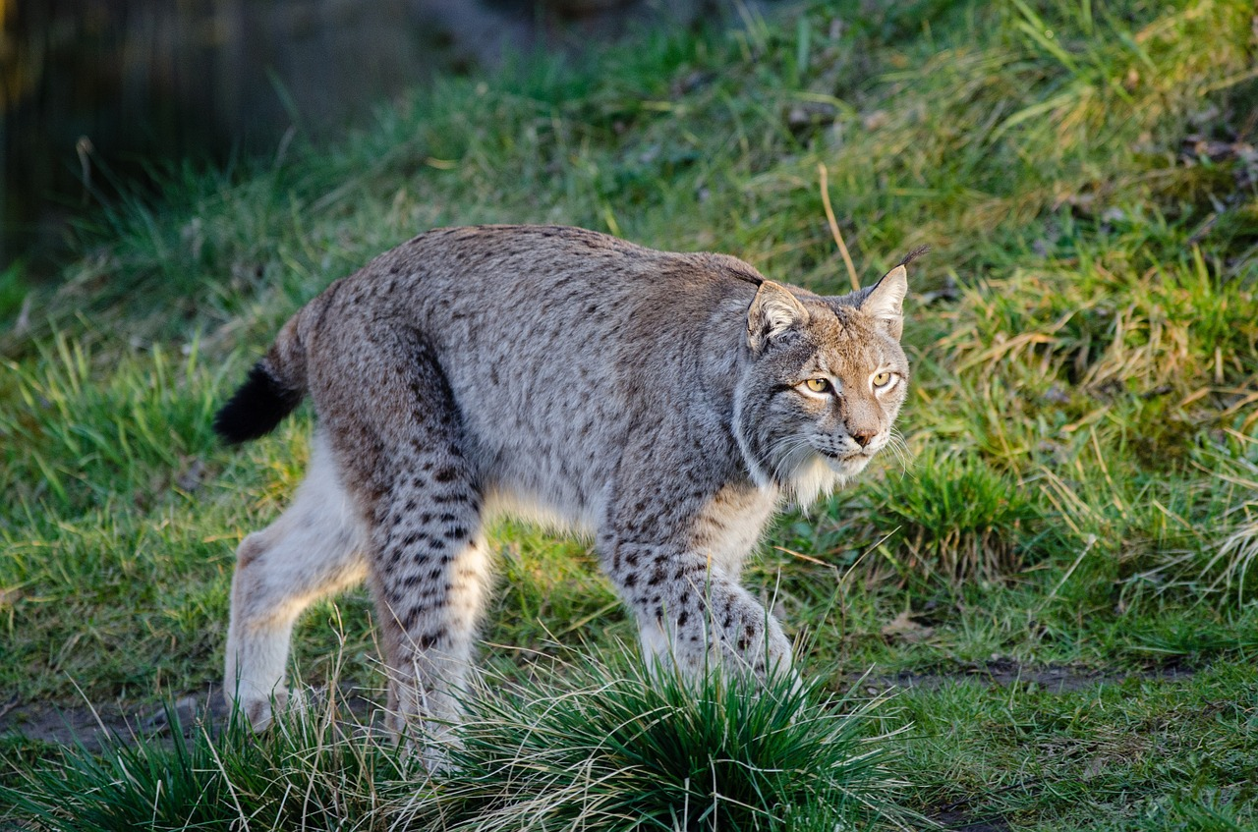
Predators
Volcano rabbits dart into the grasses to hide from predators such as long-tailed weasels, bobcats, and red-tailed hawks. Tender, young shoots of zacaton also serve as the rabbits' main source of nutrition, though they eat other things, including spiny herbs and alder tree bark.
Notes:
1 Background Color
1 Title (or write the question)
1 Pictures
1 Include Transitions
1 Answering question using complete sentences (multiple sentences if needed to fully explain your answer)
1 Accuracy of information
6

Slide 8
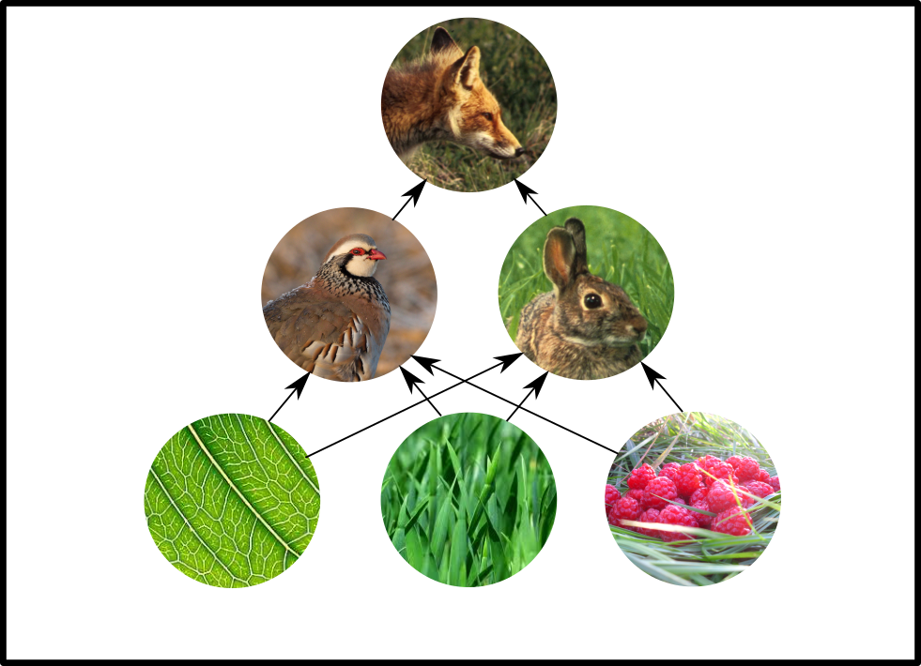
Food chain
a fox, a rabbit, and a plant are linked because the rabbit eats the plant and the fox eats the rabbit. These links are called food chains. Animals and plants get the energy they need from their food.
Notes:
1 Background Color
1 Title (or write the question)
1 Pictures
1 Include Transitions
0 Answering question using complete sentences (multiple sentences if needed to fully explain your answer)
1 Accuracy of information
5
Since Food Chain is the title Chain needs to be capitalized. A typical food chain might include a fox, a rabbith and then a plant because…...

Slide 9
How volcano rabbits survive
, tall and dense, helps the rabbits hide from predators, such as long-tailed weasels, bobcats, and red-tailed hawks
Notes:
1 Background Color
1 Title (or write the question)
0 Pictures
1 Include Transitions
0 Answering question using complete sentences (multiple sentences if needed to fully explain your answer)
1 Accuracy of information
4
Vegetation that is tall and dense heops the rabbit hide from….. There needs to be pictures on every slide but the first and last. .

Slide 10
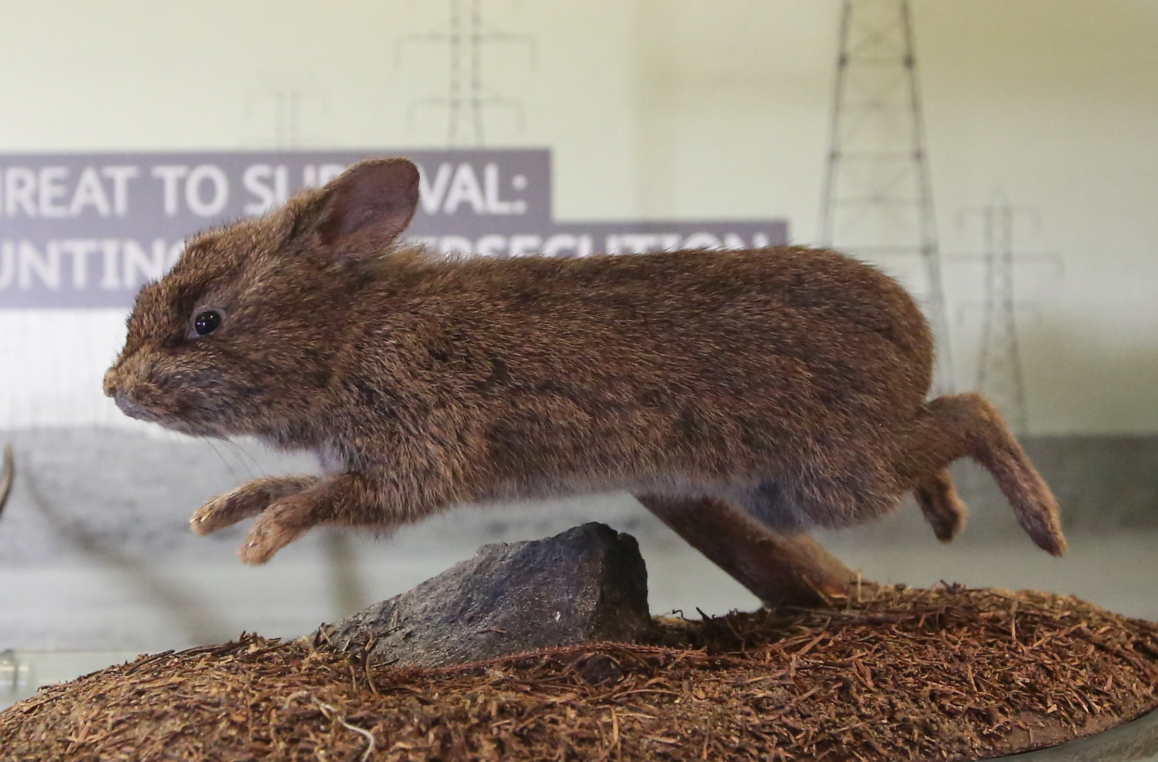
How do that look, weighs and how tall
escription. The tiny rabbits weigh about a pound fully grown. Their ears are stubby and rounded, and their fur is short, dense, and either black or brown in color, which helps the rabbits blend in with the rocky. It has small rounded ears, short legs, and short, thick fur and weighs approximately 390–600 g (0.86–1.3 lb). It has a lifespan of 7 to 9 years.
Notes:
1 Background Color
0 Title (or write the question)
1 Pictures
1 Include Transitions
0 Answering question using complete sentences (multiple sentences if needed to fully explain your answer)
1 Accuracy of information
4
Does your title make sense?? Read it outloud to yourself. Also, it is not punctuated properly.
In the paragraph the first word of a sentence needs to be capitalized. And I think you meant to spell Description?

Slide 11
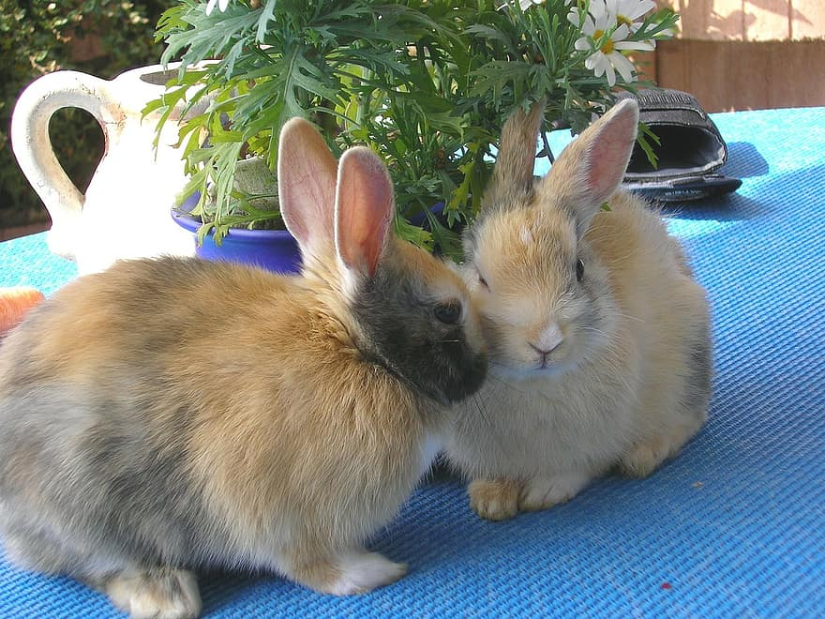
Female or male
You need to flip the rabbit over, part their fur, and look for the "perfect volcano". When a baby rabbit is eight weeks old you can’t tell the gender
Notes:
1 Background Color
0 Title (or write the question)
1 Pictures
1 Include Transitions
1 Answering question using complete sentences (multiple sentences if needed to fully explain your answer)
1 Accuracy of information
5
Title issues.

Slide 12
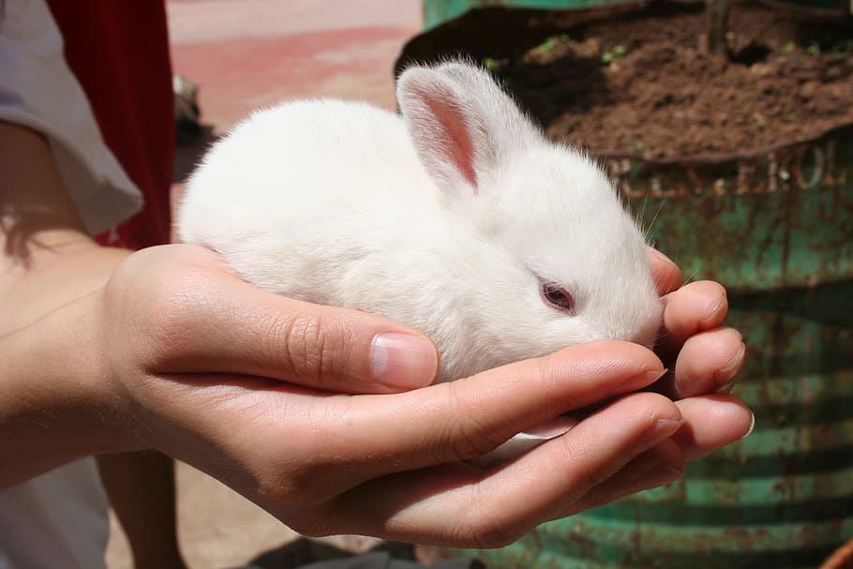
Life span
It has a life span of 7 to 9 years. The volcano rabbit lives in groups of 2 to 5 animals in burrows (underground nests) and runways among grass tussocks. The burrows can be as long as 5 m and as deep as 40 cm. There are usually 2 to 3 young per litter
Notes:
1 Background Color
0 Title (or write the question)
1 Pictures
1 Include Transitions
0 Answering question using complete sentences (multiple sentences if needed to fully explain your answer)
1 Accuracy of information
4
Lifeapan is one word. . .One cannot use “it” until after one has used the proper noun in a sentence. Here you could say…. The Volcano rabbit has a lifespan of 7 to 9 years. This rabbit lives in ….. Put a period at the end.

Slide 13
Fun facts
- known as teporingo or zacatuche, is a small rabbit that resides in the mountains of Mexico.
-The volcano rabbit is endangered, with fewer than 7,000 individuals thought to remain in the wild.
-The volcano rabbit, or zacatuche, inhabits dense undergrowth of bunchgrass in pine forests in the high mountains surrounding Mexico City.
-The volcano rabbits tail isn't visible to the eye Their fur helps them blend into the environment. Volcano rabbits burrow into the grass
-Unfortunately, estimates show that there are only about 1,200 volcano rabbits in existence. This makes them some of the rarest small mammals on the planet. Unsurprisingly, they are on the endangered species list. This also means they do not make suitable pets.
- with possibly fewer than 250 breeding pairs remaining worldwide, because of habitat destruction throughout its range.
-The volcano rabbit’s adult weight goes up to 500 g. It has short, dense fur that ranges in color from brown to black.
- Volcano rabbits are commonly found at higher altitudes. Almost 71% of volcano rabbits are found in pine forests, alder forests, and grasslands.
Notes:
1 Background Color
1 Title (or write the question)
1 Pictures
1 Include Transitions
0 Answering question using complete sentences (multiple sentences if needed to fully explain your answer)
1 Accuracy of information
5
Capitalize the title word Facts. The Volcano rabbit …the first word in a sentence needs to be capitalized.

Slide 14

Sources
-https://en.wikipedia.org/wiki/Volcano_rabbit
-http://www.edgeofexistence.org/species/volcano-rabbit/
-https://animalia.bio/volcano-rabbit
Notes:
6

