Slide 1

Tigers
Natalia Yanez
Notes:
1 Background Color
1 Title (or write the question)
1 Pictures
0 Include Transitions
1 Answering question using complete sentences (multiple sentences if needed to fully explain your answer)
1 Accuracy of information
6
This slide has no transition.

Slide 2
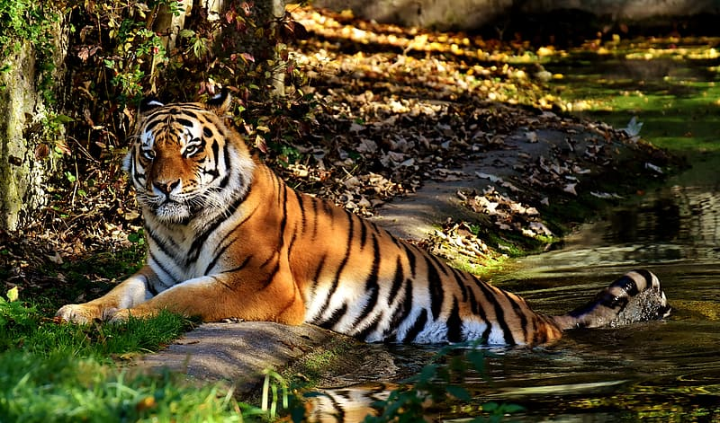
Where Tigers Live
Tigers mostly live in Asia; some tigers are also found in India and China,
Notes:
1 Background Color
1 Title (or write the question)
1 Pictures
0 Include Transitions
0 Answering question using complete sentences (multiple sentences if needed to fully explain your answer)
1 Accuracy of information
6
This slide has no transition.
If the title is not a sentence use all capital each word. Where Tigers Live
Mostly and Some should be lowercase.

Slide 3
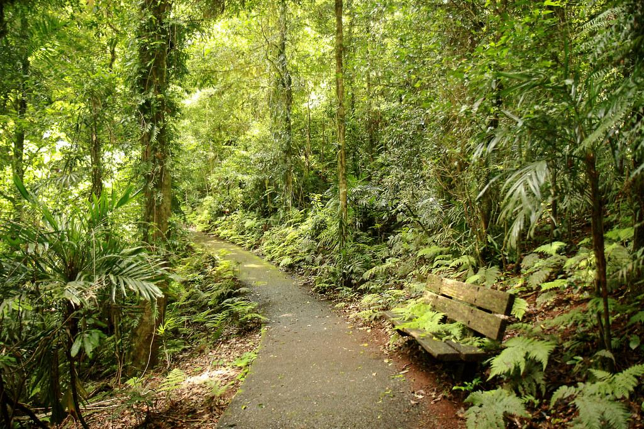
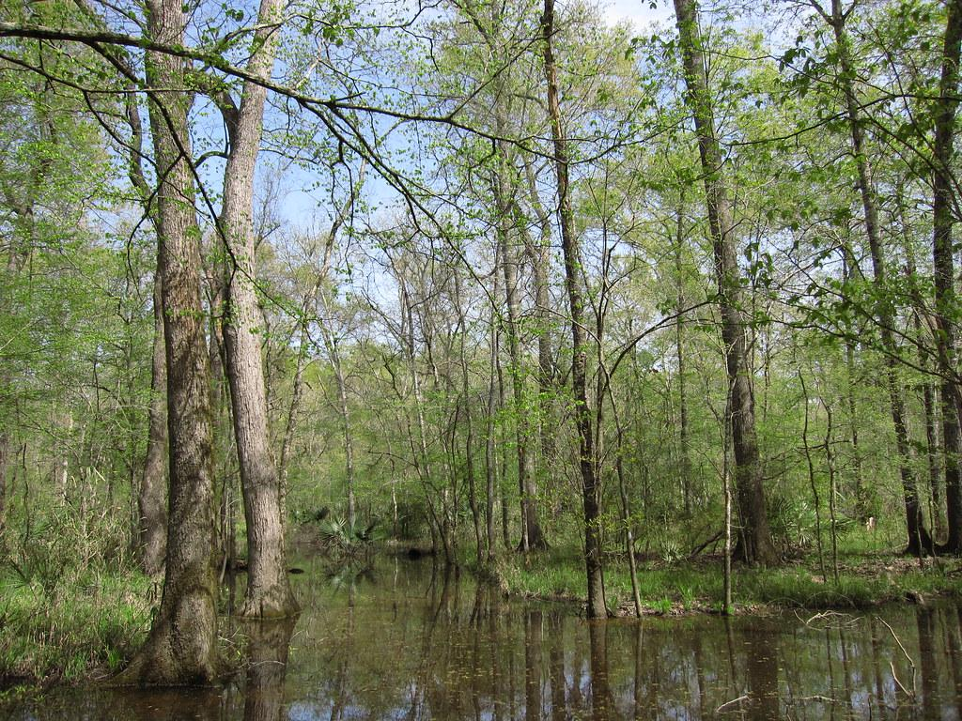
What Ecosystem do Tigers live in?
Tigers live in rainforests, grasslands, mangrove swamps.
Notes:
1 Background Color
1 Title (or write the question)
1 Pictures
0 Include Transitions
0 Answering question using complete sentences (multiple sentences if needed to fully explain your answer)
1 Accuracy of information
6
This slide has no transition.
Please place a question mark at the end of the title.
In rainforests, grasslands, mangrove, and swamps.

Slide 4
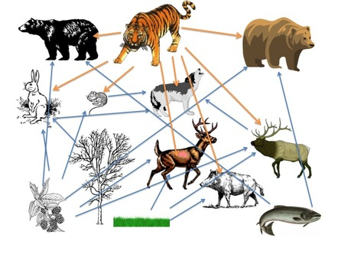
What is it like in a Tigers Ecosystem?
In the rainforest it's mostly warm all year. Tigers like to be in the warm but mostly in the cold.
Notes:
1 Background Color
1 Title (or write the question)
0 Pictures
0 Include Transitions
0 Answering question using complete sentences (multiple sentences if needed to fully explain your answer)
1 Accuracy of information
6
This slide has no transition.
This slide has no picture.
Please put a question mark behind the title.
Change the word “me” to the word “be’.

Slide 5
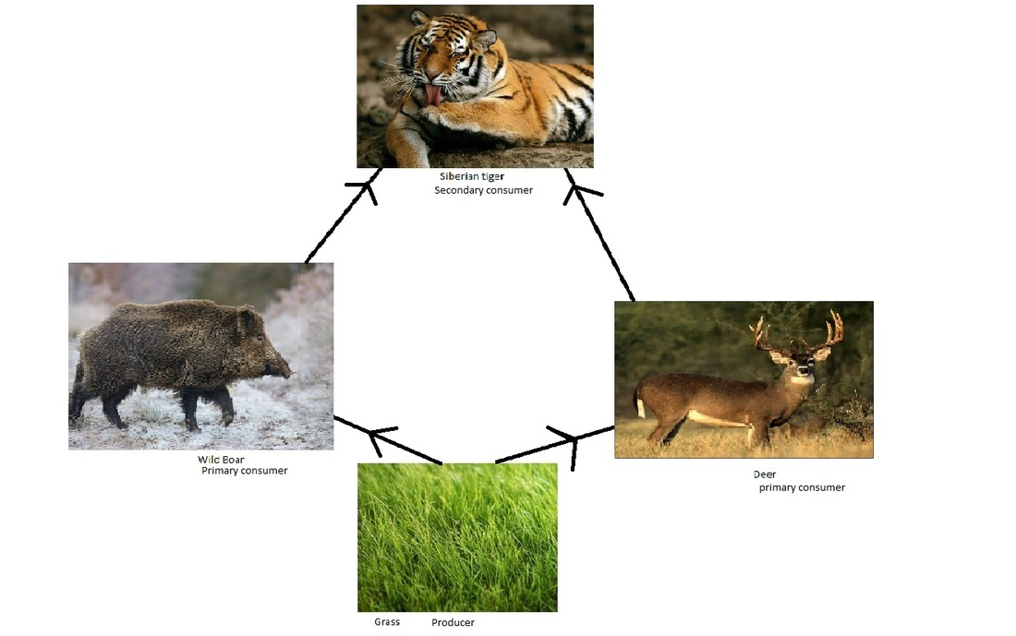
What type of consumer is a Tiger?
A Tiger is a producer which means that they get their own food.
Notes:
1 Background Color
1 Title (or write the question)
0 Pictures
0 Include Transitions
0 Answering question using complete sentences (multiple sentences if needed to fully explain your answer)
0 Accuracy of information
6
This slide has no transition.
This slide has no picture.
Please put a question mark behind the title.
Producer and Which should be lowercase,
This is inaccurate because a Tiger is a Consumer.

Slide 6
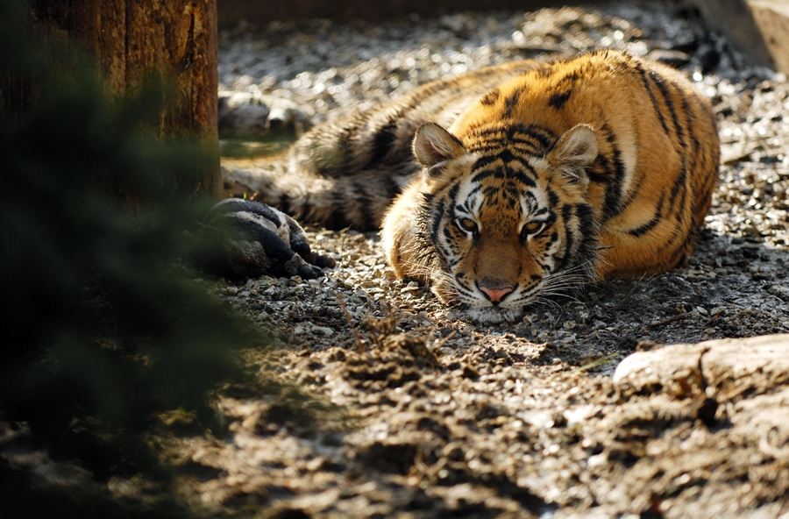
SPECIFIC FOOD A TIGER EATS.
Tigers specifically like deer and wild boar. Those animals are a Tigers favorite food.
Notes:
1 Background Color
1 Title (or write the question)
1 Pictures
0 Include Transitions
0 Answering question using complete sentences (multiple sentences if needed to fully explain your answer)
1 Accuracy of information
4
This slide has no transition.
If the title is not a sentence every word should be capitalized. Specific Food A Tiger Eats
Specifically should be lowercase. And there is an extra space between tigers and specifically. .deer and wild boar. Those animals are a tigers favorite food.

Slide 7
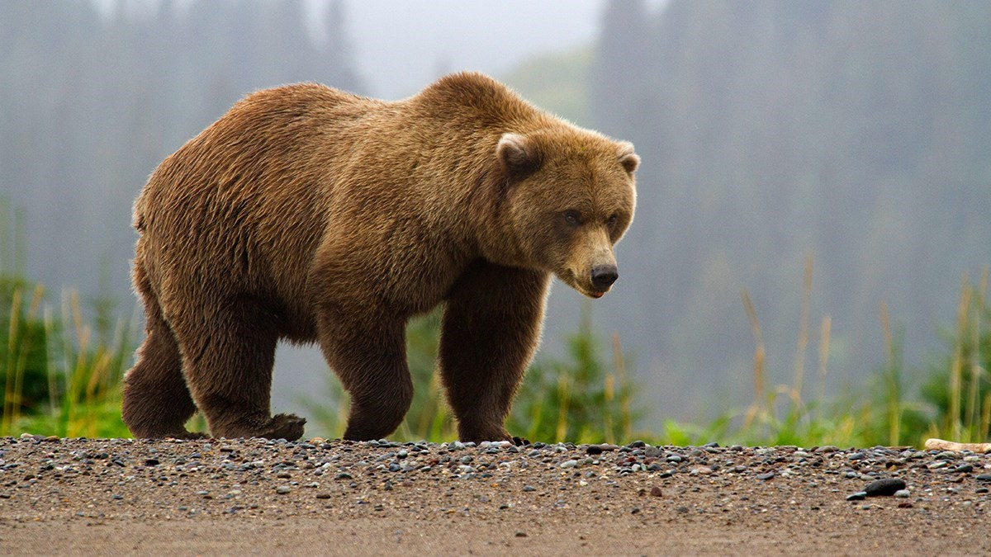
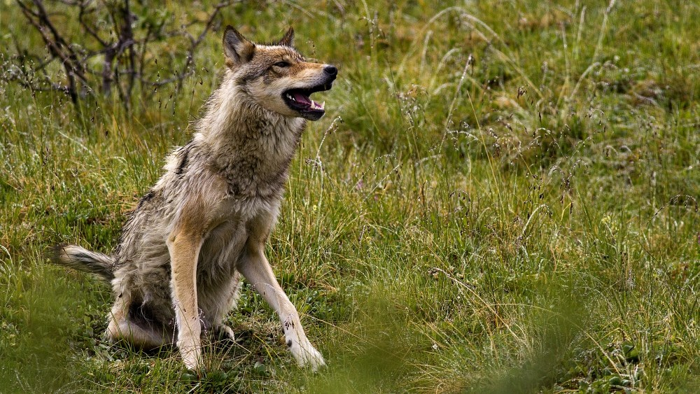
Tigers Predators
Tigers do have Predators they are: Leopards, Alistic Wild dogs, Brown bears, and Wolves.
Notes:
1 Background Color
1 Title (or write the question)
1 Pictures
0 Include Transitions
0 Answering question using complete sentences (multiple sentences if needed to fully explain your answer)
1 Accuracy of information
6
This slide has no transition.
Just add a period after Wolves.

Slide 8
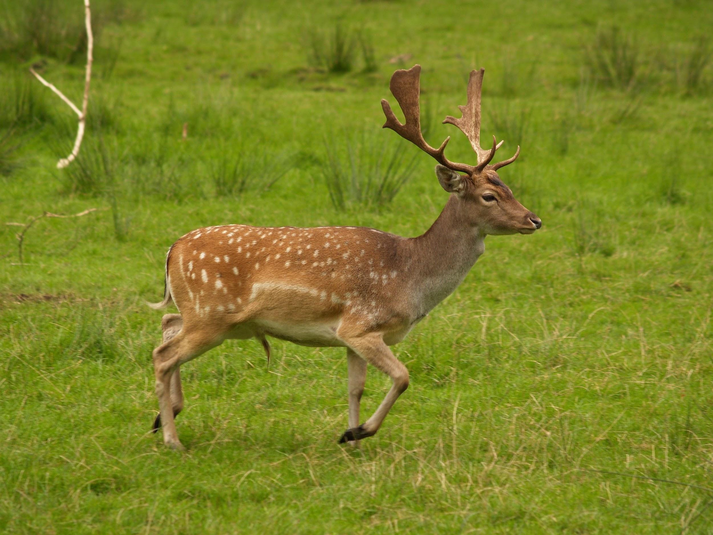
What are a Tigers food chain?
Tigers also likes to eat: Pigs, Deer, Antelope, and Buffalo.
Notes:
1 Background Color
1 Title (or write the question)
1 Pictures
0 Include Transitions
0 Answering question using complete sentences (multiple sentences if needed to fully explain your answer)
1 Accuracy of information
4
This slide has no transition.
Title that is not a sentence… Tigers Food Chain
Remove the space before the :

Slide 9
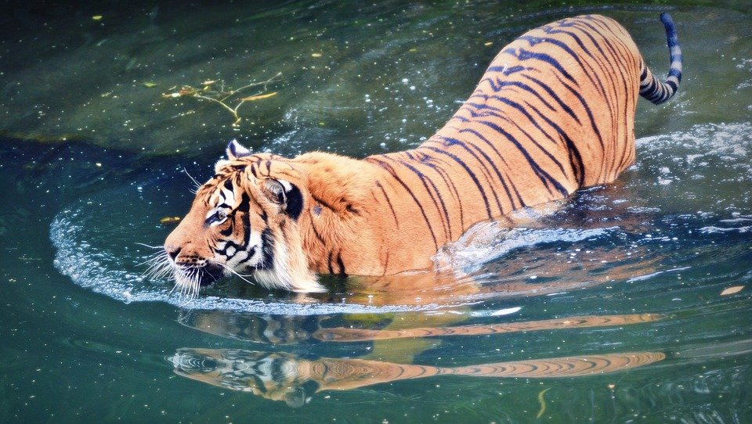
Tigers Adaptations
A Tigers adaptations include having a very flexible spines and long legs. This allows them to jump 33 ft high, and also makes them swim faster.
Notes:
1 Background Color
1 Title (or write the question)
1 Pictures
0 Include Transitions
0 Answering question using complete sentences (multiple sentences if needed to fully explain your answer)
1 Accuracy of information
6
This slide has no transition.
A Tigers adaptations include having a very flexible spine and long legs. This makes them able to jump up to 33ft high. This also makes them swim faster.

Slide 10
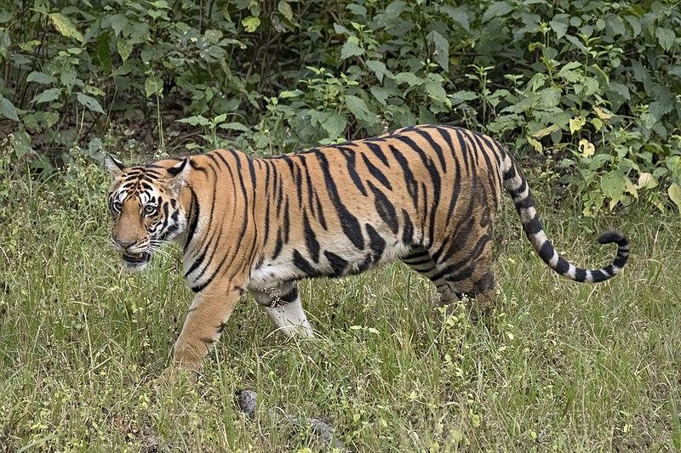
What does a Tiger look like?
Tigers are orange or reddish orange with black stripes. A Tiger can weigh from 200 to 680 lbs. Tigers grow to 2.3 to 45ft.
Notes:
1 Background Color
1 Title (or write the question)
1 Pictures
0 Include Transitions
0 Answering question using complete sentences (multiple sentences if needed to fully explain your answer)
1 Accuracy of information
6
This slide has no transition.
What does a Tiger look like?
Please make the following words lowercase: orange, reddish orange, black. weigh

Slide 11
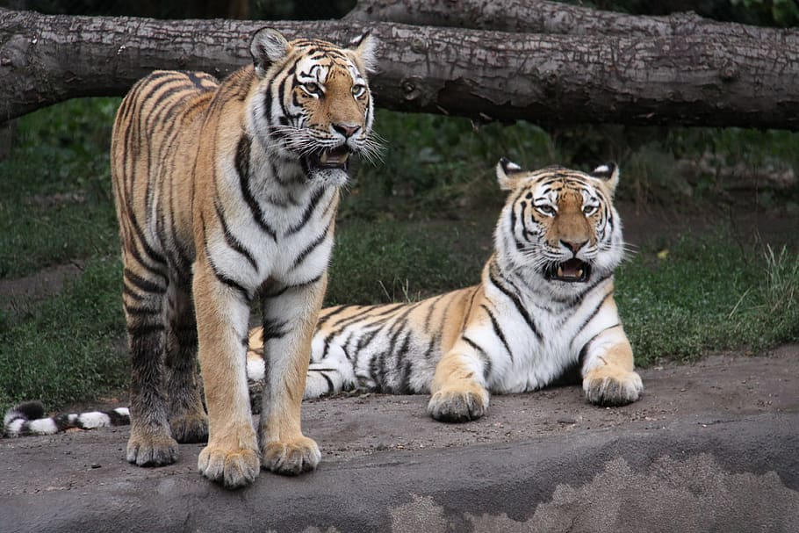
Are female and male Tigers the same?
Male Tigers weigh 1.7 times more than females.
Male Tigers weigh up
to 600 lbs, A female
Tiger can weigh up to
140 lbs.
Notes:
1 Background Color
1 Title (or write the question)
1 Pictures
0 Include Transitions
0 Answering question using complete sentences (multiple sentences if needed to fully explain your answer)
1 Accuracy of information
6
This slide has no transition.
Are female and male Tigers the same?
1.7 times more than….
.up to 600 lbs.

Slide 12
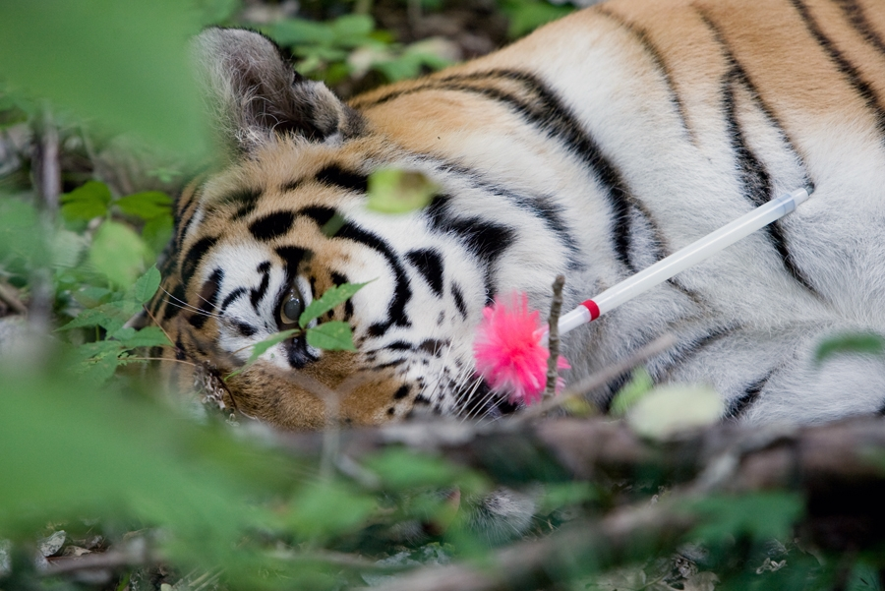
What are Tigers lifespan?
Tigers live up to 8 to 10 years.
Notes:
1 Background Color
1 Title (or write the question)
1 Pictures
0 Include Transitions
0 Answering question using complete sentences (multiple sentences if needed to fully explain your answer)
1 Accuracy of information
4
This slide has no transition.
Please put a question mark on the end of the title.

Slide 13
Facts about Tigers
Tigers are the Largest cats among other wild cats.
Tiger cubs are born blind and only half of the cubs survive.
Tigers love to swim and play in the water.
A group of tigers are called an Ambush or Streak.
Tigers and sprint over 60 Kilometre.
Tiger stripes are also found in their skin.
Tigers cannot purr.
Notes:
1 Background Color
1 Title (or write the question)
1 Pictures
0 Include Transitions
0 Answering question using complete sentences (multiple sentences if needed to fully explain your answer)
1 Accuracy of information
4
This slide has no transition.
Facts About Tigers (when in a title)
Please put punctuation on the end of every sentence.

Slide 14
Sources
The source I used was goggle.
Notes:
Google is a source..
Sources means to list the site that gave google the information.
3

