Slide 1
Aye Aye facts
By Tyler K.
Notes:
1 Background Color
1 Title (or write the question)
1 Pictures
1 Include Transitions
1 Answering question using complete sentences (multiple sentences if needed to fully explain your answer)
1 Accuracy of information

Slide 2
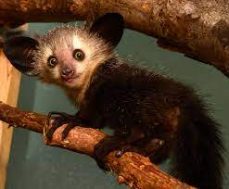
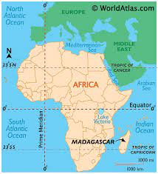
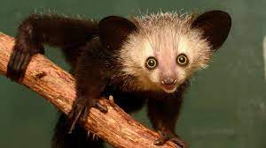
Where did the Aye Aye come from?
The aye-aye (Daubentonia madagascariensis) is a lemur native to the island of Madagascar.
Notes:
1 Background Color
1 Title (or write the question)
1 Pictures
1 Include Transitions
0 Answering question using complete sentences (multiple sentences if needed to fully explain your answer)
1 Accuracy of information
Madagascariensis
Needs to be caplitalized

Slide 3
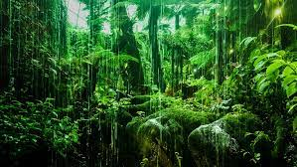
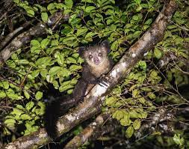
What ecosystem do aye ayes live in?
Aye-ayes spend their lives in rain forest trees and avoid coming down to earth.
Notes:
1 Background Color
1 Title (or write the question)
1 Pictures
1 Include Transitions
0 Answering question using complete sentences (multiple sentences if needed to fully explain your answer)
1 Accuracy of information
Aye-Ayes need to be Capitalized.

Slide 4
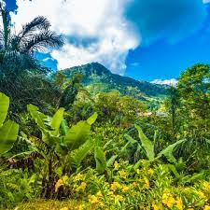
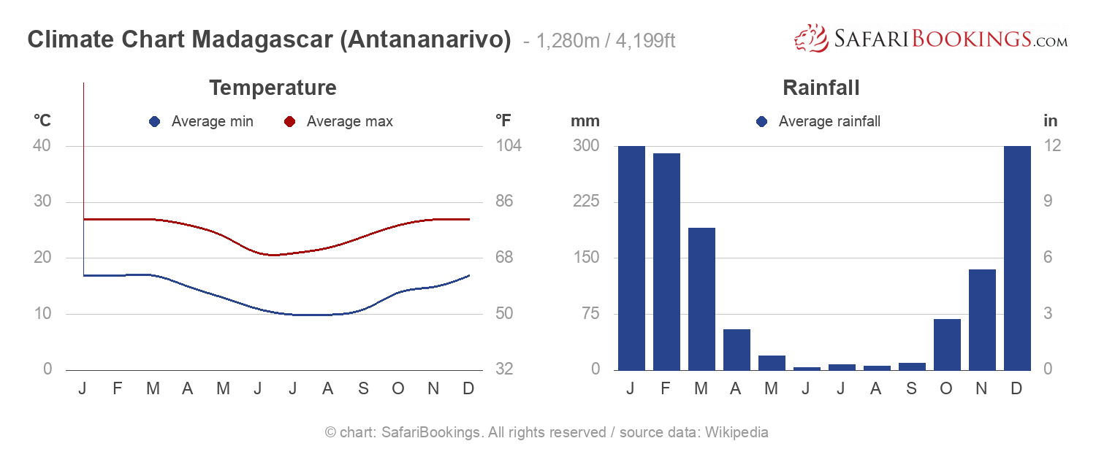
What is it like in the rainforest?
The Madagascar lowland forests or Madagascar humid forests are a tropical moist broadleaf forest ecoregion found on the eastern coast of the island of Madagascar, home to a plant and animal mix that is 80 to 90% endemic, with the forests of the eastern plain being a particularly important location of this endemism.
Notes:
1 Background Color
1 Title (or write the question)
1 Pictures
1 Include Transitions
1 Answering question using complete sentences (multiple sentences if needed to fully explain your answer)
1 Accuracy of information

Slide 5
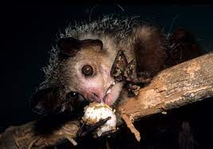
What type of consumer is the Aye Aye?
Aye Ayes are Omnivores, meaning they eat both plants and other animals.
Notes:
1 Background Color
1 Title (or write the question)
1 Pictures
1 Include Transitions
1 Answering question using complete sentences (multiple sentences if needed to fully explain your answer)
1 Accuracy of information

Slide 6
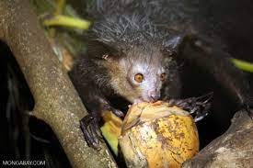
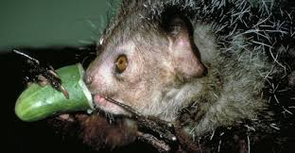
What specific foods does the Aye Aye eat?
The Aye Aye eat grubs and insects in trees. The Aye-Aye can also be found eating seeds, fungi, and fruits, which makes it an omnivore.
Notes:
1 Background Color
1 Title (or write the question)
1 Pictures
1 Include Transitions
1 Answering question using complete sentences (multiple sentences if needed to fully explain your answer)
1 Accuracy of information

Slide 7

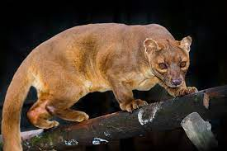
Does the Aye Aye have any predators?
Predators of Aye Ayes include humans, fossas, and birds of prey.
Notes:
1 Background Color
1 Title (or write the question)
1 Pictures
1 Include Transitions
1 Answering question using complete sentences (multiple sentences if needed to fully explain your answer)
1 Accuracy of information

Slide 8
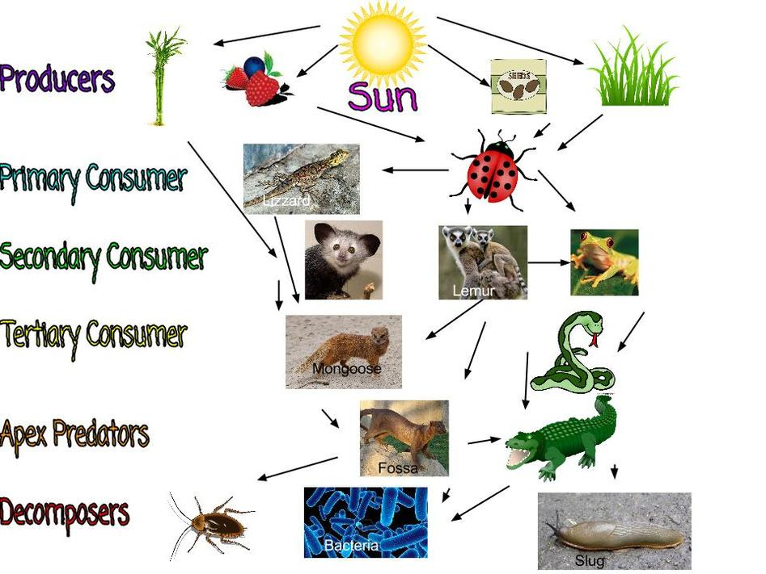
What is a typical food chain for the Aye Aye?
The Aye Aye is a secondary consumer, which means that Terity consumers, Apex predators and Decomposers can feed on the Aye Aye.
Notes:
1 Background Color
1 Title (or write the question)
1 Pictures
1 Include Transitions
1 Answering question using complete sentences (multiple sentences if needed to fully explain your answer)
1 Accuracy of information

Slide 9
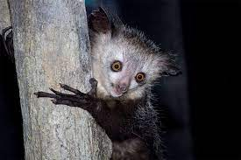
Does the Aye Aye have any specific adaptations to help it survive?
Aye-ayes are dark brown or black and are distinguished by a bushy tail that is larger than their body. They also feature big eyes, slender fingers, and large, sensitive ears. Aye-ayes have pointed claws on all their fingers and toes except for their opposable big toes, which enable them to dangle from branches.
Notes:
1 Background Color
1 Title (or write the question)
1 Pictures
1 Include Transitions
1 Answering question using complete sentences (multiple sentences if needed to fully explain your answer)
1 Accuracy of information

Slide 10

How much does the Aye Aye weigh and how tall is it?
Aye-ayes grow to be 36 to 44 centimetres (14 to 17 inches) in height, with a tail of even greater length, and they weigh from 2 to 2.7 kilograms (4.4 to 6 pounds).
Notes:
1 Background Color
1 Title (or write the question)
1 Pictures
1 Include Transitions
1 Answering question using complete sentences (multiple sentences if needed to fully explain your answer)
1 Accuracy of information

Slide 11
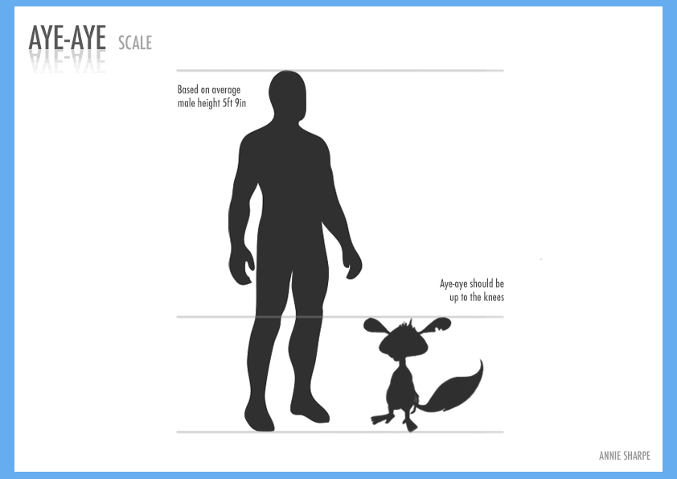
Do male and female Aye Ayes weigh the same, and are they the same height?
The male and female Aye Ayes are the same height, even with the tail, but the male Aye Aye weighs 0.1 pound more than the female Aye Aye.
Notes:
1 Background Color
1 Title (or write the question)
1 Pictures
1 Include Transitions
1 Answering question using complete sentences (multiple sentences if needed to fully explain your answer)
1 Accuracy of information

Slide 12
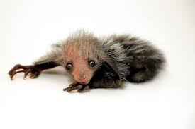
What is the lifespan of the Aye Aye?
Lifespan in the wild is unknown but aye-ayes have lived 23 years in captivity.
Notes:
1 Background Color
1 Title (or write the question)
1 Pictures
1 Include Transitions
1 Answering question using complete sentences (multiple sentences if needed to fully explain your answer)
1 Accuracy of information

Slide 13
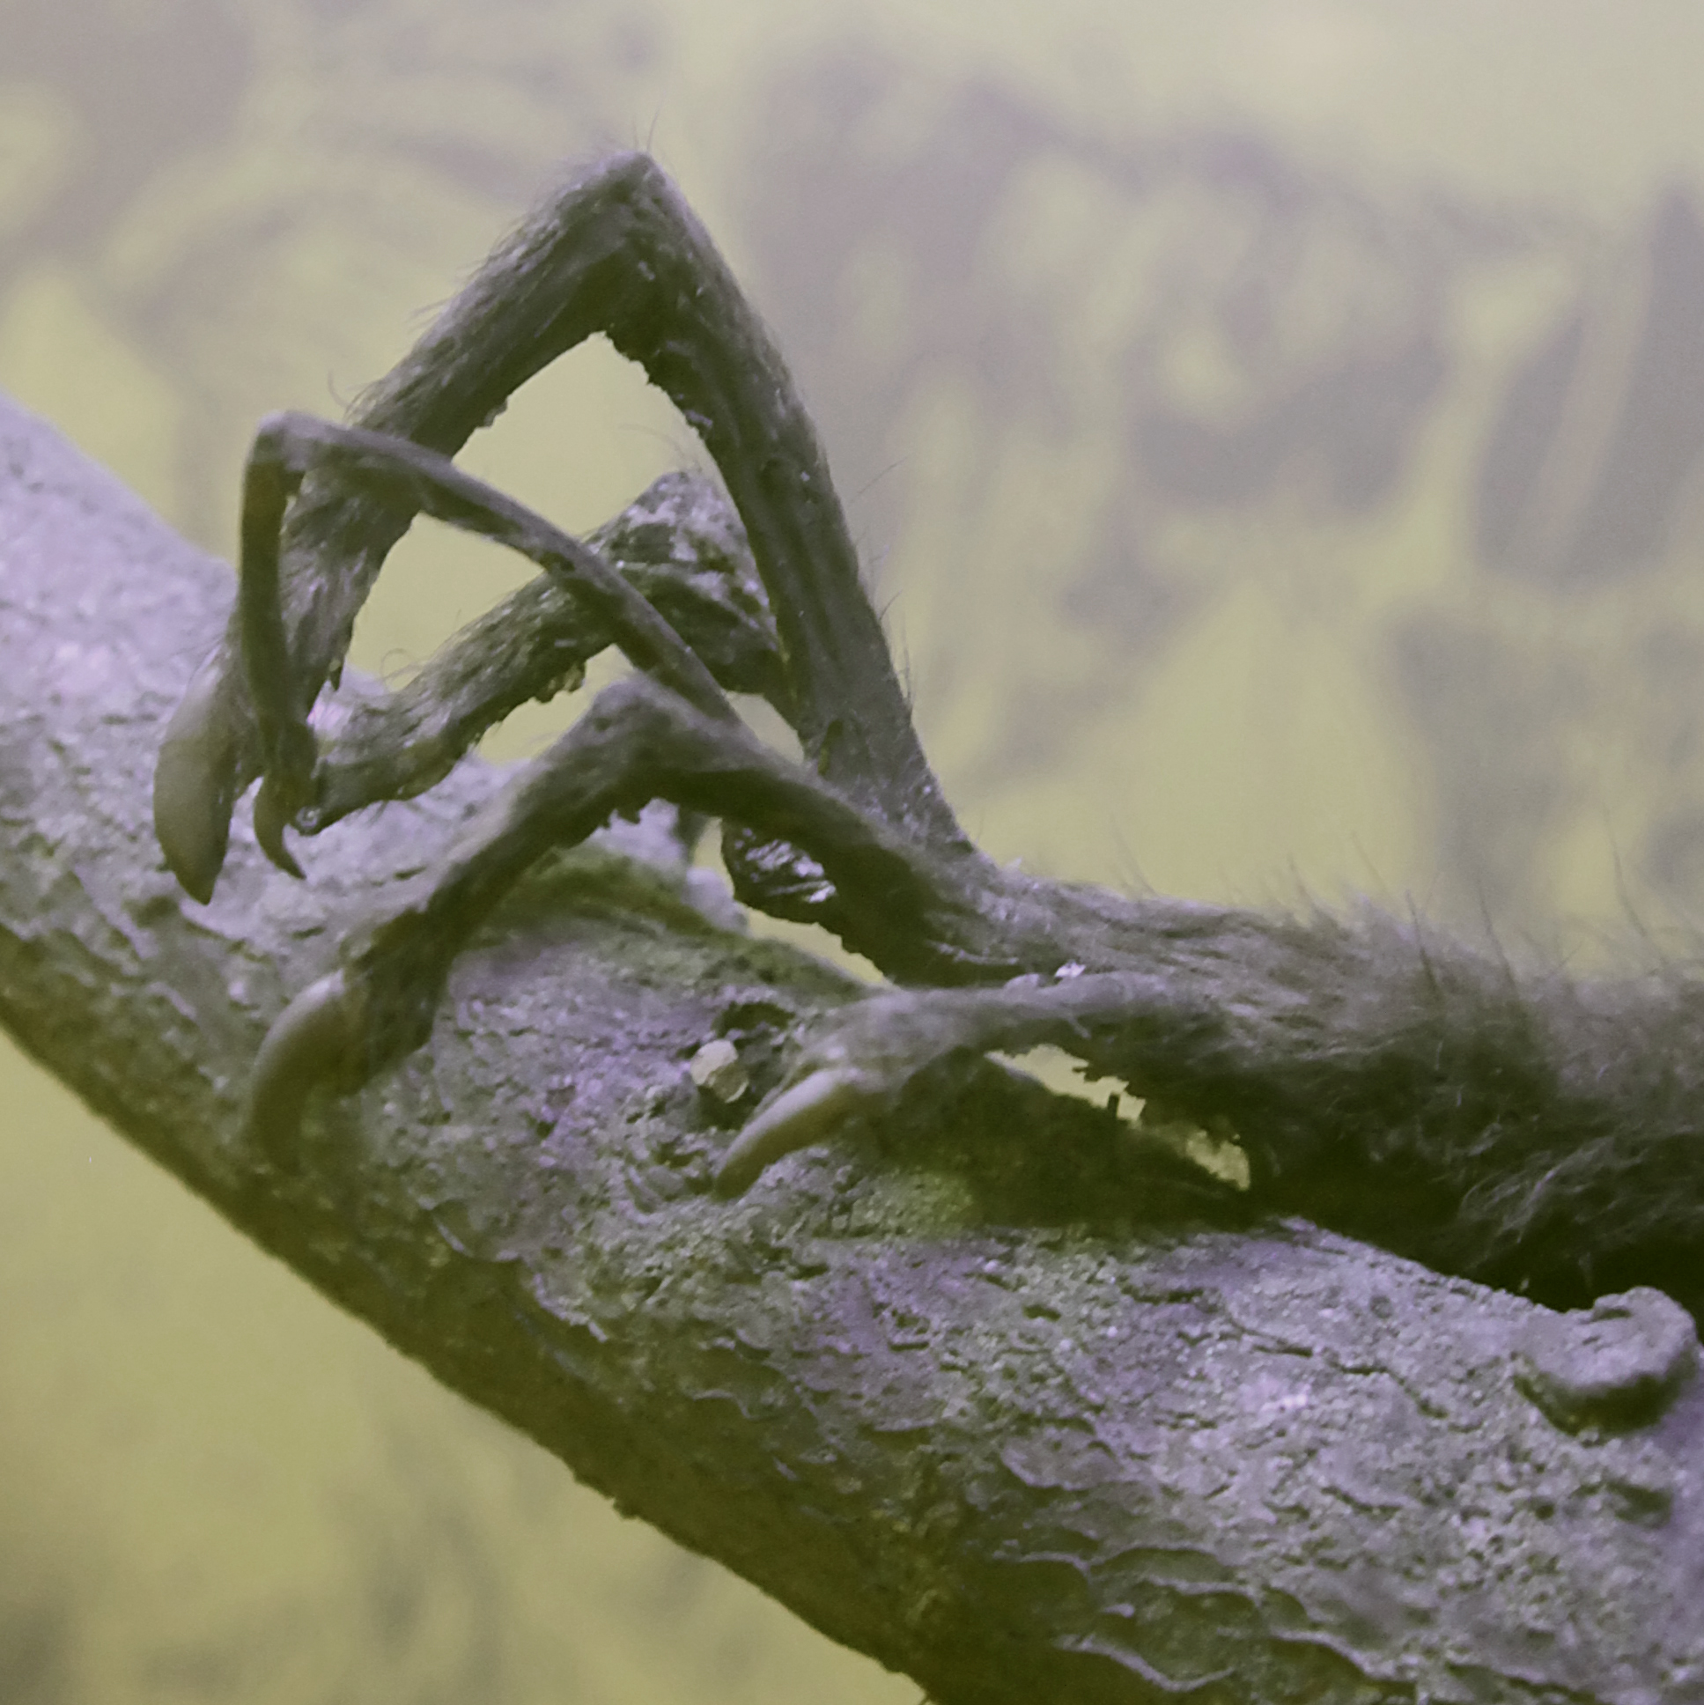
8 facts about the Aye Aye.
Aye-ayes sleep in treetop nests they construct.
Aye-ayes are mostly solitary. Adult aye-ayes spend most of their lives alone and they are only around other aye ayes when they are young.
They have unusual fingers and toes. Aye-ayes have pointed claws on all their fingers and toes, except for their opposable big toes.
Their feeding method is called "percussive foraging." The aye-aye's third finger is thin long. They find their food by knocking on a tree.
Aye-Ayes are Madagascar's answer to the woodpecker. The aye-aye, with its ability to detect and rip out grubs from trees, fills in for the woodpecker.
There used to be giant aye-ayes. An extinct form of the aye-aye was three to five times the size of the average aye aye and weighed about 25 pounds.
The aye-aye had a bad reputation. Some people that live in madagascar thought that the aye aye was a bad omen.
Aye-ayes communicate with a number of vocalizations. Aye-ayes scream to indicate aggression, and a closed-mouth variation of this scream can indicate protest
Notes:
1 Background Color
1 Title (or write the question)
1 Pictures
1 Include Transitions
1 Answering question using complete sentences (multiple sentences if needed to fully explain your answer)
1 Accuracy of information

Slide 14
Sources
Weird & Wonderful Creatures: The Aye-Aye | American Association for the Advancement of Science
Aye-Aye | National Geographic
The Creature Feature: 10 Fun Facts About the Aye-Aye - Mary ...
Aye-Aye - Denver Zoo
Aye-Aye - Ten Random Facts
https://marybatessciencewriter.com/home/2015/06/08/the-creature-feature-10-fun-facts-about-the-aye-aye
Notes:
1 Background Color
1 Title (or write the question)
1 Pictures
1 Include Transitions
1 Answering question using complete sentences (multiple sentences if needed to fully explain your answer)
1 Accuracy of information

