Slide 1
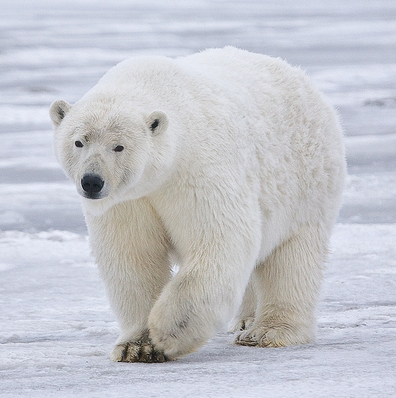
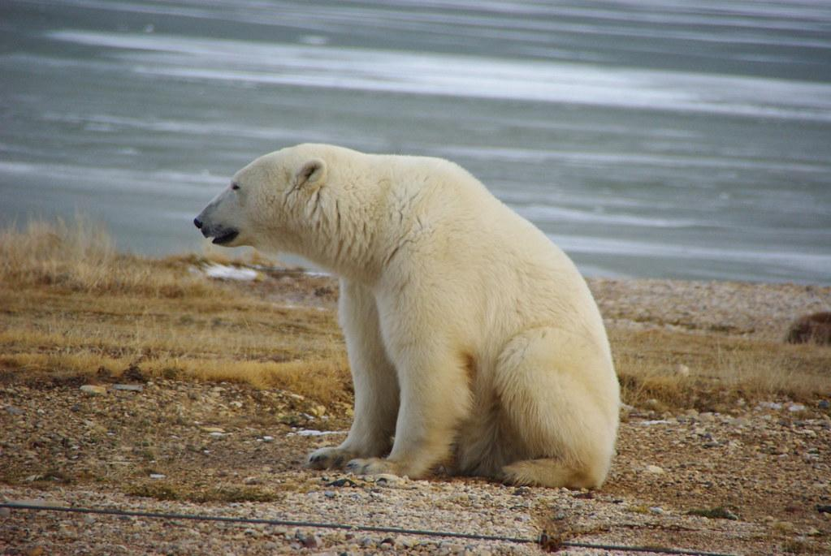
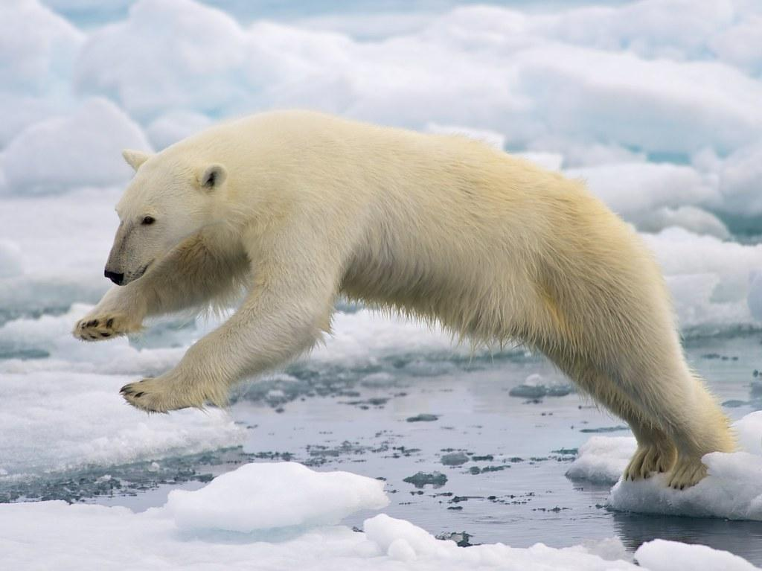
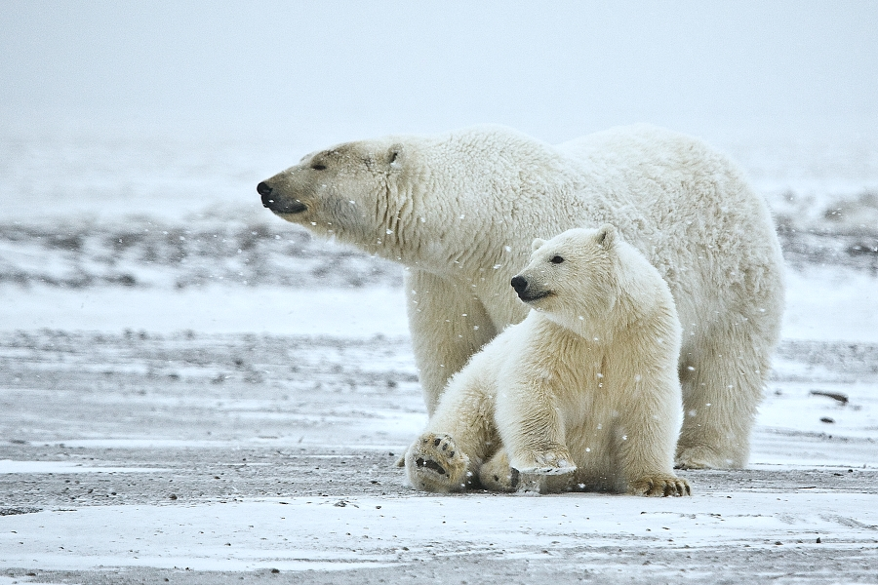
Polar Bear
Zaima Bhatti
Notes:
1 Background Color
1 Title (or write the question)
1 Pictures
1 Include Transitions
1 Answering question using complete sentences (multiple sentences if needed to fully explain your answer)
1 Accuracy of information

Slide 2
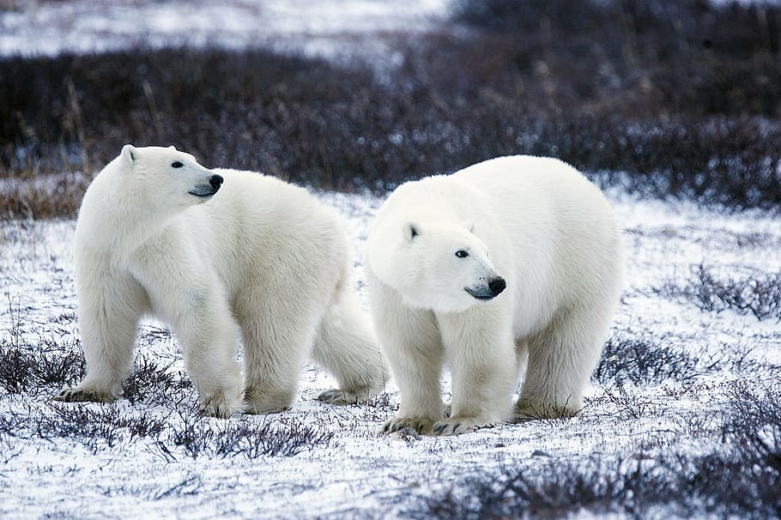
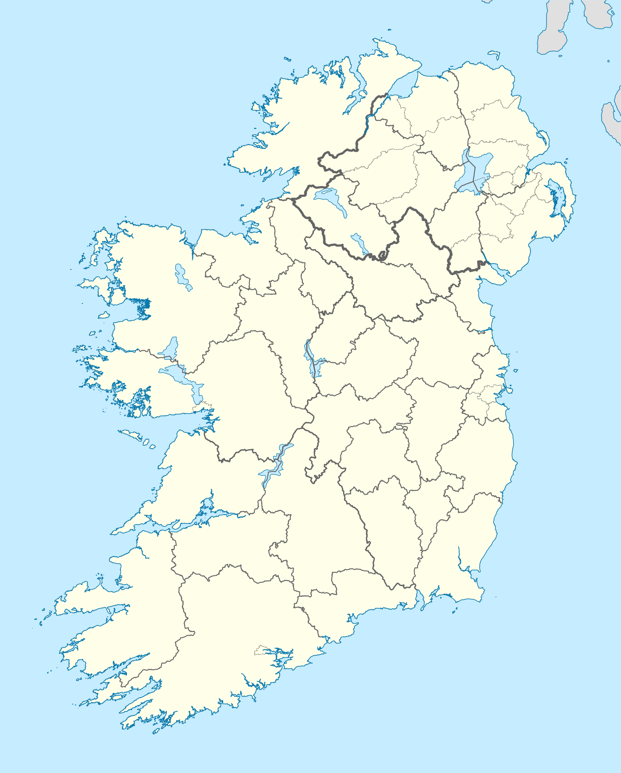
Where did polar bears come from?
Scientist have discovered that polar bears came from Ireland.
Notes:
1 Background Color
1 Title (or write the question)
1 Pictures
1 Include Transitions
1 Answering question using complete sentences (multiple sentences if needed to fully explain your answer)
1 Accuracy of information

Slide 3
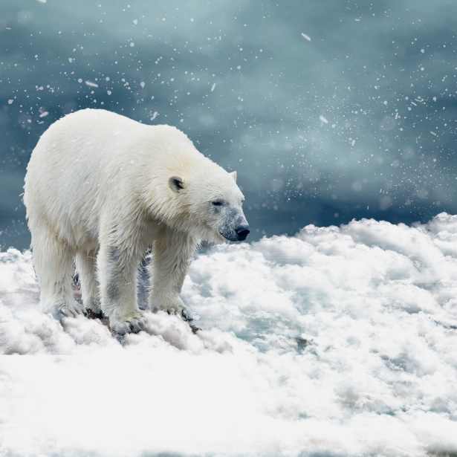
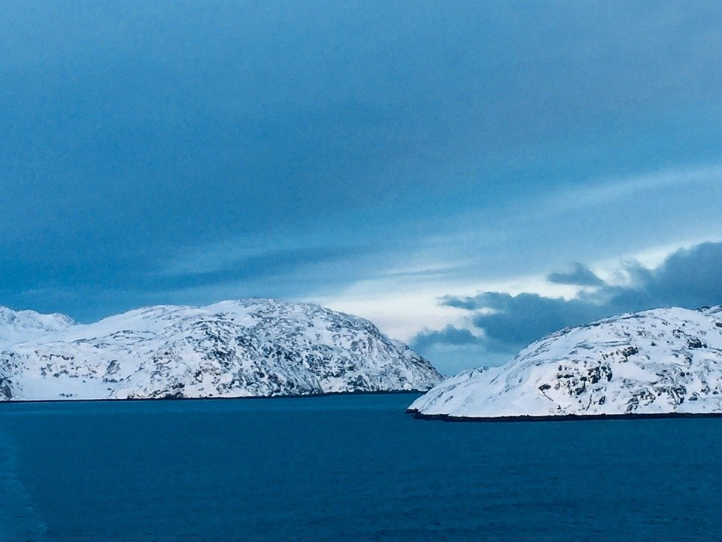
What ecosystem do polar bears live in?
Polar bears are only found in the Arctic.
Notes:
1 Background Color
1 Title (or write the question)
1 Pictures
1 Include Transitions
1 Answering question using complete sentences (multiple sentences if needed to fully explain your answer)
1 Accuracy of information

Slide 4
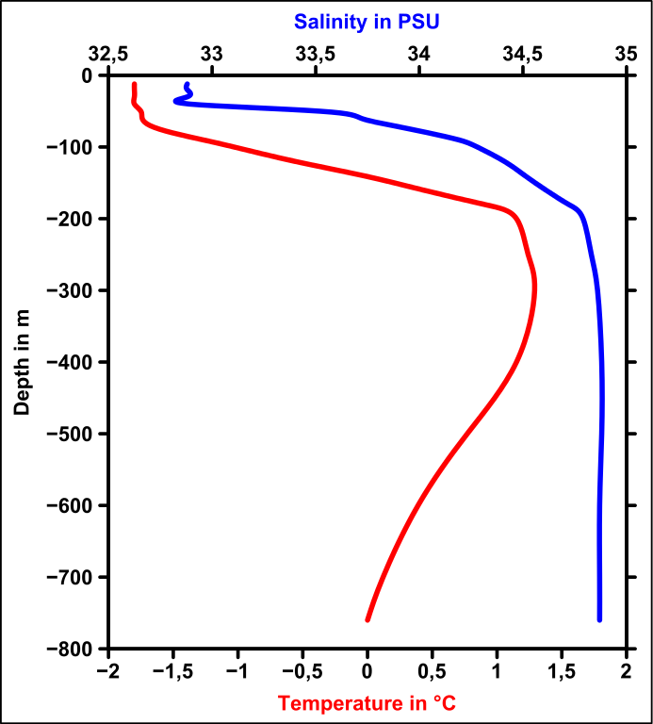
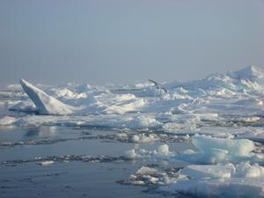
What is it like in the ecosystem?
Polar bears ecosystem is the arctic sea ice, islands, and continental coastlines.
Notes:
1 Background Color
1 Title (or write the question)
1 Pictures
1 Include Transitions
1 Answering question using complete sentences (multiple sentences if needed to fully explain your answer)
1 Accuracy of information

Slide 5
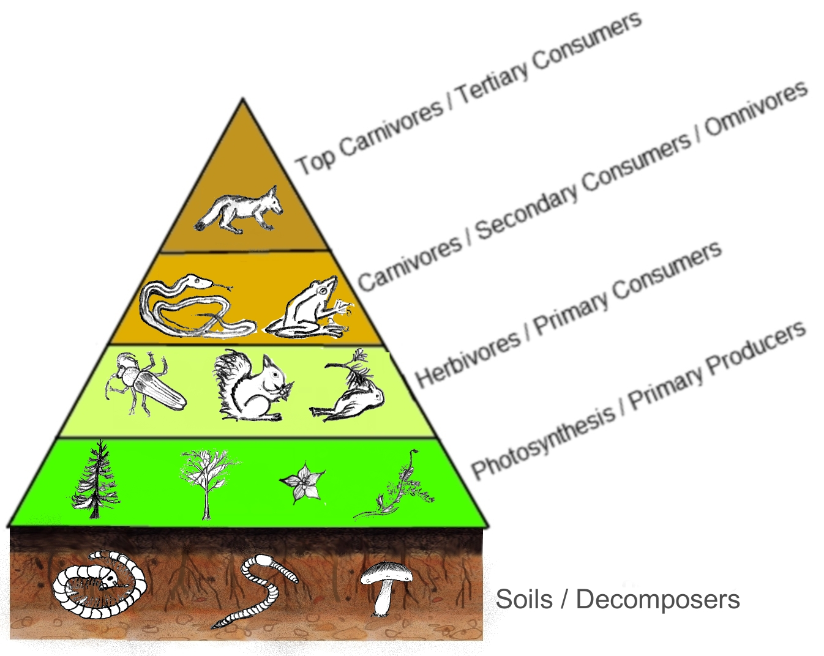
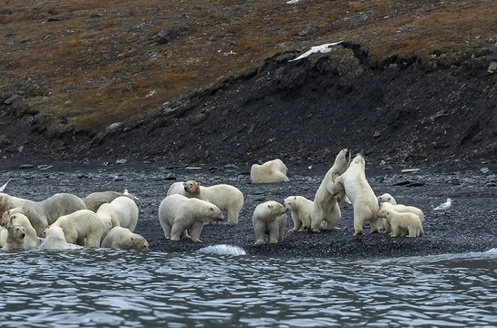
What type of consumers are polar bears?
Polar bears are carnivores consumers, meaning they eat other secondary and primary consumers.
Notes:
1 Background Color
1 Title (or write the question)
1 Pictures
1 Include Transitions
1 Answering question using complete sentences (multiple sentences if needed to fully explain your answer)
1 Accuracy of information

Slide 6
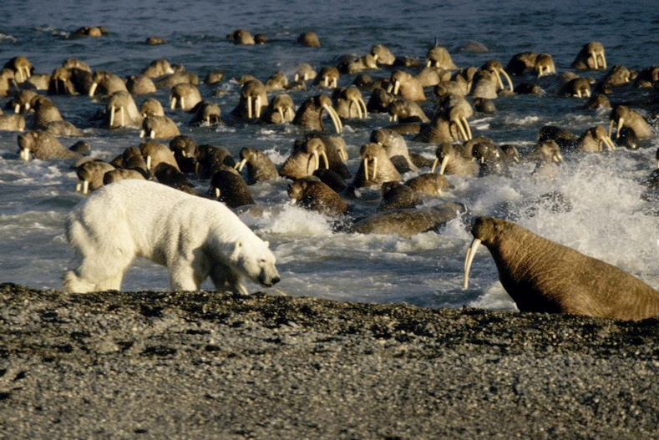
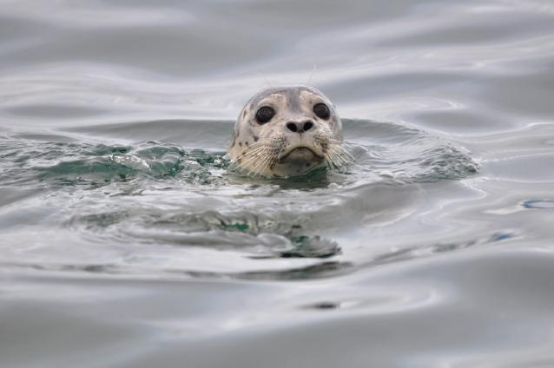
What specific foods do polar bears eat?
Polar bears first choice to eat seals. Seals have thick layers of fat that are rich in the calories polar bears need to keep themselves warm.
Notes:
1 Background Color
1 Title (or write the question)
1 Pictures
1 Include Transitions
1 Answering question using complete sentences (multiple sentences if needed to fully explain your answer)
1 Accuracy of information

Slide 7
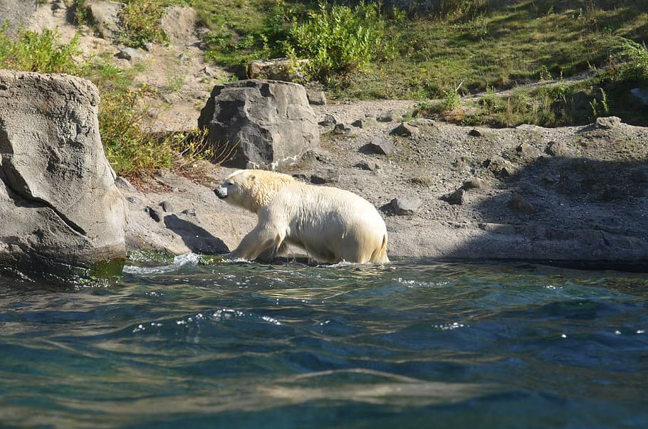
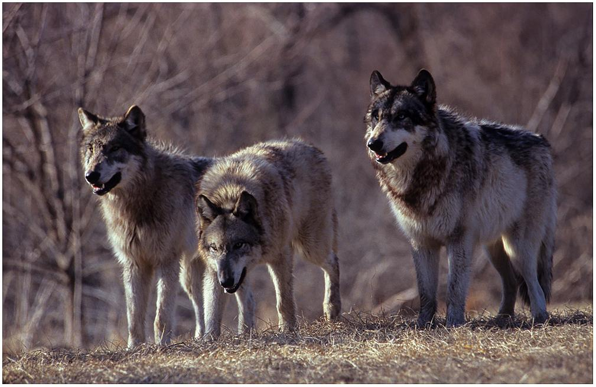
Does your creature have any predators?
Adult polar bears have no predators, though walruses and wolves can kill them.
Notes:
1 Background Color
1 Title (or write the question)
1 Pictures
1 Include Transitions
1 Answering question using complete sentences (multiple sentences if needed to fully explain your answer)
1 Accuracy of information

Slide 8
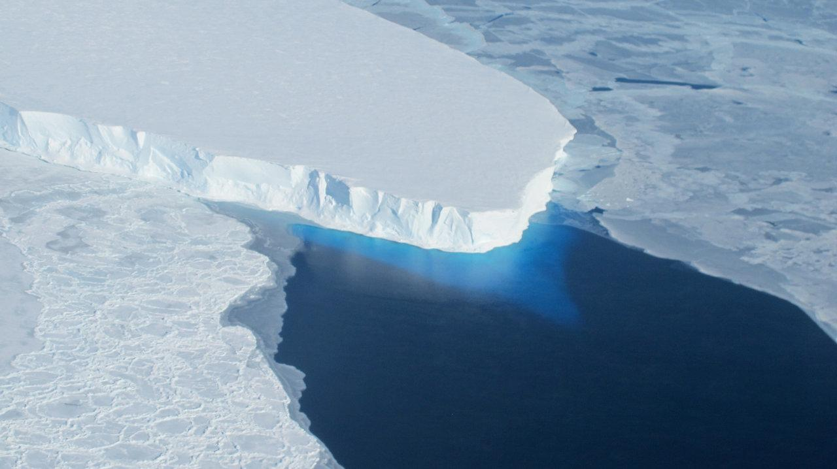
What is a typical food chain for your creature?
The polar bear is at the top of the Arctic food chain. Its most common prey is the ringed seal and the bearded seal. Out on the sea ice they will eat young walruses, Greenland seals, hooded seals, beluga whales and narwhals. When on land polar bears also catch reindeer and the young and eggs of sea birds and geese.
Notes:
1 Background Color
1 Title (or write the question)
1 Pictures
1 Include Transitions
1 Answering question using complete sentences (multiple sentences if needed to fully explain your answer)
1 Accuracy of information

Slide 9
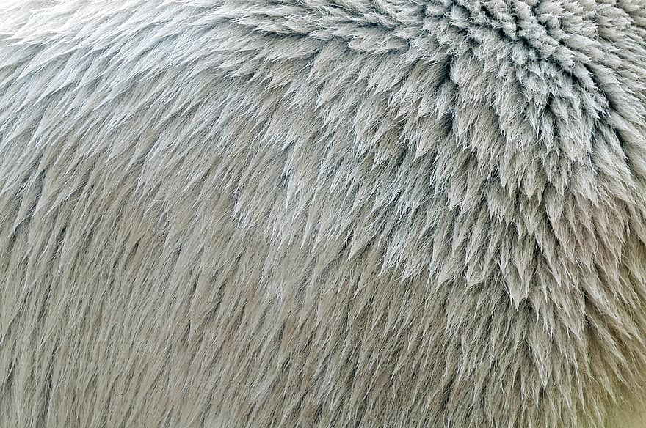
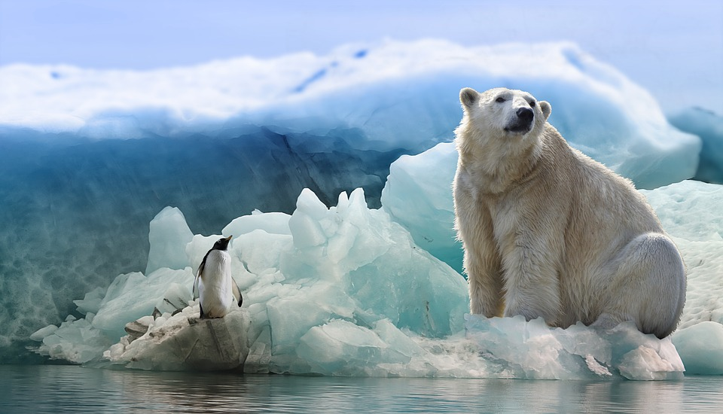
Do polar bears have a specific adaptation to survive?
Polar bears have special adaptations, or features that have evolved, letting them live in this bitterly cold Arctic climate.
Notes:
1 Background Color
1 Title (or write the question)
1 Pictures
1 Include Transitions
1 Answering question using complete sentences (multiple sentences if needed to fully explain your answer)
1 Accuracy of information

Slide 10
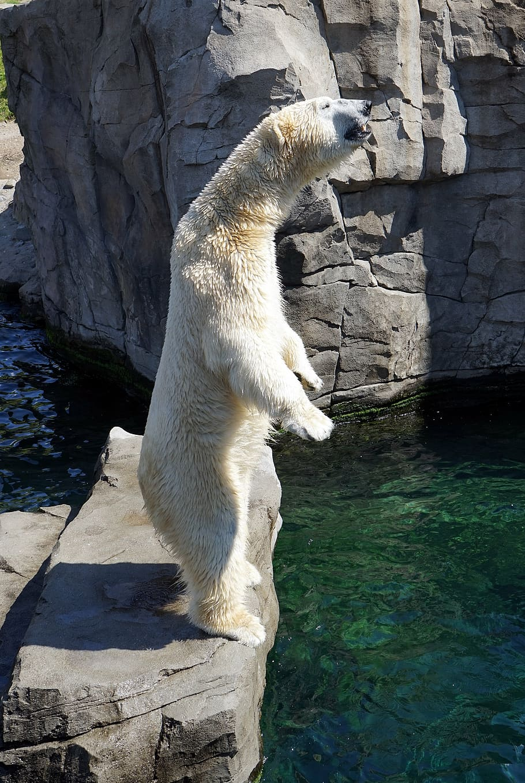
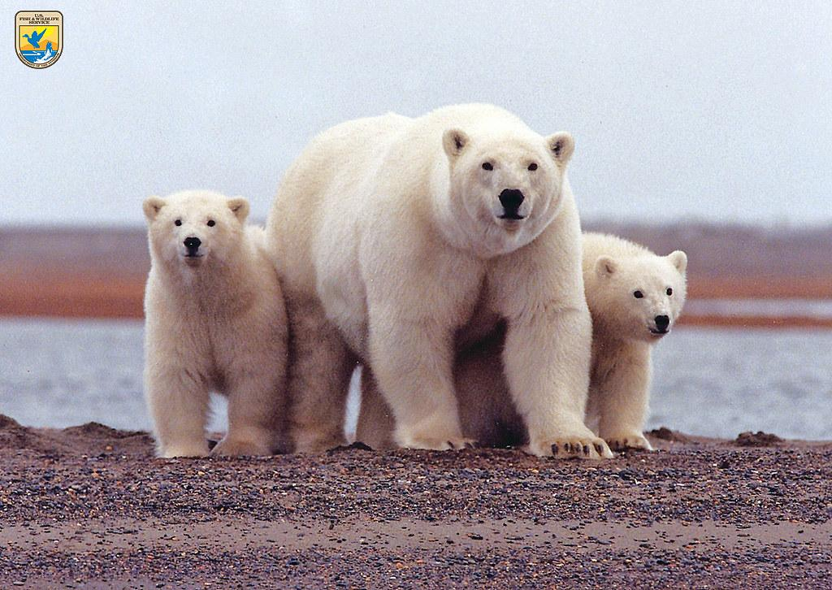
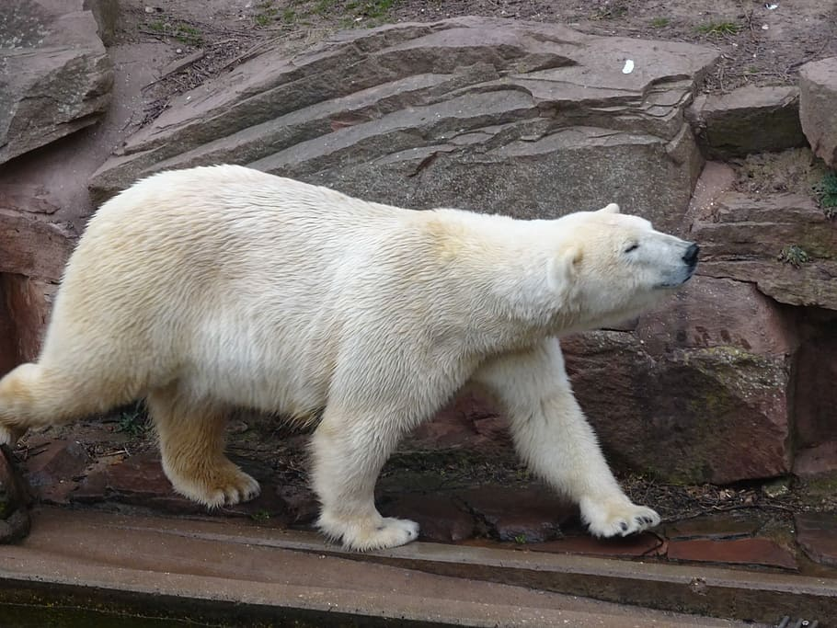
What do polar bears look like, how much does it weigh, and how tall is it?
Polar bears have a long neck, small heads, short, rounded ears, and a short tail. The males are larger than the female and weigh 900 to 1,600 pounds. Polar bears grow about 5.3 feet.
Notes:
1 Background Color
1 Title (or write the question)
1 Pictures
1 Include Transitions
1 Answering question using complete sentences (multiple sentences if needed to fully explain your answer)
1 Accuracy of information

Slide 11
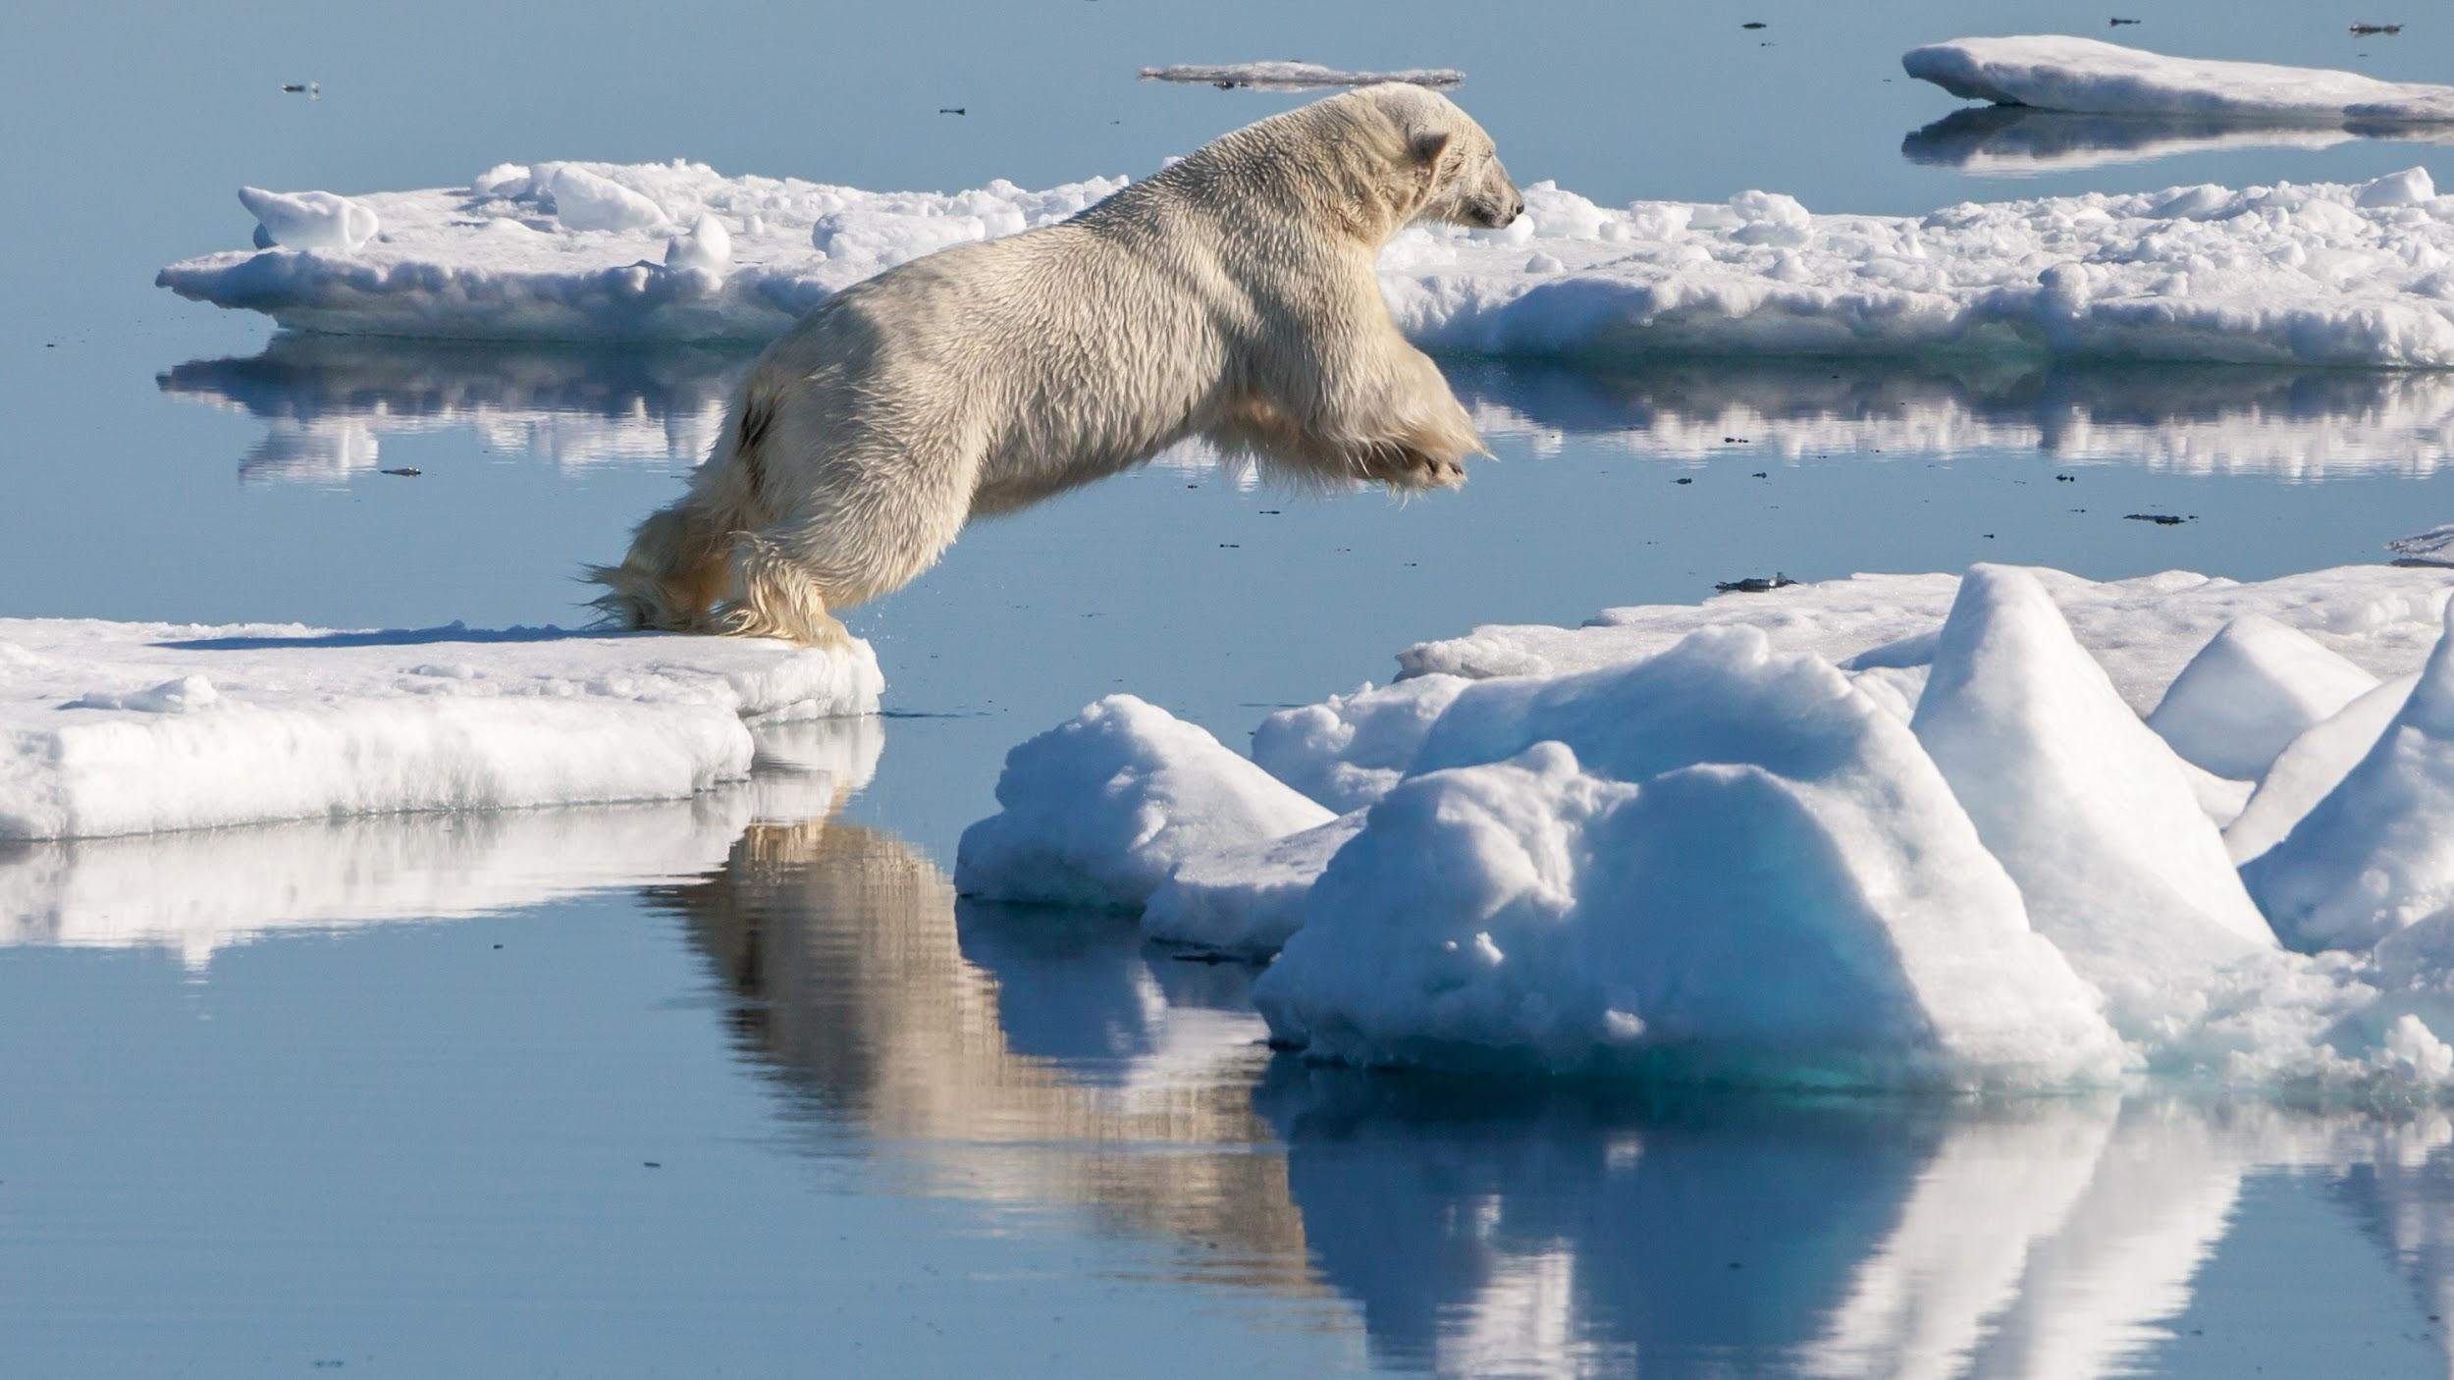
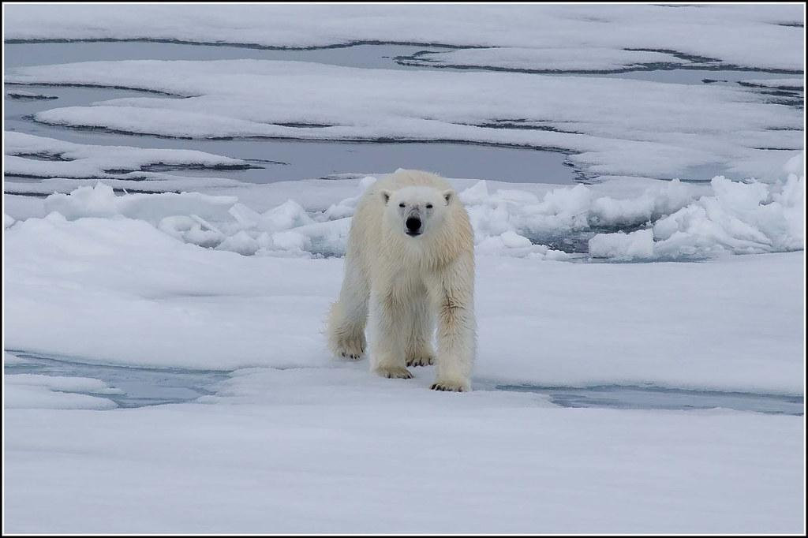
Do female and male polar bears weigh the same and are the same size?
Male polar bears usually weigh between 770 pounds and more than 1,300 pounds. Female polar bears weigh 330 to 650 pounds. Male polar bears are much larger than the female polar bears.
Notes:
1 Background Color
1 Title (or write the question)
1 Pictures
1 Include Transitions
1 Answering question using complete sentences (multiple sentences if needed to fully explain your answer)
1 Accuracy of information

Slide 12
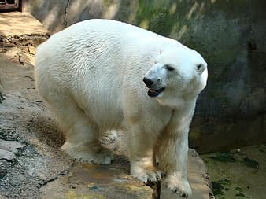
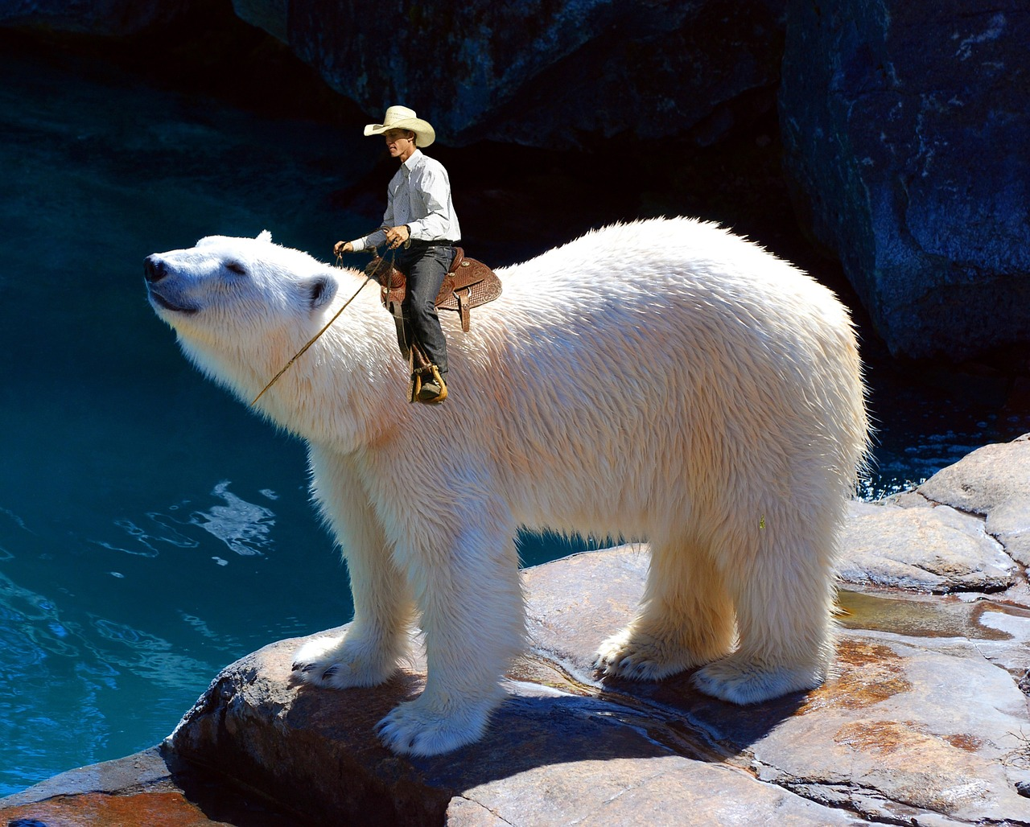
What is the lifespan of polar bears?
Polar bears can live up to 25 or 30 years.

Slide 13
8 facts about polar bears
-Polar bears have black skin and although their fur appears white, it is actually transparent.
-Polar bears use sea ice as a platform to hunt seals.
-They can swim constantly for days at a time.
-Scientists can extract polar bear DNA from just their footprints.
-They face more threats than climate change.
-Polar bears can reach speeds up to 40 kph (25 mph) on land and 10 kph (6 mph) in water.
-Scientists estimate that there are around 20000 polar bears.
-Polar bears have an excellent sense of smell, with the ability to detect seals nearly a mile away (1.6 km).
Notes:
1 Background Color
1 Title (or write the question)
1 Pictures
1 Include Transitions
1 Answering question using complete sentences (multiple sentences if needed to fully explain your answer)
1 Accuracy of information

Slide 14
Sources
-https://www.theguardian.com/science/2011/jul/07/polar-bear-ancestors-ireland#:~:text=It's%20a%20long%20way%20from,during%20the%20last%20ice%20age.
-https://www.theguardian.com/science/2011/jul/07/polar-bear-ancestors-ireland#:~:text=It's%20a%20long%20way%20from,during%20the%20last%20ice%20age.
-https://study.com/academy/lesson/polar-bear-food-chain.html#:~:text=Polar%20bears%20are%20tertiary%20consumers,provide%20energy%20for%20polar
-https://www.britannica.com/animal/polar-bear -https://www.britannica.com/animal/polar-bear
-https://oceanwide-expeditions.com/blog/the-polar-bear-king-of-the-arctic-food-chain#:~:text=The%20polar%20bear%20is%20at,seal%20and%20the%20bearded%20seal.&text=Out%20on%20the%20sea%20ice,of%20sea%20birds%20and%20geese.
-https://www.biologicaldiversity.org/species/mammals/polar_bear/natural_history.html#:~:text=LIFE%20CYCLE%3A%20Polar%20bears%20can,carcasses%20found%20along%20the%20coast.
-https://www.wwf.org.uk/learn/fascinating-facts/polar-bears -https://www.sciencekids.co.nz/sciencefacts/animals/polarbear.html
-
Notes:
1 Background Color
1 Title (or write the question)
1 Pictures
1 Include Transitions
1 Answering question using complete sentences (multiple sentences if needed to fully explain your answer)
1 Accuracy of information

