Slide 1

Convergent Boundary
Notes:
Please include pictures and complete sentences for EVERY slide or you will lose points.
Slide #1: Convergent Boundary (title with picture)

Slide 2

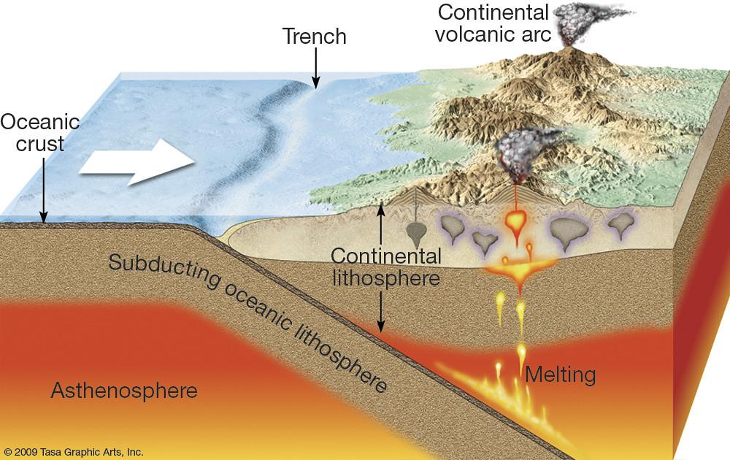
What happens at a Convergent Boundary?
This occurs when plates move towards each other and collide, and when a continental plate meets an oceanic plate, the thinner, denser, and more flexible oceanic plate sinks beneath the thicker, more rigid continental plate. This is called subduction.
Notes:
Please include pictures and complete sentences for EVERY slide or you will lose points.
Slide #2: What happens at a Convergent Boundary?

Slide 3

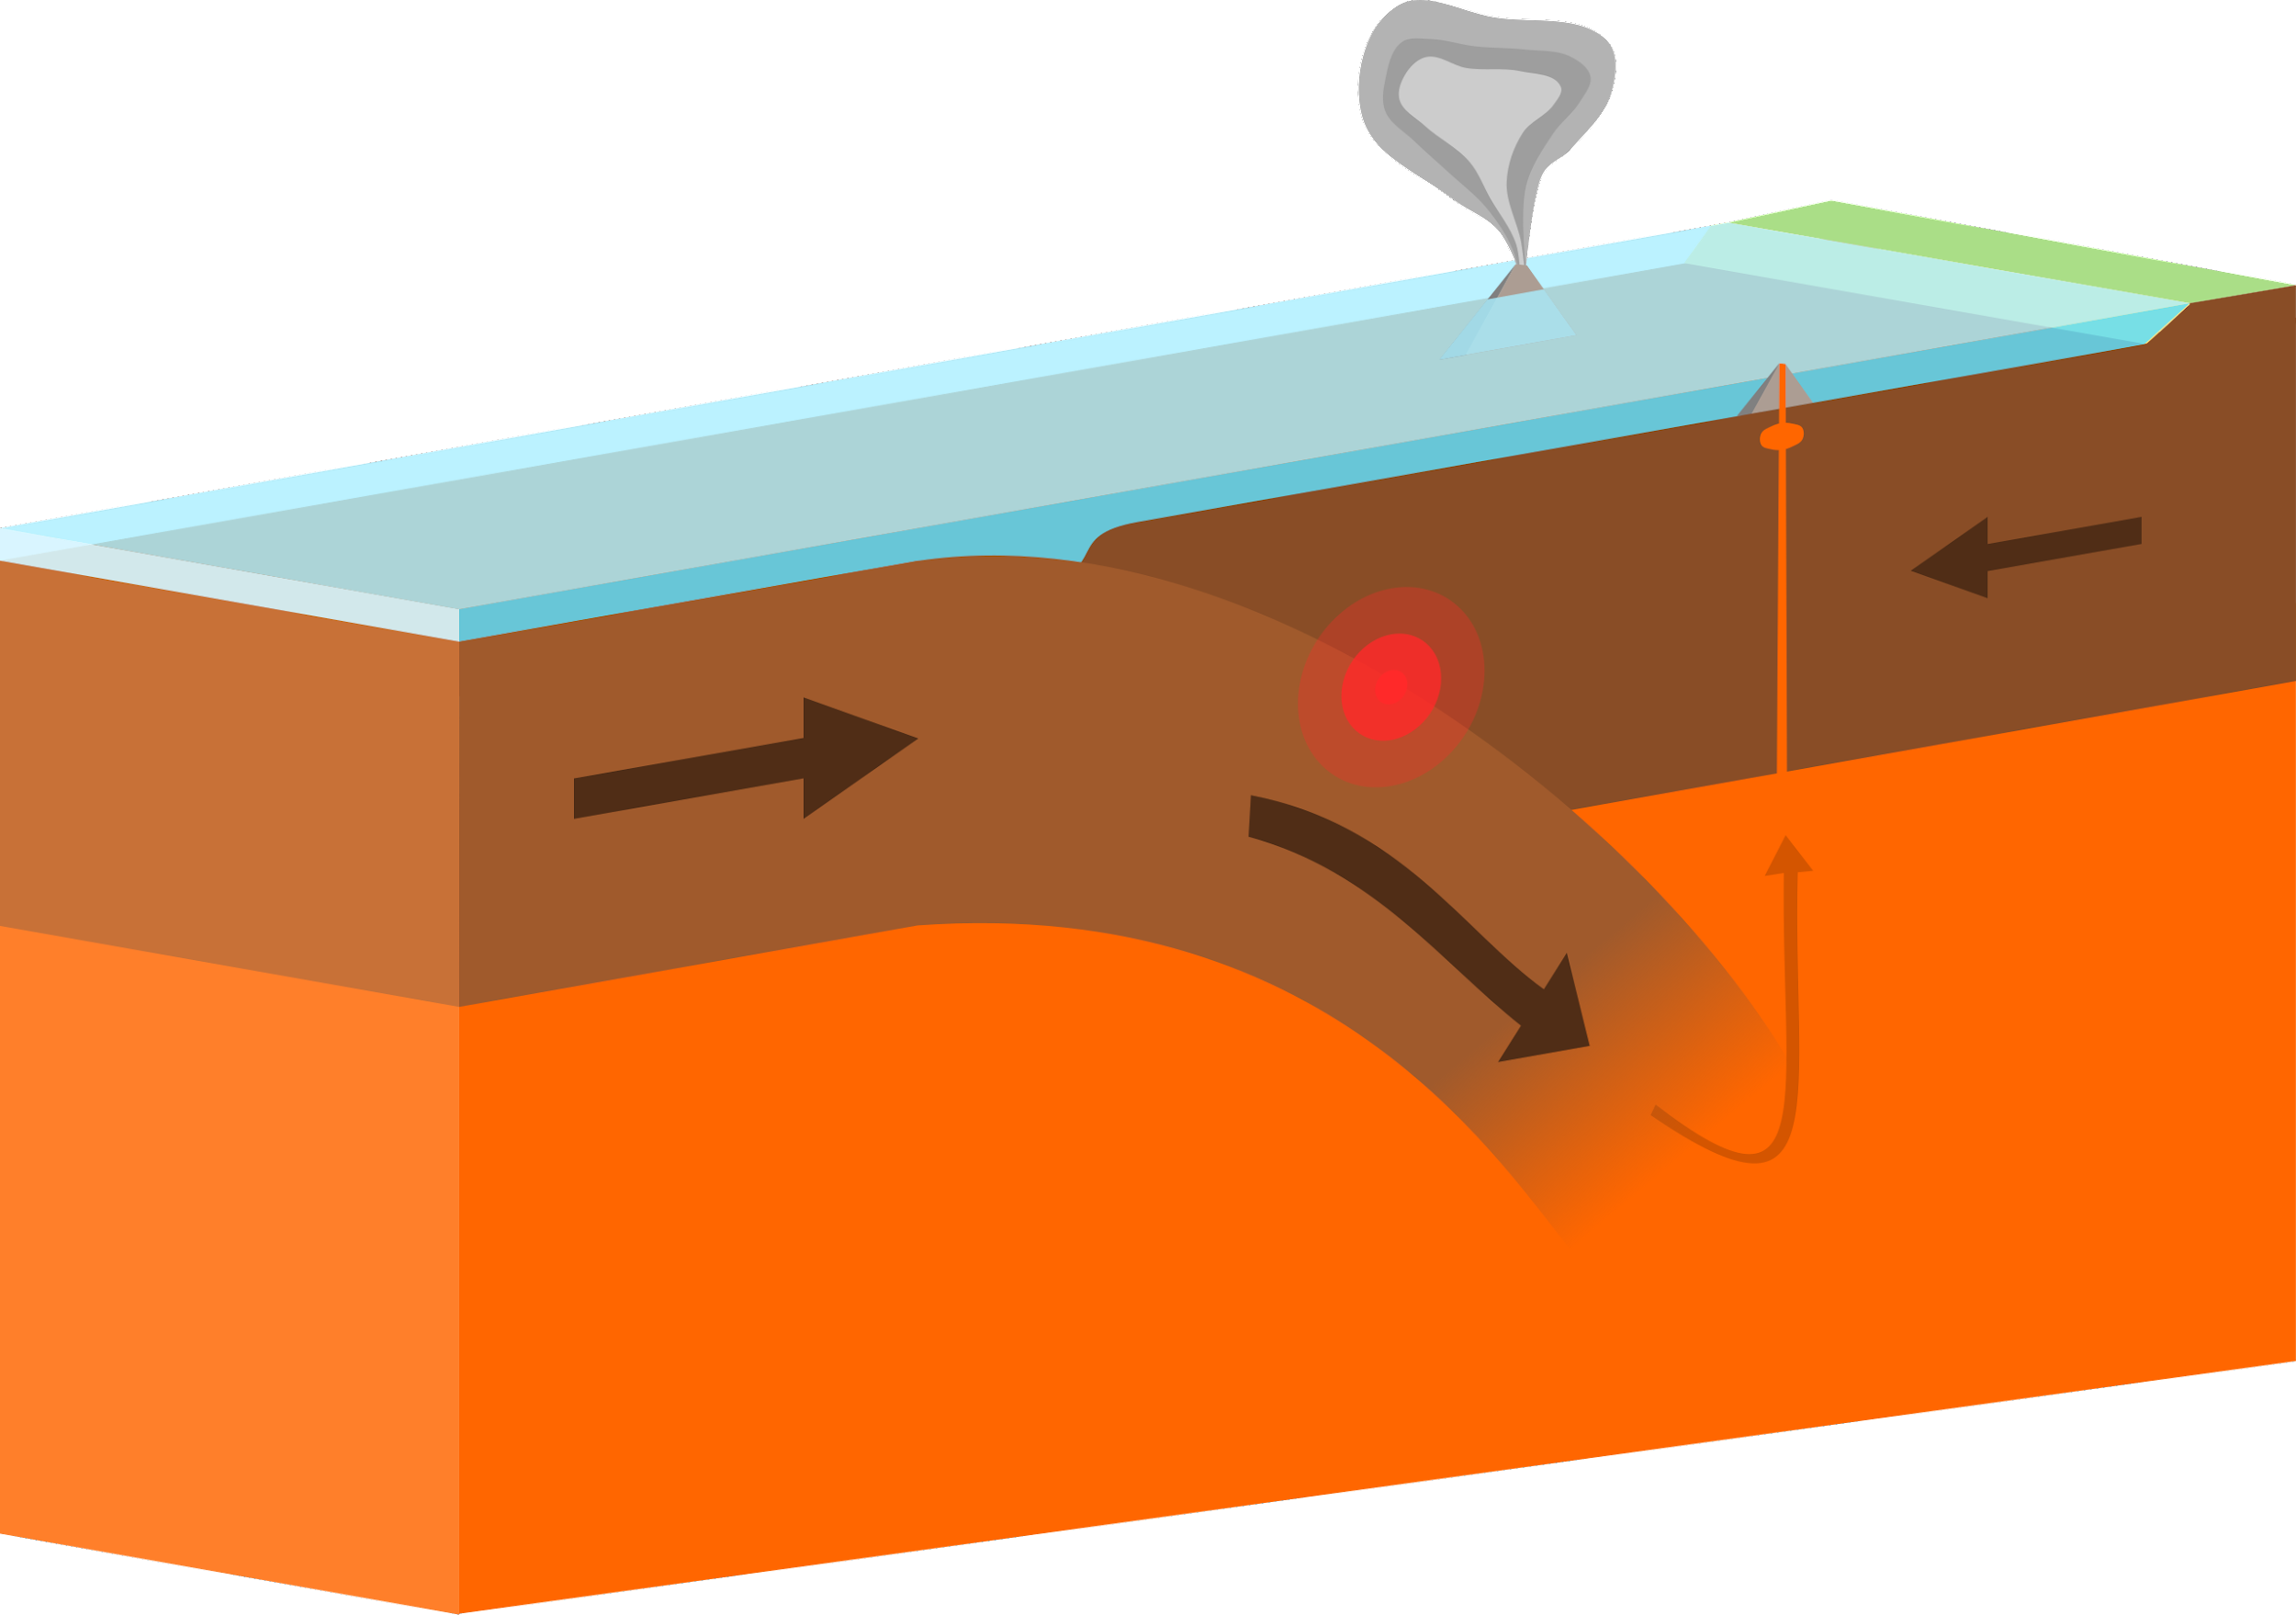
Oceanic
2 oceanic plates collide during subduction, a trench is formed- besides trenches, underwater volcanoes form
Notes:
Please include pictures and complete sentences for EVERY slide or you will lose points.
Slide #3: First type of Convergent plate boundary explained.

Slide 4
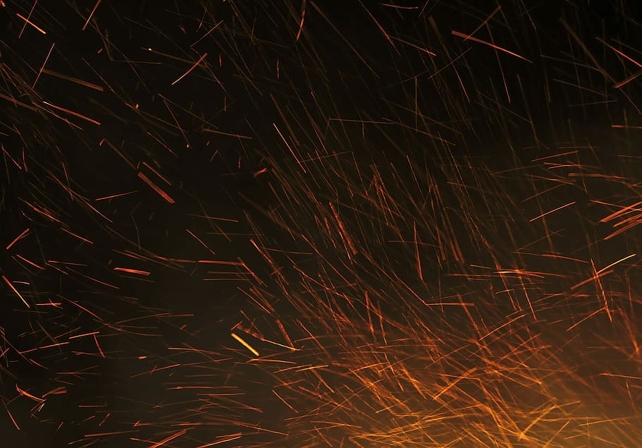
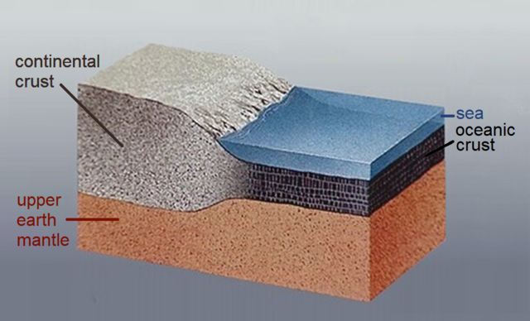
2. Oceanic- Continental
Oceanic - Continental - When an ocean and continental plate collide - Oceanic plate is denser and subducts - mountains or
Notes:
Please include pictures and complete sentences for EVERY slide or you will lose points.
Slide #4: Second type of Convergent plate boundary explained.

Slide 5
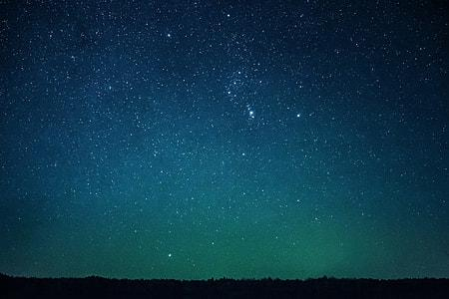
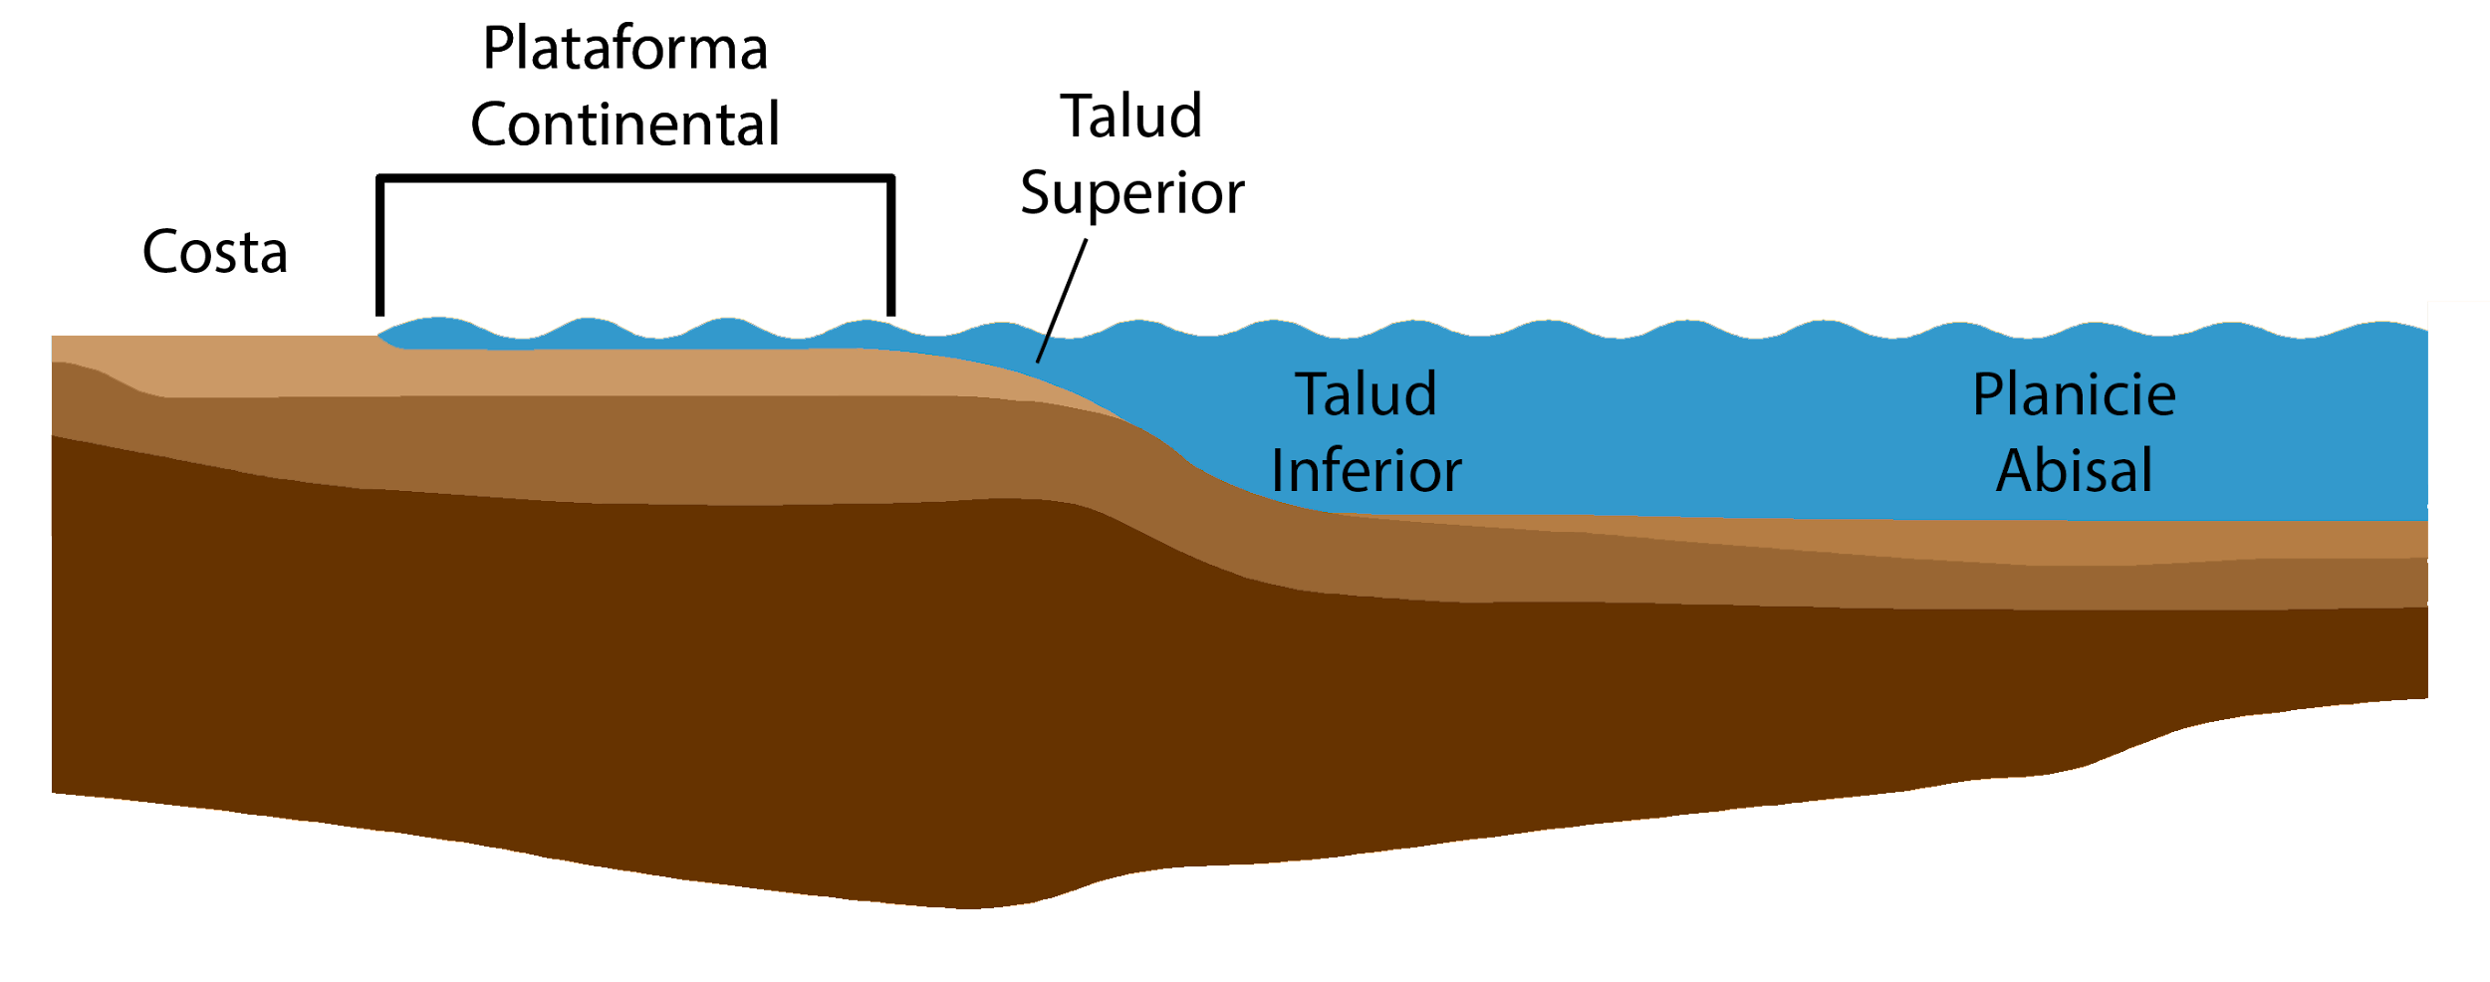
Continental - Continental
Continental - 2 continental plates collide - mountains are formed because plates “squish” together
Notes:
Please include pictures and complete sentences for EVERY slide or you will lose points.
Slide #5: Third type of Convergent plate boundary explained.

Slide 6

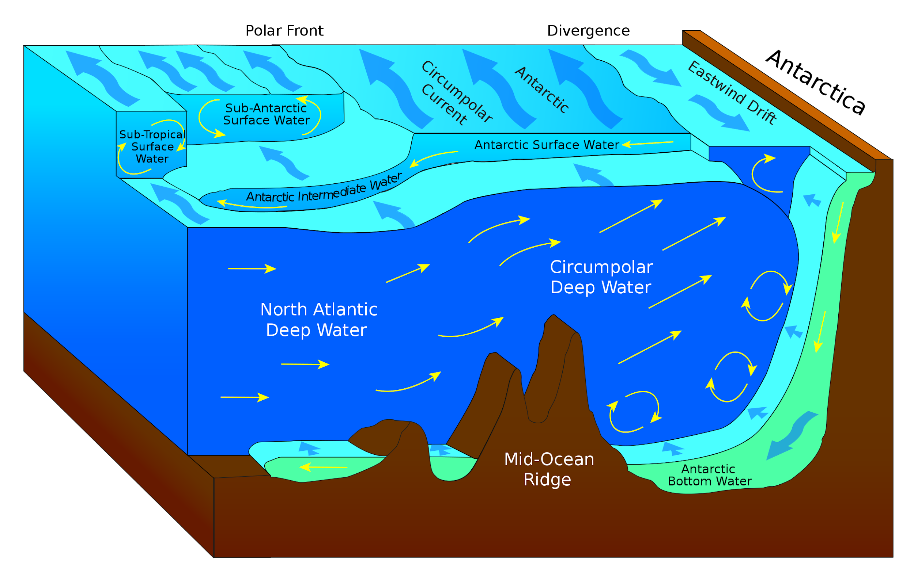
What forms at the 1st Convergent Boundary?
Effects found at a convergent boundary between continental plates include: intense folding and faulting; a broad folded mountain range; shallow earthquake activity; shortening and thickening of the plates within the collision zone, Ocean trenches, volcanos, island arcs, submarine mountain ranges, and fault lines.
Notes:
Please include pictures and complete sentences for EVERY slide or you will lose points.
Slide #6: What forms at the 1st Convergent Boundary? – Give well known example of landform created at this boundary.

Slide 7

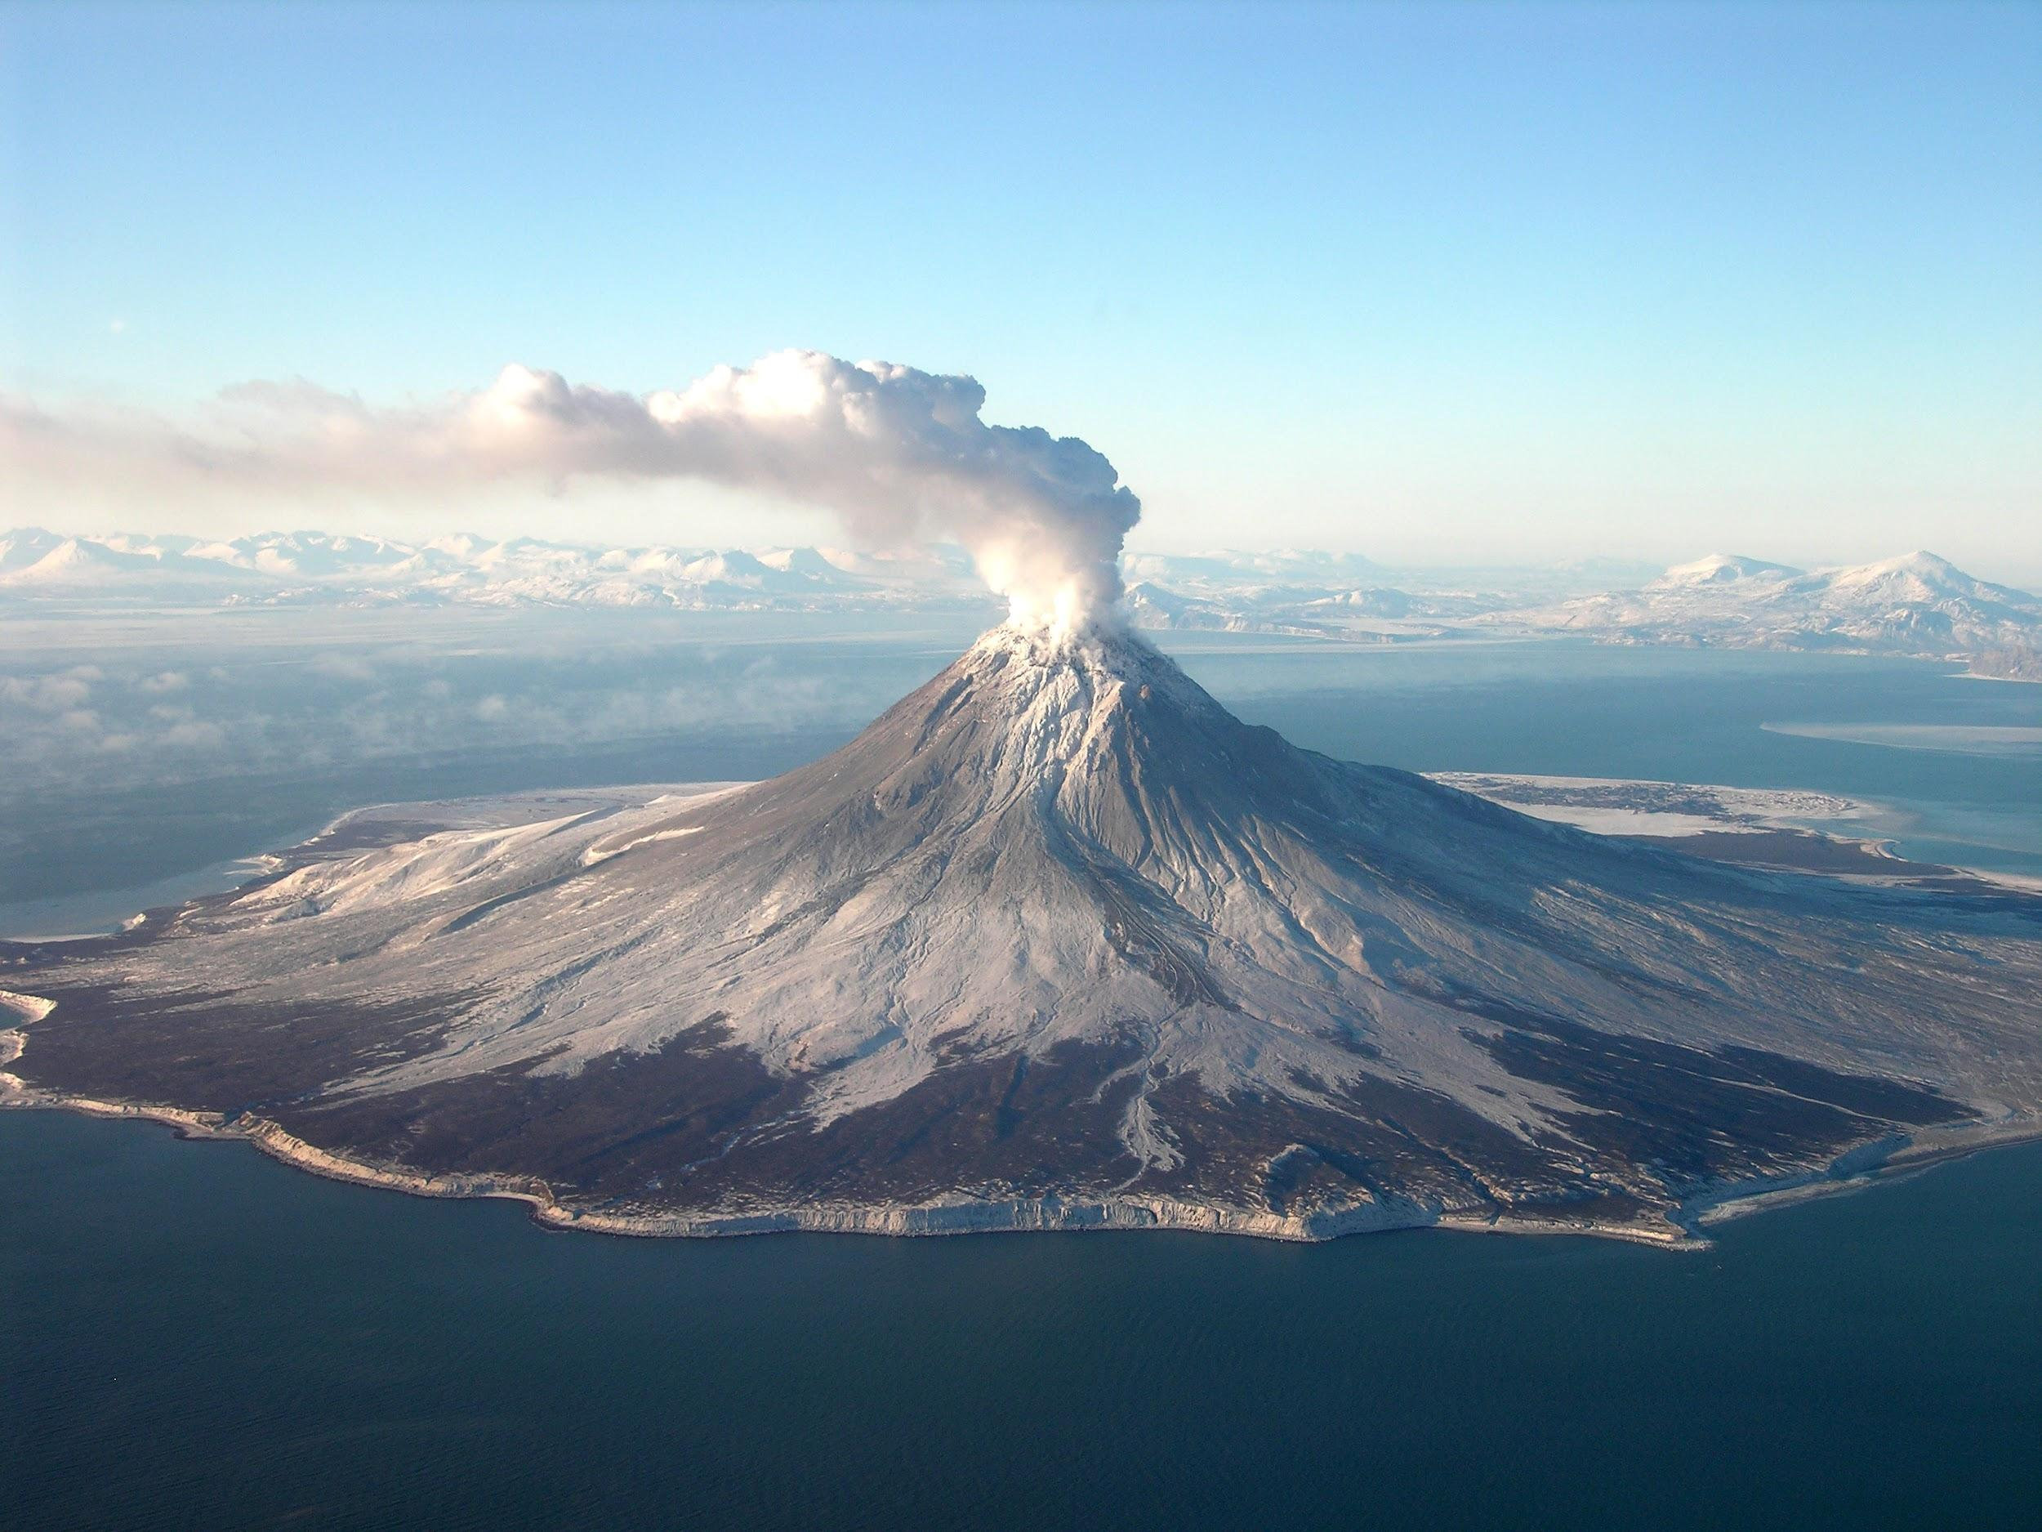
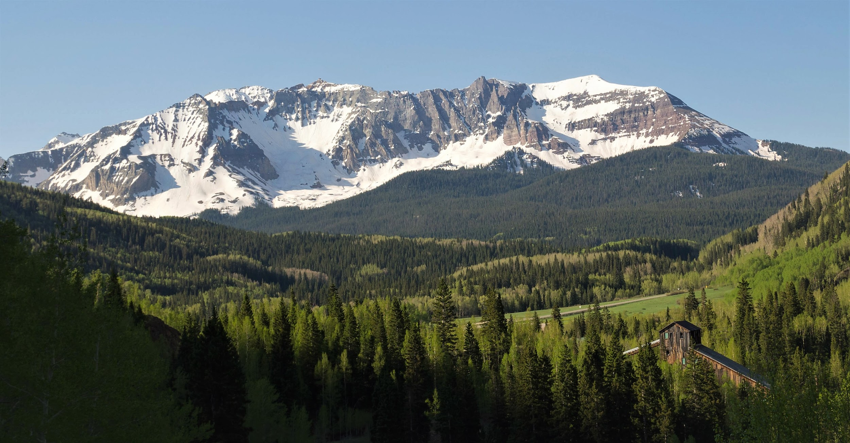
What forms at the 2nd Convergent Boundary?
Mountains and volcanoes form
Notes:
Please include pictures and complete sentences for EVERY slide or you will lose points.
Slide #7: What forms at the 2nd Convergent Boundary? – Give well known example of landform created at this boundary.

Slide 8

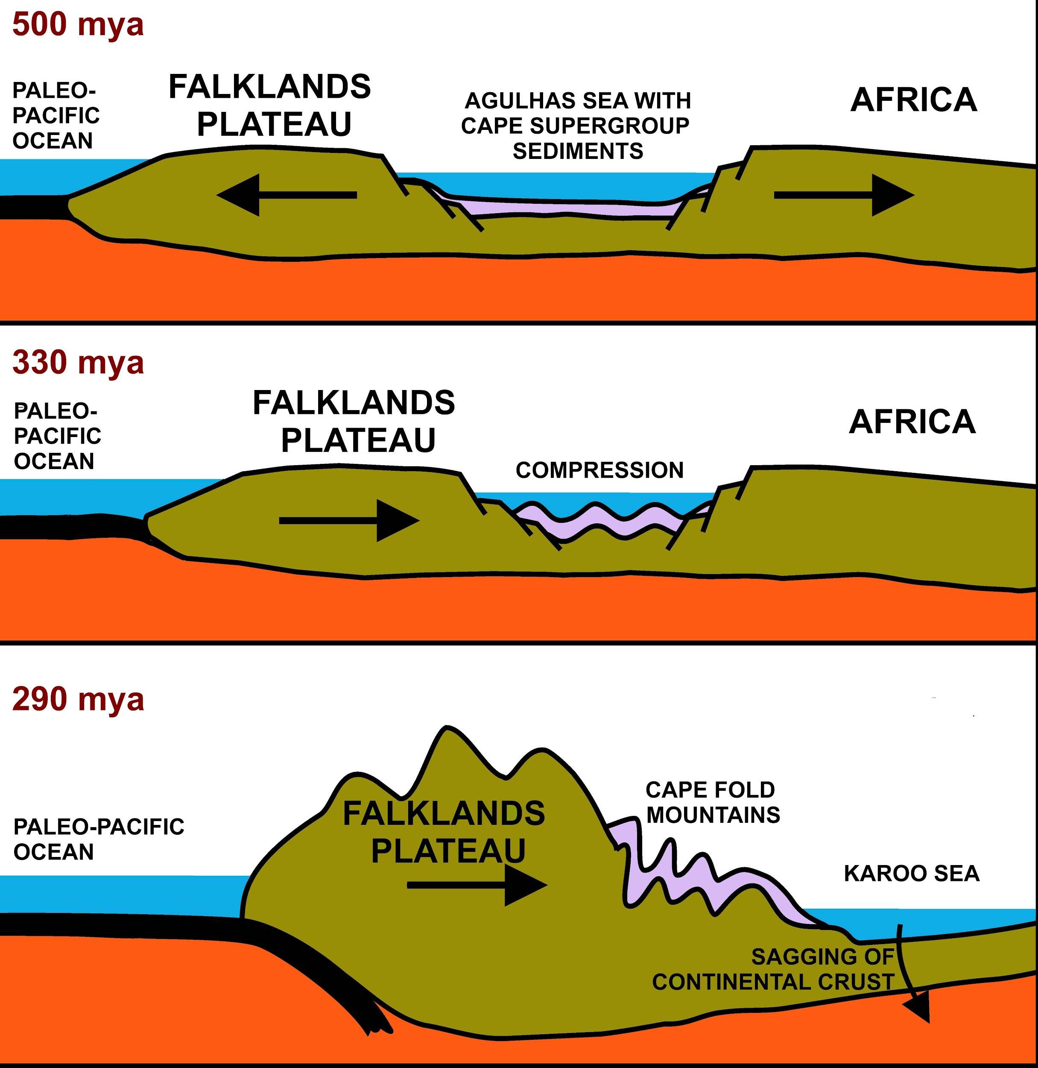
What forms at the 3rd Convergent Boundary?
Mountains are formed
Notes:
Please include pictures and complete sentences for EVERY slide or you will lose points.
Slide #8: What forms at the 3rd Convergent Boundary? – Give well known example of landform created at this boundary.

Slide 9
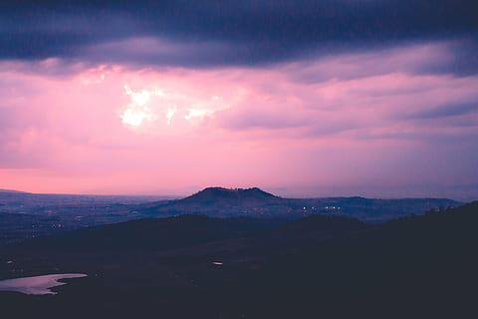
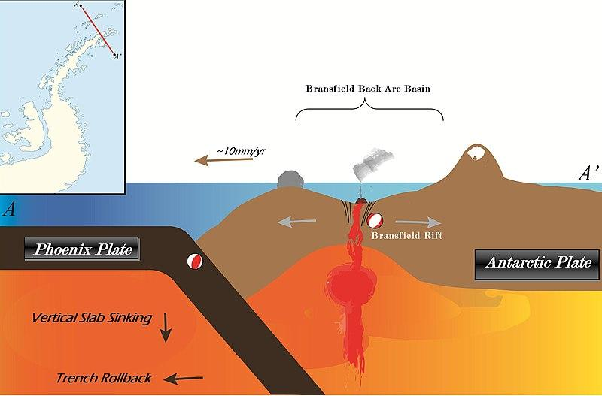
Divergent Boundary
Where plates move away from each other - called constructive boundary because new crust is made - molten lava is pushed up from earth and becomes new crust after it cools
Notes:
Please include pictures and complete sentences for EVERY slide or you will lose points.
Slide #9:Divergent Boundary (title with picture).

Slide 10

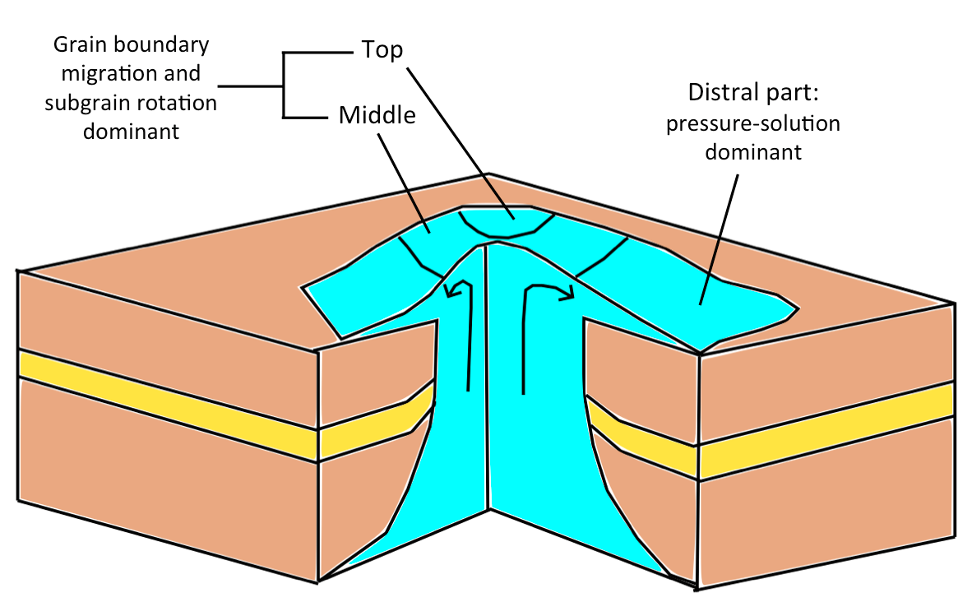
What happens at a Divergent Boundary?
A divergent boundary occurs when two tectonic plates move away from each other. Along these boundaries, earthquakes are common and magma (molten rock) rises from the Earth's mantle to the surface, solidifying to create new oceanic crust. The Mid-Atlantic Ridge is an example of divergent plate boundaries.
Notes:
Please include pictures and complete sentences for EVERY slide or you will lose points.
Slide #10: What happens at a Divergent Boundary?

Slide 11
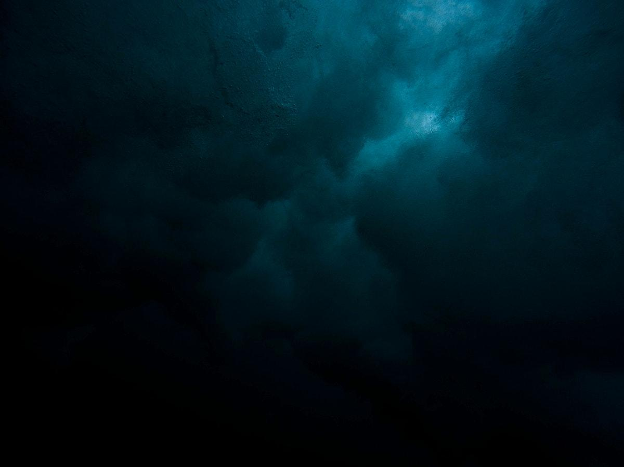
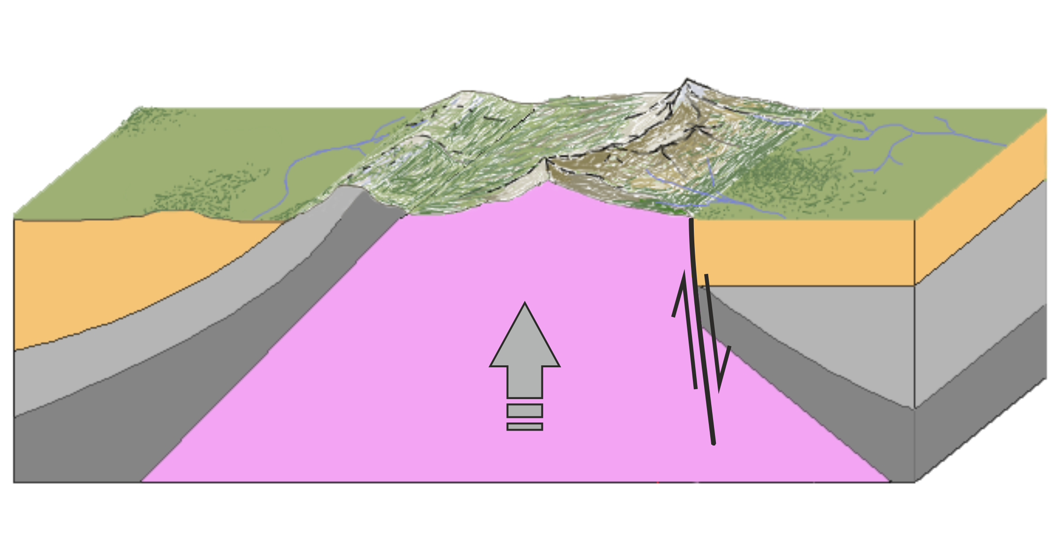
What forms at a Divergent Boundary?
When two plates are moving away from each other, we call this a divergent plate boundary. Along these boundaries, magma rises from deep within the Earth and erupts to form new crust on the lithosphere. Most divergent plate boundaries are underwater and form submarine mountain ranges called oceanic spreading ridges.
Notes:
Please include pictures and complete sentences for EVERY slide or you will lose points.
Slide #11: What forms at a Divergent Boundary?

Slide 12
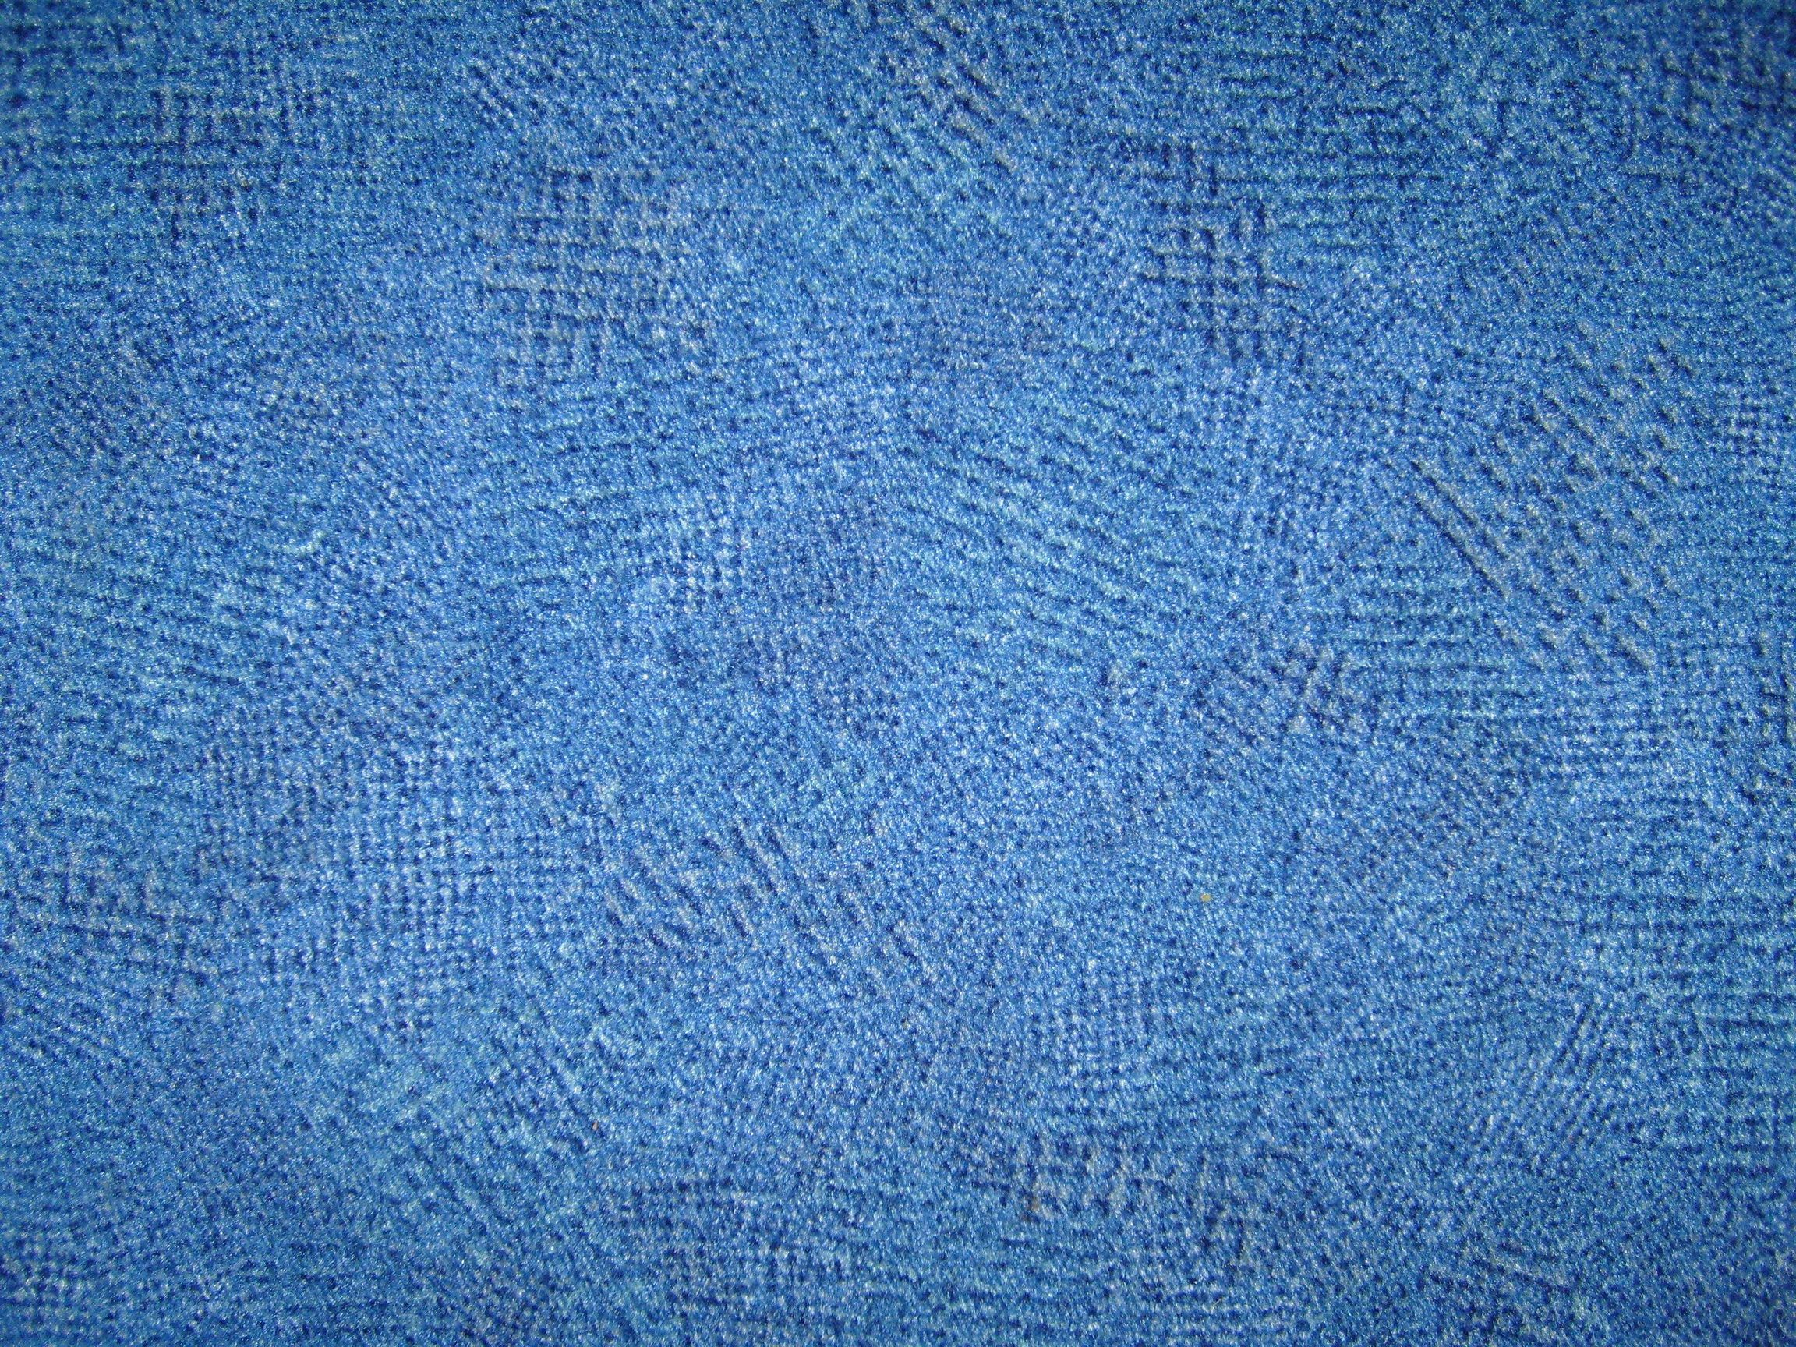
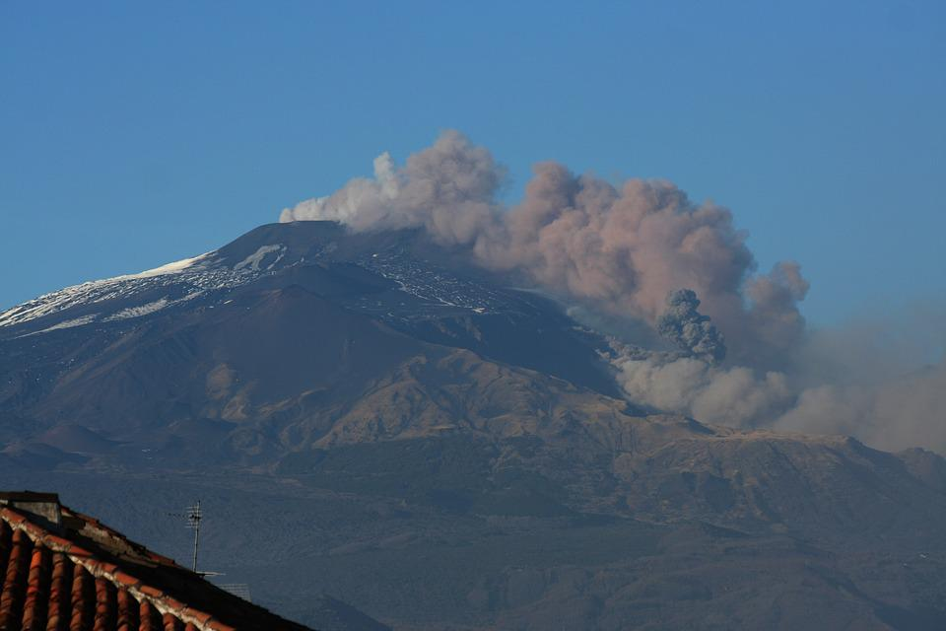
Mount Etna is an example of a Divergent Boundary
Notes:
Please include pictures and complete sentences for EVERY slide or you will lose points.
Slide #12: Well known example of landform created at a Divergent Boundary.

Slide 13

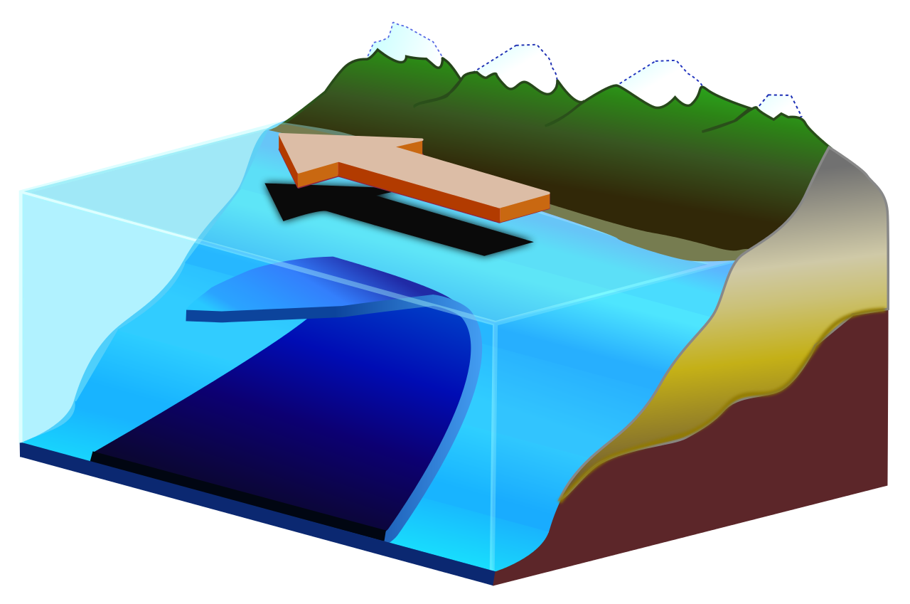
Transform Fault
Transform fault, in geology and oceanography, a type of fault in which two tectonic plates slide past one another. A transform fault may occur in the portion of a fracture zone that exists between different offset spreading centres or that connects spreading centres to deep-sea trenches in subduction zones.
Notes:
Please include pictures and complete sentences for EVERY slide or you will lose points.
Slide #13: Transform Fault (title with picture).

Slide 14

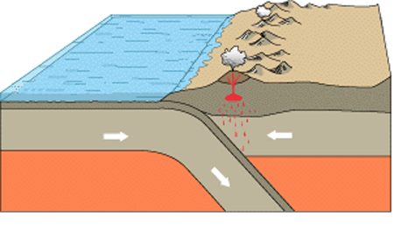
What happens at a Transform Fault Boundary?
A transform boundary (or conservative boundary) is where two of the tectonic plates slide alongside each other. When this happens, the scraping of the two plates causes earthquakes
Notes:
Please include pictures and complete sentences for EVERY slide or you will lose points.
Slide #14: What happens at a Transform Fault Boundary?

Slide 15
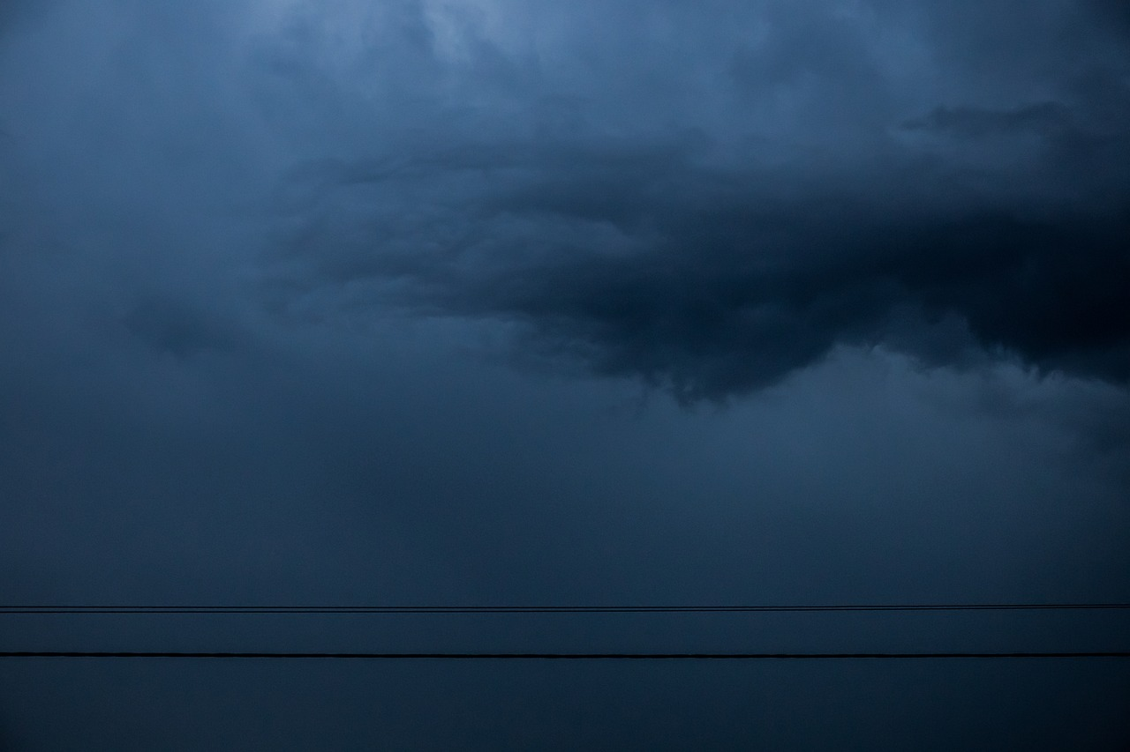
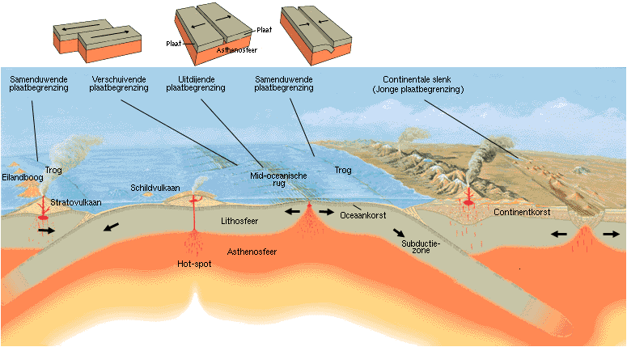
What forms at a Transform Fault Boundary?
The Earth's crust is split into sections called tectonic plates. Transform boundaries are where two of these plates are sliding alongside each other. This causes intense earthquakes, the formation of thin linear valleys, and split river beds.
Notes:
Please include pictures and complete sentences for EVERY slide or you will lose points.
Slide #15: What forms at a Transform Fault Boundary?

Slide 16

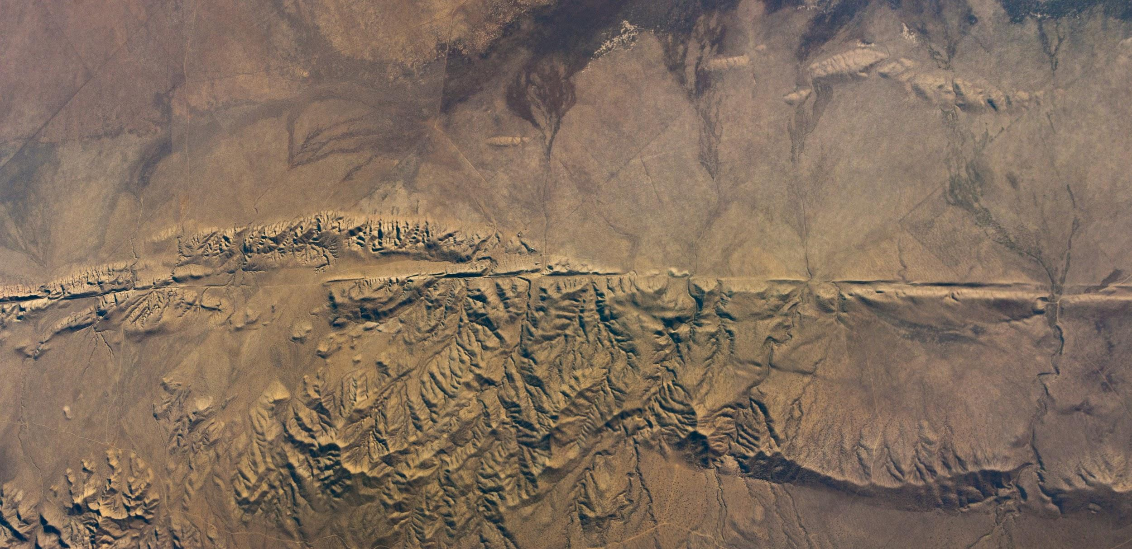
Transform fault facts
The San Andreas Fault and Queen Charlotte Fault are transform plate boundaries developing where the Pacific Plate moves northward past the North American Plate. The San Andreas Fault is just one of several faults that accommodate the transform motion between the Pacific and North American plates.
Notes:
Please include pictures and complete sentences for EVERY slide or you will lose points.
Slide #16: Example of a well-known Transform fault and a few facts about it.

