Slide 1
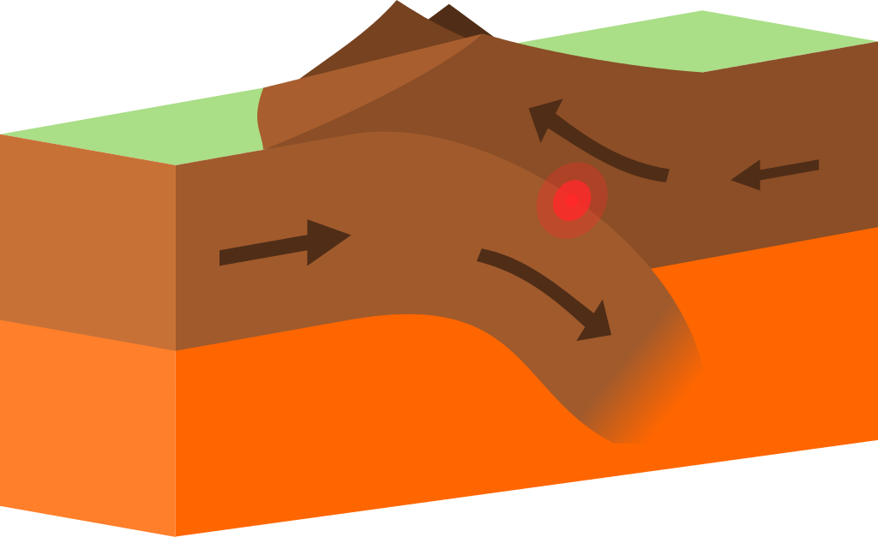
Convergent Boundary
By America Estrada
Notes:
Please include pictures and complete sentences for EVERY slide or you will lose points.
Slide #1: Convergent Boundary (title with picture)

Slide 2
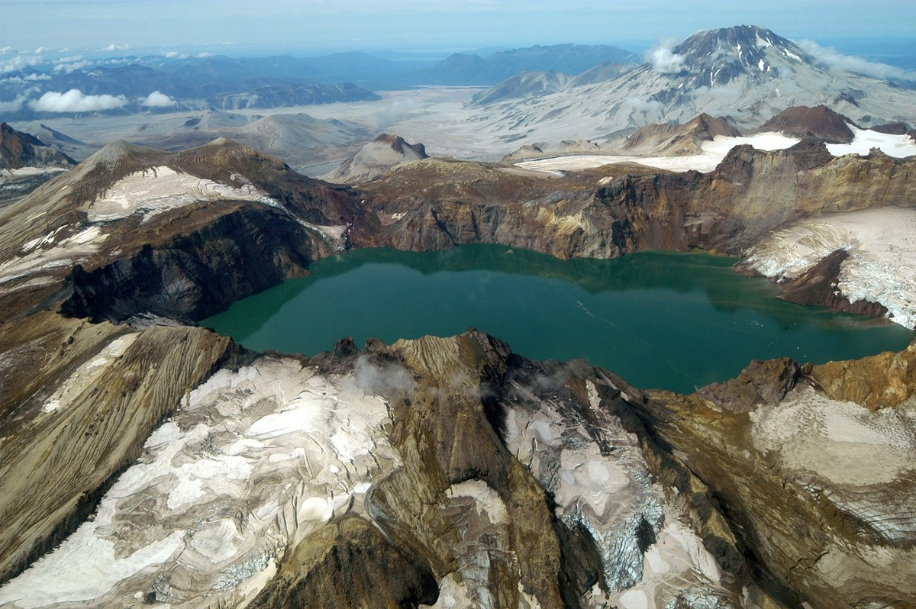
What happens at a Convergent Boundary?
At a Convergent Boundary its when 2 plates collide into one another.
Notes:
Please include pictures and complete sentences for EVERY slide or you will lose points.
Slide #2: What happens at a Convergent Boundary?

Slide 3
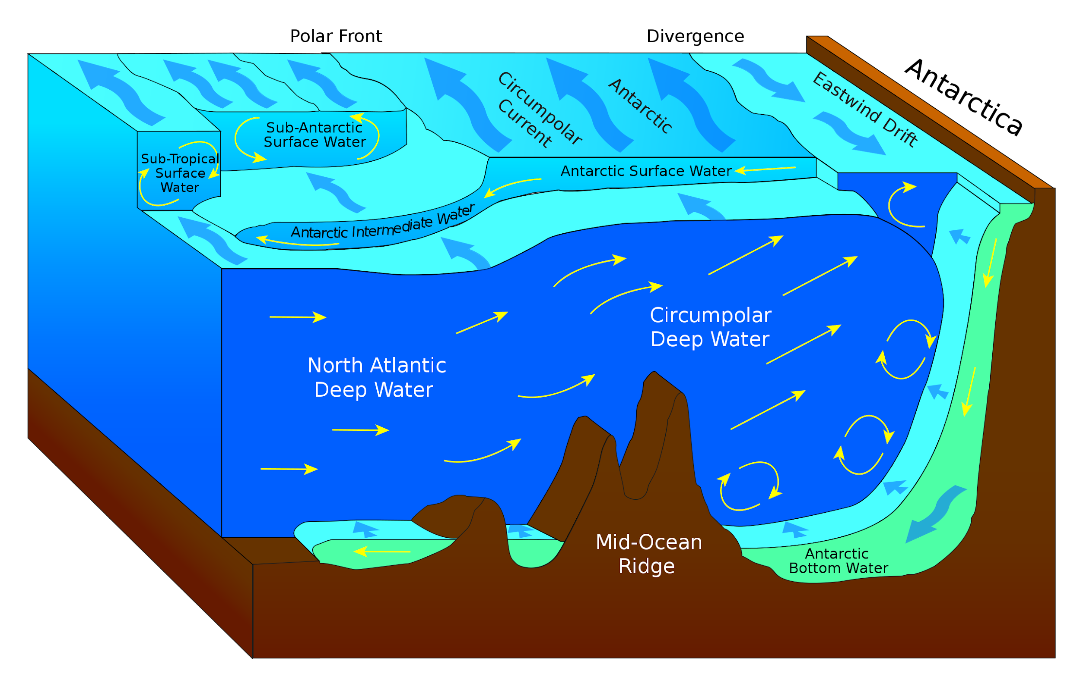
First type of Convergent plate boundary explained.
O-O
The first type of Convergent Boundary are Oceanic-Oceanic but when 2 oceanic plates collide during a subduction a trench is being formed but also underwater volcanoes are being formed too.
Notes:
Please include pictures and complete sentences for EVERY slide or you will lose points.
Slide #3: First type of Convergent plate boundary explained.

Slide 4
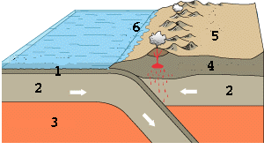
Second type of Convergent plate boundary explained.
O-C
When a Ocean and continental plate collide the Oceanic gets denser and subducts but the continental plate is near a Mountain or a Volcano plate.
Notes:
Please include pictures and complete sentences for EVERY slide or you will lose points.
Slide #4: Second type of Convergent plate boundary explained.

Slide 5
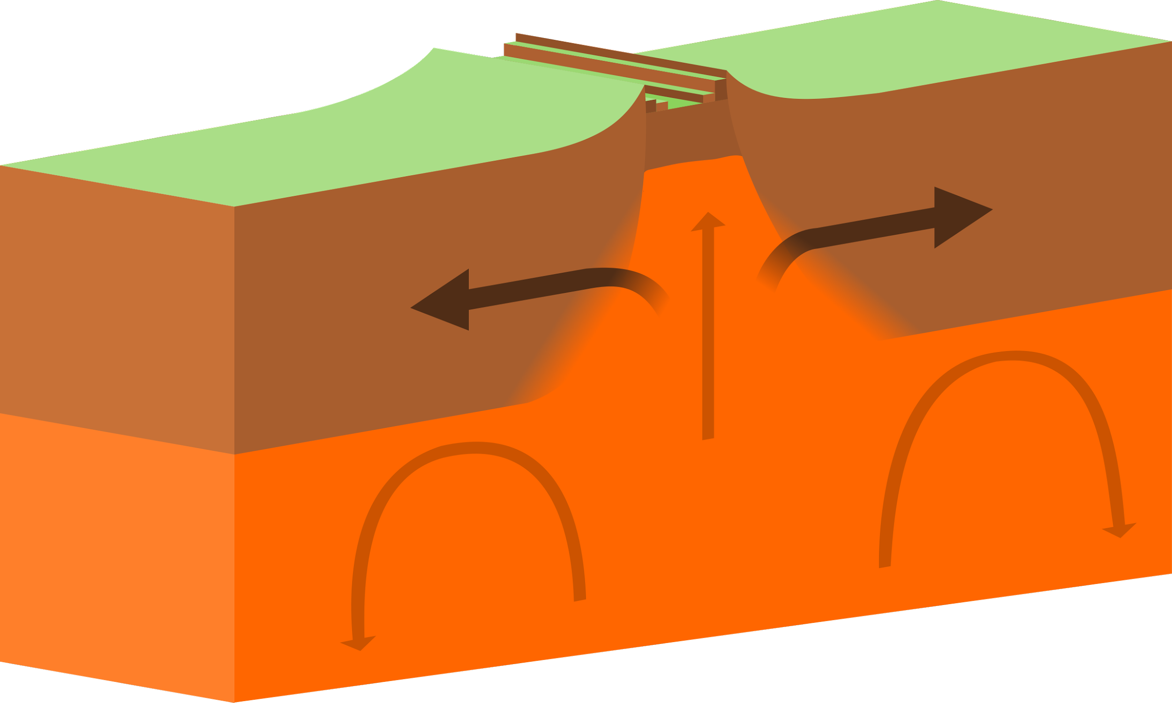
Third type of Convergent plate boundary explained.
C-C
Continental- Continental plates move away from each other.Molten lava is pushed up from each other and becomes new crust after it cools
Notes:
Please include pictures and complete sentences for EVERY slide or you will lose points.
Slide #5: Third type of Convergent plate boundary explained.

Slide 6
What forms at the 1st Boundary?
The 1st boundary that forms is a earthquake.
Notes:
Please include pictures and complete sentences for EVERY slide or you will lose points.
Slide #6: What forms at the 1st Convergent Boundary? – Give well known example of landform created at this boundary.

Slide 7
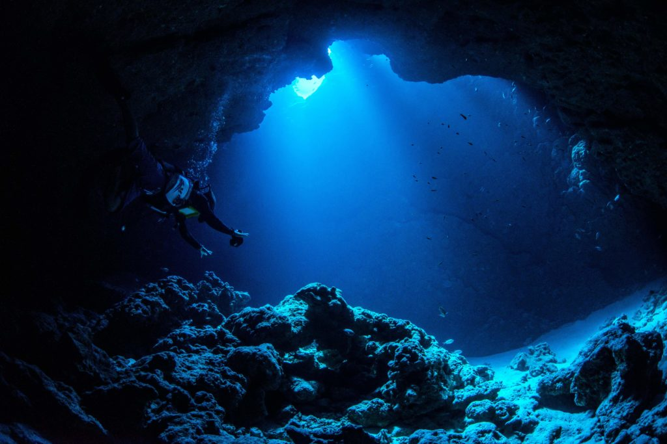
What forms at the 2nd convergent Boundary.
A deep ocean trench forms.
Notes:
Please include pictures and complete sentences for EVERY slide or you will lose points.
Slide #7: What forms at the 2nd Convergent Boundary? – Give well known example of landform created at this boundary.

Slide 8
What forms at the 3rd Convergent Boundary
Notes:
Please include pictures and complete sentences for EVERY slide or you will lose points.
Slide #8: What forms at the 3rd Convergent Boundary? – Give well known example of landform created at this boundary.

Slide 9
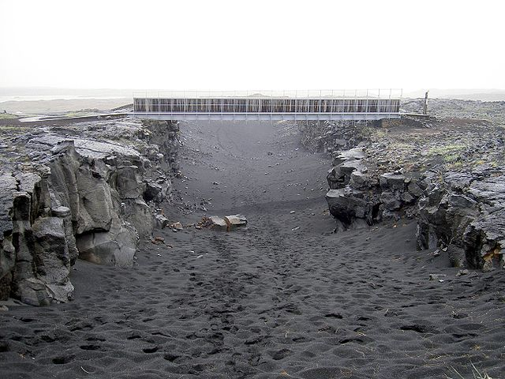
Divergent Boundary
Notes:
Please include pictures and complete sentences for EVERY slide or you will lose points.
Slide #9:Divergent Boundary (title with picture).

Slide 10
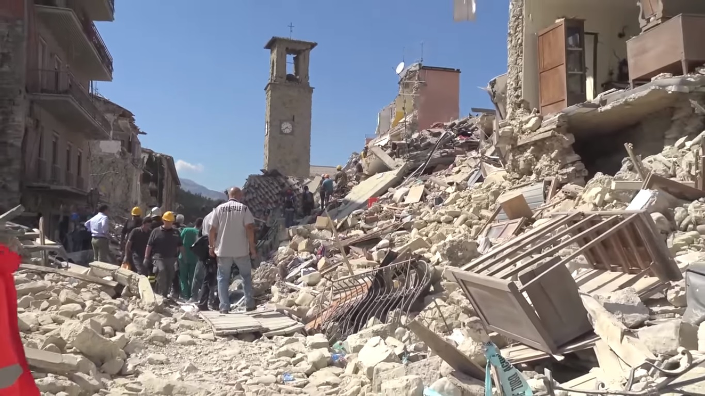
What happens at a Divergent Boundary
Earthquakes happen at divergent boundary.
Notes:
Please include pictures and complete sentences for EVERY slide or you will lose points.
Slide #10: What happens at a Divergent Boundary?

Slide 11
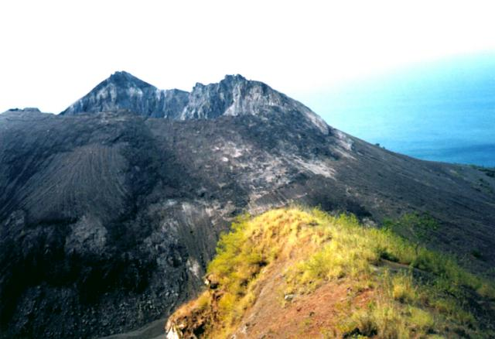
What forms at a divergent Boundary
Submarine mountain ridges form at Divergent Boundary.
Notes:
Please include pictures and complete sentences for EVERY slide or you will lose points.
Slide #11: What forms at a Divergent Boundary?

Slide 12
Well known example of landform created at a Divergent Boundary
Rift Valleys and mid oceanic ridges form.
Notes:
Please include pictures and complete sentences for EVERY slide or you will lose points.
Slide #12: Well known example of landform created at a Divergent Boundary.

Slide 13
Transform Fault
Notes:
Please include pictures and complete sentences for EVERY slide or you will lose points.
Slide #13: Transform Fault (title with picture).

Slide 14
What happens at a Transform Fault Boundary?
An earthquake happens when the two plates are scraping into each other.
Notes:
Please include pictures and complete sentences for EVERY slide or you will lose points.
Slide #14: What happens at a Transform Fault Boundary?

Slide 15
What forms at a Transform Fault Boundary
A Earthquake happens and it splits in half.
Notes:
Please include pictures and complete sentences for EVERY slide or you will lose points.
Slide #15: What forms at a Transform Fault Boundary?

Slide 16
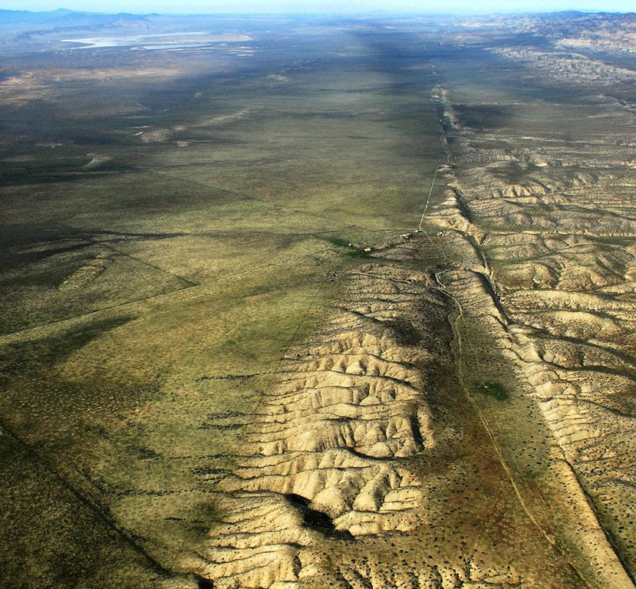
Example of a well known Transform fault
The San Andreas fault is an example. Some facts about it is it is 700 to 800 miles long and about 10 miles deep.
Notes:
Please include pictures and complete sentences for EVERY slide or you will lose points.
Slide #16: Example of a well-known Transform fault and a few facts about it.

