Slide 1
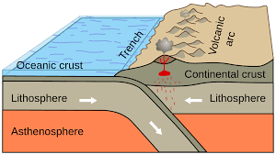
Convergent Boundary:
Notes:
Please include pictures and complete sentences for EVERY slide or you will lose points.
Slide #1: Convergent Boundary (title with picture)

Slide 2
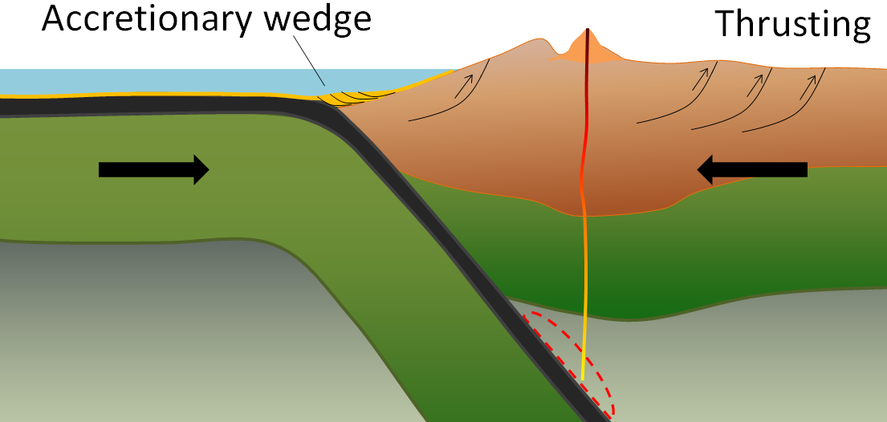
What happens at a Convergent Boundary?:
In a Convergent Boundary two plates move toward each other, the denser plate subducts/goes below the dense plate and then the plate melts and become part of the mantle.
Notes:
Please include pictures and complete sentences for EVERY slide or you will lose points.
Slide #2: What happens at a Convergent Boundary?

Slide 3
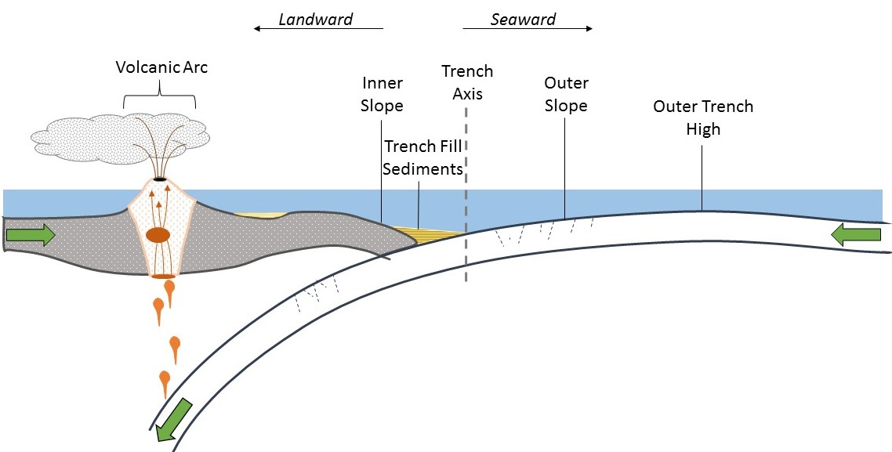
O-O
The first type of Convergent plate boundary is Oceanic-Oceanic. Oceanic-Oceanic is when two oceanic plates collide during subduction, then a trench is formed, not only do trenches form but underwater volcanoes form as well.
Notes:
Please include pictures and complete sentences for EVERY slide or you will lose points.
Slide #3: First type of Convergent plate boundary explained.

Slide 4
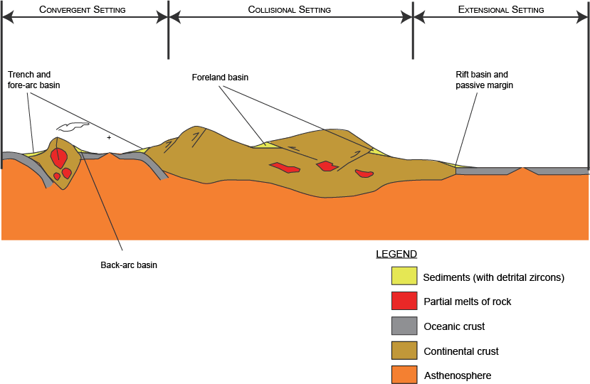
O-C
The second type of Convergent plate boundary is the Oceanic-Continental. The Oceanic-Continental is when an ocean and a continental plate collide, the oceanic plate is denser and subducts and then mountains or volcanoes form near the continental plate.
Notes:
Please include pictures and complete sentences for EVERY slide or you will lose points.
Slide #4: Second type of Convergent plate boundary explained.

Slide 5
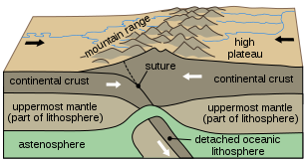
C-C
The third type of Convergent plate boundary is the Continental-Continental. The Continental-Continental is when two continental plates collide, then mountains are formed because of the plates that “squish” together.
Notes:
Please include pictures and complete sentences for EVERY slide or you will lose points.
Slide #5: Third type of Convergent plate boundary explained.

Slide 6
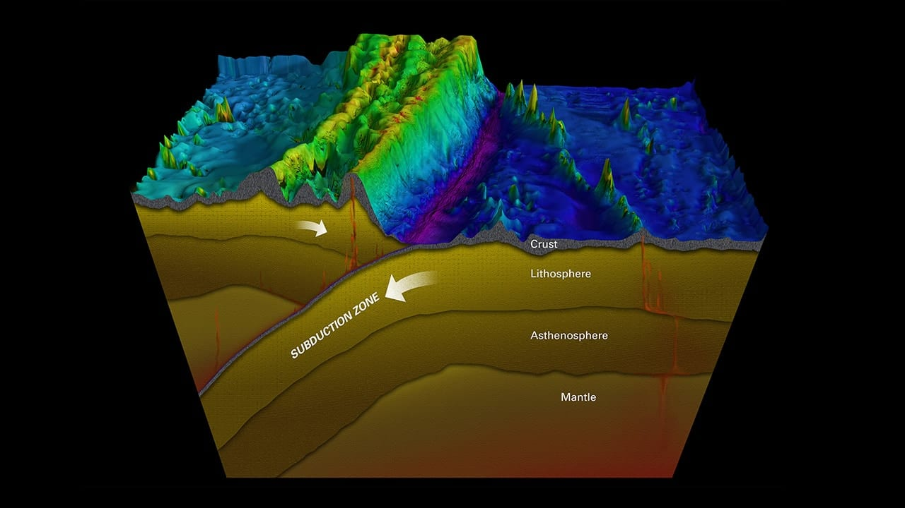
What forms at the 1st Convergent Boundary?:
The thing that forms at the 1st Convergent Boundary is a deep ocean trench, which forms a line of the two colliding plates. One plate that is made of oceanic crust can slide down underneath the other plate which then forms the narrow and deep trench.
Notes:
Please include pictures and complete sentences for EVERY slide or you will lose points.
Slide #6: What forms at the 1st Convergent Boundary? – Give well known example of landform created at this boundary.

Slide 7
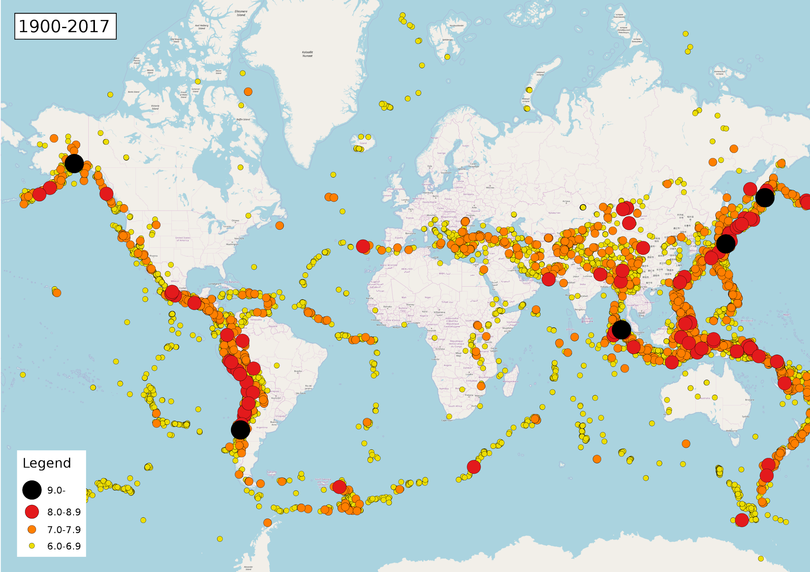
What forms at the 2nd Convergent Boundary?:
The thing that forms is that the collision of tectonic plates can result in earthquakes, volcanoes, the formation of mountains and also other geological events.
Notes:
Please include pictures and complete sentences for EVERY slide or you will lose points.
Slide #7: What forms at the 2nd Convergent Boundary? – Give well known example of landform created at this boundary.

Slide 8
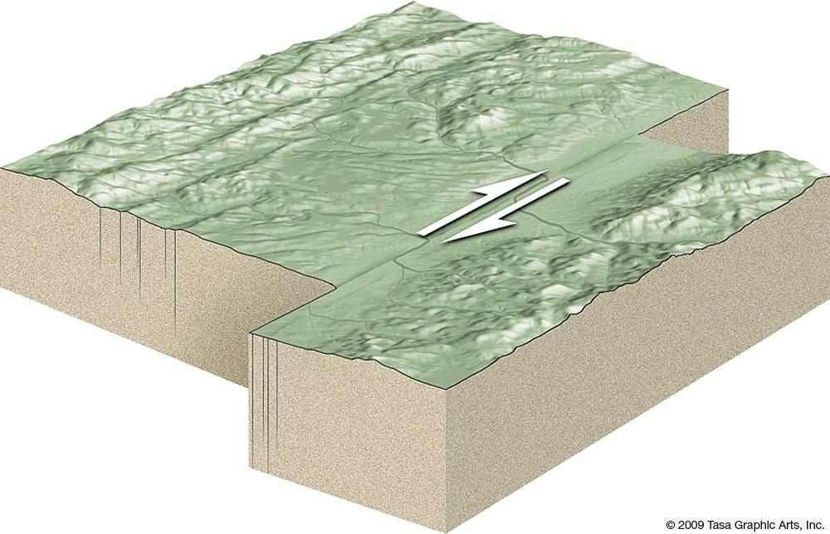
What forms at the 3rd Convergent Boundary?
The third one is when they transform which is when two plates are going the opposite way from each other and they slide past each other. THen it causes earthquakes and other things.
Notes:
Please include pictures and complete sentences for EVERY slide or you will lose points.
Slide #8: What forms at the 3rd Convergent Boundary? – Give well known example of landform created at this boundary.

Slide 9
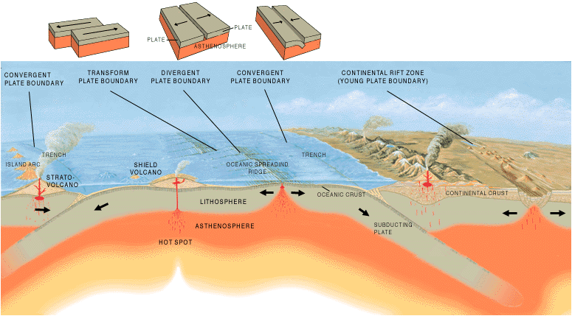
Divergent Boundary:
Divergent boundary is where plates move away from each other. They also create new crust which is why its called constructive boundary. Then molten lava is pushed up from earth and becomes new crust after it cools.
Notes:
Please include pictures and complete sentences for EVERY slide or you will lose points.
Slide #9:Divergent Boundary (title with picture).

Slide 10
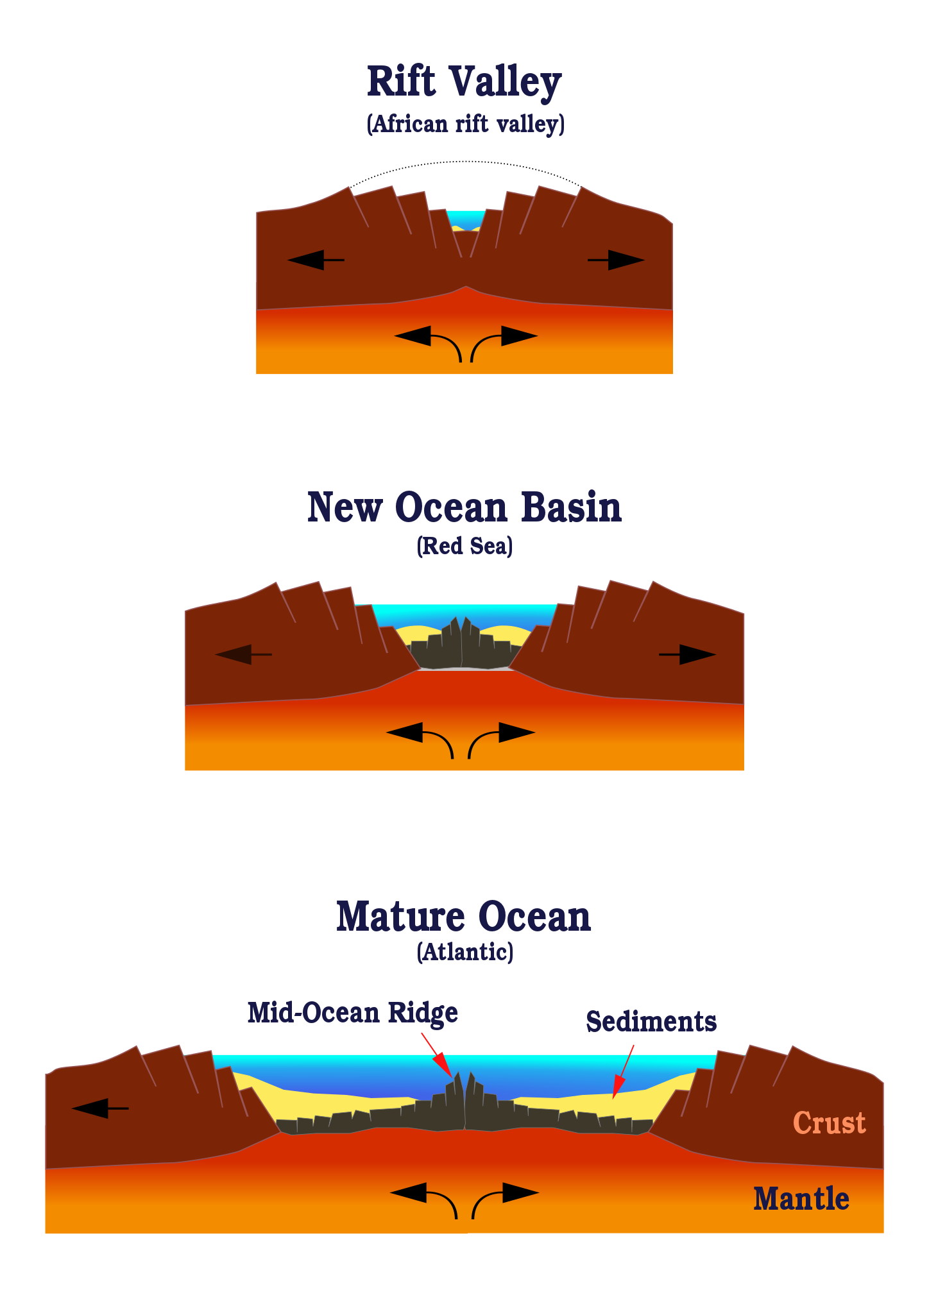
What happens at a Divergent Boundary?
At a divergent boundary new crust is made, its when the molten lava gets pushed up from earth and then it become new crust after it cools.
Notes:
Please include pictures and complete sentences for EVERY slide or you will lose points.
Slide #10: What happens at a Divergent Boundary?

Slide 11
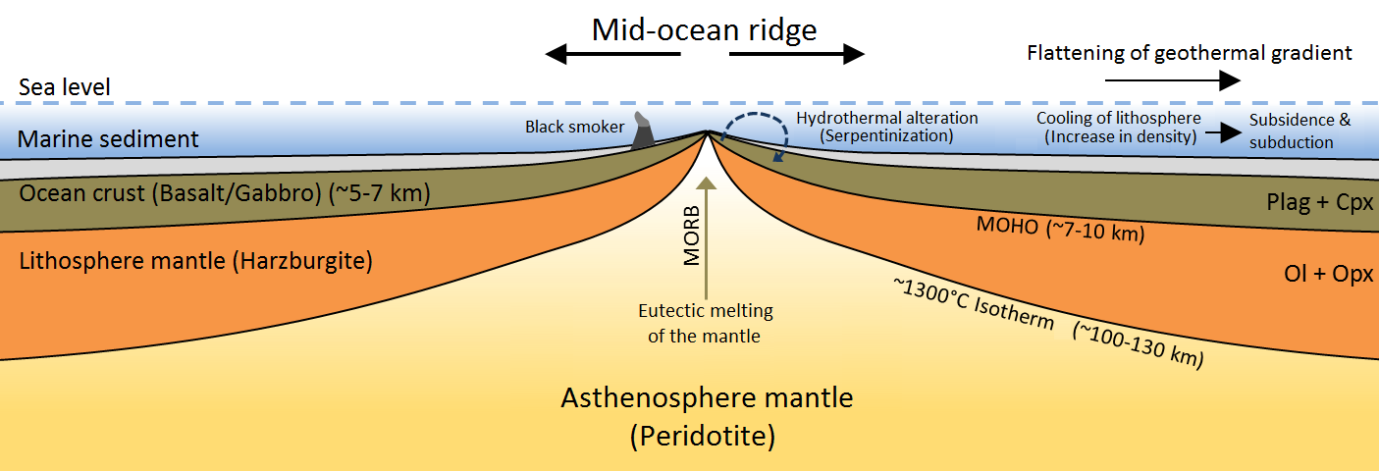
What forms at a Divergent Boundary?:
At a divergent boundary ridges form, which is a mountain range. It forms when magma escapes into the space between the spreading tectonic plates.
Notes:
Please include pictures and complete sentences for EVERY slide or you will lose points.
Slide #11: What forms at a Divergent Boundary?

Slide 12
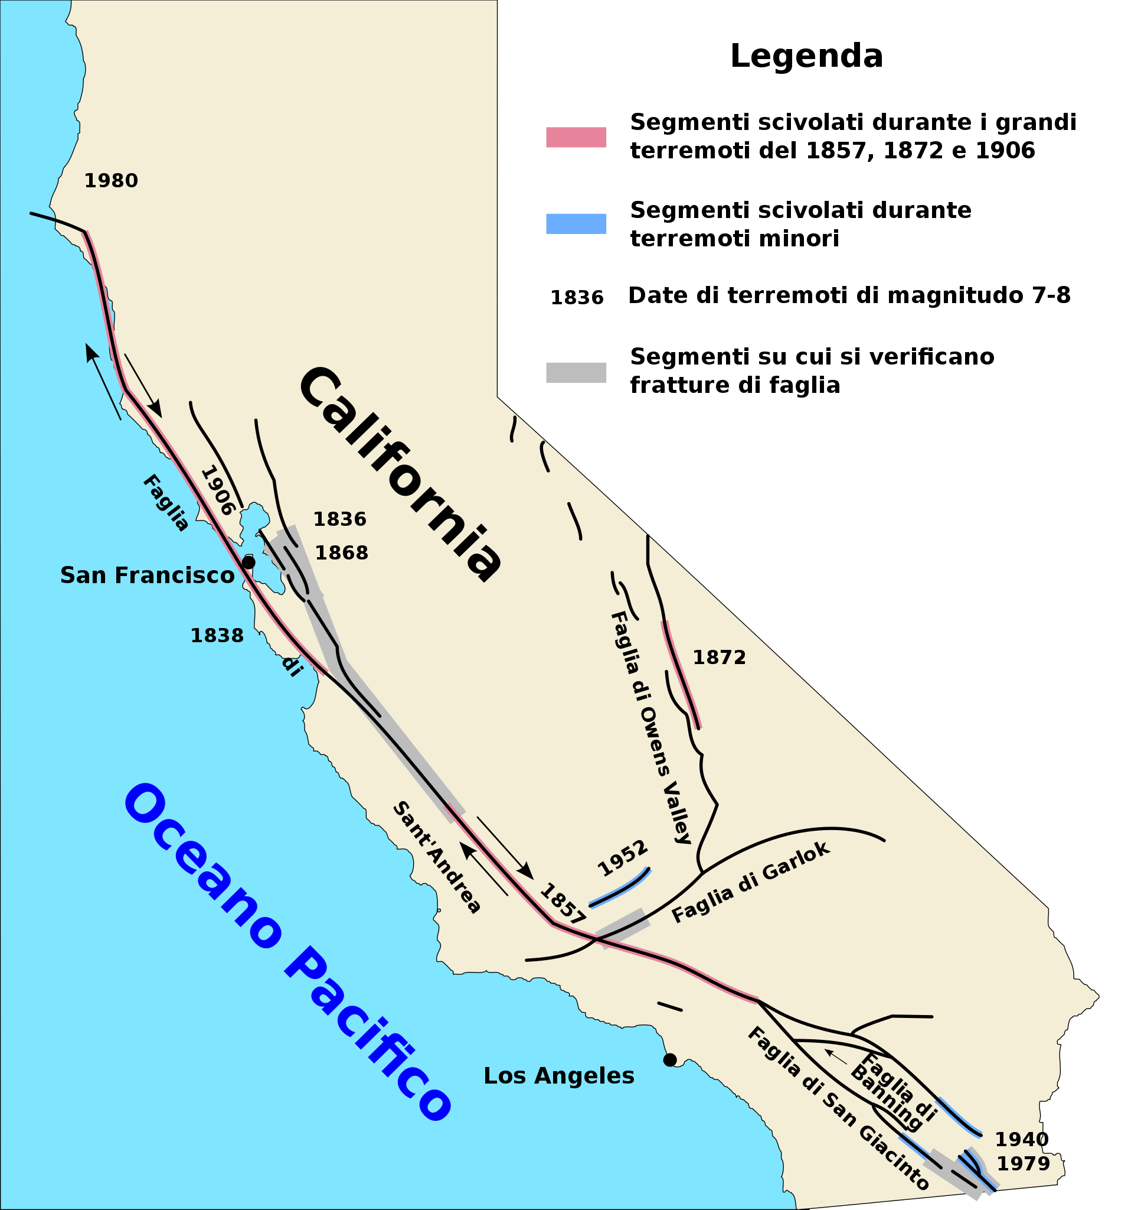
Transform Fault:
Its a type of fault that where two tectonic plates slide past one another. It's also where no crust gets destroyed and the closest fault to su is the San Andreas fault.
Notes:
Please include pictures and complete sentences for EVERY slide or you will lose points.
Slide #13: Transform Fault (title with picture).

Slide 13
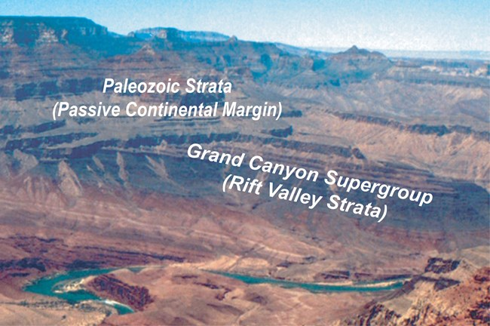
Well known example of landform created at a Divergent Boundary.
An example is when the plates move apart allowing molten magma to rise and form new crust in the form of ridges, valleys and volcanoes. Also landforms created created by divergent plates include the Mid Atlantic Ridge and the Great African Rift Valley.
Notes:
Please include pictures and complete sentences for EVERY slide or you will lose points.
Slide #12: Well known example of landform created at a Divergent Boundary.

Slide 14
What happens at a Transform Fault Boundary?
In a transform fault boundary, two tectonic plates slide alongside each other and when it occurs the scraping of the two plates causes earthquakes.
Notes:
Please include pictures and complete sentences for EVERY slide or you will lose points.
Slide #14: What happens at a Transform Fault Boundary?

Slide 15
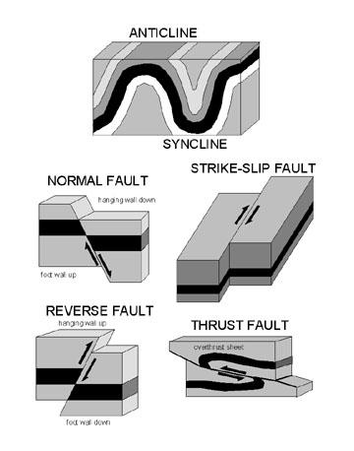
What forms at a Transform Fault Boundary?
As the plates rub against each other, huge stresses can cause portions of the rock to break, resulting in earthquakes. When these occur in places its called faults.
Notes:
Please include pictures and complete sentences for EVERY slide or you will lose points.
Slide #15: What forms at a Transform Fault Boundary?

Slide 16

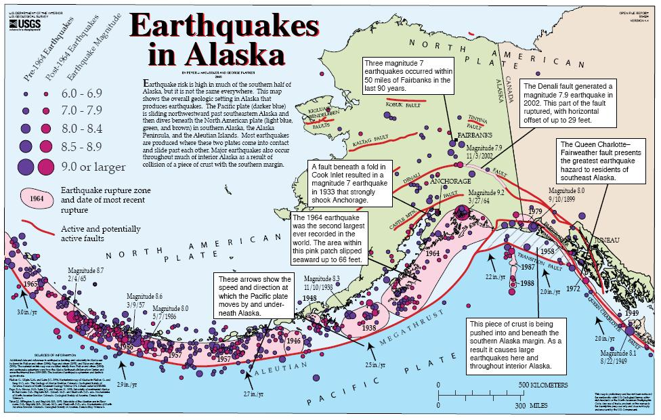
Example of a well-known Transform fault and a few facts about it.
The San Andreas fault and the Queen Charlottes fault are transform plate boundaries developing, where the pacific plate moves north ward and past the north American plates. A fact for the San Andreas fault is that it was 700-800 miles long and about 10 miles deep. A fact about the Queen Charlottes fault is that it is an active transform fault that marks the boundary of the North American and the Pacific plate.
Notes:
Please include pictures and complete sentences for EVERY slide or you will lose points.
Slide #16: Example of a well-known Transform fault and a few facts about it.

