Slide 1
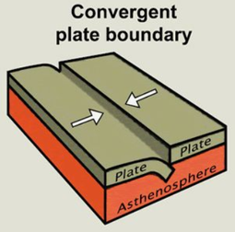
Convergent Boundary
By Jayna
Notes:
Please include pictures and complete sentences for EVERY slide or you will lose points.
Slide #1: Convergent Boundary (title with picture)

Slide 2
What happens at a Convergent Boundary?
What happens is 2 plates move toward each other and crash.
Notes:
Please include pictures and complete sentences for EVERY slide or you will lose points.
Slide #2: What happens at a Convergent Boundary?

Slide 3
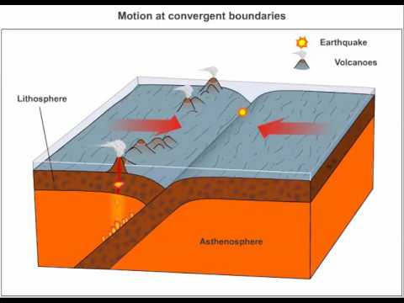
Oceanic - Oceanic
Oceanic-Oceanic is when 2 oceans collide
Notes:
Please include pictures and complete sentences for EVERY slide or you will lose points.
Slide #3: First type of Convergent plate boundary explained.

Slide 4
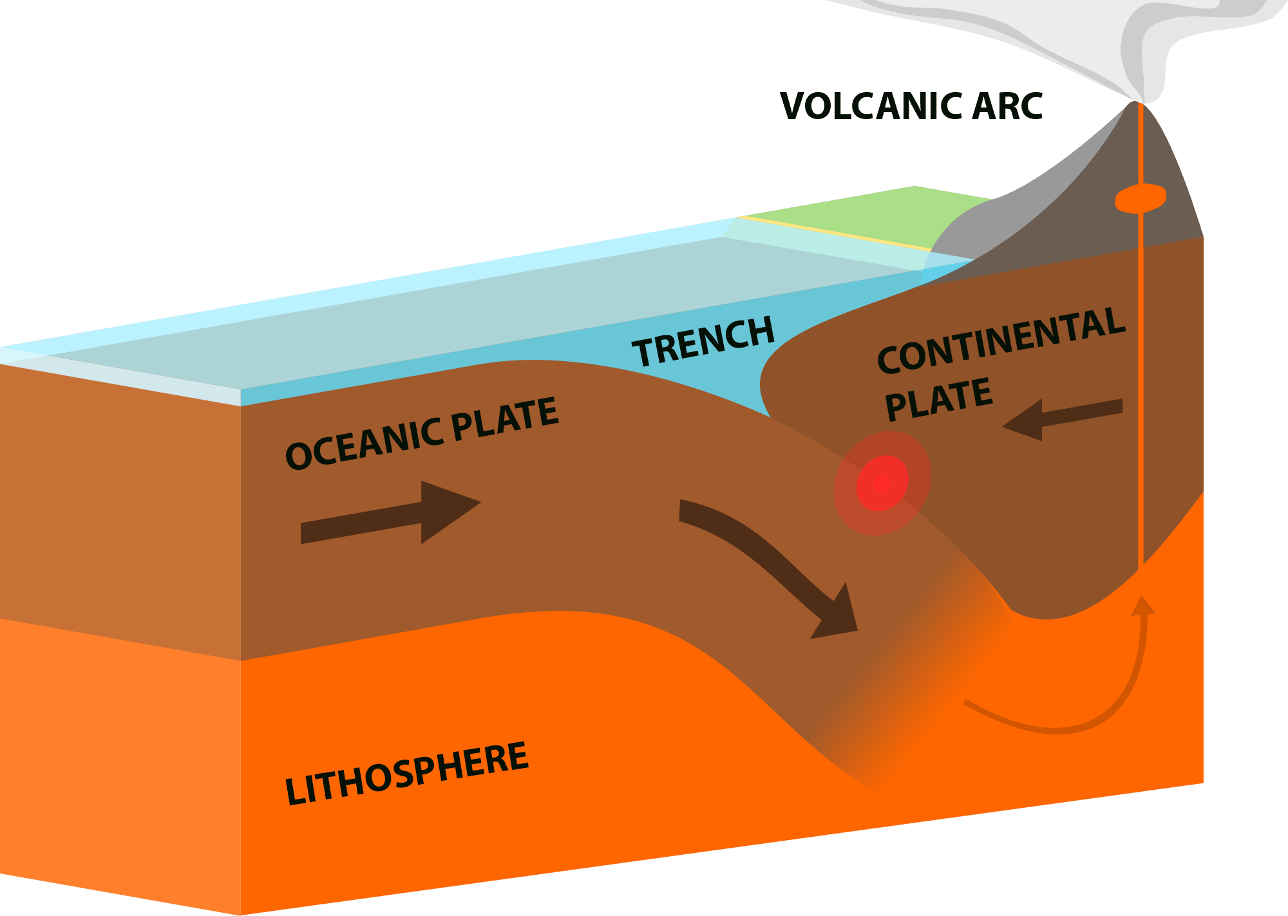
Oceanic - Continental
When ocean and continental plates collide
Notes:
Please include pictures and complete sentences for EVERY slide or you will lose points.
Slide #4: Second type of Convergent plate boundary explained.

Slide 5
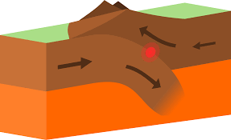
Continental - Continental
When 2 continental plates collide
Notes:
Please include pictures and complete sentences for EVERY slide or you will lose points.
Slide #5: Third type of Convergent plate boundary explained.

Slide 6
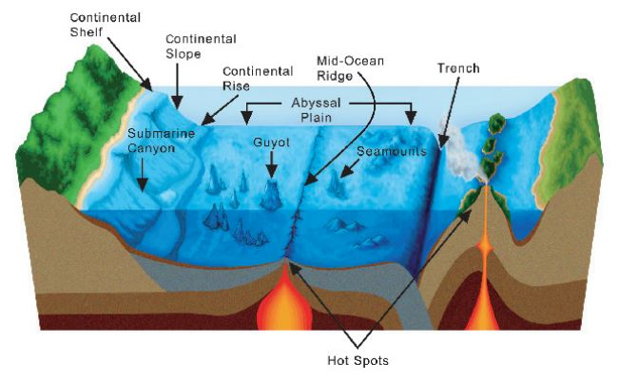
Oceanic - Oceanic
When Oceanic-Oceanic boundary happens, trenches and underwater volcanoes are formed.
Notes:
Please include pictures and complete sentences for EVERY slide or you will lose points.
Slide #6: What forms at the 1st Convergent Boundary? – Give well known example of landform created at this boundary.

Slide 7
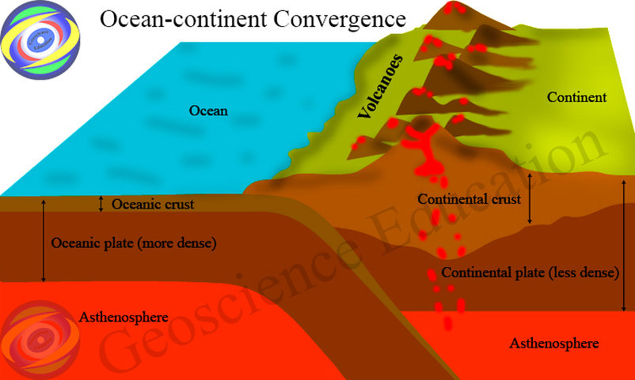
Oceanic - Continental
Mountains and volcanoes form.
Notes:
Please include pictures and complete sentences for EVERY slide or you will lose points.
Slide #7: What forms at the 2nd Convergent Boundary? – Give well known example of landform created at this boundary.

Slide 8
Continental - Continental
Mountains form when 2 continental plates collide.
Notes:
Please include pictures and complete sentences for EVERY slide or you will lose points.
Slide #8: What forms at the 3rd Convergent Boundary? – Give well known example of landform created at this boundary.

Slide 9
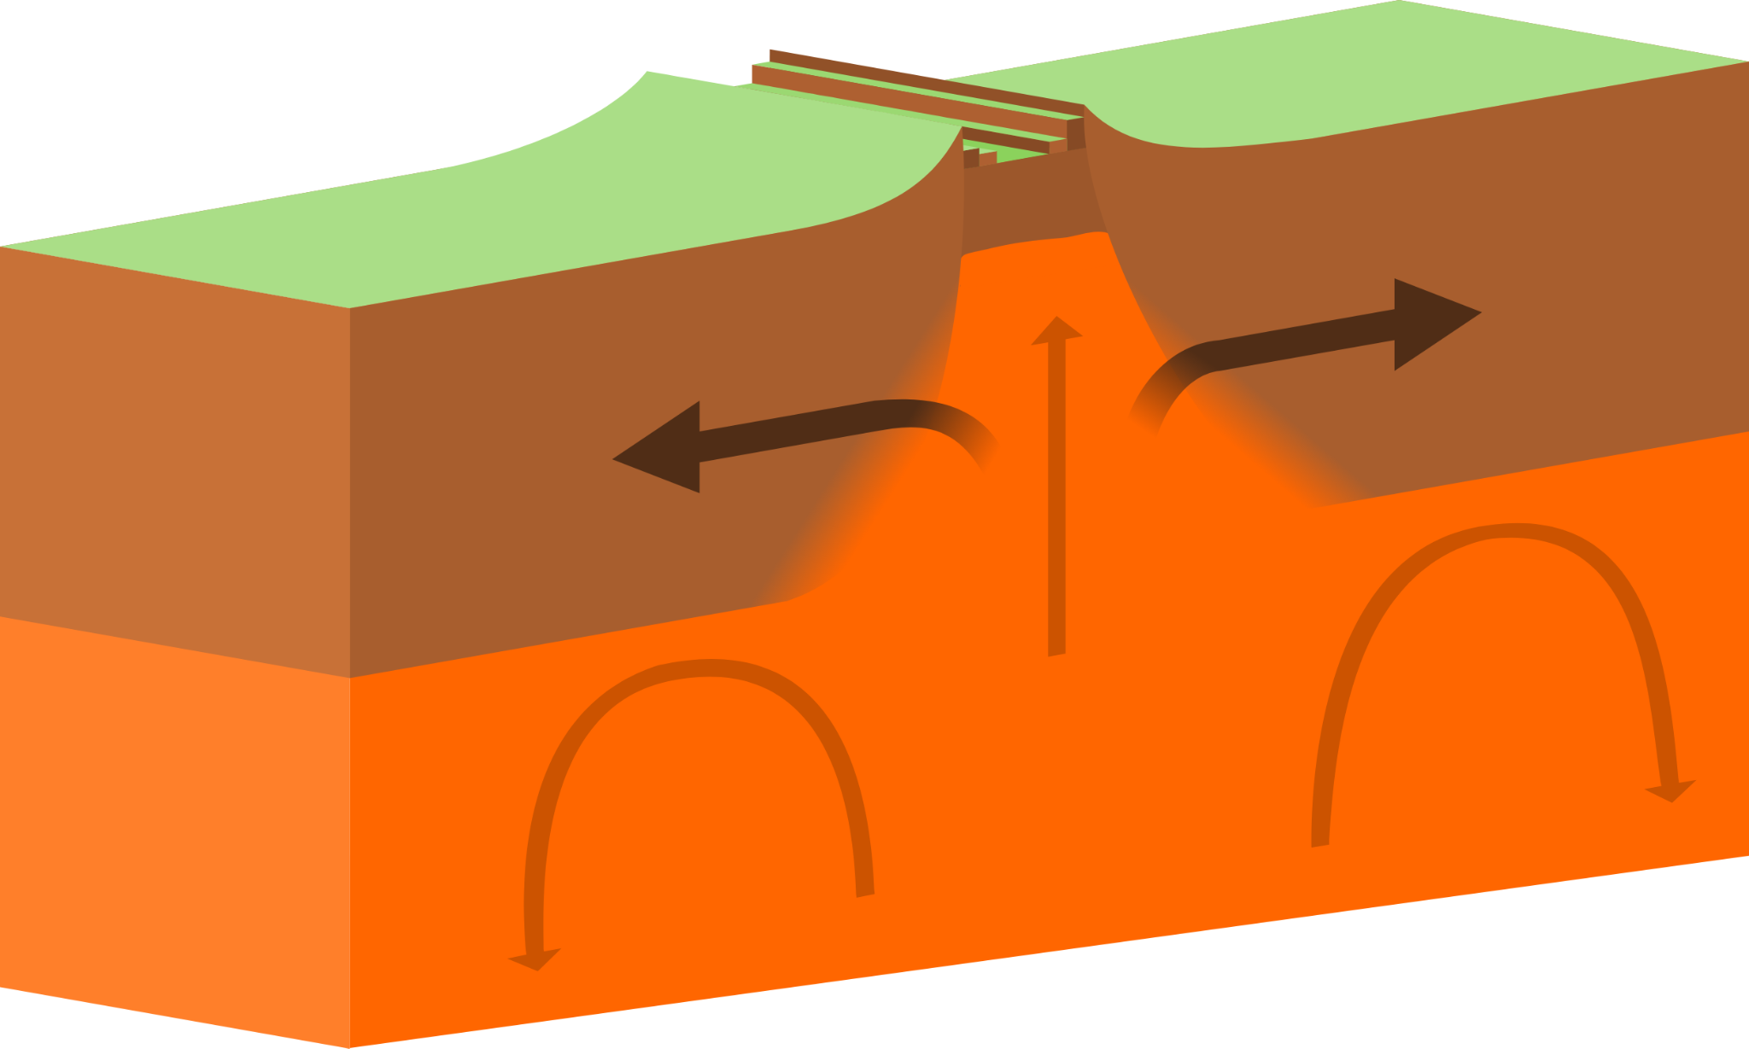
Divergent Boundary
Notes:
Please include pictures and complete sentences for EVERY slide or you will lose points.
Slide #9:Divergent Boundary (title with picture).

Slide 10
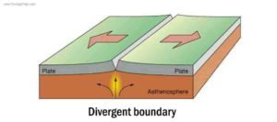
Divergent
Divergent boundary is where plates move away from each other.
Notes:
Please include pictures and complete sentences for EVERY slide or you will lose points.
Slide #10: What happens at a Divergent Boundary?

Slide 11
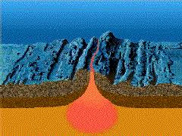
A divergent boundary forms mountain ranges called oceanic spreading ridges
Notes:
Please include pictures and complete sentences for EVERY slide or you will lose points.
Slide #11: What forms at a Divergent Boundary?

Slide 12
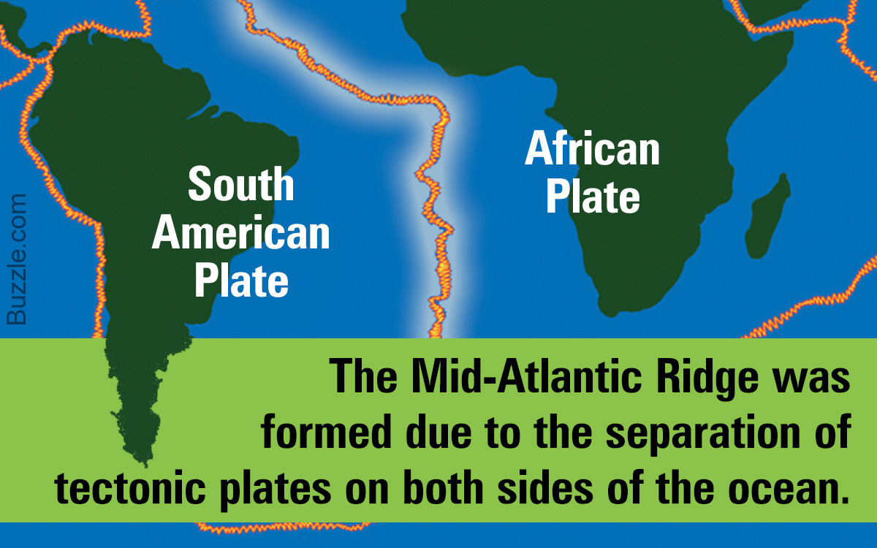
Mid-atlantic Ridge
Notes:
Please include pictures and complete sentences for EVERY slide or you will lose points.
Slide #12: Well known example of landform created at a Divergent Boundary.

Slide 13
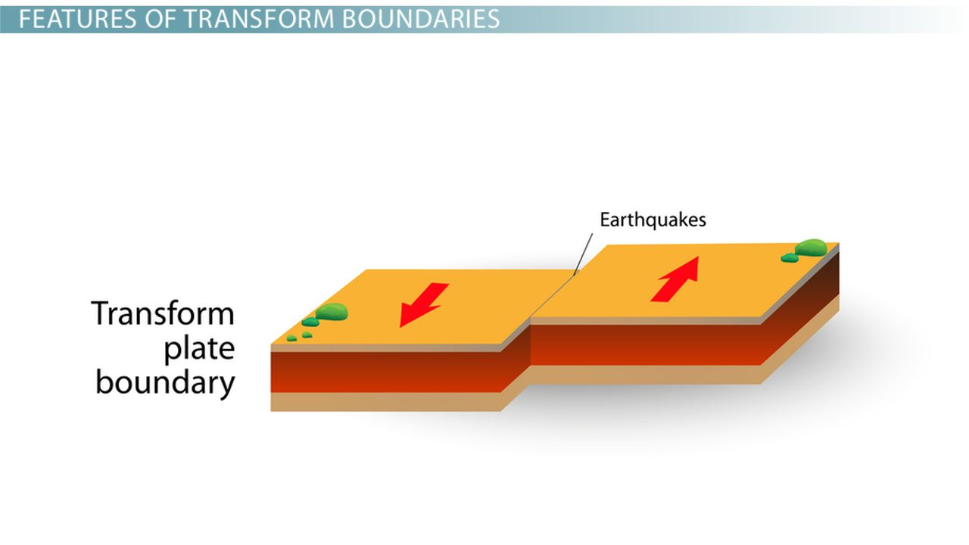
Transform Fault
Notes:
Please include pictures and complete sentences for EVERY slide or you will lose points.
Slide #13: Transform Fault (title with picture).

Slide 14
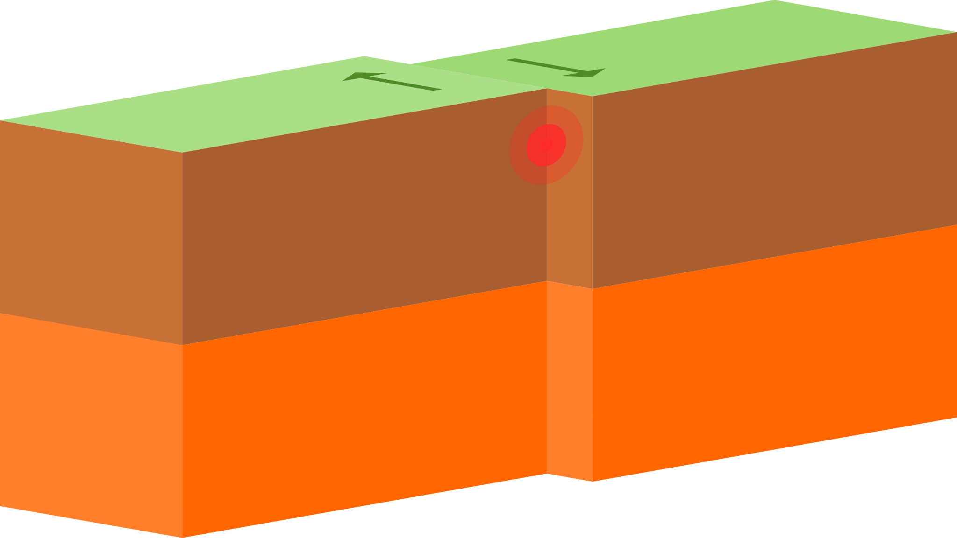
Plates slide past each other in a fault boundary.
Notes:
Please include pictures and complete sentences for EVERY slide or you will lose points.
Slide #14: What happens at a Transform Fault Boundary?

Slide 15
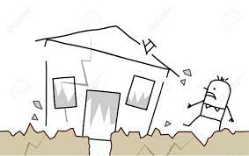
Earthquakes form at fault boundary.
Notes:
Please include pictures and complete sentences for EVERY slide or you will lose points.
Slide #15: What forms at a Transform Fault Boundary?

Slide 16
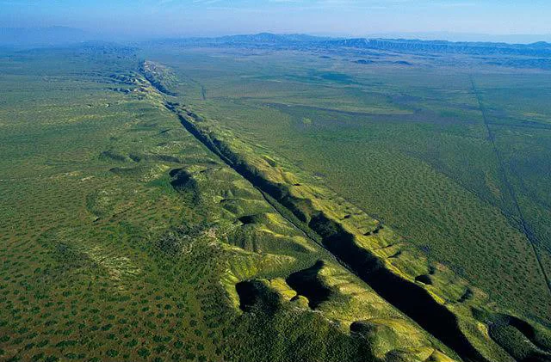
The san andreas fault is a well known fault boundary
Notes:
Please include pictures and complete sentences for EVERY slide or you will lose points.
Slide #16: Example of a well-known Transform fault and a few facts about it.

