Slide 1
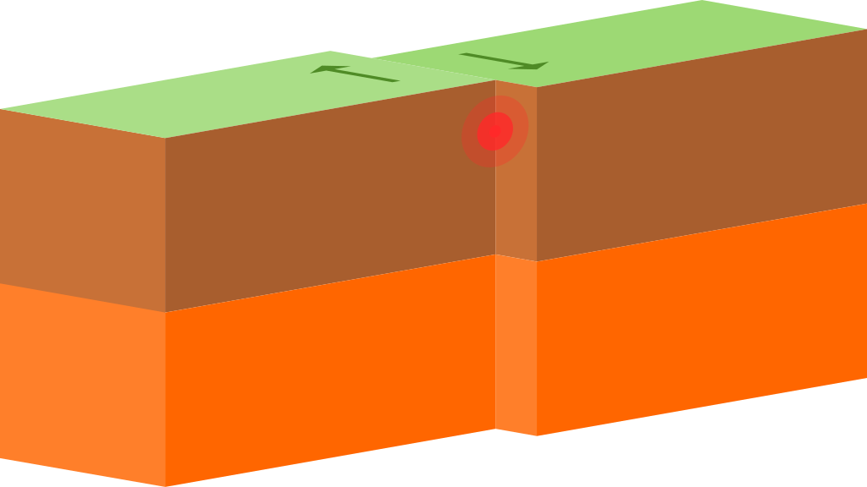
Convergent boundary
Notes:
Please include pictures and complete sentences for EVERY slide or you will lose points.
Slide #1: Convergent Boundary (title with picture)

Slide 2
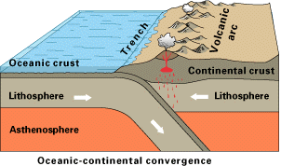
Convergent Boundaries
Definition: 2 plates that move toward each other
Notes:
Please include pictures and complete sentences for EVERY slide or you will lose points.
Slide #2: What happens at a Convergent Boundary?

Slide 3
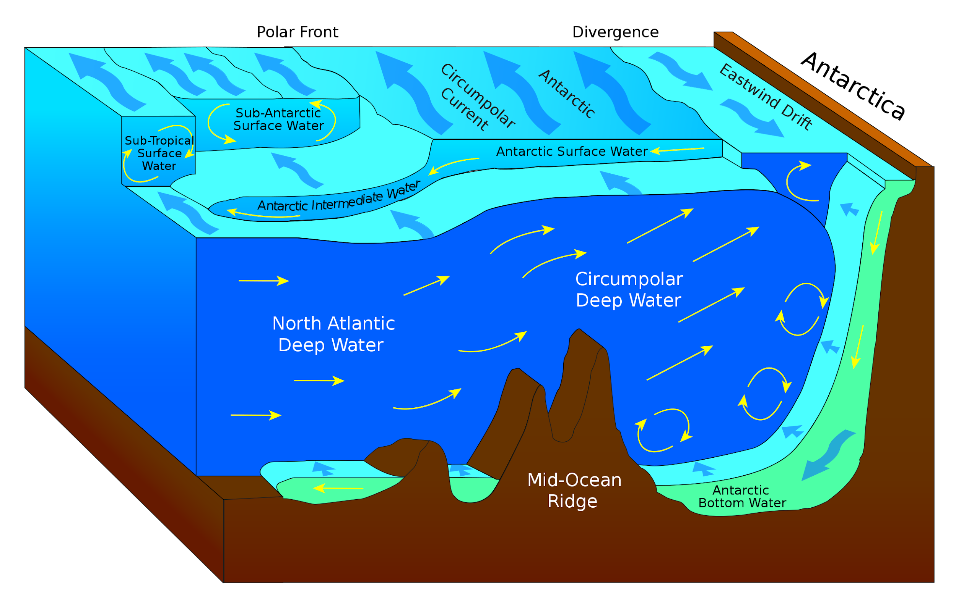
O-O
Oceanic Oceanic
Definition: 2 oceanic plates collide during subduction, a trench is formed and underwater volcanoes
Notes:
Please include pictures and complete sentences for EVERY slide or you will lose points.
Slide #3: First type of Convergent plate boundary explained.

Slide 4
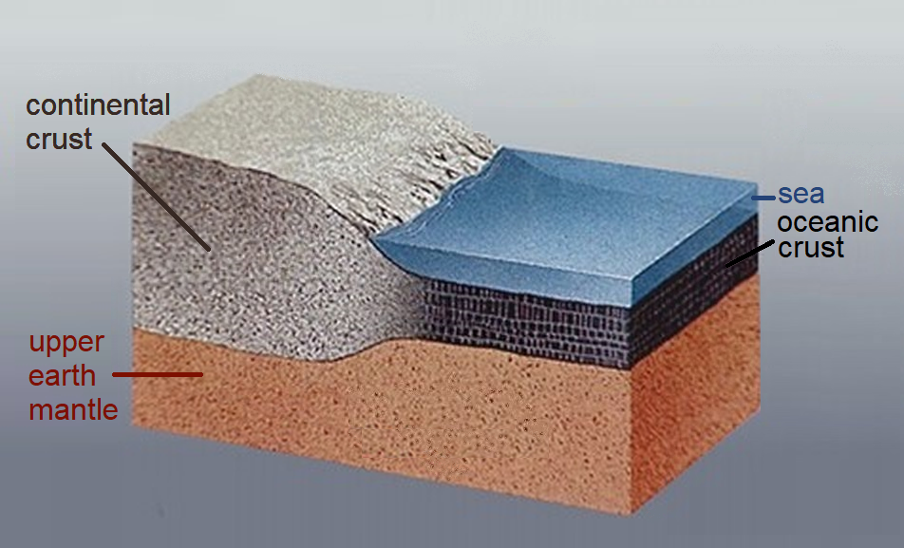
O-C Oceanic-Continental:when an ocean and continental plate collide.
Notes:
Please include pictures and complete sentences for EVERY slide or you will lose points.
Slide #4: Second type of Convergent plate boundary explained.

Slide 5
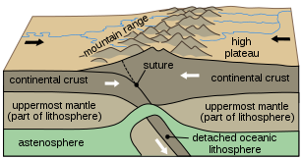
C-C
Continental continental: when 2 continental plates collide
Notes:
Please include pictures and complete sentences for EVERY slide or you will lose points.
Slide #5: Third type of Convergent plate boundary explained.

Slide 6
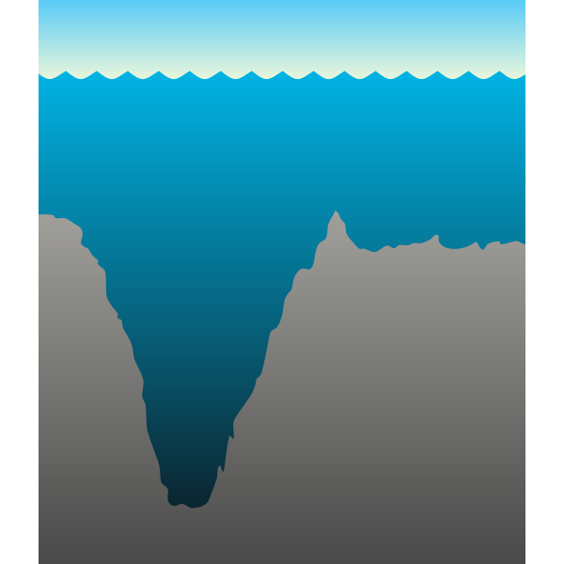
The first thing that happens at the first convergent boundary is how a trench is formed
Notes:
Please include pictures and complete sentences for EVERY slide or you will lose points.
Slide #6: What forms at the 1st Convergent Boundary? – Give well known example of landform created at this boundary.

Slide 7
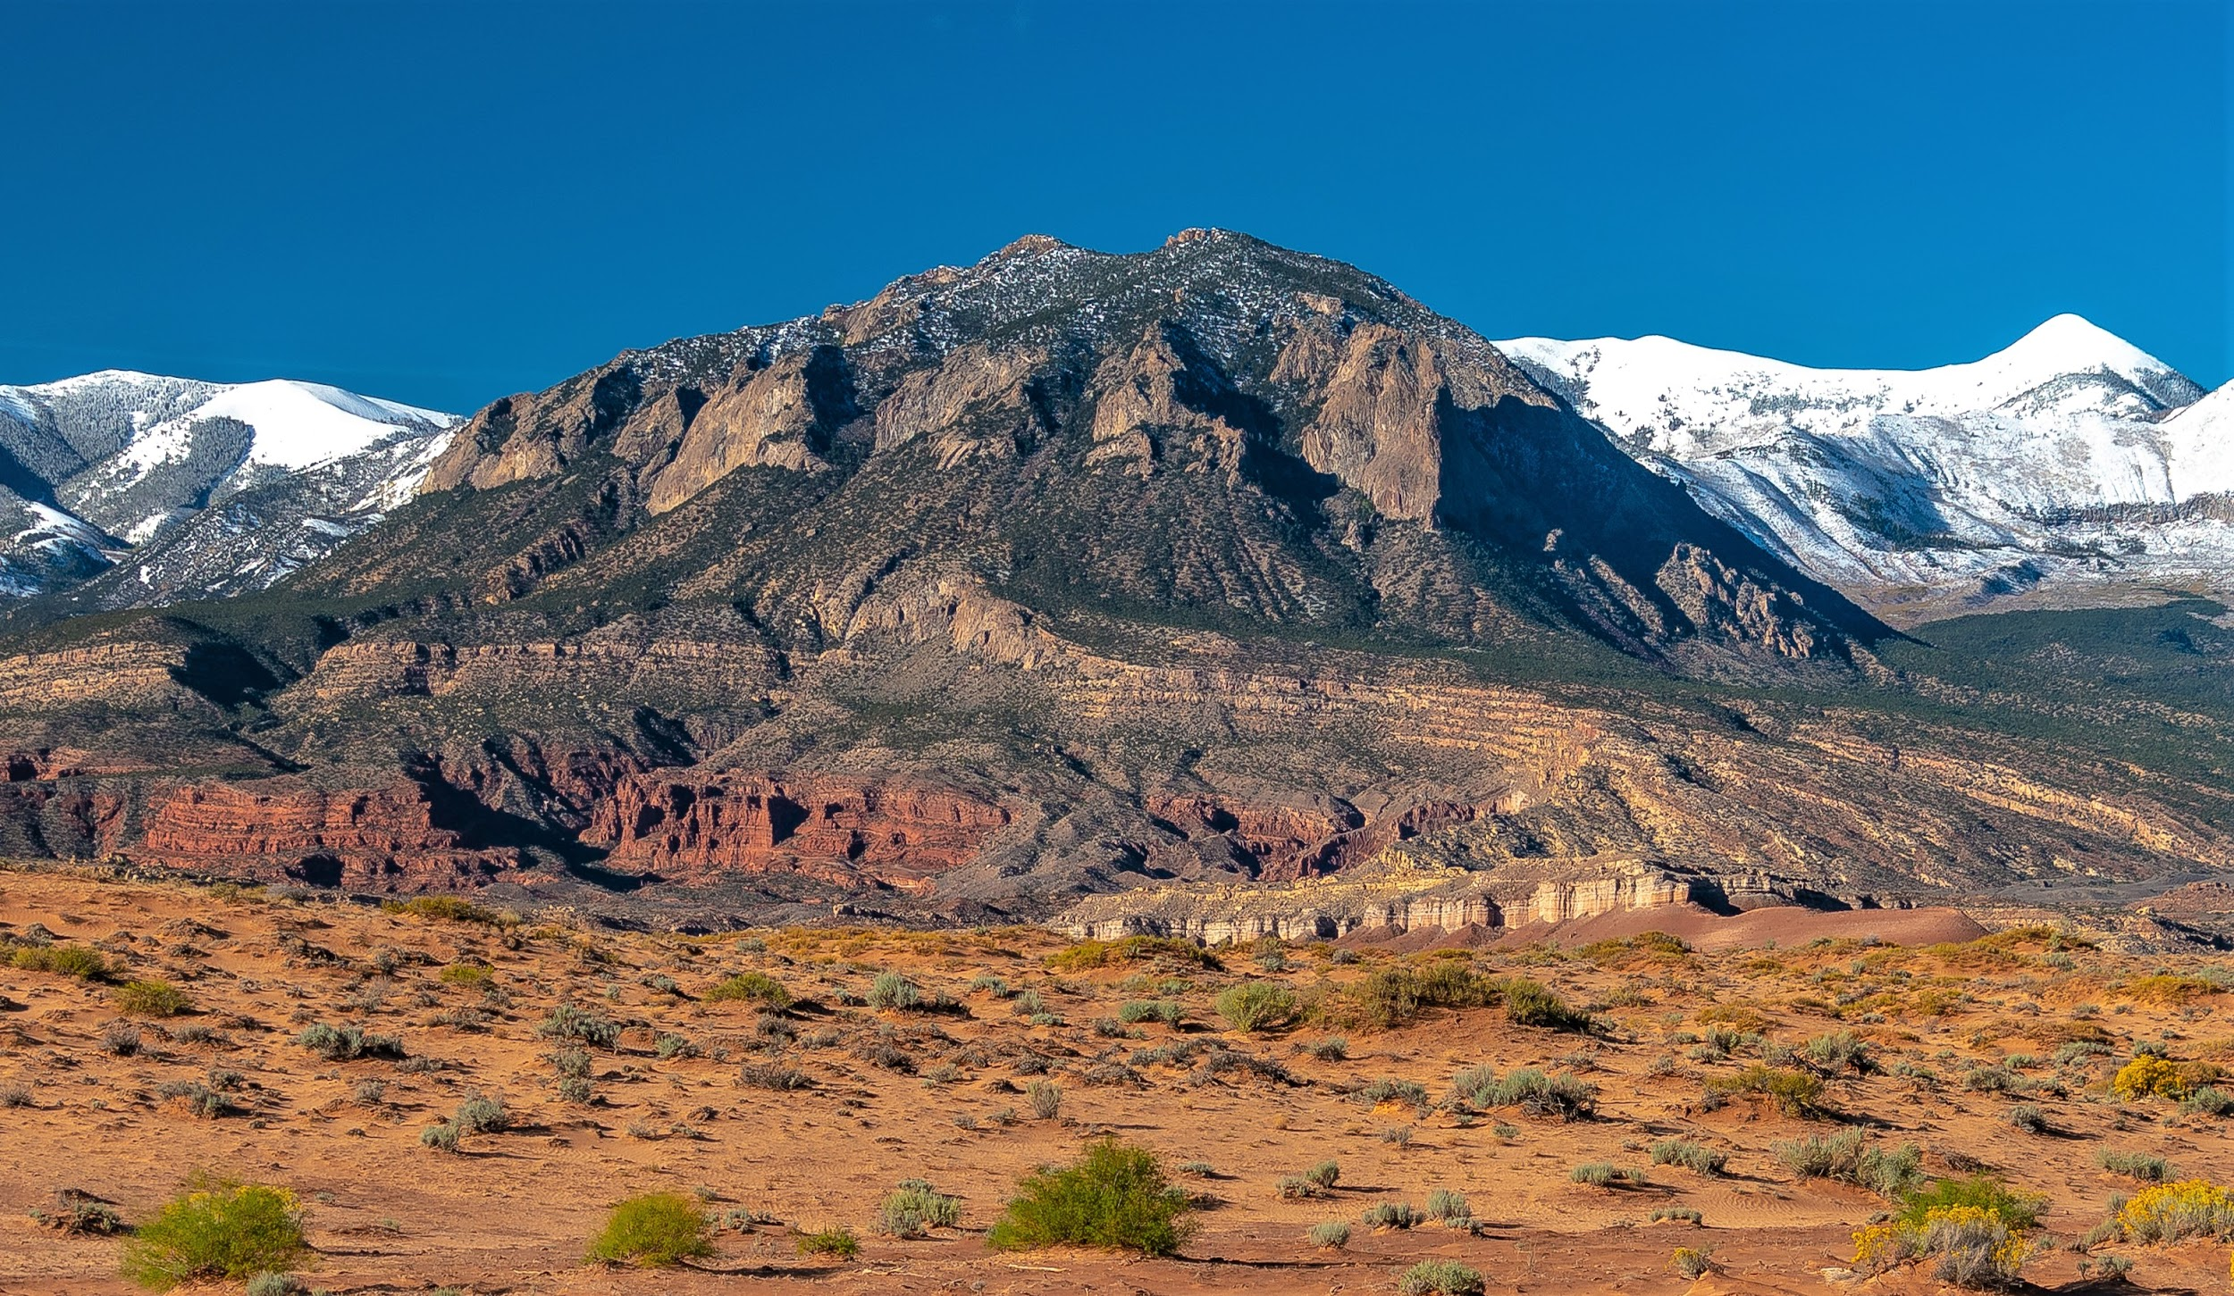
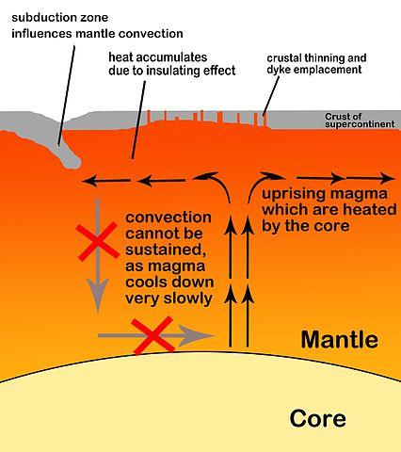
Two thing could happen the first one is it can create mountains the second thing that could happen is how it goes back down into the ground and gets melted
Notes:
Please include pictures and complete sentences for EVERY slide or you will lose points.
Slide #7: What forms at the 2nd Convergent Boundary? – Give well known example of landform created at this boundary.

Slide 8
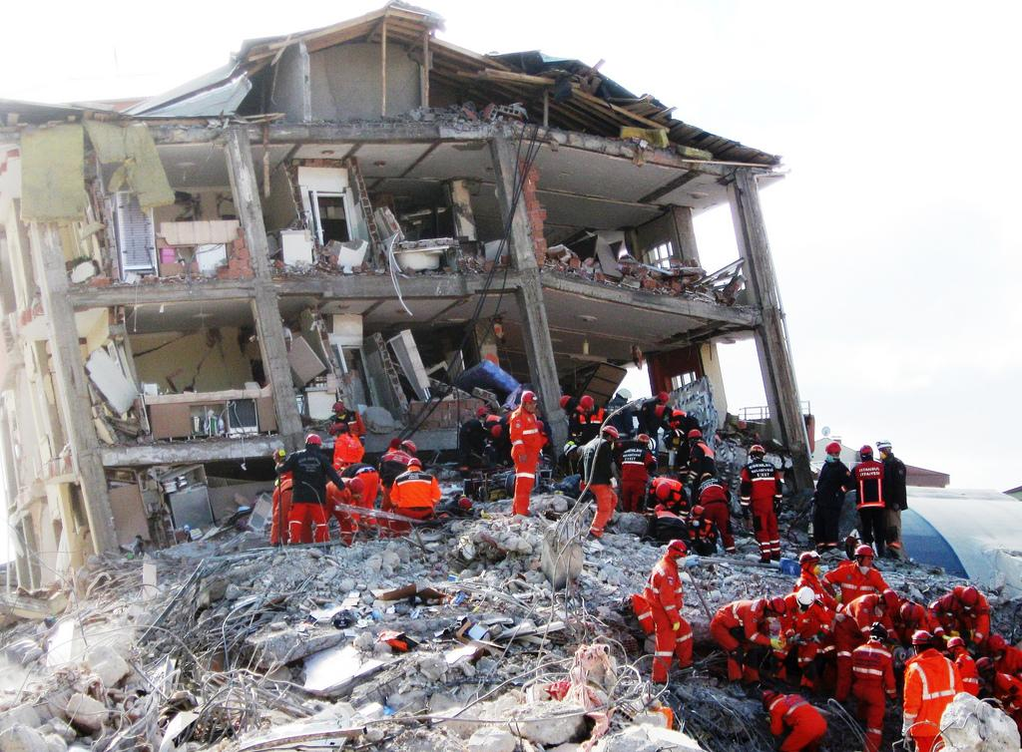
Plates slide past each other but at the cost of strong earthquakes
Notes:
Please include pictures and complete sentences for EVERY slide or you will lose points.
Slide #8: What forms at the 3rd Convergent Boundary? – Give well known example of landform created at this boundary.

Slide 9
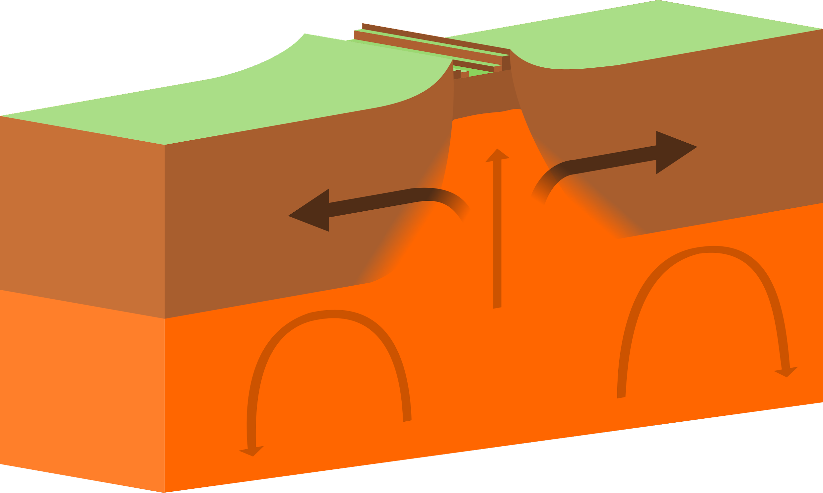
Divergent Boundary
Notes:
Please include pictures and complete sentences for EVERY slide or you will lose points.
Slide #9:Divergent Boundary (title with picture).

Slide 10
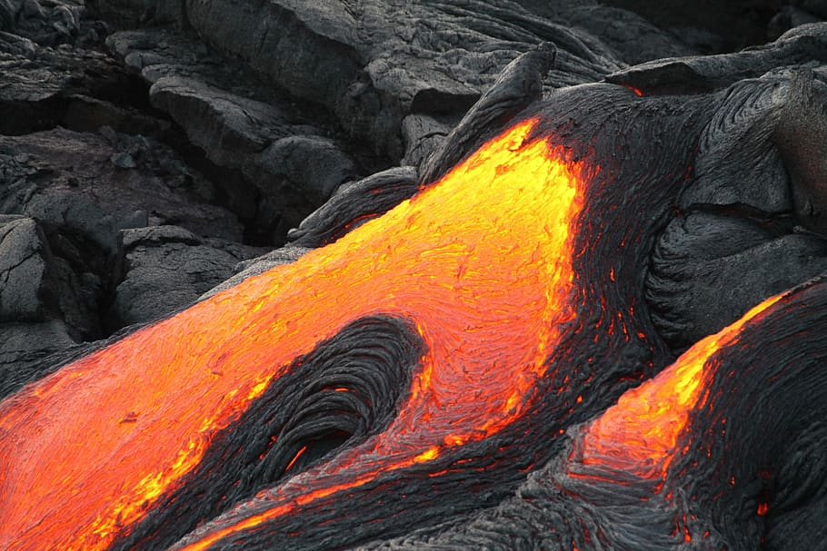
Divergent Boundaries
Things that can happen at a divergent boundary well obviously they slide past each other, earthquakes and magma rises to the top of the surface
Notes:
Please include pictures and complete sentences for EVERY slide or you will lose points.
Slide #10: What happens at a Divergent Boundary?

Slide 11
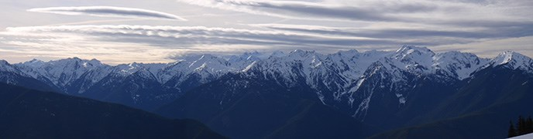
It forms a mountain chain commonly known as a ridge
Notes:
Please include pictures and complete sentences for EVERY slide or you will lose points.
Slide #11: What forms at a Divergent Boundary?

Slide 12
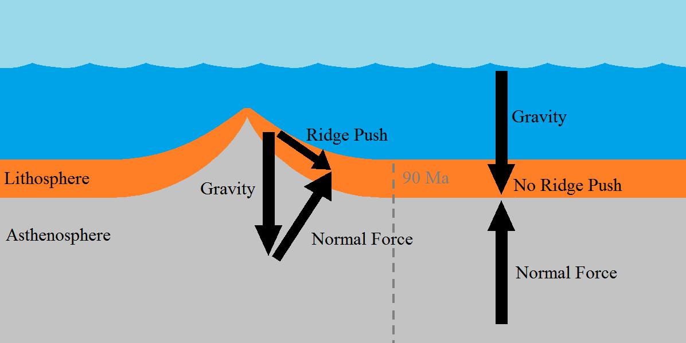
A well known Example of a landform created at a divergent boundary is a mid ocean ridge
Notes:
Please include pictures and complete sentences for EVERY slide or you will lose points.
Slide #12: Well known example of landform created at a Divergent Boundary.

Slide 13
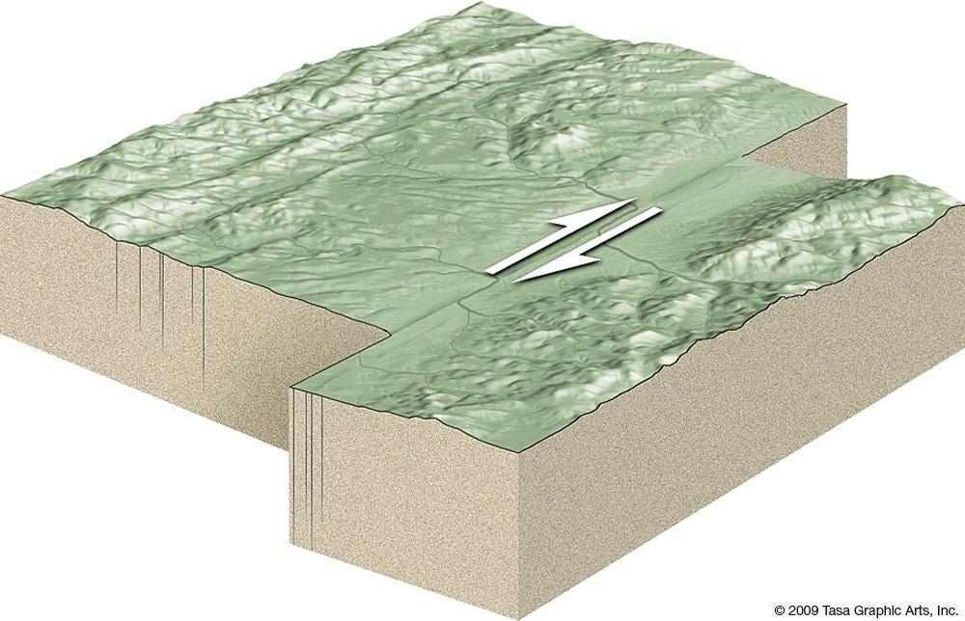
TransForm Fault
Notes:
Please include pictures and complete sentences for EVERY slide or you will lose points.
Slide #13: Transform Fault (title with picture).

Slide 14
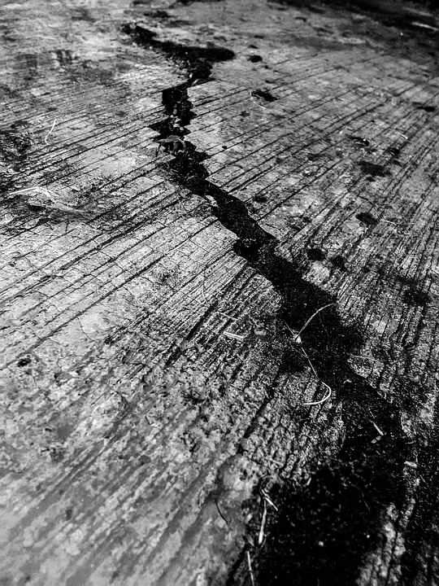
The scraping of the two plates causes earthquakes
Notes:
Please include pictures and complete sentences for EVERY slide or you will lose points.
Slide #14: What happens at a Transform Fault Boundary?

Slide 15
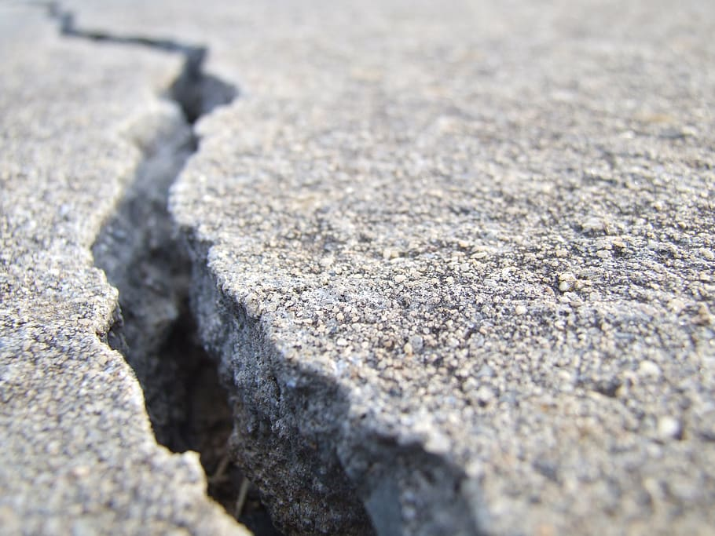
Huge portions of rock break resulting to earthquakes
Notes:
Please include pictures and complete sentences for EVERY slide or you will lose points.
Slide #15: What forms at a Transform Fault Boundary?

Slide 16
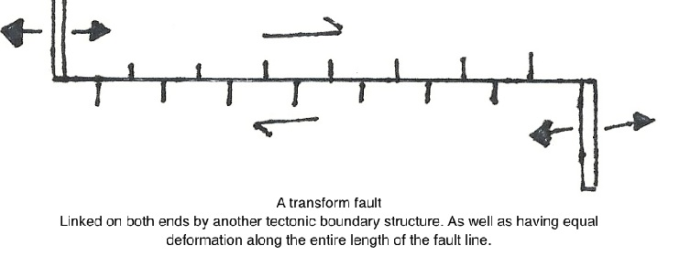
Some facts about transform fault is its a fault zone. Fault zone is when two plates slide past each other horizontally they are found in the ocean then create zig zag pattern between plates
Notes:
Please include pictures and complete sentences for EVERY slide or you will lose points.
Slide #16: Example of a well-known Transform fault and a few facts about it.

