Slide 1
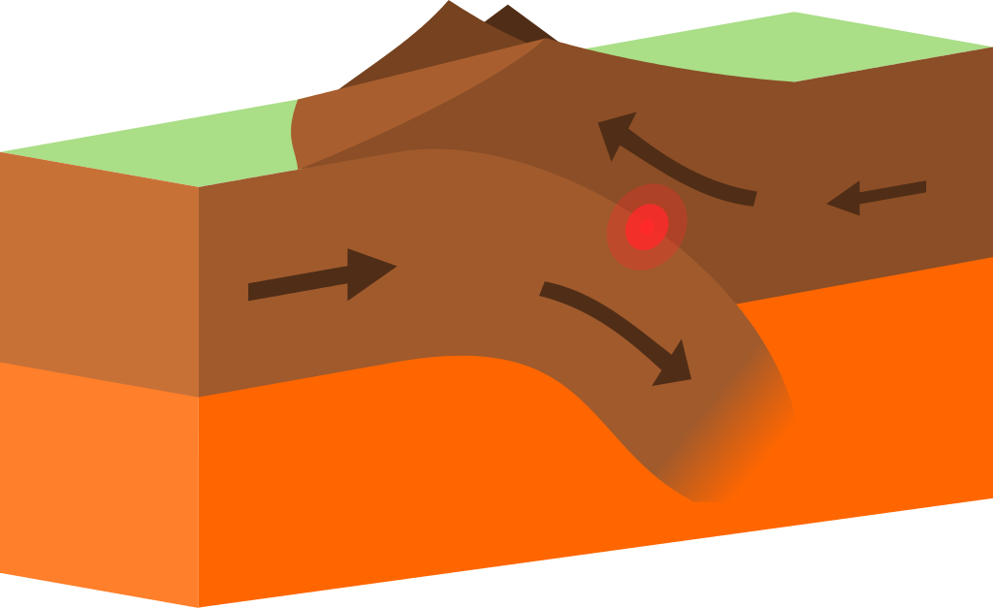
Convergent boundary
Karla hernandez
Notes:
Please include pictures and complete sentences for EVERY slide or you will lose points.
Slide #1: Convergent Boundary (title with picture)

Slide 2
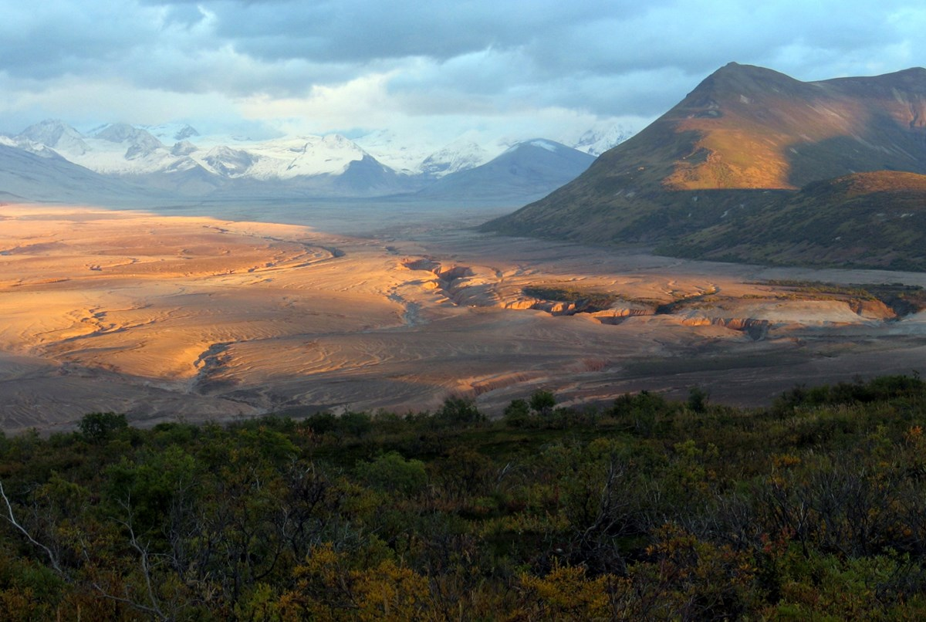
What happens at a convergent boundary?
Its a long stretch of mountains they form when plates collide together
Notes:
Please include pictures and complete sentences for EVERY slide or you will lose points.
Slide #2: What happens at a Convergent Boundary?

Slide 3
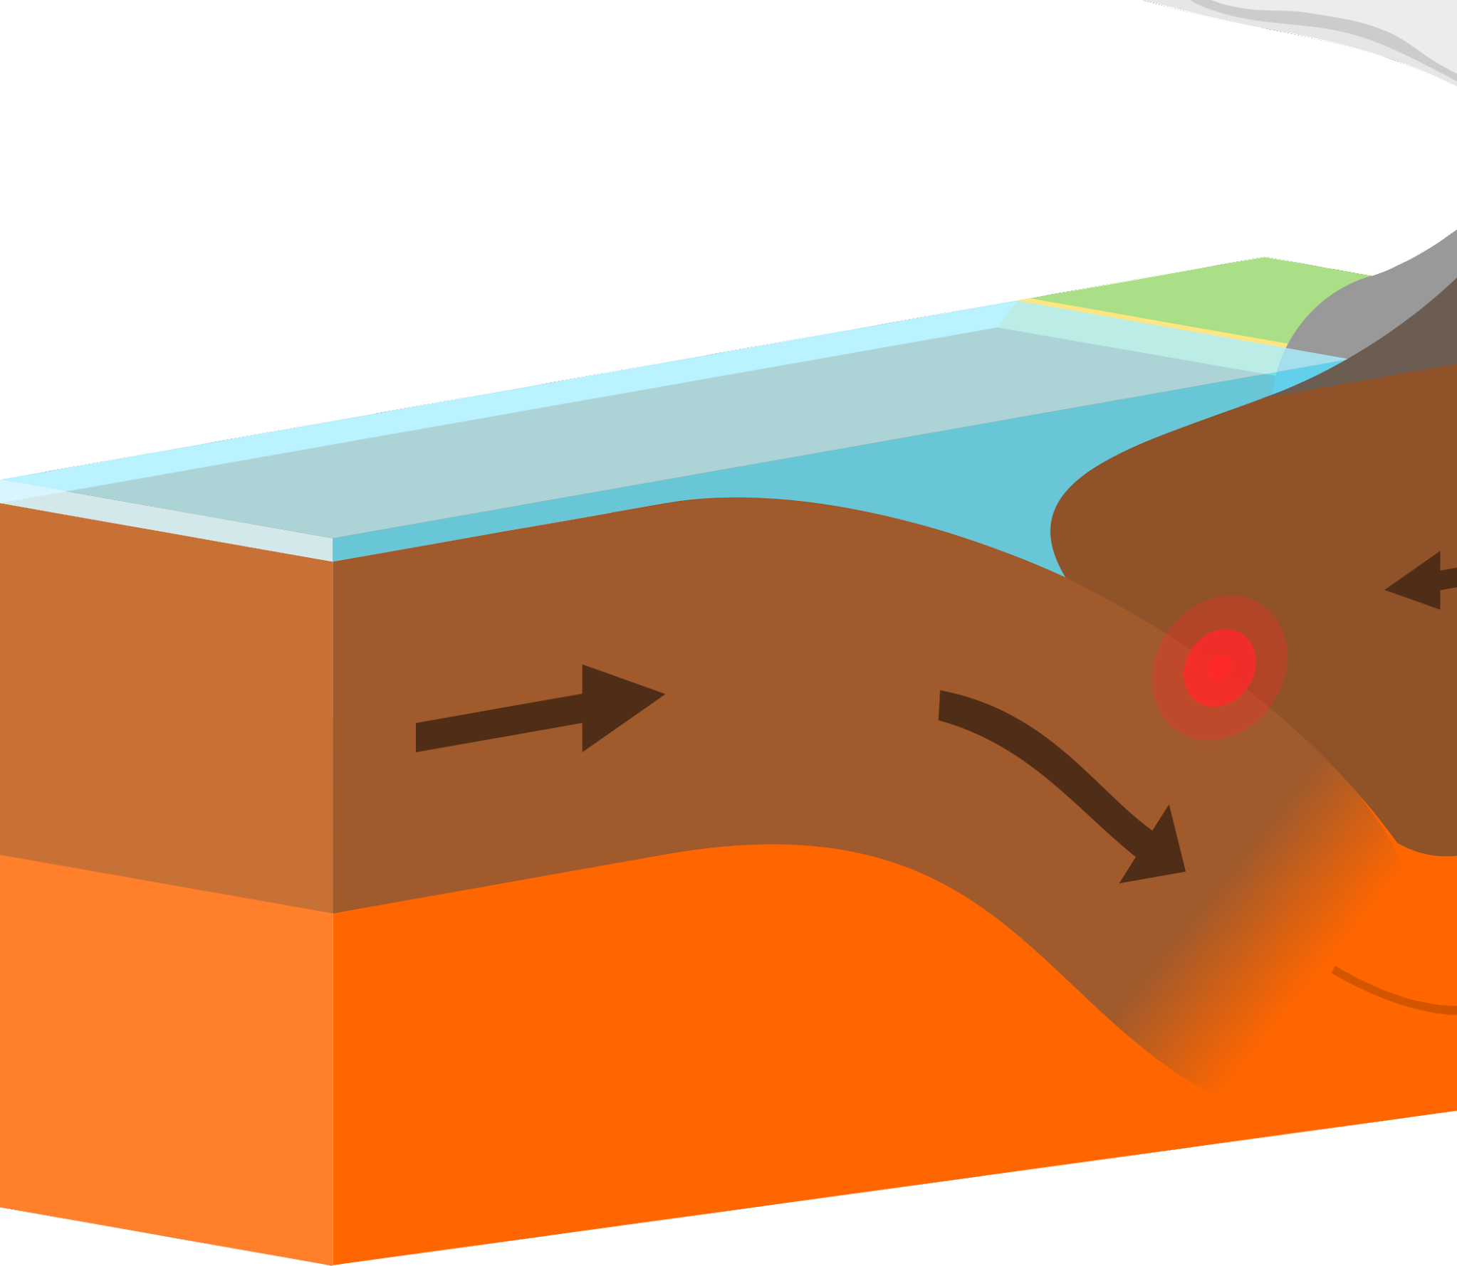
O-O
Oceanic- oceanic. When two oceanic plates collide during subduction.
This is what it looks like when plates collide
Notes:
Please include pictures and complete sentences for EVERY slide or you will lose points.
Slide #3: First type of Convergent plate boundary explained.

Slide 4
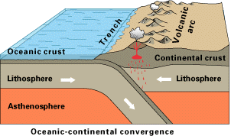
O-C
Oceanic continental - when an ocean and continental plates collide.
Notes:
Please include pictures and complete sentences for EVERY slide or you will lose points.
Slide #4: Second type of Convergent plate boundary explained.

Slide 5
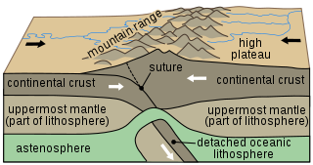
C-C
Continental continental - when two continental plates collide.
Notes:
Please include pictures and complete sentences for EVERY slide or you will lose points.
Slide #5: Third type of Convergent plate boundary explained.

Slide 6
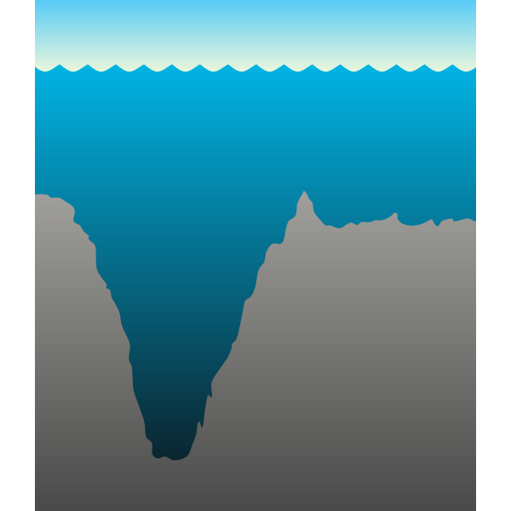
What forms at the 1st Convergent Boundary?
When two tectonic plates collide and one moves beneath the other
Notes:
Please include pictures and complete sentences for EVERY slide or you will lose points.
Slide #6: What forms at the 1st Convergent Boundary? – Give well known example of landform created at this boundary.

Slide 7
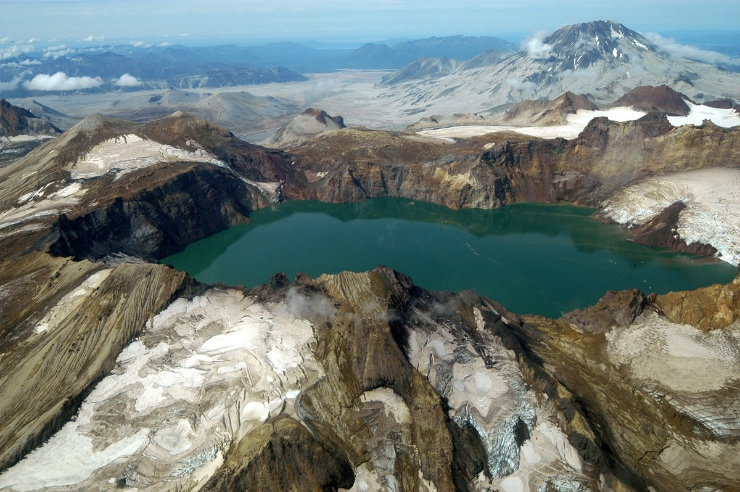
What forms at the 2nd convergent boundary?
When an ocean and continental plate collide
Notes:
Please include pictures and complete sentences for EVERY slide or you will lose points.
Slide #7: What forms at the 2nd Convergent Boundary? – Give well known example of landform created at this boundary.

Slide 8
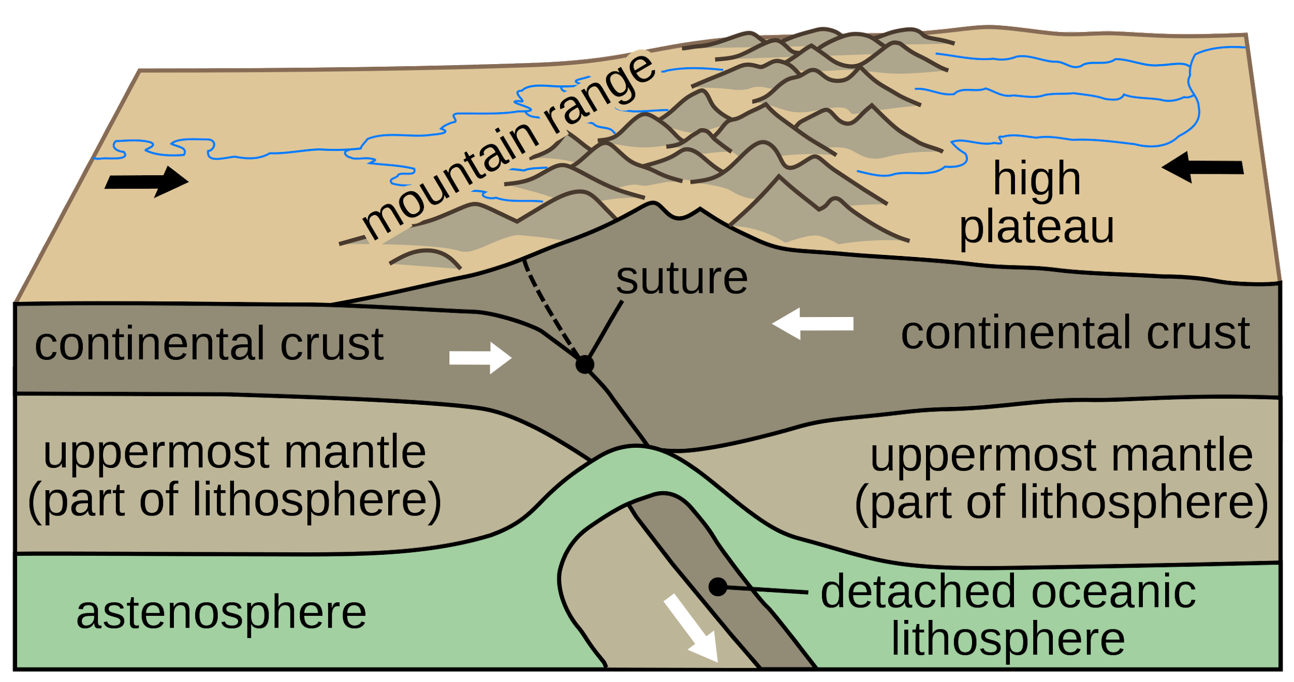
What forms at the 3rd convergent boundary?
When two continental plates collide. Mountains are formed because plates “squish” together
Notes:
Please include pictures and complete sentences for EVERY slide or you will lose points.
Slide #8: What forms at the 3rd Convergent Boundary? – Give well known example of landform created at this boundary.

Slide 9
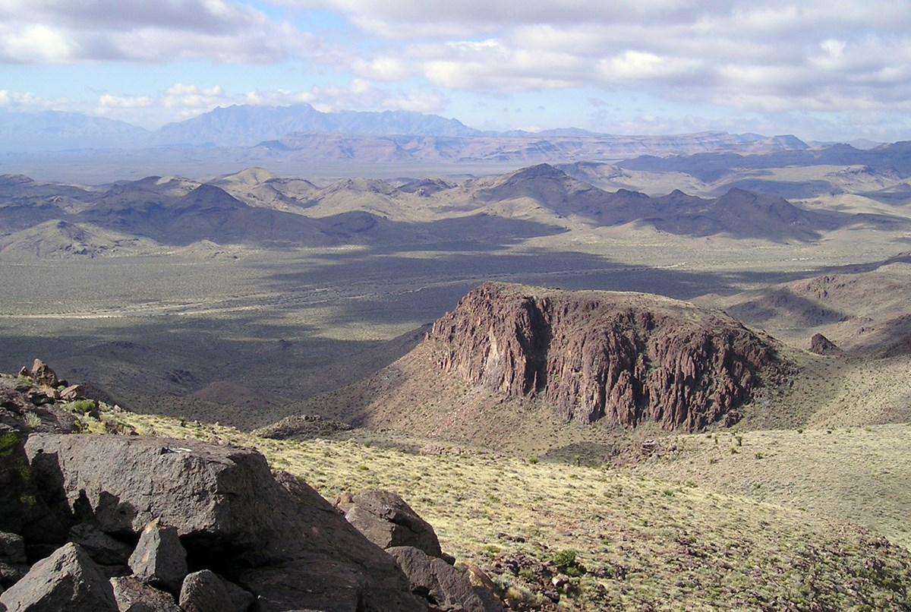
Divergent boundary
Notes:
Please include pictures and complete sentences for EVERY slide or you will lose points.
Slide #9:Divergent Boundary (title with picture).

Slide 10

What happens at a divergent boundary?
When plates move away from each other also called constructive boundary because new crust is made.
Notes:
Please include pictures and complete sentences for EVERY slide or you will lose points.
Slide #10: What happens at a Divergent Boundary?

Slide 11

What forms at a divergent boundary?
Magma rises from deep within the earth and erupts to form new crust on the lithosphere
Notes:
Please include pictures and complete sentences for EVERY slide or you will lose points.
Slide #11: What forms at a Divergent Boundary?

Slide 12

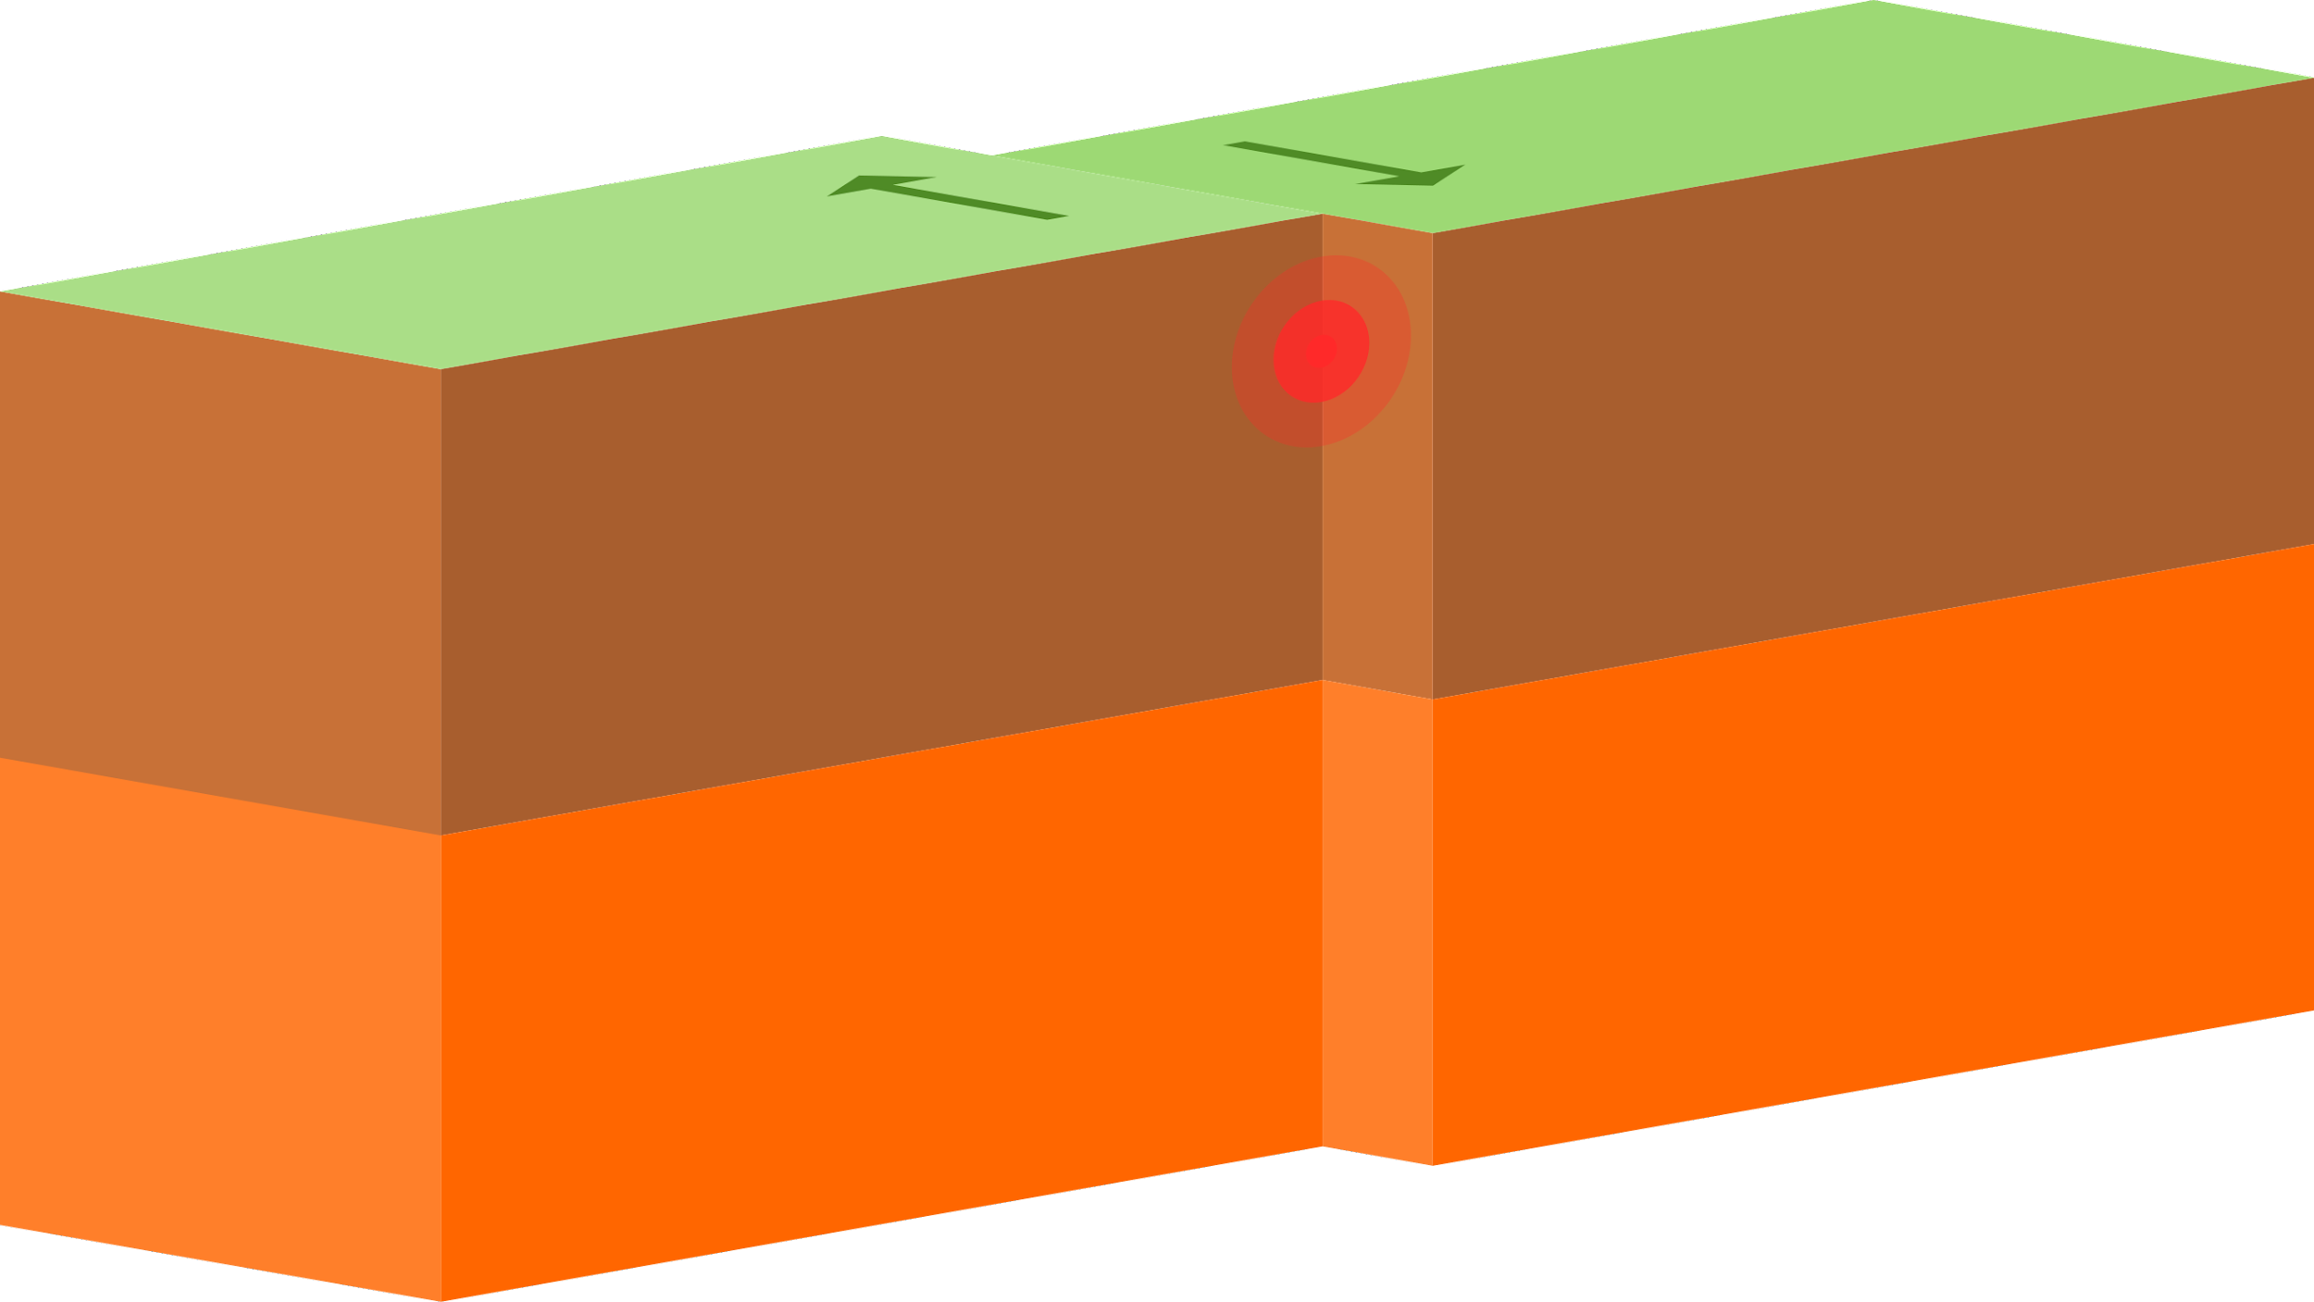
Well known example of landform created at a divergent boundary
At divergent boundaries the plates move apart allowing molten magma rise and form new crust in the form of ridges, valleys and volcanoes.
Notes:
Please include pictures and complete sentences for EVERY slide or you will lose points.
Slide #12: Well known example of landform created at a Divergent Boundary.

Slide 13
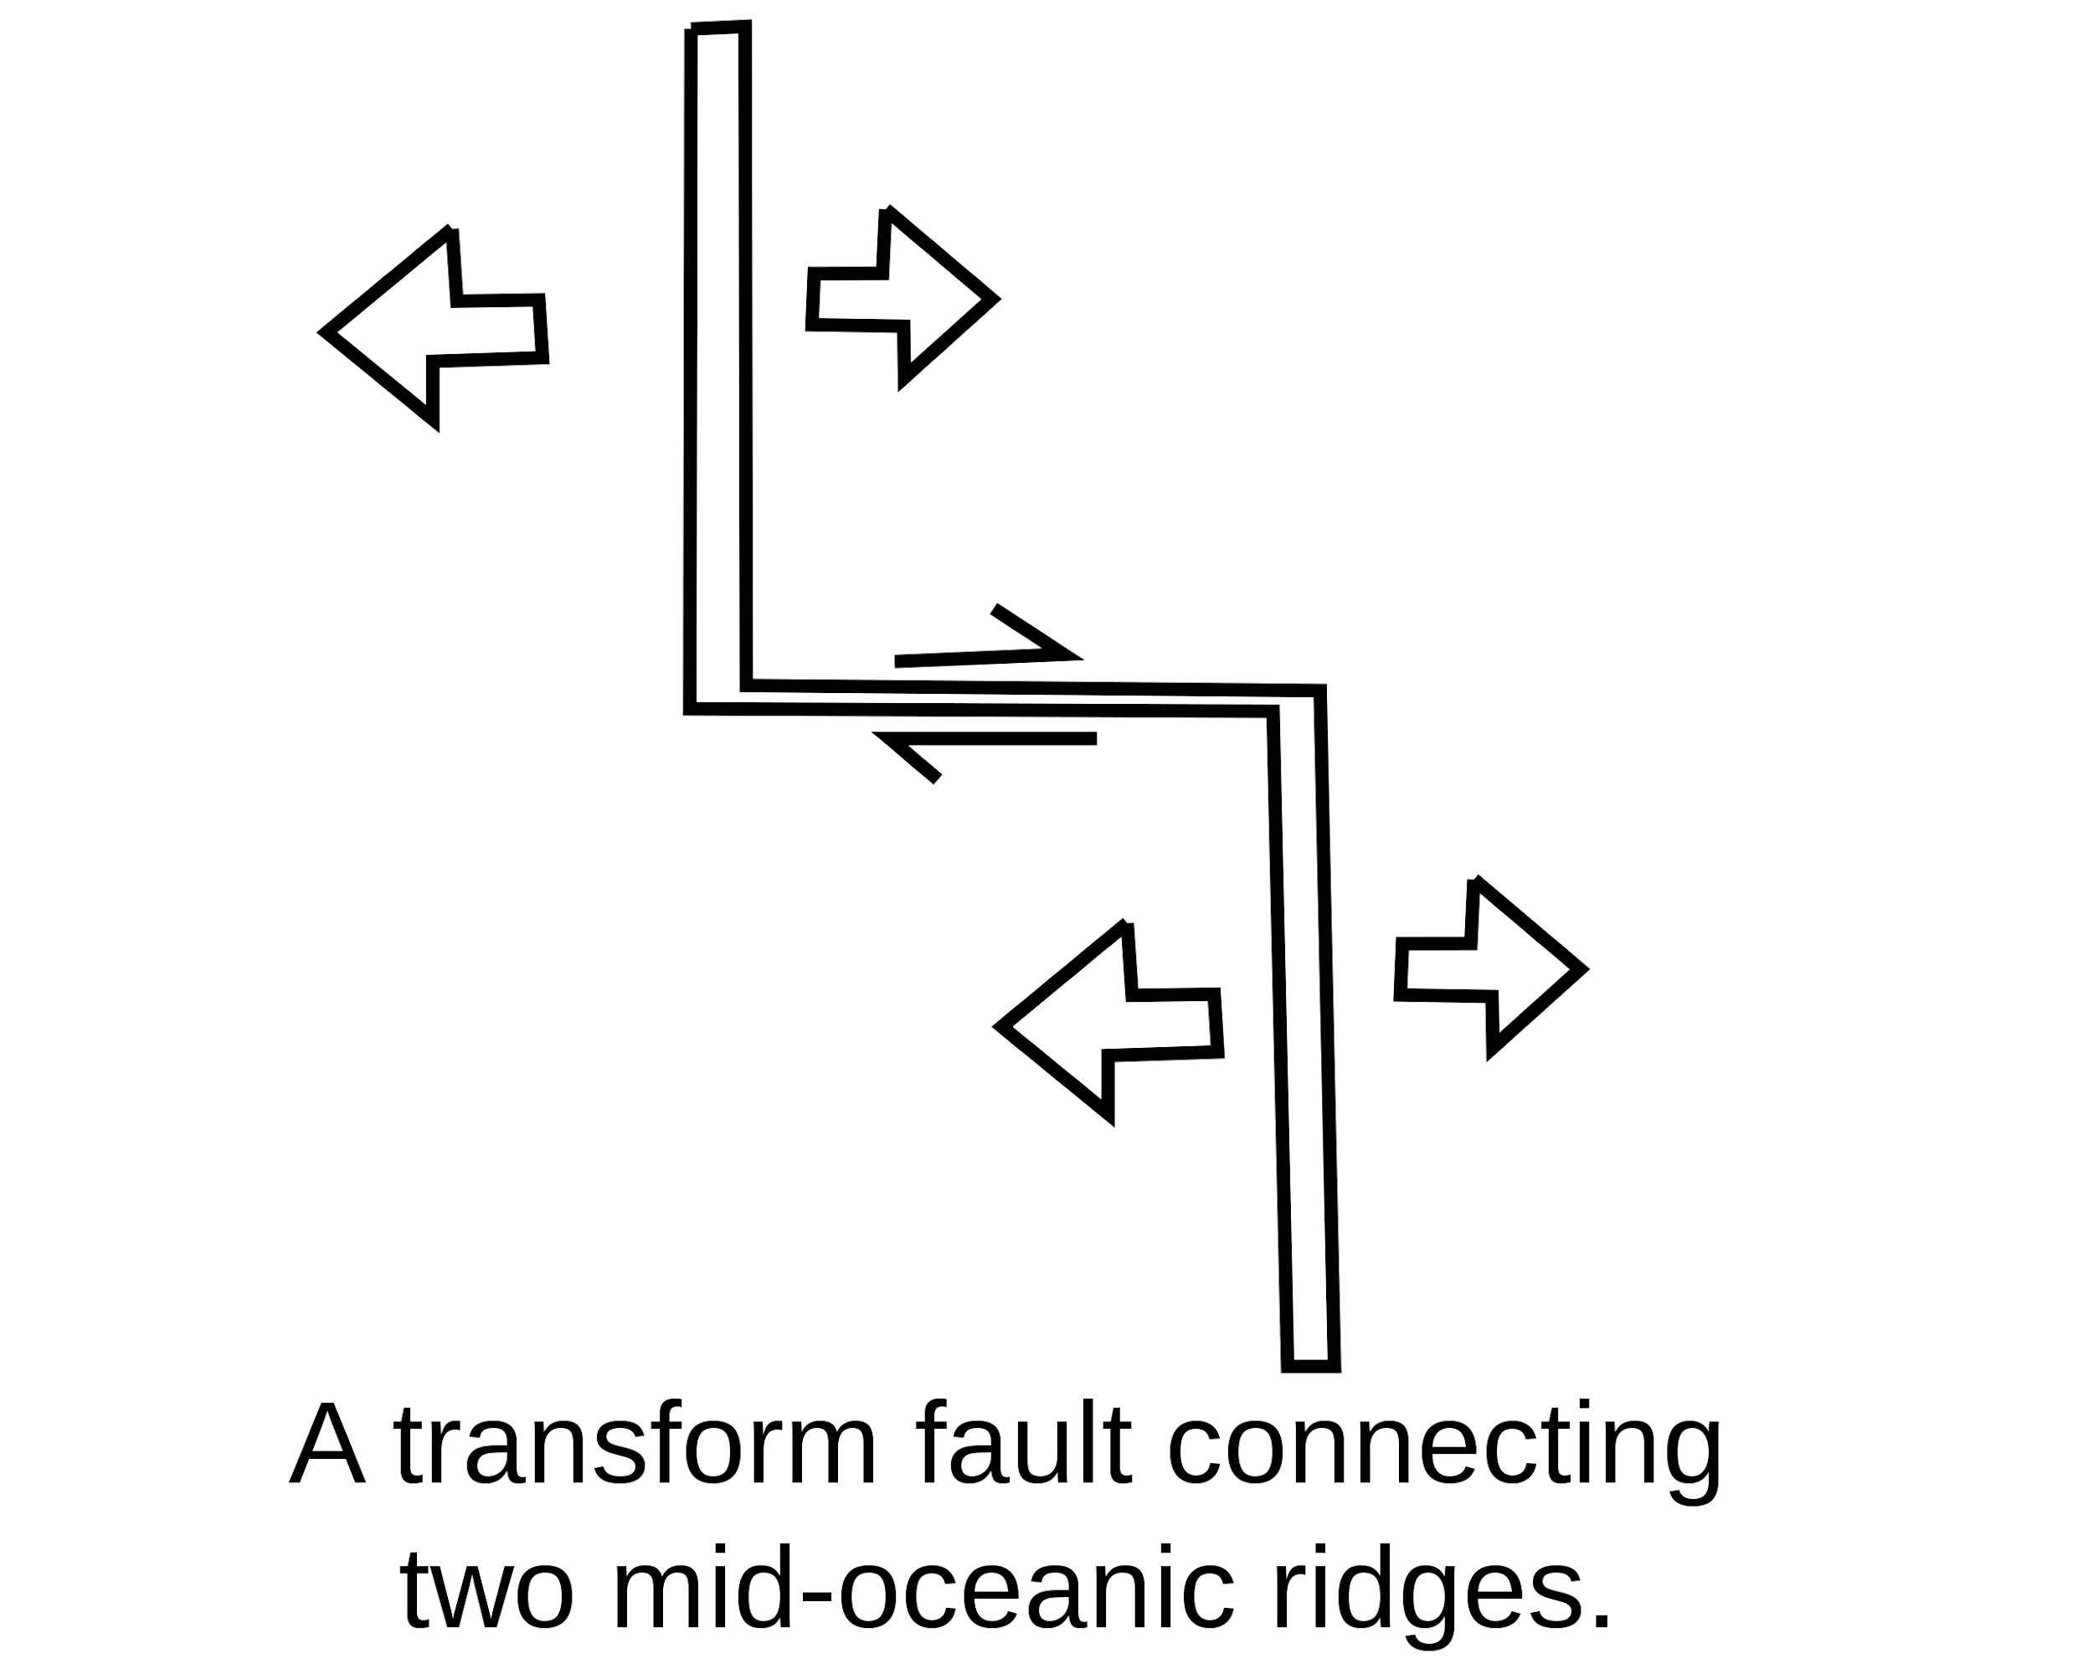
Transform fault
Notes:
Please include pictures and complete sentences for EVERY slide or you will lose points.
Slide #13: Transform Fault (title with picture).

Slide 14

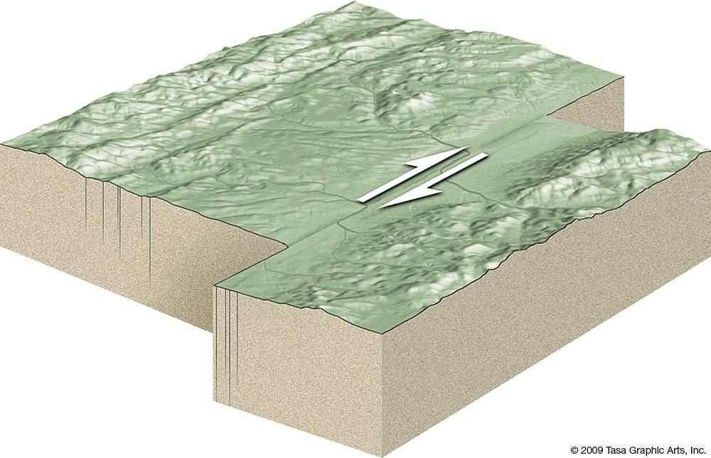
What happens at a transform fault boundary?
Two of the tectonic plates slide alongside each other.
Notes:
Please include pictures and complete sentences for EVERY slide or you will lose points.
Slide #14: What happens at a Transform Fault Boundary?

Slide 15

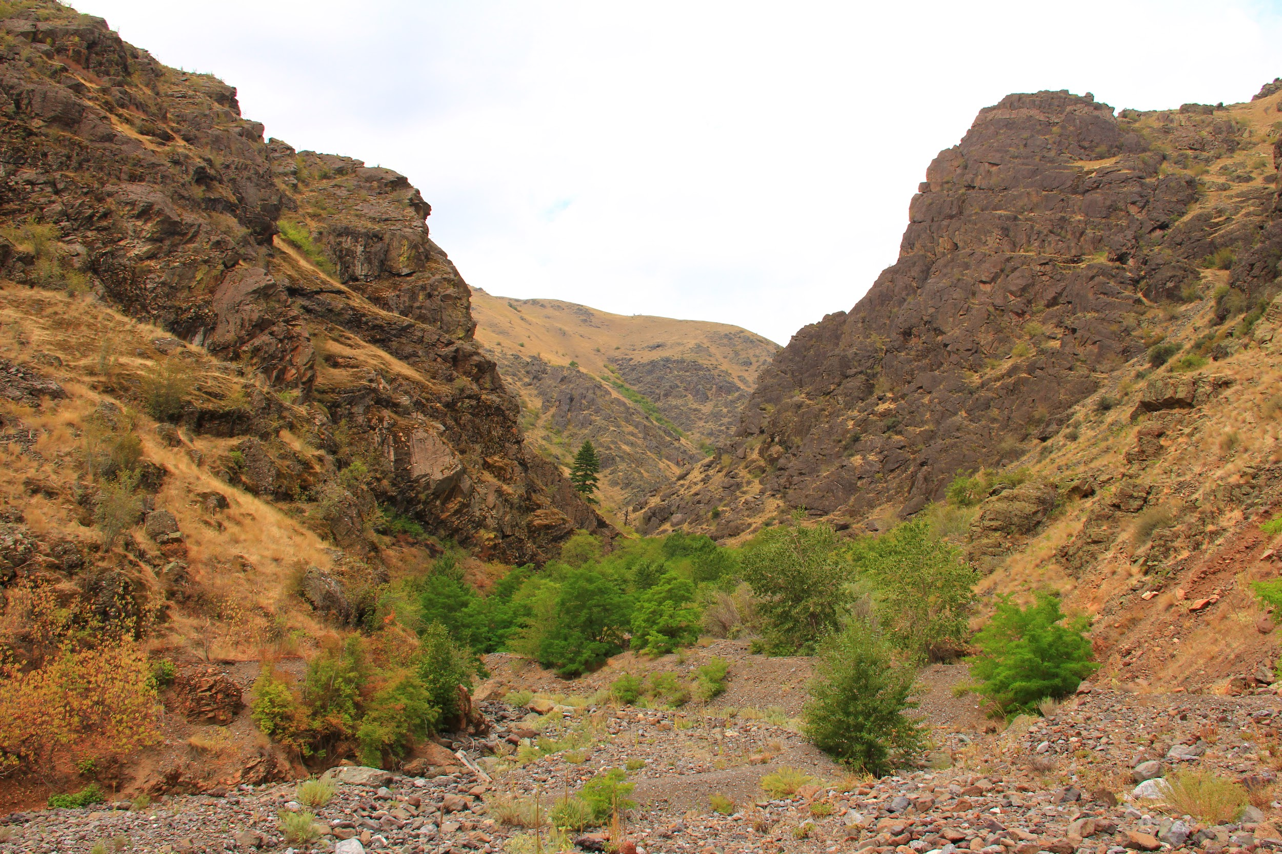
What forms at a transform fault boundary?
They cause intense earthquakes, the formation of thin linear valleys, and split river beds.
Notes:
Please include pictures and complete sentences for EVERY slide or you will lose points.
Slide #15: What forms at a Transform Fault Boundary?

Slide 16

Well known transform fault and facts
The san andreas fault and queen charlotte fault are transform plate boundaries developing where the pacific plate moves northward past the north american plates
They slide past each other
They cause earthquakes and displace rocks
Create ridges and valleys along each side of the strike slip fault
Notes:
Please include pictures and complete sentences for EVERY slide or you will lose points.
Slide #16: Example of a well-known Transform fault and a few facts about it.

