Slide 1
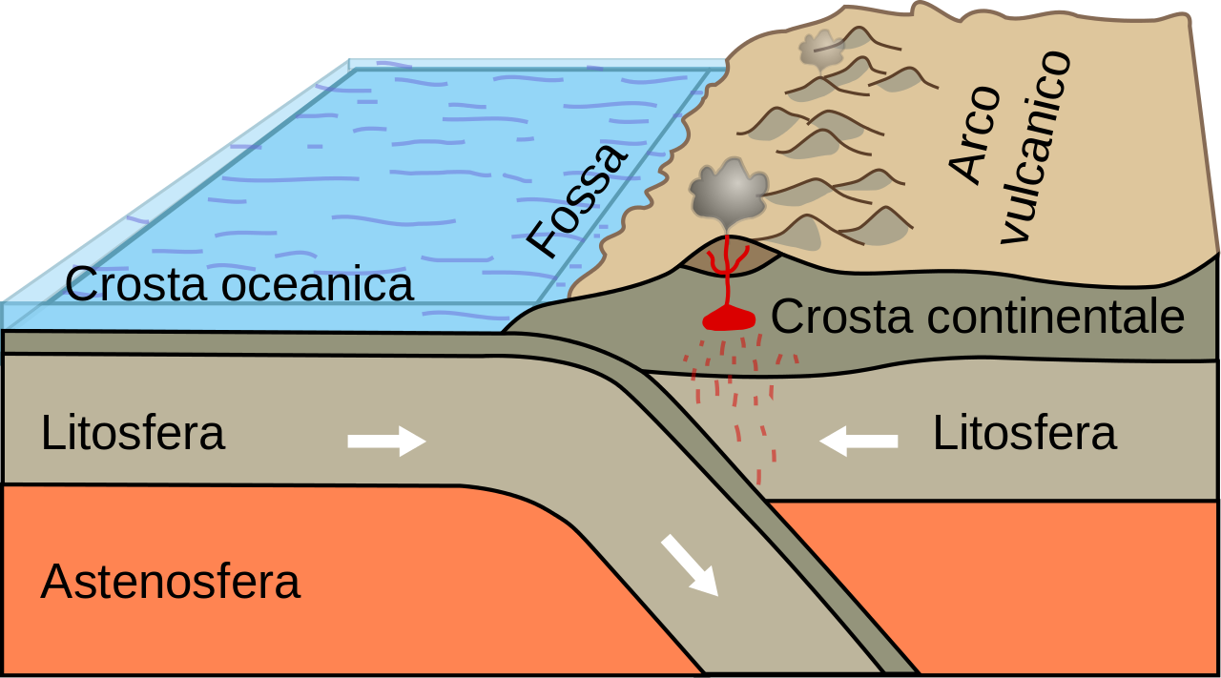
CONVERT BOUNDARY
Keyaan Khan
Notes:
Please include pictures and complete sentences for EVERY slide or you will lose points.
Slide #1: Convergent Boundary (title with picture)

Slide 2
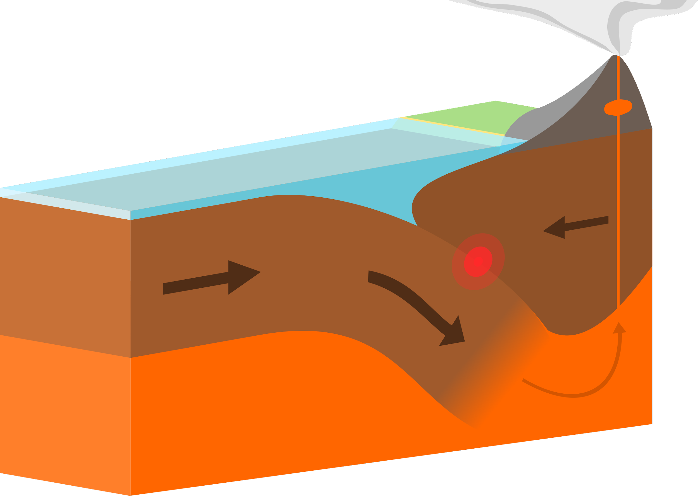
What happens at convergent boundary
When plates move towards each other and collide.
Notes:
Please include pictures and complete sentences for EVERY slide or you will lose points.
Slide #2: What happens at a Convergent Boundary?

Slide 3
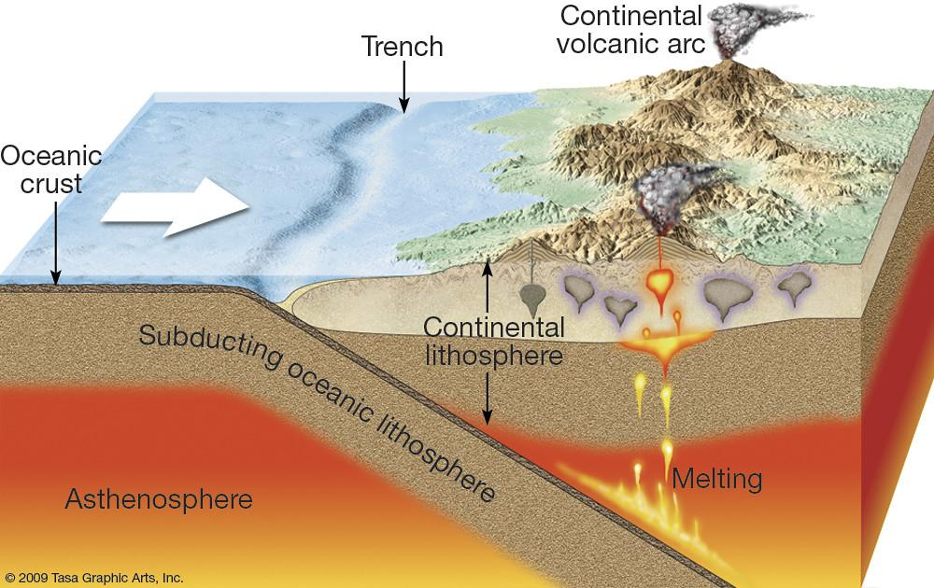
First type of Convergent plate boundary explained
Oceanic - continental
Is an area on Earth where two or more lithospheric plates collide.
Notes:
Please include pictures and complete sentences for EVERY slide or you will lose points.
Slide #3: First type of Convergent plate boundary explained.

Slide 4
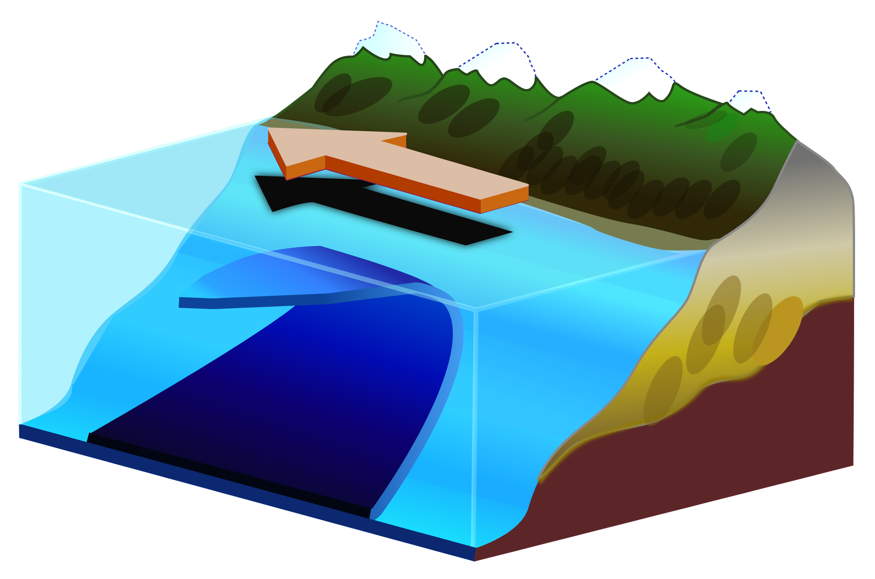
Second type of Convergent plate boundary explained.
Continental - Continental
where two tectonic plates are moving toward each other, often causing one plate to slide below the other
Notes:
Please include pictures and complete sentences for EVERY slide or you will lose points.
Slide #4: Second type of Convergent plate boundary explained.

Slide 5
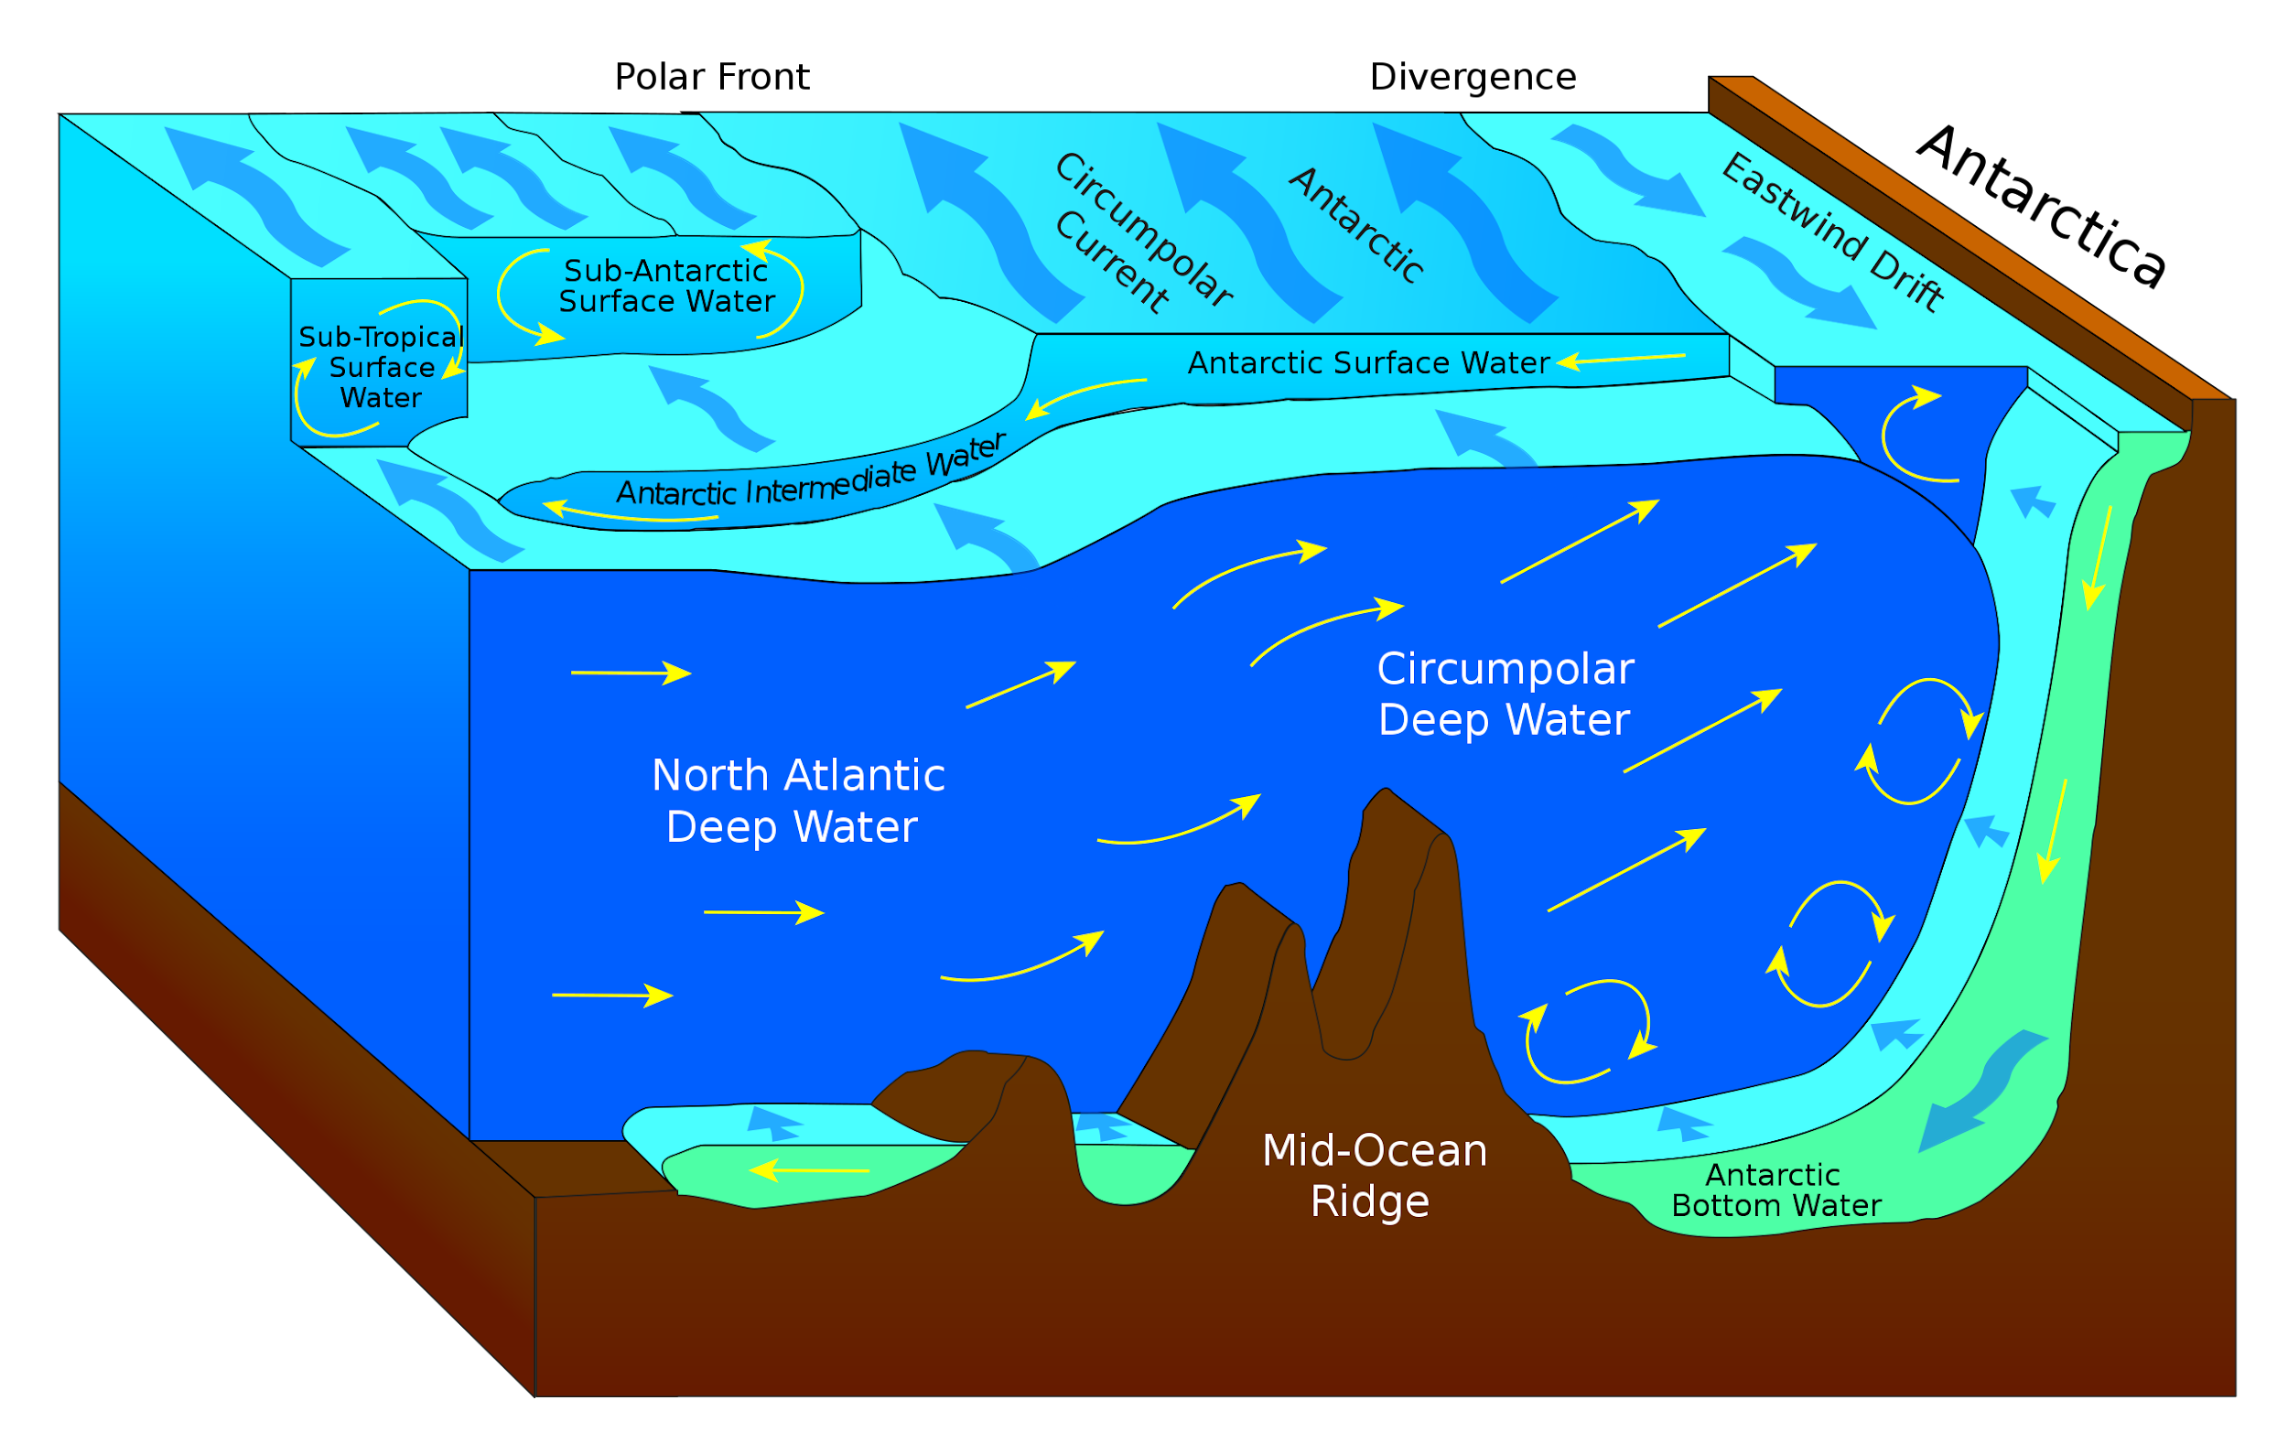
Third type of Convergent plate boundary explained.
Oceanic -Oceanic
two continents collide. The continents were separated at one time by oceanic crust that was progressively subducted
Notes:
Please include pictures and complete sentences for EVERY slide or you will lose points.
Slide #5: Third type of Convergent plate boundary explained.

Slide 6
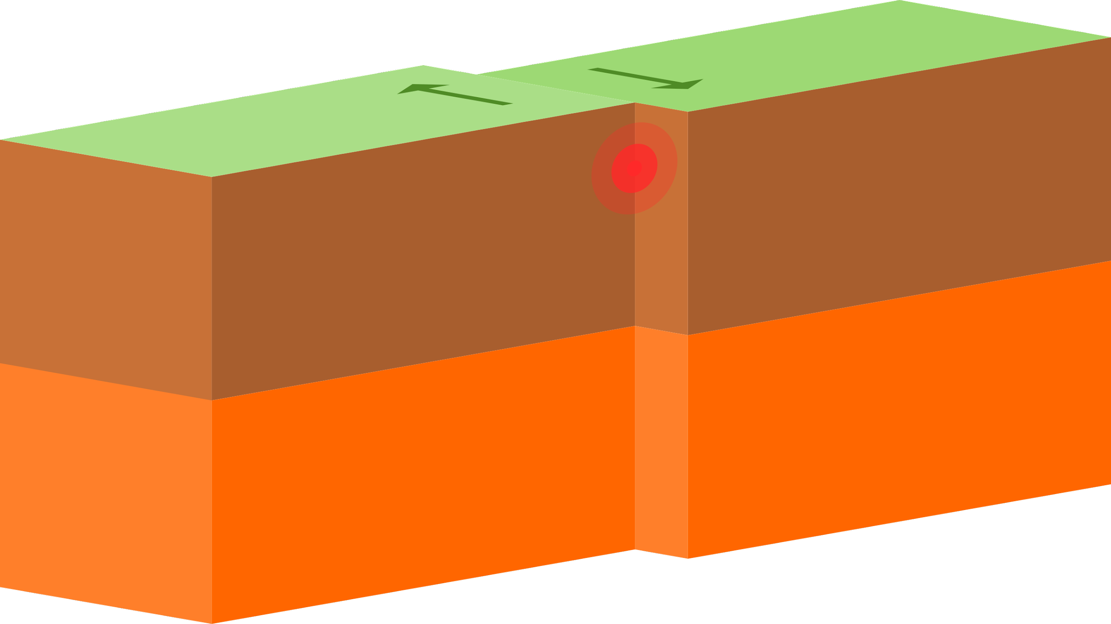
What forms at the 1st convergent boyundary
An accretionary wedge forms on the continental crust as deep-sea sediments and oceanic crust are scraped from the oceanic plate.
Notes:
Please include pictures and complete sentences for EVERY slide or you will lose points.
Slide #6: What forms at the 1st Convergent Boundary? – Give well known example of landform created at this boundary.

Slide 7

What forms at the 2nd Convergent Boundary?
molten rock rises from the Earth's mantle to the surface, solidifying to create new oceanic crust.
Notes:
Please include pictures and complete sentences for EVERY slide or you will lose points.
Slide #7: What forms at the 2nd Convergent Boundary? – Give well known example of landform created at this boundary.

Slide 8
What forms at the 3rd Convergent Boundary?
This results in the formation of a ridge of new rock
Notes:
Please include pictures and complete sentences for EVERY slide or you will lose points.
Slide #8: What forms at the 3rd Convergent Boundary? – Give well known example of landform created at this boundary.

Slide 9
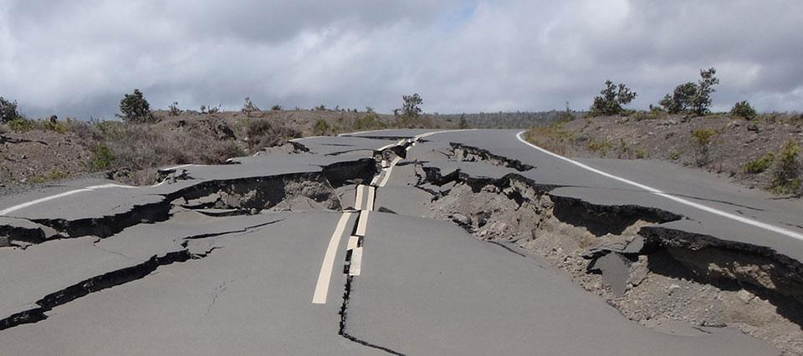
Divergent Boundary
A divergent boundary occurs when two tectonic plates move away from each other.
Notes:
Please include pictures and complete sentences for EVERY slide or you will lose points.
Slide #9:Divergent Boundary (title with picture).

Slide 10
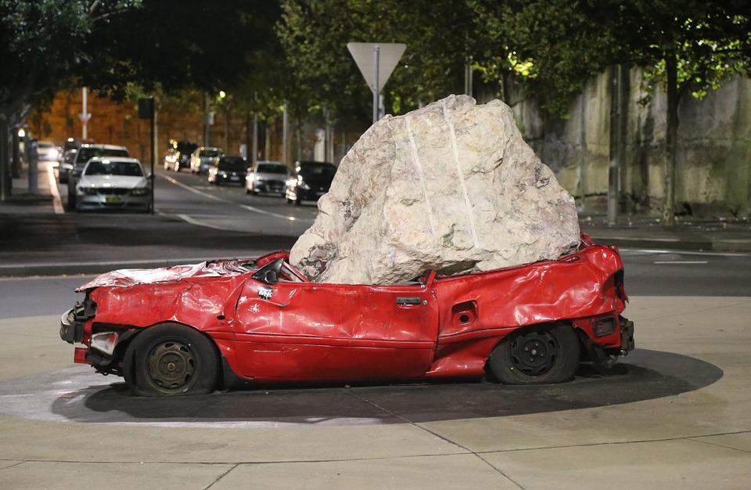
What happens at a Divergent Boundary?
two plates move away from each other and the space that this creates is filled with new crustal material sourced from molten magma that forms below
Notes:
Please include pictures and complete sentences for EVERY slide or you will lose points.
Slide #10: What happens at a Divergent Boundary?

Slide 11

What forms at a Divergent Boundary?
Most divergent plate boundaries are underwater and form submarine mountain ranges called oceanic spreading ridges.
Notes:
Please include pictures and complete sentences for EVERY slide or you will lose points.
Slide #11: What forms at a Divergent Boundary?

Slide 12

Well known example of landform created at a Divergent Boundary.
MId ocean-ridges are made underwater.
Notes:
Please include pictures and complete sentences for EVERY slide or you will lose points.
Slide #12: Well known example of landform created at a Divergent Boundary.

Slide 13
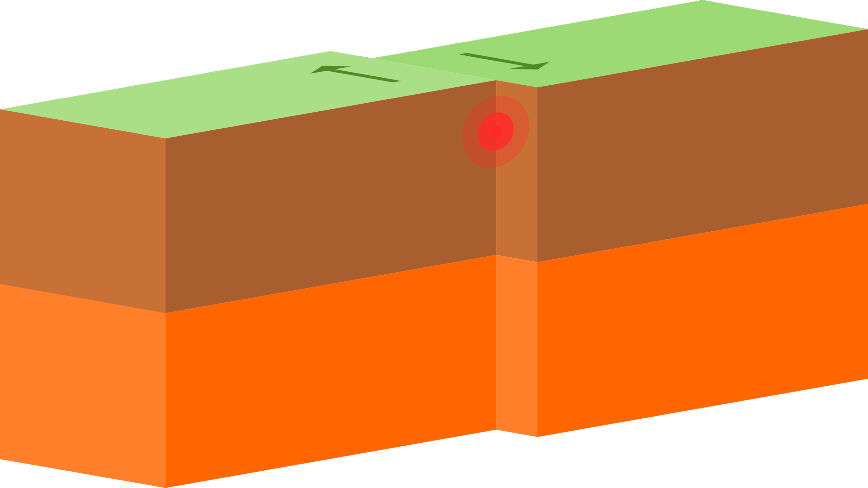
Transform Fault
Slide move past each other
Notes:
Please include pictures and complete sentences for EVERY slide or you will lose points.
Slide #13: Transform Fault (title with picture).

Slide 14
What happens at a Transform Fault Boundary?
the scraping of the two plates causes earthquakes.
Notes:
Please include pictures and complete sentences for EVERY slide or you will lose points.
Slide #14: What happens at a Transform Fault Boundary?

Slide 15
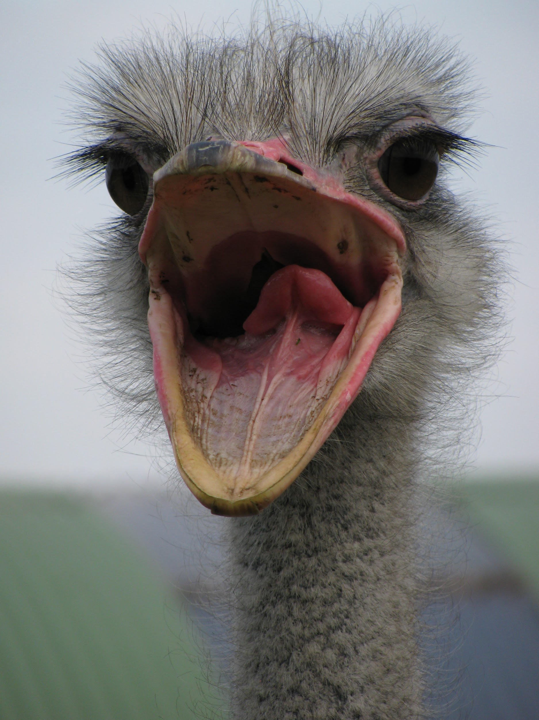
What forms at a Transform Fault Boundary?
What forms at transform boundary are stream beds split in half, deep trenches, and scarps and ridges often mark the location of a transform boundary
Notes:
Please include pictures and complete sentences for EVERY slide or you will lose points.
Slide #15: What forms at a Transform Fault Boundary?

Slide 16
Example of a well-known Transform fault and a few facts about it.
The most famous example of this is the San Andreas Fault
Notes:
Please include pictures and complete sentences for EVERY slide or you will lose points.
Slide #16: Example of a well-known Transform fault and a few facts about it.

