Slide 1
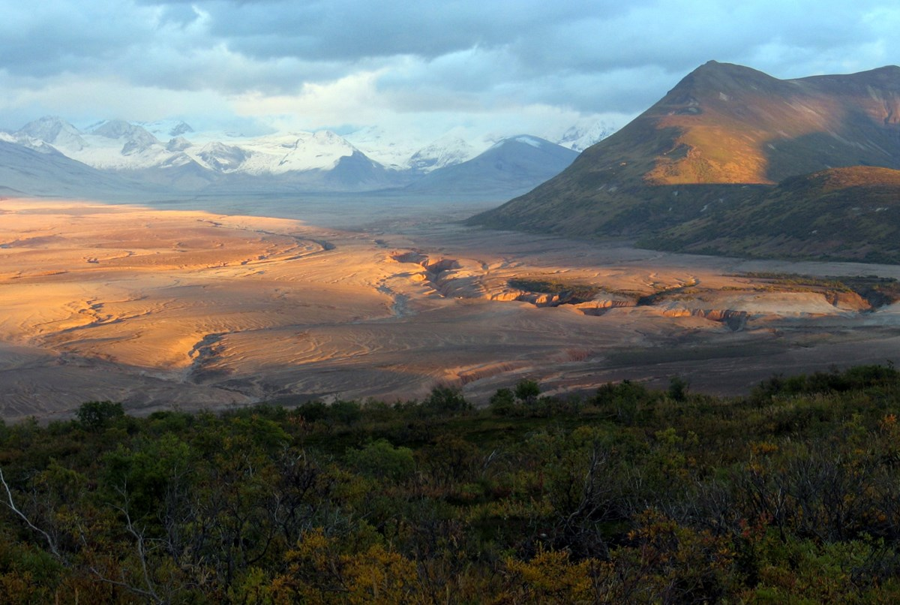
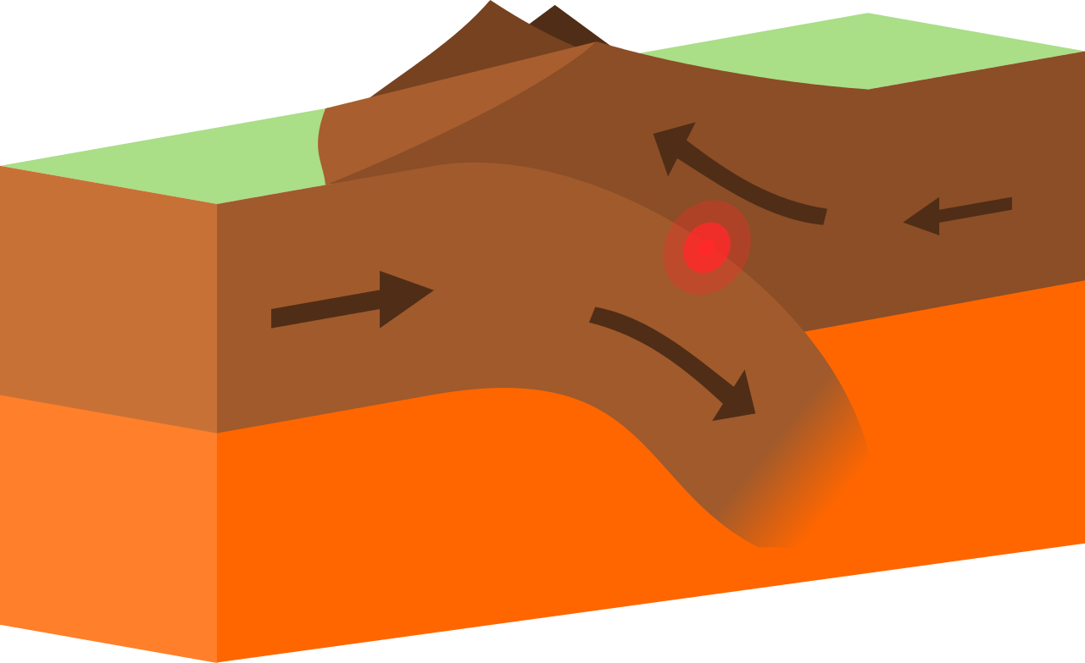
Convergent Boundaries
By Nushmia Khan
Notes:
Please include pictures and complete sentences for EVERY slide or you will lose points.
Slide #1: Convergent Boundary (title with picture)

Slide 2
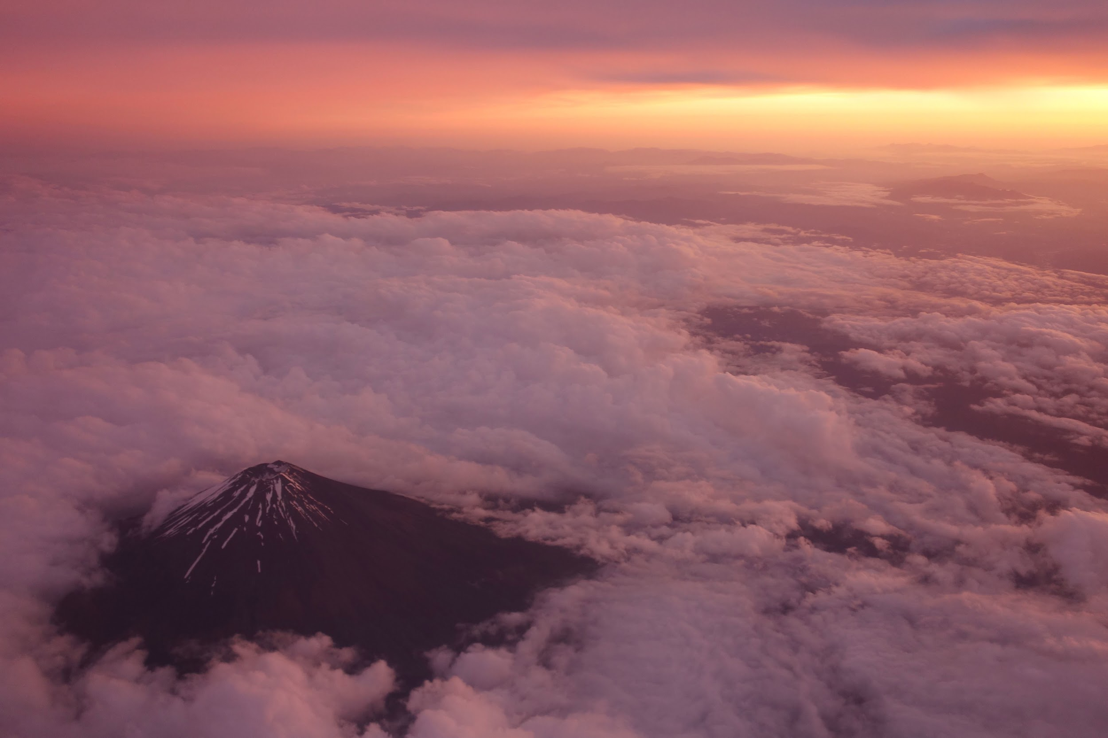
What Happens @ A Convergent Boundary?
When plates move towards eachother and collide, it is called Convergent Boundary.
Notes:
Please include pictures and complete sentences for EVERY slide or you will lose points.
Slide #2: What happens at a Convergent Boundary?

Slide 3
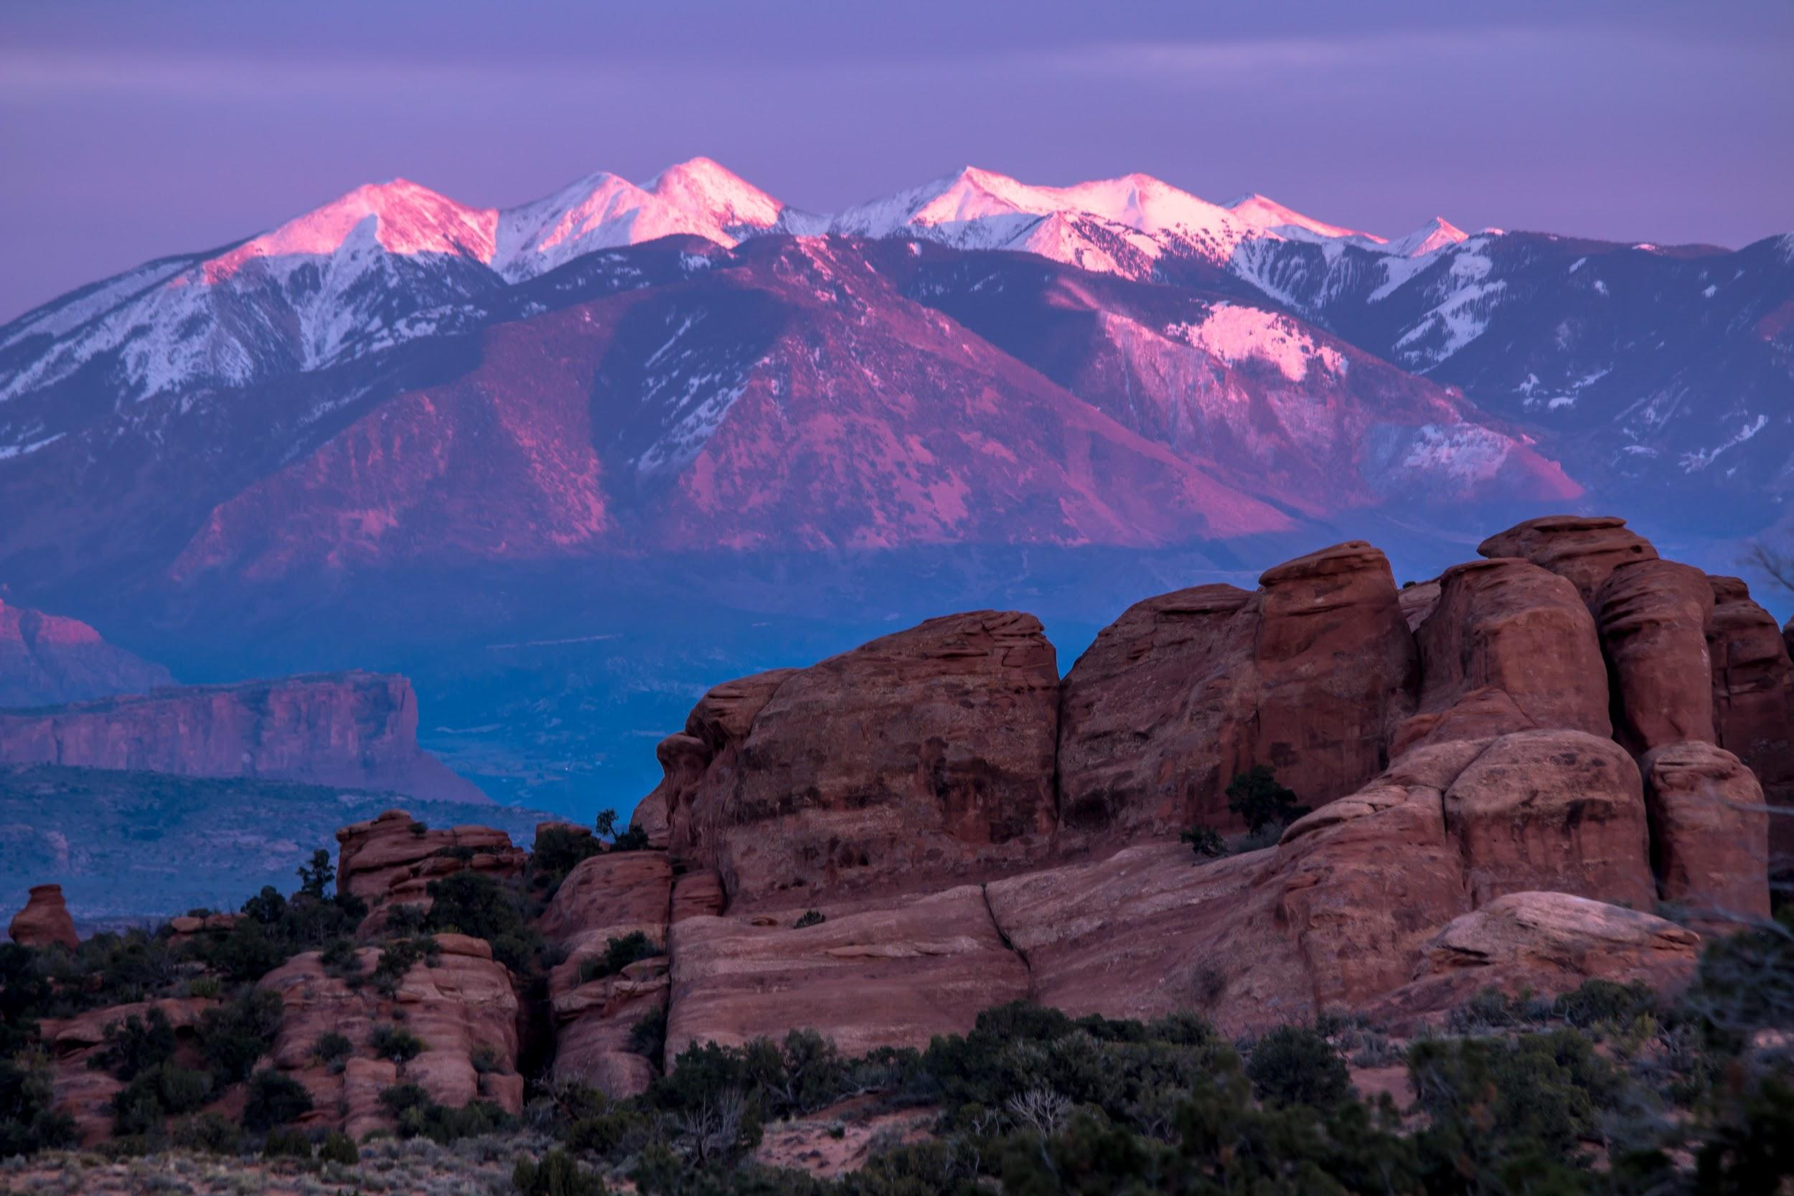
1st type of Convergent Plate Boundary: Oceanic-Oceanic.
Oceanic-Oceanic is the 1st convergent boundary, it’s where 2 oceanic plates come together and the denser plate sinks, or subducts, beneath the less dense plate, forming a deep ocean trench.
Notes:
Please include pictures and complete sentences for EVERY slide or you will lose points.
Slide #3: First type of Convergent plate boundary explained.

Slide 4
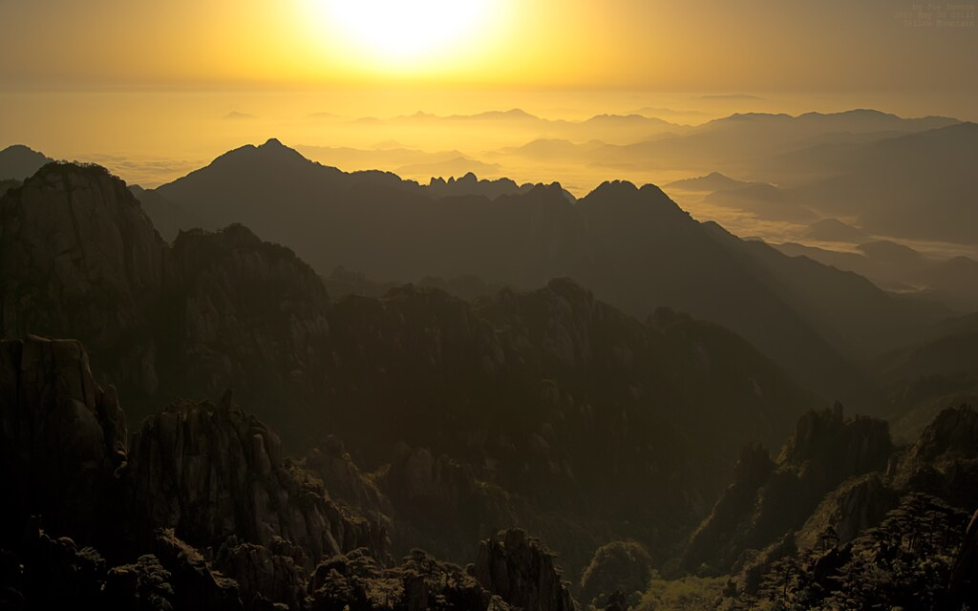
2nd Type of Convergent Plate Boundary: Oceanic-Continental.
Oceanic-Continental is the 2nd type of Convergent Boundary, when oceanic crust converges with continental crust, the denser oceanic plate plunges beneath the continental plate.
Notes:
Please include pictures and complete sentences for EVERY slide or you will lose points.
Slide #4: Second type of Convergent plate boundary explained.

Slide 5
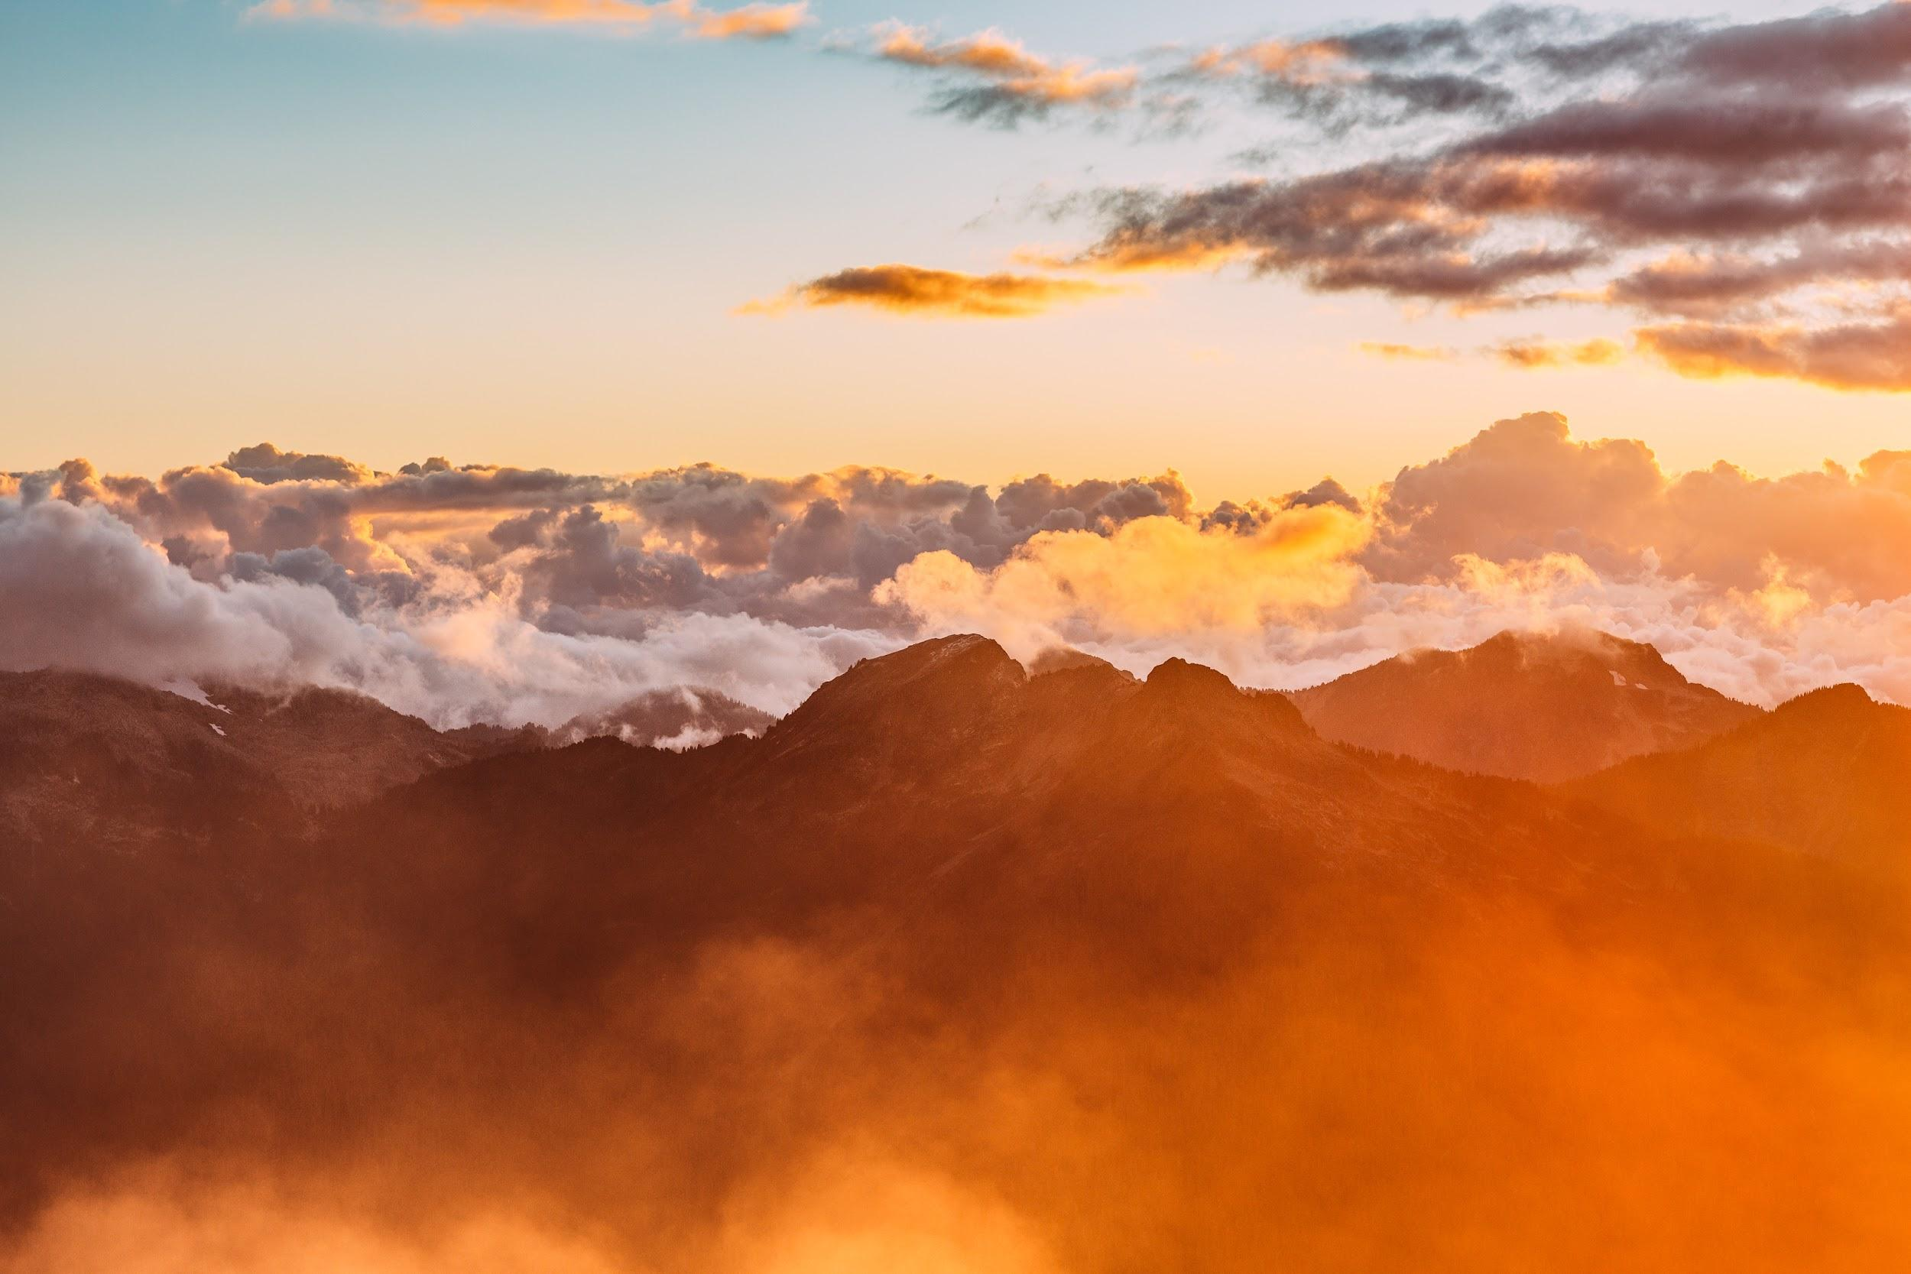
3rd type of Convergent Plate Boundary: Continental-Continental.
Continental-Continental is the 3rd Plate Boundary, when 2 continental plates converge, they smash together and create mountains.
Notes:
Please include pictures and complete sentences for EVERY slide or you will lose points.
Slide #5: Third type of Convergent plate boundary explained.

Slide 6

What forms @ the 1st Convergent Boundary?
Oceanic-Oceanic form Strong earthquakes, volcanic mountains or volcanic arc mountain ranges.
Notes:
Please include pictures and complete sentences for EVERY slide or you will lose points.
Slide #6: What forms at the 1st Convergent Boundary? – Give well known example of landform created at this boundary.

Slide 7
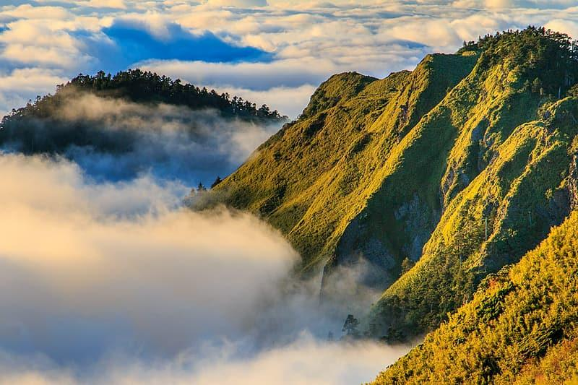
What forms @ the 2nd Convergent Boundary?
Oceanic-Continental boundaries form Volcanoes, Trenches and Earthquakes
Notes:
Please include pictures and complete sentences for EVERY slide or you will lose points.
Slide #7: What forms at the 2nd Convergent Boundary? – Give well known example of landform created at this boundary.

Slide 8
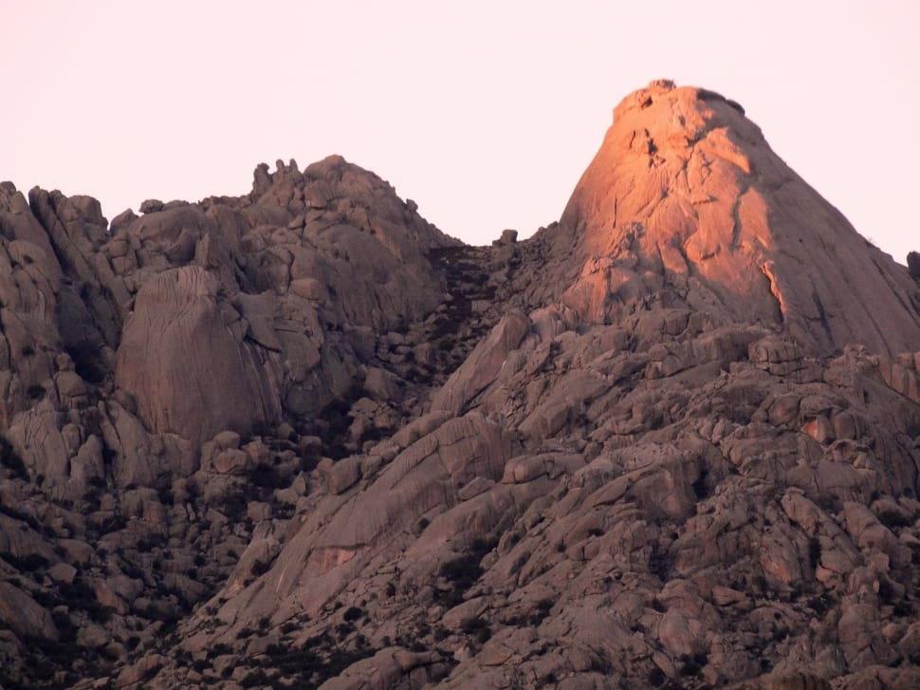
What forms @ the 3rd Convergent Boundary?
Continental-Continental boundaries form Mountains.
Notes:
Please include pictures and complete sentences for EVERY slide or you will lose points.
Slide #8: What forms at the 3rd Convergent Boundary? – Give well known example of landform created at this boundary.

Slide 9
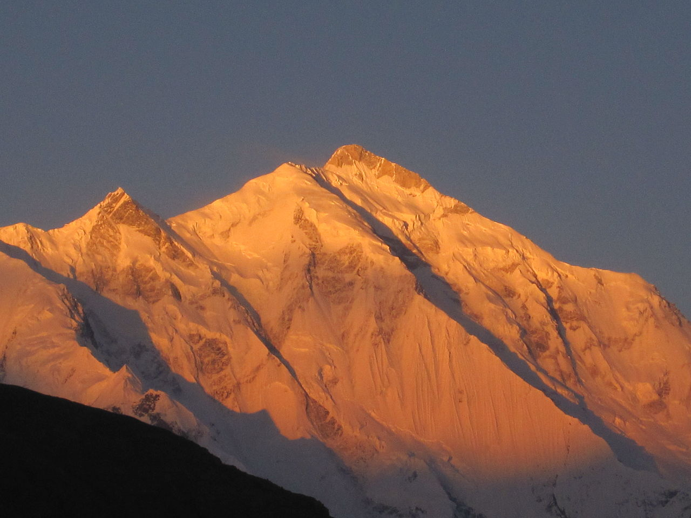
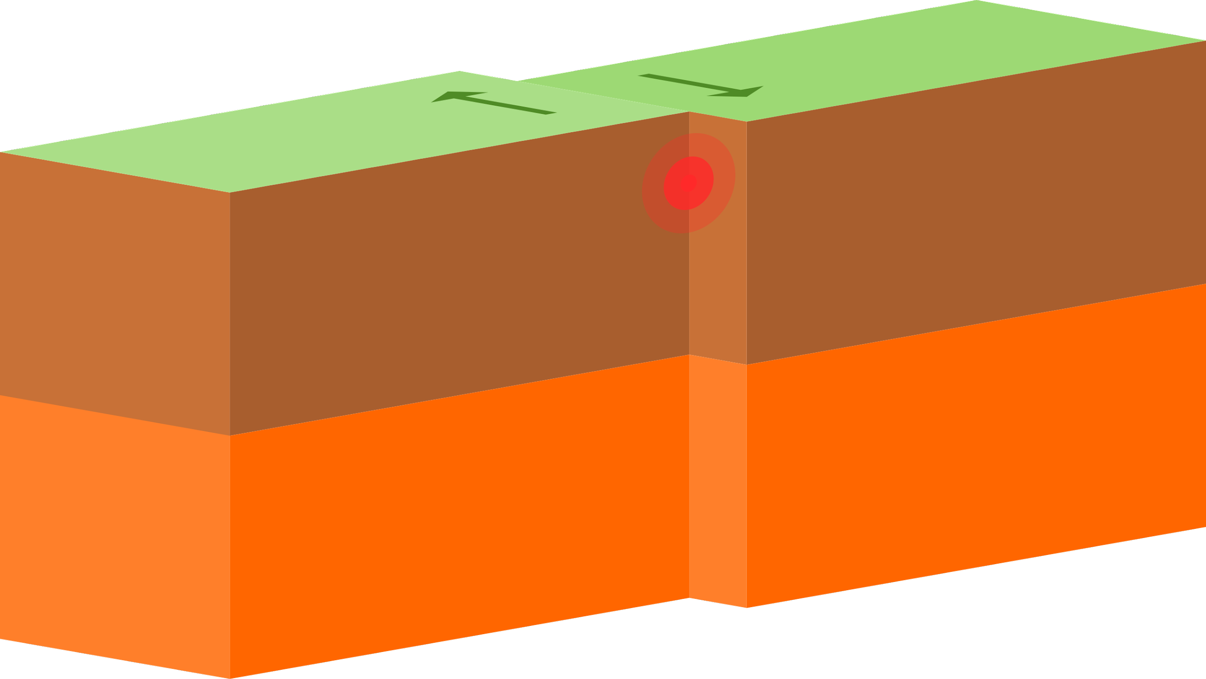
Divergent Boundary
Notes:
Please include pictures and complete sentences for EVERY slide or you will lose points.
Slide #9:Divergent Boundary (title with picture).

Slide 10
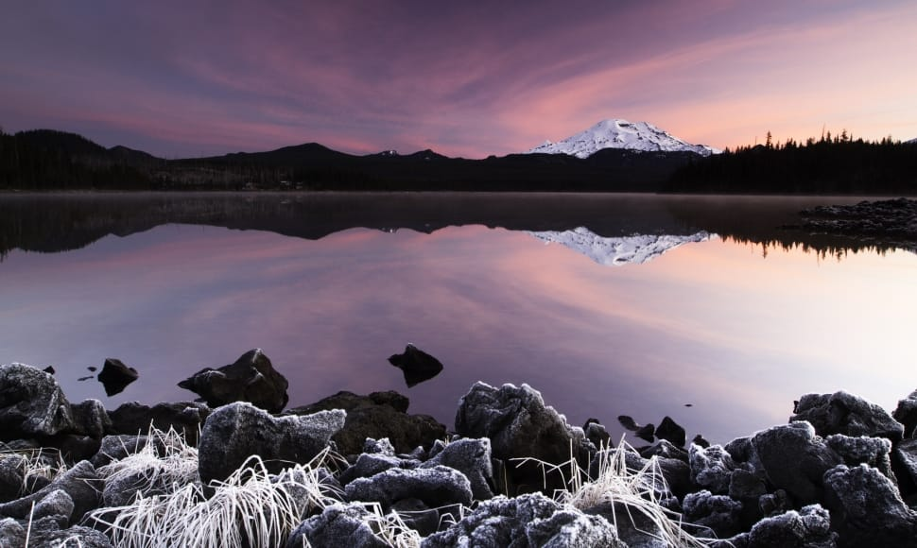
What happens @ Divergent Boundary?.
Divergent Boundaries occur along spreading centers where plates are moving apart and new crust is created by magma pushing up from the mantle.
Notes:
Please include pictures and complete sentences for EVERY slide or you will lose points.
Slide #10: What happens at a Divergent Boundary?

Slide 11
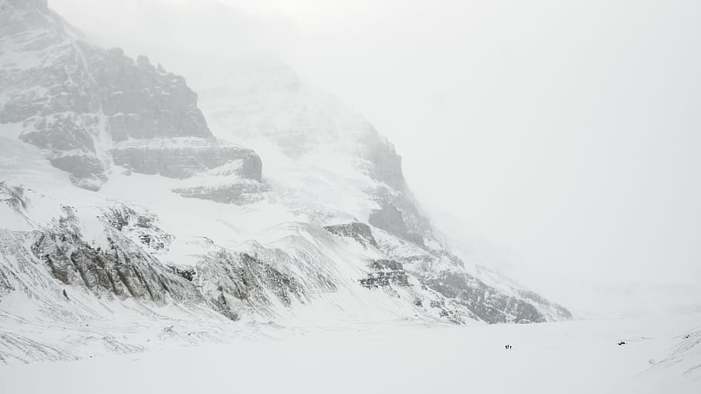
What forms @ Divergent Boundary?
Mountain Ranges known as Ridges form @ Divergent Boundaries.
Notes:
Please include pictures and complete sentences for EVERY slide or you will lose points.
Slide #11: What forms at a Divergent Boundary?

Slide 12
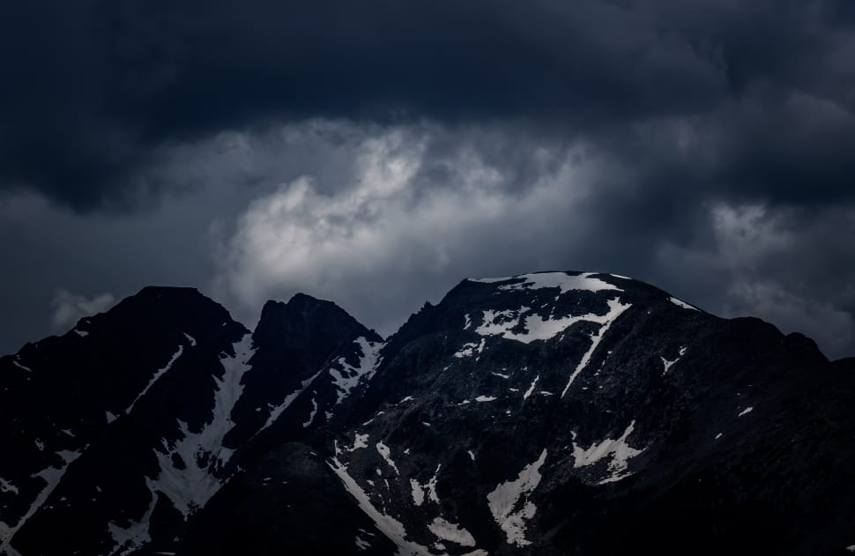
Well Known Example of Landform Created @ Divergent Boundary
Mid Atlantic Ridge and Great Rift Valley are both well known examples of landform created at a Divergent Boundary.
Notes:
Please include pictures and complete sentences for EVERY slide or you will lose points.
Slide #12: Well known example of landform created at a Divergent Boundary.

Slide 13
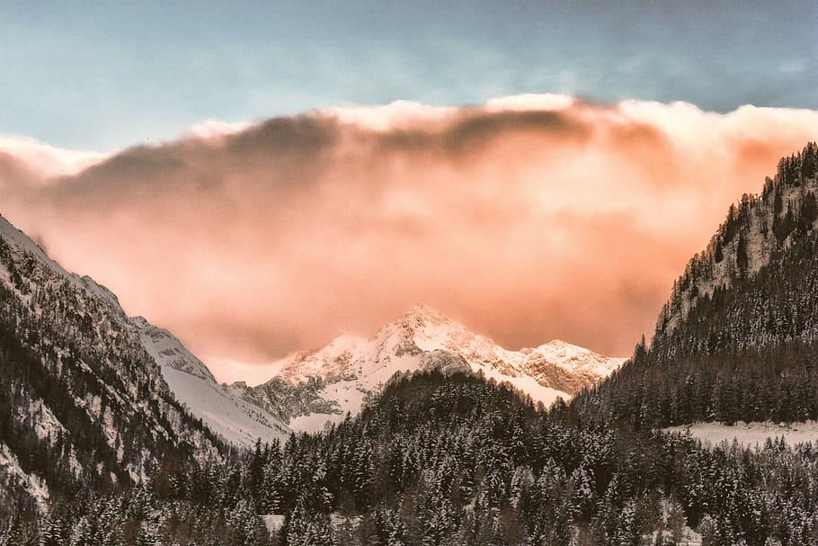
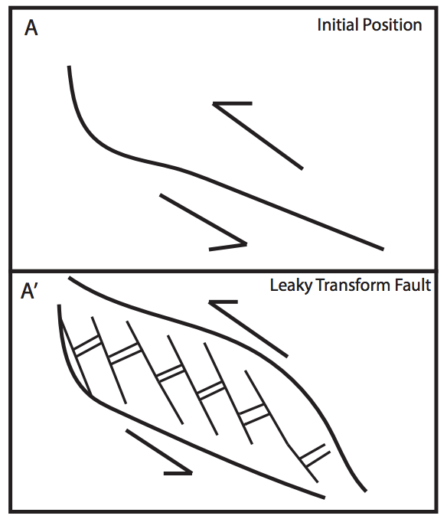
Transform Fault
Notes:
Please include pictures and complete sentences for EVERY slide or you will lose points.
Slide #13: Transform Fault (title with picture).

Slide 14
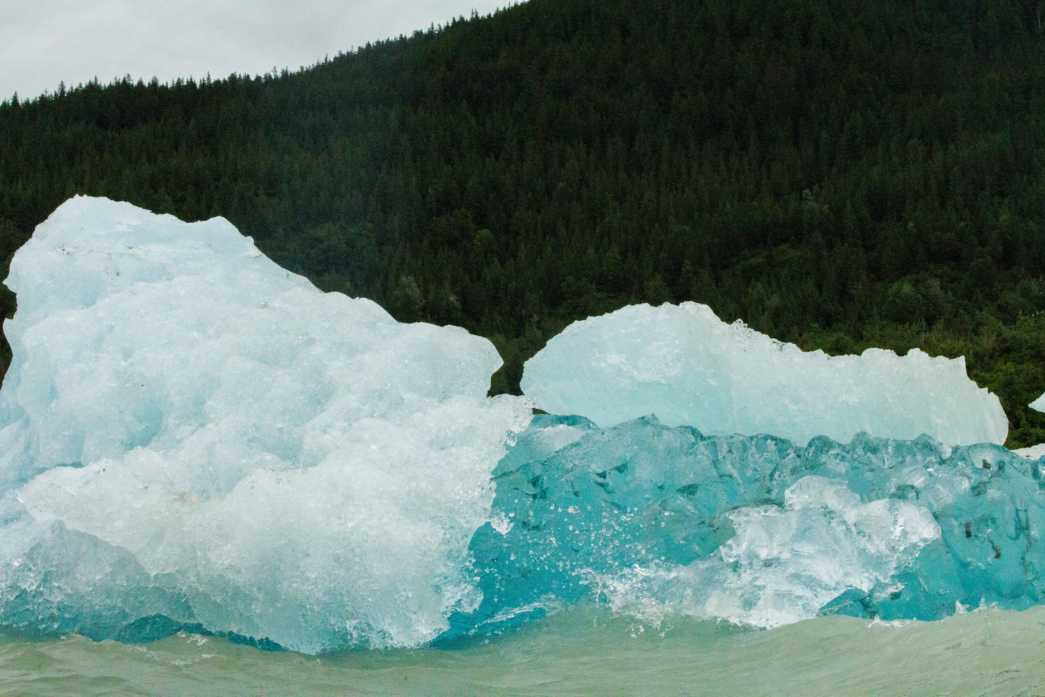
What Happens @ Transform Fault Boundary? .
Notes:
Please include pictures and complete sentences for EVERY slide or you will lose points.
Slide #14: What happens at a Transform Fault Boundary?

Slide 15
Notes:
Please include pictures and complete sentences for EVERY slide or you will lose points.
Slide #15: What forms at a Transform Fault Boundary?

Slide 16

Notes:
Please include pictures and complete sentences for EVERY slide or you will lose points.
Slide #16: Example of a well-known Transform fault and a few facts about it.

