Slide 1

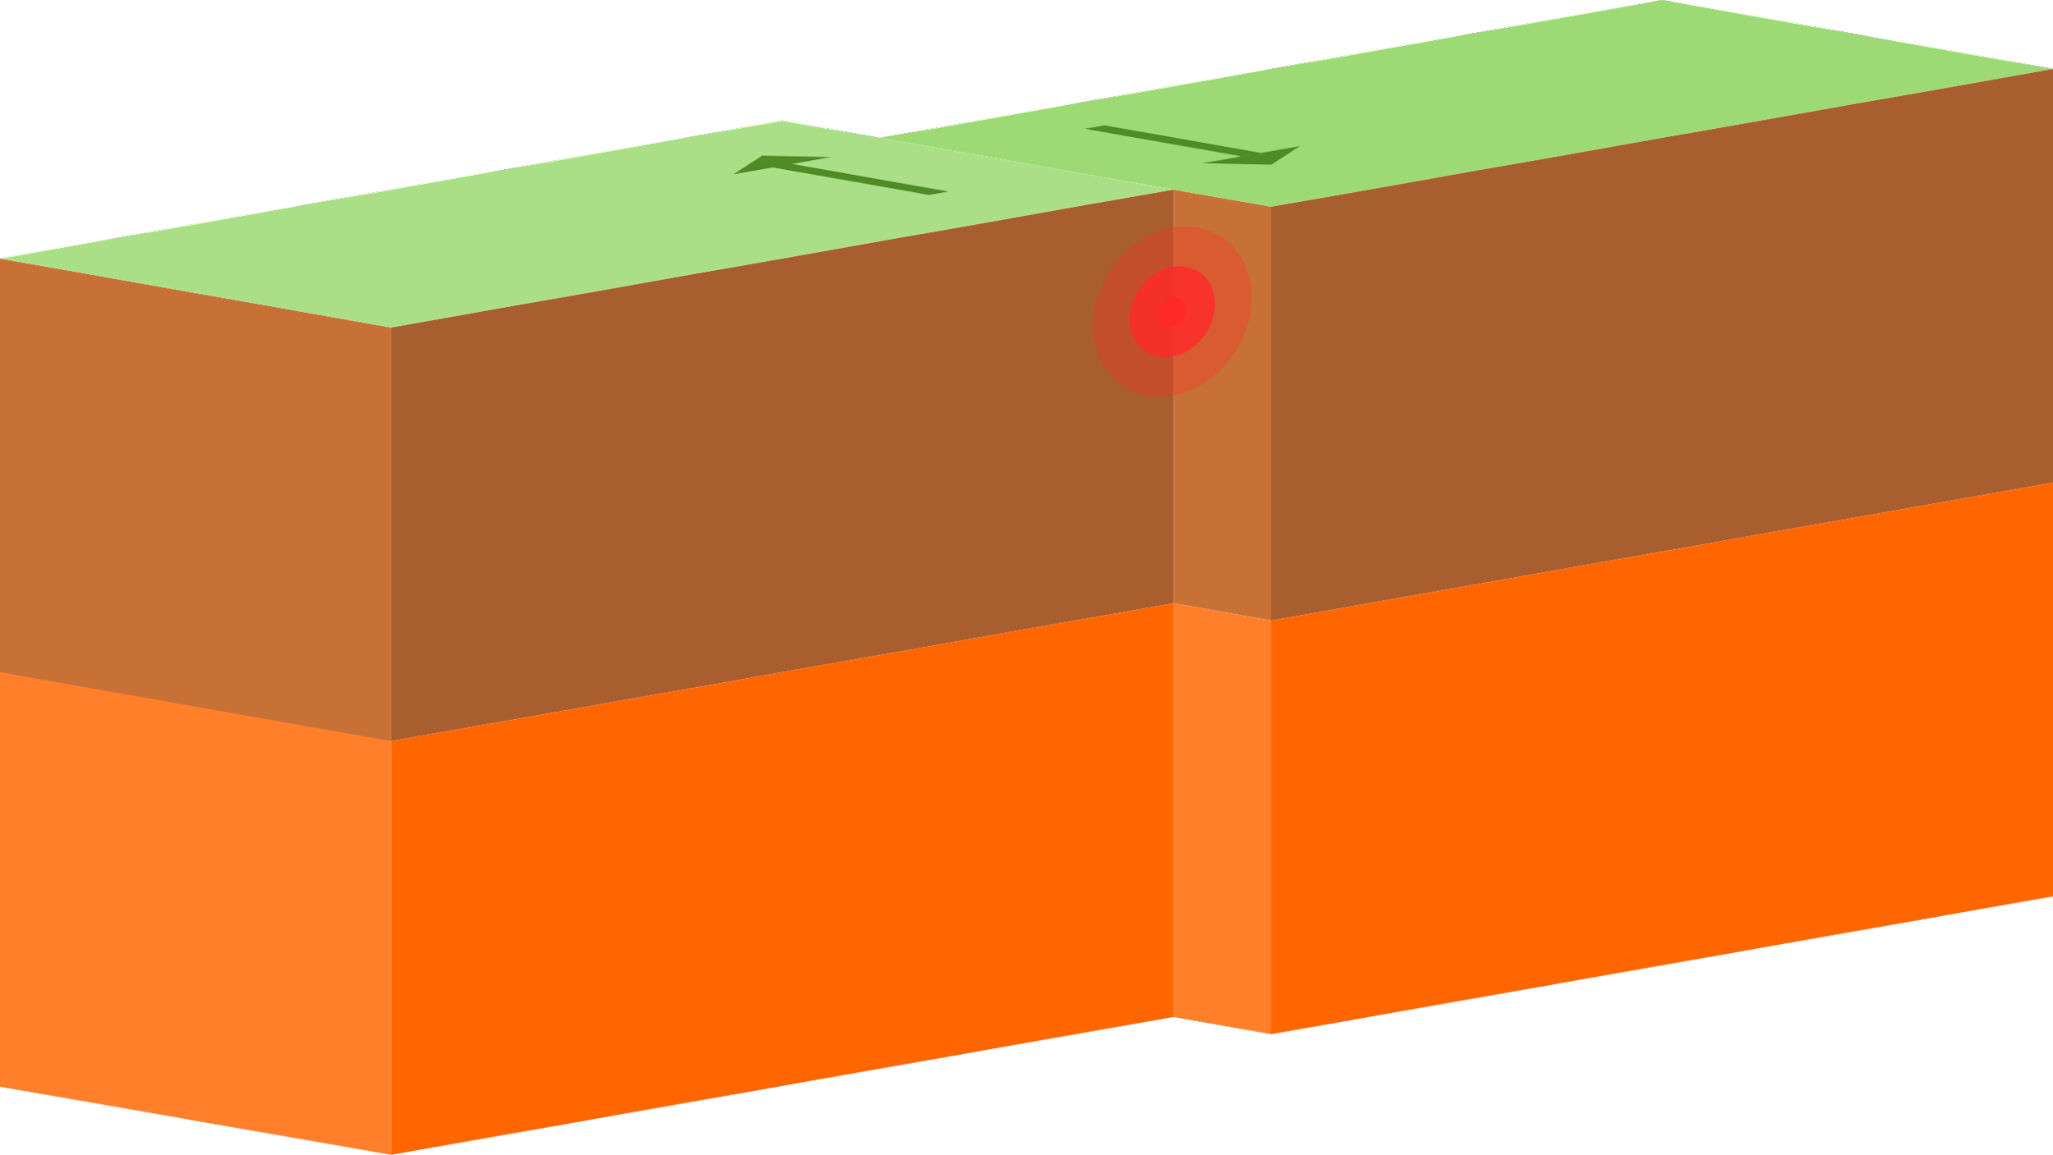
Convergent boundary
Notes:
Please include pictures and complete sentences for EVERY slide or you will lose points.
Slide #1: Convergent Boundary (title with picture)

Slide 2
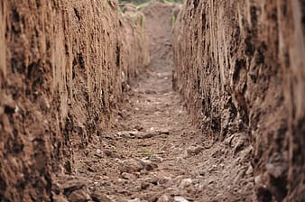
CONVERGENT BOUNDARY
A convergent boundary is when 2 lithospheric plates collide, one plate wins and moves up the other one fails and falls
Notes:
Please include pictures and complete sentences for EVERY slide or you will lose points.
Slide #2: What happens at a Convergent Boundary?

Slide 3
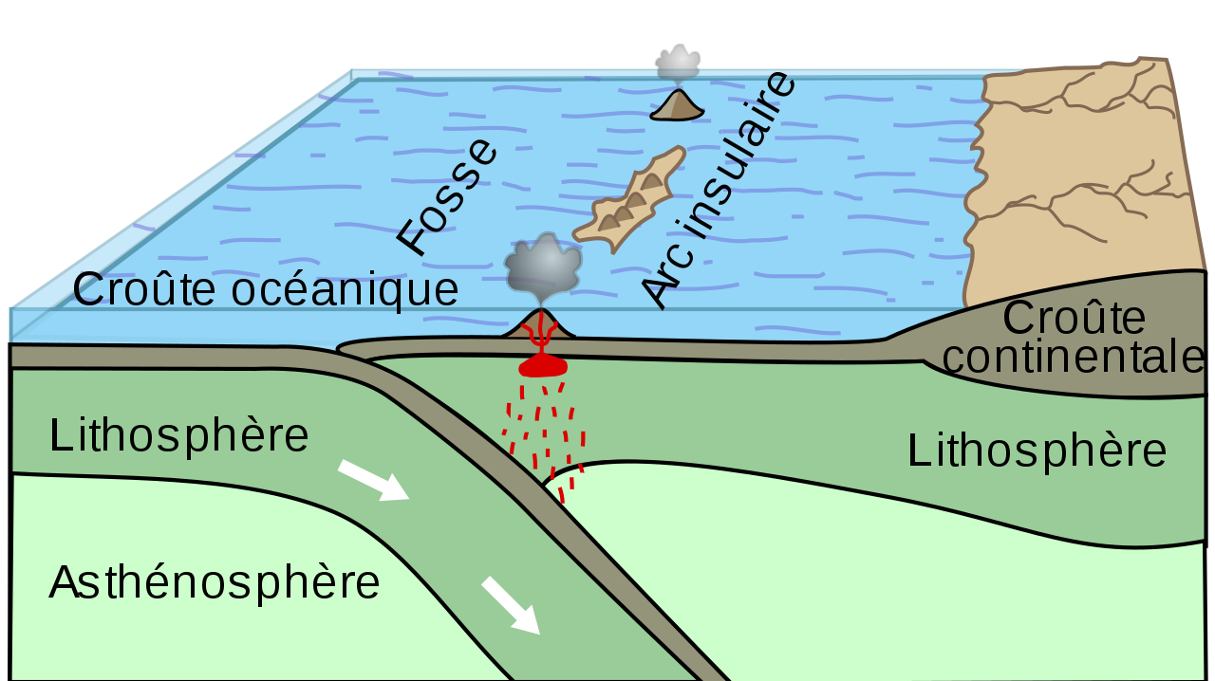
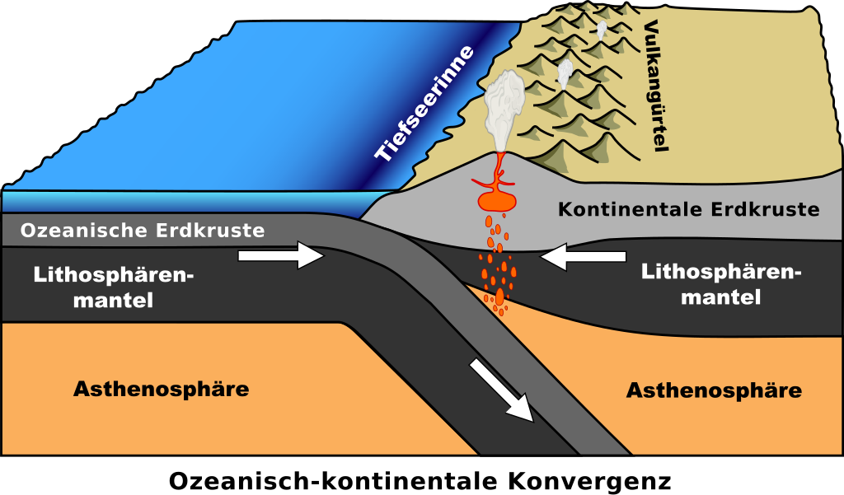
OCEANIC OCEANIC
O-O
At oceanic oceanic the two ocean plates collide but one of them slides under the other one and the one on top is usually younger but more dominant.
Notes:
Please include pictures and complete sentences for EVERY slide or you will lose points.
Slide #3: First type of Convergent plate boundary explained.

Slide 4
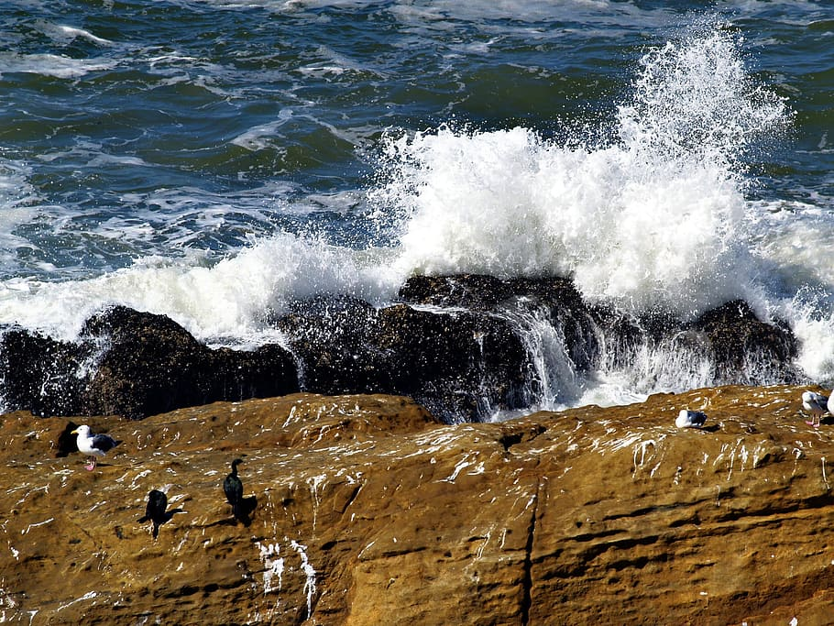
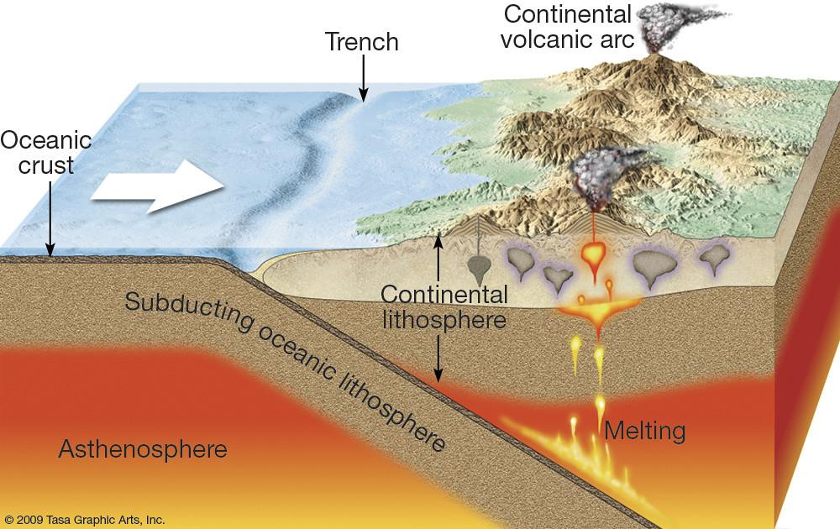
Oceanic plates collide into the earth or continent and they plunge underneath the continental plates and this process is called subduction
O-C
Notes:
Please include pictures and complete sentences for EVERY slide or you will lose points.
Slide #4: Second type of Convergent plate boundary explained.

Slide 5
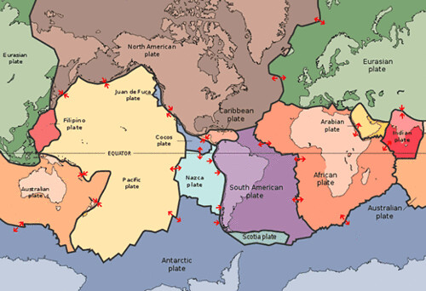
A continental-continental convergent boundary describes the collision of two tectonic plates composed of continental lithosphere.
C-C
Notes:
Please include pictures and complete sentences for EVERY slide or you will lose points.
Slide #5: Third type of Convergent plate boundary explained.

Slide 6
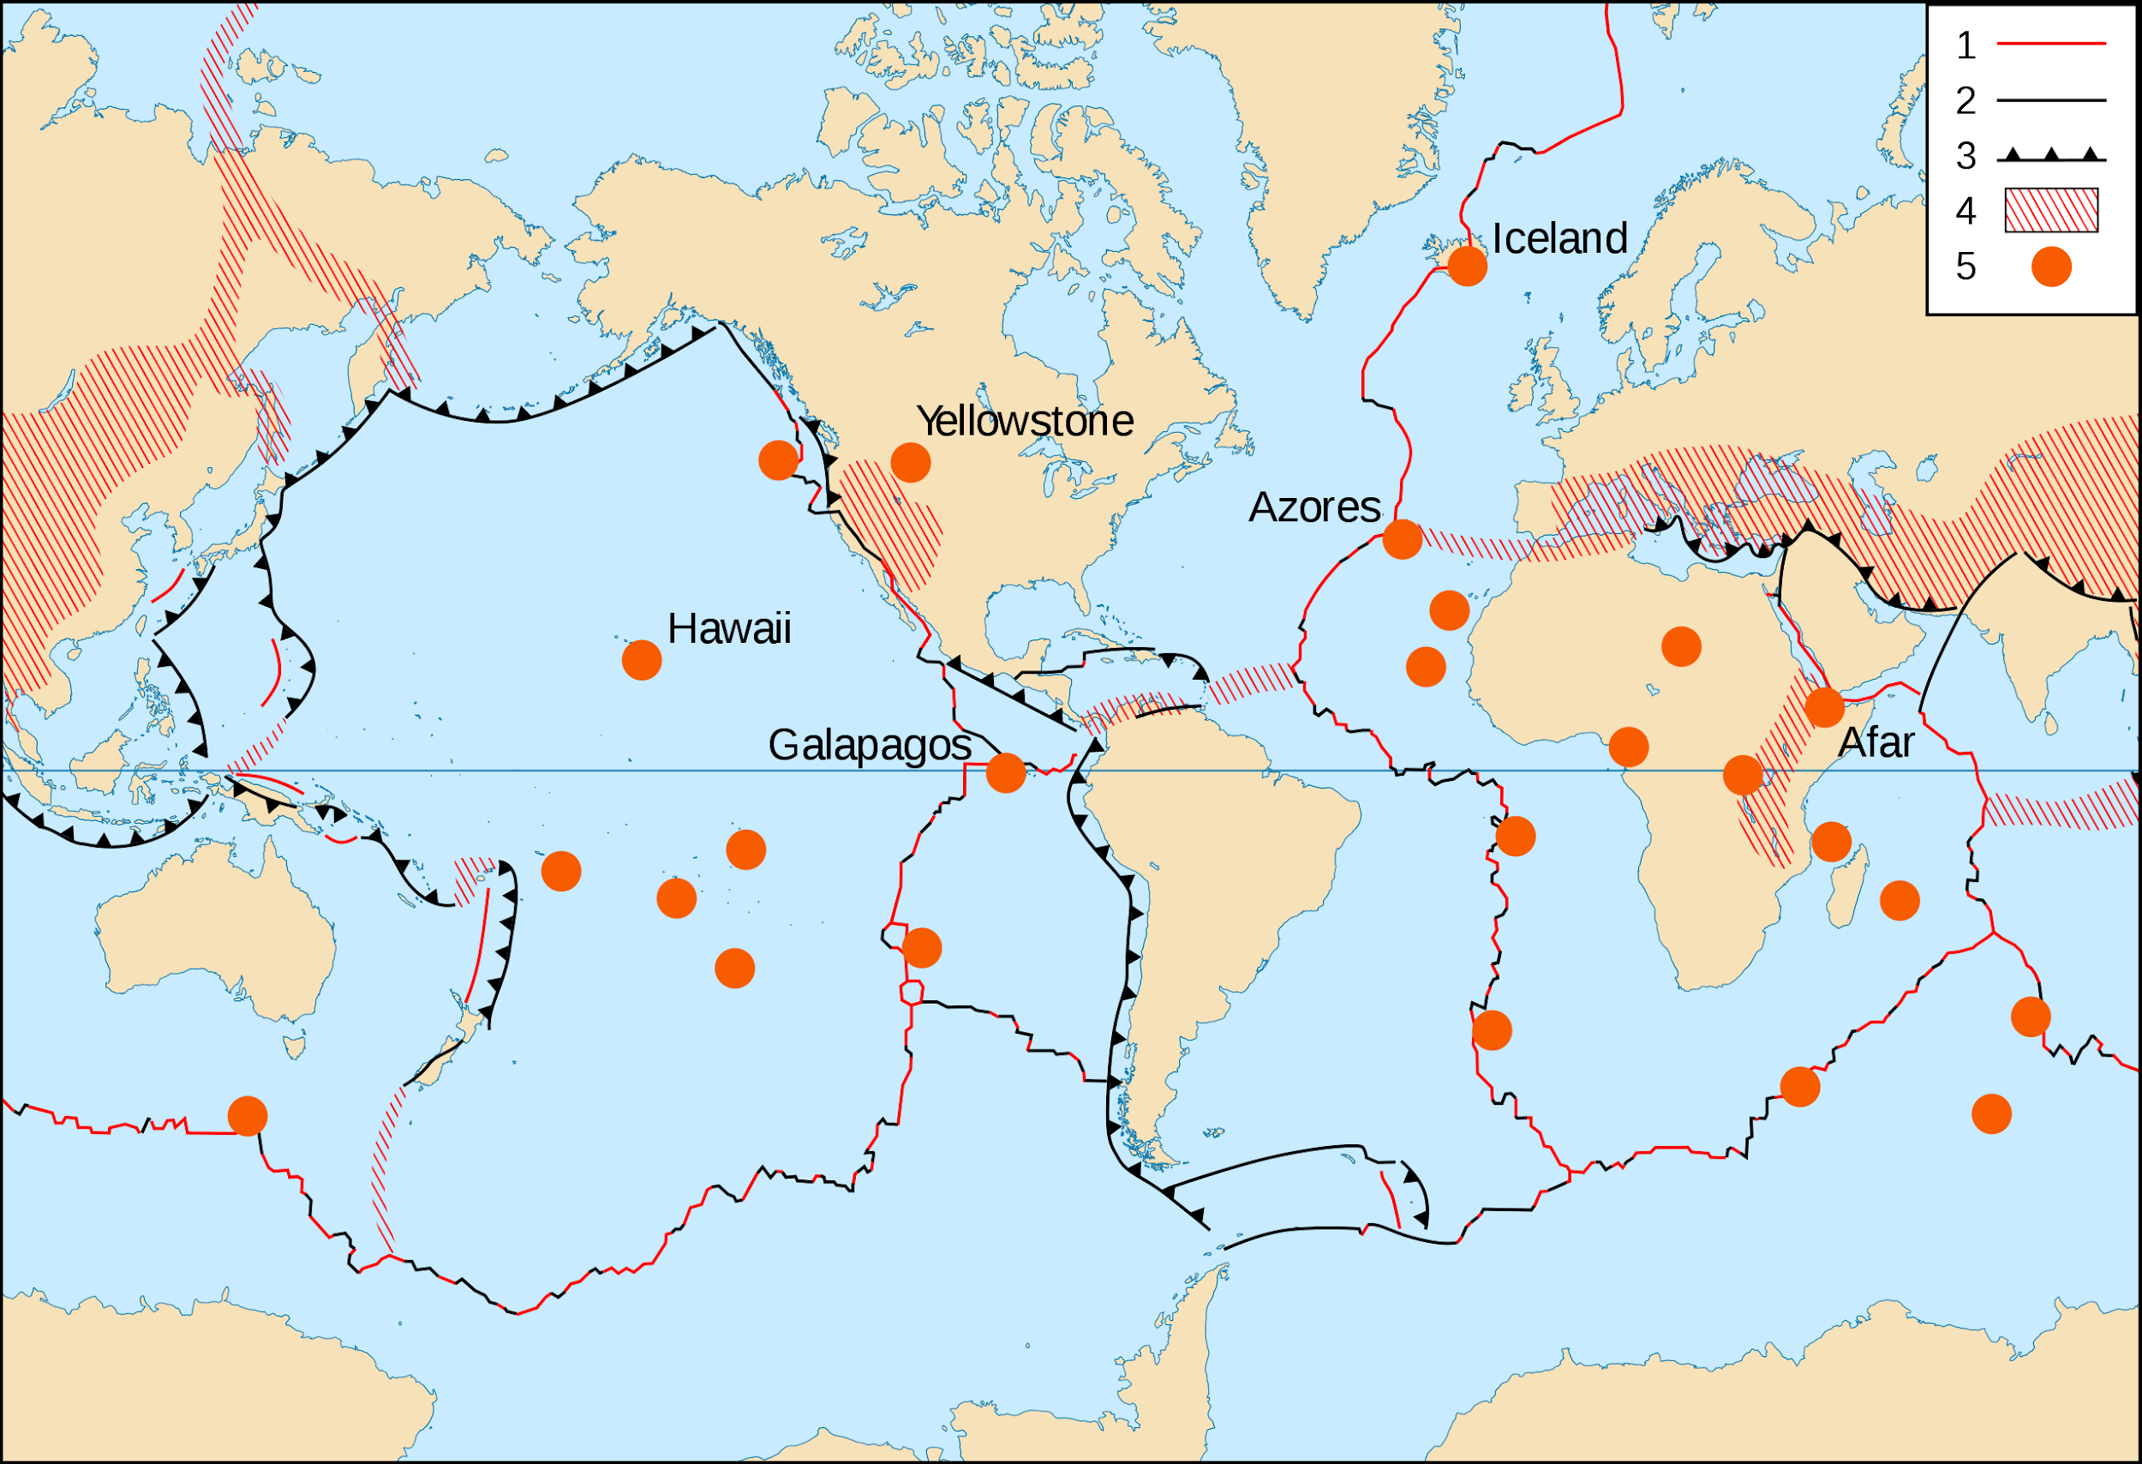
Two plates slowly move toward each other but one is more dominant and moves overtop of the older one.
Notes:
Please include pictures and complete sentences for EVERY slide or you will lose points.
Slide #6: What forms at the 1st Convergent Boundary? – Give well known example of landform created at this boundary.

Slide 7
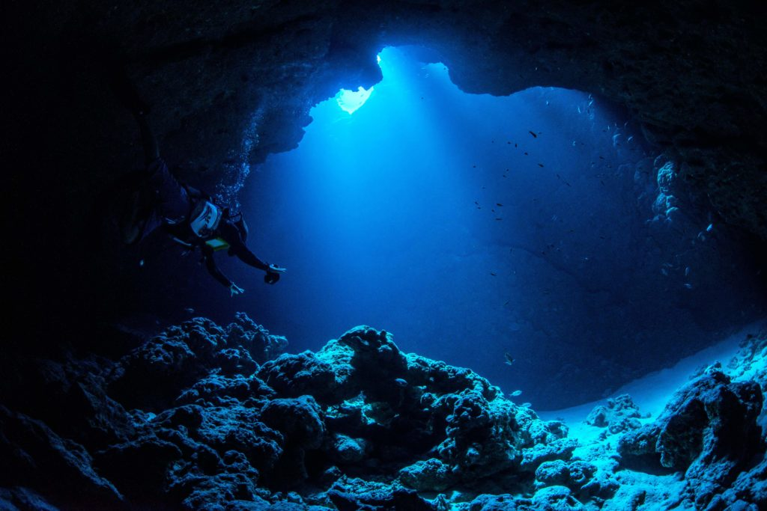
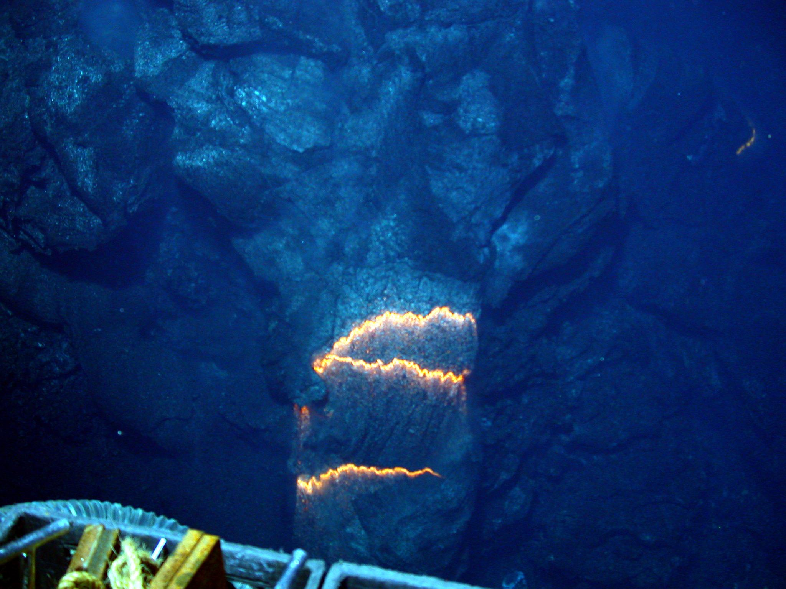
Two oceanic plates collide and make underwater trenches like the mariana trench and they can also form underwater volcanoes
Notes:
Please include pictures and complete sentences for EVERY slide or you will lose points.
Slide #7: What forms at the 2nd Convergent Boundary? – Give well known example of landform created at this boundary.

Slide 8
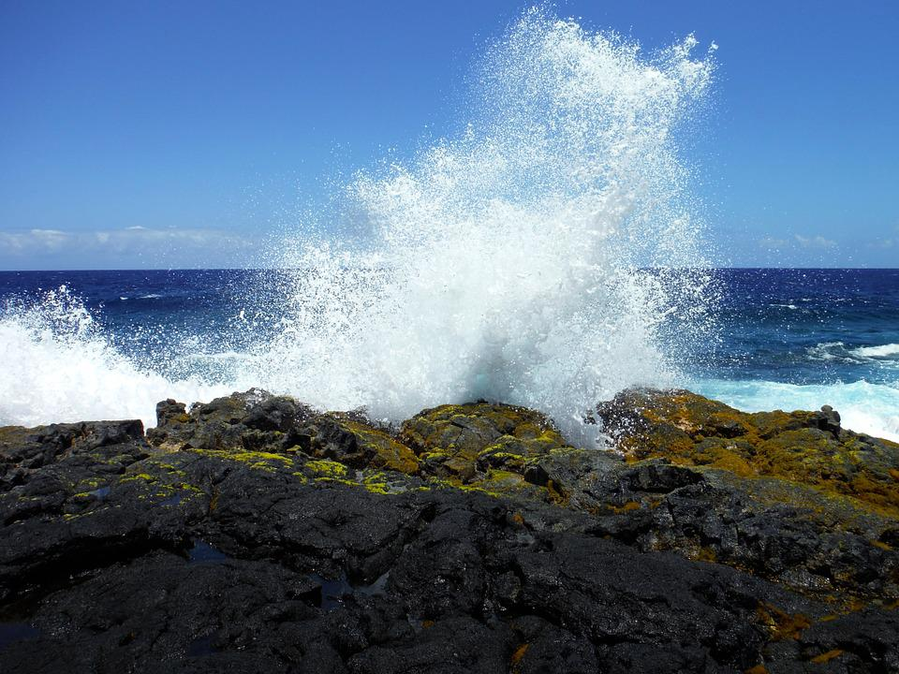
Oceanic plates clash into the earth's crust and slip under it and this is called subduction when an oceanic plate slides under a continental plate.
Notes:
Please include pictures and complete sentences for EVERY slide or you will lose points.
Slide #8: What forms at the 3rd Convergent Boundary? – Give well known example of landform created at this boundary.

Slide 9
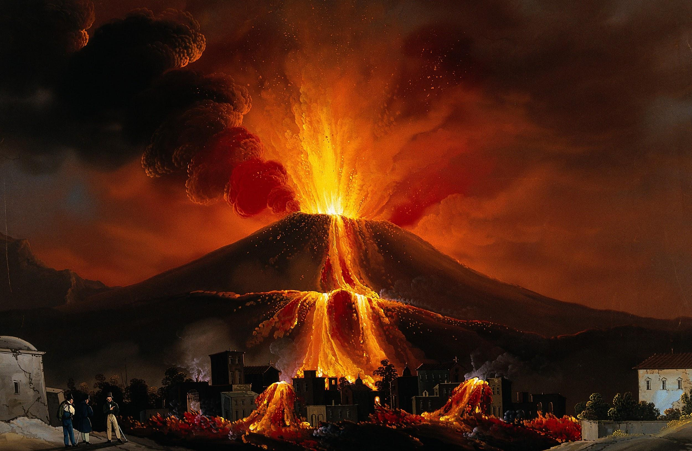
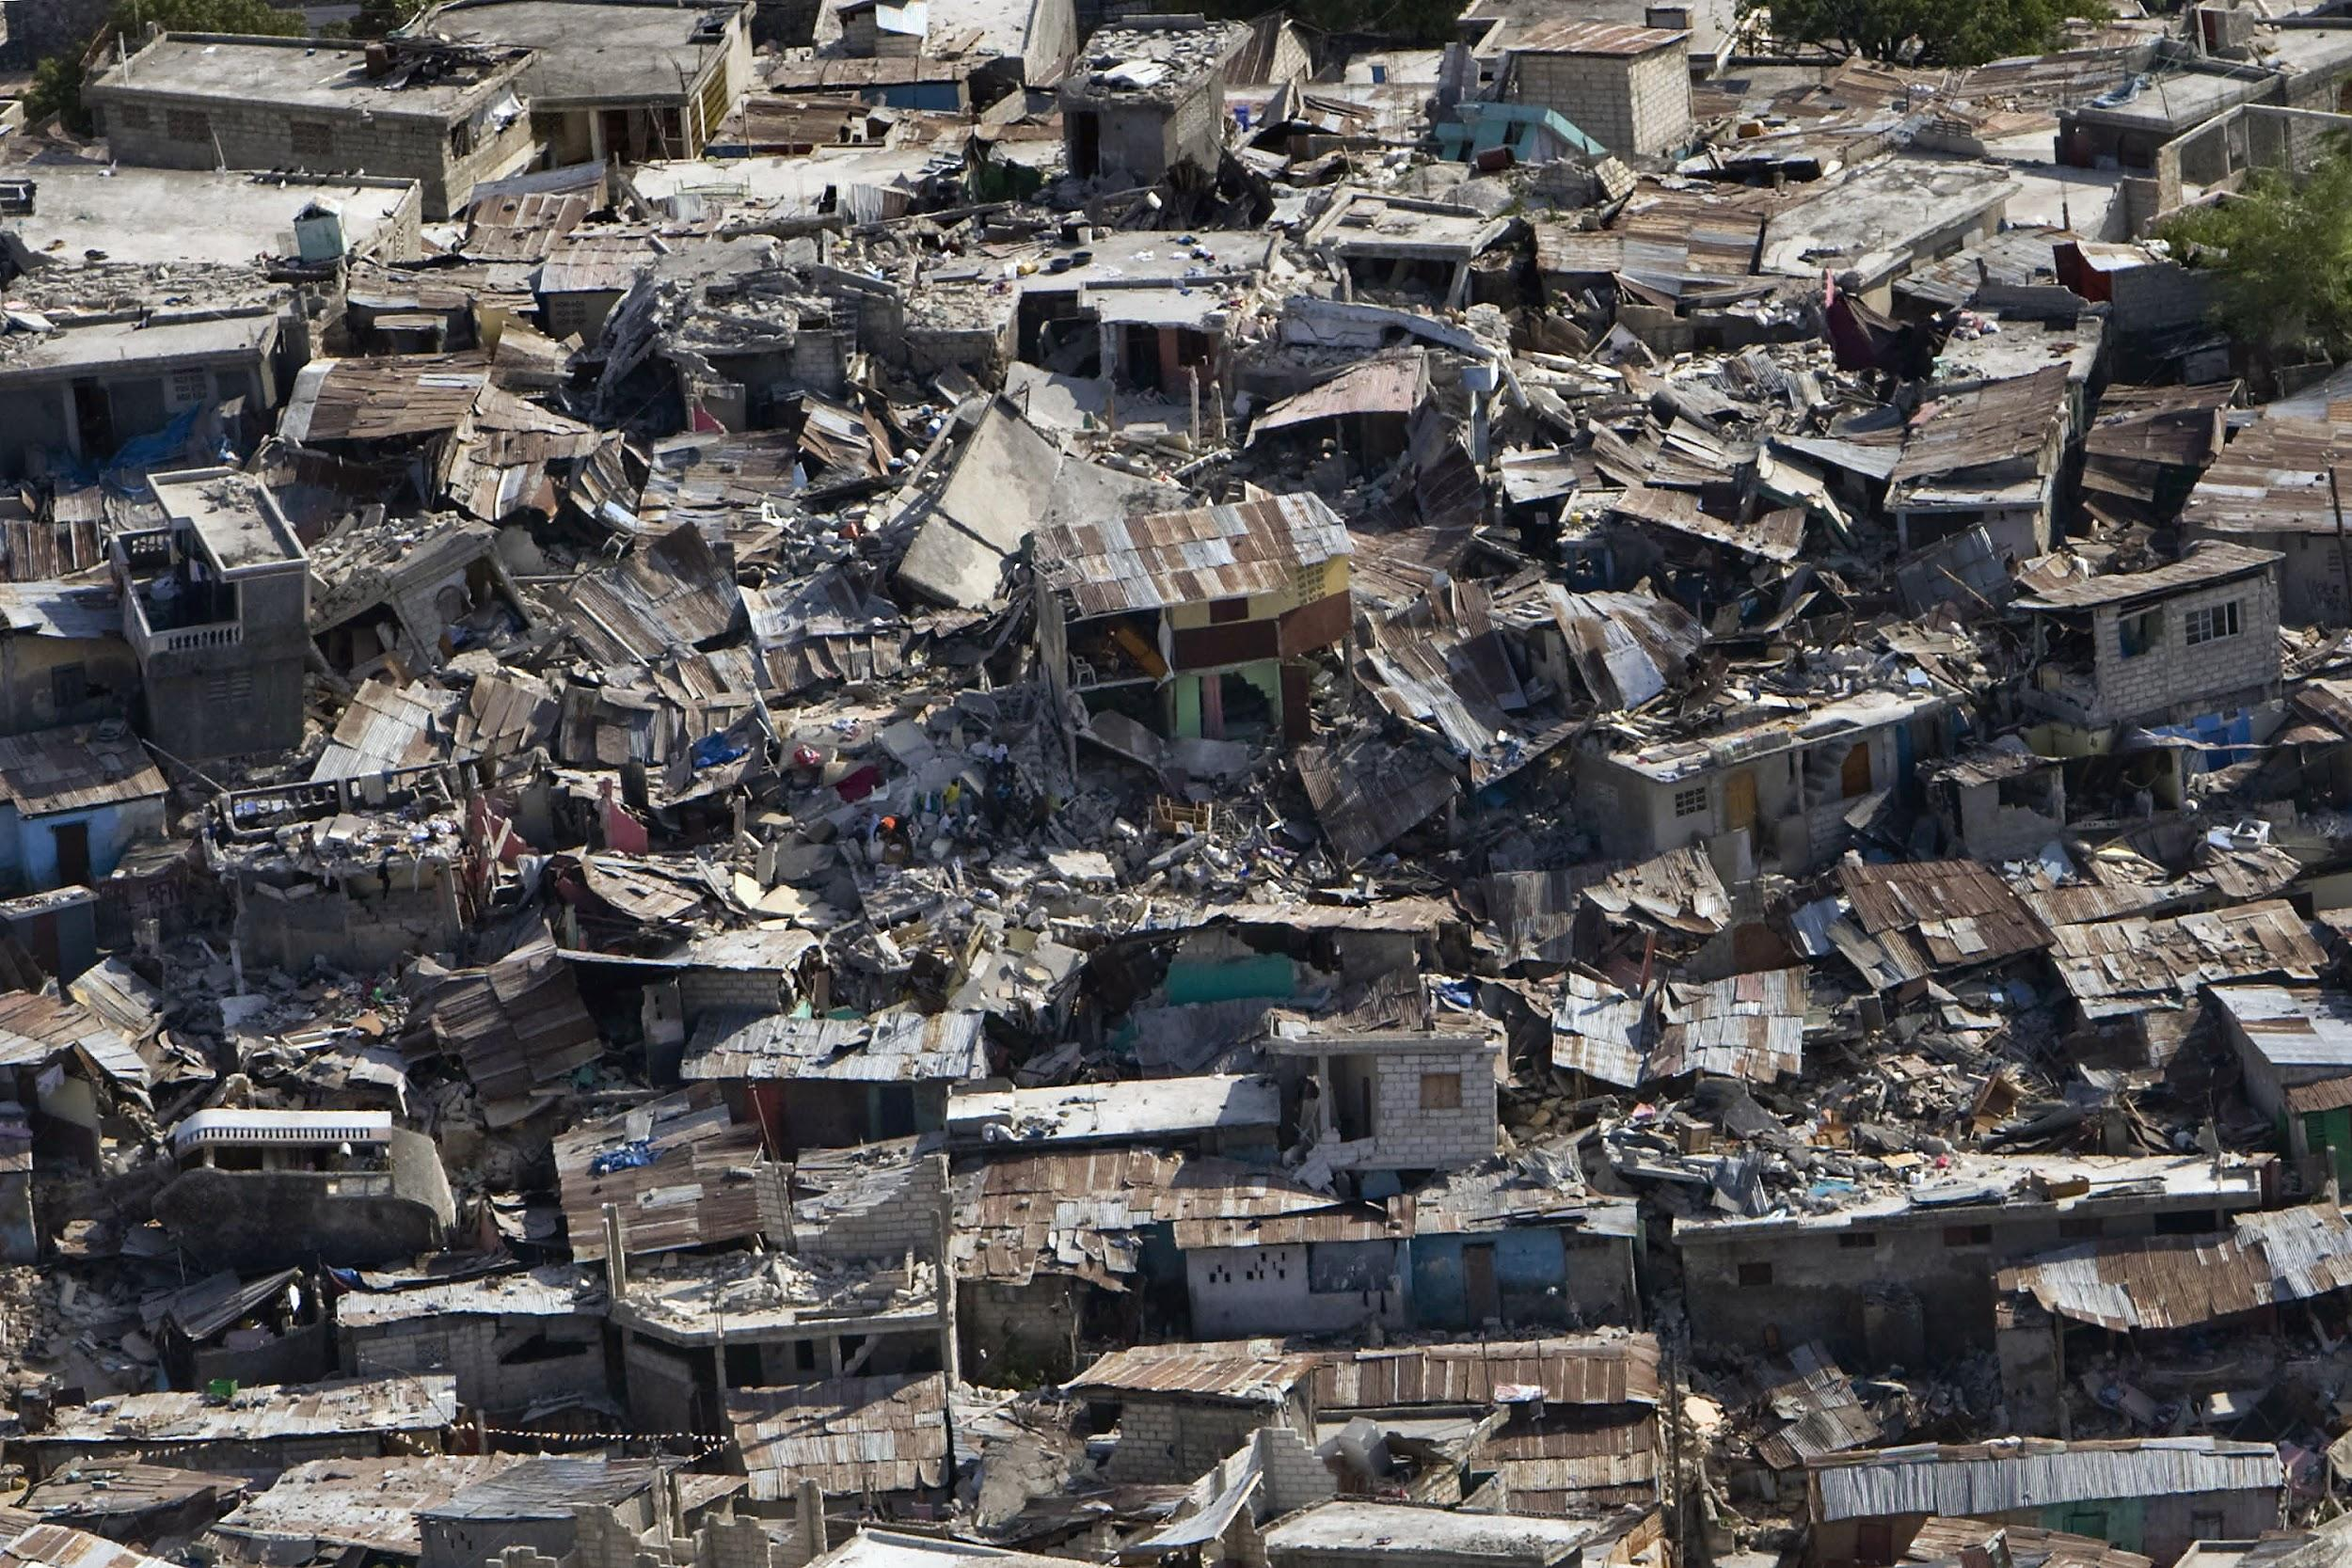
A divergent boundary occurs when two tectonic plates move away from each other.
Notes:
Please include pictures and complete sentences for EVERY slide or you will lose points.
Slide #9:Divergent Boundary (title with picture).

Slide 10
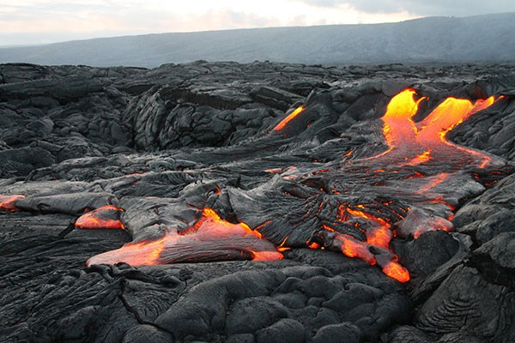
Along these boundaries, earthquakes are common and magma, molten rock rises from the Earth's mantle to the surface.
Notes:
Please include pictures and complete sentences for EVERY slide or you will lose points.
Slide #10: What happens at a Divergent Boundary?

Slide 11
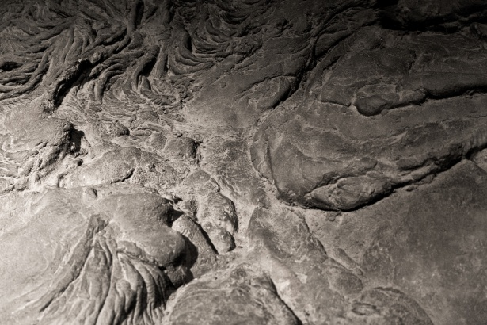
After these divergent boundaries are done and the lavais done getting pushed out then it starts to cool and makes new crust which can stretch land.
Notes:
Please include pictures and complete sentences for EVERY slide or you will lose points.
Slide #11: What forms at a Divergent Boundary?

Slide 12
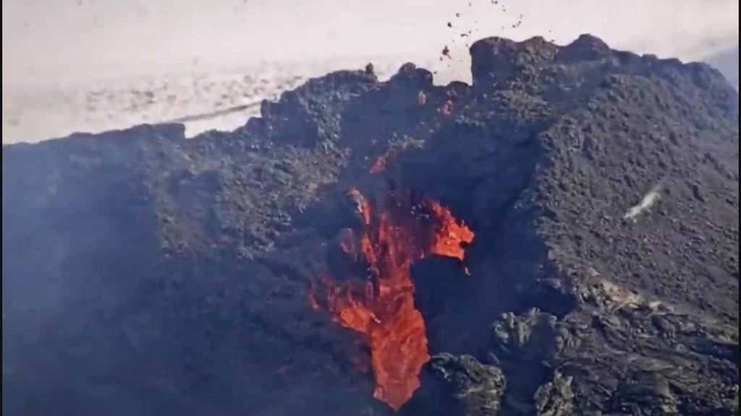
plates move apart allowing magma to seep through and make new crust in the form of ridges, valleys and volcanoes.
Notes:
Please include pictures and complete sentences for EVERY slide or you will lose points.
Slide #12: Well known example of landform created at a Divergent Boundary.

Slide 13
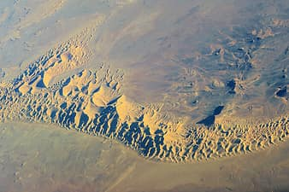
transform fault, in geology and oceanography, a type of fault in which two tectonic plates slide past one another. A transform fault may occur in the portion of a fracture zone that exists between different offset spreading centres or that connects spreading centres
Notes:
Please include pictures and complete sentences for EVERY slide or you will lose points.
Slide #13: Transform Fault (title with picture).

Slide 14
Notes:
Please include pictures and complete sentences for EVERY slide or you will lose points.
Slide #14: What happens at a Transform Fault Boundary?

Slide 15
Notes:
Please include pictures and complete sentences for EVERY slide or you will lose points.
Slide #15: What forms at a Transform Fault Boundary?

Slide 16
Notes:
Please include pictures and complete sentences for EVERY slide or you will lose points.
Slide #16: Example of a well-known Transform fault and a few facts about it.

