Slide 1
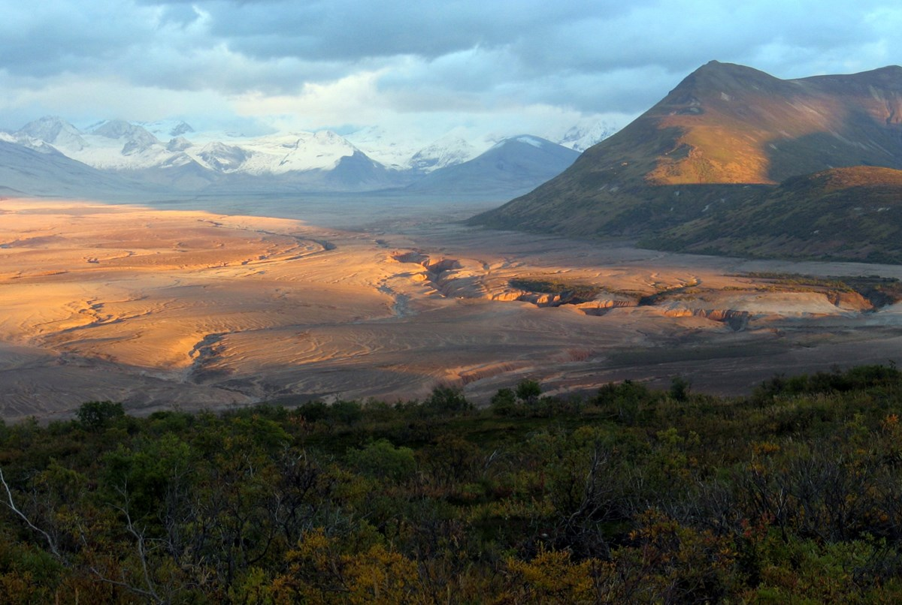
Convergent Boundaries
By:Yuliana Alanis Meza
Notes:
Please include pictures and complete sentences for EVERY slide or you will lose points.
Slide #1: Convergent Boundary (title with picture)

Slide 2
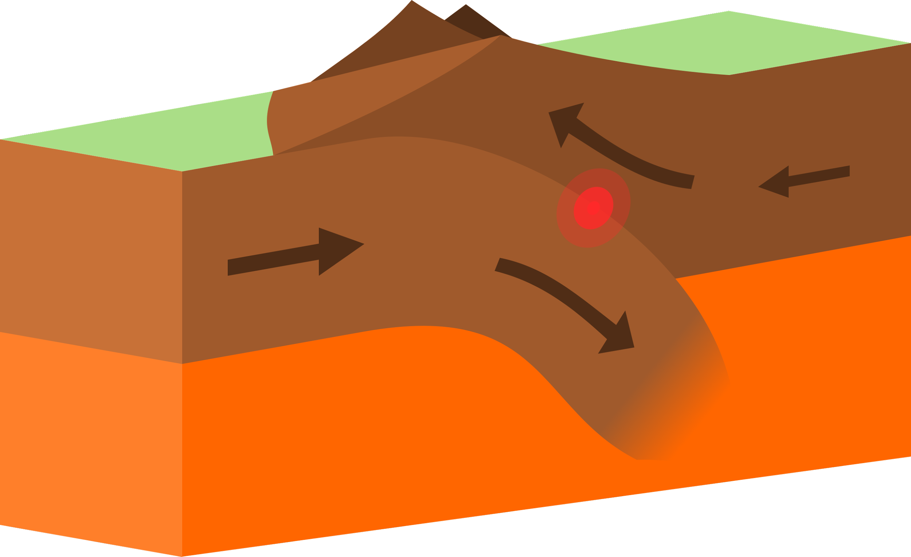
What happens at a convergent Boundary?
Tectonic plates move towards each other.
Notes:
Please include pictures and complete sentences for EVERY slide or you will lose points.
Slide #2: What happens at a Convergent Boundary?

Slide 3
What is the first type of the Convergent Plate?
O-O
The first Convergent plate is Oceanic-Oceanic.In oceanic-oceanic is when two oceanic plates collide and the more dense one goes under the other which forms trench and underwater volcanoes.
Notes:
Please include pictures and complete sentences for EVERY slide or you will lose points.
Slide #3: First type of Convergent plate boundary explained.

Slide 4
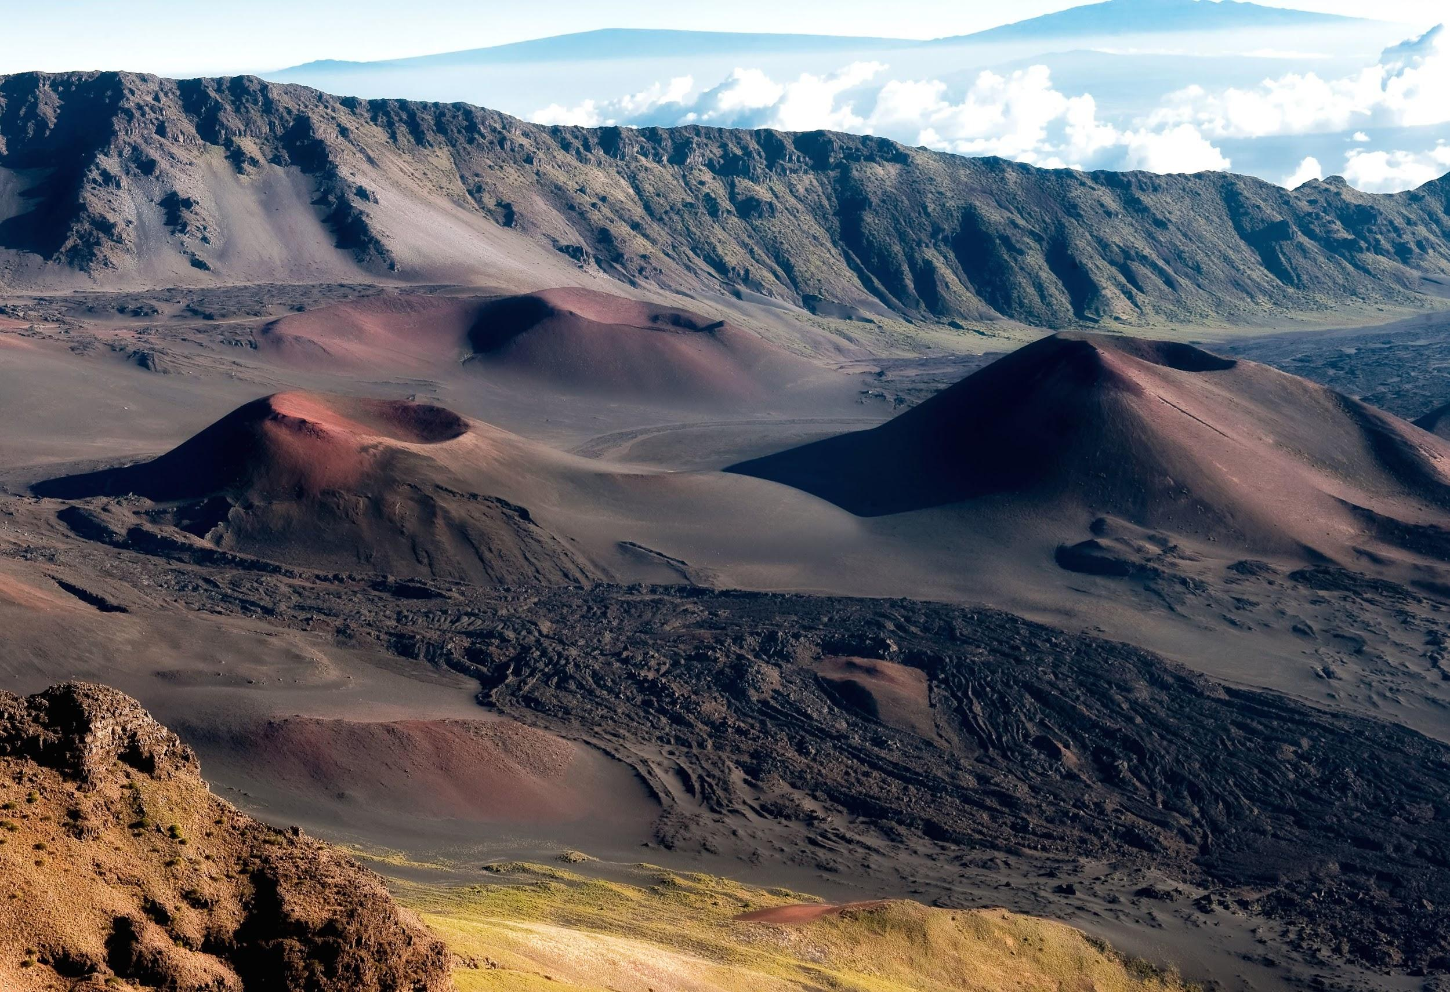
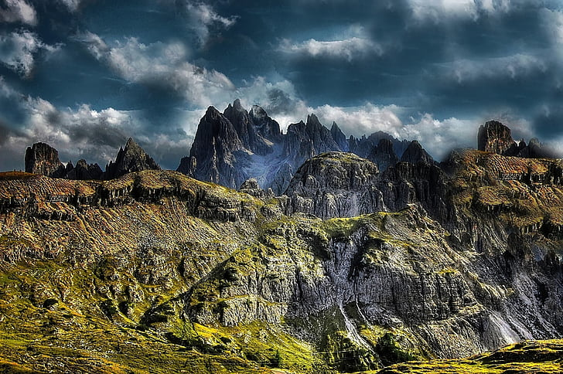
What is the second type of convergent boundary?
O-C
oceanic-Continental is when all ocean and continental plate collide,oceanic plate is denser and subducts,Mountains or volcanoes form near continental plate.
Volcano
Mountain
Notes:
Please include pictures and complete sentences for EVERY slide or you will lose points.
Slide #4: Second type of Convergent plate boundary explained.

Slide 5
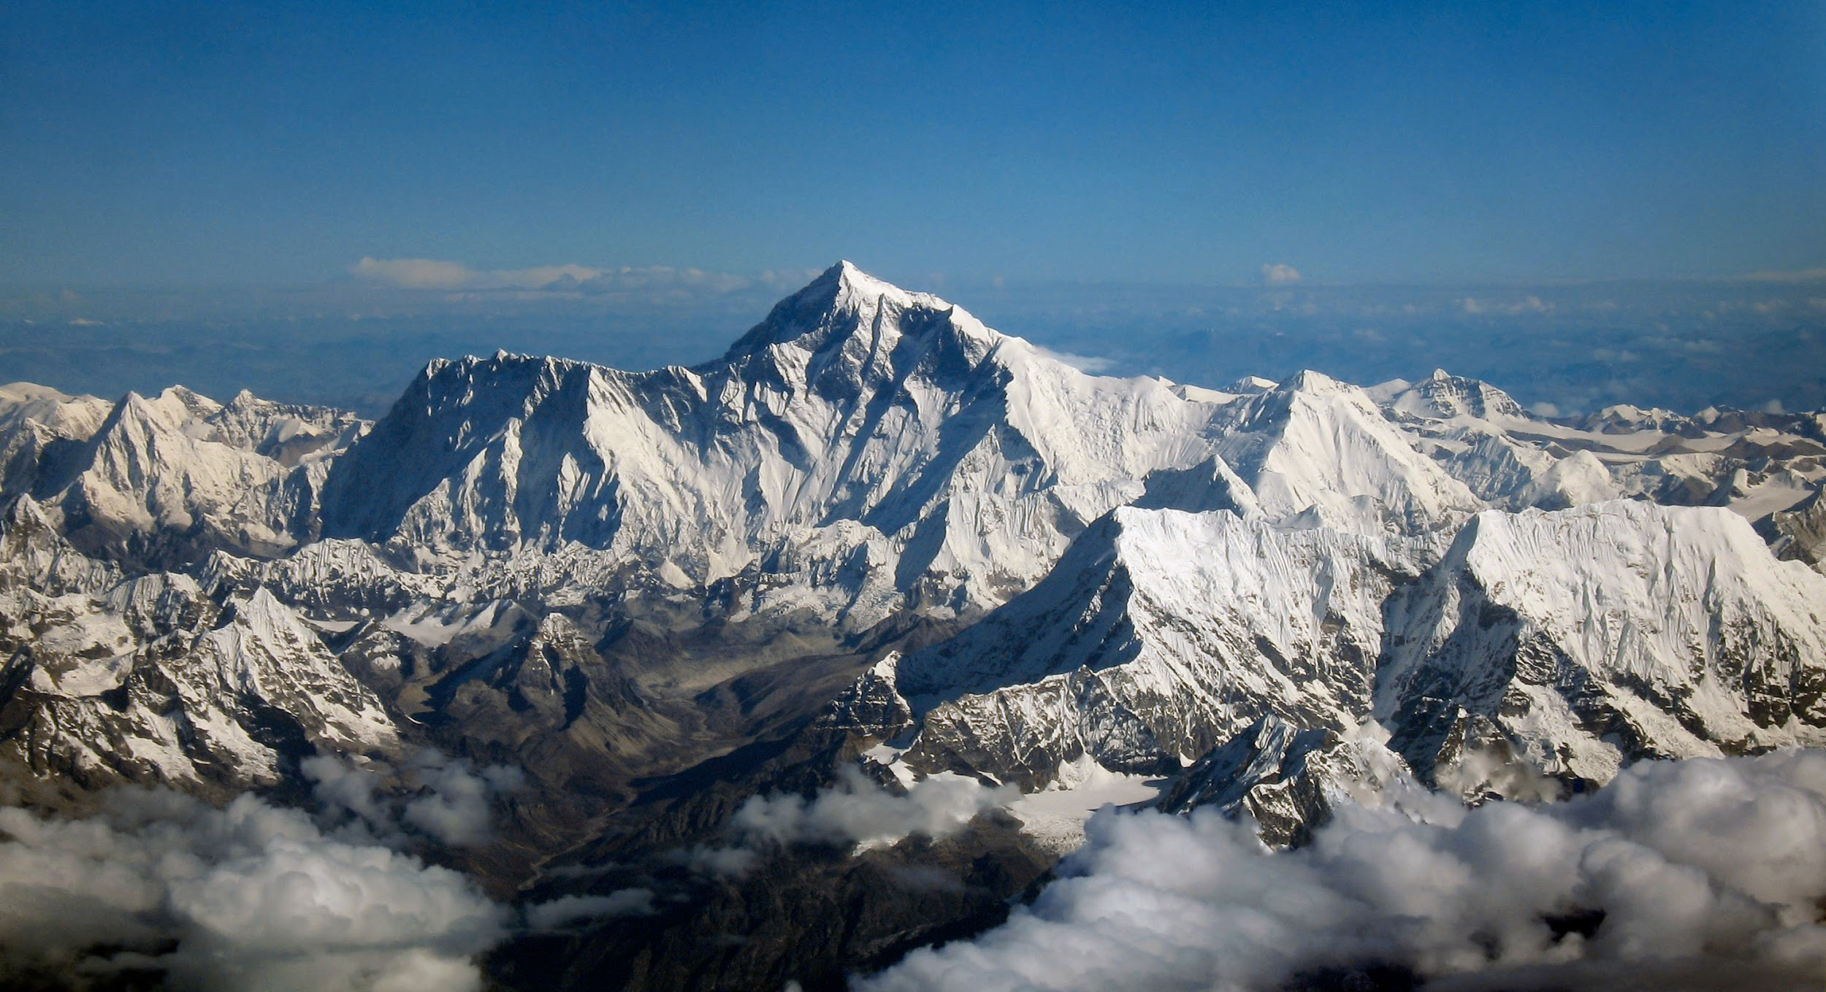
What is the 3rd type of convergent boundary
The third type of convergent boundary is Continental-Continental. Continental-Continental is 2 continental plates that collide which forms mountains because the plates “squish” together.
Example:
Notes:
Please include pictures and complete sentences for EVERY slide or you will lose points.
Slide #5: Third type of Convergent plate boundary explained.

Slide 6
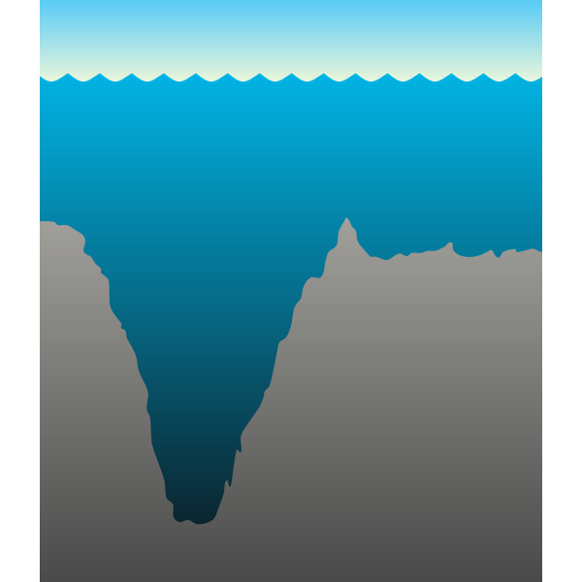
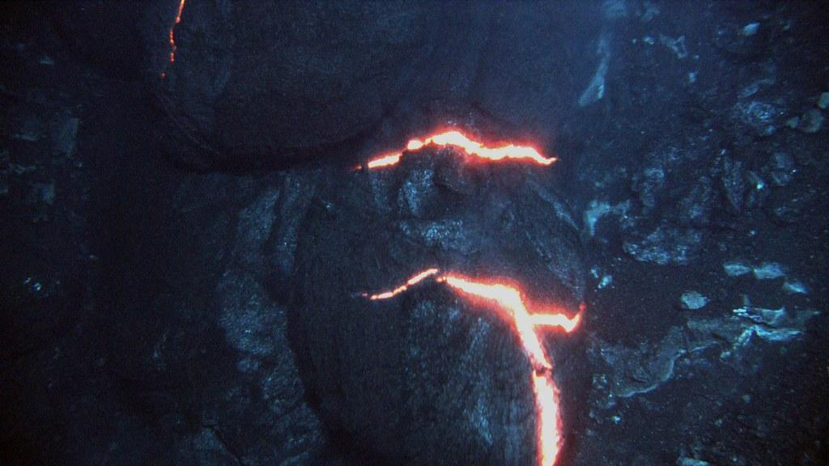
What forms at the 1st convergent Boundary?
They form trenches and underwater volcanoes.when 2 oceanic plates collide during subduction trenches and underwater volcanoes form.
Underwater trench
Underwater volcanoes
Notes:
Please include pictures and complete sentences for EVERY slide or you will lose points.
Slide #6: What forms at the 1st Convergent Boundary? – Give well known example of landform created at this boundary.

Slide 7
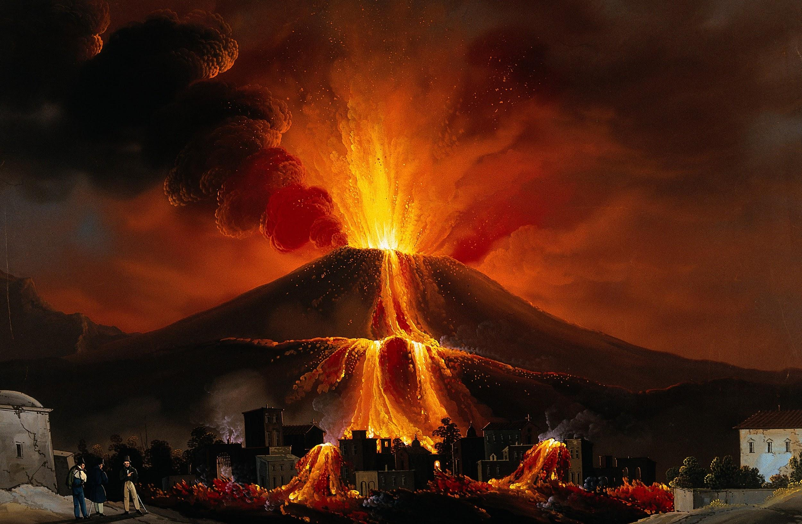
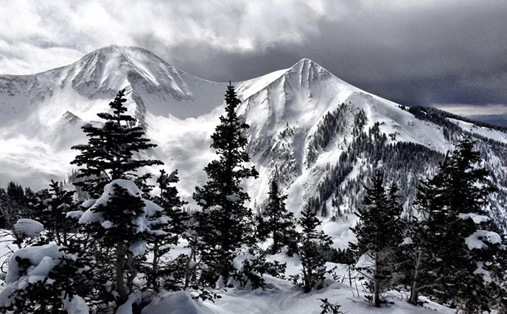
What forms at the 2nd Convergent boundary?
When an ocean and continental plates collide they form mountains and volcanoes
Notes:
Please include pictures and complete sentences for EVERY slide or you will lose points.
Slide #7: What forms at the 2nd Convergent Boundary? – Give well known example of landform created at this boundary.

Slide 8
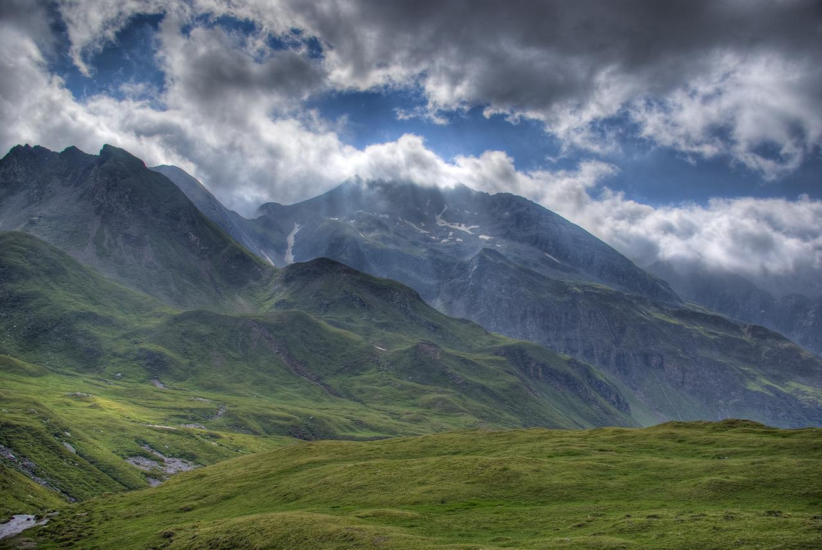
What forms at the 3rd convergent boundary?
When 2 continental plates collide it forms mountains because the plates squish together.
Notes:
Please include pictures and complete sentences for EVERY slide or you will lose points.
Slide #8: What forms at the 3rd Convergent Boundary? – Give well known example of landform created at this boundary.

Slide 9
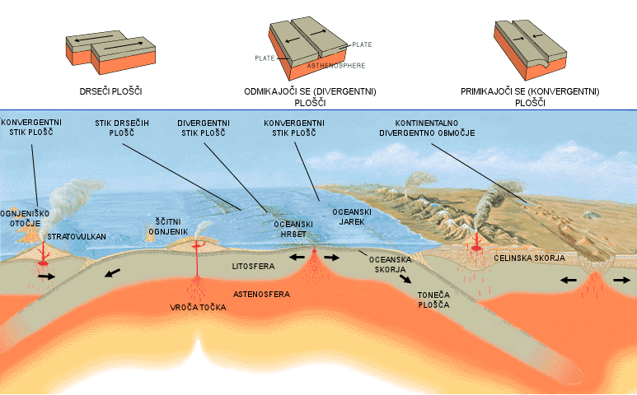
Divergent Boundaries
Yuliana Alanis Meza
Notes:
Please include pictures and complete sentences for EVERY slide or you will lose points.
Slide #9:Divergent Boundary (title with picture).

Slide 10
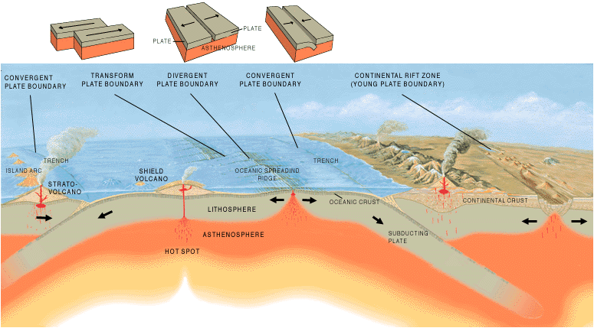
What happens at a Divergent Boundary?
In a Divergent Boundary is where 2 plates move away from each other. For an example ,earthquakes are common and magma (molten rock) rises from the Earth's mantle to the surface, solidifying to create new oceanic crust.
Notes:
Please include pictures and complete sentences for EVERY slide or you will lose points.
Slide #10: What happens at a Divergent Boundary?

Slide 11
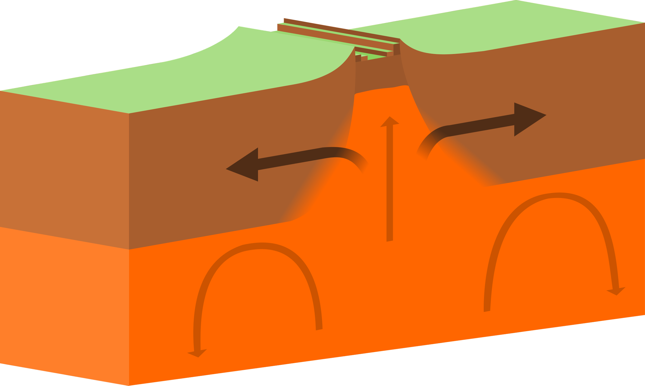
What forms at a Divergent Boundary?
A Divergent Boundary occurs where 2 plates move away from each other.
Notes:
Please include pictures and complete sentences for EVERY slide or you will lose points.
Slide #11: What forms at a Divergent Boundary?

Slide 12
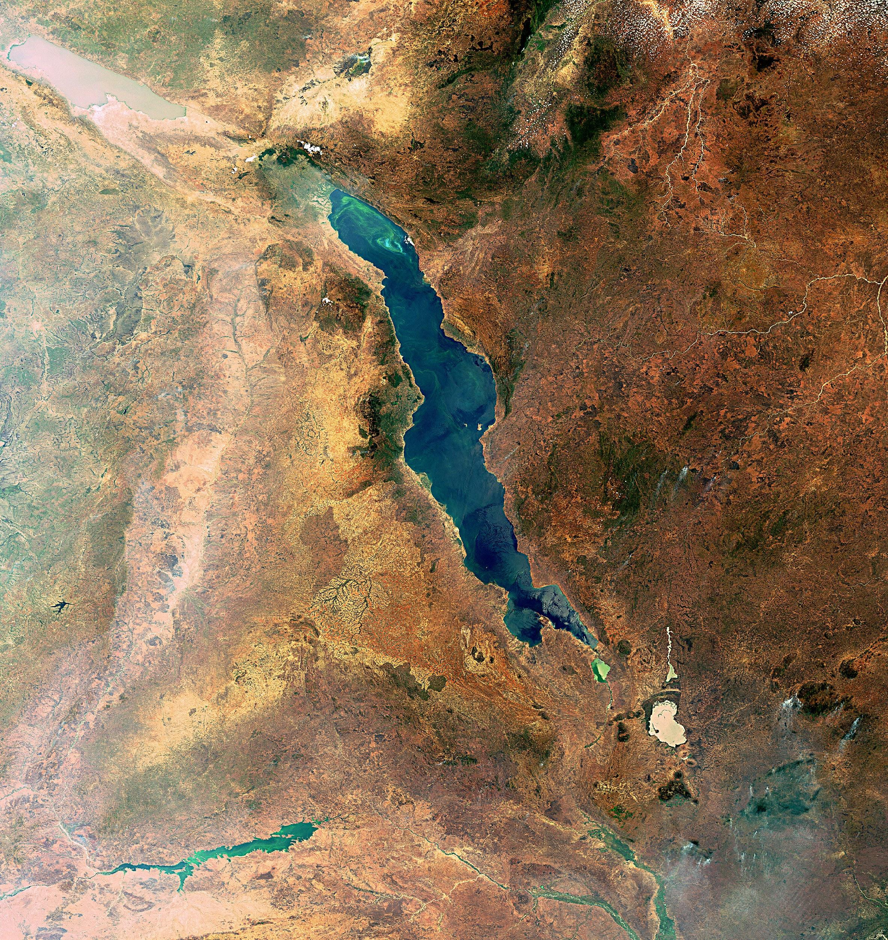
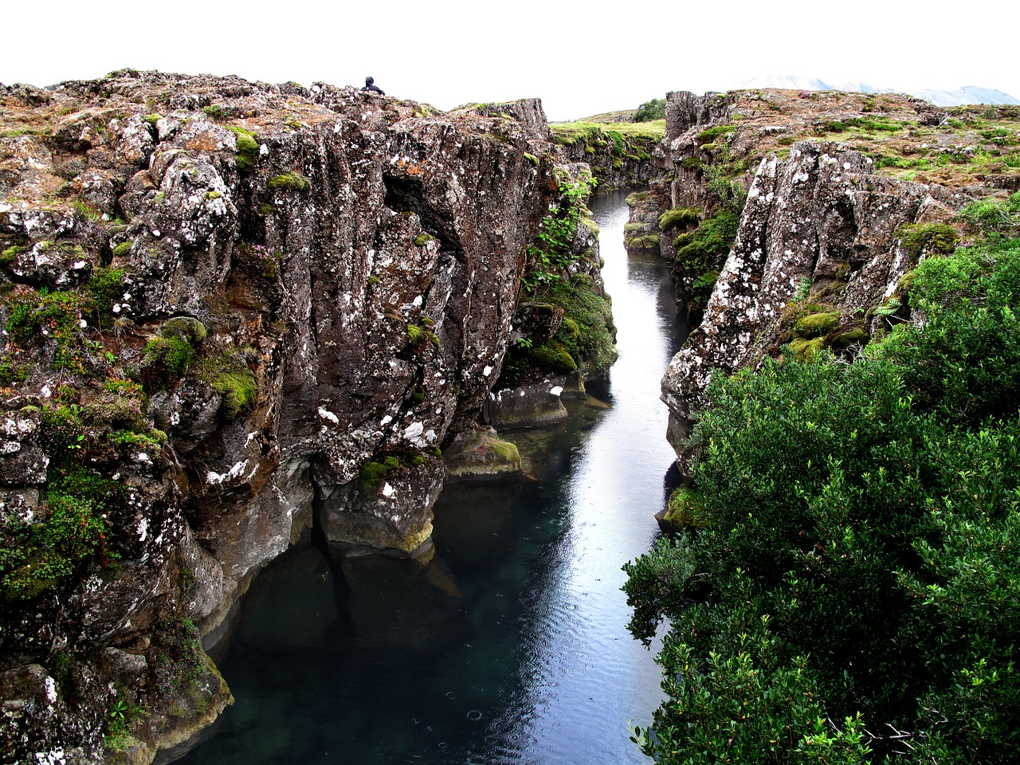
Well known example of landform created at a Divergent Boundary?
A Divergent Boundary is when the plates move apart allowing molten magma to rise and form new crust in the form of ridges, valleys and volcanoes.For an example, the Mid Atlantic Ridge and the Great African Rift Valley.
Mid Atlantic ridge The Great African Rift Valley
Notes:
Please include pictures and complete sentences for EVERY slide or you will lose points.
Slide #12: Well known example of landform created at a Divergent Boundary.

Slide 13
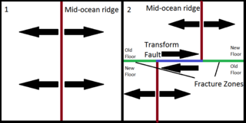
Transform fault .
YULIANA ALANIS MEZA
Notes:
Please include pictures and complete sentences for EVERY slide or you will lose points.
Slide #13: Transform Fault (title with picture).

Slide 14
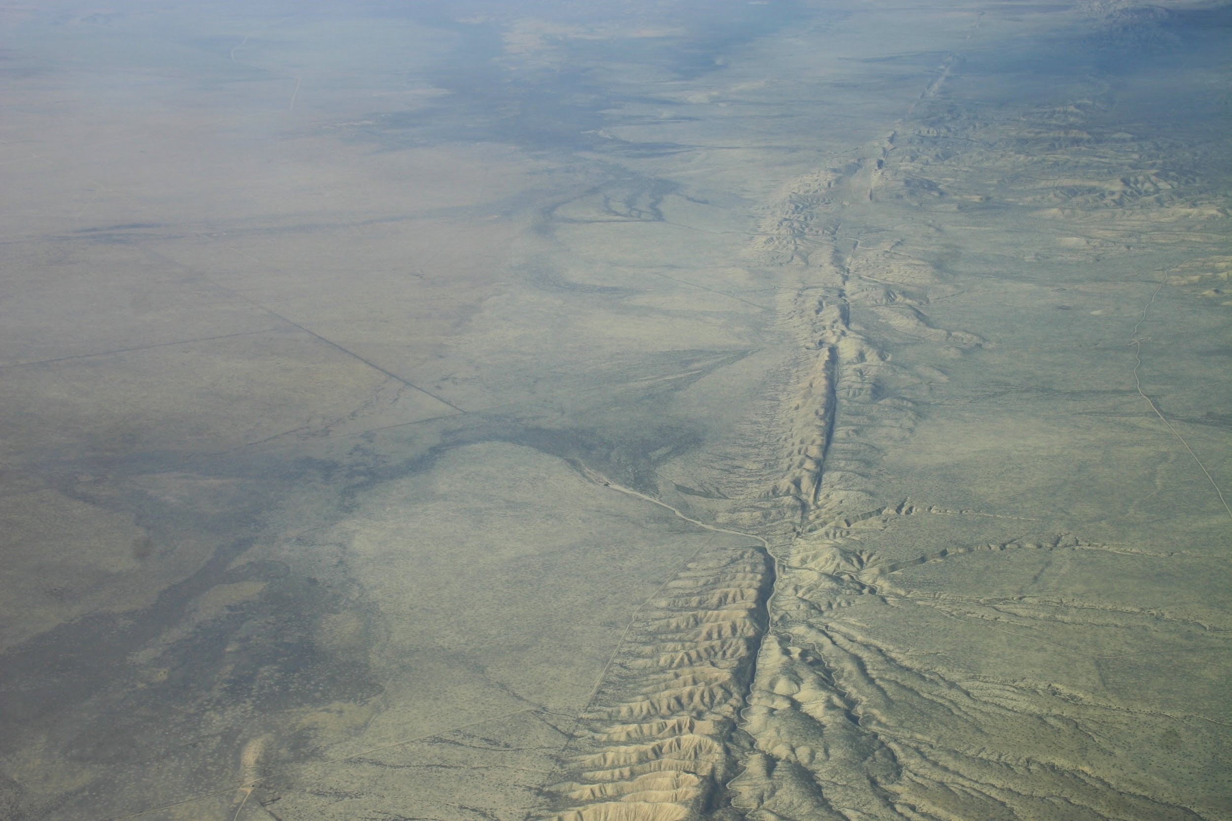
What happens at a Transform Fault Boundary?
Transform Fault Boundary is when two plates slide past each other called conservative boundary because no crust is destroyed – San Andreas fault is closest to us.
San Andreas Fault
Notes:
Please include pictures and complete sentences for EVERY slide or you will lose points.
Slide #14: What happens at a Transform Fault Boundary?

Slide 15
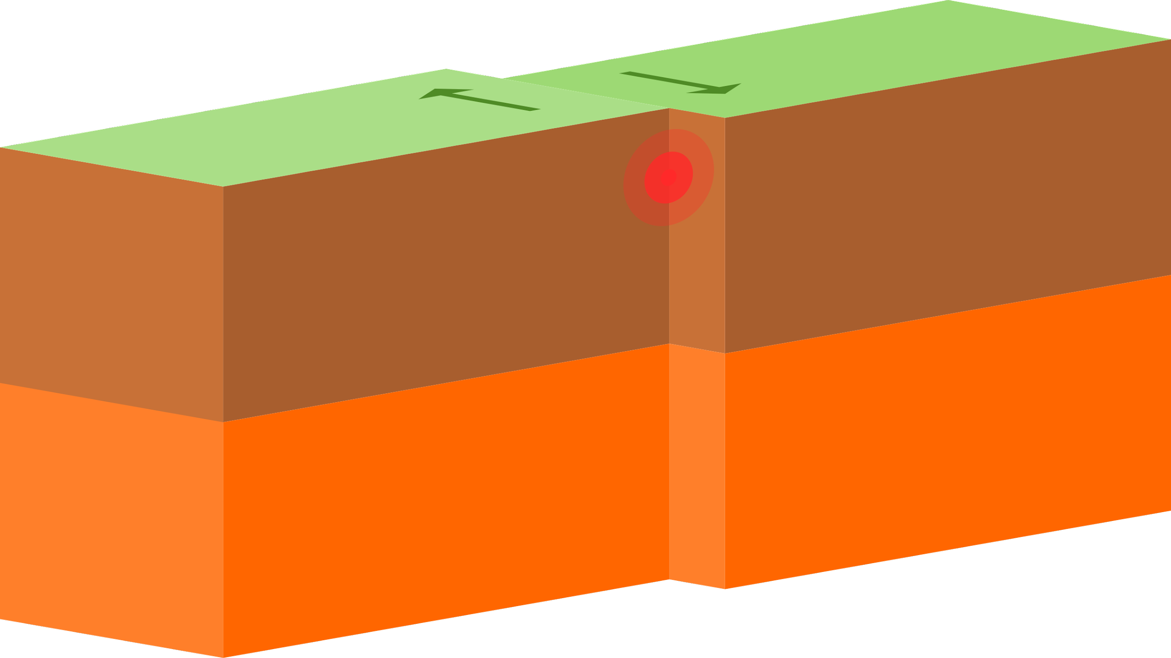
What form at a transform fault boundary
When two plates slide past each other which makes shallow earthquakes, large lateral displacement of rock, and a broad zone of crustal deformation.
Notes:
Please include pictures and complete sentences for EVERY slide or you will lose points.
Slide #15: What forms at a Transform Fault Boundary?

Slide 16
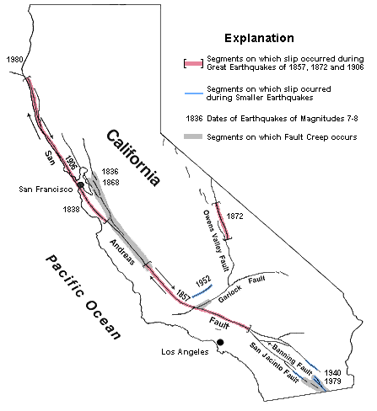
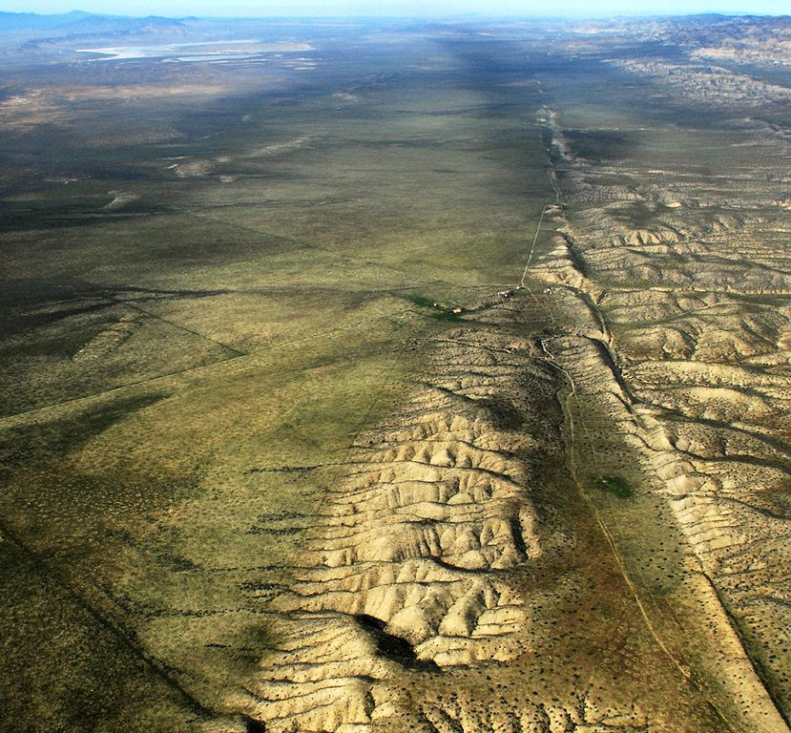
Example of a well known transform fault and a few facts about it?
An example of well known transform fault is San Andreas Fault Zone of Western America.Few facts about san andreas fault is that it was 700-800 miles long approximately ten miles deep. It is about 28 million years old. Most faults are found in the ocean but the SAF(San Andrea Fault) is a plate boundary found on land.
Notes:
Please include pictures and complete sentences for EVERY slide or you will lose points.
Slide #16: Example of a well-known Transform fault and a few facts about it.

