Slide 1
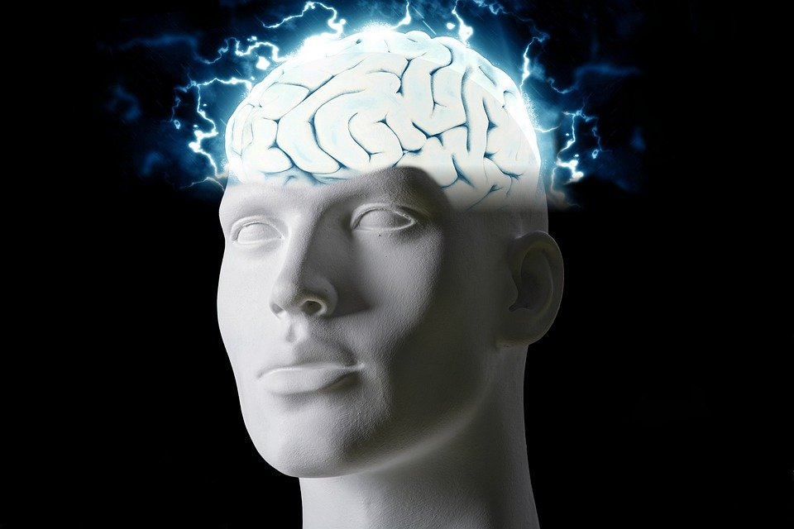
Regions of the Brain

Slide 2
For today’s assignment, you will create a Google Slides Presentation describing the 7 regions of the brain (Frontal Lobe, Motor Cortex, Sensory Cortex, Parietal Lobe, Temporal Lobe, Occipital Lobe and Cerebellum).
You must include the following on each slide:
Description of that region’s function
Example of how you use that region’s function in your daily life
Label the included brain photos with an arrow pointing to that particular region of the brain
Once you have fully completed all 7 slides, show me you are done to earn the opportunity to make the brain hat.

Slide 3
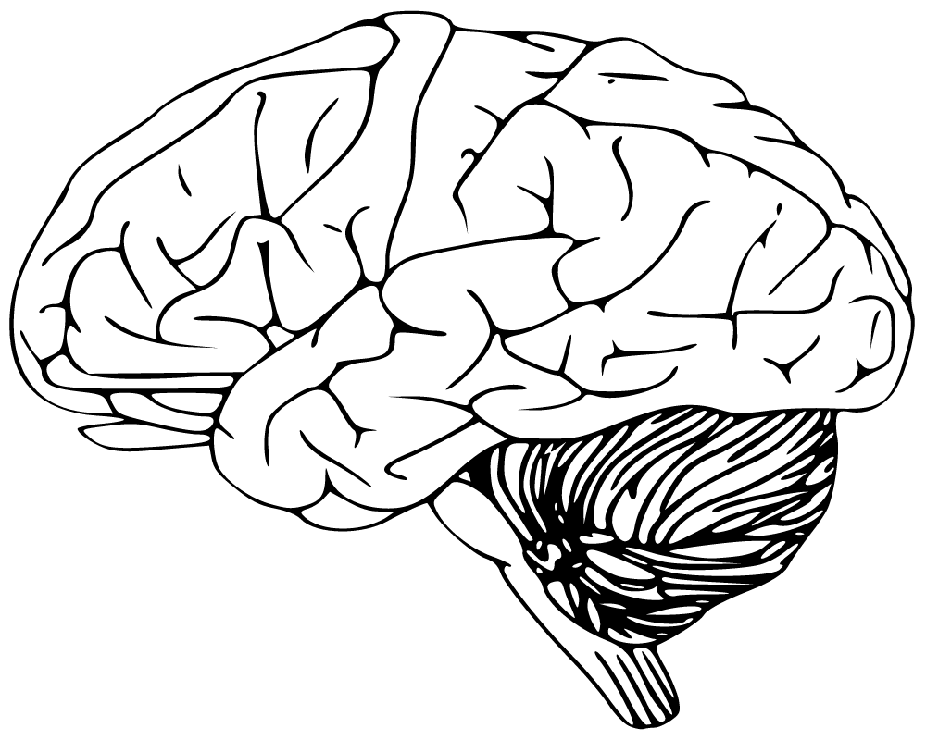
Cerebellum
Has to do with speaking and your balance
I use this part of my brain when i walk

Slide 4
Occipital Lobe
The occipital lobes sit at the back of the head and are responsible for visual perception, including colour, form and motion.
The occipital lobe is also responsible for analyzing contents, such as shapes, colors, and movement, and also for interpreting and drawing conclusions about the images we see

Slide 5
Temporal Lobe
- The temporal lobes sit behind the ears and are the second largest lobe. They are most commonly associated with processing auditory information and with the encoding of memory.
The temporal lobe is largely responsible for creating and preserving both conscious and long-term memory

Slide 6
Parietal lobe
It processes sensory information it receives from the outside world, mainly relating to touch, taste, and temperature.
The parietal lobe is vital for sensory perception and integration, including the management of taste, hearing, sight, touch, and smell.

Slide 7
Sensory Cortex
Sensory cortex refers to all cortical areas associated with sensory function. In the case of vision, this includes virtually all of the occipital cortex and much of the temporal and parietal cortex.
The sensory cortex is involved in somatic sensation, visual stimuli, and movement planning.

Slide 8
Mortar Cortex
The motor cortex is an area within the cerebral cortex of the brain that is involved in the planning, control, and execution of voluntary movements.
The motor cortex also relies partially on the use of the posterior parietal cortex, which too controls aspects of motor planning and may play a role in using multisensory information to determine movements.

Slide 9
Frontal lobe
The frontal lobe is responsible for higher cognitive functions such as memory, emotions, impulse control, problem solving, social interaction, and motor function.
Learning something new, like a language, instrument, or other skill, is even more effective than word games at enhancing your prefrontal cortex.

