Slide 1
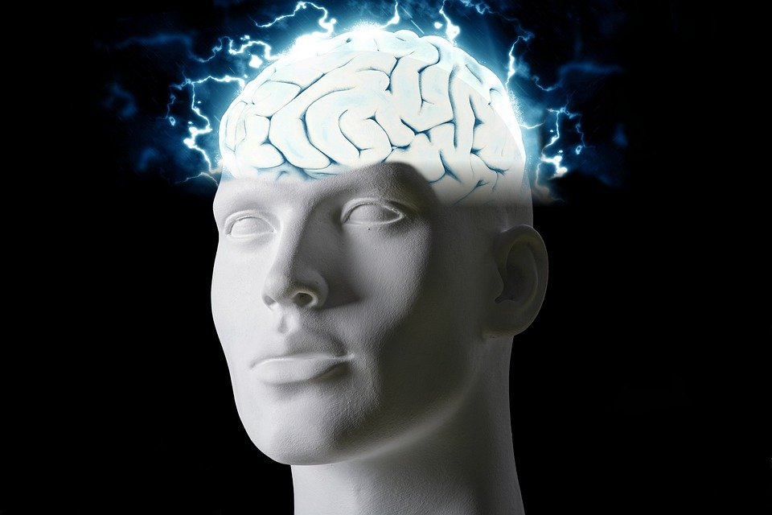
Regions of the Brain

Slide 2
For today’s assignment, you will create a Google Slides Presentation describing the 7 regions of the brain (Frontal Lobe, Motor Cortex, Sensory Cortex, Parietal Lobe, Temporal Lobe, Occipital Lobe and Cerebellum).
You must include the following on each slide:
Description of that region’s function
Example of how you use that region’s function in your daily life
Label the included brain photos with an arrow pointing to that particular region of the brain
Once you have fully completed all 7 slides, show me you are done to earn the opportunity to make the brain hat.

Slide 3
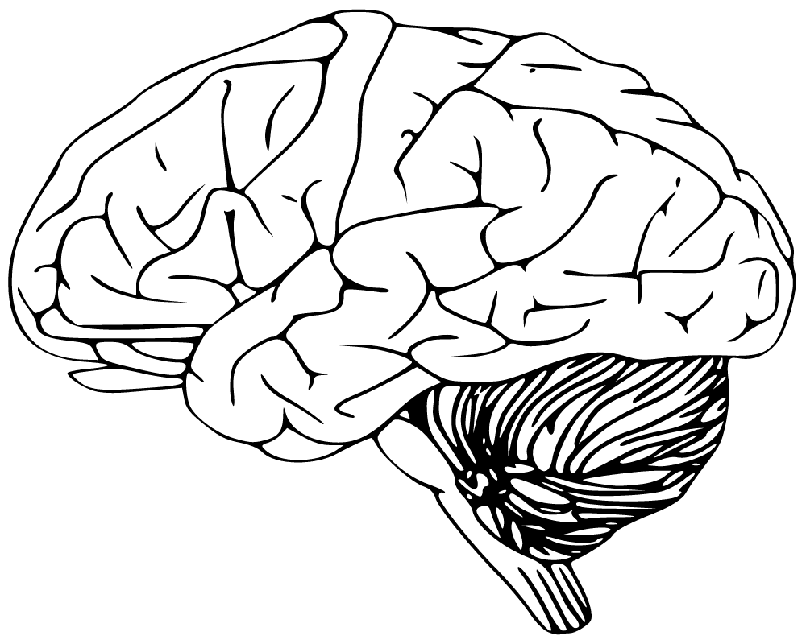
Cerebellum
Has to do with speaking and balance
I use this part of my brain to dance

Slide 4
Frontal Lobe
It controls emotion, behavior, learning, personality, and Voluntary movement
I use this part of my brain to feel happy

Slide 5
Sensory Cortex
It processes and makes out information gathered by 5 senses ( sound, smell, taste and touch)
I use this part of my brain during class and at home

Slide 6
Motor Cortex
It generates signals to the movement of the body.
I use this part of my body during PE.

Slide 7
Parietal Lobe
It has to do with Body sensations
I use this part of my brain when i feel cold.

Slide 8
Temporal Lobe
This helps you hear
I use this part of my brain all the time

Slide 9
Occipital Lobe
It helps with your vision
I use this part of my brain all the time

