Slide 1
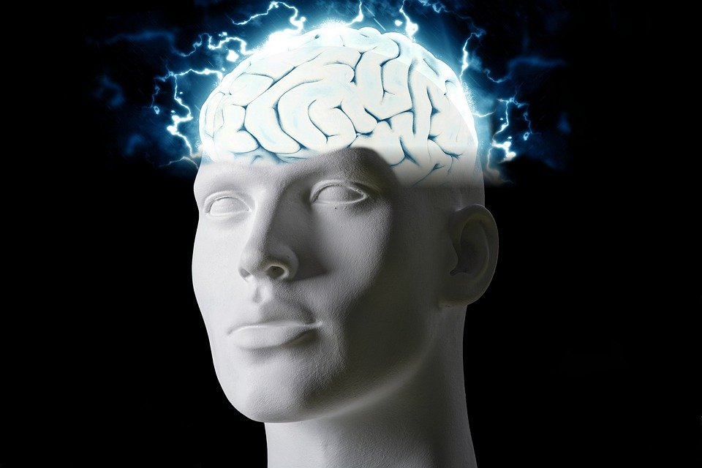
Regions of the Brain

Slide 2
For today’s assignment, you will create a Google Slides Presentation describing the 7 regions of the brain (Frontal Lobe, Motor Cortex, Sensory Cortex, Parietal Lobe, Temporal Lobe, Occipital Lobe and Cerebellum).
You must include the following on each slide:
Description of that region’s function
Example of how you use that region’s function in your daily life
Label the included brain photos with an arrow pointing to that particular region of the brain
Once you have fully completed all 7 slides, show me you are done to earn the opportunity to make the brain hat.

Slide 3
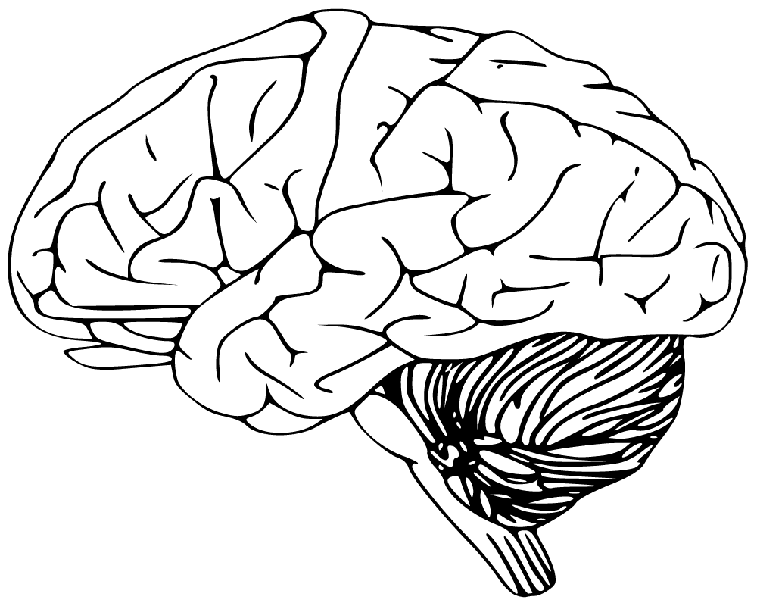
Frontal Lobe:
They are important because it allows voluntary movement, expressive language, and also lets us manage higher level executive functions. We use the frontal lobe on a daily basis by thinking, planning, organizing, problem-solving and movement.

Slide 4
Motor Cortex:
It generates signals to direct the movement of the body. It sends impulses through the spinal cord which makes movement happen. It is incharge of basic motor functions, including walking, running, kicking and throwing.

Slide 5
Sensory Cortex:
It is a region in the brain that is responsible for receiving and processing sensory information from across the body. We use it for sensations such as touch, pressure, temptation and pain.

Slide 6
Parietal Lobe:
It controls sensation, since it contains primary sensory cortex. It used for sensory perception and integration, for example, taste, hearing, sight, touch and smell.

Slide 7
Temporal Lobe:
The functions are that it processes affect/emotions, language, and also certain aspects of visual perception. It allows people to understand language and learning and even remembering verbal information.

Slide 8
Occipital Lobe:

Slide 9
Cerebellum:

