Slide 1
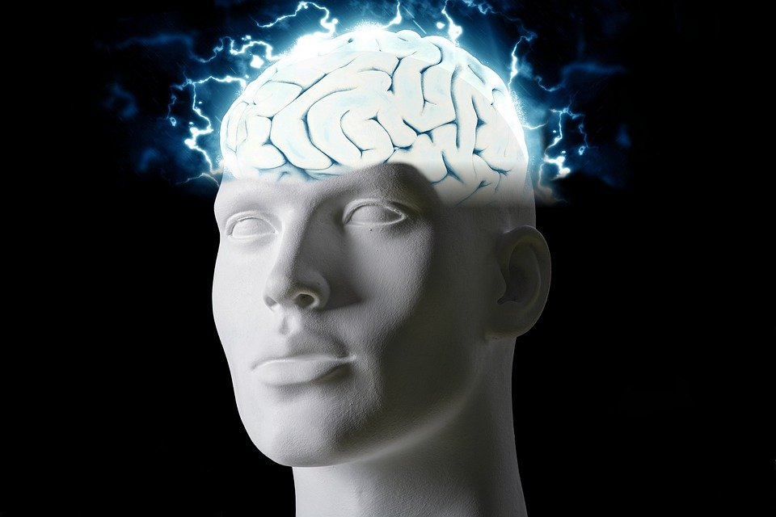
Regions of the Brain

Slide 2
For today’s assignment, you will create a Google Slides Presentation describing the 7 regions of the brain (Frontal Lobe, Motor Cortex, Sensory Cortex, Parietal Lobe, Temporal Lobe, Occipital Lobe and Cerebellum).
You must include the following on each slide:
Description of that region’s function
Example of how you use that region’s function in your daily life
Label the included brain photos with an arrow pointing to that particular region of the brain
Once you have fully completed all 7 slides, show me you are done to earn the opportunity to make the brain hat.

Slide 3
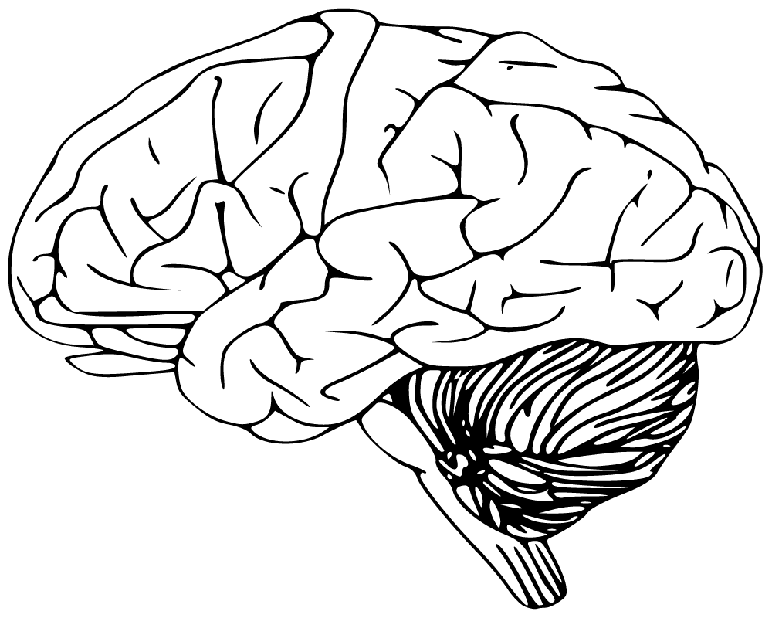
Cerebellum
-Has to do with speaking and your balance
-We us this part of the brain when we walk

Slide 4
Frontal lobe
-Has to do with voluntary movement, expressive language and for managing higher level executive functions
-I use this part of my brain when i’m moving my arms

Slide 5
Temporal Lobe
-Has to do with memory and your emotion
-I use this part of my brain when i’m angry

