Slide 1
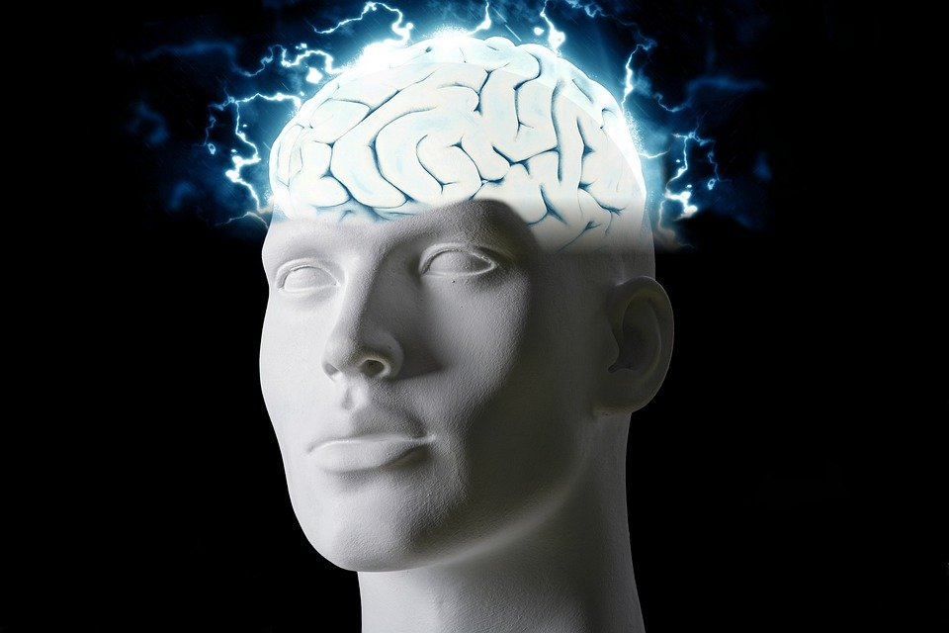
Regions of the Brain

Slide 2
For today’s assignment, you will create a Google Slides Presentation describing the 7 regions of the brain (Frontal Lobe, Motor Cortex, Sensory Cortex, Parietal Lobe, Temporal Lobe, Occipital Lobe and Cerebellum).
You must include the following on each slide:
Description of that region’s function
Example of how you use that region’s function in your daily life
Label the included brain photos with an arrow pointing to that particular region of the brain
Once you have fully completed all 7 slides, show me you are done to earn the opportunity to make the brain hat.

Slide 3
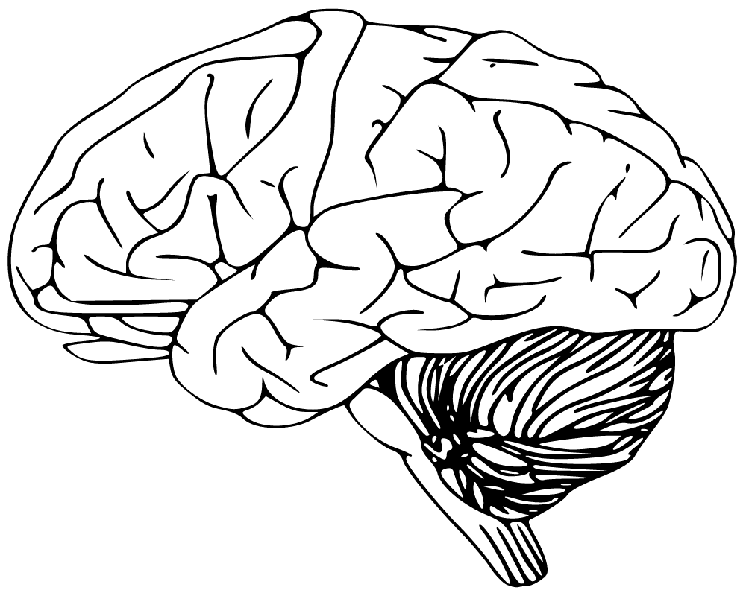
Cerebellum:
Has to do with speaking and your balance
I use this part of the brain to walk

Slide 4
Occipital Lobe:
The occipital Lobe has to do with visual perception, including colour, form and motion.
I use the Occipital Lobe to see what color my book was

Slide 5
Temporal Lobe:
The Temporal lobe has to do with processing affect/emotions, language, and certain aspects of visual perception.
I used the temporal lobe to feel the pain my best friend was going through.

Slide 6
Parietal Lobe:
The parietal lobe controls sensation (touch, pressure).
I used the parietal lobe to feel the pain when I tripped on my shoe laces.

Slide 7
Sensory Cortex:
Sensory cortex is responsible for processing somatic sensations.
I used the sensory cortex to feel that my stomach was hurting.

Slide 8
Motor Cortex:
The mortor cortex job is to generate signals to direct the movement of the body.
I used the motor cortex to pick up my baby brother.

Slide 9
Frontal Lobe:
The Frontal lobe is in charge of the voluntary movement, expressive language and for managing higher level executive functions.
I used the frontal lobe to run for my dog.

