Slide 1
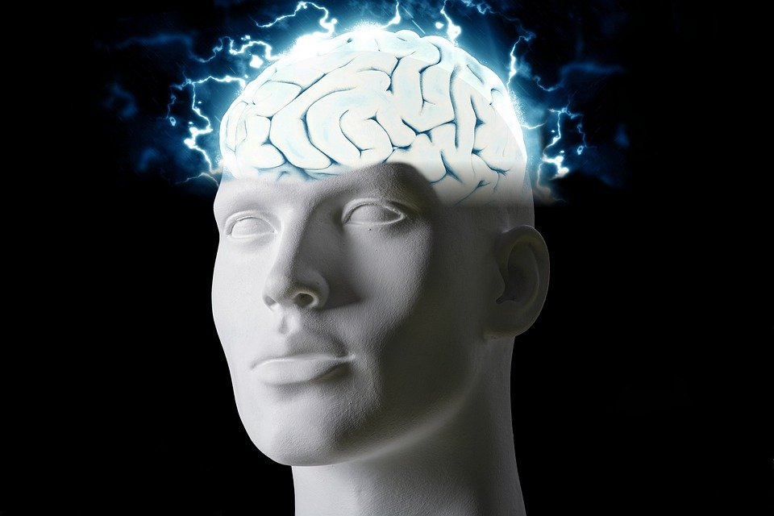
Regions of the Brain

Slide 2
For today’s assignment, you will create a Google Slides Presentation describing the 7 regions of the brain (Frontal Lobe, Motor Cortex, Sensory Cortex, Parietal Lobe, Temporal Lobe, Occipital Lobe and Cerebellum).
You must include the following on each slide:
Description of that region’s function
Example of how you use that region’s function in your daily life
Label the included brain photos with an arrow pointing to that particular region of the brain
Once you have fully completed all 7 slides, show me you are done to earn the opportunity to make the brain hat.

Slide 3
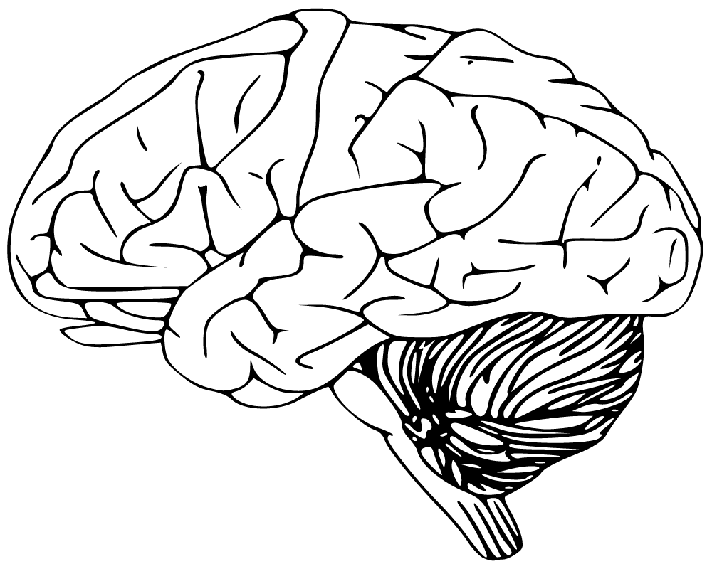
Cerebellum
Has to do with speaking and you're balance
I use this part of my brain when i walk

Slide 4
Frontal Lobe
Has to do with voluntary movement, expressive language and executive functions
I use this part of my brain at school a lot

Slide 5
Motor Cortex
Has to do with the use of generating signals to direct the movement of the body
I use this part of my brain when i am writing notes

Slide 6
Sensory Cortex
Has to do with processing somatic sensations
I use this part of my brain when i burn myself while cooking

Slide 7
Parietal Lobe
Has to do with processing somatosensory information from the body
This includes touch,pain, and temperature i use this when i burn myself

Slide 8
Temporal lobe
Has to do with processing affect/emotions, language, and certain aspects of visual perception
I use this part of my brain when i am listening to my teachers at school

Slide 9
Occipital Lobe
Has to do with visual perception, including color, form and motion
I use this part of my brain when i open my eyes because i see things with color

