Slide 1
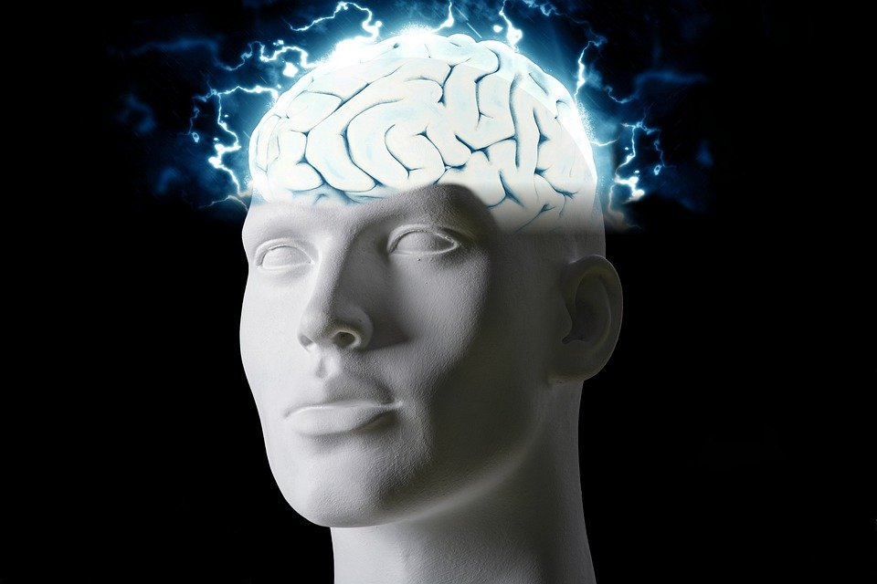
Regions of the Brain

Slide 2
For today’s assignment, you will create a Google Slides Presentation describing the 7 regions of the brain (Frontal Lobe, Motor Cortex, Sensory Cortex, Parietal Lobe, Temporal Lobe, Occipital Lobe and Cerebellum).
You must include the following on each slide:
Description of that region’s function
Example of how you use that region’s function in your daily life
Label the included brain photos with an arrow pointing to that particular region of the brain
Once you have fully completed all 7 slides, show me you are done to earn the opportunity to make the brain hat.

Slide 3
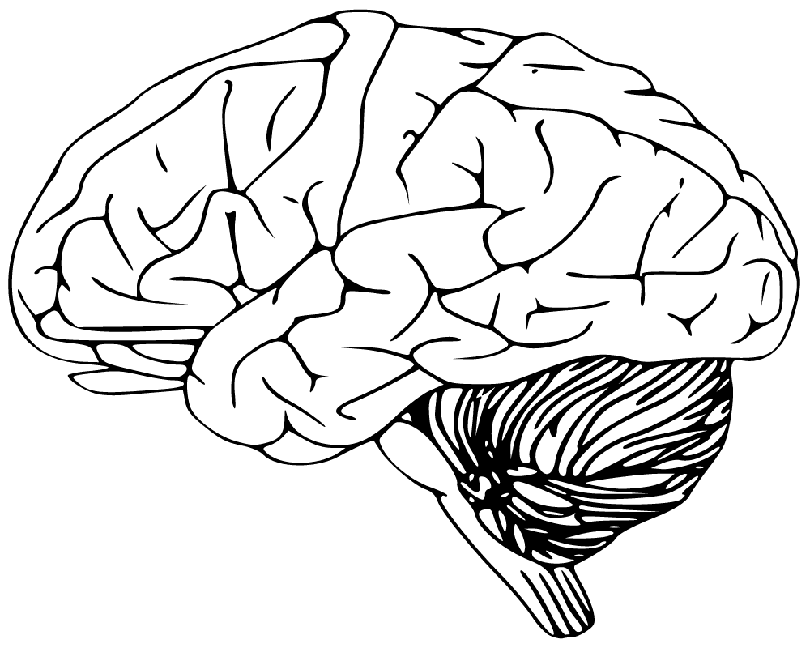
Cerebellum
Has to do with speaking and your balance.
I use this part when I walk and move.

Slide 4
Frontal lobe
I use the frontal lobe too express myself in language and plan and organize.
Has to do with voluntary movement and expressive language.

Slide 5
Motor cortex
We use the motor cortext to plan, control,and execute voluntary movements.
I use this to control myself from not falling asleep.

Slide 6
Sensory cortex
The sensory cortex helps with processing somatic sensations and detecting touch.
I use this too feel when am in pain.

Slide 7
Parietal lobe
The parietal lobe helps send messages to the body that it is in pain.
I use this for when i am hurt.

Slide 8
Temporal lobe
The temporal lobe is used for emotions and language.
I use this to talk and feel happy.

Slide 9
Optical lobe
The optical lobe helps with visual prescription and color.
I use this to watch a movie.

