Slide 1

Regions of the Brain

Slide 2
For today’s assignment, you will create a Google Slides Presentation describing the 7 regions of the brain (Frontal Lobe, Motor Cortex, Sensory Cortex, Parietal Lobe, Temporal Lobe, Occipital Lobe and Cerebellum).
You must include the following on each slide:
Description of that region’s function
Example of how you use that region’s function in your daily life
Label the included brain photos with an arrow pointing to that particular region of the brain
Once you have fully completed all 7 slides, show me you are done to earn the opportunity to make the brain hat.

Slide 3
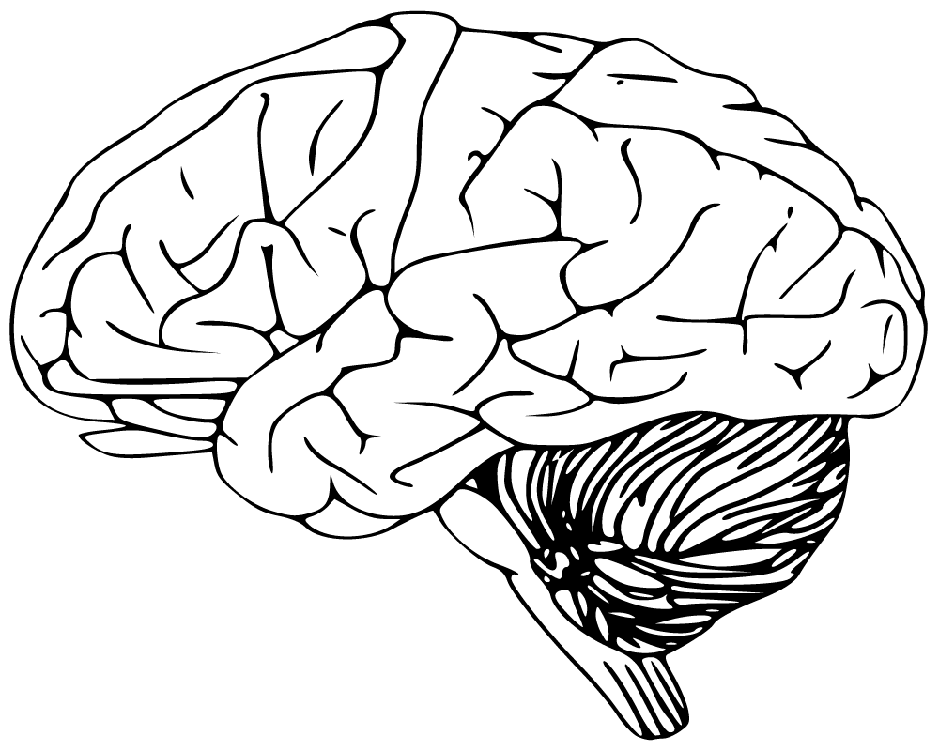
Frontal Lobe
With the frontal lobe I have:
voluntary movement
  Move limbs on my own
Expressive Language
  Able to communicate through feelings, symbols, etc.
Manage higher level of executive functions.
  Knowing what you need to do and when.

Slide 4
Motor Cortex
With Motor Cortex I have:
Planning
  I can make plans
Control
  I can make my body do things
Execution of involuntary actions
  I can make my limbs move

Slide 5
Sensory Cortex
With Sensory Cortex I have:
Processing somatic sensation
  Using my senses
    Hear
    See
    Feel
    Taste
    Smell

Slide 6
Occipital Lobe
With Occipital Lobe I have:
Vision
  I can see things
    Light
    Color
    Motion

Slide 7
Parietal Lobe
With Parietal Lobe I have:
The feeling of pain
  I can feel it when I get hurt
The feeling of temperature
  I can feel weather its cold or hot

Slide 8
Temporal Lobe
With Temporal Lobe I have:
Emotions
  What I feel
Language
Visual Perception
  Ability to interpret what i see

Slide 9
Cerebellum
With Cerebellum I have:
Balance
  I can stand up without falling
Posture
  I can stand up straight

