Slide 1
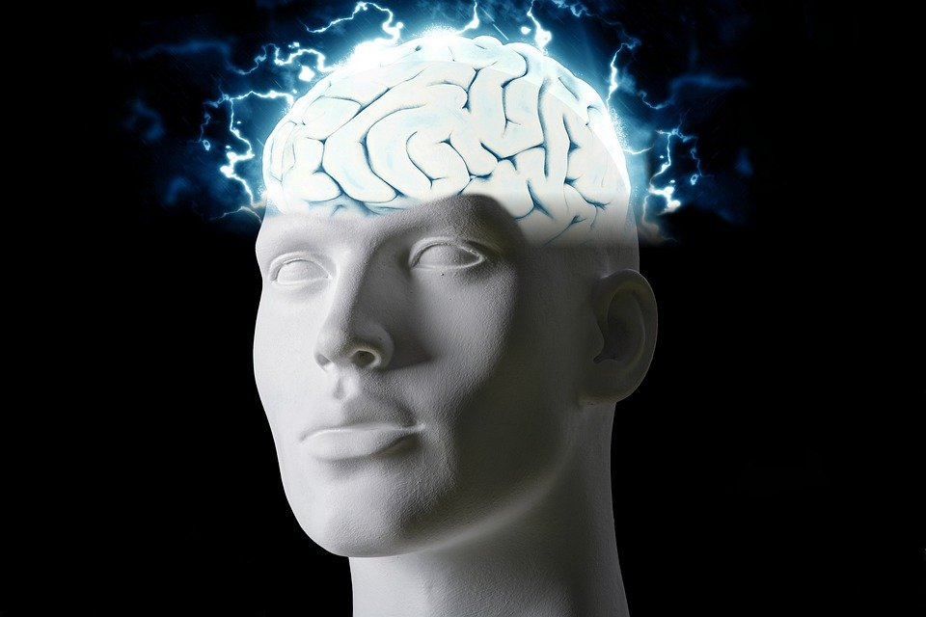
Regions of the Brain

Slide 2
For today’s assignment, you will create a Google Slides Presentation describing the 7 regions of the brain (Frontal Lobe, Motor Cortex, Sensory Cortex, Parietal Lobe, Temporal Lobe, Occipital Lobe and Cerebellum).
You must include the following on each slide:
Description of that region’s function
Example of how you use that region’s function in your daily life
Label the included brain photos with an arrow pointing to that particular region of the brain
Once you have fully completed all 7 slides, show me you are done to earn the opportunity to make the brain hat.

Slide 3
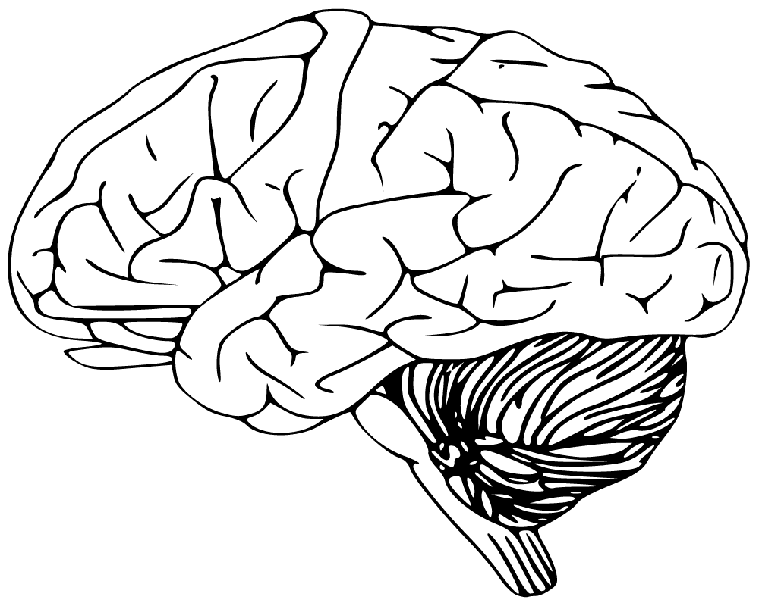
Frontal lobe
the frontal lobe is responsible for higher cognitive functions such as memory, emotions, impulse control, problem solving. I use this part of the brain in math class

Slide 4
Motor cortex
The motor cortex is an area within the cerebral cortex of the brain that is involved in the planning, control, and execution of voluntary movements.this helps when i move around.

Slide 5
Sensory cortex
In the case of vision, this includes virtually all of the occipital cortex and much of the temporal and parietal cortex.this helps me see

Slide 6
Parietal lobe
It processes sensory information it receives from the outside world, mainly relating to touch, taste, and temperature. This helps me when i eat something and see whats the taste and also when i touch something.

Slide 7
Temporal lobe
hey are most commonly associated with processing auditory information and with the encoding of memory.this helps with me remembering my memory.

Slide 8
Occipital lobe
he occipital lobes sit at the back of the head and are responsible for visual perception, including colour, form and motion. This helps me move

Slide 9
Cerembellum
a structure that is located at the back of the brain, underlying the occipital and temporal lobes of the cerebral cortex.this helps me walk and speech.

