Slide 1
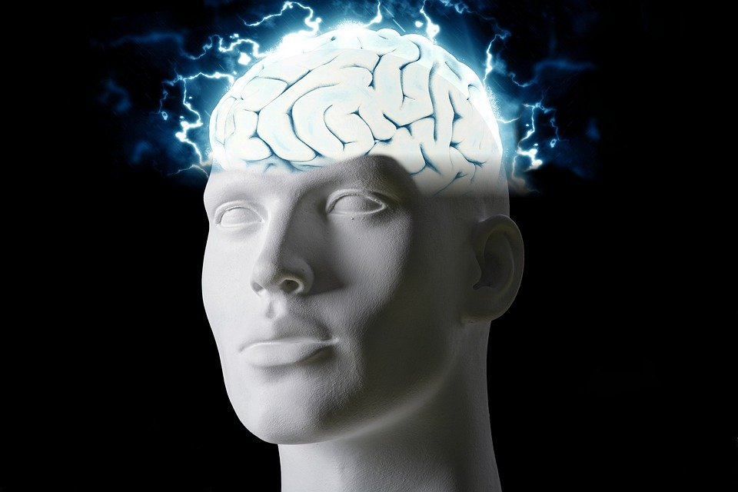
Regions of the Brain

Slide 2
For today’s assignment, you will create a Google Slides Presentation describing the 7 regions of the brain (Frontal Lobe, Motor Cortex, Sensory Cortex, Parietal Lobe, Temporal Lobe, Occipital Lobe and Cerebellum).
You must include the following on each slide:
Description of that region’s function
Example of how you use that region’s function in your daily life
Label the included brain photos with an arrow pointing to that particular region of the brain
Once you have fully completed all 7 slides, show me you are done to earn the opportunity to make the brain hat.

Slide 3
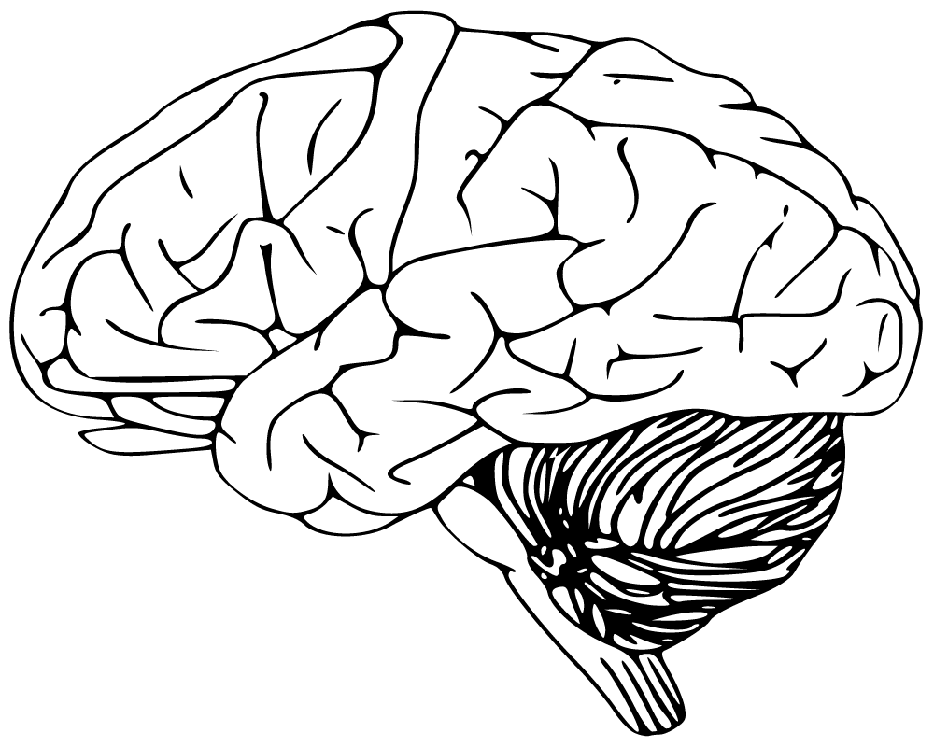
Cerebellum
-Has to do with speaking, your balance, and write
I use this part of my brain when I walk and write.

Slide 4
Frontal Lobe
- voluntary movement, expressive language and for managing higher level executive functions
-I use this part of my brain when i’m doing math.

Slide 5
Occipital Lobe
-responsible for visual perception, including colour, form and motion.
I use this part of my brain to see colors.

Slide 6
Parietal Lobe
-processing somatosensory information from the body
I use this part of my brain when I feel pain.

Slide 7
Temporal Lobe
-processing affect/emotions, language, and certain aspects of visual perception
I use this part of my brain when I i’m sad.

Slide 8
Motor Cortex
-generate signals to direct the movement of the body
I use this part of my brain when I turn to cross the road

Slide 9
Sensory Cortex
-processing somatic sensations.
I use this part of my brain to detect when someone touched me.

