Slide 1
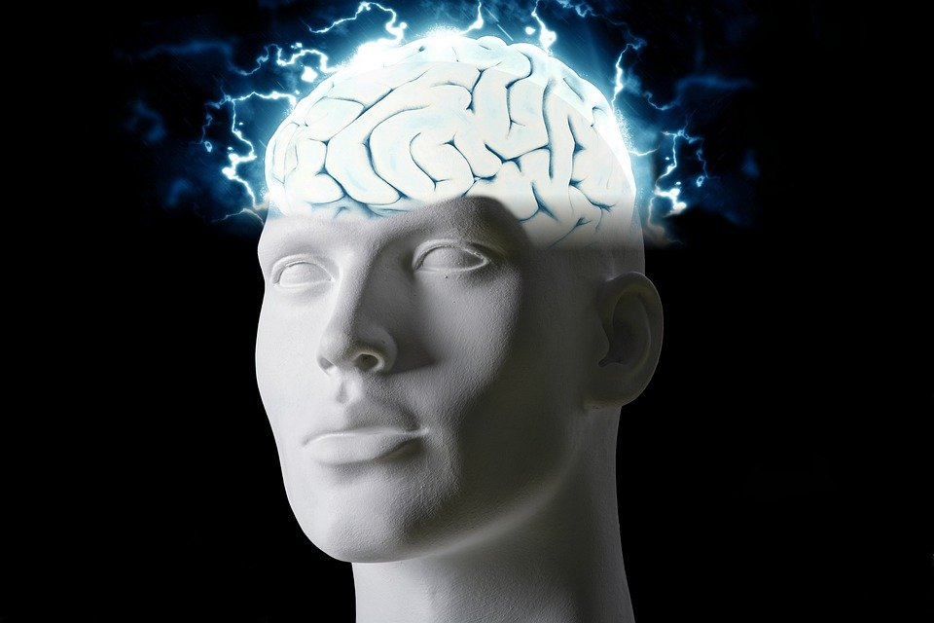
Regions of the Brain

Slide 2
For today’s assignment, you will create a Google Slides Presentation describing the 7 regions of the brain (Frontal Lobe, Motor Cortex, Sensory Cortex, Parietal Lobe, Temporal Lobe, Occipital Lobe and Cerebellum).
You must include the following on each slide:
Description of that region’s function
Example of how you use that region’s function in your daily life
Label the included brain photos with an arrow pointing to that particular region of the brain
Once you have fully completed all 7 slides, show me you are done to earn the opportunity to make the brain hat.

Slide 3
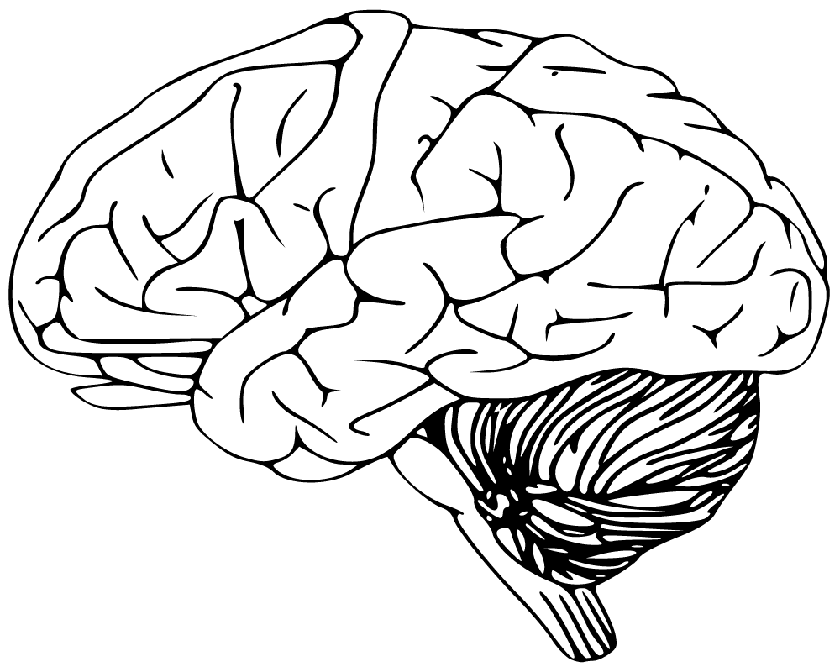
Cerebellum
It’s what makes you walk,talk, and to stay balanced
It helps me stay in one spot standing up

Slide 4
Frontal lobe
The frontal lobe is what makes us have emotions, memor,impulse control,problem solving,social interactions, and motor function
I use this in math

Slide 5
Motor cortex
The motor cortex is the part of the brain that helps us have control and execution of voluntary movements
I use this in sports

Slide 6
Sensory cortex
Sensory lobe makes be able to feel things and feel temperature and pain
The other day a bee stung me

Slide 7
Parietal lobe
Parietal lobe also is the part of the brain that makes taste things and somatosensory information
I taste things when i eat

Slide 8
Temporal lobe
It helps us listen and also is apart of another lobe that helps us remember things or memory
I remember to do this assignment

Slide 9
Occipital lobe
It’s what makes us detect motion and color and visual perception .i use this part of brain every day when am awake

