Slide 1
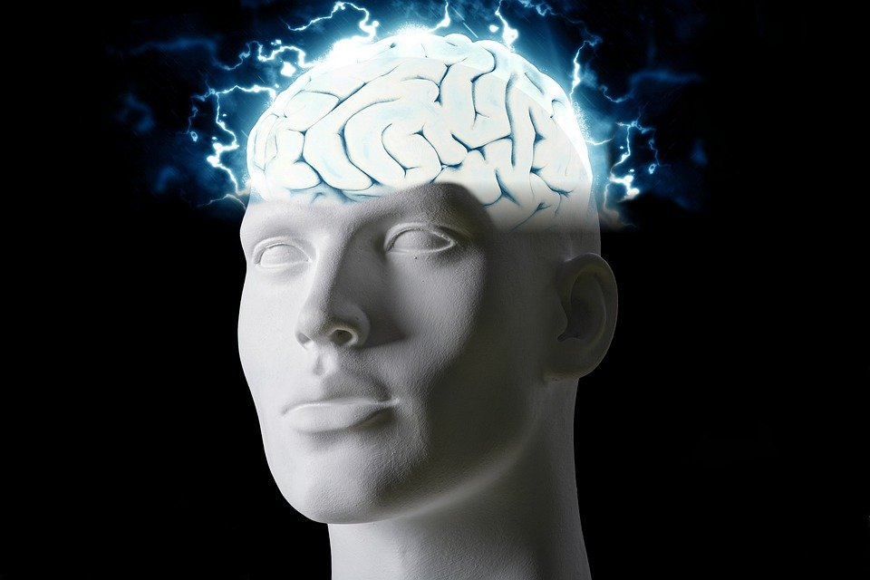
Regions of the Brain

Slide 2
For today’s assignment, you will create a Google Slides Presentation describing the 7 regions of the brain (Frontal Lobe, Motor Cortex, Sensory Cortex, Parietal Lobe, Temporal Lobe, Occipital Lobe and Cerebellum).
You must include the following on each slide:
Description of that region’s function
Example of how you use that region’s function in your daily life
Label the included brain photos with an arrow pointing to that particular region of the brain
Once you have fully completed all 7 slides, show me you are done to earn the opportunity to make the brain hat.

Slide 3
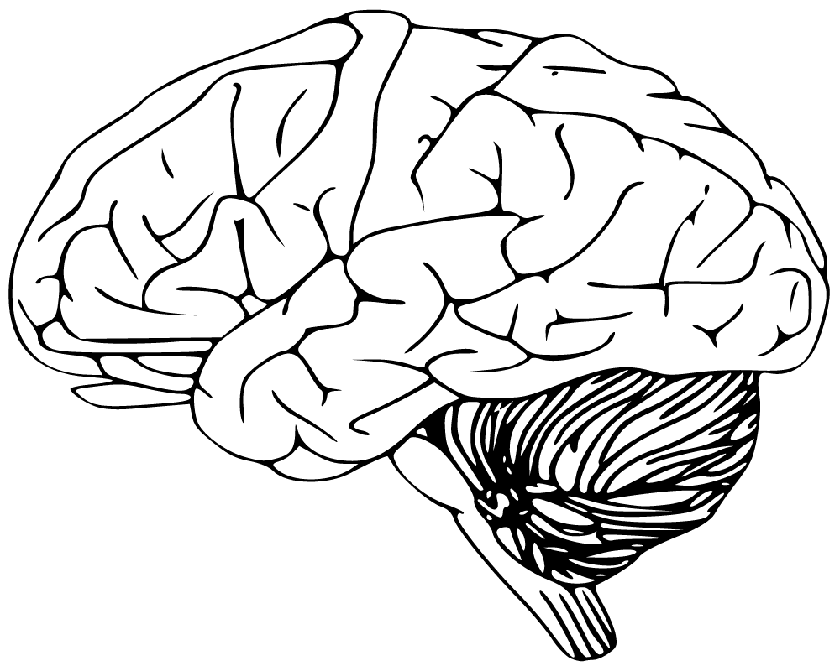
Cerebellum
Has to do with speaking and balance
I use this part of my brain when i walk

Slide 4
Frontal lobe
The frontal lobes are important for voluntary movement, expressive language and for managing higher level executive functions.
I use this part of the brain when talking to friends.

Slide 5
Motor cortex
to generate signals to direct the movement of the body
I use this part of the brain when I ride my scooter to school.

Slide 6
Sensory cortex
vision, audition (sound), olfaction (smell), gustation (taste), and somatosensation (touch).
I use this part of the brain when I eat lunch

Slide 7
Parietal lobe
this includes touch, pain, temperature, and the sense of limb position
I use this part of the brain when I burn myself

Slide 8
Temporal lobe
processing auditory information and with the encoding of memory.
I use this part of the brain when I remember something

Slide 9
Occipital Lobe
visual perception, including colour, form and motion
I use this part of the brain when I look at something.

