Slide 1
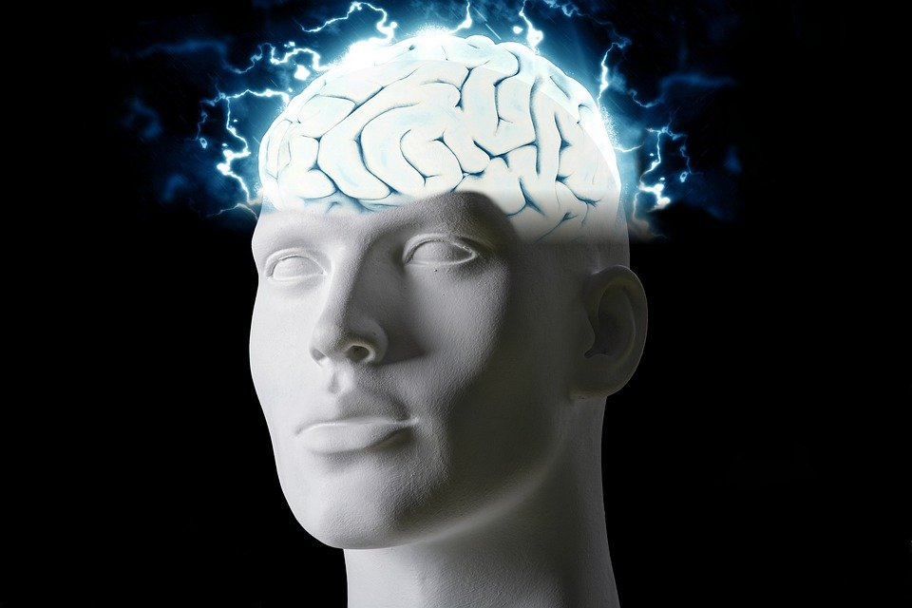
Regions of the Brain

Slide 2
For today’s assignment, you will create a Google Slides Presentation describing the 7 regions of the brain (Frontal Lobe, Motor Cortex, Sensory Cortex, Parietal Lobe, Temporal Lobe, Occipital Lobe and Cerebellum).
You must include the following on each slide:
Description of that region’s function
Example of how you use that region’s function in your daily life
Label the included brain photos with an arrow pointing to that particular region of the brain
Once you have fully completed all 7 slides, show me you are done to earn the opportunity to make the brain hat.

Slide 3
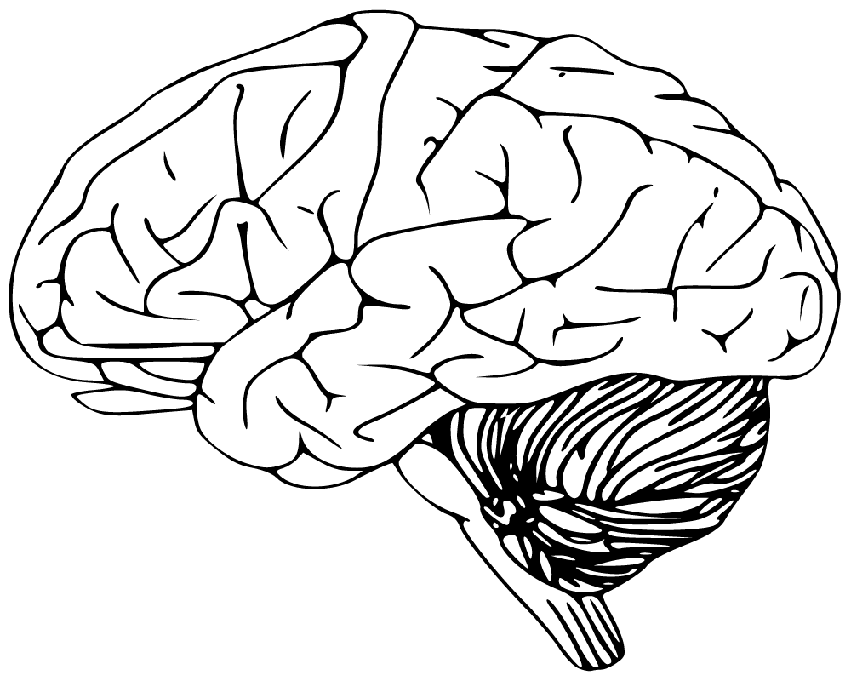
Cerebellum
Has to do with speaking and your balance
I use this part of my brain when I walk

Slide 4
Frontal Lobe
The frontal lobe is the most anterior part of the brain
The frontal lobes are important for voluntary movement, expressive language and for managing higher level executive functions.

Slide 5
Motor Cortex
The motor cortex is an area within the cerebral cortex of the brain that is involved in the planning, control, and execution of voluntary movements.
The primary function of the motor cortex is to generate signals to direct the movement of the body.

Slide 6
Sensory Cortex,
Sensory cortex refers to all cortical areas associated with sensory function.
This sensory information is then carried to the brain via neural pathways to the spinal cord, brainstem, and thalamus
The sensory cortex is a part the brain which is used for receiving and processing sensory information from across the body, such as touch, temperature, and pain

Slide 7
Parietal Lobe
The parietal lobes are located near the back and top of the head.
The parietal lobes are responsible for processing somatosensory information from the body.

Slide 8
Temporal Lobe
The temporal lobes sit behind the ears and are the second largest lobe
The temporal lobes are also believed to play an important role in processing affect/emotions, language, and certain aspects of visual perception.

Slide 9
Occipital lobe
The occipital lobes sit at the back of the head .used for visual perception, including colour, form and motion

