Slide 1
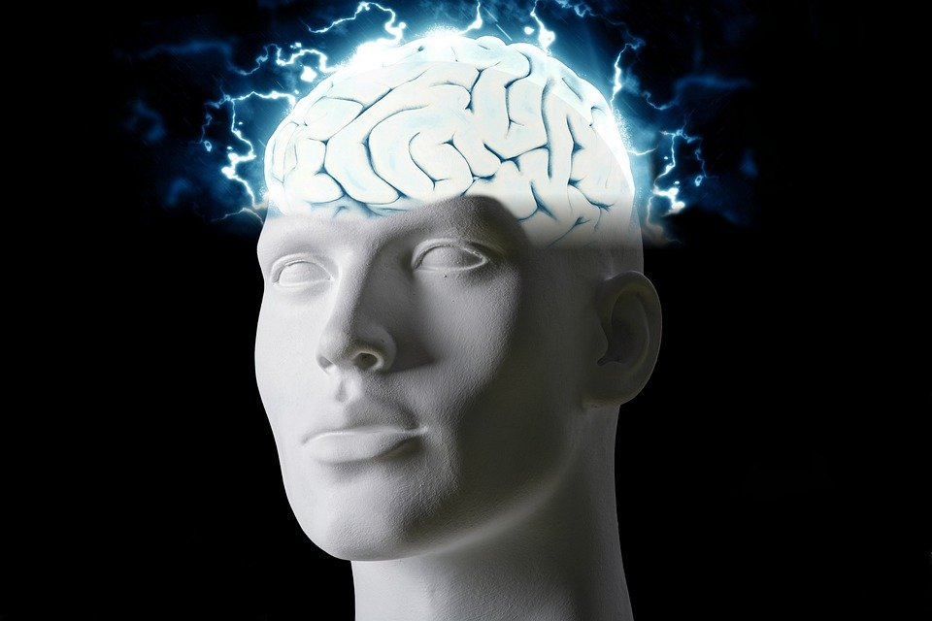
Regions of the Brain

Slide 2
For today’s assignment, you will create a Google Slides Presentation describing the 7 regions of the brain (Frontal Lobe, Motor Cortex, Sensory Cortex, Parietal Lobe, Temporal Lobe, Occipital Lobe and Cerebellum).
You must include the following on each slide:
Description of that region’s function
Example of how you use that region’s function in your daily life
Label the included brain photos with an arrow pointing to that particular region of the brain
Once you have fully completed all 7 slides, show me you are done to earn the opportunity to make the brain hat.

Slide 3
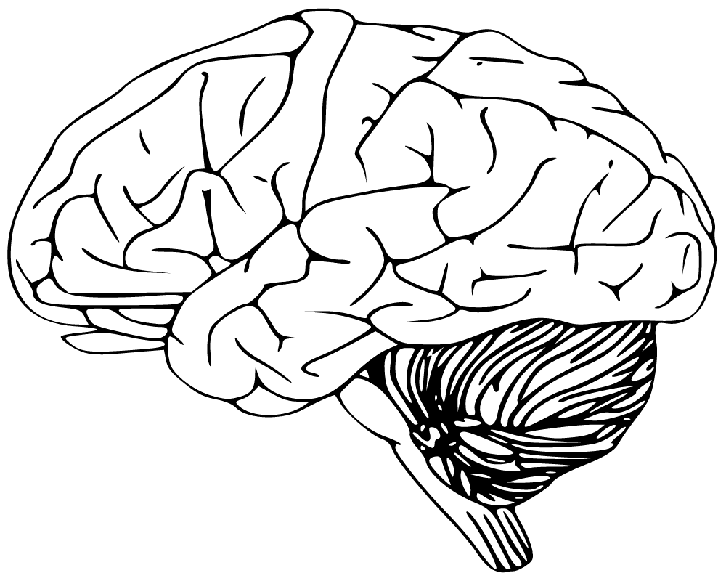
Frontal Lobe
movement, expressive language and for managing higher level executive functions. You use the frontal lobe for memory, emotions, impulse control, problem solving,social interaction and ect.

Slide 4
Motor Cortex
The primary motor cortex is the main contributor to generating neural impulses that pass down to the spinal cord and control the execution of movement. generate signals to direct the movement of the body

Slide 5
Sensory Cortex
Parts of the cerebral cortex in the parietal lobe are involved with processing information related to touch.

Slide 6
Parietal Lobe
When you touch any object with any part of your body, your parietal lobe enables you to feel the sensation at the site of the touch and not, say, in your brain or all over your body. Integrating sensory information from most regions of the body.

Slide 7
Temporal Lobe
understanding language and learning and remembering verbal information. The temporal lobe also helps with object recognition and interacts with other structures to create new and long term memories.

Slide 8
Occipital Lobe
The occipital lobes sit at the back of the head and are responsible for visual perception, including colour, form and motion

Slide 9
Cerebellum
The cerebellum is important for making postural adjustments in order to maintain balance.

