Slide 1
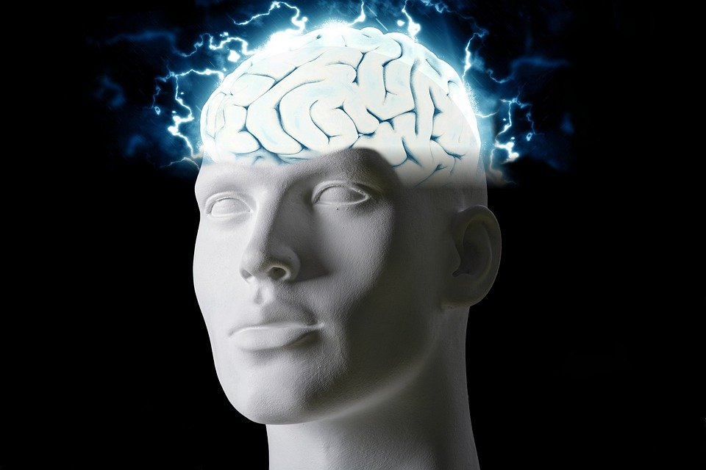
Regions of the Brain

Slide 2
For today’s assignment, you will create a Google Slides Presentation describing the 7 regions of the brain (Frontal Lobe, Motor Cortex, Sensory Cortex, Parietal Lobe, Temporal Lobe, Occipital Lobe and Cerebellum).
You must include the following on each slide:
Description of that region’s function
Example of how you use that region’s function in your daily life
Label the included brain photos with an arrow pointing to that particular region of the brain
Once you have fully completed all 7 slides, show me you are done to earn the opportunity to make the brain hat.

Slide 3
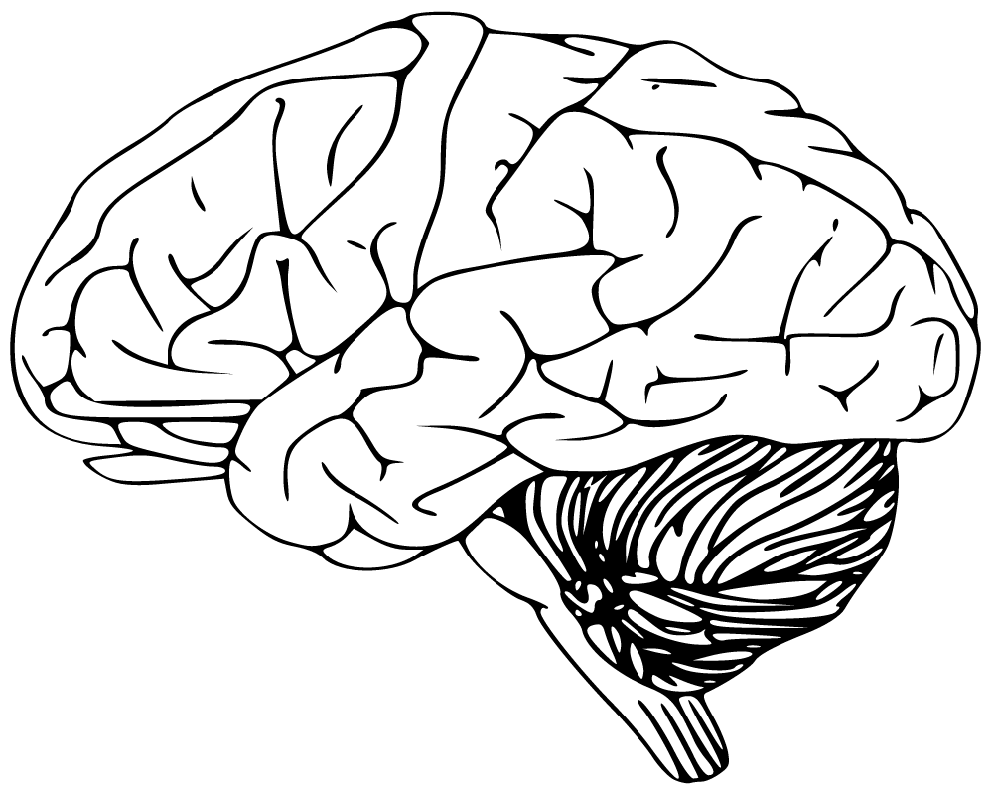
Frontal lobe
The Lobe of the brain situated at the front of the cerebral hemisphere.

Slide 4
Motor Cortex
The region of the cerebral cortex involved in the planning, control, and execution of voluntary movements.

Slide 5
Sensory Cortex
All cortical areas associated with sensory function.

Slide 6
Parietal Lobe
The parietal lobe is one of the major lobes in the brain, roughly located in the upper back area of the skull.

Slide 7
Temporal Lobe
The Temporal lobe sit behind the ears and are the second largest lobe.

Slide 8
Occipital Lobe
The Occipital Lobe is part of the human brain responsible for interpreting information from the eyes and turning it into the world as a person sees it.

Slide 9
Cerebellum
The portion of the brain in the back of the head between the cerebrum and the brain stem.

