Slide 1
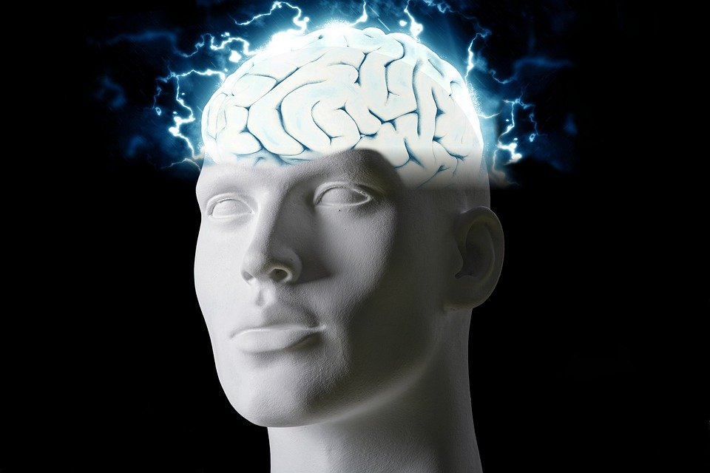
Regions of the Brain

Slide 2
For today’s assignment, you will create a Google Slides Presentation describing the 7 regions of the brain (Frontal Lobe, Motor Cortex, Sensory Cortex, Parietal Lobe, Temporal Lobe, Occipital Lobe and Cerebellum).
You must include the following on each slide:
Description of that region’s function
Example of how you use that region’s function in your daily life
Label the included brain photos with an arrow pointing to that particular region of the brain
Once you have fully completed all 7 slides, show me you are done to earn the opportunity to make the brain hat.

Slide 3
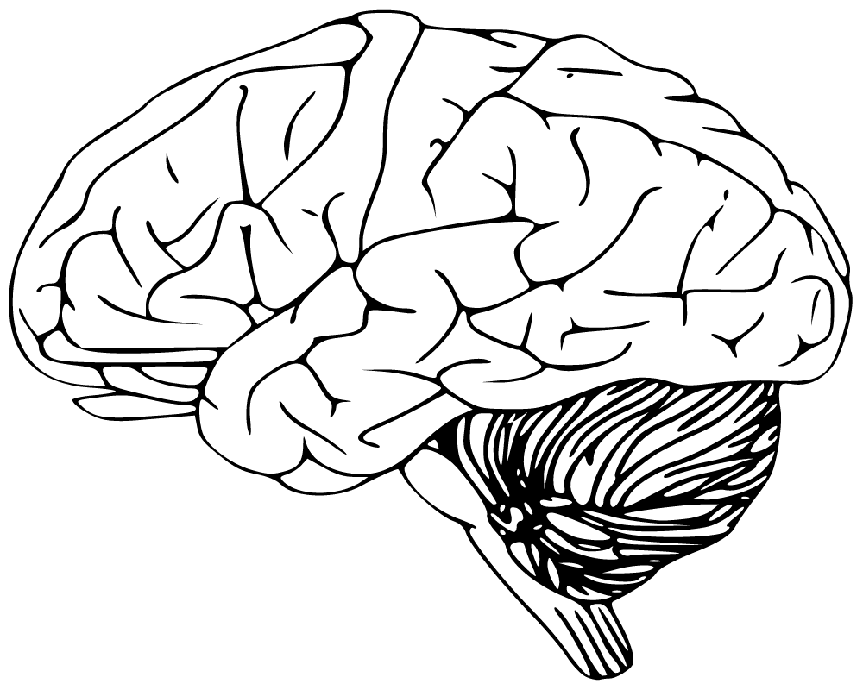
Cerebellum
Has to do with speaking and balance
I use this part of my brain while walking

Slide 4
Frontal Lobe
Controls voluntary movement, expressive language and for managing higher level executive functions
I use this when I want to move

Slide 5
Motor Cortex
Generates signals to direct movement of the body
I use this when my body moves in different directions

Slide 6
Sensory Cortex
Responsible for detecting touch.
I use this part of the brain when i feel things

Slide 7
Parietal Lobe
Controls touch, pain, temperature, and the sense of limb position
I use this when i feel hot or cold

Slide 8
Temporal Lobe
processing affect/emotions, language, and certain aspects of visual perception.
I use this part of the brain when i feel different emotions

Slide 9
Occipital Lobe
visuospatial processing, distance and depth perception, color determination, object and face recognition, and memory formation.
I use this part of my brain when remembering faces

