Slide 1
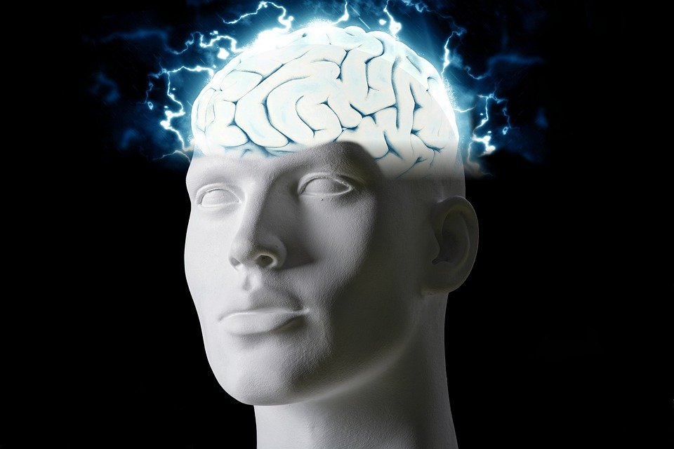
Regions of the Brain

Slide 2
For today’s assignment, you will create a Google Slides Presentation describing the 7 regions of the brain (Frontal Lobe, Motor Cortex, Sensory Cortex, Parietal Lobe, Temporal Lobe, Occipital Lobe and Cerebellum).
You must include the following on each slide:
Description of that region’s function
Example of how you use that region’s function in your daily life
Label the included brain photos with an arrow pointing to that particular region of the brain
Once you have fully completed all 7 slides, show me you are done to earn the opportunity to make the brain hat.

Slide 3
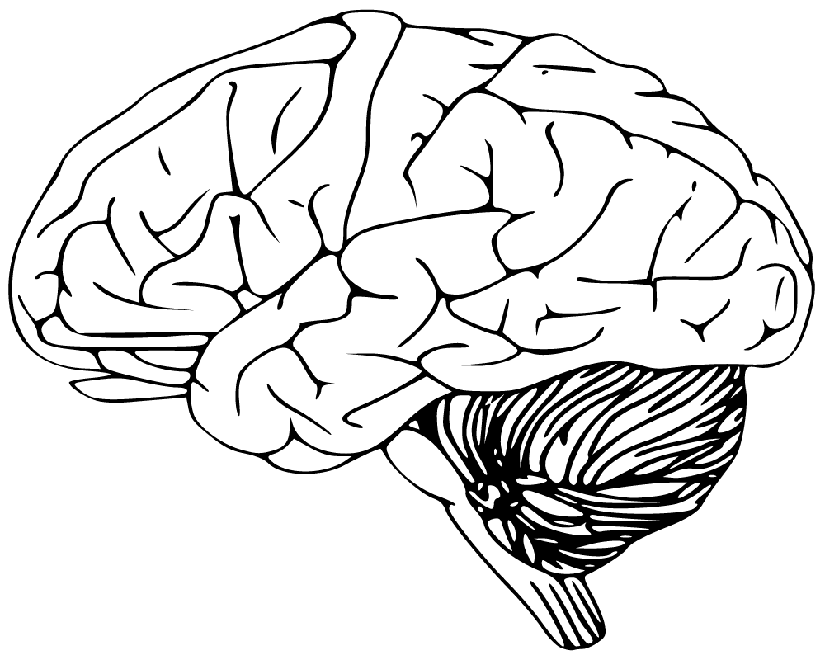
Cerebellum
This part has to do with speaking and your balance.
I use this part of the brain to walk everyday.

Slide 4
Frontal Lobe
This part of the brain is how we memorize things, how we are in our social behavior, and our language.
I use this part of my brain when I’m hanging out with my friends.

Slide 5
Motor Cortex
I use this part of my brain for movement throughout the body.
I use this part of my brain for movement like running, jumping and moving my arms.

Slide 6
Sensory Cortex
I use this part of my brain when I touch things and feel pain.
I use this part of my brain when I burn my arm.

Slide 7
Parietal Lobe
This part of my brain is used to tell the rest of my body of the things outside my body that I touch
I use this part of my brain when I bump into something.

Slide 8
Temporal Lobe
This part of the brain is used to process affect/emotions and language.
I use this part of my brain when I am happy, sad or excited.

Slide 9
Occipital Lobe
This part of the brain is used for seeing things, along with colors.
I use this part of my brain when I am outside or watching something.

