Slide 1
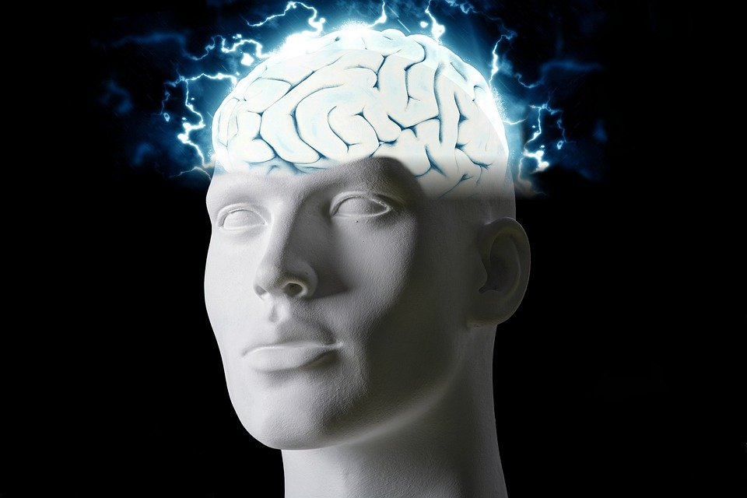
Regions of the Brain

Slide 2
For today’s assignment, you will create a Google Slides Presentation describing the 7 regions of the brain (Frontal Lobe, Motor Cortex, Sensory Cortex, Parietal Lobe, Temporal Lobe, Occipital Lobe and Cerebellum).
You must include the following on each slide:
Description of that region’s function
Example of how you use that region’s function in your daily life
Label the included brain photos with an arrow pointing to that particular region of the brain
Once you have fully completed all 7 slides, show me you are done to earn the opportunity to make the brain hat.

Slide 3
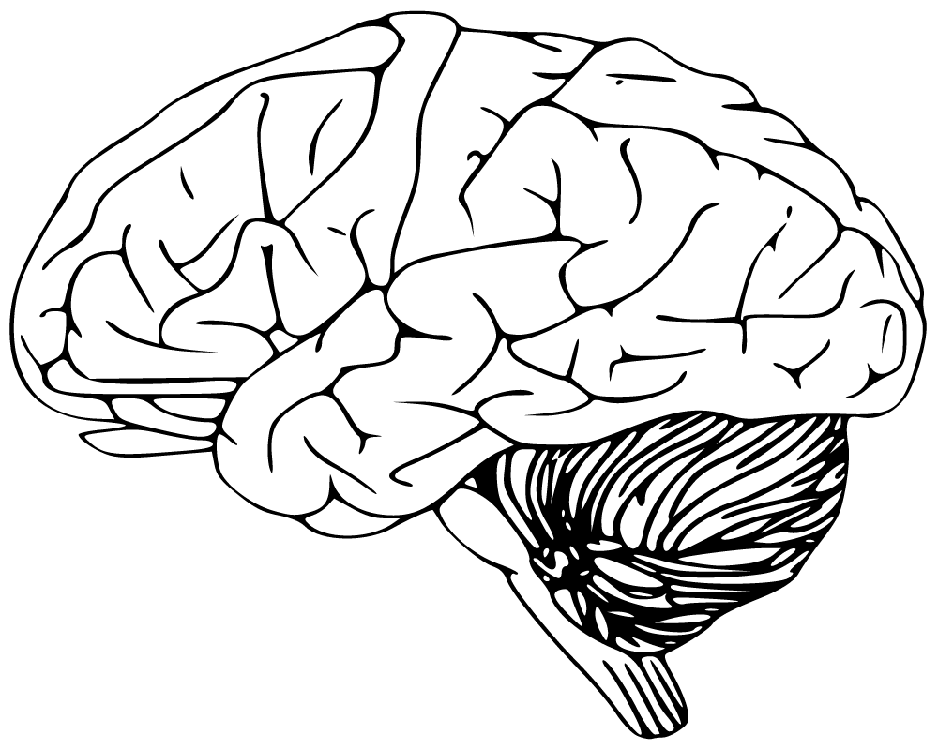
I use this part of my brain in order to speak and help me maintain a balance while walking
Cerebellum

Slide 4
I use this part of my brain to solve problems like a Math equation
Frontal Lobe

Slide 5
I use this part of my brain whenever I am using one of my senses such as when i am eating food or listening to music.
Parietal Lobe

Slide 6
I use this part of my brain in order to properly see and visualise the world around me, such as in watching TV.
Occipital Lobe

Slide 7
I use this part of my brain to process emotions and certain aspects of visual perception and understanding language, learning and understanding verbal information. I use this when I am given a task verbally.
Temporal Lobe

Slide 8
I use this part of my brain in order to carry out all of the messages from my brain throughout my body, such as a simple task to move my arm.
Spinal Cord

Slide 9
The brainstem connects the brain to the spinal cord in order for everything to do as it should properly like breathing and heart rate. I use this part of my brain in order to properly breathe
Brain stem

